Slide 1




SUDHEE 2025
CBIT HACKATHON
AI-Powered Real-Time Sign Language Translation from Spoken Language
Domain Name : AI & ML
Problem Statement ID : A1
WHILE (1) INNOVATE
PELLI SREE MADHAV
GURUNANAK INSTITUTIONS TECHINICAL CAMPUS

Slide 2

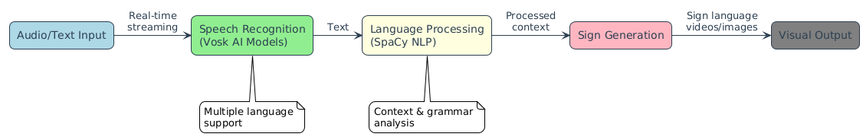
ABSTRACT
The Challenge
Over 70 million deaf individuals worldwide face daily communication barriers, with existing solutions being expensive, fragmented, and requiring specialized hardware.
Our Mission
To create an accessible, real-time speech-to-sign language system that works across all devices and platforms.
"Making communication seamless and inclusive for the global deaf community through innovative AI technology.
Our project develops a revolutionary real-time system that converts spoken language into visually accessible sign language, bridging the communication gap for the Deaf and Hard of Hearing community. Using advanced AI technologies including Vosk speech recognition and SpaCy NLP, we've created a solution that supports multiple sign languages (ASL, ISL) and regional Indian languages.

Slide 3
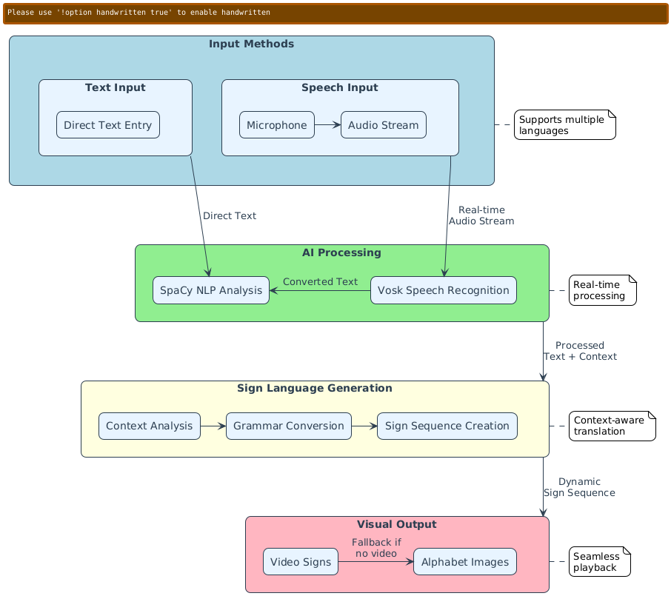

IDEA/PROTOTYPE
Innovative Features
• Real-time speech-to-sign conversion
• Multi-language & regional support
• Context-aware grammar adaptation
• Dynamic visual sign representation
• User feedback for improvement
Key Innovations
• Video signs + alphabet images
• Emotion-aware sign detection
• Low-latency real-time streaming
• Smart grammar adaptation
PROTOTYPE
VISUALIZATION

Slide 4
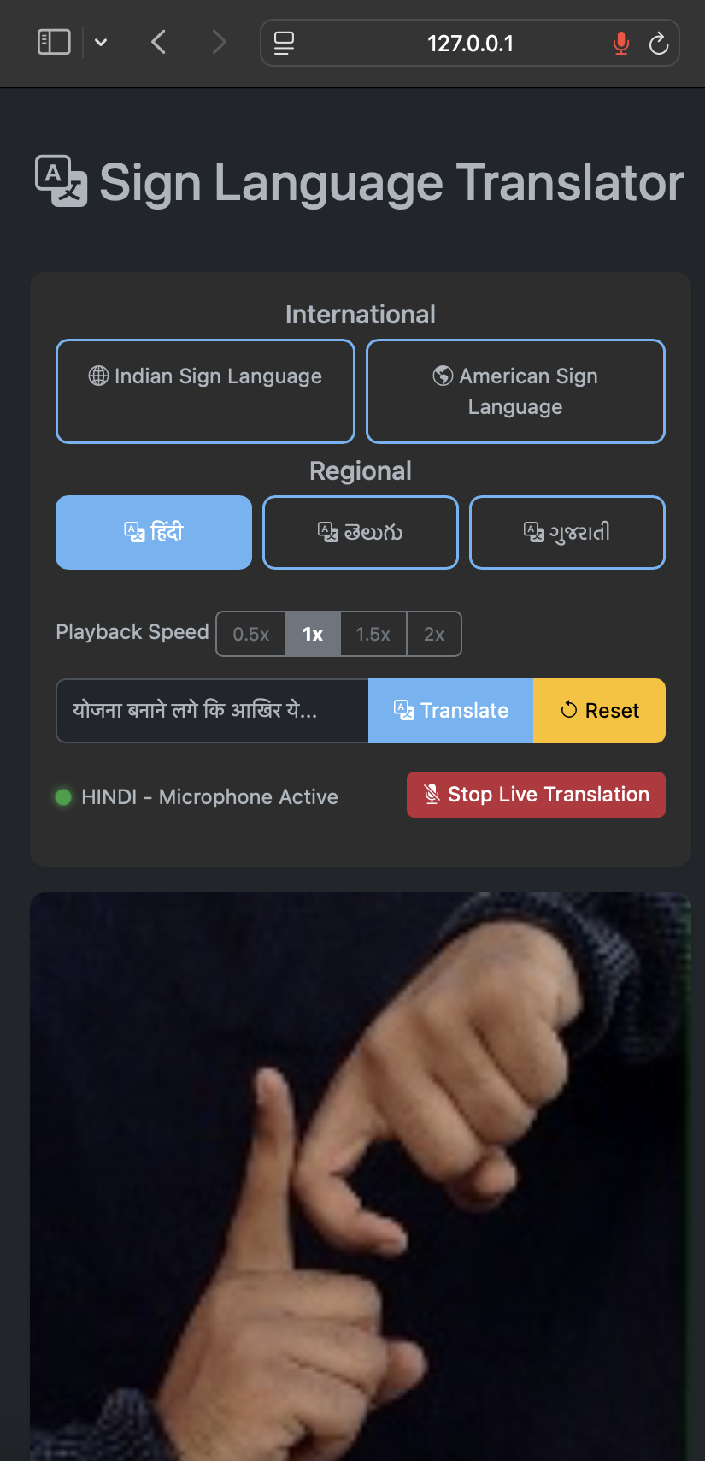


TECH STACK
USE CASES
AI/ML Components:
Vosk Speech Recognition Models
SpaCy Natural Language Processing
Custom Context Analysis System
Backend:
Python/Flask
PyAudio for audio processing
Real-time streaming architecture
Frontend:
HTML5/CSS3/JavaScript
Server-Sent Events (SSE)
Bootstrap 5 UI Framework
• Education:
Real-time sign translation for learning.
• Healthcare:
Aids doctor-patient communication.
• Workplace:
Supports meetings and training.
• Entertainment:
Translates events and media.
• Social Use: Improves daily interactions.
• Tourism: Helps travelers communicate.

Slide 5
SHOWSTOPPER DEPENDENCIES
Showstopper:
First-of-its-kind web-based real-time sign language generator
Supports multiple languages and regional sign systems
Context-aware translation system
Integrated feedback learning mechanism
Platform-independent accessibility
Unmatched efficiency in processing speed and resource use
AI Models:
Vosk speech recognition models
SpaCy language models
Custom sign language datasets
Hardware Requirements:
Microphone input
Sufficient processing power
Network connectivity

Slide 6
TEAM DETAILS
Team Lead
Name: Pelli Sree Madhav
Phone Number: 9391228193
College: Guru Nanak Institutions Techinical Campus
Team Member-1
Name: Poonam Mahunta
Phone Number: 7032940854
College: Guru Nanak Institutions Techinical Campus
Team Member-2
Name: Puli Shravya
Phone Number: 7331142509
College: Guru Nanak Institutions Techinical Campus
Team Member-3
Name: Nandikonda Shivani Reddy
Phone Number: 7416994961
College: Guru Nanak Institutions Techinical Campus
THANK YOU

