Slide 1



NLP Research Project
Improving Hinglish Sentiment Analysis
Hinglish SVM
Using Machine Learning and Sentence Embeddings

Slide 2




02
Problem Statement
Sentiment analysis is widely used in NLP for understanding opinions and emotions in text. Traditional models perform well on standard English, but Hinglish presents unique challenges: code-mixing between Hindi and English, informal grammar structures, and non-standard spelling variations.
Example: "yeh phone mast hai but battery bakwaas hai"

Slide 3



03
Hinglish Sentiment Analysis
Challenges in Hinglish
CODE-MIXING
SPELLING VARIATIONS
SLANG & NEGATION
Hinglish blends Hindi and English within sentences, creating complex language structures that traditional NLP models struggle to parse effectively.
Romanized Hindi has no standard spelling. Words like "acha", "accha", and "achha" all mean the same thing.
Informal slang (mast, bakwaas) and complex negation patterns ("nahi acha") require special handling for accurate sentiment detection.

Slide 4


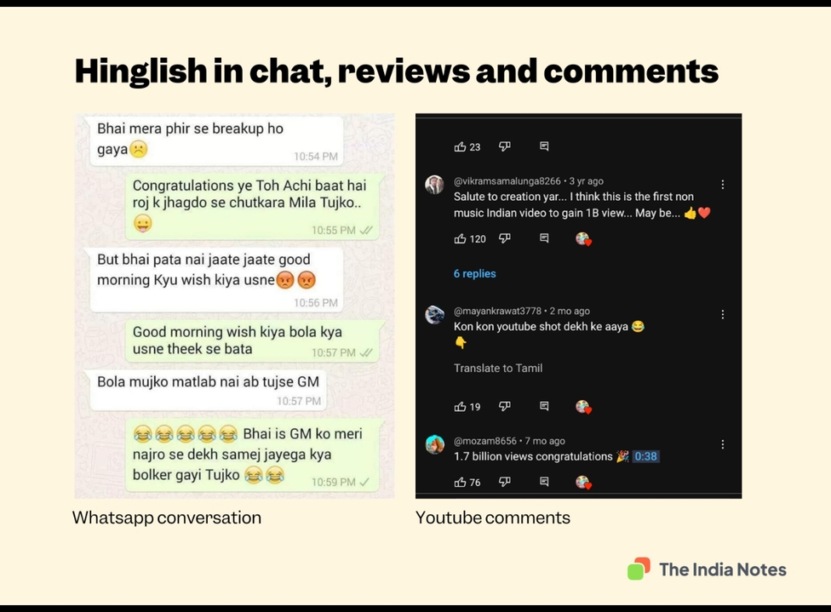
04
Hinglish Sentiment Analysis
Motivation
The rapid growth of Hinglish content across social media, e-commerce reviews, and digital platforms creates an urgent need for effective sentiment analysis tools. Current solutions are inadequate for code-mixed languages, leaving a significant gap in understanding user opinions. This project aims to develop lightweight, interpretable, and real-time capable sentiment analysis specifically designed for Hinglish text.

Slide 5

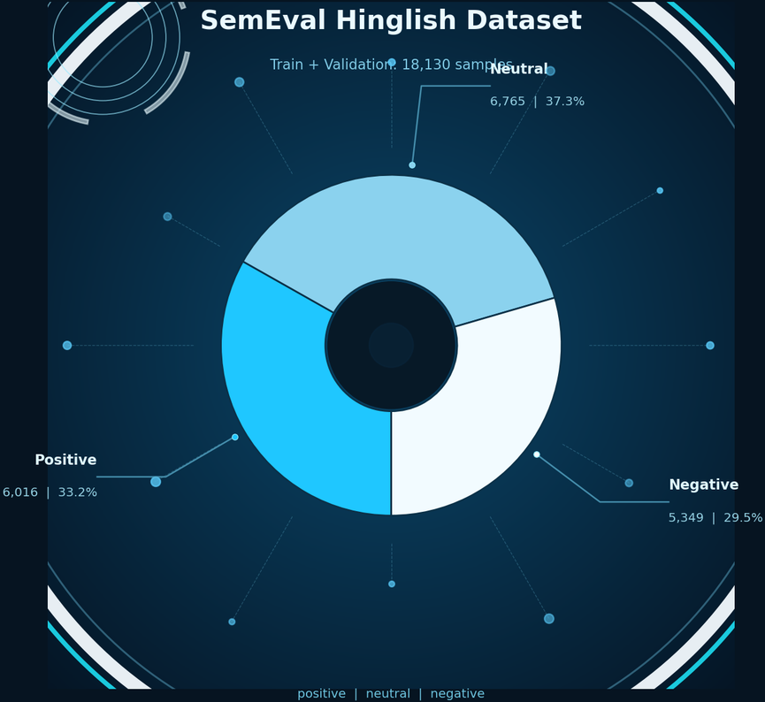
Hinglish Sentiment Analysis
05
Dataset
SemEval Hinglish Dataset
• ~18,000 labeled sentiment samples
• Three classes: Positive, Negative, Neutral
• Training and validation sets combined for model development
• Test dataset unlabeled; predictions generated separately
• Real-world Hinglish social media text samples

Slide 6




06
Hinglish Sentiment Analysis
Project Architecture
DATA & MODELS
SOURCE CODE
OUTPUTS & REPORTS
data/ — raw and processed datasets
models/ — trained model files (.pkl)
Structured storage for artifacts
src/ — core processing scripts
Preprocessing, training, evaluation modules
Modular and maintainable design
outputs/ — predictions and results
reports/ — evaluation metrics and analysis
Deployment-ready components

Slide 7


07
Hinglish Sentiment Analysis
Preprocessing
Text cleaning and normalization steps applied before modeling:
• Lowercasing text for consistency
• Removing punctuation and URLs
• Spelling normalization (acha / accha → acha)
• Slang mapping (mast → good, bakwaas → bad)
• Negation handling ("not good" → "not_good")

Slide 8




08
Hinglish Sentiment Analysis
Baseline Approach (TF-IDF)
TF-IDF (Term Frequency-Inverse Document Frequency) vectorization converts text into numerical feature vectors using unigrams and bigrams. This traditional approach counts word occurrences and weights them by document frequency. However, TF-IDF treats words as independent tokens and does not capture semantic meaning or contextual relationships between words.

Slide 9
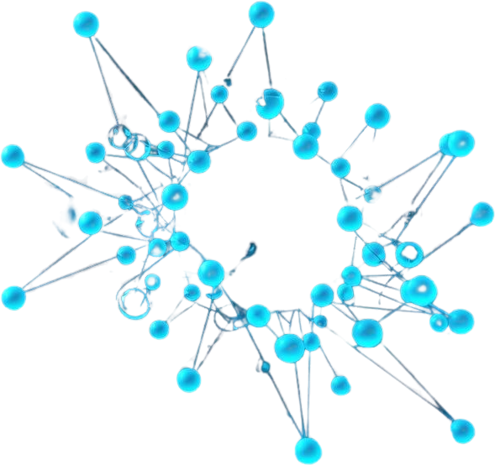


09
Hinglish Sentiment Analysis
Improved Approach
Multilingual sentence embeddings using paraphrase-multilingual-MiniLM model capture semantic meaning and contextual relationships. Unlike TF-IDF, embeddings understand that similar sentences produce similar vectors, enabling better cross-lingual sentiment detection for code-mixed Hinglish text.

Slide 10




10
Models Used
LOGISTIC REGRESSION
SVM (TF-IDF)
SVM (EMBEDDINGS)
TF-IDF: Traditional baseline approach using term frequency features for classification.
Embeddings: Leverages semantic vectors for improved understanding.
Support Vector Machine with TF-IDF features. Strong baseline with hyperplane-based classification.
Best performing model combining SVM with multilingual sentence embeddings for semantic understanding.

Slide 11


11
Hinglish Sentiment Analysis
Training Pipeline
Step-by-step training and evaluation workflow:
Data Preprocessing — Clean and normalize Hinglish text
Feature Extraction — TF-IDF vectorization or sentence embeddings
Model Training — Train classifiers on processed features
Evaluation — Measure accuracy, F1-score, confusion matrix
Artifacts Generated:
• Trained models (.pkl files)
• TF-IDF vectorizer
• Model metadata
• Evaluation outputs

Slide 12



12
Hinglish Sentiment Analysis
Results
Model Performance Comparison:
• SVM (Embeddings): Accuracy 0.6475, F1 0.6476
• Logistic Regression (TF-IDF): Accuracy 0.6448, F1 0.6434
• SVM (TF-IDF): Accuracy 0.6390, F1 0.6386
• Logistic Regression (Embeddings): Accuracy 0.5874, F1 0.5826
SVM with sentence embeddings achieves the best overall performance, demonstrating the value of semantic understanding in Hinglish sentiment classification.

Slide 13

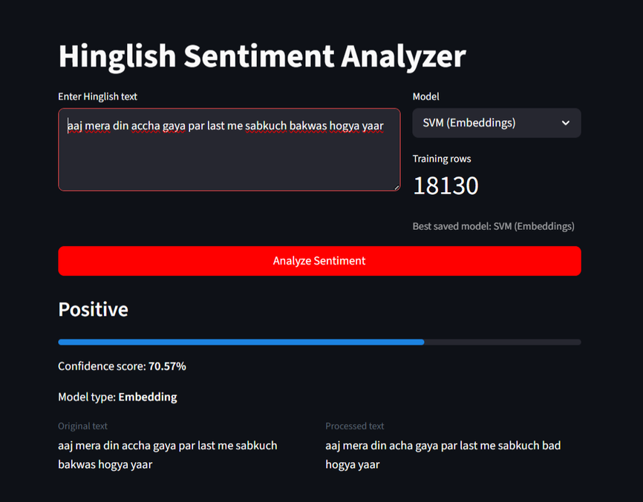
13
Hinglish Sentiment Analysis
Analysis
SVM performs best overall across all evaluation metrics, demonstrating superior classification capability for Hinglish text. Sentence embeddings improve semantic understanding by capturing contextual meaning and multilingual similarities that TF-IDF cannot detect. The performance gain from embeddings is moderate but consistent, validating the approach for code-mixed language processing.

Slide 14



14
Hinglish Sentiment Analysis
Error Analysis
NEGATION ISSUES
HINGLISH AMBIGUITY
COMPLEX STRUCTURES
Model struggles with negation patterns like "nahi acha" or "not good". Mixed sentiment in same sentence causes confusion in classification.
Context misunderstanding due to code-mixing. Words like "mast" can be positive or sarcastic depending on context.
Long sentences with multiple clauses and mixed Hindi-English syntax create parsing difficulties for the model.

Slide 15

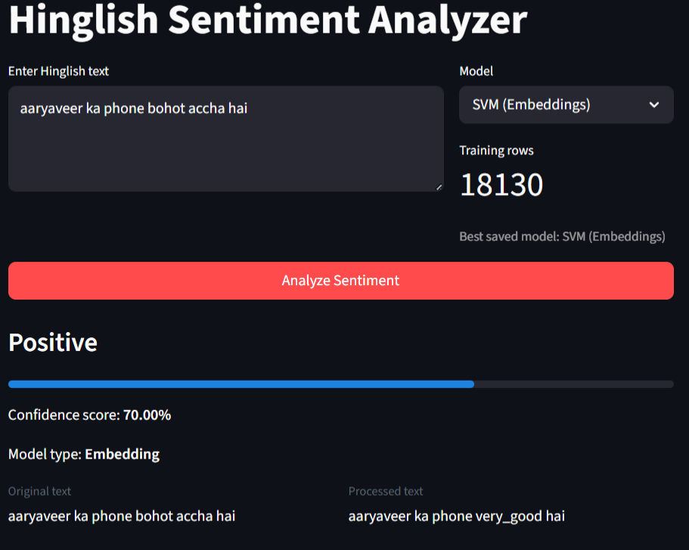
15
Hinglish Sentiment Analysis
Application (Streamlit)
User inputs Hinglish text into the interface and the model predicts sentiment in real-time. The application displays the sentiment label (Positive, Negative, Neutral), confidence score, and processed text. Users can switch between TF-IDF and Embedding-based models for comparison. Clean, intuitive interface designed for easy interaction and demonstration.

Slide 16




16
Hinglish Sentiment Analysis
Limitations
SARCASM DETECTION
MIXED SENTIMENT
ABBREVIATIONS
Current models struggle to detect sarcasm and irony in Hinglish text, often misclassifying sarcastic negative statements as positive sentiment.
Difficulty handling sentences with both positive and negative opinions, leading to incorrect overall sentiment classification.
Poor handling of common internet abbreviations like gr8, lol, btw which are prevalent in informal Hinglish communication.

Slide 17




17
Hinglish Sentiment Analysis
Future Work
TRANSFORMER MODELS
DATA EXPANSION
CONTEXT MODELING
Integrate advanced transformer architectures like BERT and IndicBERT for deeper contextual understanding of Hinglish text.
Improve abbreviation handling for terms like "gr8", "lol", "btw" and expand dataset size for better coverage.
Develop better context understanding mechanisms to handle sarcasm, mixed sentiment, and complex linguistic patterns.

Slide 18




18
thynk unlimited
Conclusion
• Built a complete end-to-end Hinglish sentiment analysis system
• Compared traditional TF-IDF and modern embeddings approaches
• Achieved improved performance with multilingual sentence embeddings
• Developed a deployable Streamlit application for real-time predictions
• Demonstrated practical viability of lightweight ML solutions for code-mixed languages

Slide 19


19
Hinglish Sentiment Analysis
Team Members
Madhav Kathuria — Core ML + Architecture + UI
Prakhar Parashar — Models + Training
Utkarsh Jha — Preprocessing + Data
Aaryaveer Rathore — Results + Analysis
K.Siddhartha — Application + Limitations
K. Ribhu —Documentation and Evaluation Analysis

Slide 20

Questions?
Thank You!
Thank you for your attention. We welcome any questions about our Hinglish sentiment analysis project.

