Slide 1
Exploration of the unknown
Experiment instructions

Slide 2
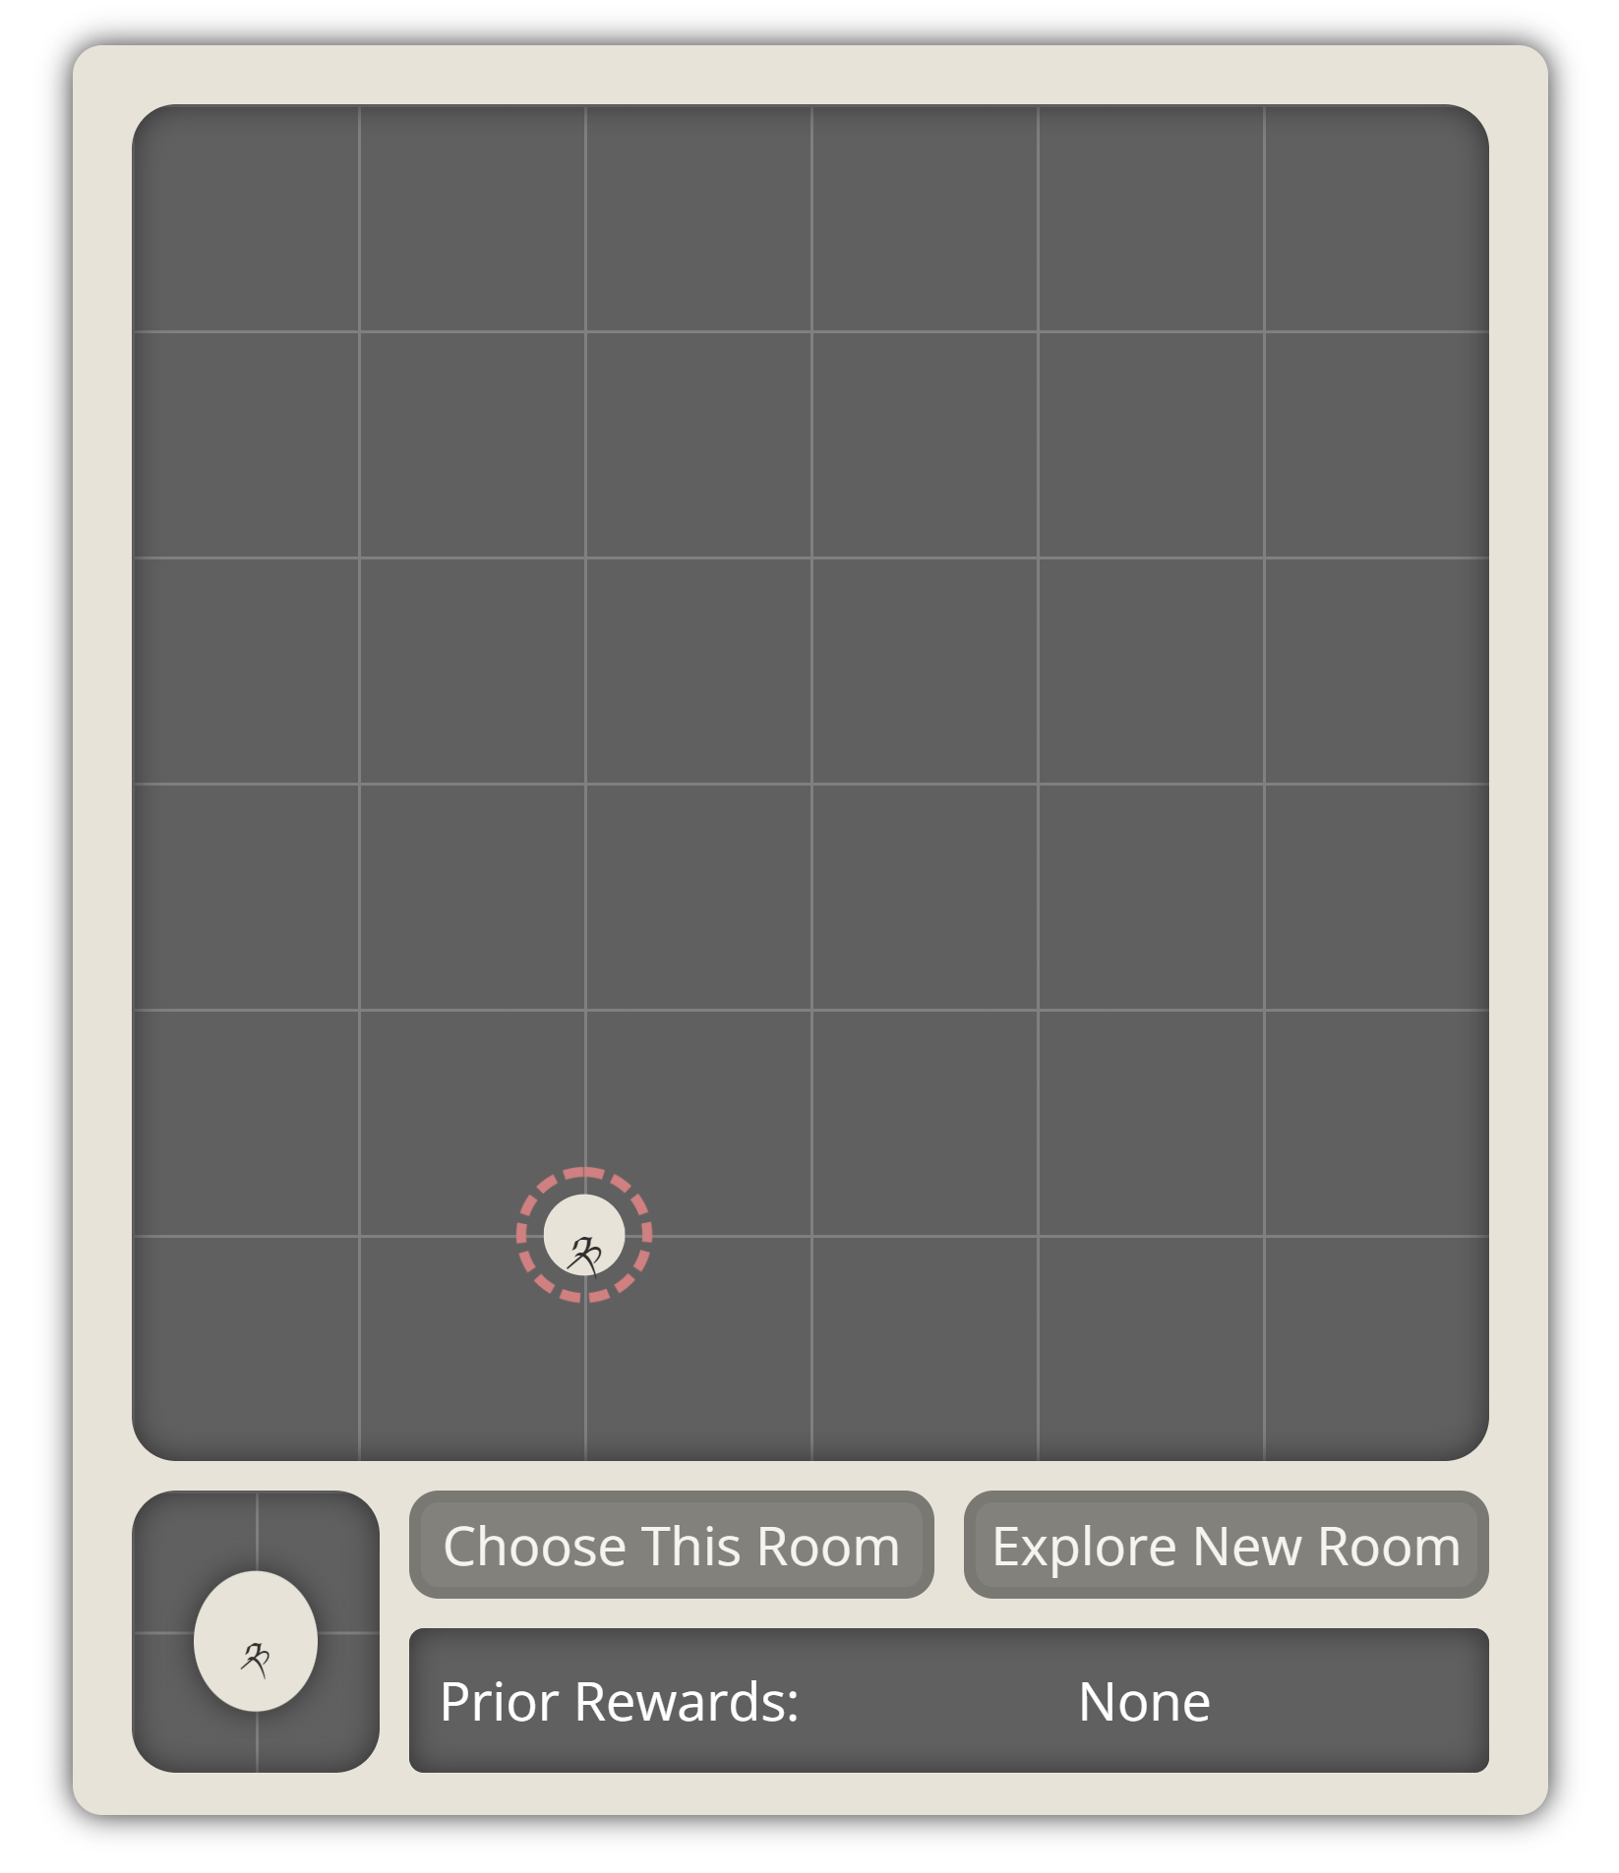
Task Instructions
Welcome to the choice task
In the following task you will be presented with rooms.
The room with your current location is shown with a red circle.
For example the current map shows a single room.
The red circle around that room shows you are currently in that room.
👉

Slide 3
Task Instructions
Welcome to the choice task
In the following task you will be presented with rooms.
Whenever you are in a room, you can choose that room.
👉

Slide 4
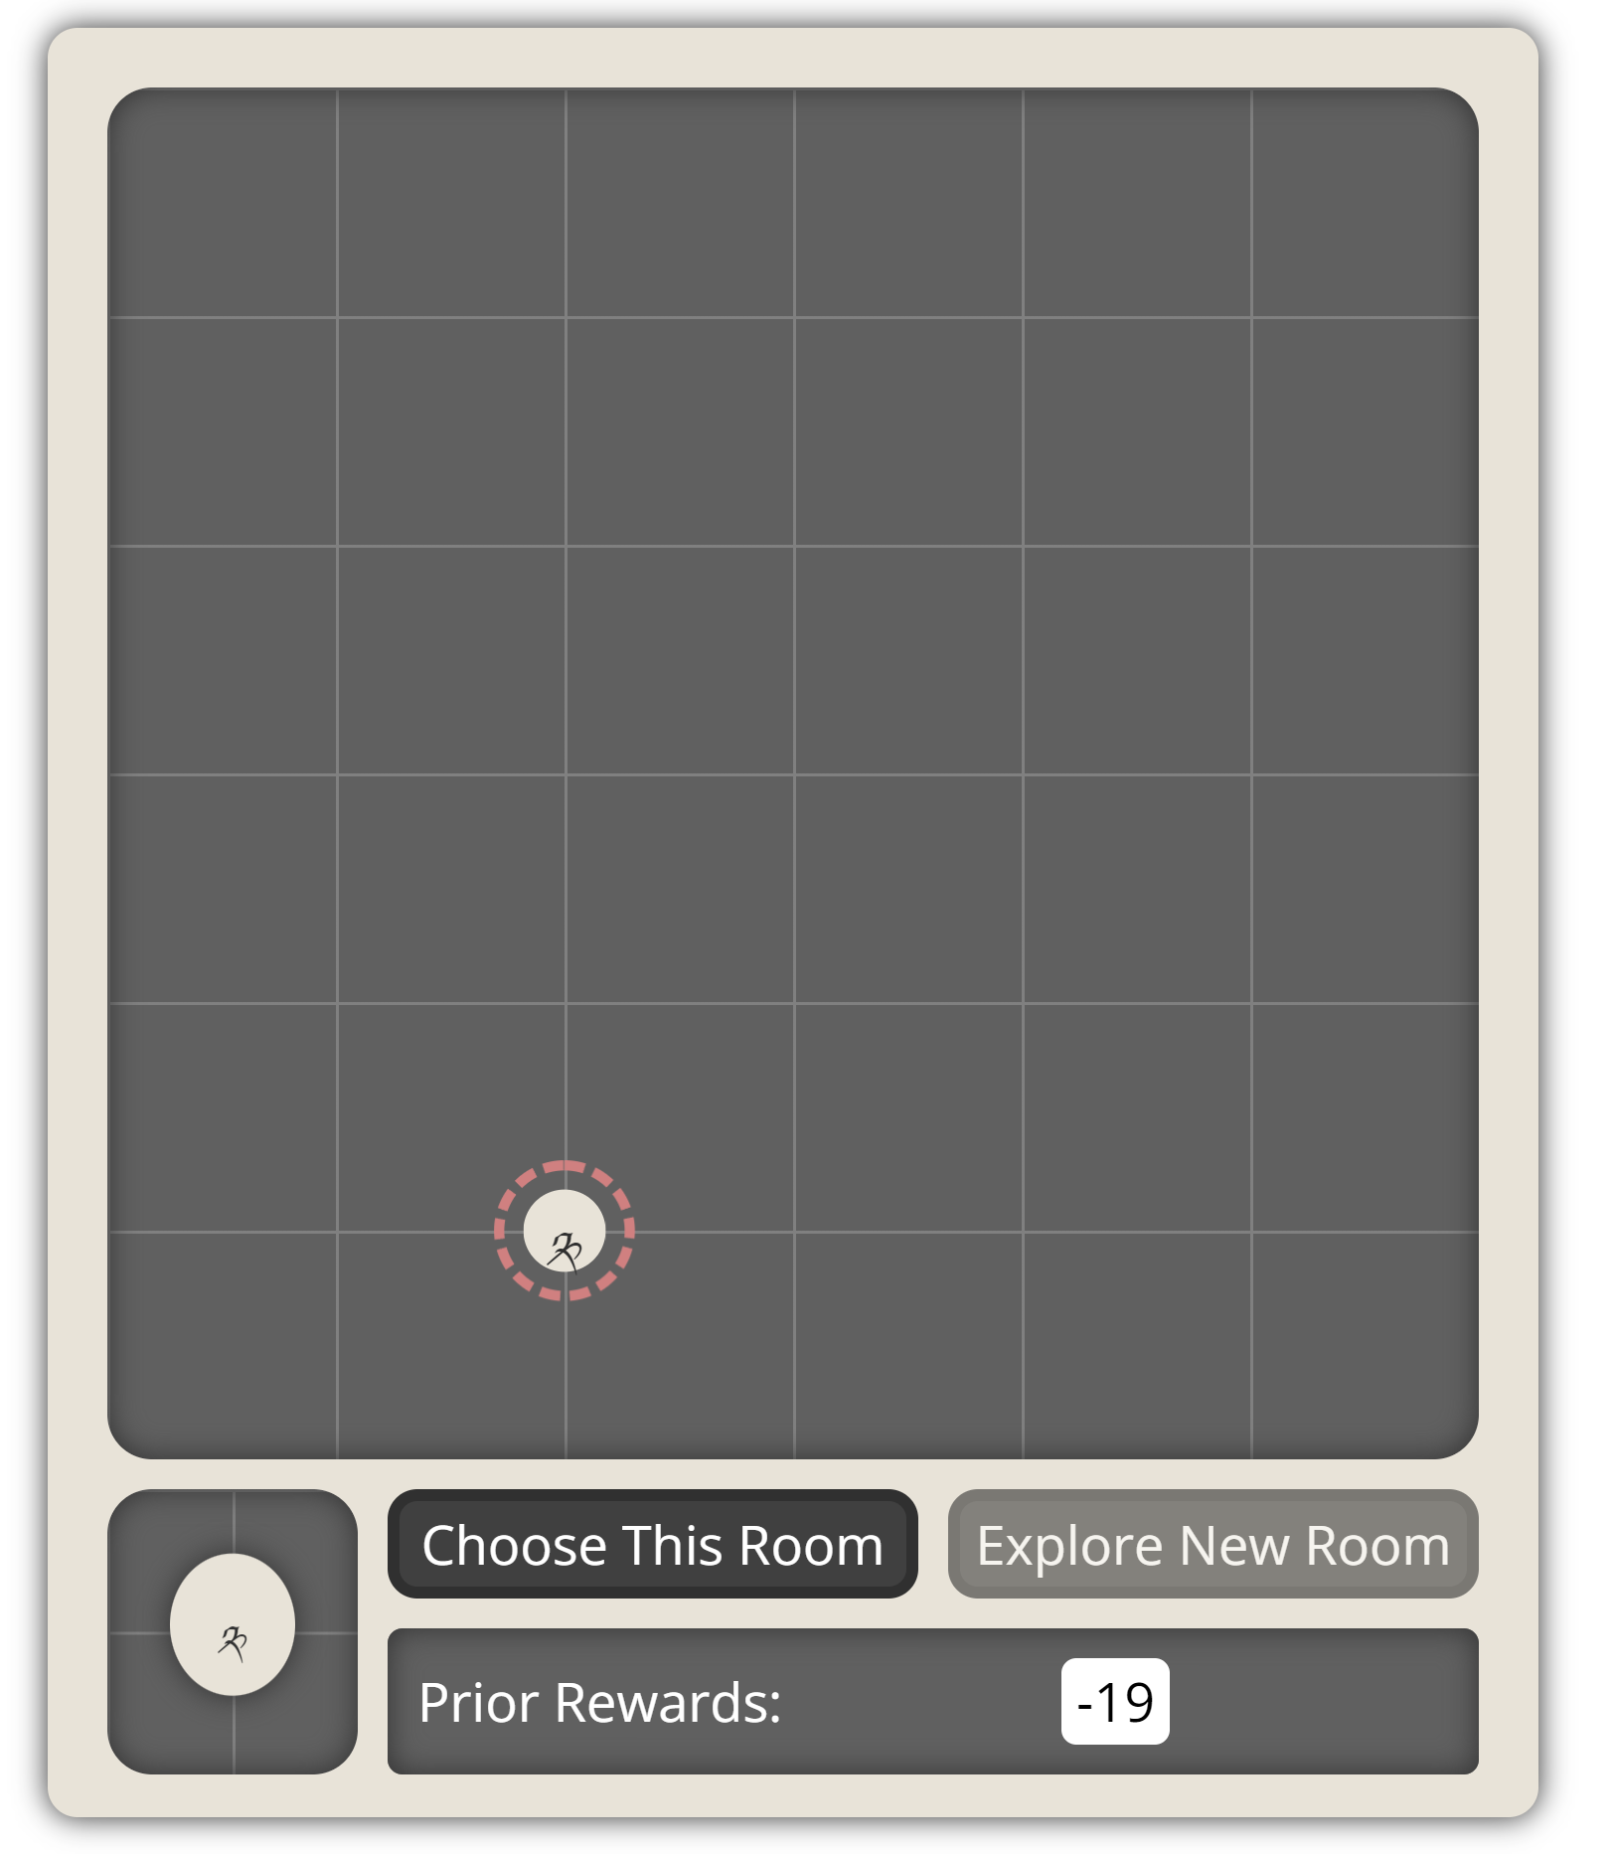
Task Instructions
Welcome to the choice task
In the following task you will be presented with rooms.
Whenever you are in a room, you can choose that room.
When you choose a room, you get a certain amount of points.
All the points you received from a room are shown in the box at the bottom.
👉

Slide 5
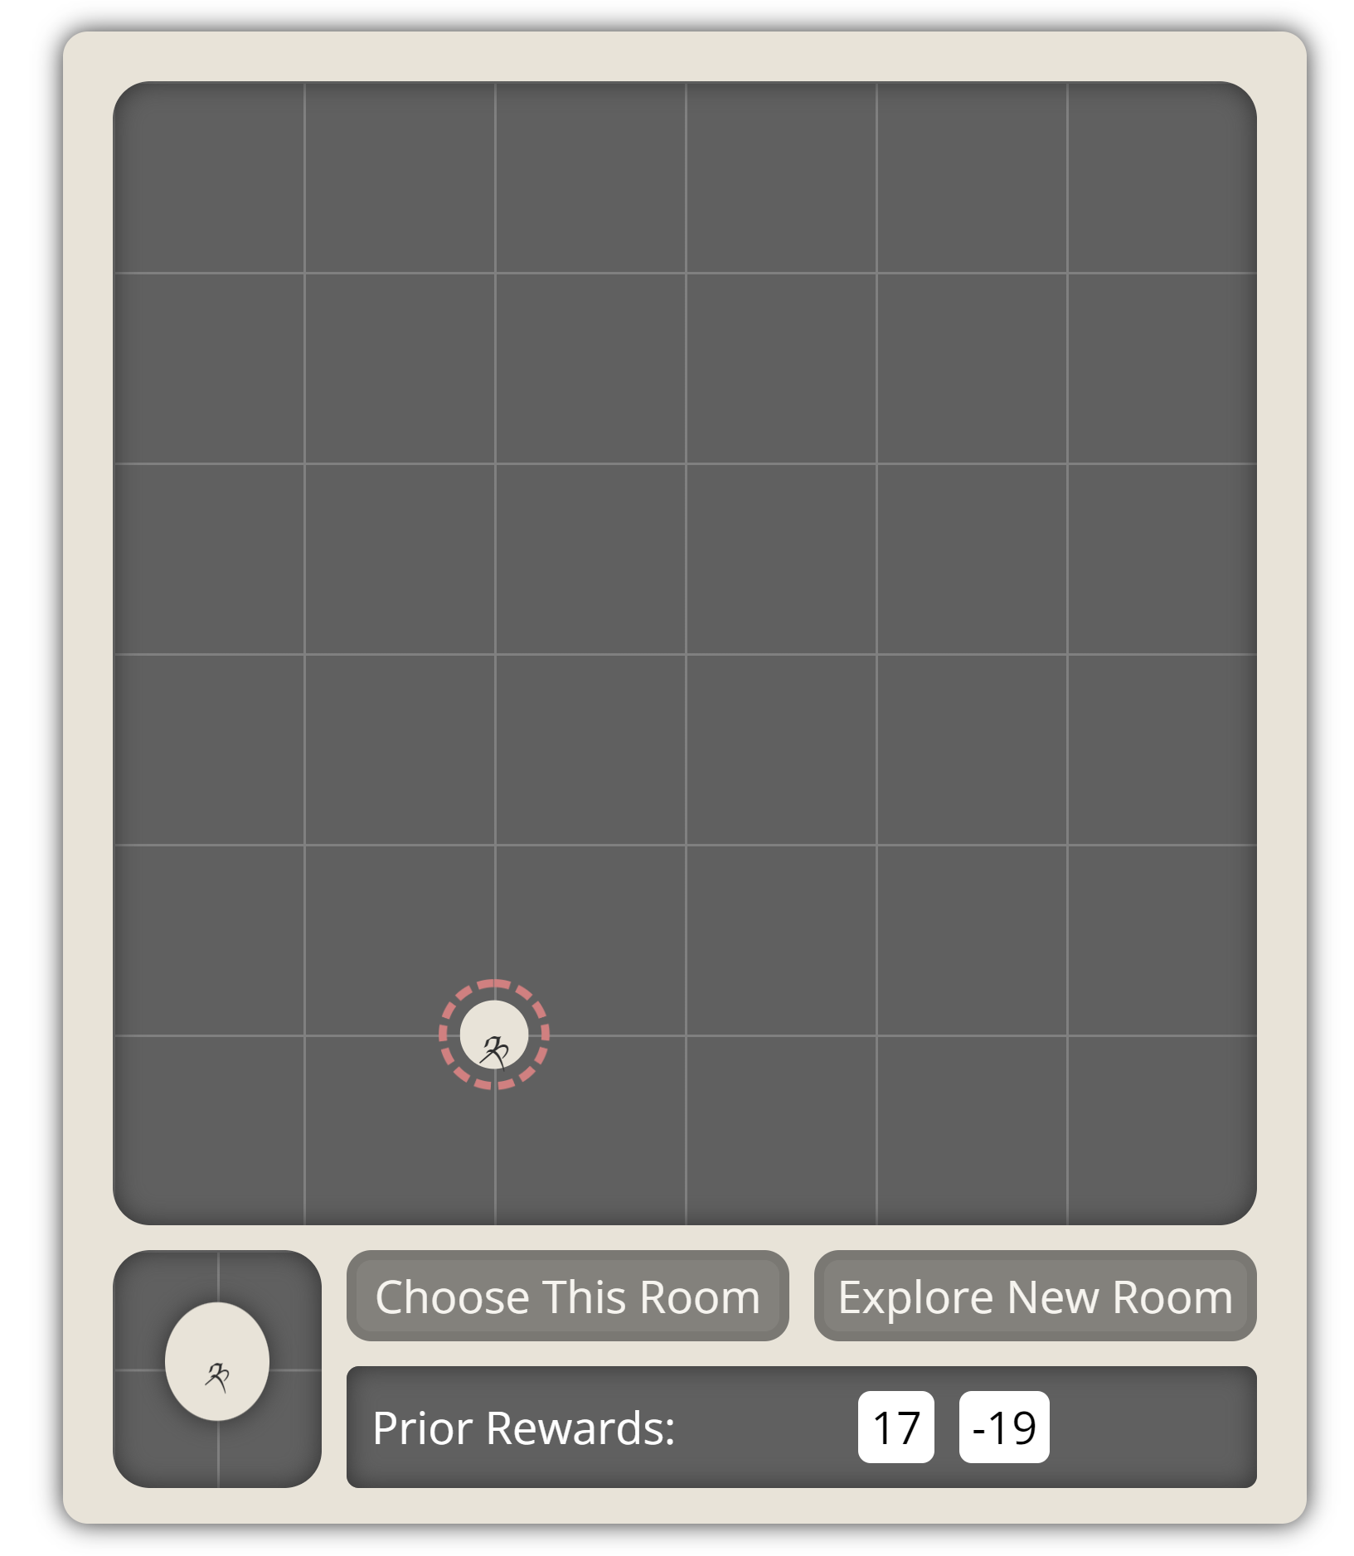
Task Instructions
Welcome to the choice task
In the following task you will be presented with rooms.
Whenever you are in a room, you can choose that room.
When you choose a room, you get a certain amount of points.
All the points you received from a room are shown in the bottom box.
You can choose a room as many times as you like.
👉

Slide 6
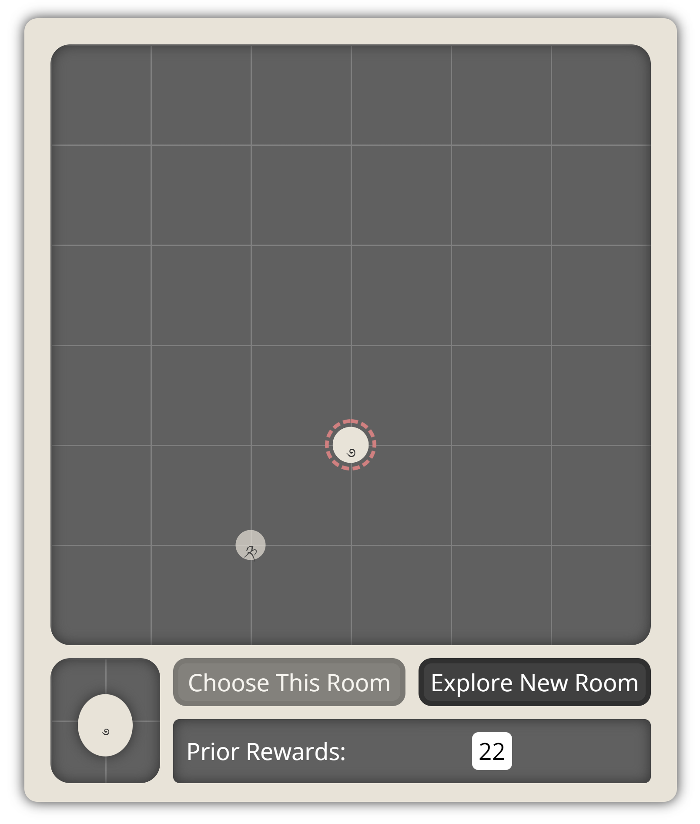
Task Instructions
Welcome to the choice task
In the following task you will be presented with rooms.
Whenever you are in a room, you can choose that room.
When you choose a room, you get a certain amount of points.
In addition to the current room, you can explore a new room to open up a new room on the map.
👉
When you explore a new room, you automatically choose it once.
👉

Slide 7
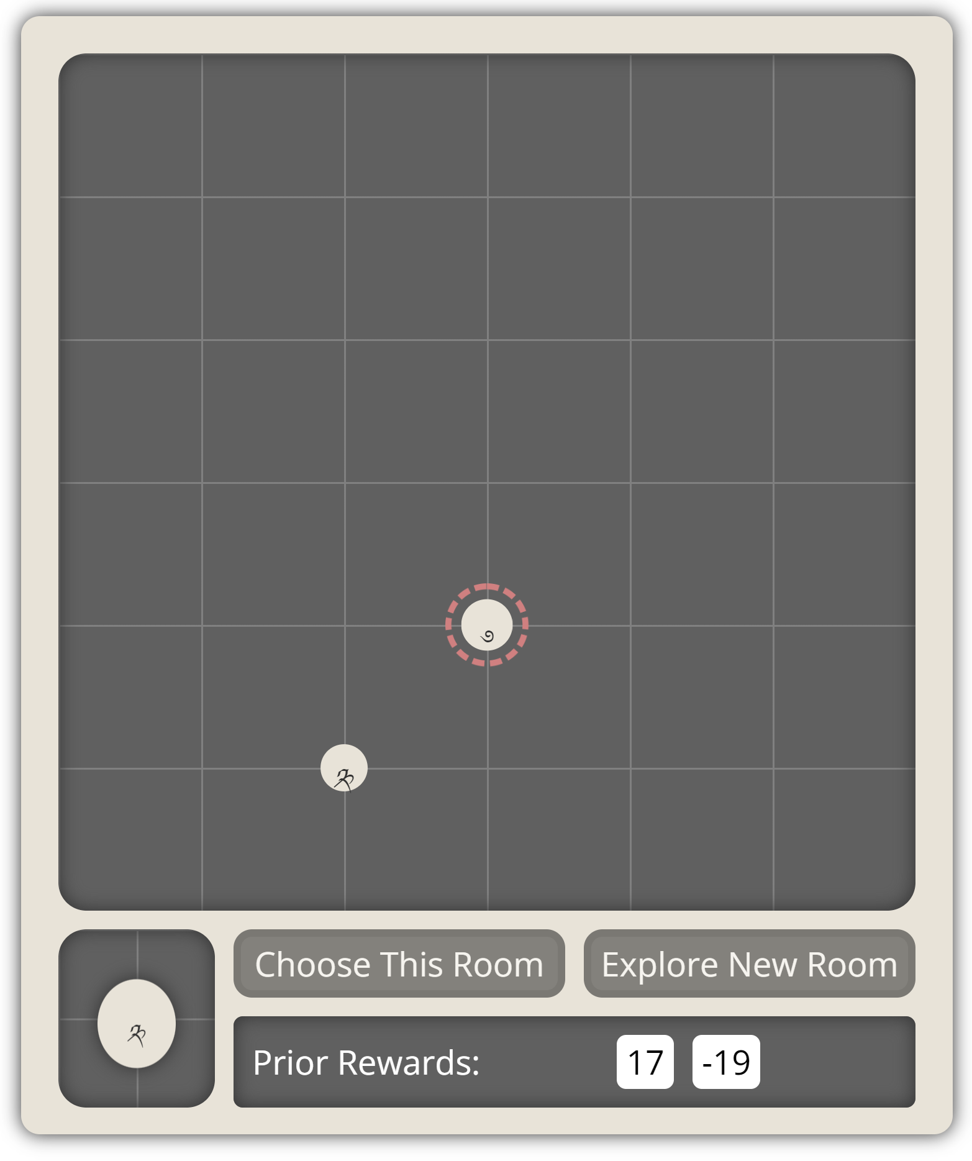
Task Instructions
Welcome to the choice task
In the following task you will be presented with rooms.
Whenever you are in a room, you can choose that room.
When you choose a room, you get a certain amount of points.
In addition to the current room, you can explore a new room to open up a new room on the map.
When you explore a new room, you automatically choose it once.
To see the rewards you received from another room, simply hover over that room, or click on it to enter it.
👉
👉

Slide 8
Task Instructions
Welcome to the choice task
In the following task you will be presented with rooms.
Whenever you are in a room, you can choose that room.
When you choose a room, you get a certain amount of points.
In addition to the current room, you can explore a new room to open up a new room on the map.
When you explore a new room, you automatically choose it once.
To see the rewards you received from another room, simply hover over that room, or click on it to move into it.
To move into a room you previously visited, simply click on that room.
👉

Slide 9
Task Instructions
Welcome to the choice task
In the following task you will be presented with rooms.
Whenever you are in a room, you can choose that room.
When you choose a room, you get a certain amount of points.
In addition to the current room, you can explore a new room.
In each turn, you can either (a) choose the current room or (b) explore a new room.
a
b
👉
👉

Slide 10
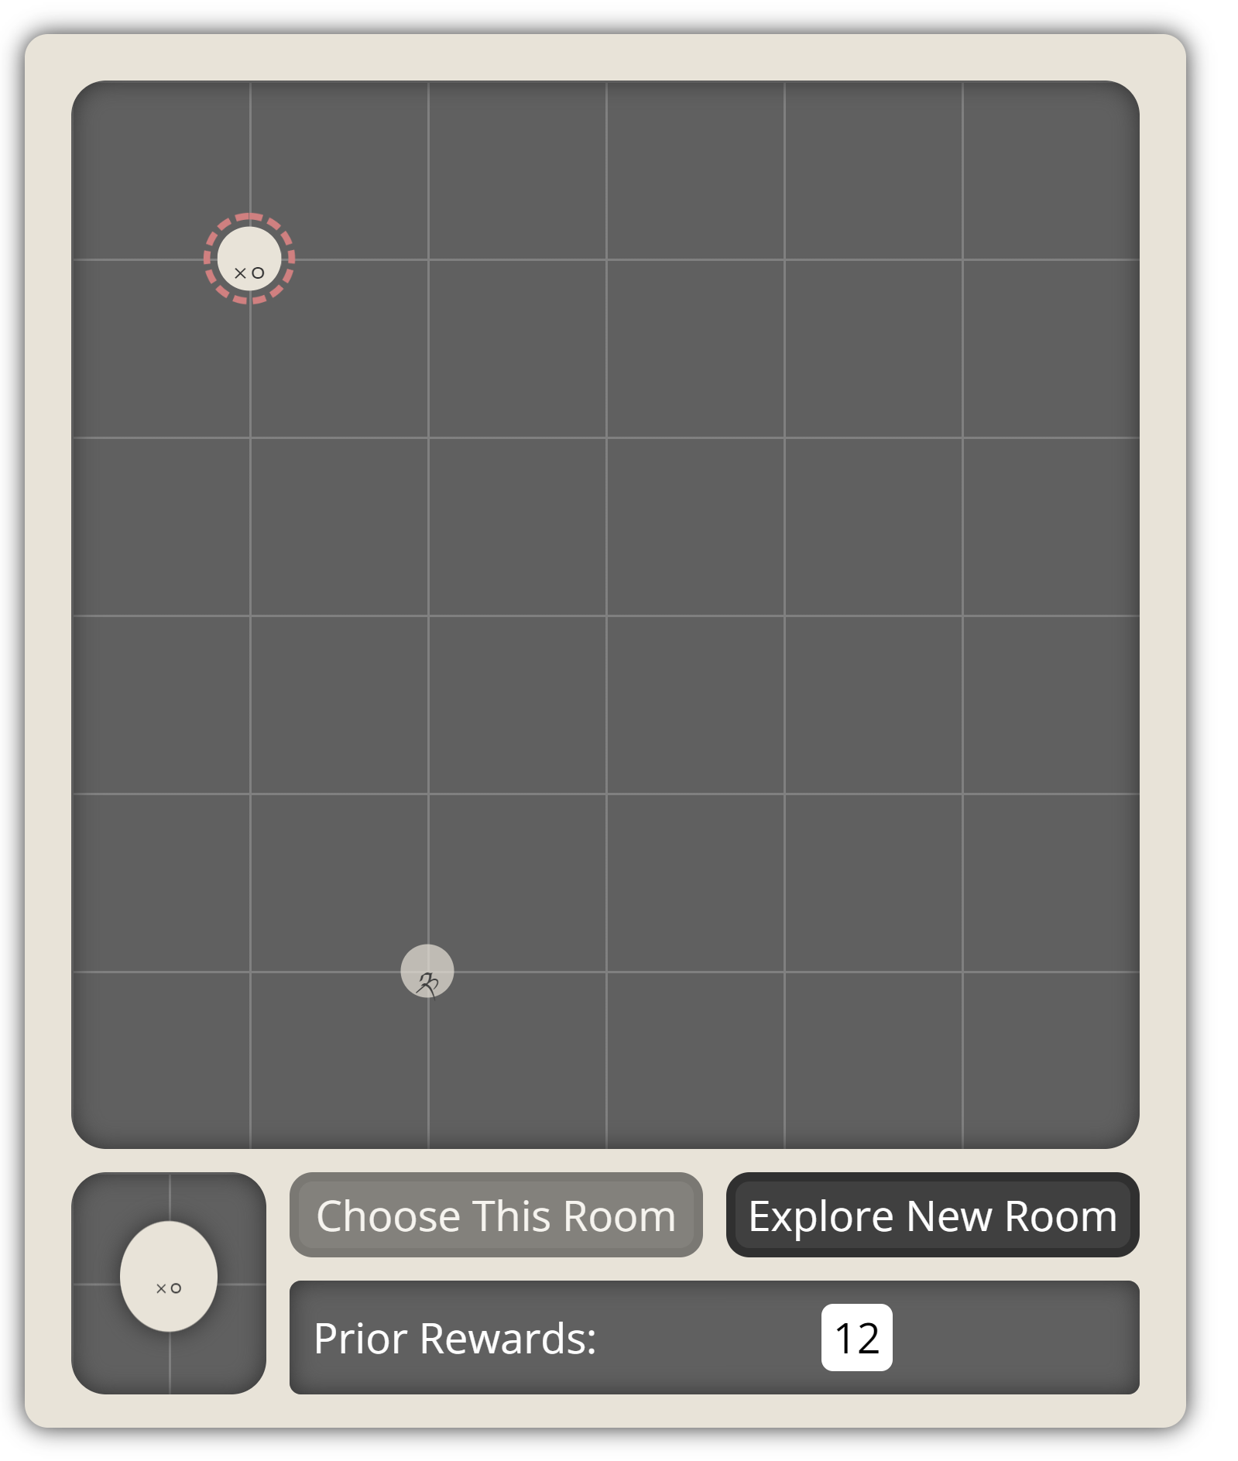
Task Instructions
Welcome to the choice task
In the following task you will be presented with rooms.
Whenever you are in a room, you can choose that room.
When you choose a room, you get a certain amount of points.
In addition to the current room, you can explore a new room.
In each turn, you can either (a) choose the current room or (b) explore a new room.
Sometimes when you make choices, rooms may disappear. When rooms disappear you cannot choose them again.
👉
👉
👉
In this example, a choice in “Explore New Room” revealed a new room (presented with dashed red circle around it, on the left) but one of the previously visited rooms disappeared.

Slide 11
Task Instructions
Welcome to the choice task
In the following task you will be presented with rooms.
Whenever you are in a room, you can choose that room.
When you choose a room, you get a certain amount of points.
In addition to the current room, you can explore a new room.
In each turn, you can either (a) choose the current room or (b) explore a new room.
Sometimes when you make choices, rooms may disappear. When rooms disappear you cannot choose them again.
Your goal in this task is to gain the maximal number of points. At the end of the task, one of the rewards you got in the task will be translated into a bonus payment.

Slide 12
Task Instructions
Welcome to the choice task
Map 1
Map 2
In the following task you will be presented with rooms.
Whenever you are in a room, you can choose that room.
When you choose a room, you get a certain amount of points.
In addition to the current room, you can explore a new room.
In each turn, you can either (a) choose the current room or (b) explore a new room.
Sometimes when you make choices, rooms may disappear. When rooms disappear you cannot choose them again.
Your goal in this task is to gain the maximal number of points. At the end of the task, one of the rewards you got in the task will be translated into a bonus payment.
The task is made of several room maps.
After you complete a certain number of choices in one map, you will automatically be transferred to a new map.
The task includes an overall of 3 maps. Completing them all should take approximately 15 minutes.

Slide 13
Task Instructions
Welcome to the choice task
In the following task you will be presented with rooms.
Whenever you are in a room, you can choose that room.
When you choose a room, you get a certain amount of points.
In addition to the current room, you can explore a new room.
In each turn, you can: (a) choose the current room. (b) move to a different room. (c) explore a new room.
Sometimes when you make choices, rooms may disappear. When rooms disappear you cannot choose them again.
Your goal in this task is to gain the maximal number of points. At the end of the task, one of the rewards you got in the task will be translated into a bonus payment.
The task is made of several room maps.
This is the end of the instructions. When you are ready to start, press the “start” button.

