Slide 1
SALES DATA ANALYSIS
Sales Performance Dashboard
Internship Mini Project Presentation
Excel • Power Query • Python • Pandas • NumPy • Matplotlib • Power BI

Slide 2
Project Overview
• Analyze 250 sales transaction records.
• Clean and prepare data before analysis.
• Calculate key sales performance indicators.
• Study sales by product, region, category, month and payment method.
• Create analytical visualizations in Python.
• Build an interactive Sales Performance Dashboard in Power BI.
• Convert analysis results into practical business insights.
Sales Data Analysis Project | Slide 2

Slide 3
Dataset & Columns
250 rows and 11 columns
Order ID — Order identifier
Order Date — Transaction date
Customer — Customer name
Product — Product purchased
Category — Product category
Region — Sales region
Quantity — Units sold
Unit Price — Price per unit
Discount — Discount applied
Sales — Final sales value
Payment Method — Payment mode
Sales Data Analysis Project | Slide 3

Slide 4
Data Cleaning & Preparation
• Duplicate records were removed to create the final 250-record dataset.
• Missing Customer values were replaced with “Unknown”.
• Missing Payment Method values were replaced with “Unknown”.
• Order Date was converted into proper datetime format.
• Data was checked for structure, missing values, duplicates and data types.
• The prepared dataset was used for Python analysis and Power BI.
Customer = fillna("Unknown") | Payment Method = fillna("Unknown") | Order Date → datetime
Sales Data Analysis Project | Slide 4

Slide 5
Key Performance Indicators
Total Sales
₹18.91M
Total Orders
250
Total Quantity Sold
986
Average Sales Order
₹75.65K
Note: Total Customer was not used as a KPI in the final dashboard.
Sales Data Analysis Project | Slide 5

Slide 6
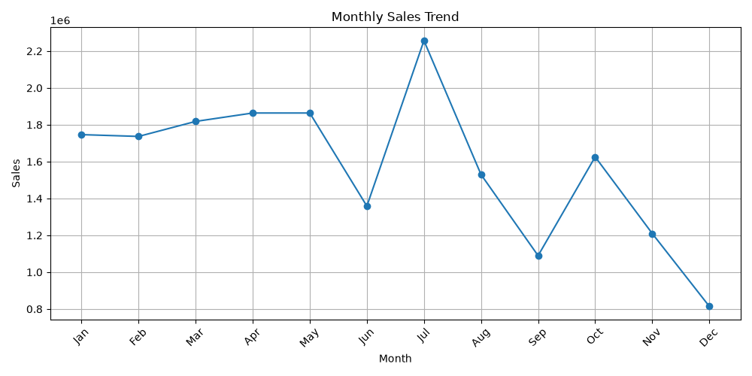
Monthly Sales Trend
Sales Data Analysis Project | Slide 6

Slide 7
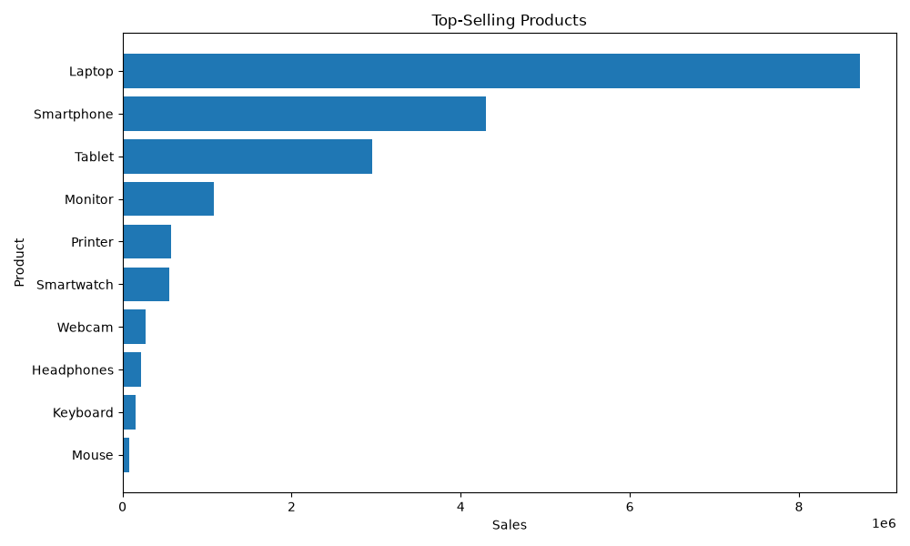
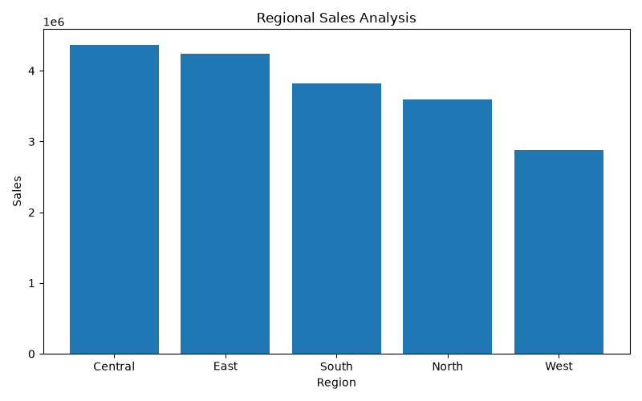
Product & Regional Analysis
Sales Data Analysis Project | Slide 7

Slide 8
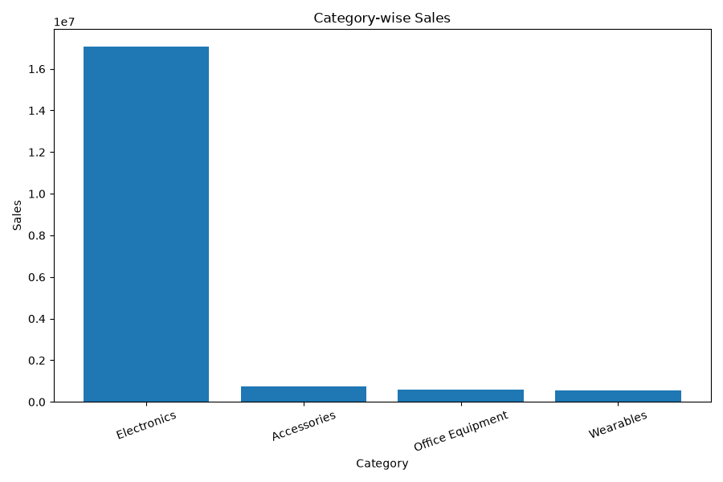
Category-wise Sales Analysis
Sales Data Analysis Project | Slide 8

Slide 9
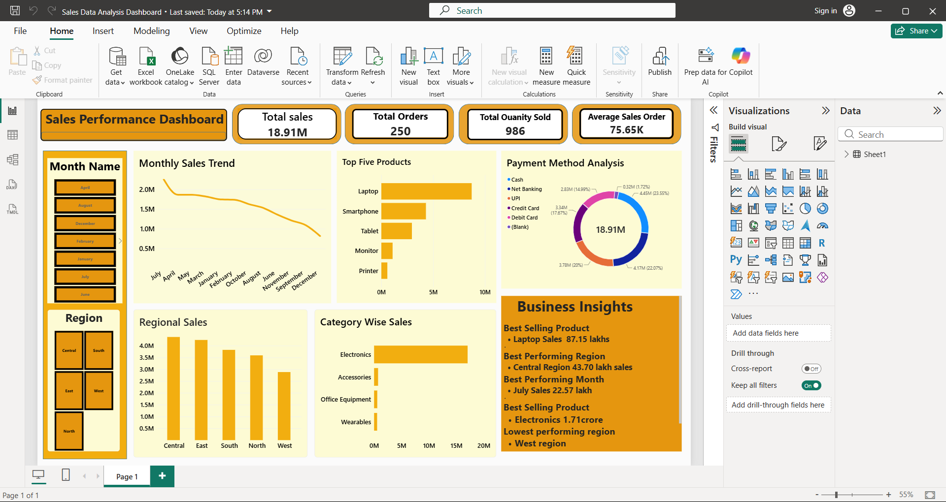
Power BI Dashboard
Interactive dashboard with KPI cards, charts, slicers and business insights
Sales Data Analysis Project | Slide 9

Slide 10
Dashboard Components
KPI Cards
Total Sales, Total Orders, Total Quantity Sold, Average Sales Order
Charts
Monthly Trend, Top Five Products, Regional Sales, Category Wise Sales, Payment Method
Slicers
Month Name and Region
Business Insights
Short conclusions derived from the analysis
Sales Data Analysis Project | Slide 10

Slide 11
Business Insights
• Best-Selling Product: Laptop — ₹87.16 lakh sales.
• Best-Performing Region: Central — ₹43.70 lakh sales.
• Best-Performing Month: December — ₹10.90 lakh sales.
• Best-Performing Category: Electronics — ₹1.71 crore sales.
• Lowest-Performing Region: West — ₹28.84 lakh sales; needs improvement.
Sales Data Analysis Project | Slide 11

Slide 12
Power BI DAX Measures
Total Sales = SUM(Sheet1[Sales])
Total Orders = COUNTROWS(Sheet1)
Total Quantity Sold = SUM(Sheet1[Quantity])
Average Sales Order = DIVIDE(SUM(Sheet1[Sales]), COUNTROWS(Sheet1))
Sales Data Analysis Project | Slide 12

Slide 13
Conclusion & Future Scope
• The project analyzed 250 sales transactions with total sales of ₹18,913,205.50.
• Laptop is the leading product and Central is the leading region.
• December recorded the highest monthly sales.
• Python provided detailed analysis and visualizations, while Power BI provided an interactive business dashboard.
• Future improvements: profit/margin analysis, sales forecasting, year-over-year growth and detailed drill-through pages.
Sales Data Analysis Project | Slide 13

Slide 14
THANK YOU
Questions & Discussion

