Slide 1
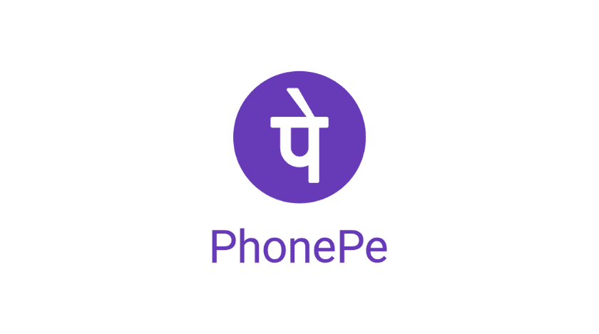
OFFLINE TRANSACTIONS USING UNIQUE KEYCODE
Team Name - BitParadox

Slide 2
Agenda
Problem Statement
Solution Flow
Edge Case Handling
Additional Security

Slide 3
Problem Statement
Offline payments are transactions that are either processed without a data connection or where the transaction is recorded offline and processed and settled at a different point of time when connectivity becomes available with one or either parties involved in a transaction.
As a user we have also faced similar challenges and unable to make payments at a remote place or somewhere with patchy connectivity.
The aim is to devise an innovative solution and/or product which would solve this problem to enable seamless offline payments.

Slide 4
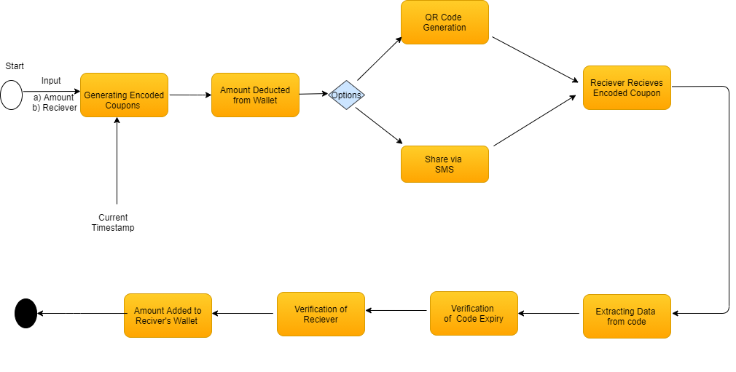
Solution Flow

Slide 5
Edge Case Handling:
Transaction will be cancelled if
Amount entered to be sent exceeds the wallet balance.
Code expiry passes the current time.
Code is not used by designated users.
Note: If code expires in that case the amount has already been deducted from sender’s wallet and wallet will be updated after network connection.
What if User Have two apps Then he can use both apps for two transaction at same time then it will create conflict hence for this feature he can use only on one app by verifying Mobile No. and IMEI similar usage as of UPI Platform.

Slide 6
After connection is established:
Devices will send this code to backend and if same transaction happened for both users then it will be updated on backend.
If at any condition if the amount has not been received then the amount refunded to the sender.

Slide 7
Additional Security for Transactions
Encrypted Code
Code can be accessed by designated user only
Time based Code for providing additional security, As even if a user's code is stolen or compromised, an attacker cannot gain access the code which expires quickly after the maximum time limit.

Slide 8
Thank YOu
For any questions feel free to contact us at:
BitParadox:
Madhav Shah Sisodiya (madhavshahsisodiya@gmail.com)
Hritik Rastogi (hritikrastogi880@gmail.com)
Akshat Gupta (ansh.gupta0512@gmail.com)
Kalpana (kumarikalpana640@gmail.com)
Aman Pandey(pandey.aman812@gmail.com)

