Slide 1
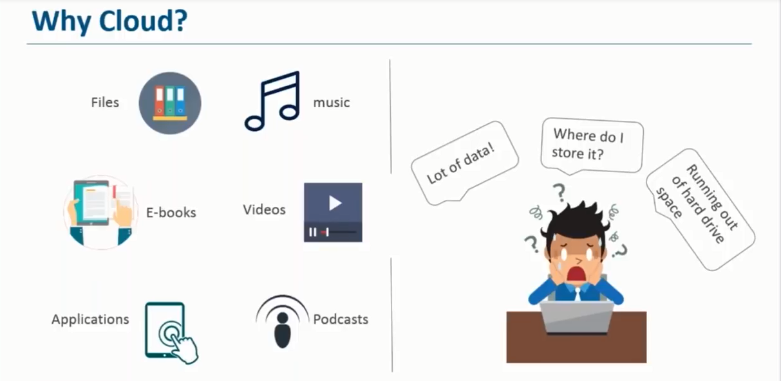

Slide 2
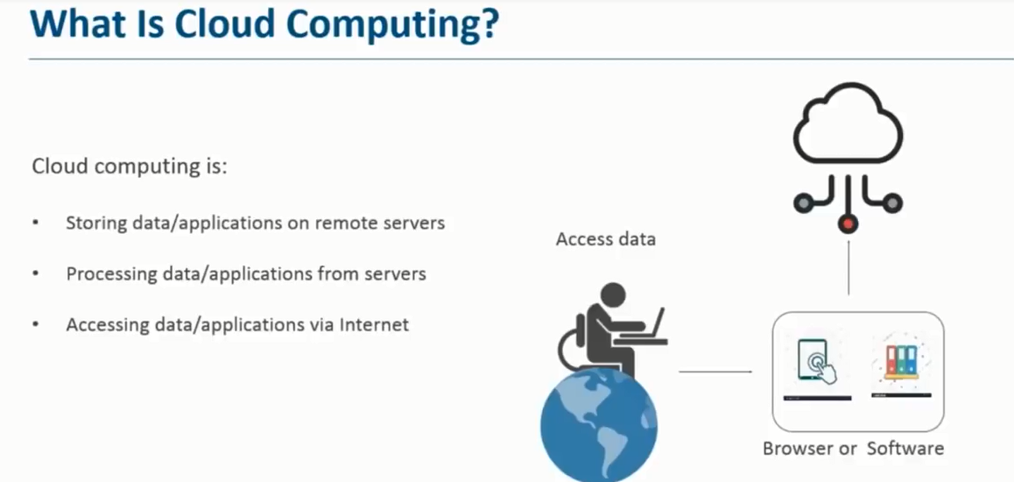
What is Azure ?

Slide 3
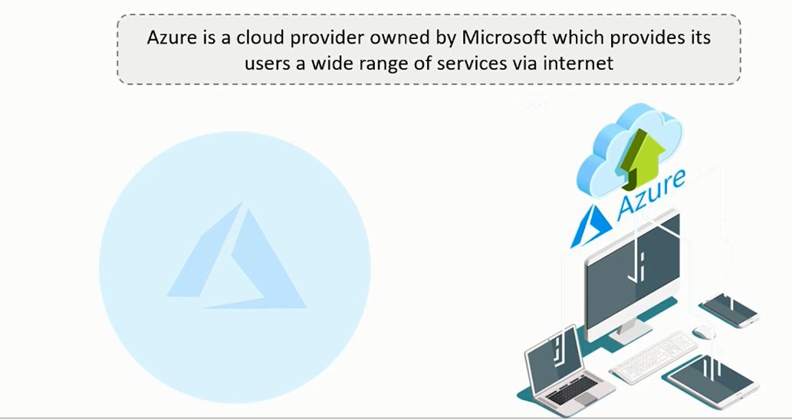
What is Azure ?

Slide 4
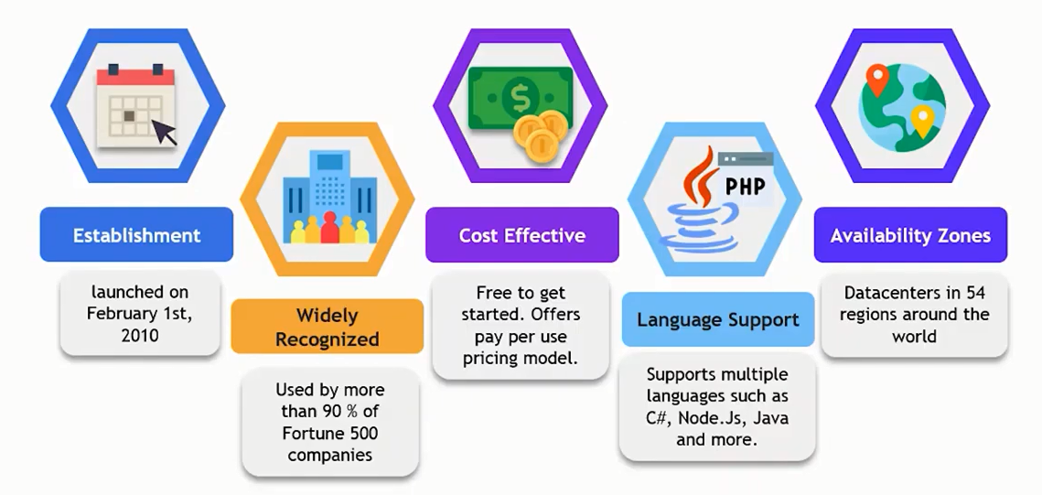
History of Azure

Slide 5

Story of a StartUp.

Slide 6
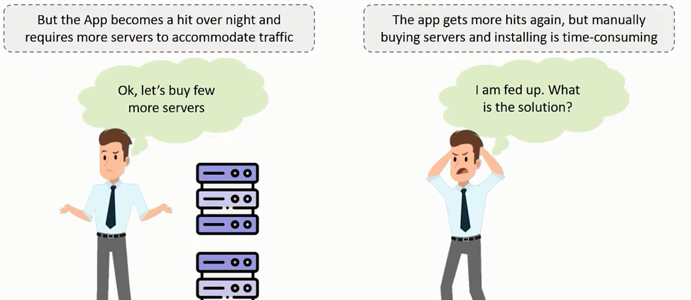

Slide 7
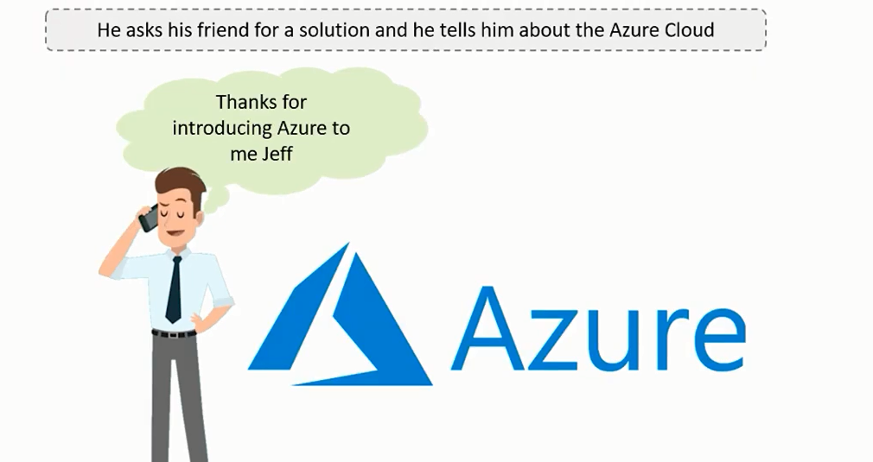

Slide 8
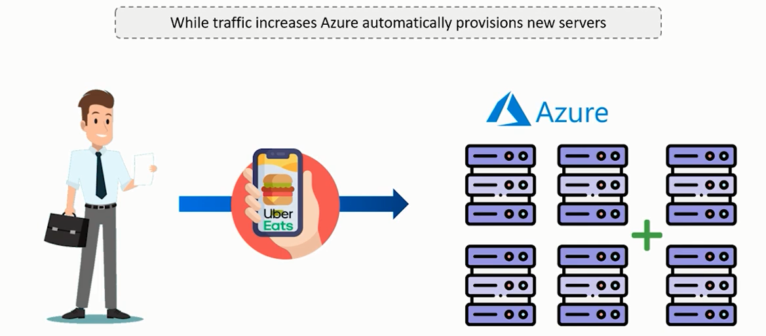

Slide 9
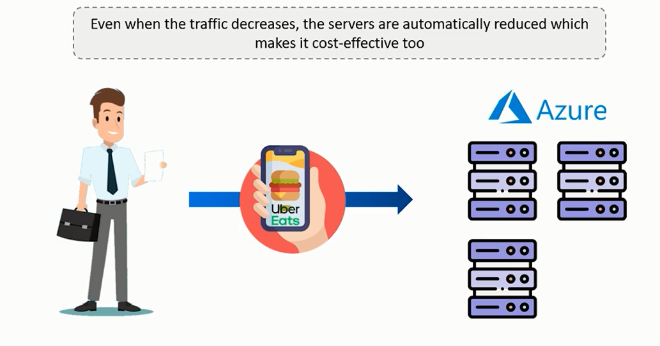

Slide 10
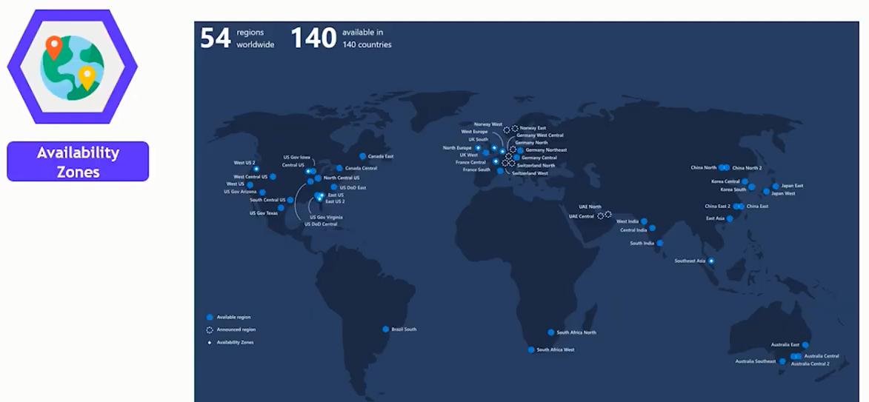

Slide 11
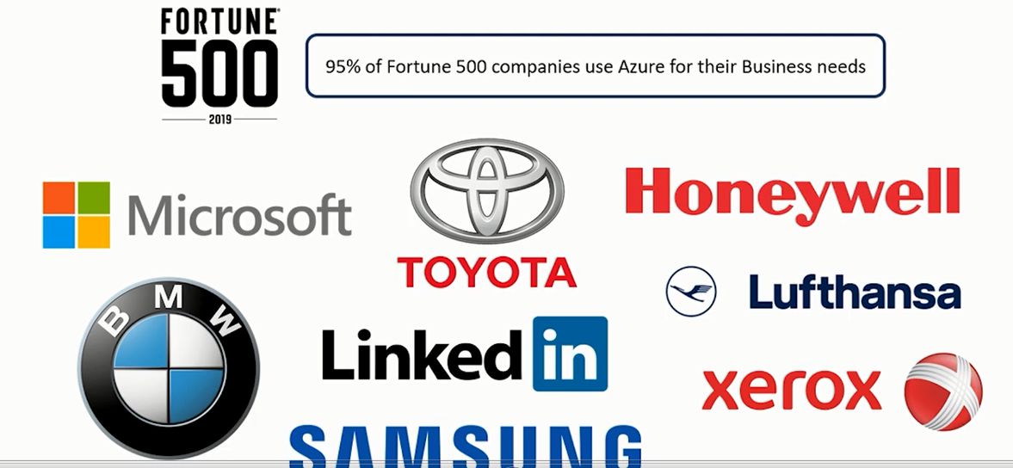
TOP Companies who Use the Azure.

Slide 12
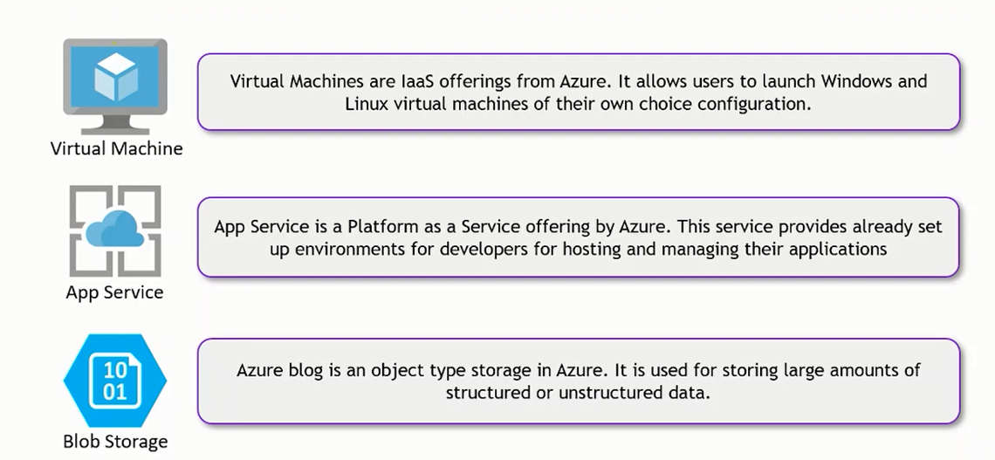
Various Azure Services & Pricing.

Slide 13
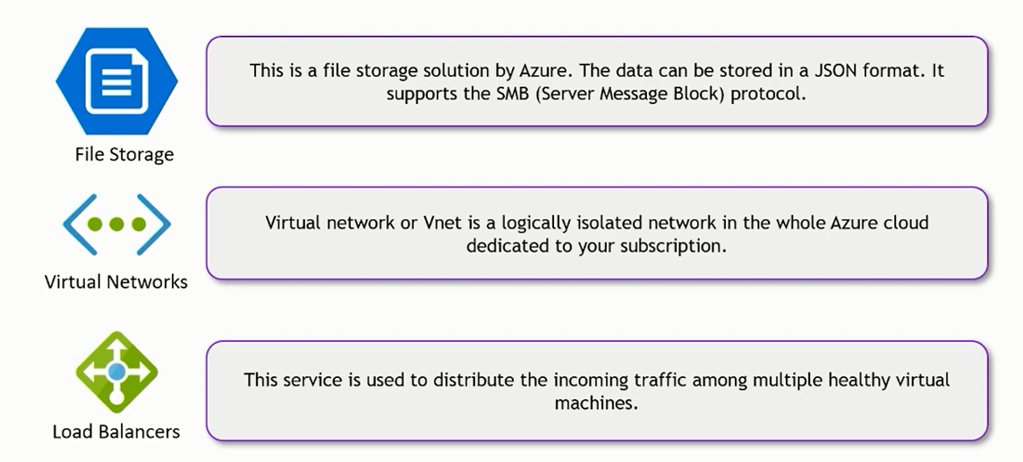

Slide 14
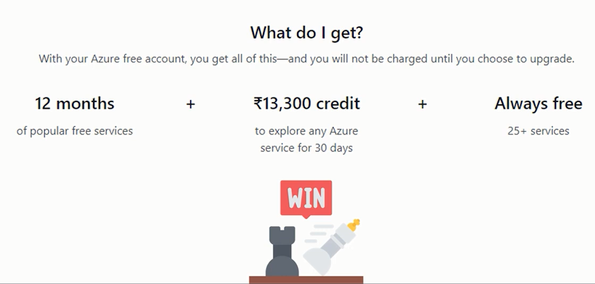
Various Azure Services & Pricing.

Slide 15
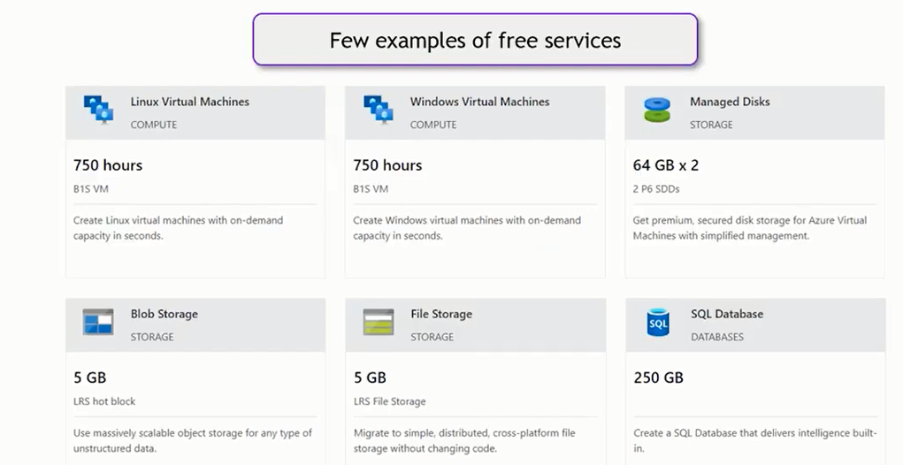

Slide 16
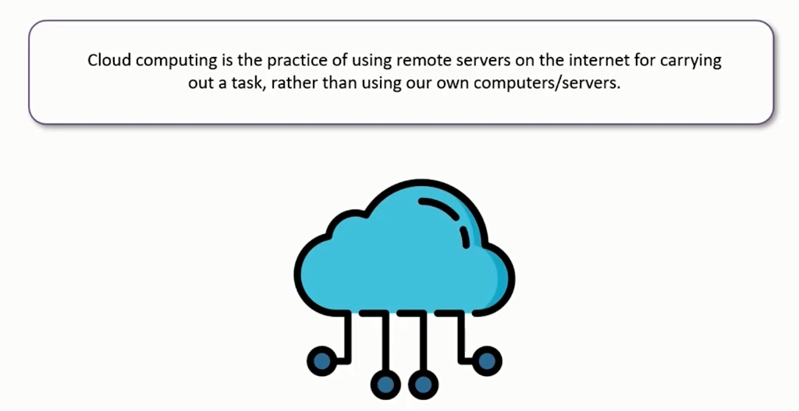
Introduction to Cloud Computing.

Slide 17
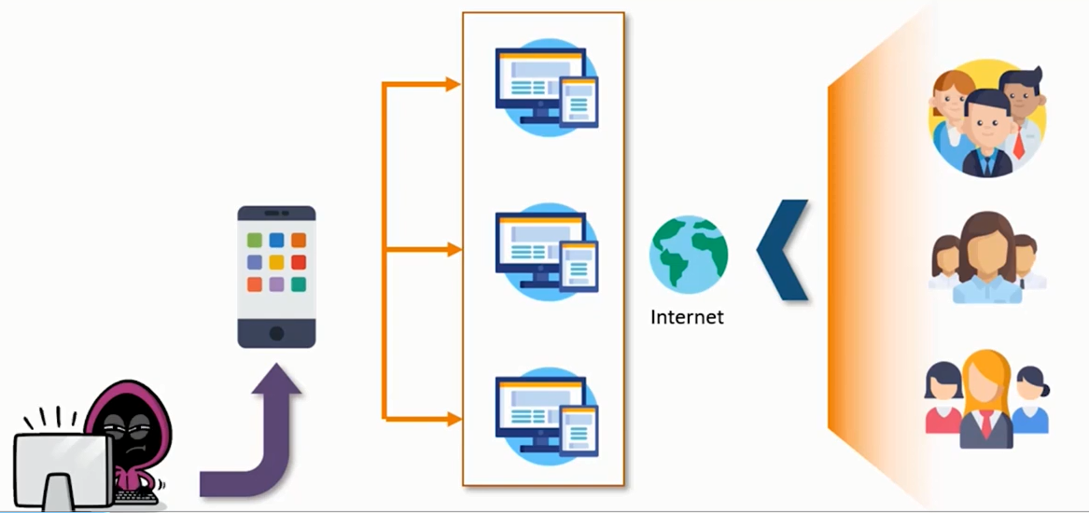
Introduction to Cloud Computing.

Slide 18
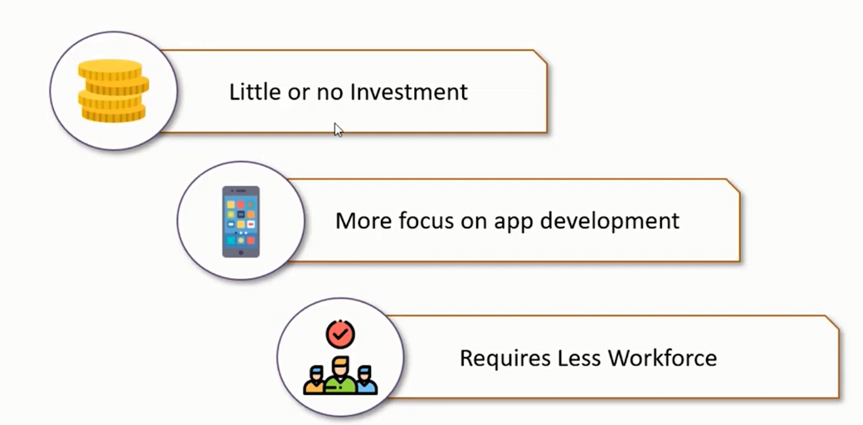
Cloud Computing-Advantages

Slide 19
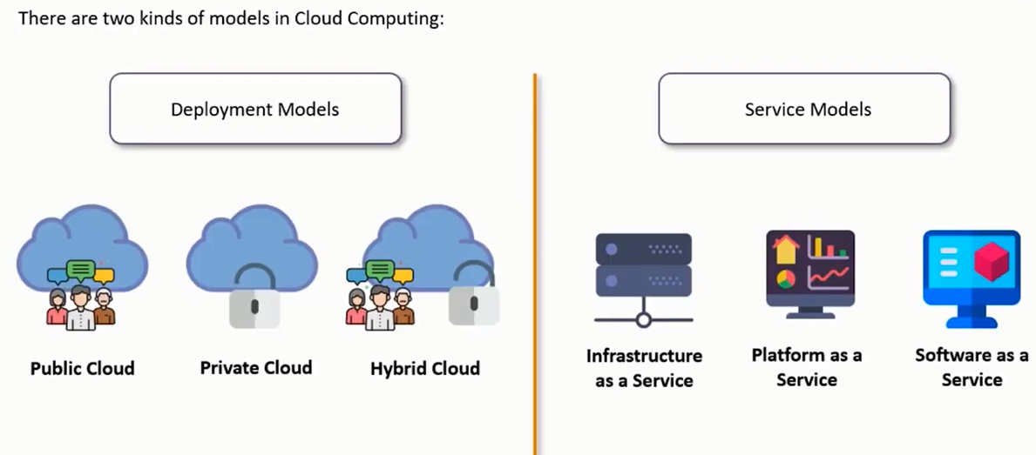
Cloud Computing Models

Slide 20
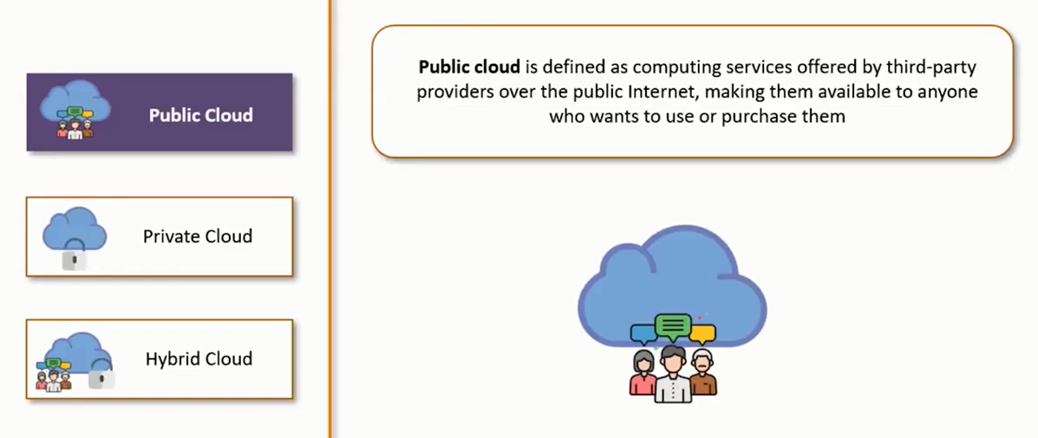

Slide 21
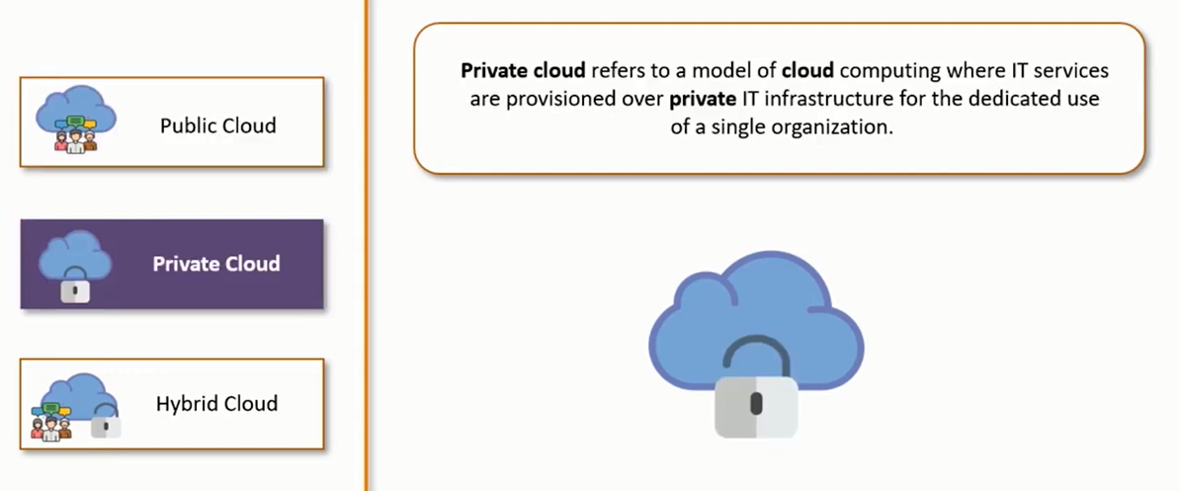

Slide 22
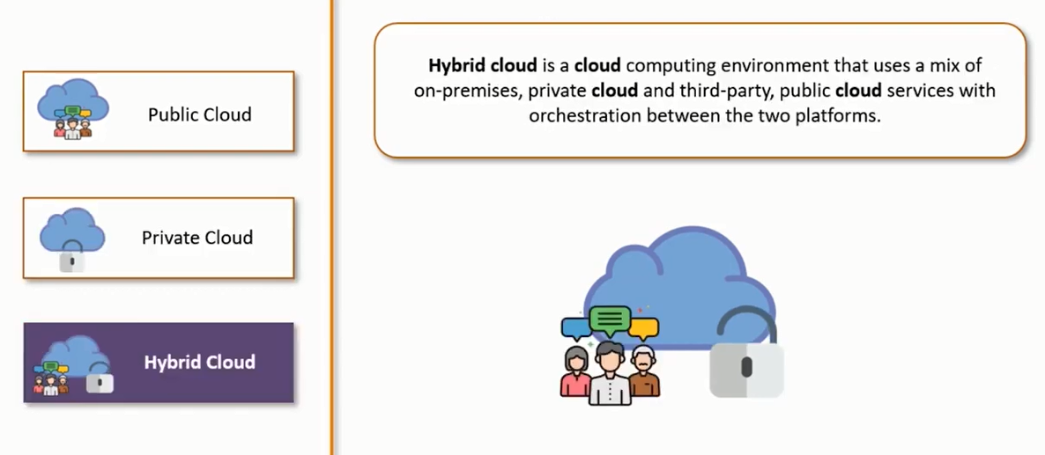

Slide 23
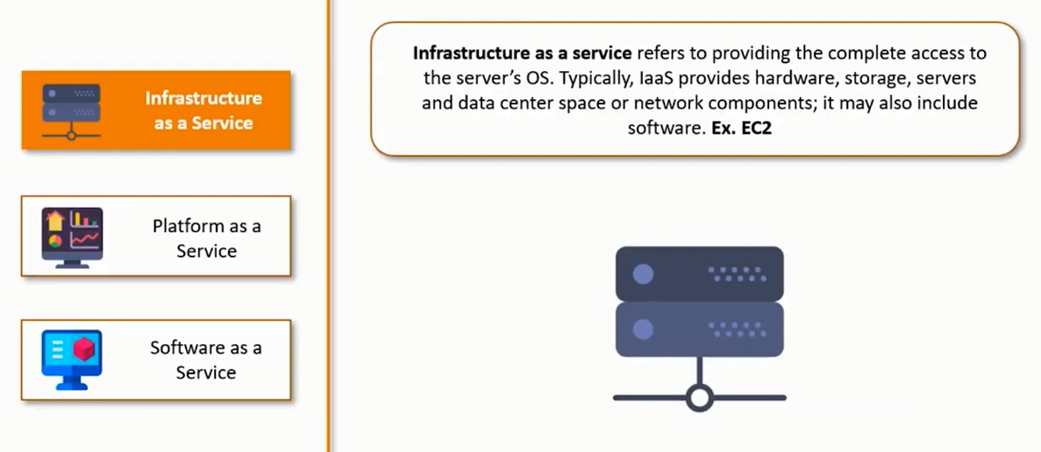

Slide 24
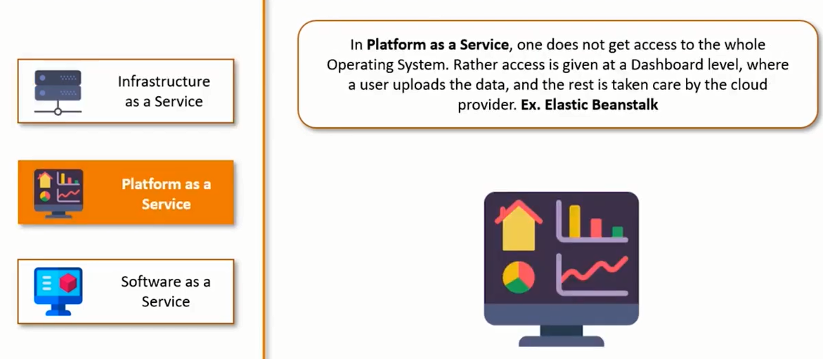

Slide 25
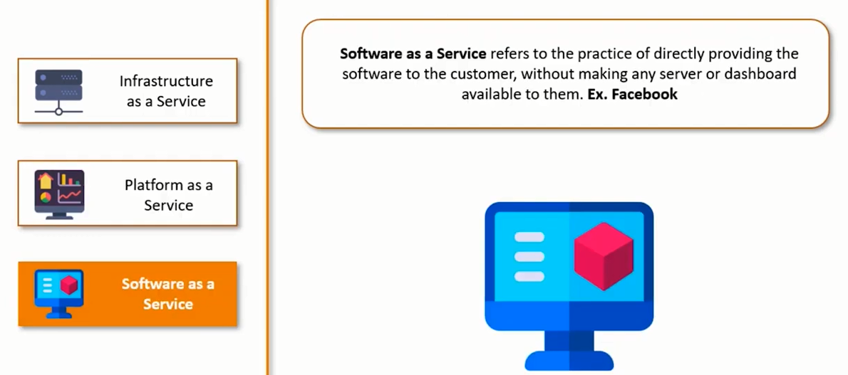

Slide 26
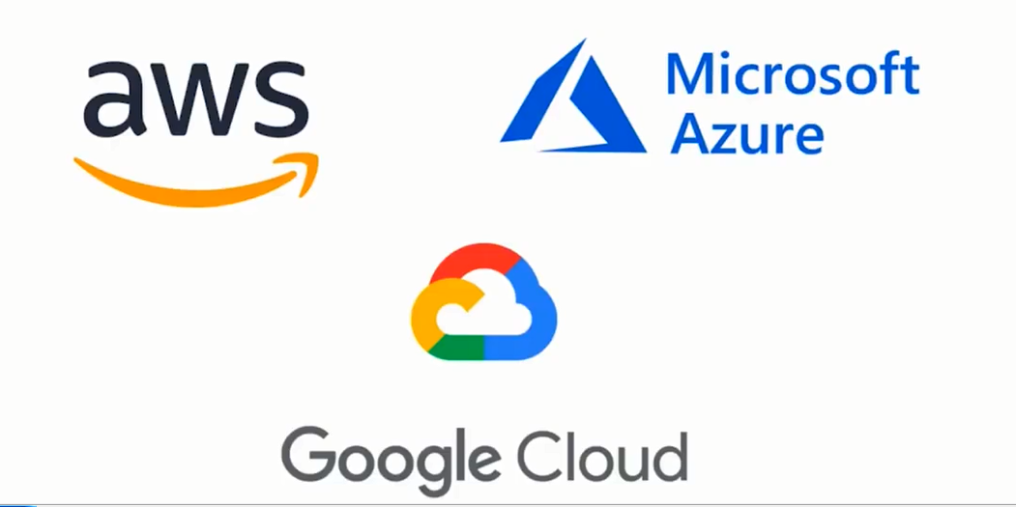
Top 3 Cloud Provider

Slide 27
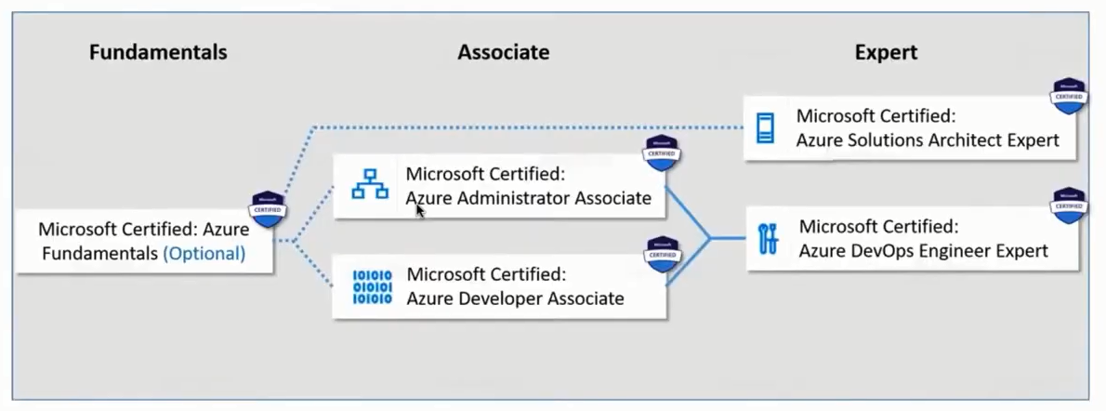
Azure Certification

Slide 28
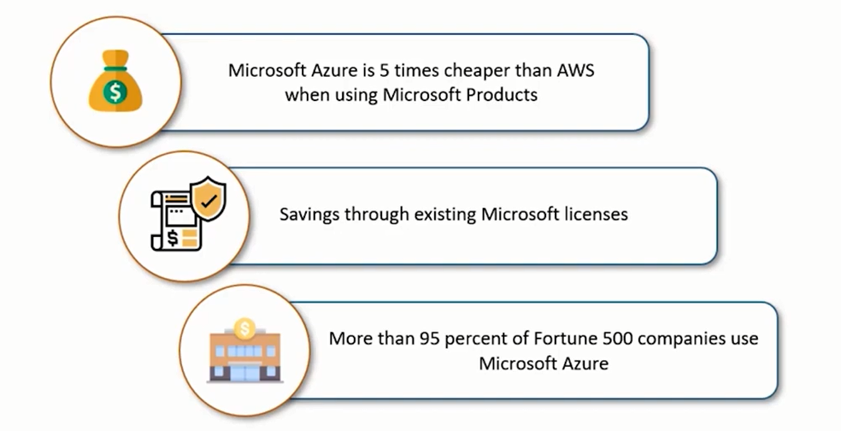
Why Microsoft Azure ?

Slide 29
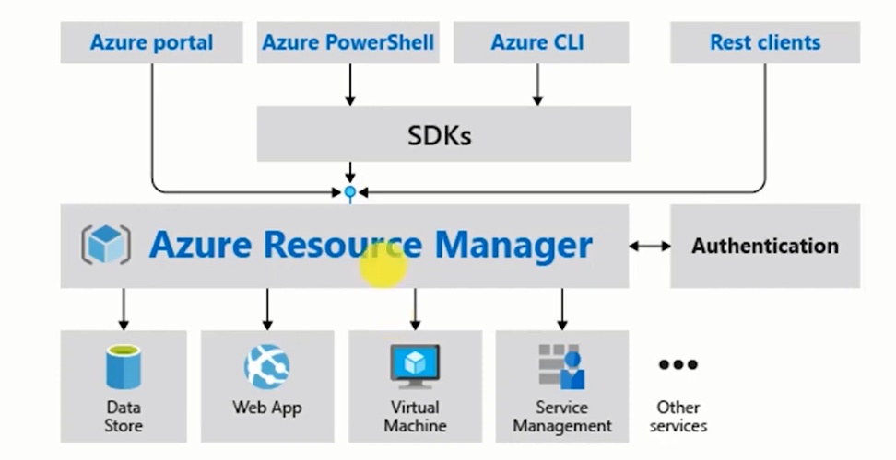
Azure Architecture

Slide 30
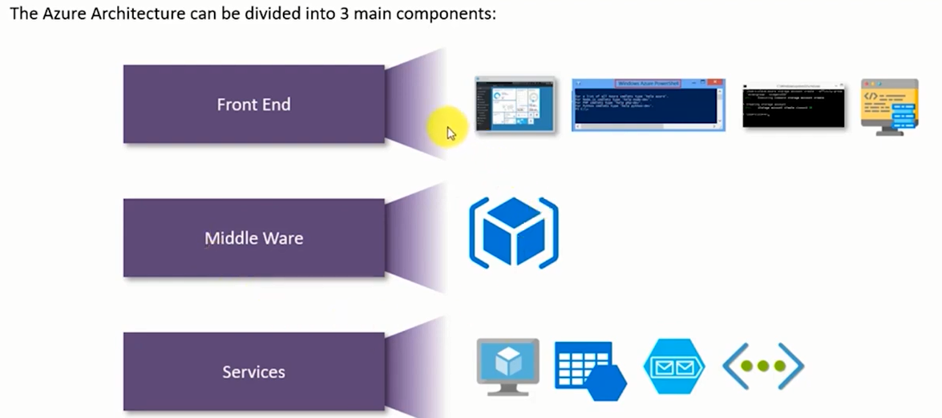
Azure Core Architecture

Slide 31
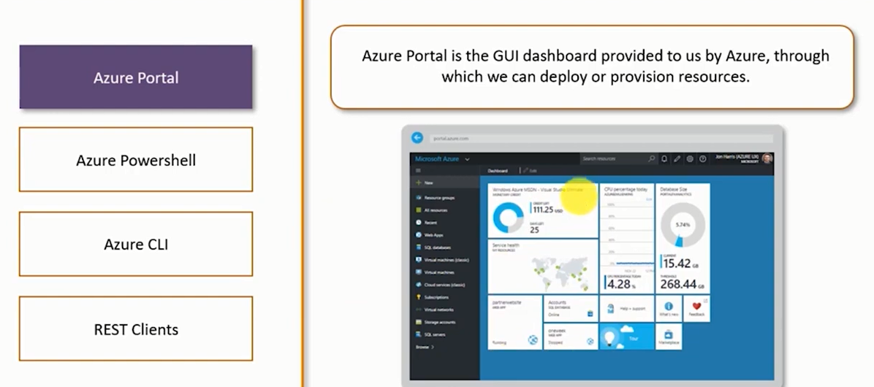

Slide 32
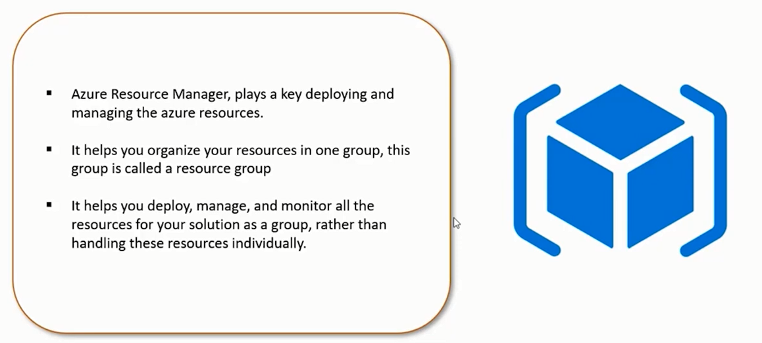
Azure Resource Manager

Slide 33
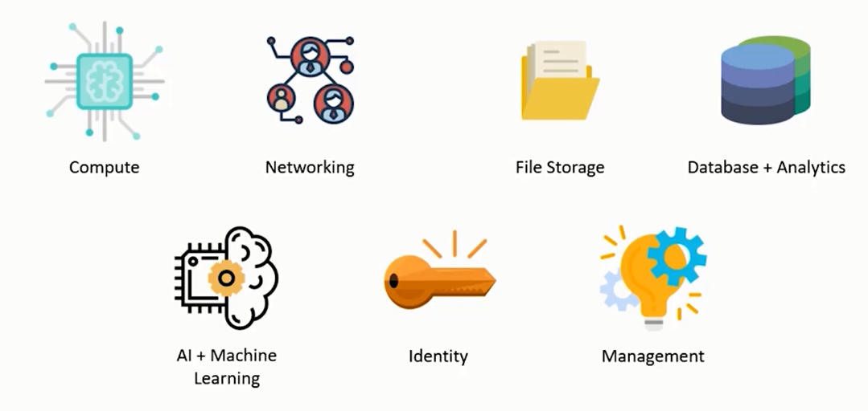
Azure Core Services.

Slide 34
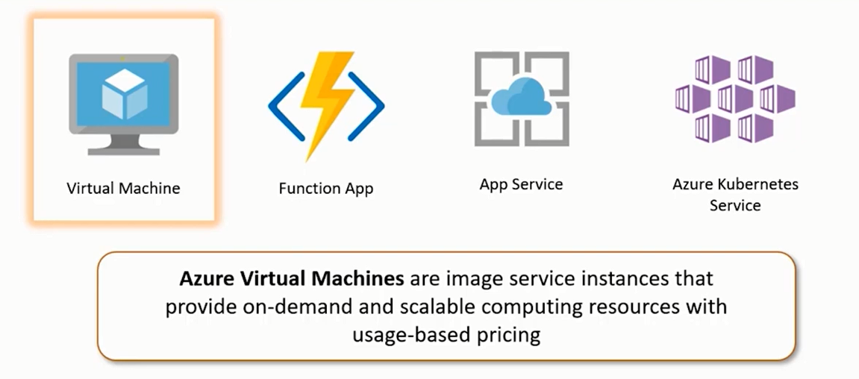
Azure Compute Service

Slide 35
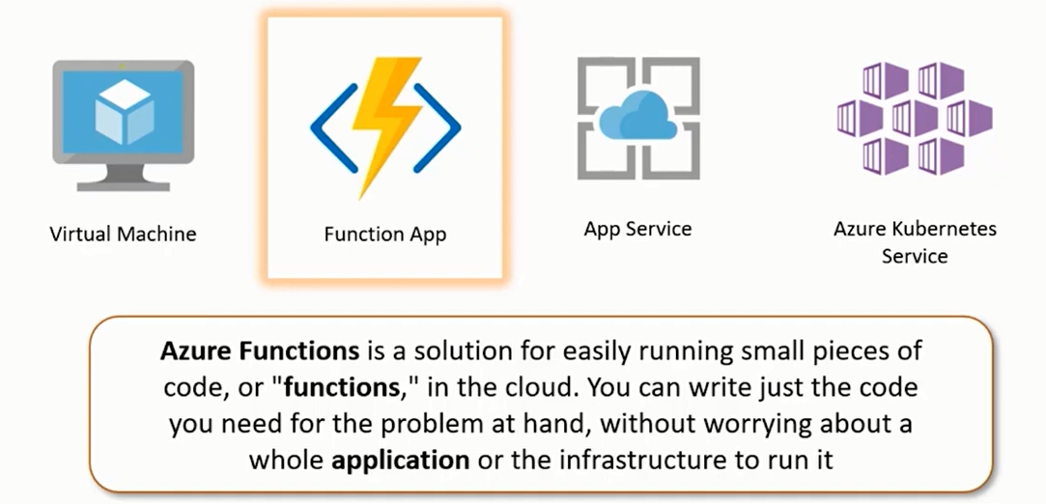
Azure- Function App

Slide 36
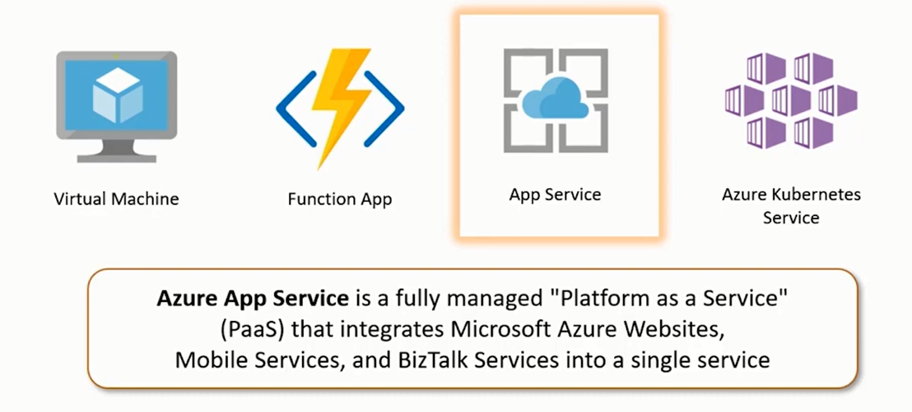

Slide 37
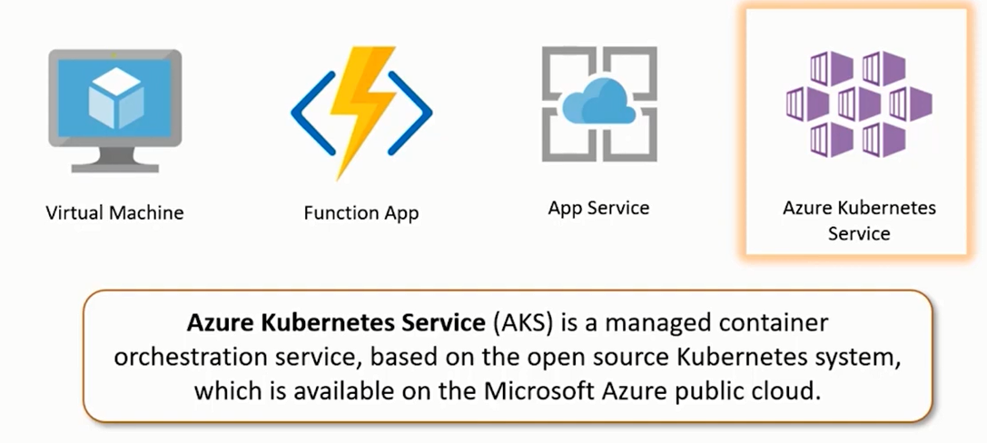

Slide 38
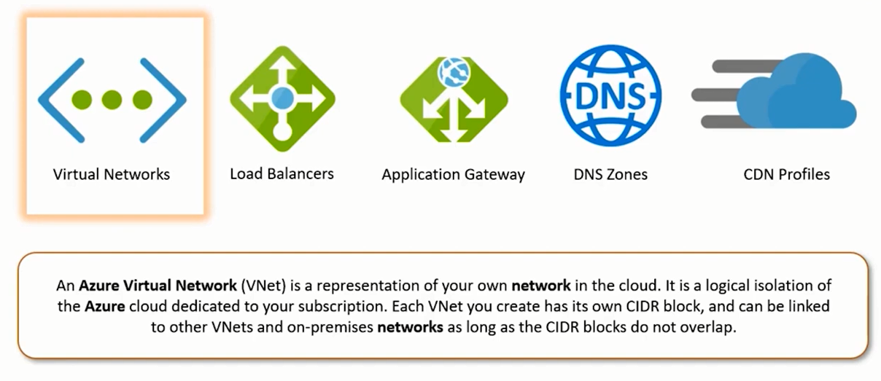
Azure- Networking Services

Slide 39
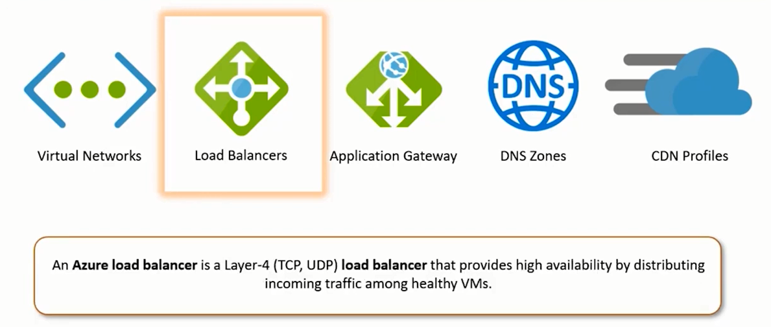
Load Balancers

Slide 40
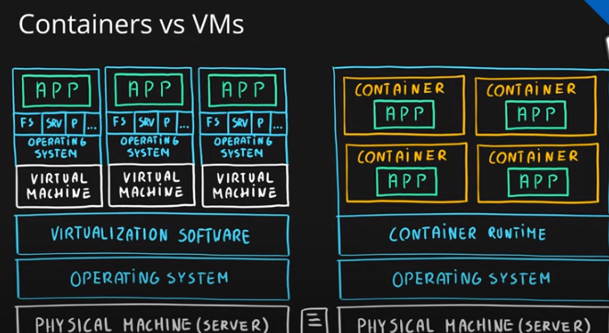

Slide 41
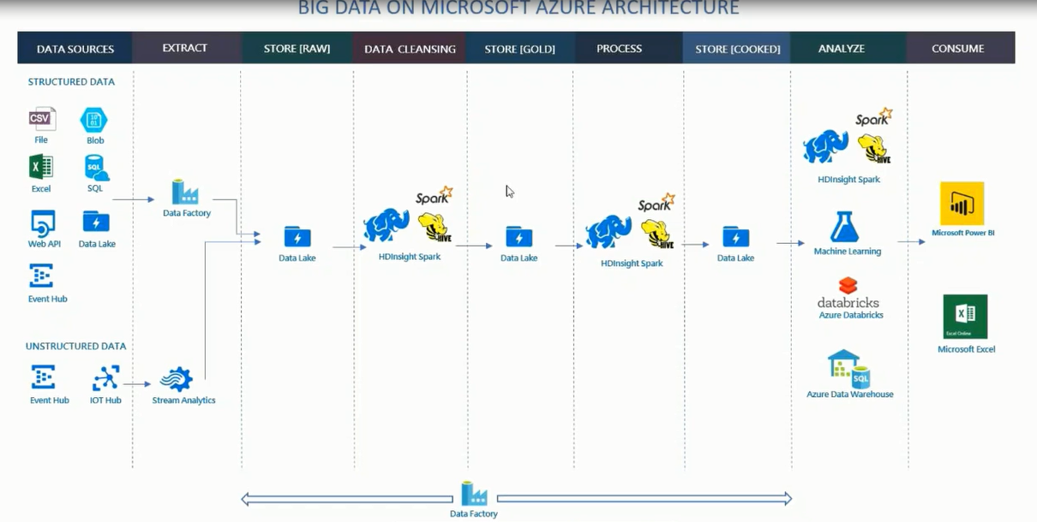

Slide 42
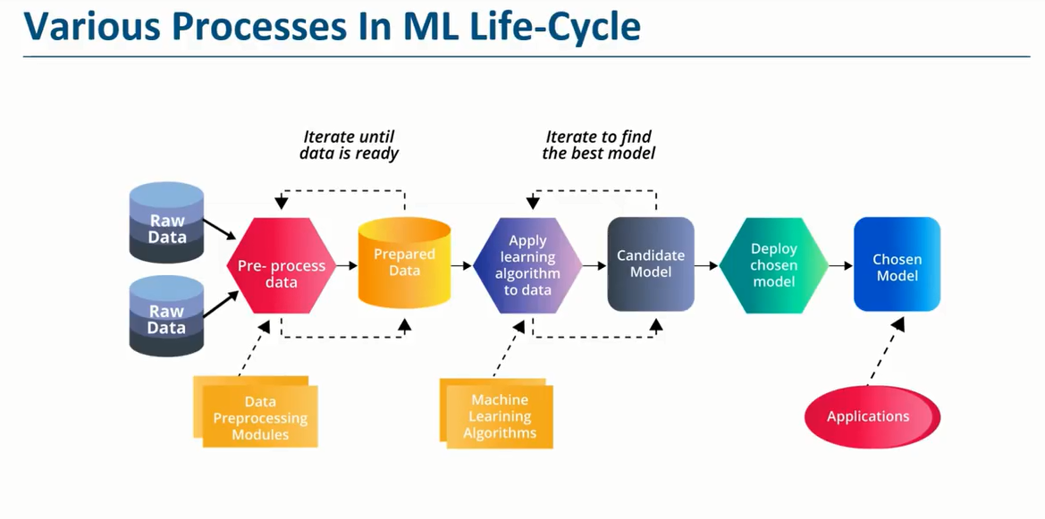
ML – Life Cycle

Slide 43
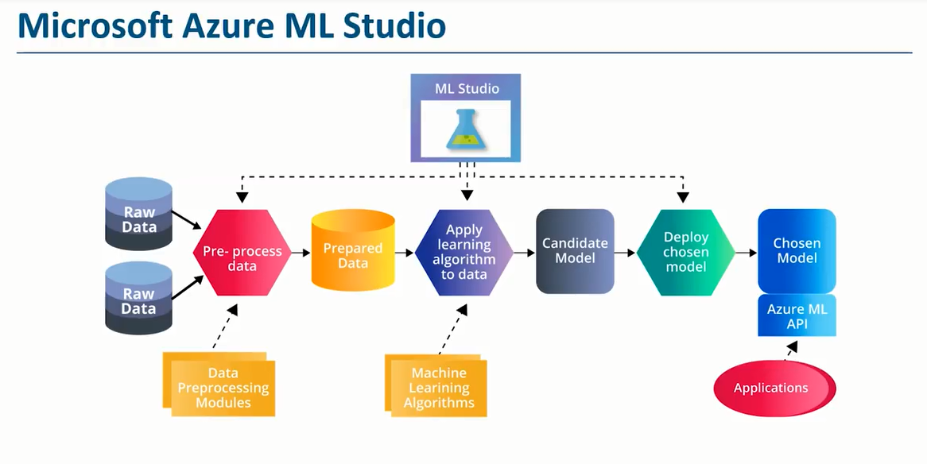

Slide 44
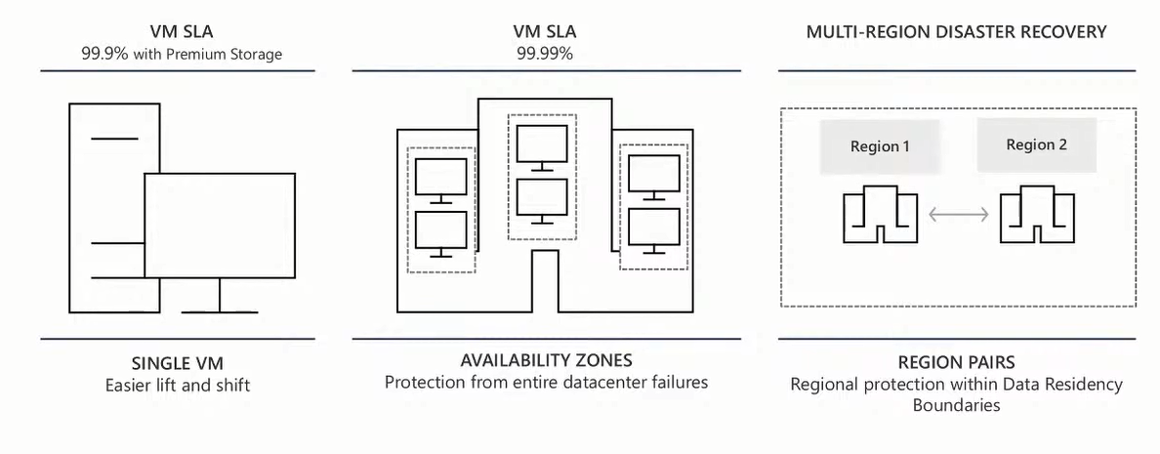
Availability Options

Slide 45
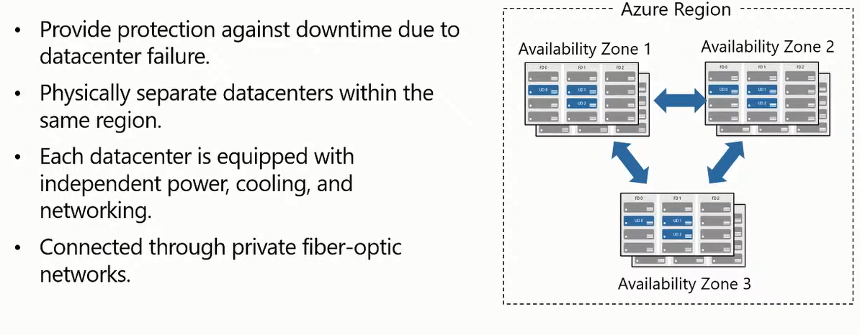
Availability Zone

Slide 46
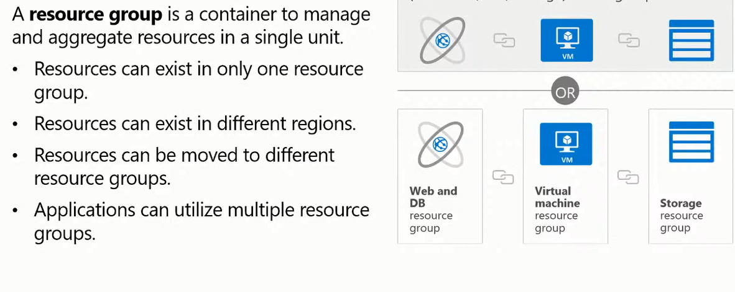

Resource Group

Slide 47
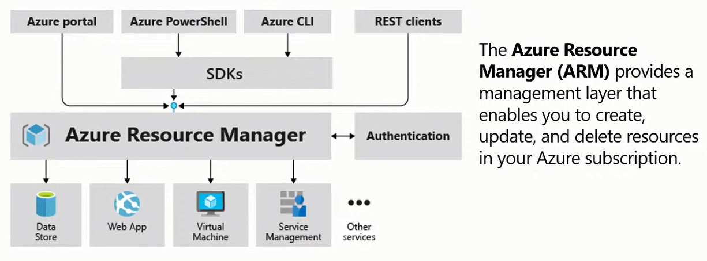
Azure Resource Manager

Slide 48
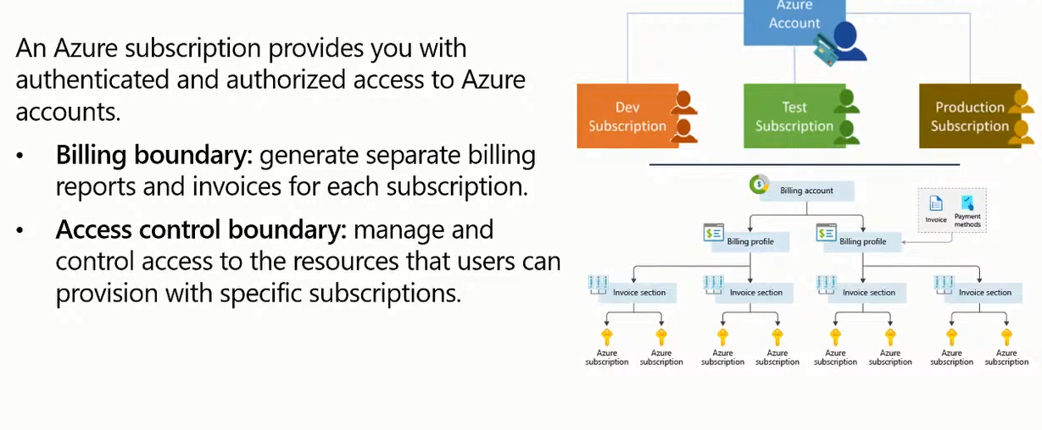
Azure Subscription

Slide 49
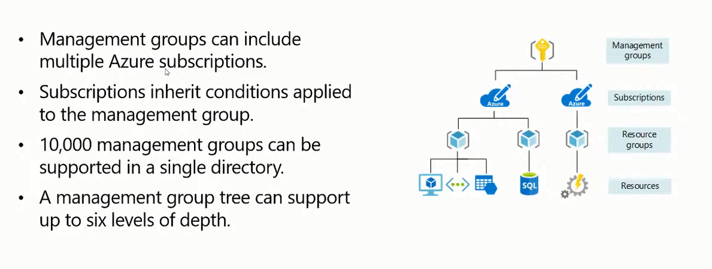
Management Group

Slide 50
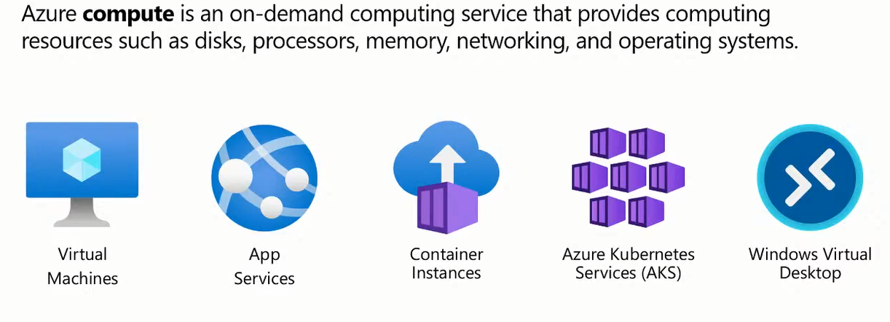
Azure Compute Service

Slide 51
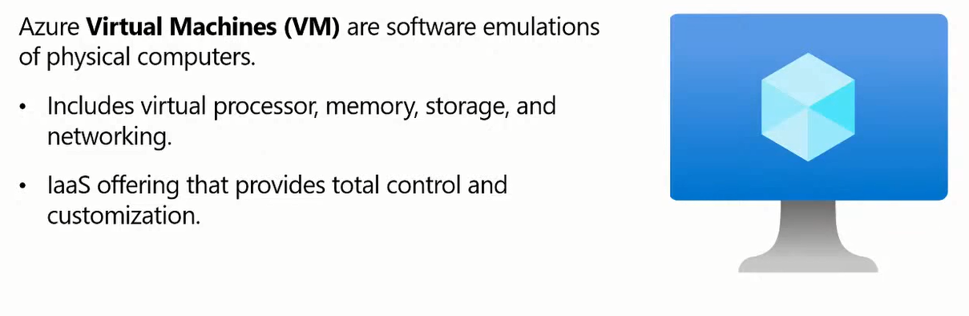

Slide 52

Azure-App Service

Slide 53


Slide 54


Slide 55


Slide 56


Slide 57


Slide 58

Big Data and analytics.

Slide 59


Slide 60


Slide 61


Slide 62


Slide 63


Slide 64


Slide 65


Slide 66


Slide 67


Slide 68


Slide 69


Slide 70


Slide 71


Slide 72


Slide 73


Slide 74


Slide 75


Slide 76


