Slide 1
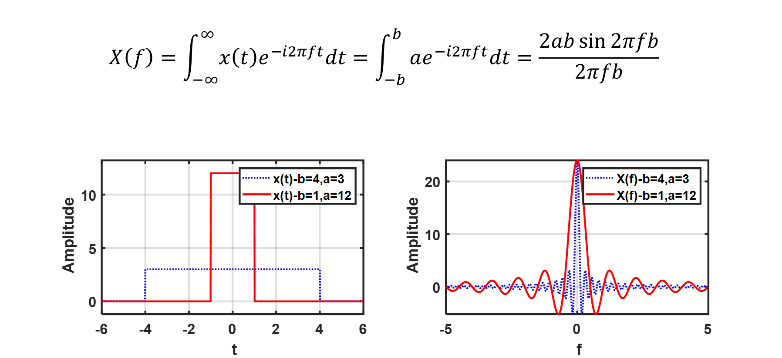
Please select all true statement(s).
What happened if ‘a’ goes infinite and ‘b’ goes to zero?
x(t) becomes a Dirac delta function
X(f) becomes a Dirac delta function
X(f) becomes a flat horizontal line.
X(f) becomes a zero frequency.

Slide 2
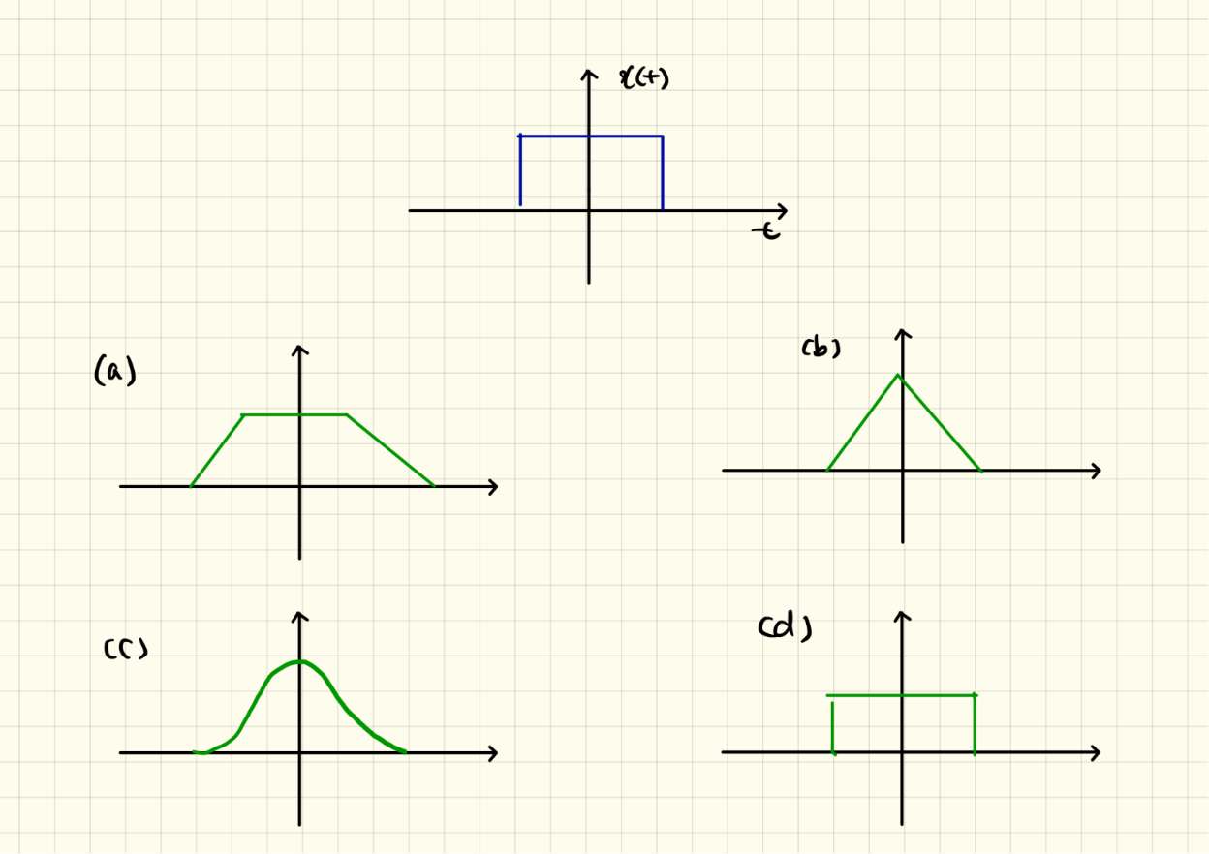
What does a convolution of $x(t)$ and $x(t)$ look like?

Slide 3
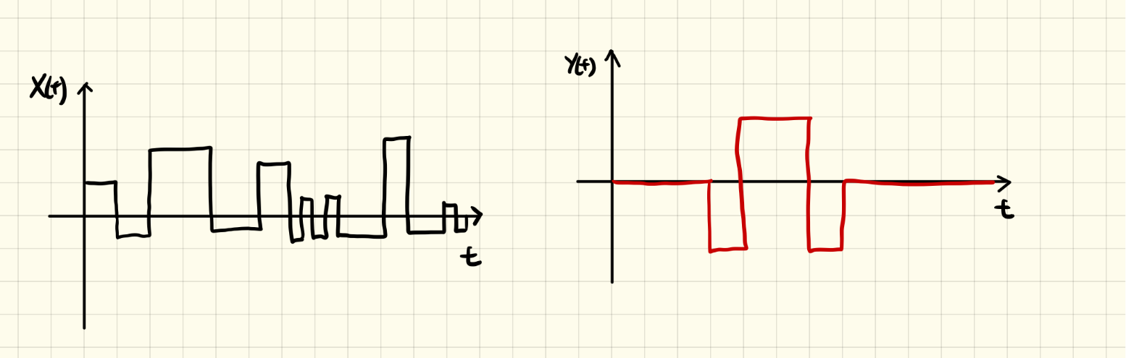
What does a convolution of x(t) and y(t) look like?
A certain signal shape in x(t) is amplified.
y(t) makes x(t) smother (a high frequency components in x(t) is filtered).
x(t) signal is truncated.
x(t) signal is shifted to the right.

