Slide 1
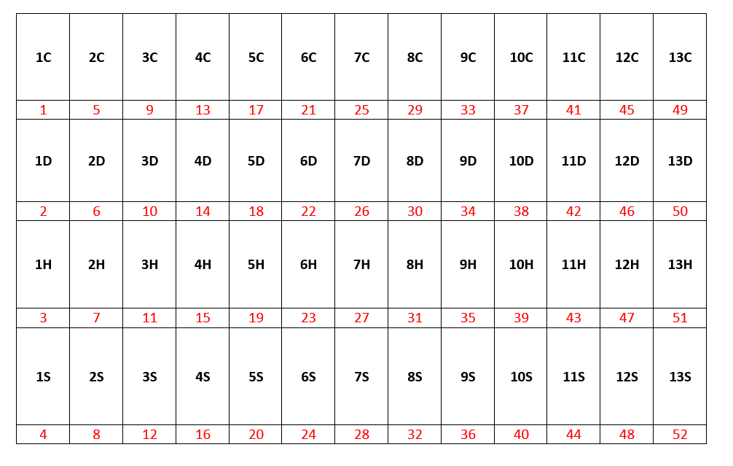
Introduction

Slide 2
1C | 2C | 3C | 4C | 5C | 6C | 7C | 8C | 9C | 10C | 11C | 12C | 13C
1D | 2D | 3D | 4D | 5D | 6D | 7D | 8D | 9D | 10D | 11D | 12D | 13D
1H | 2H | 3H | 4H | 5H | 6H | 7H | 8H | 9H | 10H | 11H | 12H | 13H
1S | 2S | 3S | 4S | 5S | 6S | 7S | 8S | 9S | 10S | 11S | 12S | 13S

Slide 3
1C | 2C | 3C | 4C | 5C | 6C | 7C | 8C | 9C | 10C | 11C | 12C | 13C
1D | 2D | 3D | 4D | 5D | 6D | 7D | 8D | 9D | 10D | 11D | 12D | 13D
1H | 2H | 3H | 4H | 5H | 6H | 7H | 8H | 9H | 10H | 11H | 12H | 13H
1S | 2S | 3S | 4S | 5S | 6S | 7S | 8S | 9S | 10S | 11S | 12S | 13S

Slide 4
1C | 2C | 3C | 4C | 5C | 6C | 7C | 8C | 9C | 10C | 11C | 12C | 13C
1D | 2D | 3D | 4D | 5D | 6D | 7D | 8D | 9D | 10D | 11D | 12D | 13D
1H | 2H | 3H | 4H | 5H | 6H | 7H | 8H | 9H | 10H | 11H | 12H | 13H
1S | 2S | 3S | 4S | 5S | 6S | 7S | 8S | 9S | 10S | 11S | 12S | 13S

Slide 5
1C | 2C | 3C | 4C | 5C | 6C | 7C | 8C | 9C | 10C | 11C | 12C | 13C
1D | 2D | 3D | 4D | 5D | 6D | 7D | 8D | 9D | 10D | 11D | 12D | 13D
1H | 2H | 3H | 4H | 5H | 6H | 7H | 8H | 9H | 10H | 11H | 12H | 13H
1S | 2S | 3S | 4S | 5S | 6S | 7S | 8S | 9S | 10S | 11S | 12S | 13S

Slide 6
1C | 2C | 3C | 4C | 5C | 6C | 7C | 8C | 9C | 10C | 11C | 12C | 13C
1D | 2D | 3D | 4D | 5D | 6D | 7D | 8D | 9D | 10D | 11D | 12D | 13D
1H | 2H | 3H | 4H | 5H | 6H | 7H | 8H | 9H | 10H | 11H | 12H | 13H
1S | 2S | 3S | 4S | 5S | 6S | 7S | 8S | 9S | 10S | 11S | 12S | 13S

Slide 7
1C | 2C | 3C | 4C | 5C | 6C | 7C | 8C | 9C | 10C | 11C | 12C | 13C
1D | 2D | 3D | 4D | 5D | 6D | 7D | 8D | 9D | 10D | 11D | 12D | 13D
1H | 2H | 3H | 4H | 5H | 6H | 7H | 8H | 9H | 10H | 11H | 12H | 13H
1S | 2S | 3S | 4S | 5S | 6S | 7S | 8S | 9S | 10S | 11S | 12S | 13S

