Slide 1
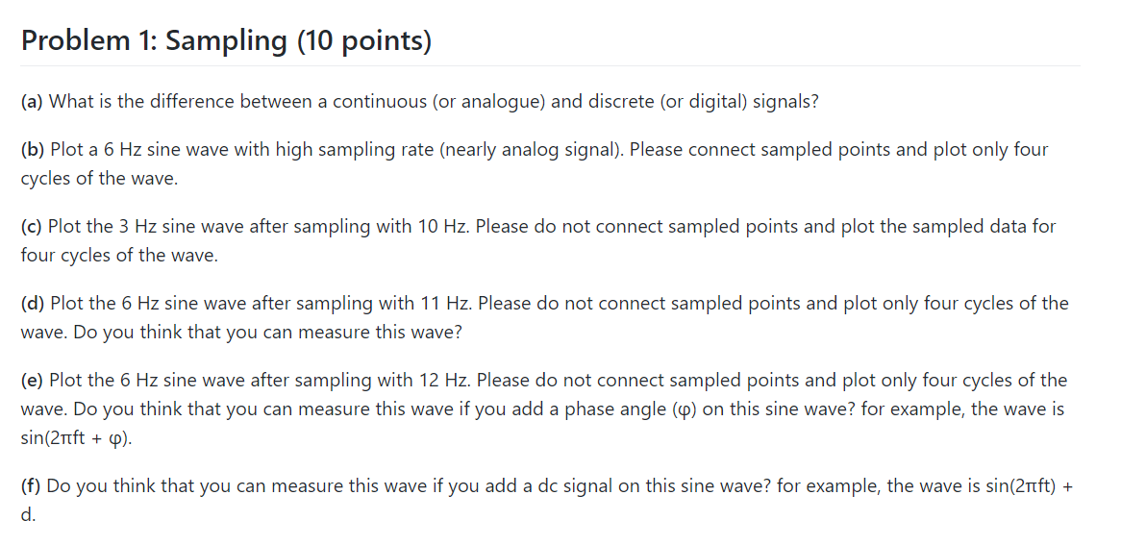
NO
NO
NO

Slide 2
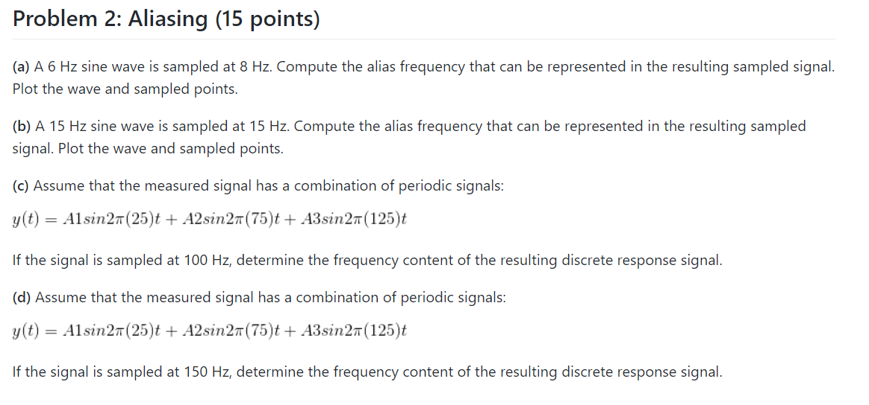

Slide 3











$$X(f)$$
Problem 2. (c)
$$−100$$
$$−50$$
$$25$$
$$50$$
$$75$$
$$100$$
$$125$$
$$200$$
$$X(f−f_{s})$$
$$X(f+f_{s})$$

Slide 4









Problem 2. (d)
$$X(f)$$
$$−150$$
$$−100$$
$$25$$
$$50$$
$$75$$
$$100$$
$$125$$
$$150$$

Slide 5
Signal frequency: 2Hz
Sampling frequency: 4.2 Hz
prob_2_d.m

Slide 6
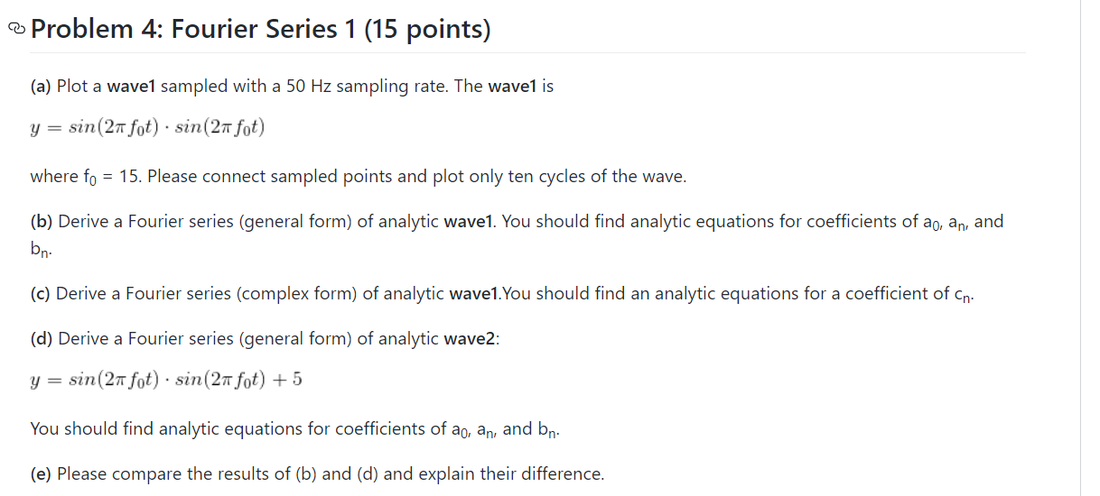

Slide 7
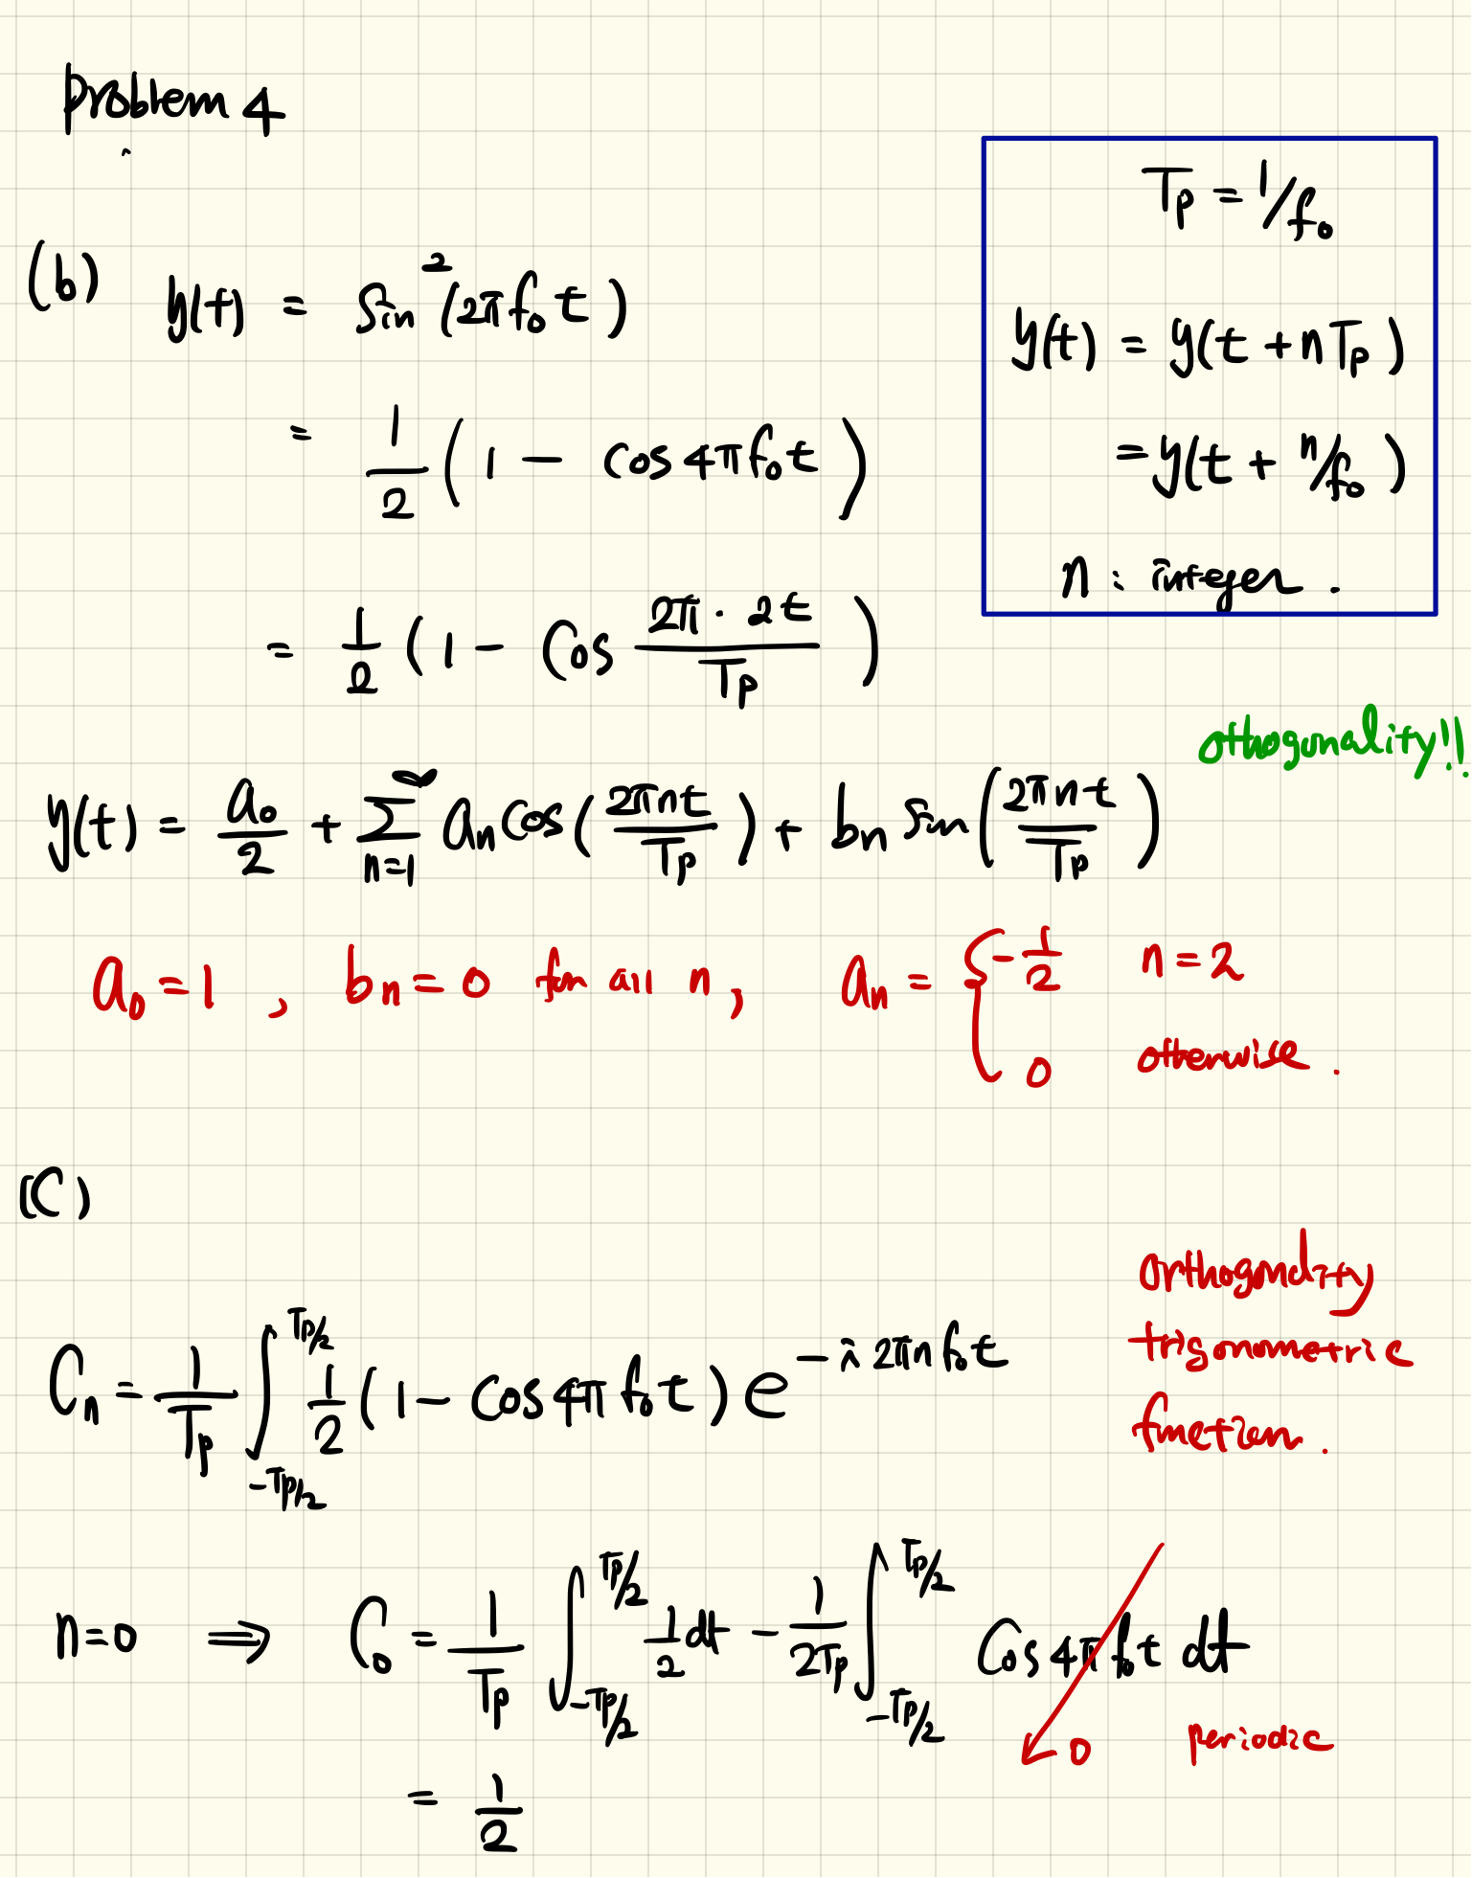
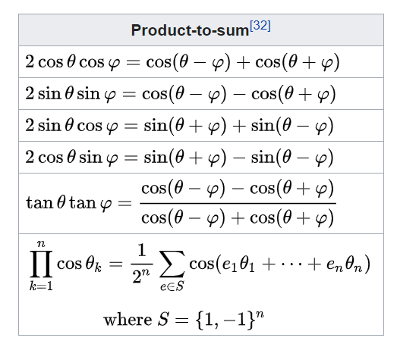
Problem 4. (b)
https://en.wikipedia.org/wiki/List_of_trigonometric_identities

Slide 8
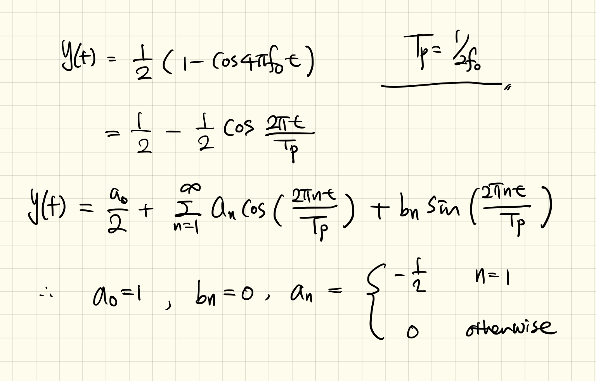
Problem 4. (b)

Slide 9
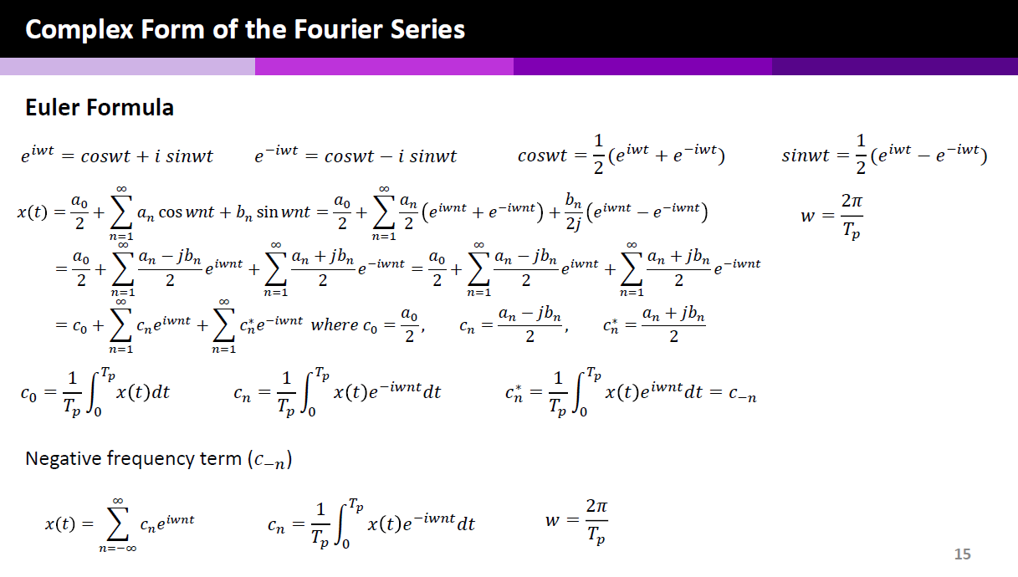

Slide 10
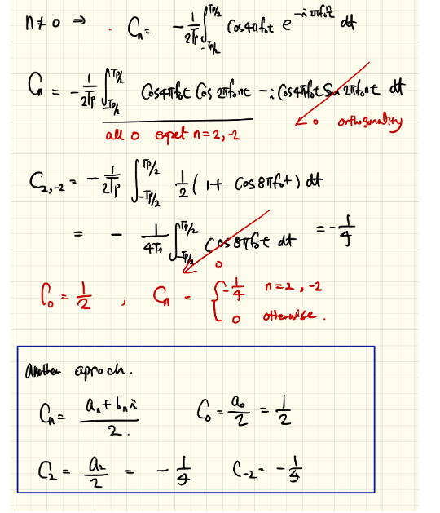
Problem 4. (c)

Slide 11
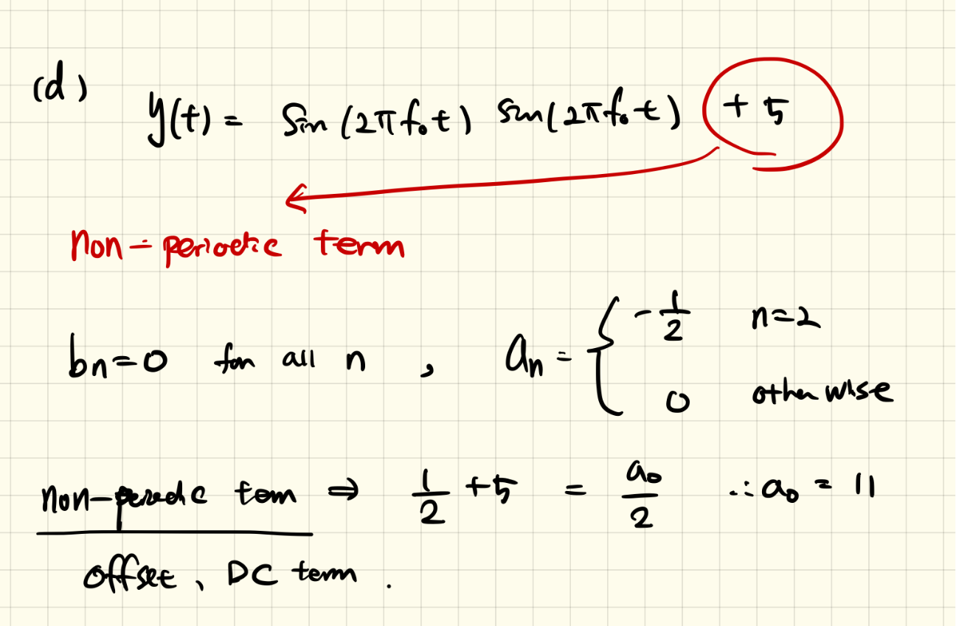
Problem 4. (d)

Slide 12
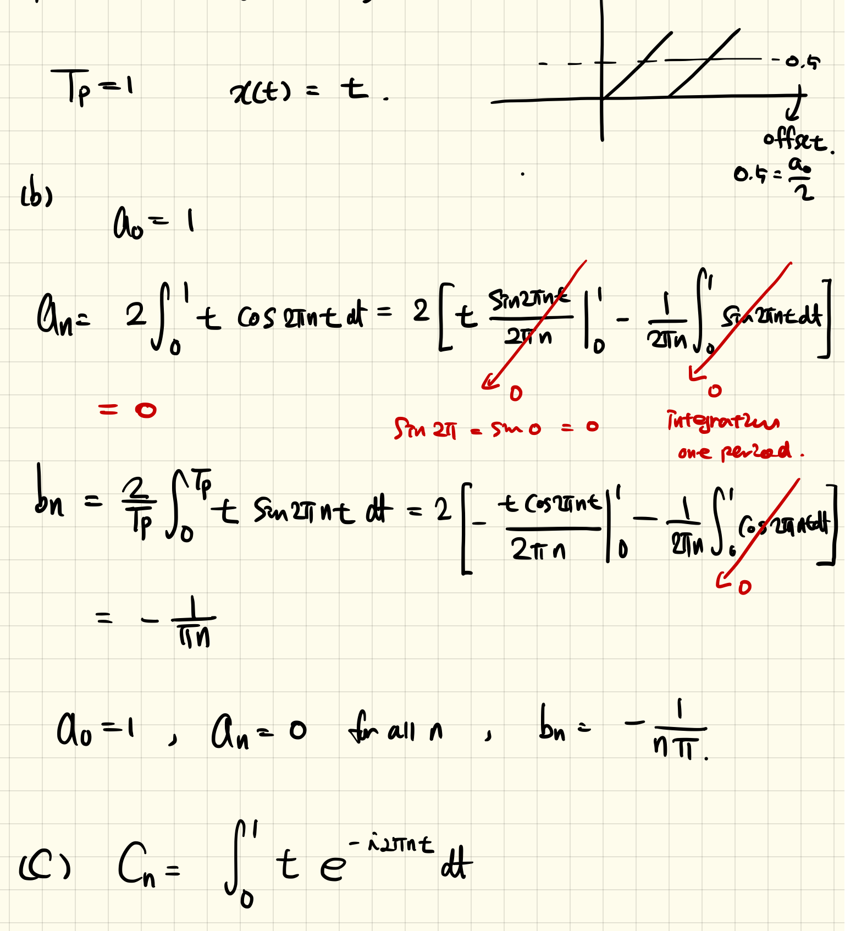
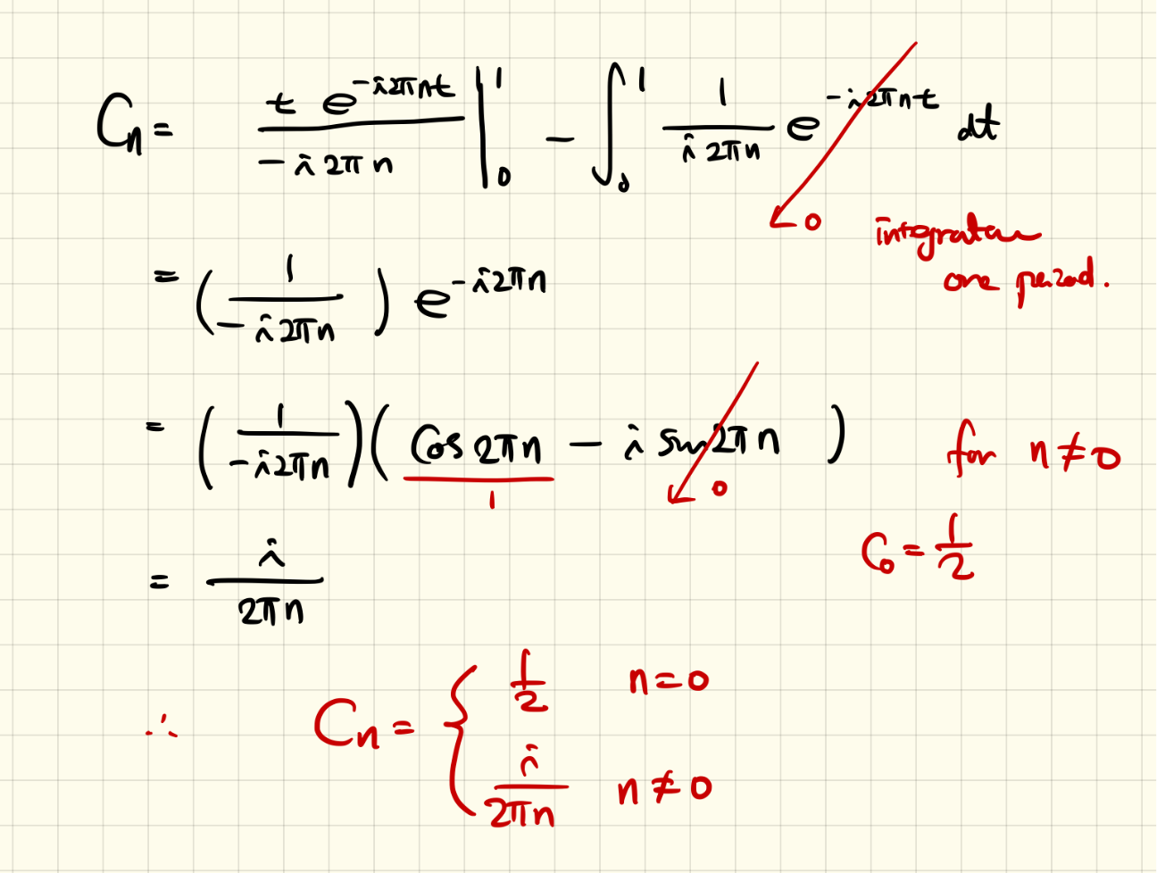
Problem 5

Slide 13
