Slide 1
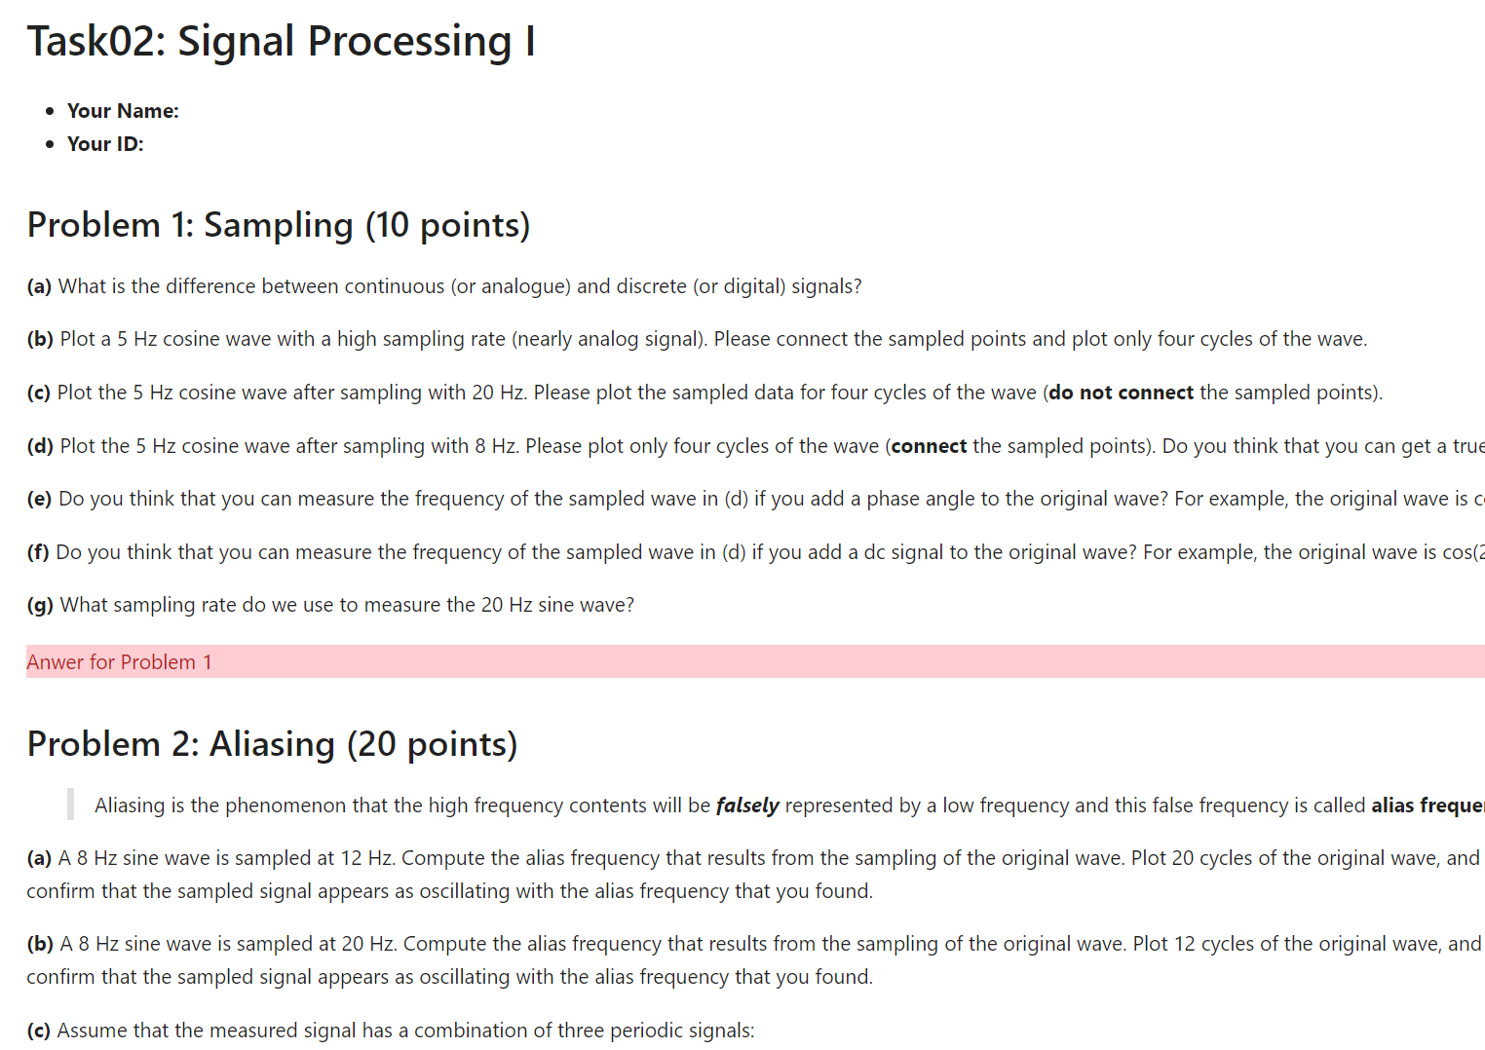
Put your name and ID
Your solution and corresponding code for each problem should be presented preceding the subsequent problem. Do not include them on the problem statement

