Slide 1
Course Syllabus: CIVE 497 – CIVE 700
Chul Min Yeum
Assistant Professor
Civil and Environmental Engineering
University of Waterloo, Canada
CIVE 497 – CIVE 700: Smart Structure Technology
Last updated: 2018-01-06

Slide 2
Course Description
This course offers an introduction to the emerging smart structure technologies in civil engineering. Smart structures integrate sensing, actuation, data processing and analysis, and control capabilities so that a structure can sense and respond to its changing external conditions in a rapid and automated manner. Among several topics in smart structure, this course focuses on structural assessment using optical sensor data by implementing state-of-art image processing and computer vision techniques. As a special topic, basic concepts in machine learning, neural networks, convolutional neural networks (deep learning) are covered and relevant applications in civil engineering are introduced. An application-based learning approach is emphasized and tasks are designed in such a way that students implement smart structure technology to address contemporary problems in civil engineering. In addition, one of the deliverable for this course will be a research project, in which student will have an opportunity to design a technique with a potential application to smart structures. This course is specially designed to suit the interest of graduate students and senior undergraduate students who may pursue graduate studies.
Notes:
This is not an introductory course.

Slide 3
Course Objectives
By the end of this course, students should be able to
Describe smart structure technology and its application in civil engineering
Explain the working principle of an accelerometer and digital camera, and their data acquisition process
Interpret the concept of image processing techniques through signal processing theory
Develop programs (MATLAB or Python) to process and analyze 2D and 3D optical data for structural assessment
Demonstrate how to implement machine learning algorithms in solving real-world problems
Employ deep convolutional neural network for image classification
Devise innovative smart structure technology for civil engineering applications and research

Slide 4
Prerequisite
This course requires basic knowledge in linear algebra, probability, and signal processing and skills at a sufficient level of a non-trivial computer programming (with MATLAB or Python). Students also need to know how to use Markdown.
Github
Matlab and Python
Matlab live editor
Power points
Markdown editor

Slide 5
Class Tips
Complete tutorials !!
All computation will be made through the course website. (You will no see any update on LEARN and get an email from them.)
Bring your laptop into the class and run tutorials.
Ask as many questions as you can through the course website.
Must submit the task assignments (there is no default score). The instructor and CA will help you finish the assignments.
Get your project idea from the course and the instructor's prior research
Make friends who are good at coding and become your research partner.
https://help.github.com/articles/be-social/
https://stackoverflow.com/questions/9843609/view-markdown-files-offline

Slide 6
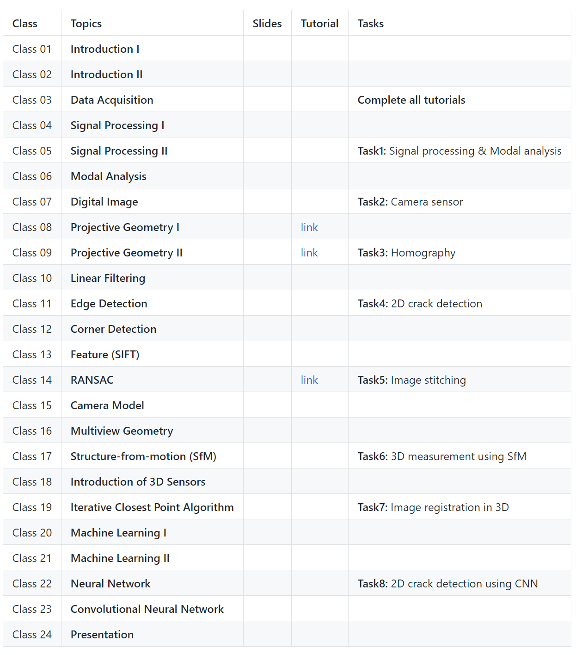
Course Outline
Signal Processing
Image Processing
3D Data Processing
Machine Learning
Notes:
What do we need?

Slide 7
Project
Students are encouraged to bring their own problems related to their thesis, research projects or potential research in civil engineering that they plan to pursue near future. This course gives special attention to exploring theory and potential techniques in the field of smart structure to address real problems that students are exposed to or involved in. Thus, students need to devise feasible project topics that are achievable within your current or future graduate study.
Tell us what you want to get from this course?

Slide 8
Grading
The final grade will be based on the total marks earned during the semester. Each task will be graded on the basis of 100 points and will contribute the final grade with different weights. The evaluation guideline for the project can be seen here. Note that undergraduate and graduate students are marked using different evaluation metrics.
Undergraduate student: Task (80%) and Project (20%) Graduate student: Task (70%) and Project (30%)

Slide 9
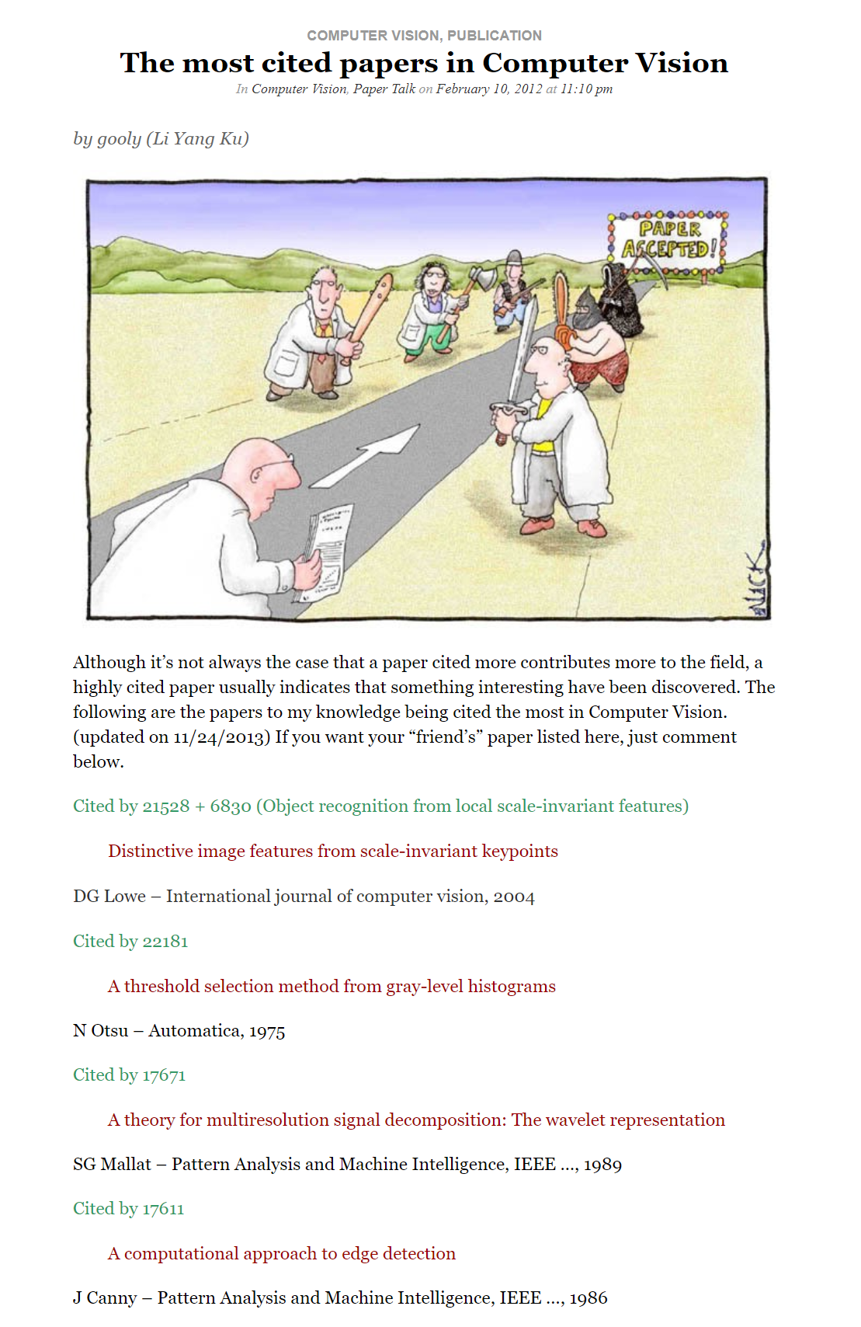
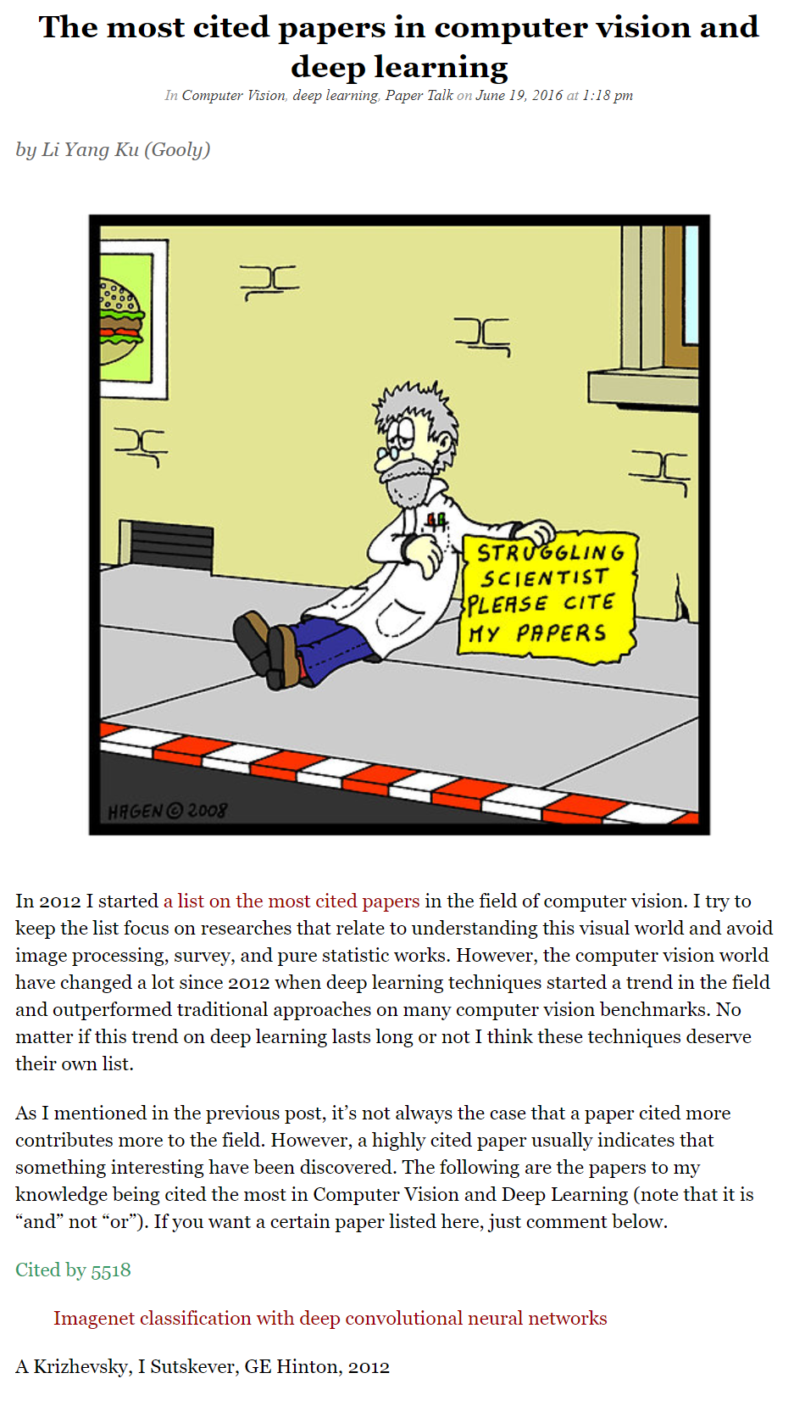
The Most Cited Papers in Computer Vision
https://computervisionblog.wordpress.com/2016/06/19/the-most-cited-papers-in-computer-vision-and-deep-learning/
https://computervisionblog.wordpress.com/2012/02/10/the-most-cited-papers-in-computer-vision/

Slide 10

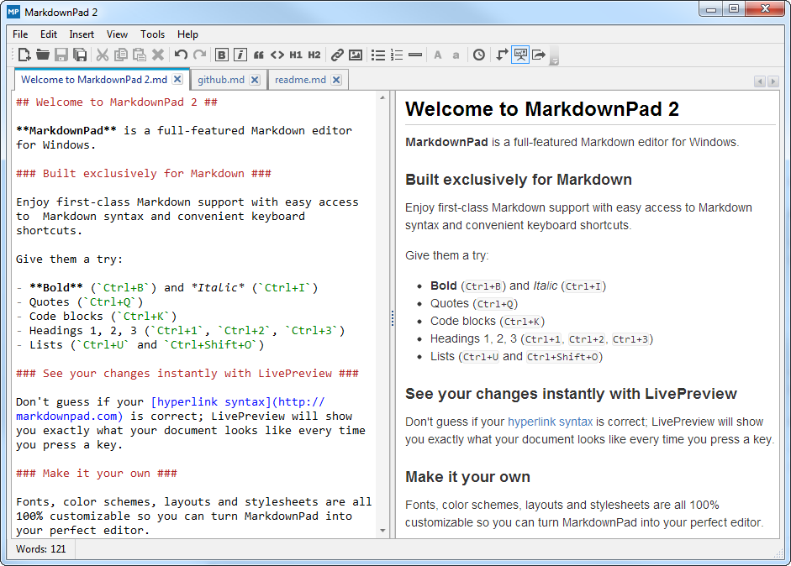


How To Use Tools
https://github.com/chulminy/CIVE497-CIVE700/compare/b80b422..cfbbc73

Slide 11
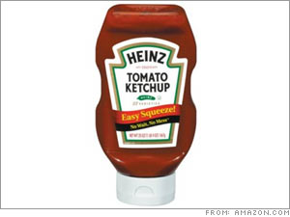
Remark
It is not that I’m so smart.
It is just that I stay with problems longer.
- Albert Einstein
https://www.youtube.com/watch?v=G2PJdmG2ICA
Notes:
http://www.virtuesforlife.com/10-great-life-lessons-from-albert-einstein/

