Slide 1



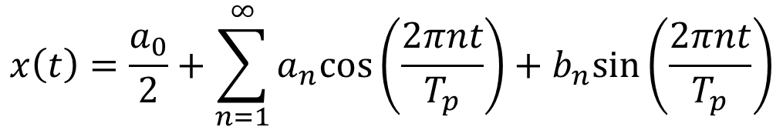



Fourier Series (Continue)
$$x\left(t\right)$$
$$x\left(t\right)=\frac{a_{0}}{2}+\sum_{n=1}^{∞}{a_{n}cos⁡\left(\frac{2πnt}{T_{p}}\right)+b_{n}sin⁡\left(\frac{2πnt}{T_{p}}\right)}$$
$$t$$
$$0$$
Q1. Prove this:
$$x\left(t\right)=x(t+nT_{p})$$
Q2. What is this term?
$$\frac{a_{0}}{2}$$
Q3. Explain $\sum_{n=1}^{∞}{a_{n}cos⁡\left(\frac{2πnt}{T_{p}}\right)+b_{n}sin⁡\left(\frac{2πnt}{T_{p}}\right)}$

Slide 2
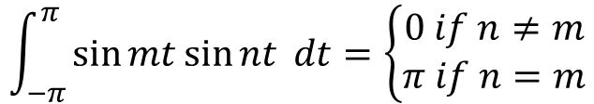
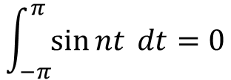
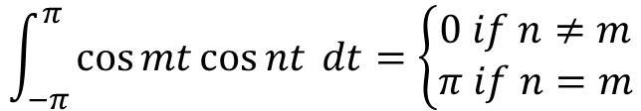
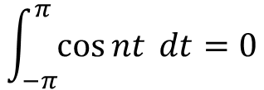



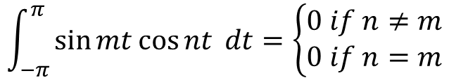
Basic Trigonometric Equations
$$\int_{−π}^{π}{\cos{nt} dt=0}$$
$$\int_{−π}^{π}{\sin{nt} dt=0}$$
Orthogonality of trigonometric functions
$$\int_{−π}^{π}{\cos{mt\cos{nt}} dt=\left\{\begin{matrix}0 if n≠m \\ π if n=m\end{matrix}\right.}$$
$$\cos{mt\cos{nt=\frac{1}{2}\left[\cos\left(m+n\right)t+\cos\left(m−n\right)t\right]}}$$
$$\int_{−π}^{π}{\sin{mt\sin{nt}} dt=\left\{\begin{matrix}0 if n≠m \\ π if n=m\end{matrix}\right.}$$
$$\sin{mt\sin{nt=\frac{1}{2}\left[\cos\left(m−n\right)t−\cos\left(m+n\right)t\right]}}$$
$$\int_{−π}^{π}{\sin{mt\cos{nt}} dt=\left\{\begin{matrix}0 if n≠m \\ 0 if n=m\end{matrix}\right.}$$
$$\sin{mt\cos{nt=\frac{1}{2}\left[\sin\left(m+n\right)t+\sin\left(m−n\right)t\right]}}$$

Slide 3
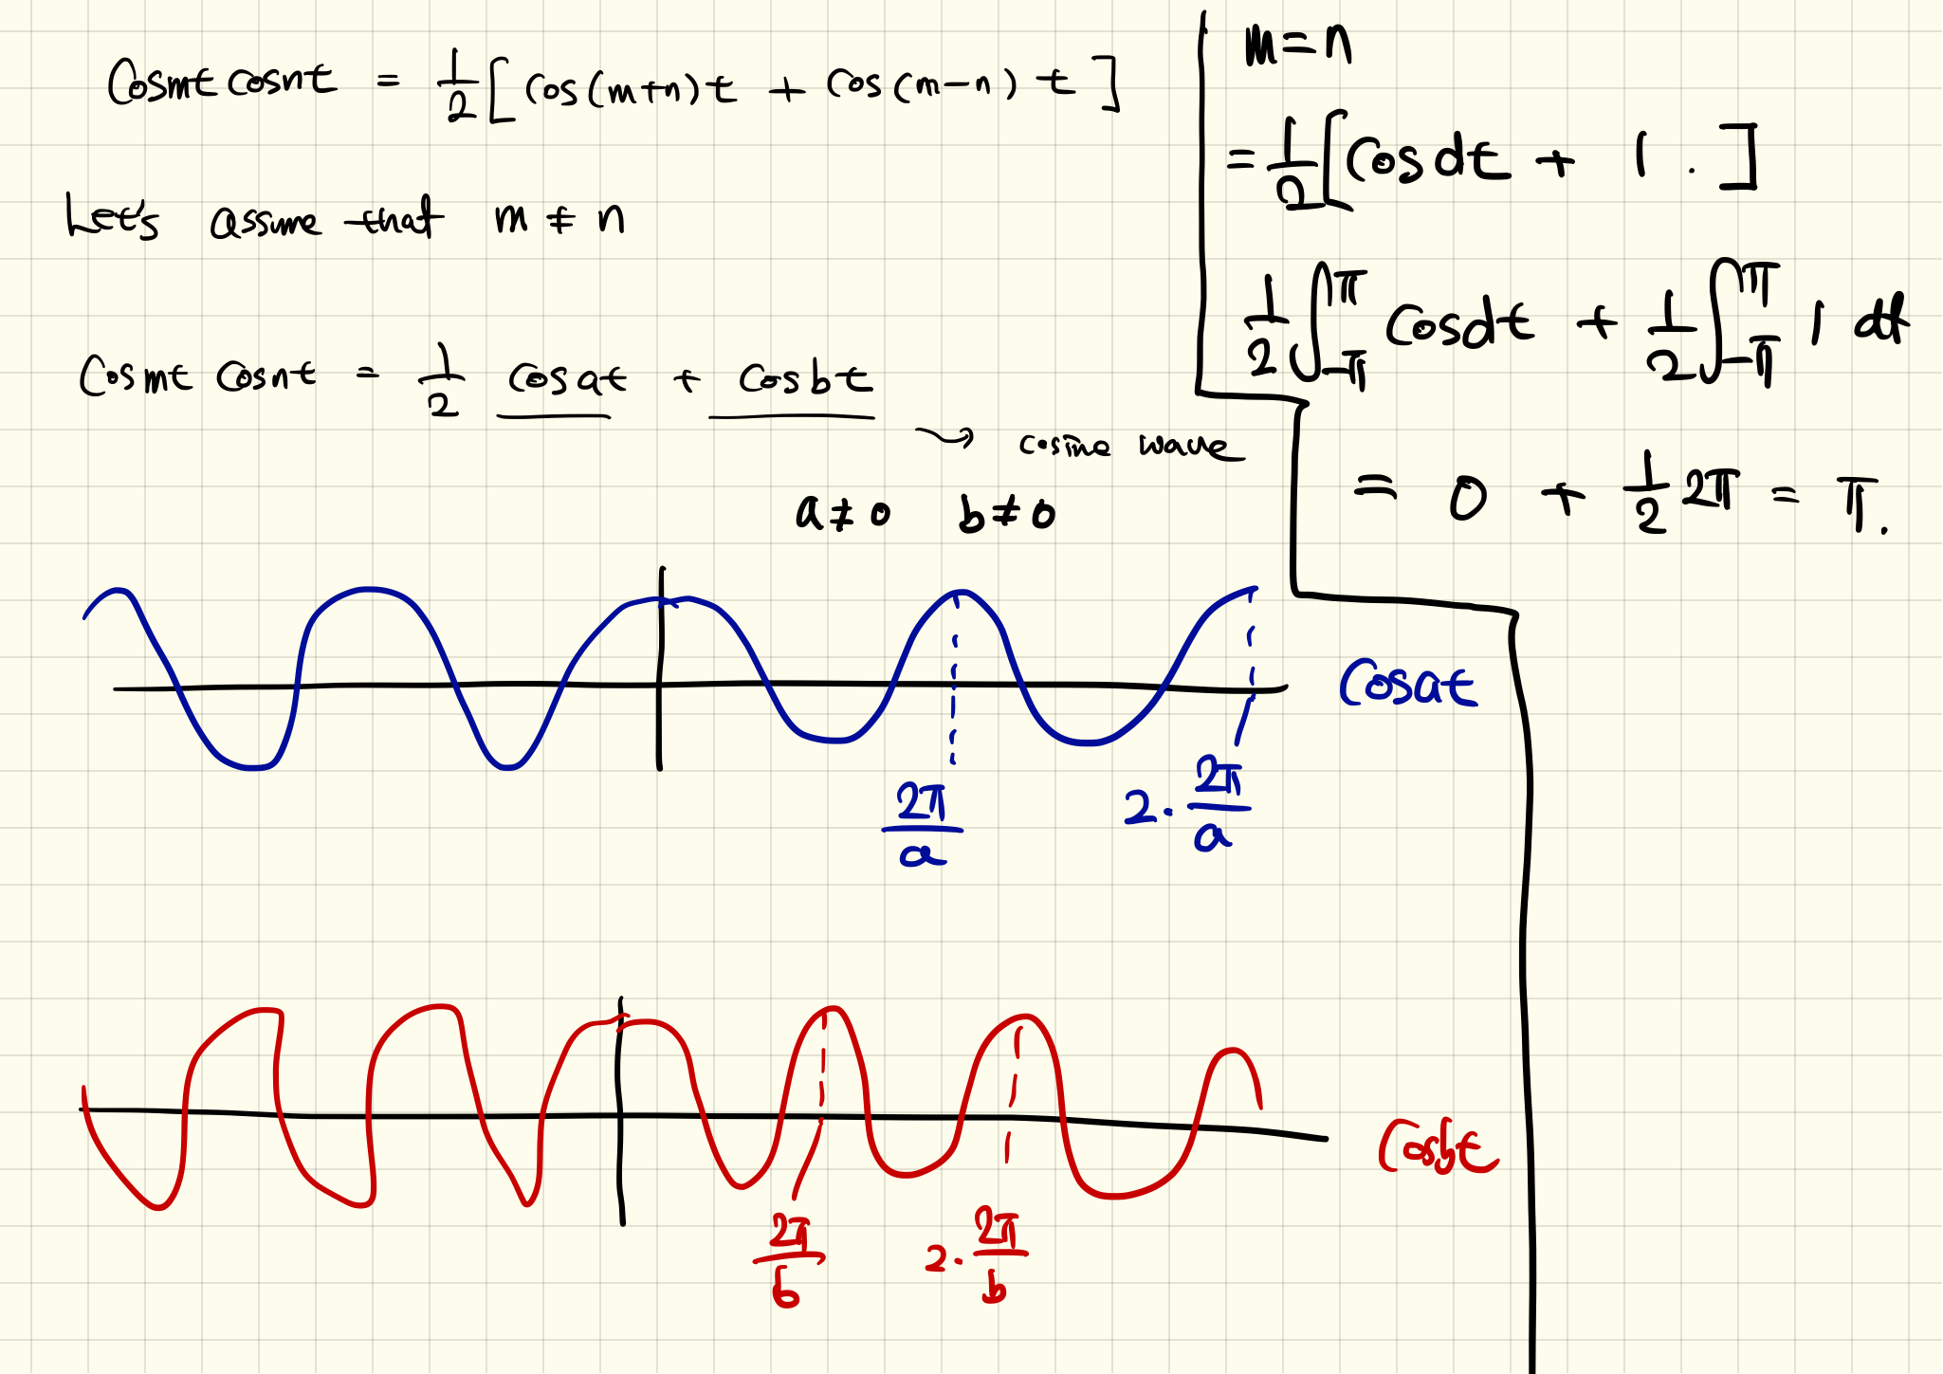

Slide 4
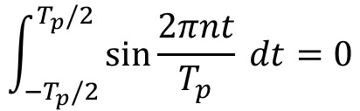
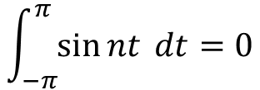
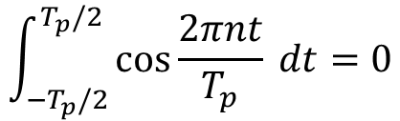
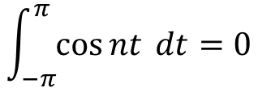
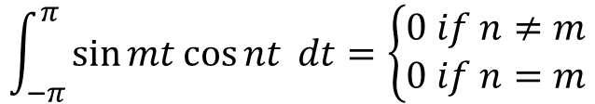
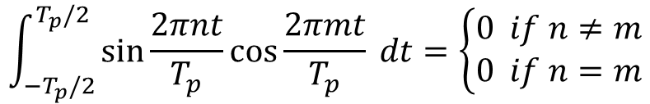
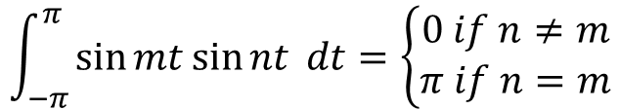
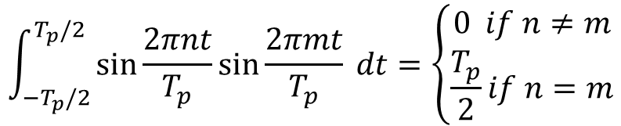
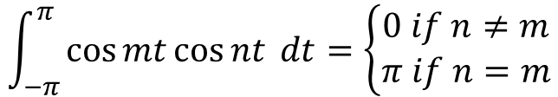
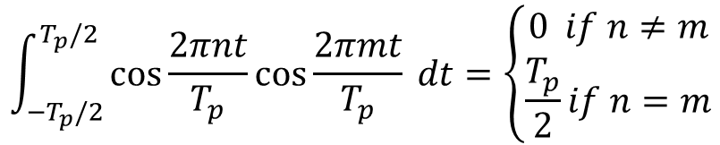
Basic Trigonometric Equations
$$\int_{−π}^{π}{\cos{nt} dt=0}$$
$$\int_{−π}^{π}{\sin{nt} dt=0}$$
$$\int_{{−T}_{p}/2}^{T_{p}/2}{\cos{\frac{2πnt}{T_{p}}} dt=0}$$
$$\int_{{−T}_{p}/2}^{T_{p}/2}{\sin{\frac{2πnt}{T_{p}}} dt=0}$$
$$\int_{−T_{p}/2}^{T_{p}/2}{\cos{\frac{2πnt}{T_{p}}\cos{\frac{2πmt}{T_{p}}}} dt=\left\{\begin{matrix}0 if n≠m \\ \frac{T_{p}}{2}if n=m\end{matrix}\right.}$$
$$\int_{−π}^{π}{\cos{mt\cos{nt}} dt=\left\{\begin{matrix}0 if n≠m \\ π if n=m\end{matrix}\right.}$$
$$\int_{−T_{p}/2}^{T_{p}/2}{\sin{\frac{2πnt}{T_{p}}\sin{\frac{2πmt}{T_{p}}}} dt=\left\{\begin{matrix}0 if n≠m \\ \frac{T_{p}}{2}if n=m\end{matrix}\right.}$$
$$\int_{−π}^{π}{\sin{mt\sin{nt}} dt=\left\{\begin{matrix}0 if n≠m \\ π if n=m\end{matrix}\right.}$$
$$\int_{−T_{p}/2}^{T_{p}/2}{\sin{\frac{2πnt}{T_{p}}\cos{\frac{2πmt}{T_{p}}}} dt=\left\{\begin{matrix}0 if n≠m \\ 0 if n=m\end{matrix}\right.}$$
$$\int_{−π}^{π}{\sin{mt\cos{nt}} dt=\left\{\begin{matrix}0 if n≠m \\ 0 if n=m\end{matrix}\right.}$$

Slide 5
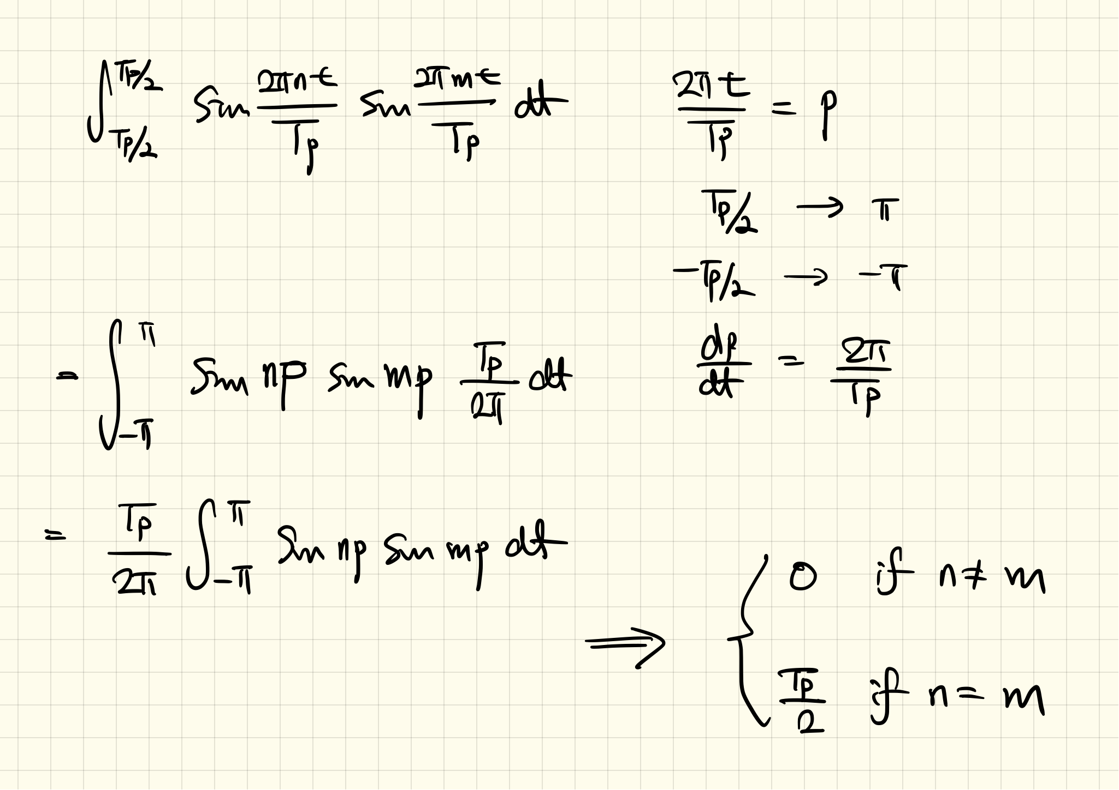

Slide 6
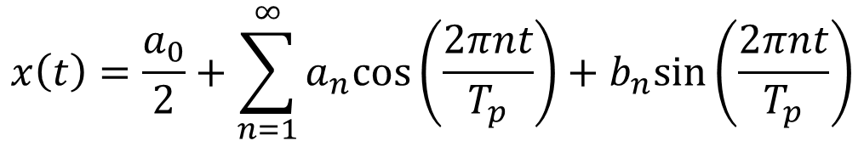
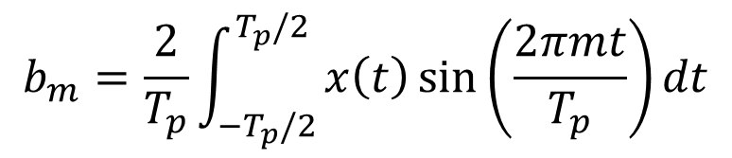
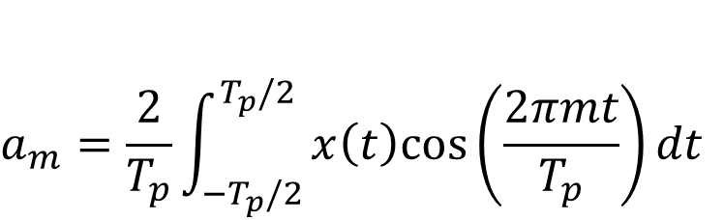
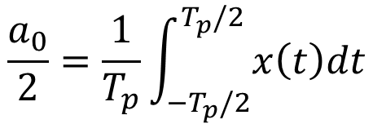
Fourier Coefficients
$$x\left(t\right)=\frac{a_{0}}{2}+\sum_{n=1}^{∞}{a_{n}cos⁡\left(\frac{2πnt}{T_{p}}\right)+b_{n}sin⁡\left(\frac{2πnt}{T_{p}}\right)}$$
$$\frac{a_{0}}{2}=\frac{1}{T_{p}}\int_{−T_{p}/2}^{T_{p}/2}{x\left(t\right)dt}$$
$$a_{m}=\frac{2}{T_{p}}\int_{−T_{p}/2}^{T_{p}/2}{x\left(t\right)cos⁡\left(\frac{2πmt}{T_{p}}\right)dt}$$
$$b_{m}=\frac{2}{T_{p}}\int_{−T_{p}/2}^{T_{p}/2}{x\left(t\right)\sin{⁡\left(\frac{2πmt}{T_{p}}\right)}dt}$$
Notes:
We have x (t). If we know the period (Tp), then, we can get all coefficient.

Slide 7
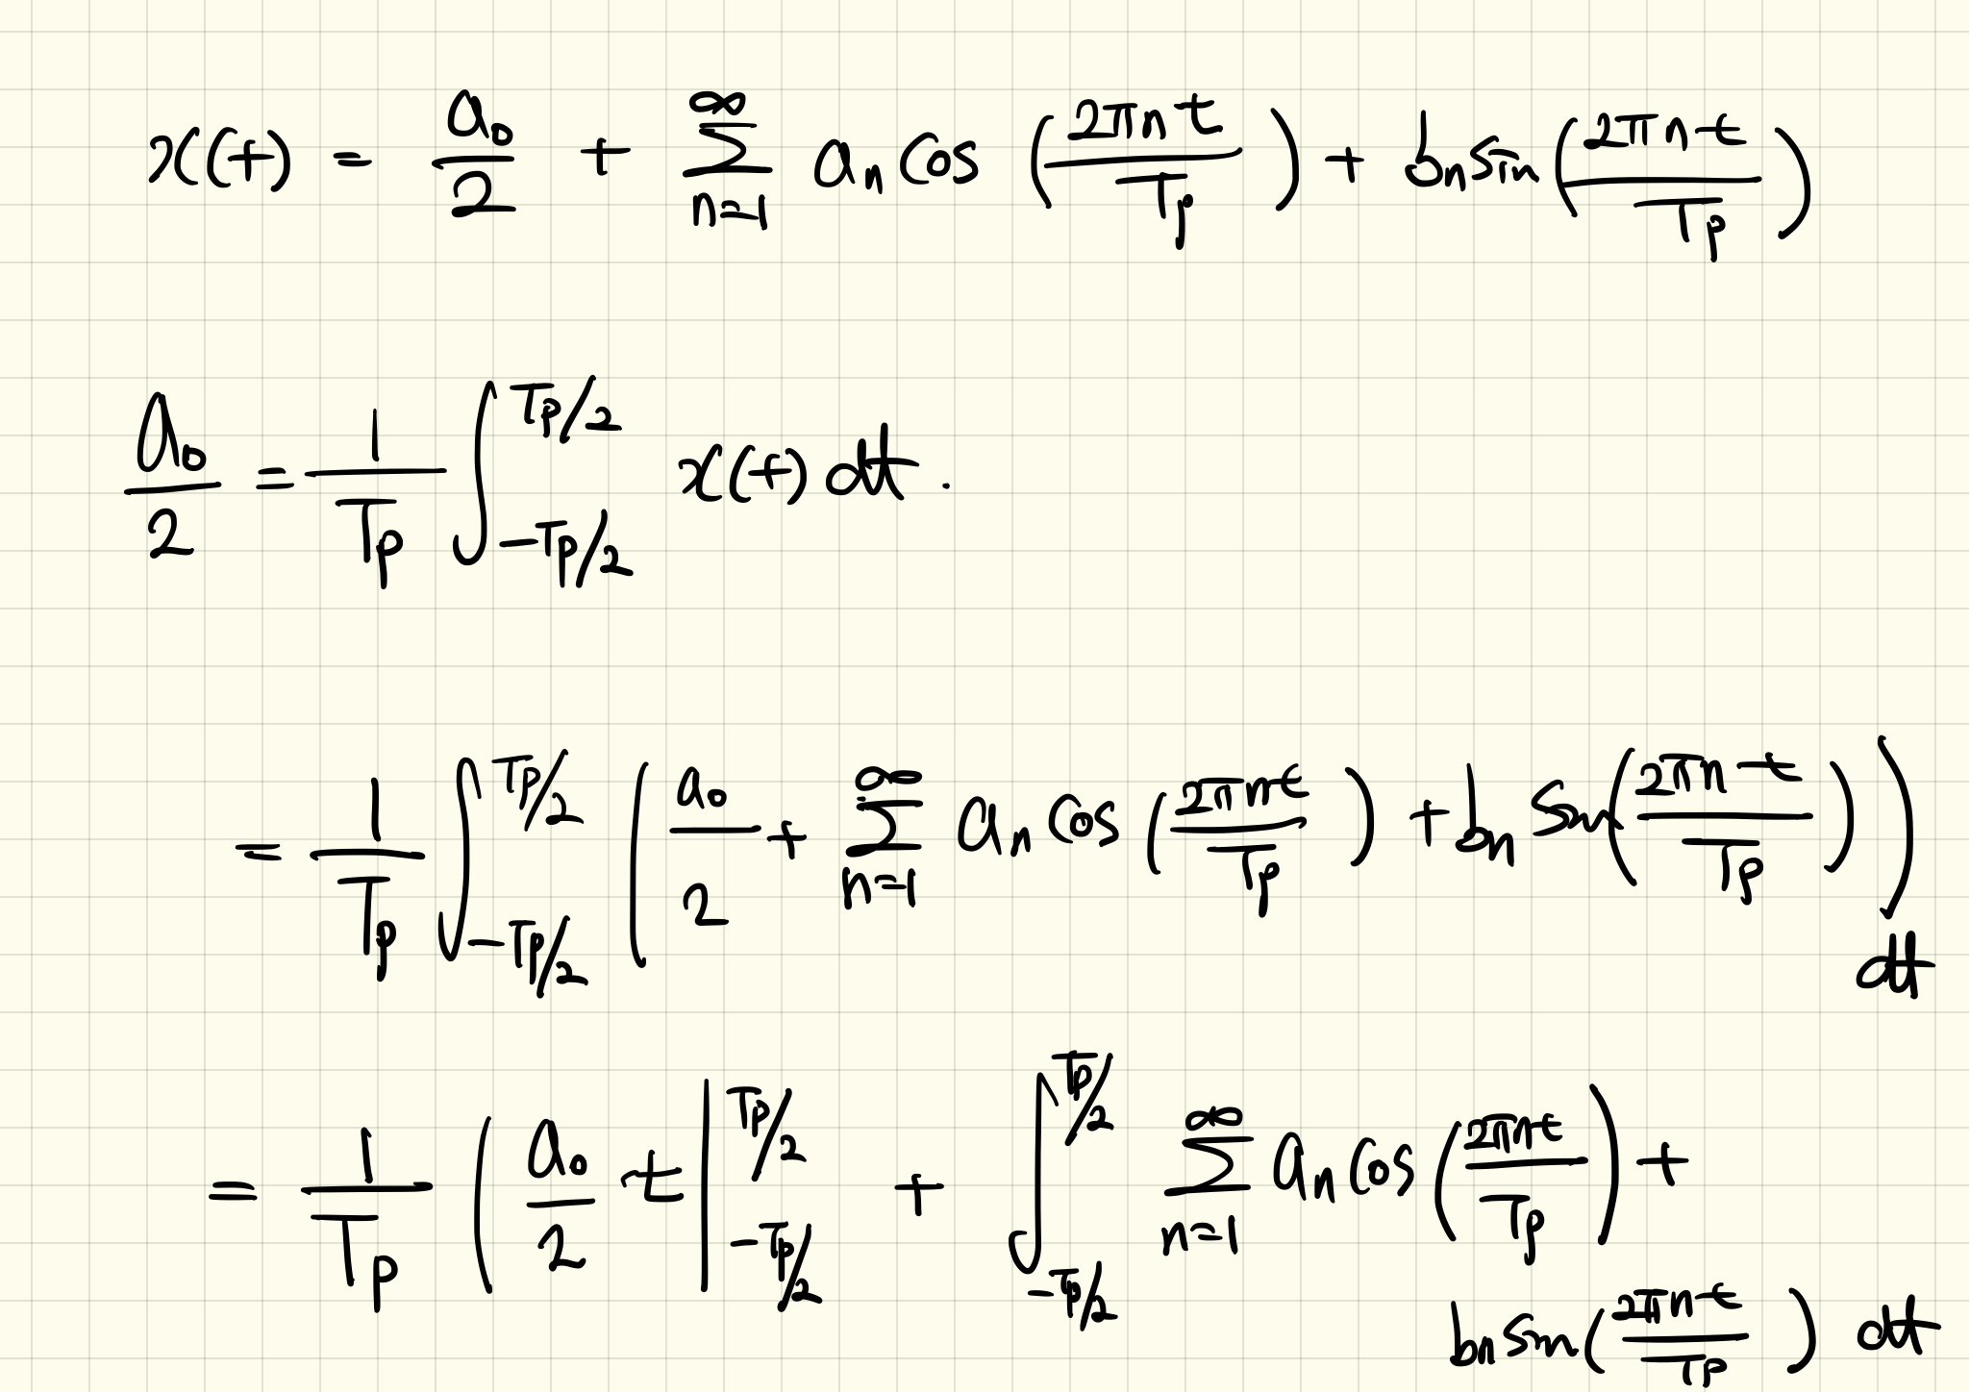

Slide 8
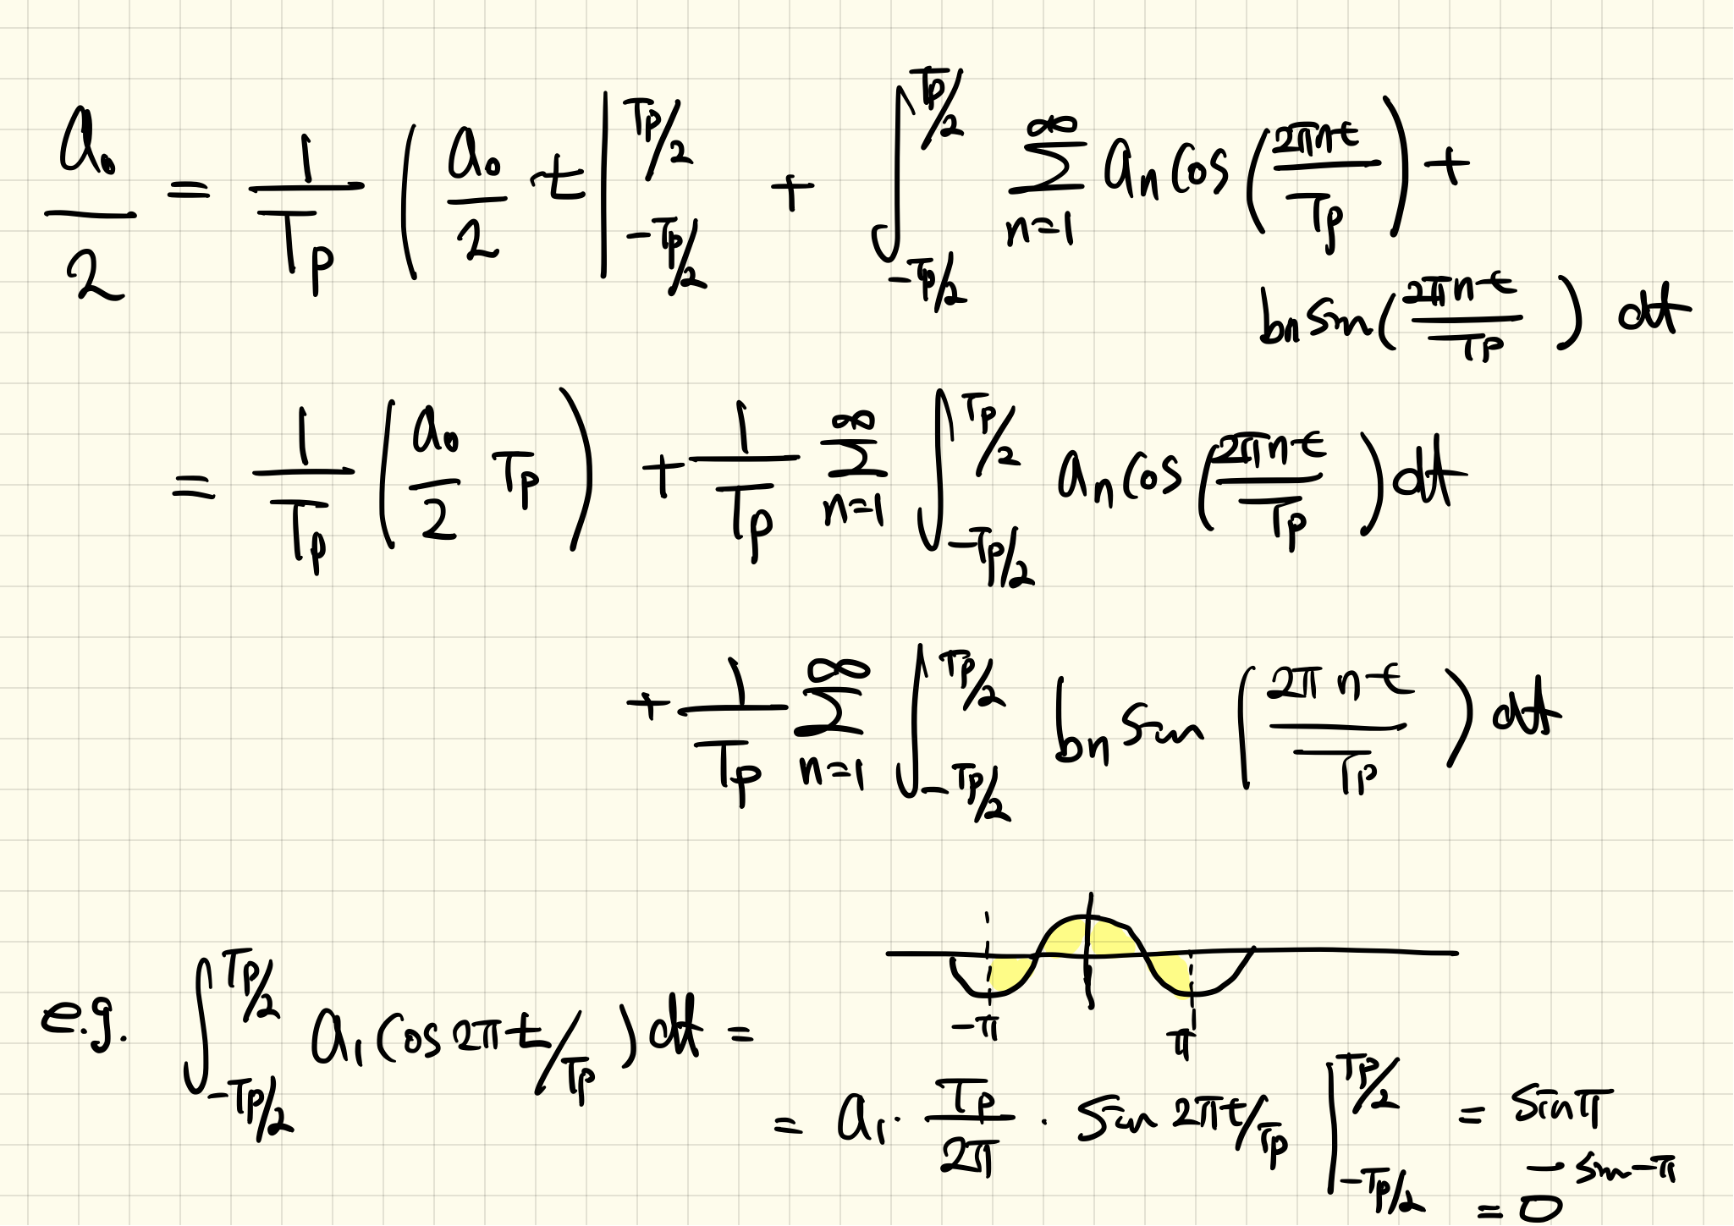

Slide 9
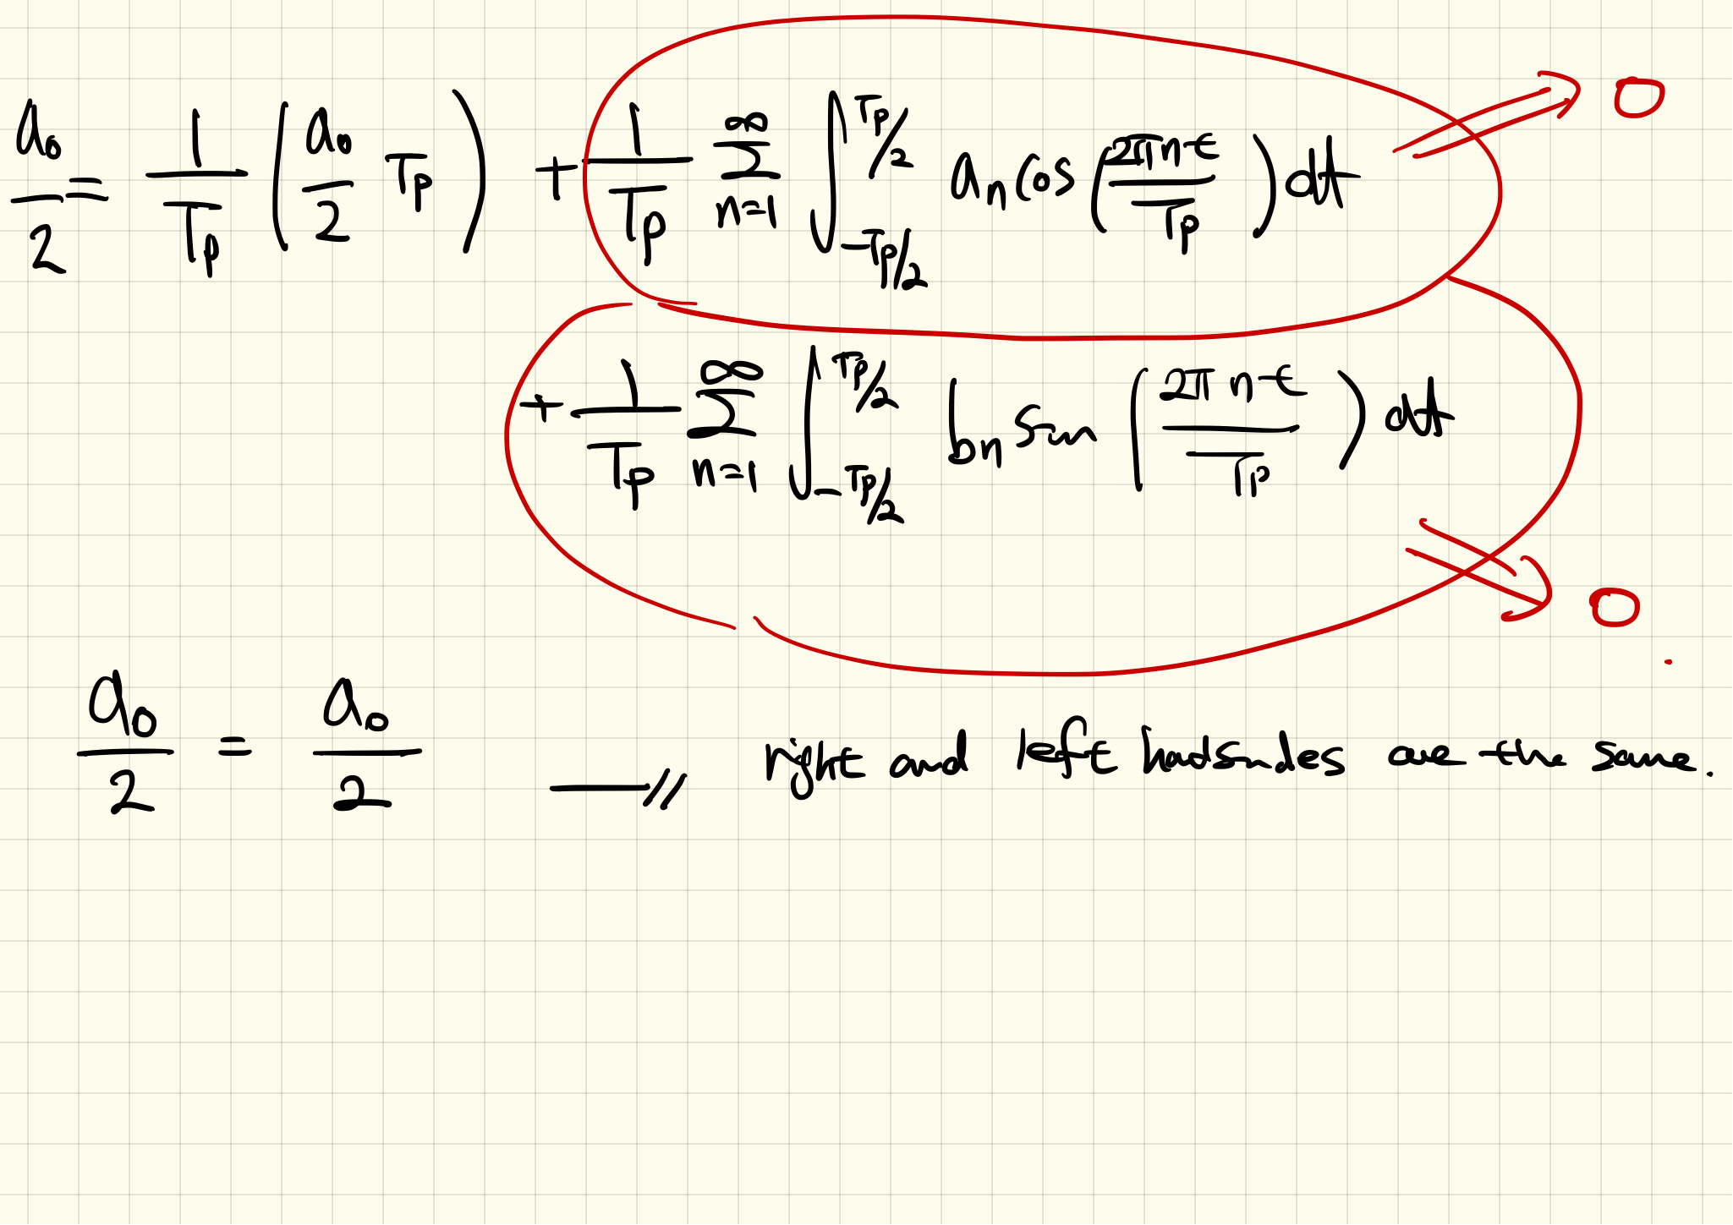

Slide 10
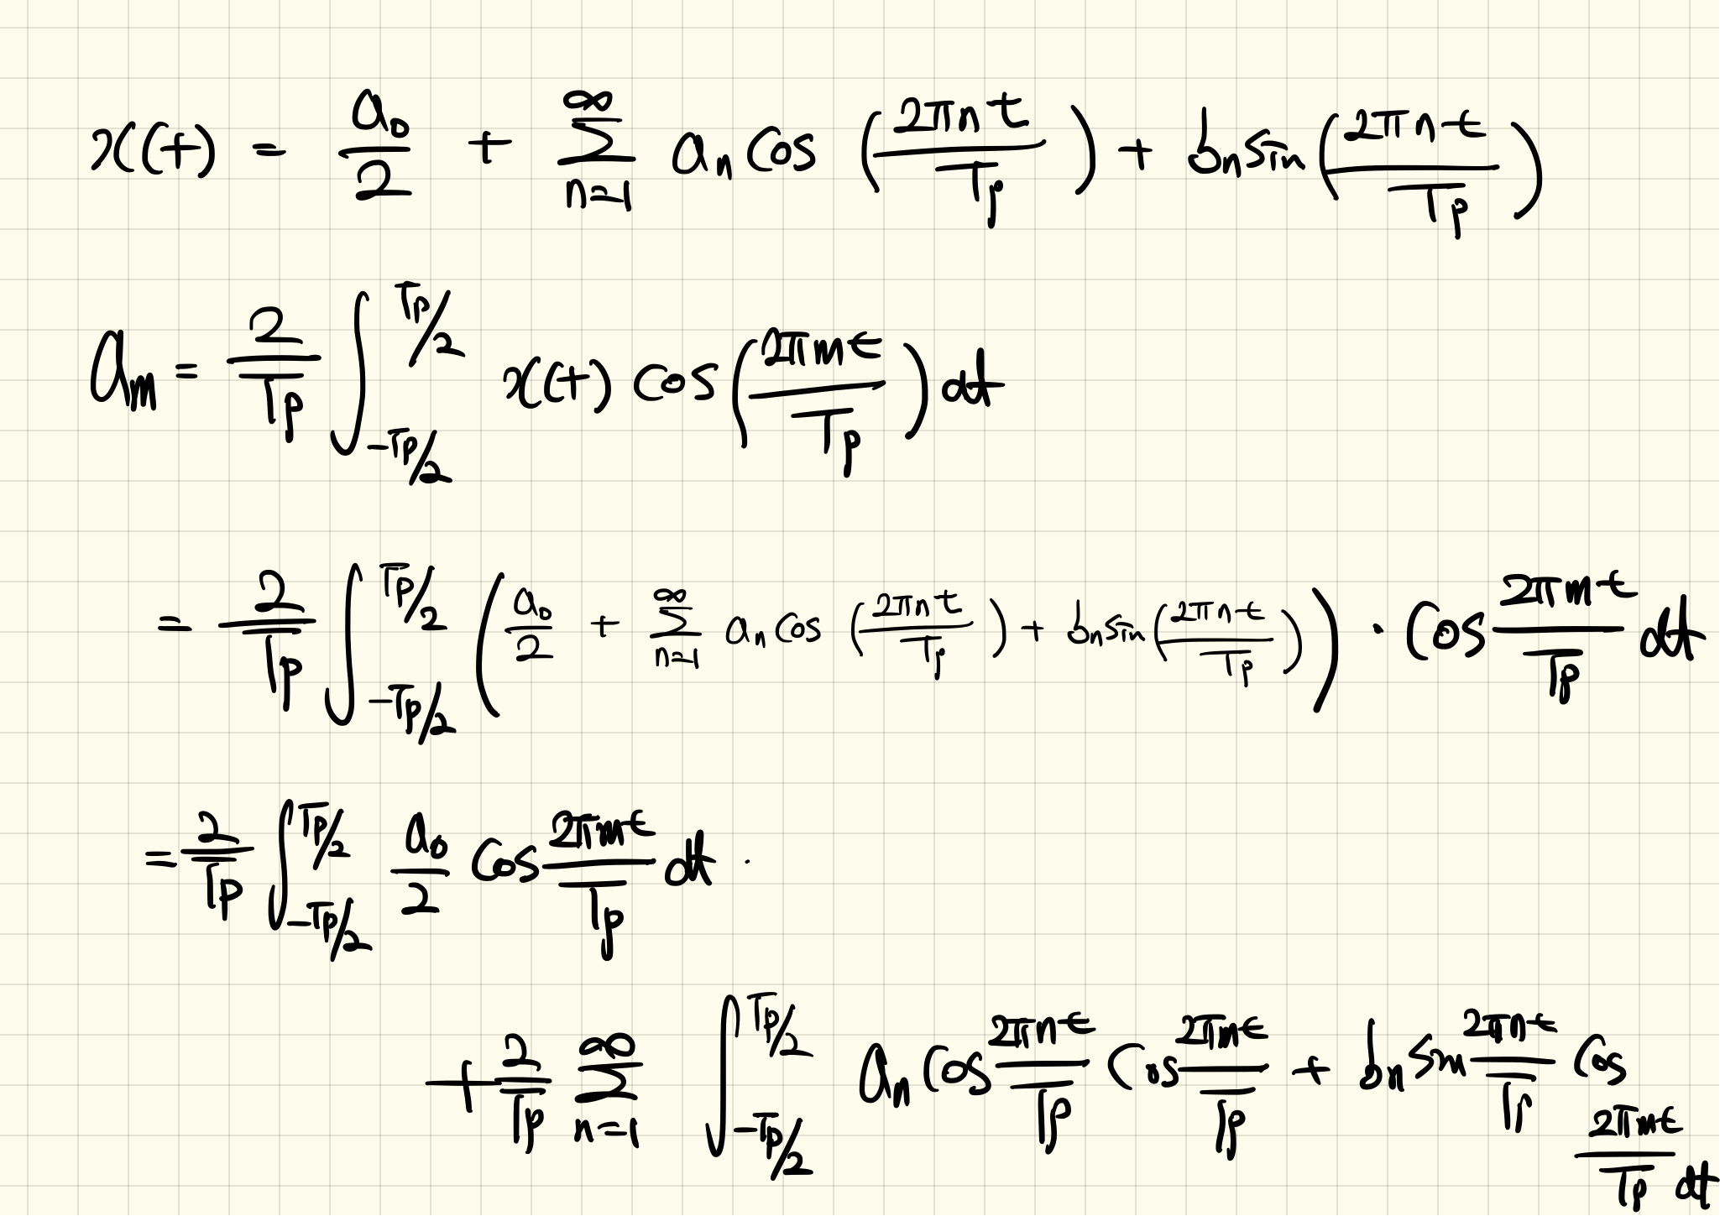

Slide 11
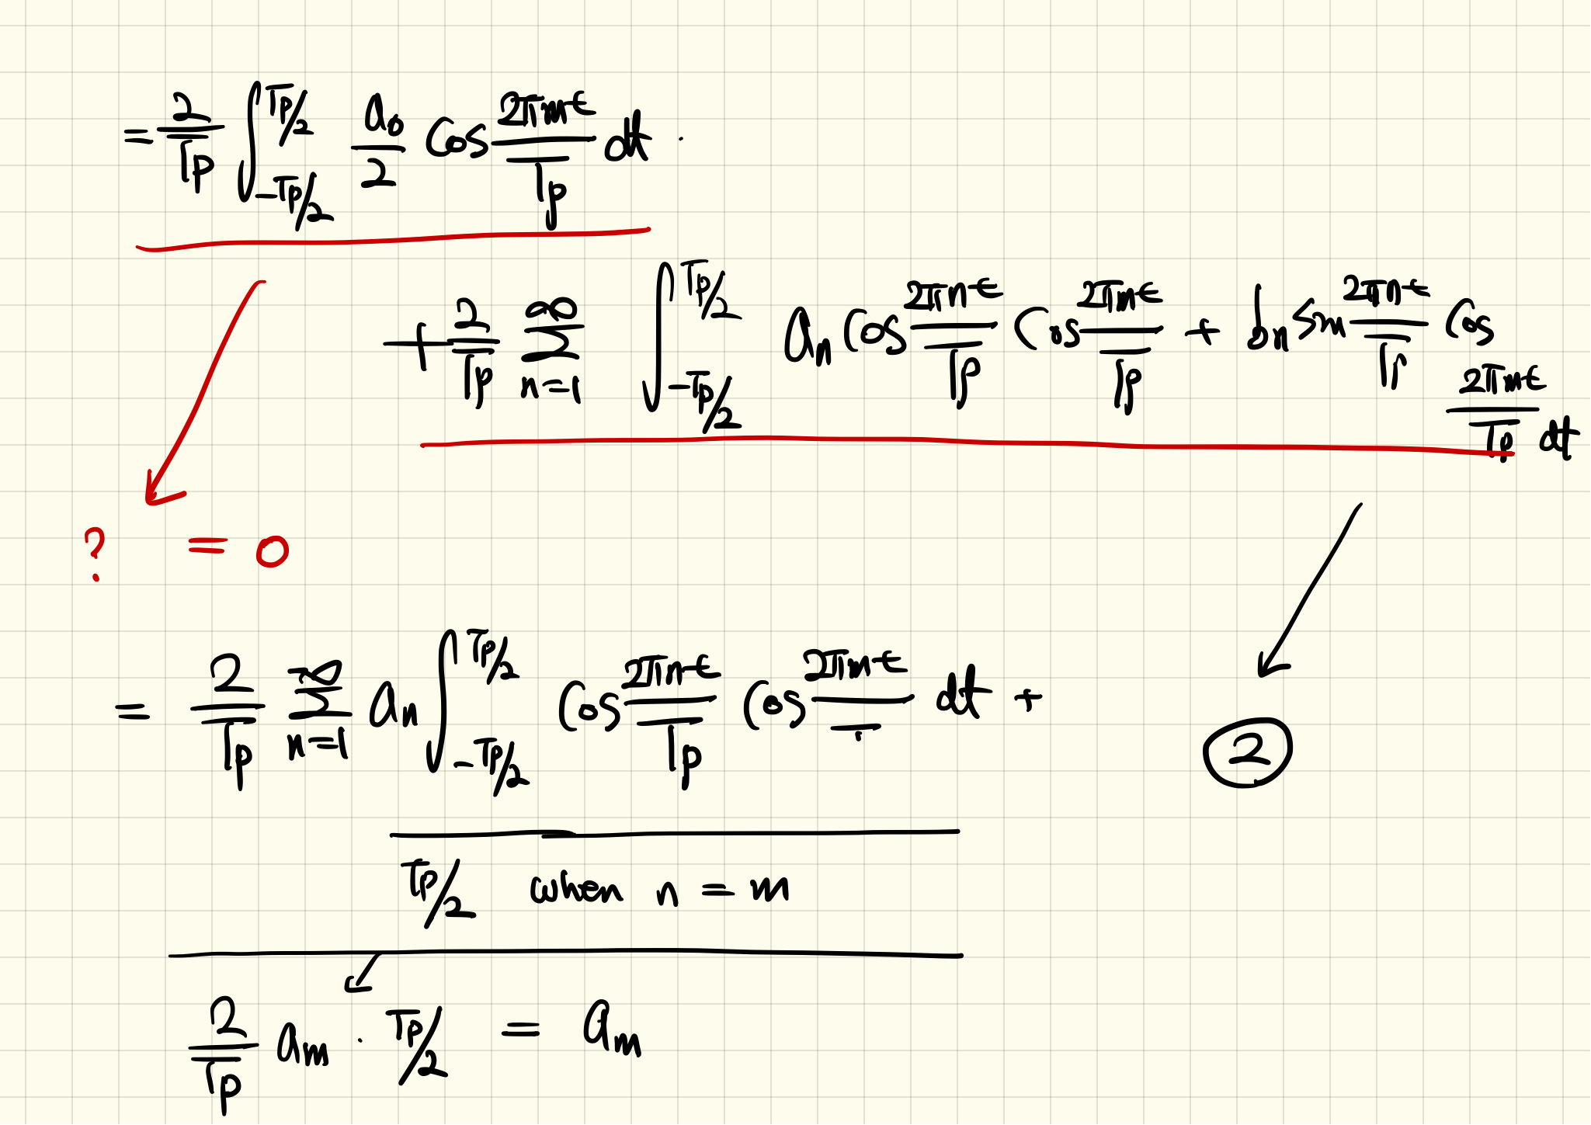

Slide 12
