Slide 1
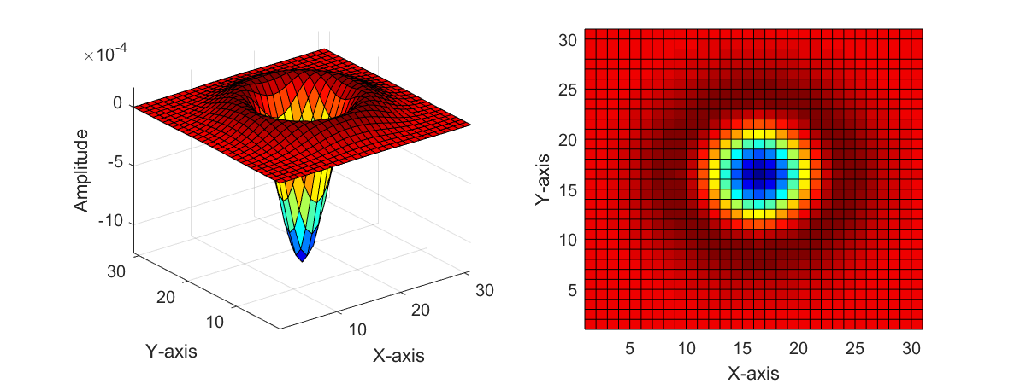
See “LoG_effect.m”

