Slide 1
Line Fitting
Data (measurement): (x₁, y₁), …, (x_{n}, y_{n})
Y
Known model: Line (y_{i} = m x_{i} + b)
We will find m and b.
Your data
0
X

Slide 2
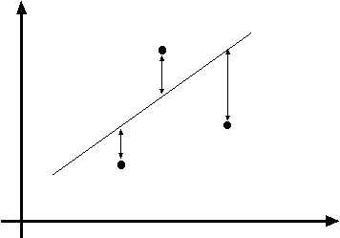
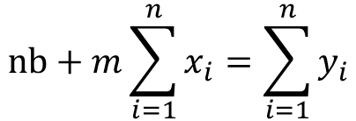
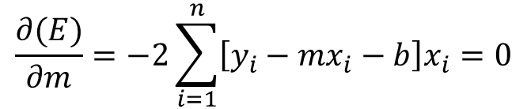
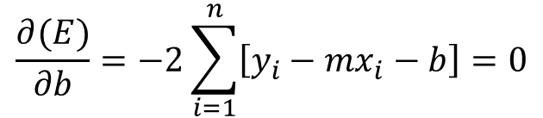
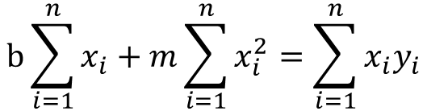
Least Squares Line Fitting
Data (measurement): (x₁, y₁), …, (x_{n}, y_{n})
Model: Line (y_{i} = m x_{i} + b)
Task: Find (m, b)
y=mx+b
(x_{i}, y_{i})
Minimize
$$\frac{∂(E)}{∂m}=−2\sum_{i=1}^{n}{\left[y_{i}−mx_{i}−b\right]x_{i}}=0$$
$$b\sum_{i=1}^{n}{x_{i}}+m\sum_{i=1}^{n}{x_{i}^{2}}=\sum_{i=1}^{n}{{x_{i}y}_{i}}$$
$$\frac{∂(E)}{∂b}=−2\sum_{i=1}^{n}{\left[y_{i}−mx_{i}−b\right]}=0$$
$$nb+m\sum_{i=1}^{n}{x_{i}}=\sum_{i=1}^{n}{y_{i}}$$

Slide 3
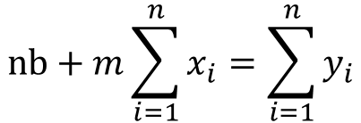
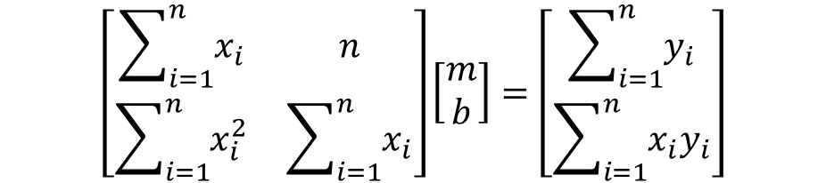
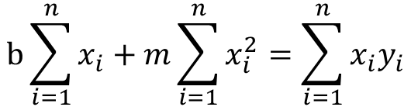
Least Squares Line Fitting
$$nb+m\sum_{i=1}^{n}{x_{i}}=\sum_{i=1}^{n}{y_{i}}$$
$$b\sum_{i=1}^{n}{x_{i}}+m\sum_{i=1}^{n}{x_{i}^{2}}=\sum_{i=1}^{n}{{x_{i}y}_{i}}$$
$$\left[\begin{matrix}\sum_{i=1}^{n}{x_{i}} & n \\ \sum_{i=1}^{n}{x_{i}^{2}} & \sum_{i=1}^{n}{x_{i}}\end{matrix}\right]\left[\begin{matrix}m \\ b\end{matrix}\right]=\left[\begin{matrix}\sum_{i=1}^{n}{y_{i}} \\ \sum_{i=1}^{n}{x_{i}y_{i}}\end{matrix}\right]$$
True: y=2x+4
Notes:
http://mathworld.wolfram.com/LeastSquaresFitting.html

Slide 4
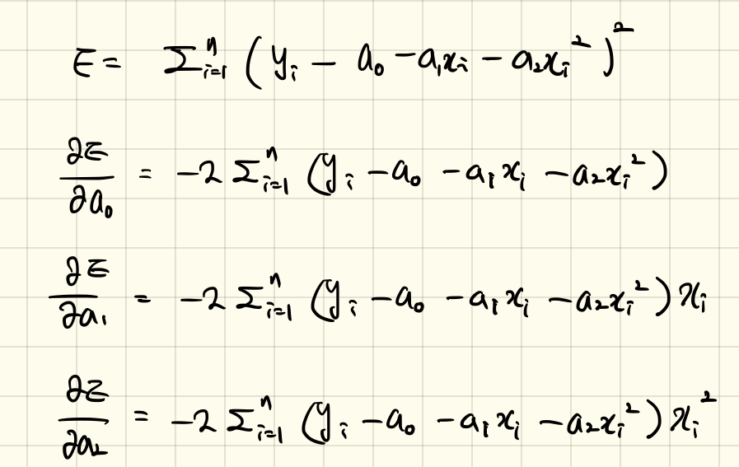
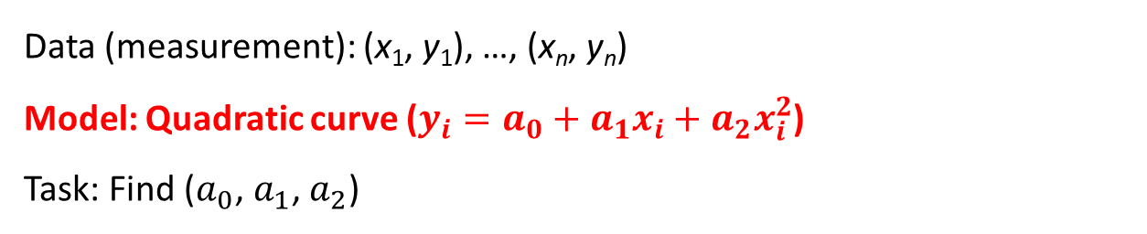
Least Squares Line Fitting (Approach 1)
Data (measurement): (x₁, y₁), …, (x_{n}, y_{n})
Model: Quadratic curve (${{y_{i}=a_{0}+a_{1}x_{i}+a}_{2}x}_{i}^{2}$)
Task: Find ($a_{0}$, $a_{1}$, $a_{2}$)

Slide 5

Least Squares Line Fitting
True: y=2x+4
ransac_supplement.m
Notes:
http://mathworld.wolfram.com/LeastSquaresFitting.html

