Slide 1
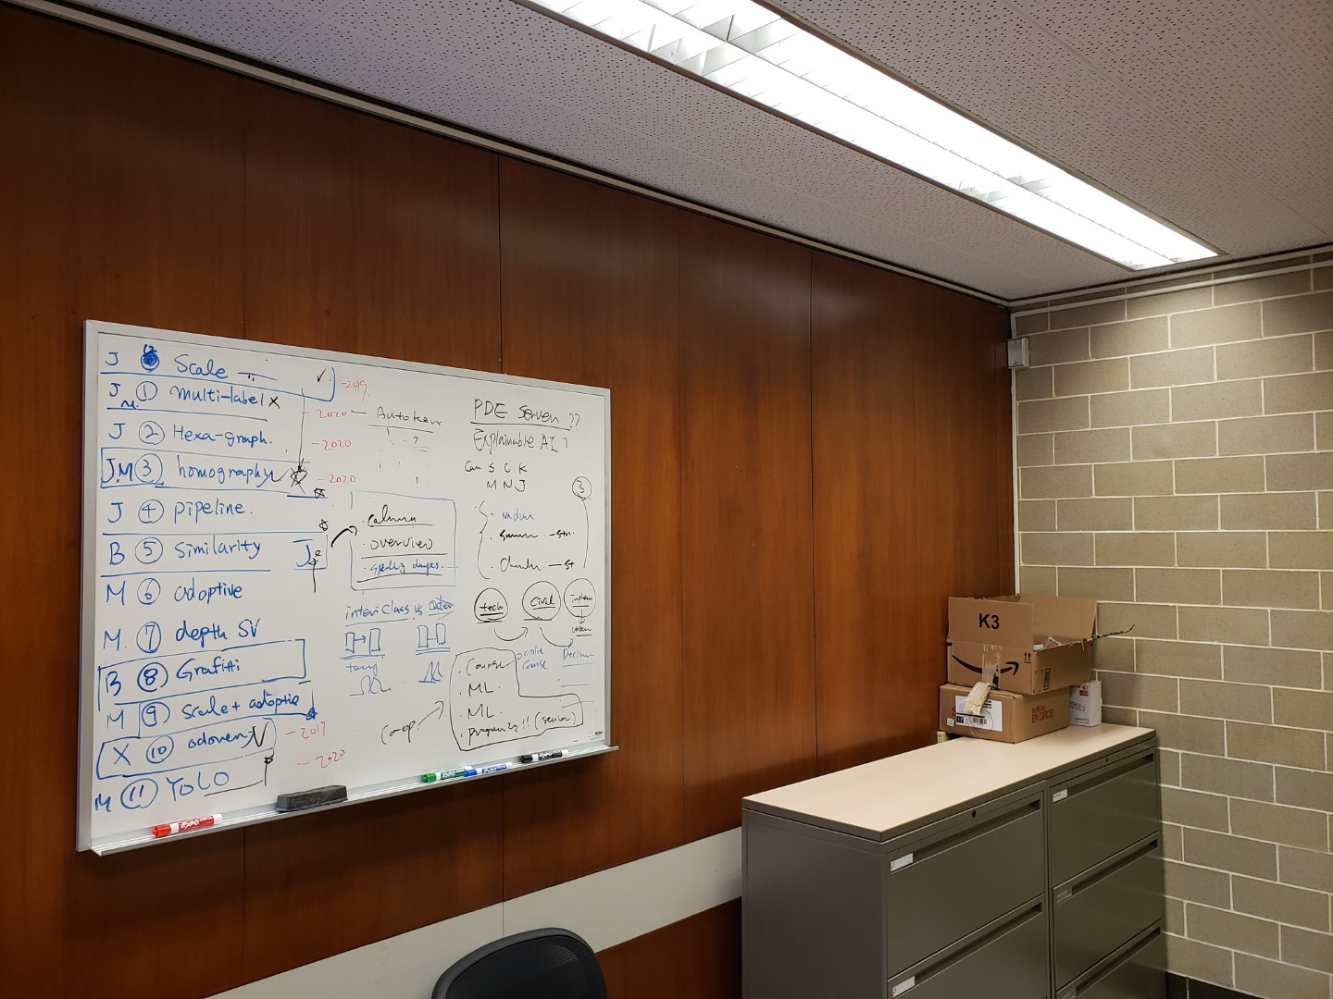
Please insert a good painting
Clock

Slide 2
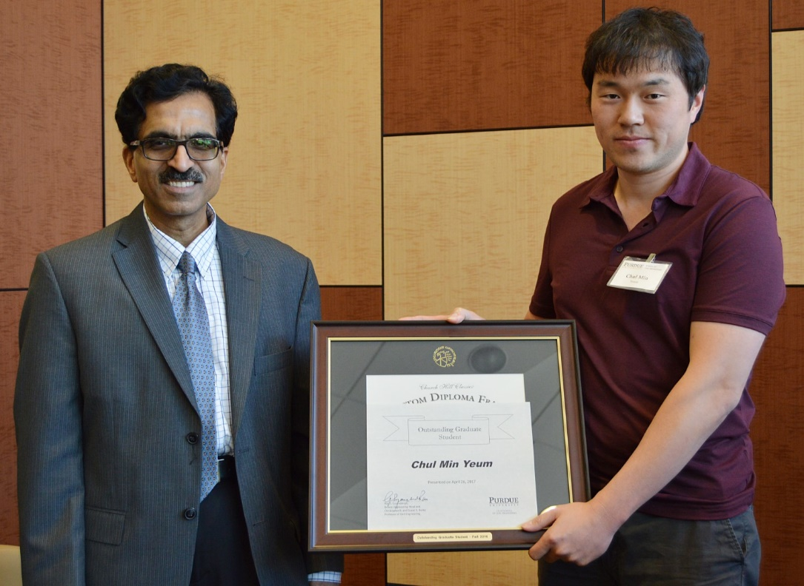
Please insert any image!

