Slide 1
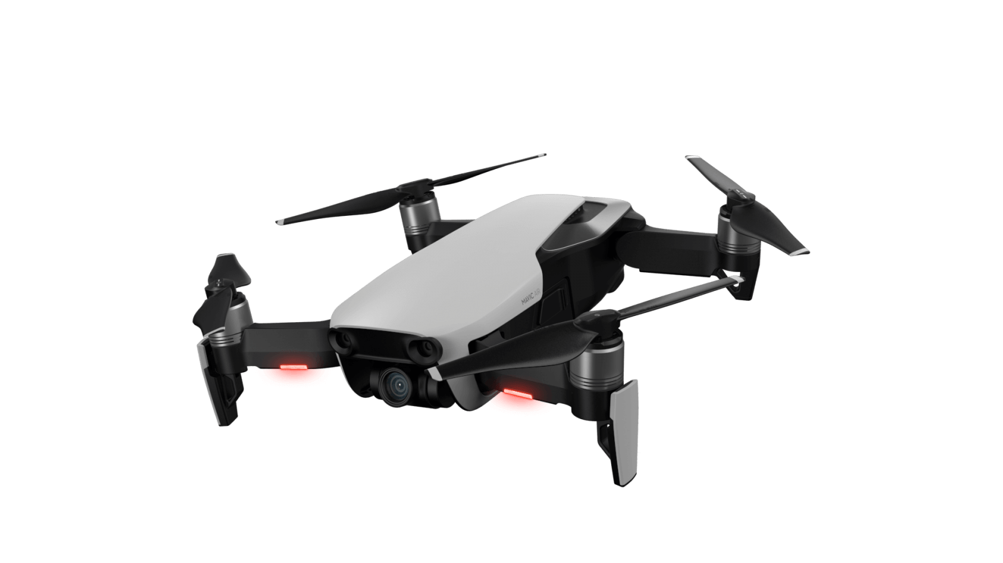
PX4 SITL With Gazebo
GPS Failure Failsafe Implementation
Name : Ch Madhava badari narayana

Slide 2
Intro to PX4 & Simulation
Why Simulation?
Safe for testing
Cost-efficient
Time-efficient
Overview
To implement GPS failsafe using PX4 and SITL simulation

Slide 3
PX4 Ecosystem
What is PX4?
It is an Open source flight control Firmware.
What is QGroundControl?
Monitors log data and for visual experience.
Components of PX4 Ecosystem
Used as Firmware,Middleware etc.
It supports the hardware like Pixhawh, SITL(Software in the loop), HITL(hardware in the loop).

Slide 4
Simulators
Gazebo | Physics based, realistic
JMAVSim | Lightweight and fast
AirSim | Supports AI/ML Integration

Slide 5
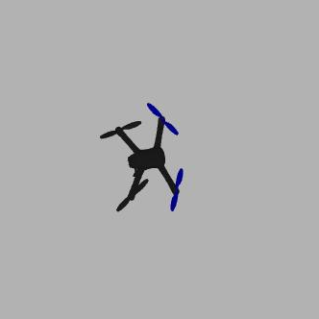
Setup PX4 SITL with Gazebo
System Requirements
Ubuntu (OS)
ROS2
Gazebo
Installation
PX4 firmware setup
QGroundControl setup
Launch : make px4_sitl gazebo

Slide 6
Running a Simulated Flight
Launching PX4 SITL
Controlling the Drone Using QGroundControl & MAVLink Commands
Example MAVlink command
Commander takeoff
Changing Flight Modes Using QGC (Position, Hold, Return etc.)

Slide 7
GPS Failsafe in PX4
What is GPS Failsafe?
- Prevents drones from crashing due to GPS loss
Failsafe Triggers:
- GPS signal loss
- Poor satellite coverage
Failsafe Mechanisms:
- Land Mode: The drone lands safely when GPS is lost.
- Return-to-Launch (RTL): The drone returns to its home location.
- Position Hold: The drone hovers in place until GPS recovers.

Slide 8
Configuring GPS Failsafe in PX4
Open QgroundControl
Navigate to parameters
Search for Failsafe
Configure NAV_RCL_ACT for Return to Launch or Land mode

Slide 9
Testing GPS Failsafe in SITL
Launch PX4 SITL in Gazebo.
Take off the drone using 'commander takeoff'
Disable GPS using ‘failure gps off’
Observe the failsafe response (RTL or Land)
Re-enable GPS using 'failure gps ok'

Slide 10
Conclusion
GPS Failsafe ensures drone safety in GPS-denied environments.
SITL testing is essential before deploying on real hardware.
Proper configuration in QGroundControl enhances reliability.

