Slide 1
AUTOSCALLING

Slide 2
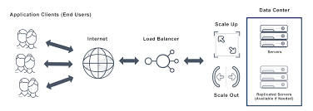
Why AutoScalling?
AWS Auto Scaling monitors your applications and automatically adjusts capacity to maintain steady, predictable performance at the lowest possible cost.And also combination of Scalein(serverup) and Scaleout(serverdown) process will be done on backend (the process of automatically increasing or decreasing the computational resources delivered to a cloud workload based on need).

Slide 3
In AutoScalling ,We have 2 types 1.Horizantal scalling(whenever server utilization will get high automatically servers will get launched in backend a.Scalein:It helps to delete an extra servers. b.Scaleout:It helps to add new servers required. 2.Vertical Scalling:-whenever server usage will be full ,this scalling will help to add the new storage before stopped the server.

Slide 4
NEED OF AUTOSCALLING
EC2
APPLICATION(required)(we’re taking nginx application)
IMAGE(same server)
TARGET GROUPS
APPLICATION LOAD BALANCER
LAUNCH CONFIGURATION AND
AUTOSCALLING.

Slide 5
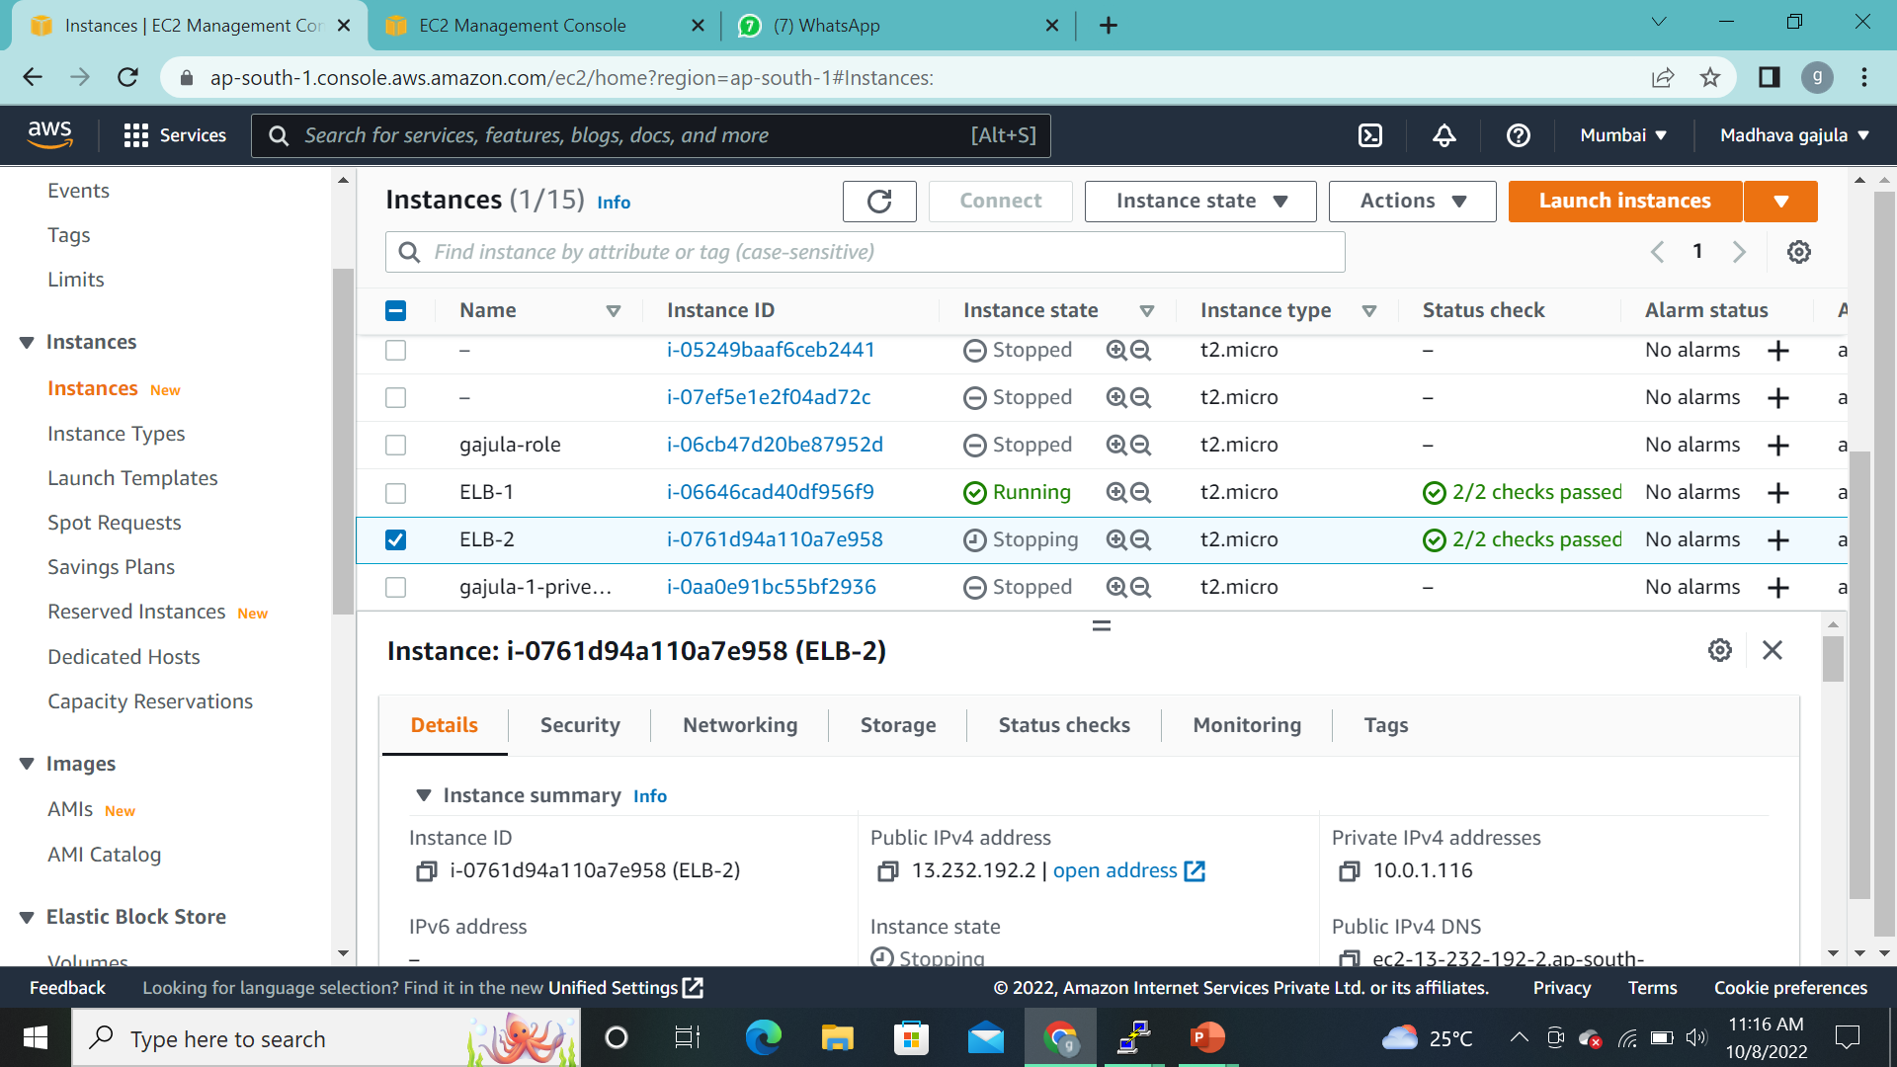
j

Slide 6
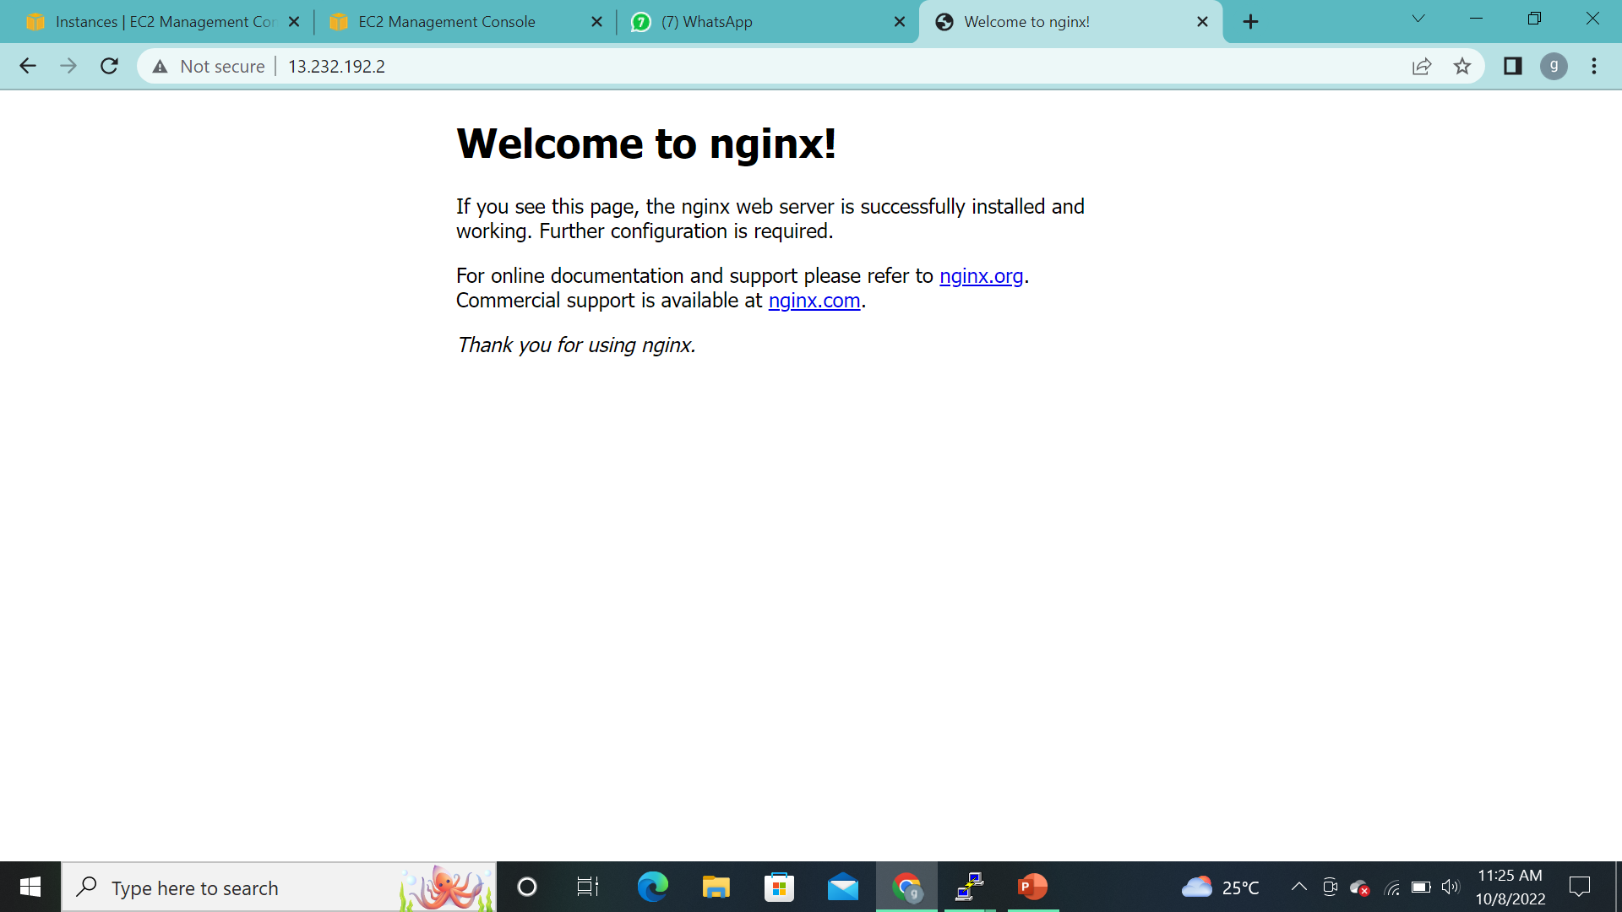
j
HERE,We’re Checking the server,whether the server had Application (or) not.If the application is here the browse will displays results.

Slide 7
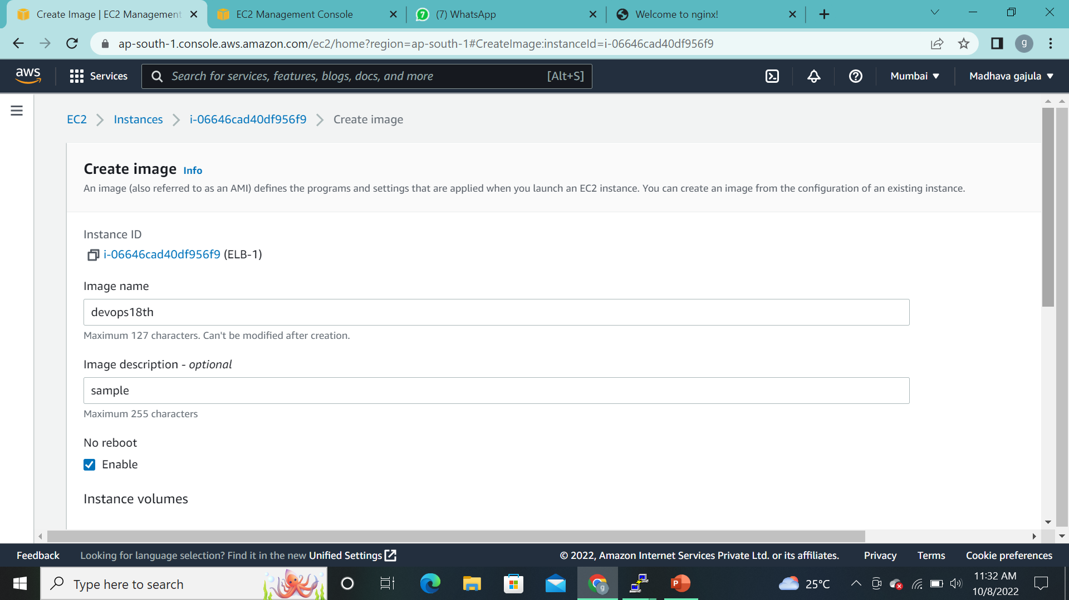
j
After checking the browse,we need to create an Image (replica of the same server)

Slide 8
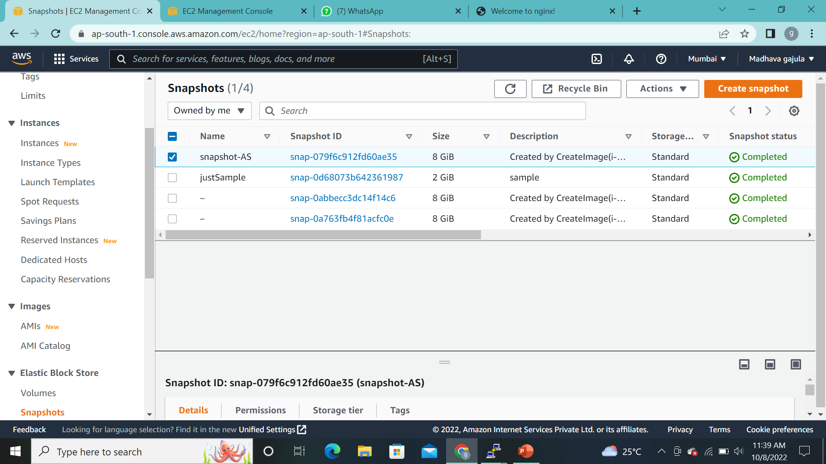
j
At the same time will get created snapshot too.

Slide 9
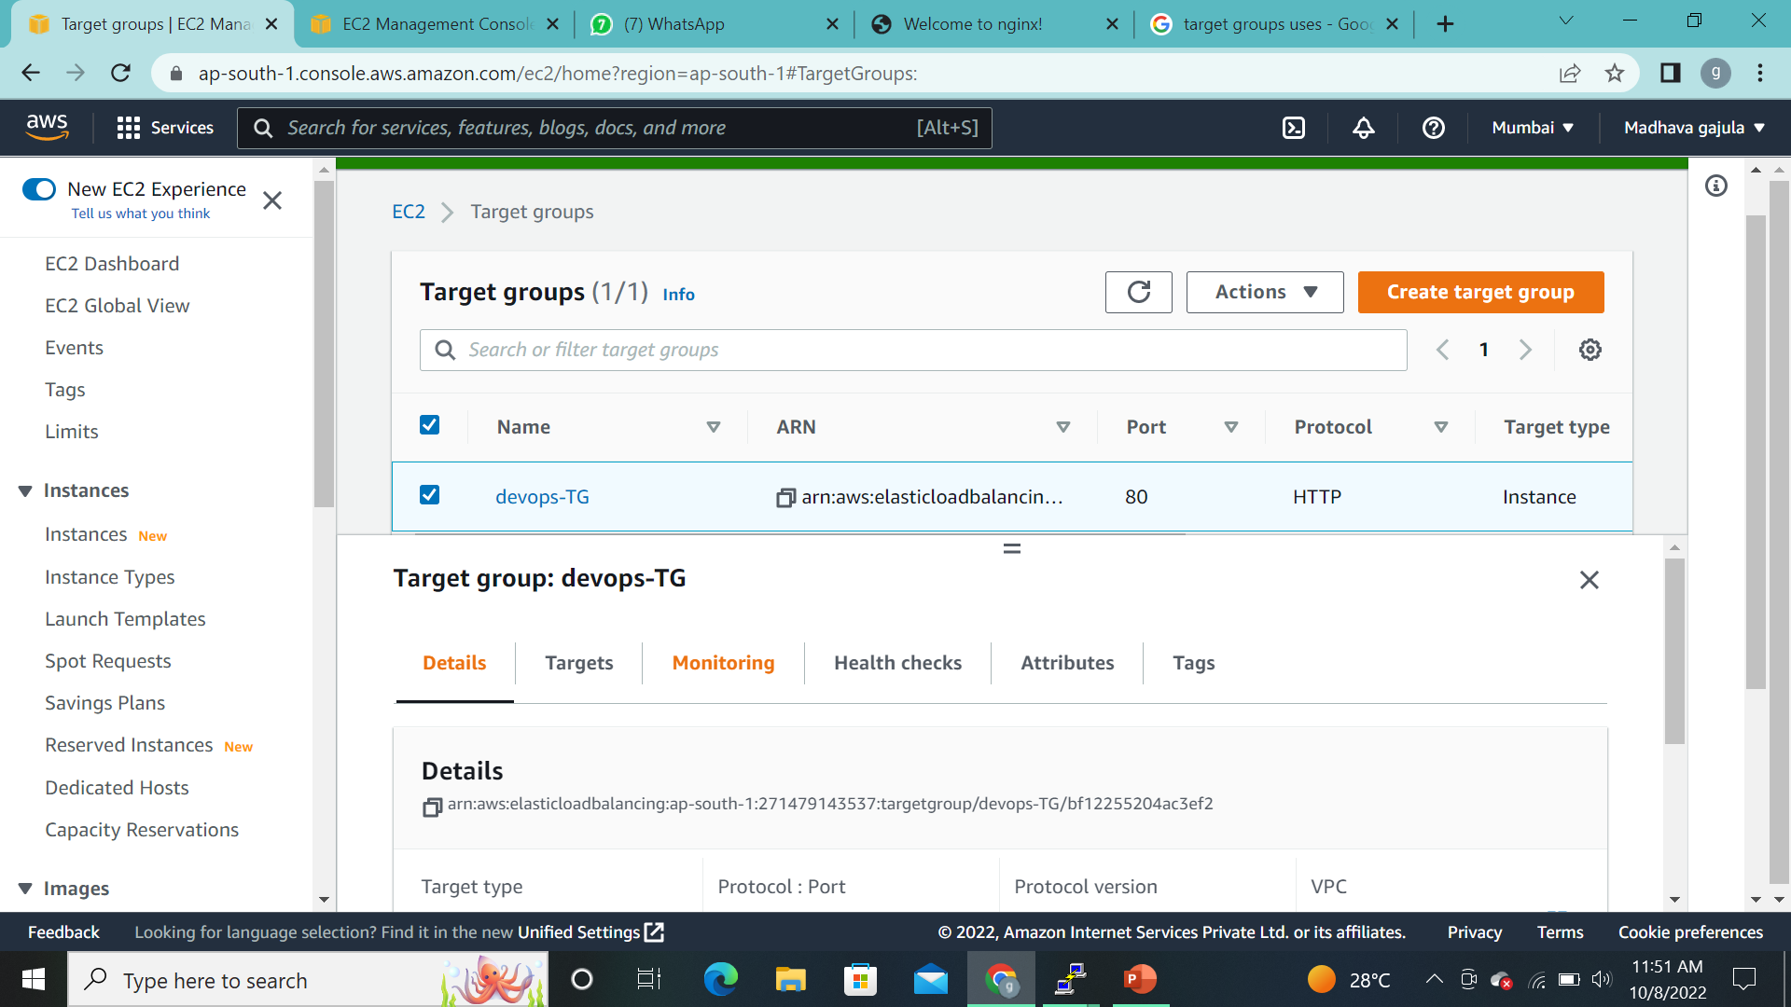
j
And Then we have to create a Target group(Each target group is used to route requests to one or more registered targets. When you create each listener rule, you specify a target group and conditions).

Slide 10
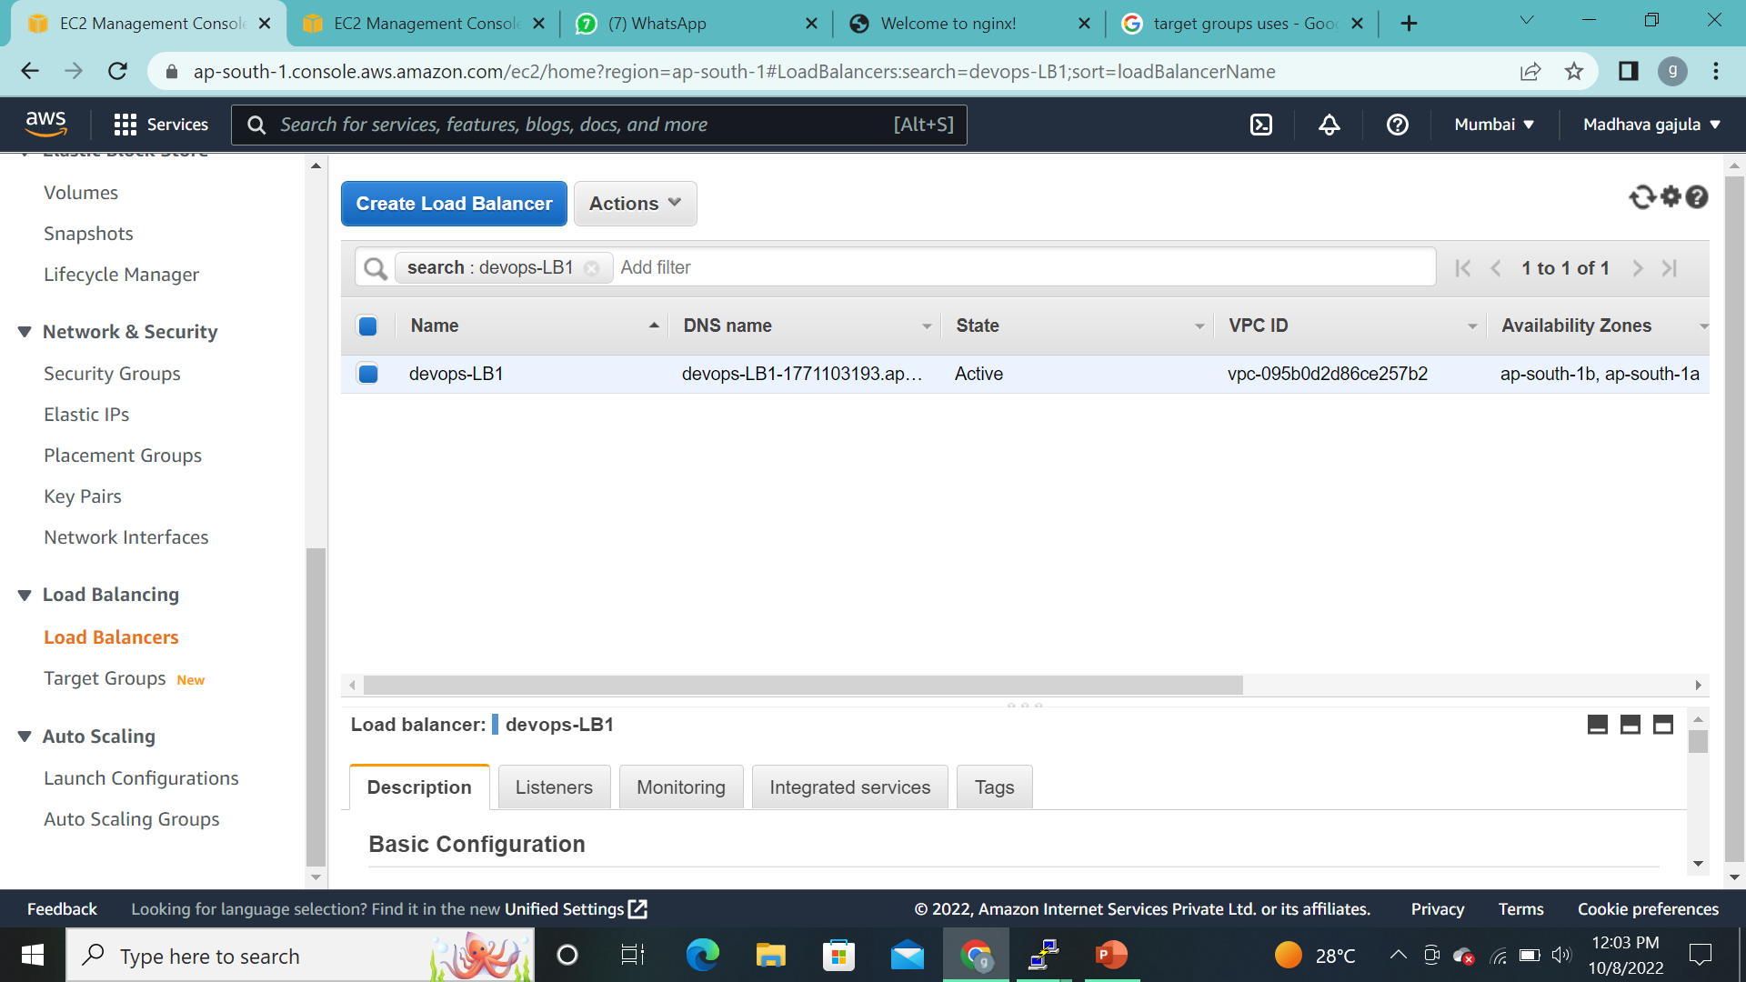
j
After creation of Target Group ,we need to create Load Balancer for adding the Target group .

Slide 11
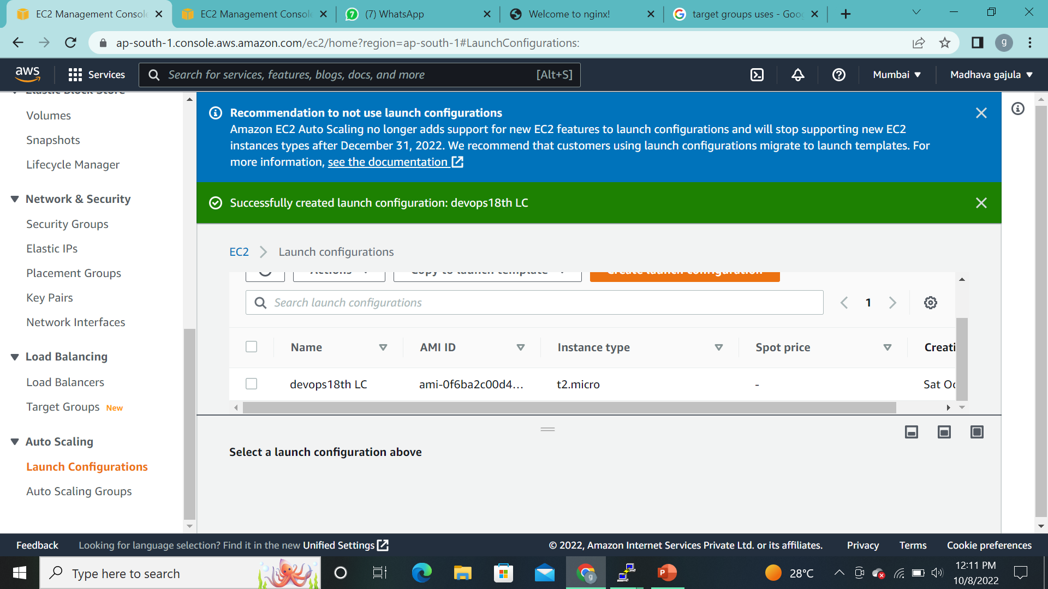
j
By using image,we have to create the Launch configuration of instance.
(Launch configuration :-we should to confirm if we want to use existing instance or new instance).

Slide 12
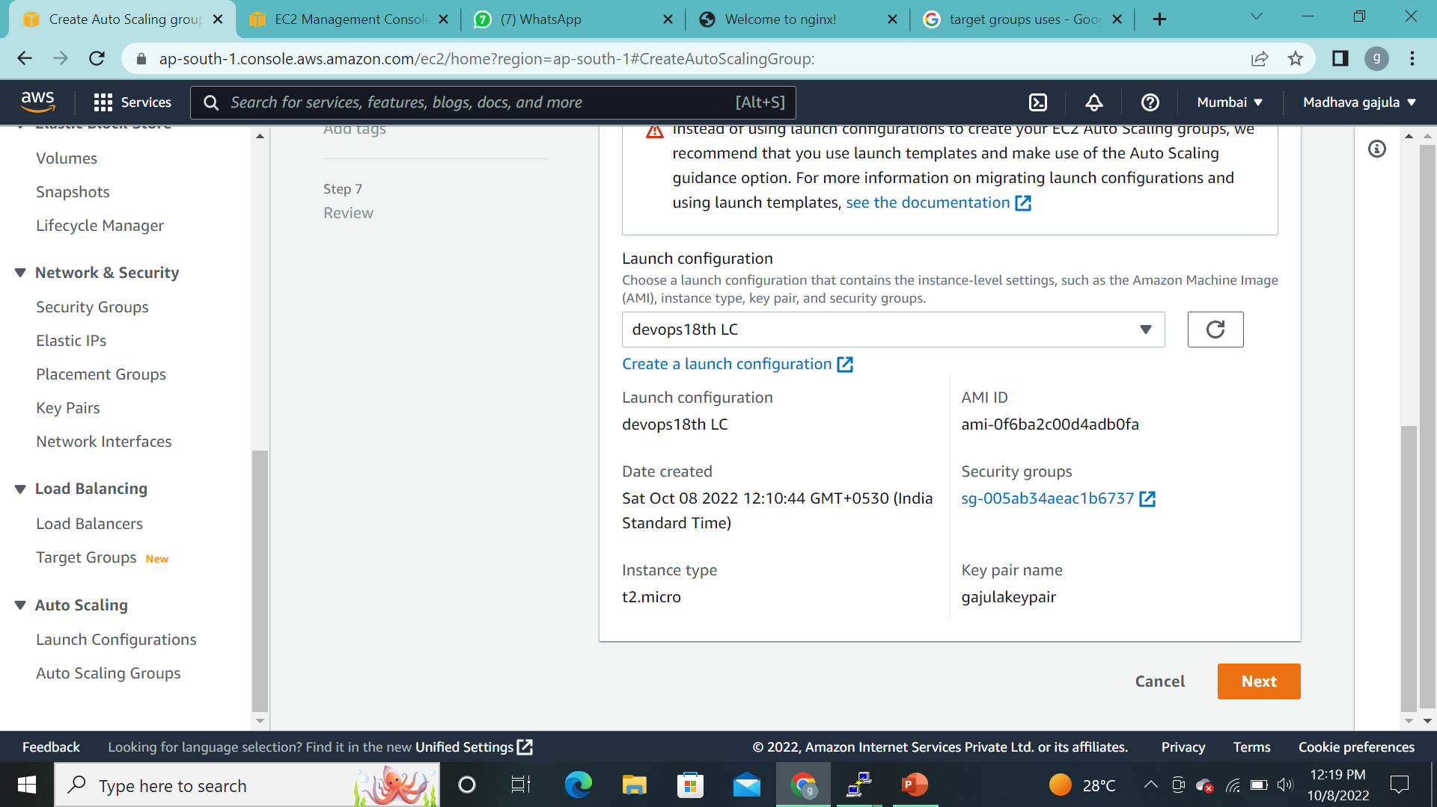
j
And,finally we have to create an Auto Scalling Group.
Step1:-Here we’re adding Launch configuration.

Slide 13
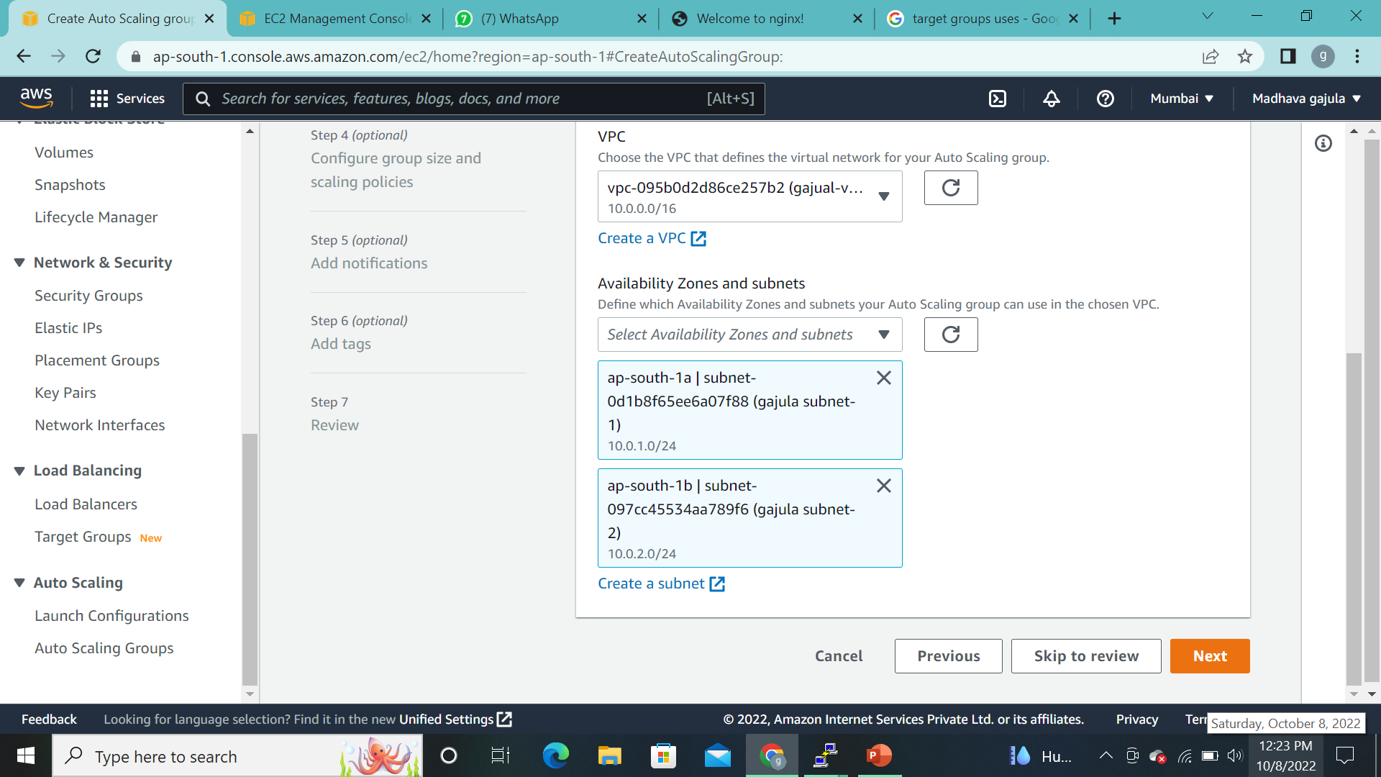
j
STEP2:-CHOOSE INSTANCE LAUNCH OPERTION:
(Here we’re adding VPC & SUBNETS)

Slide 14
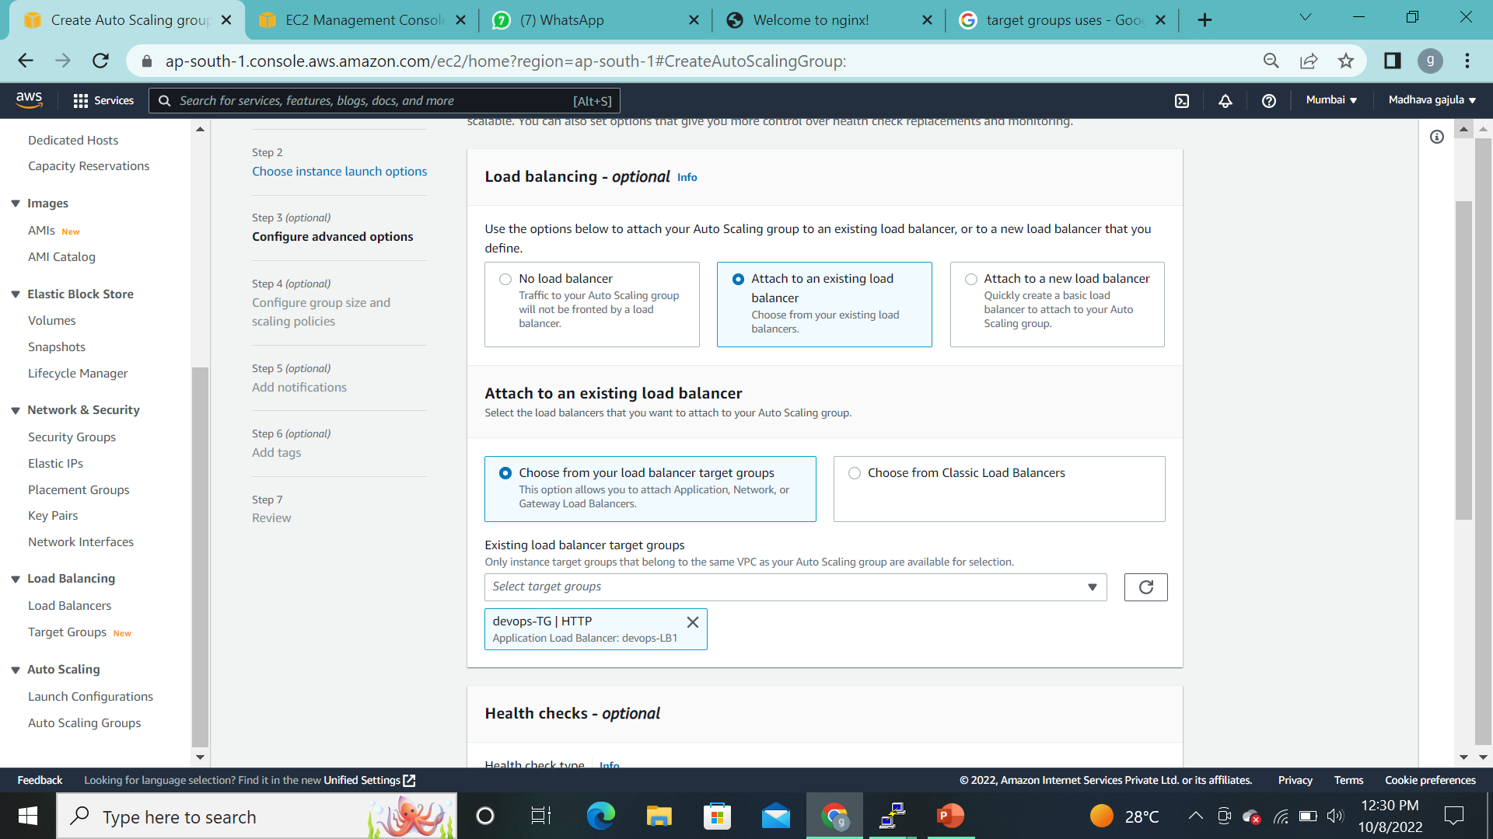
j
STEP3:-CONFIGURE ADVANCED OPERTION:
(Here we’re attached existing Load Balancer & Target group)

Slide 15
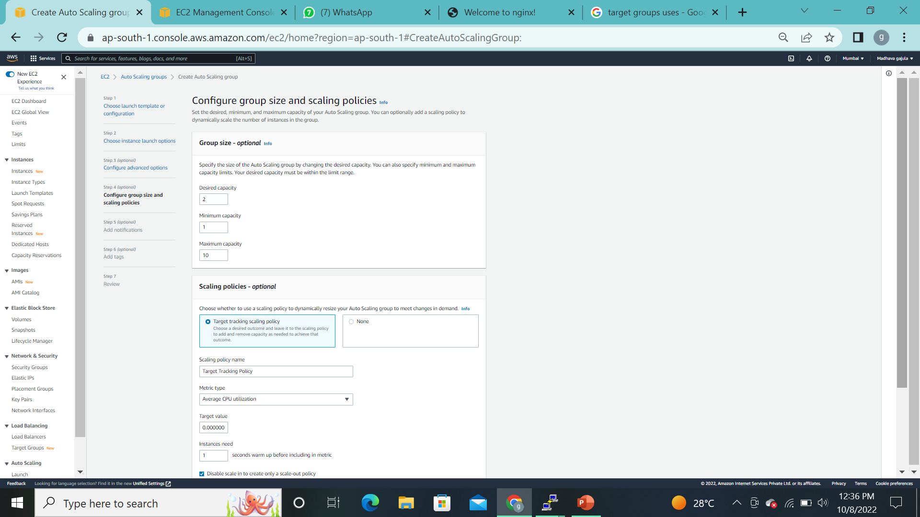
j
STEP 4:-CONFIGURE GROUP SIZE & SCALE POLICY
(here we’re adding desired capacity(min n max),Scalling policy(target value & instances need)

Slide 16
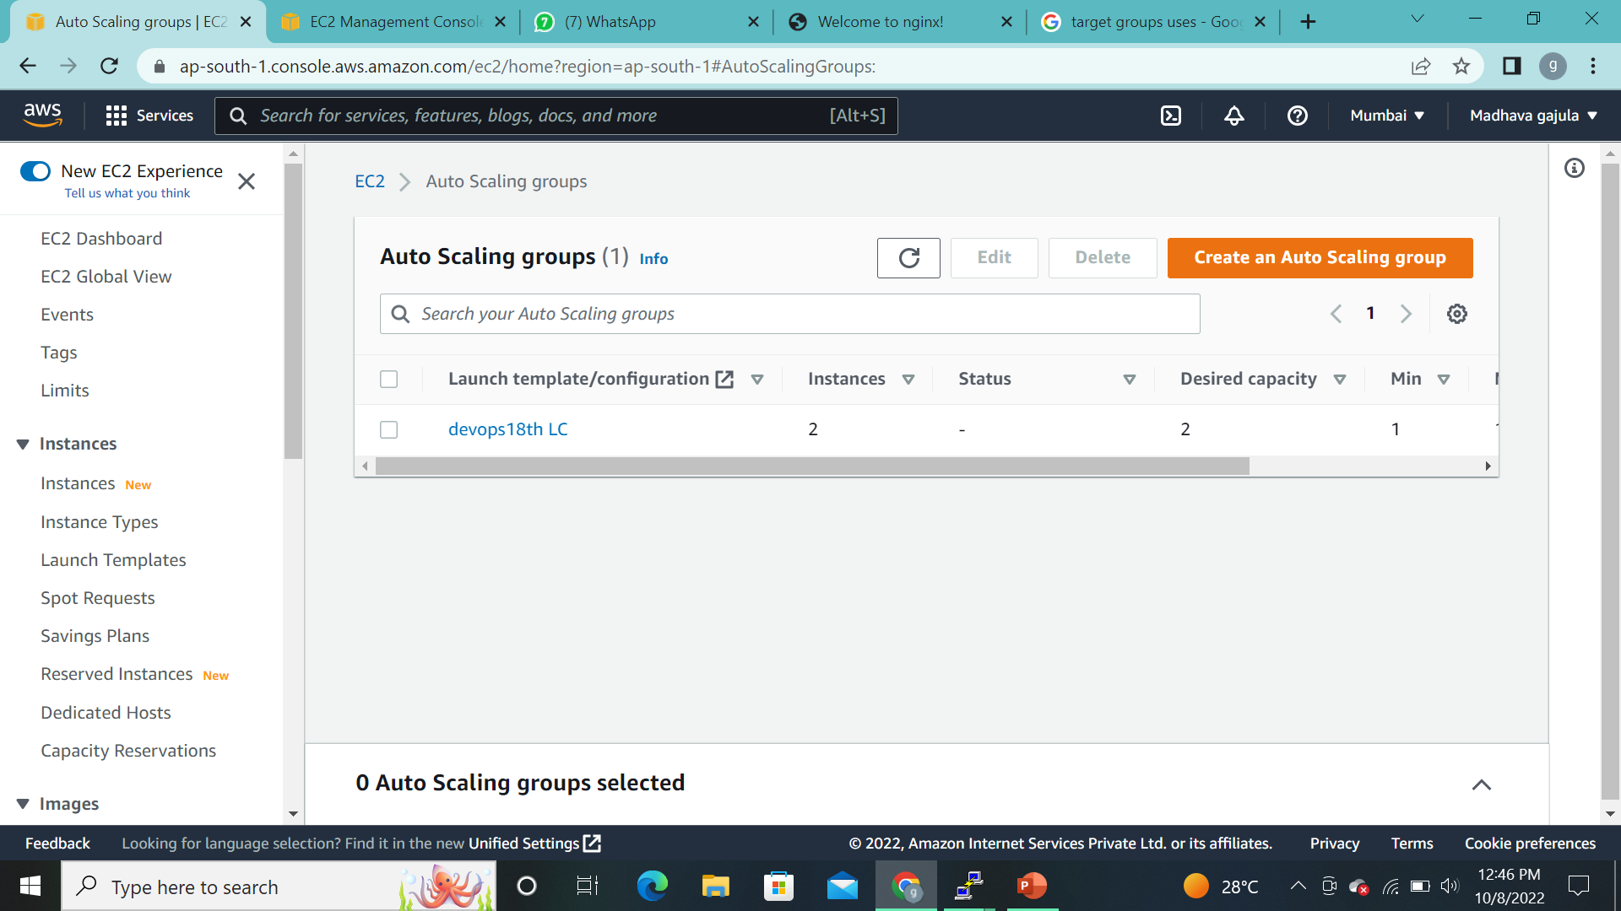
j
Final step is to create Auto Scalling (Review and Launch)

Slide 17
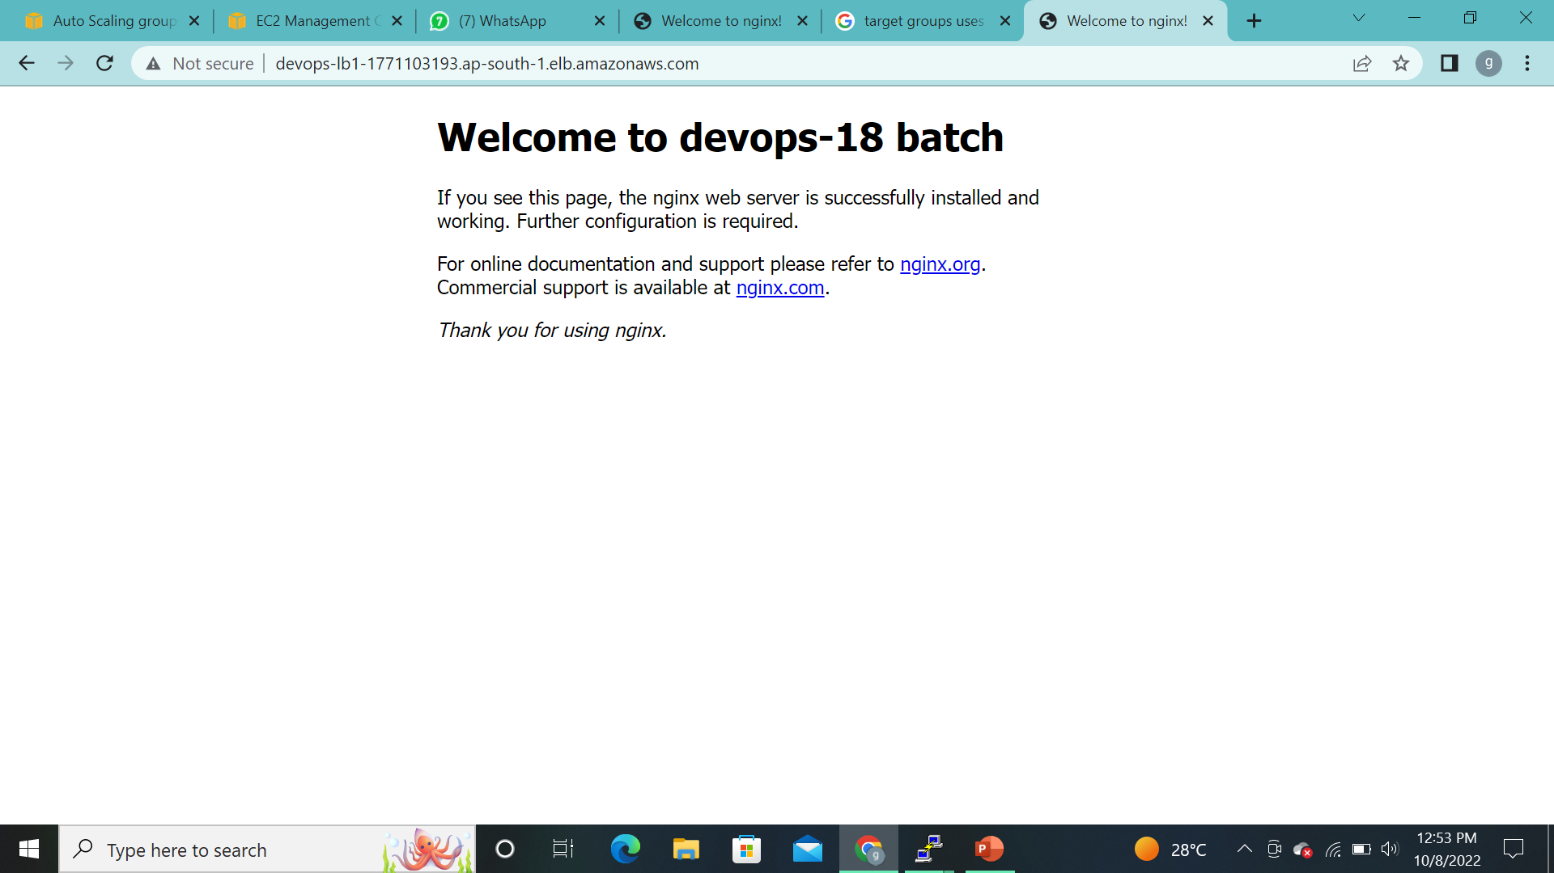
j
Here we have to take a DNS copy on load balancer and browse it.It’ll display like this.

Slide 18
j
THANK YOU.

