Slide 1
Battle of The Neighborhoods
Find the most Asian-friendly neighborhoods in Toronto
Madhava Narendran R

Slide 2
Introduction
Business Problem: As an Asian who is planning to move to Toronto from another city, how can I find the most Asian-friendly neighborhoods to settle down in Toronto?
Interest: Asians who are planning to move to Toronto but are not familiar with Toronto.

Slide 3
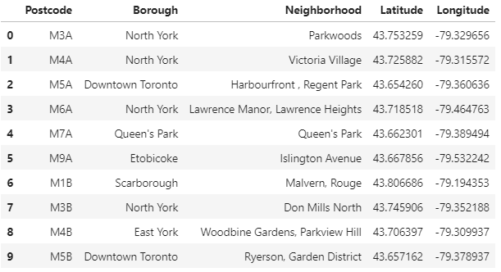
Data Source
Postcode, Borough and Neighborhood information of Toronto is retrieved from Wikipedia

Slide 4
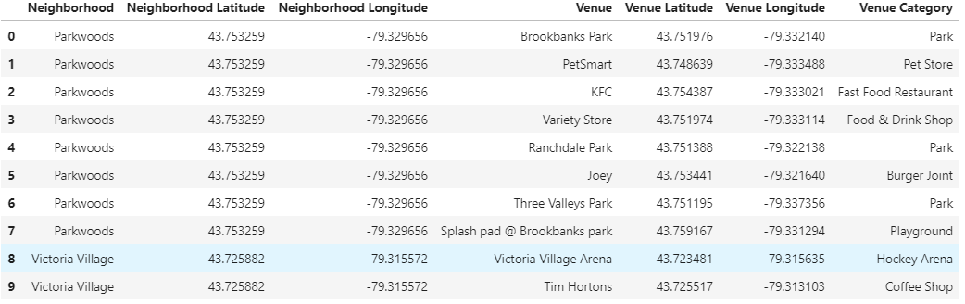
Data Source
Venues information of Toronto is retrieved from FourSquare

Slide 5
Methodology
Use k-means algorithm to cluster the neighborhoods based on 1) ratio of Asian Restaurant among all venue categories, and 2) top 5 venue categories in each neighborhood.

Slide 6
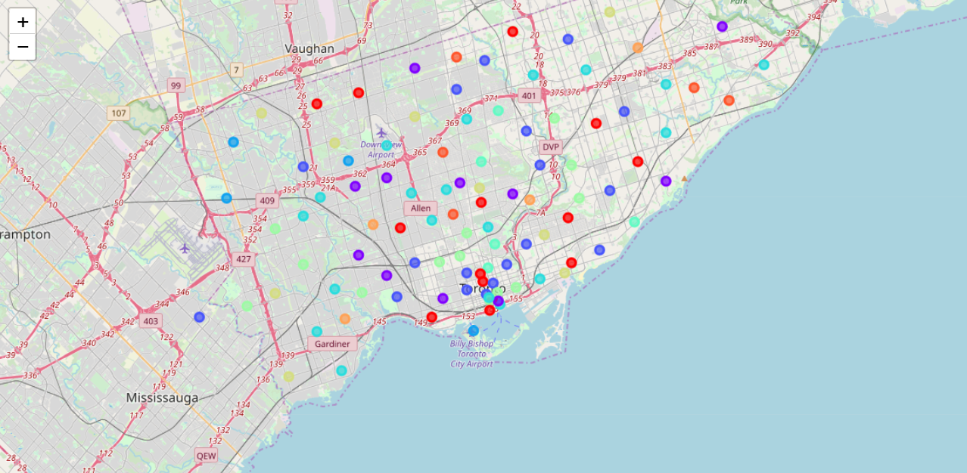
Result and Conclusion
Based on the data of the clustered neighborhoods, Cluster 7 (the yellow dots in the map above) has the most Asian-friendly neighborhoods. I will settle down in one of the neighborhoods in that cluster.

