Slide 1

CS3503 – Machine Learning PBL
Project Review
Solar Flare Prediction & Space Weather Alert System
Forecasting major (M/X-class) flares 24 hours ahead from solar magnetic-field data
Presentation by
Madhavan G (2104251040518)
Sriram Sivakumar (2104251040971)
B.E. Computer Science and Engineering
Mentor
Ms Poornima Lakshmi
Mentor & Project Coordinator
Dept. of Computer Science and Engineering

Slide 2
Problem & Objectives
Problem Statement
A major solar flare releases in minutes the energy of billions of tonnes of TNT. The radiation reaches Earth in about eight minutes and disrupts HF radio and aviation communication, degrades GPS accuracy, damages satellite electronics and can induce currents that destabilise power grids.
Satellite operators, polar-route airlines, power utilities and space agencies are all affected, and once an eruption is visible it is already too late to act.
The magnetic field of a solar active region, however, changes measurably in the hours before it erupts. The question this project asks is whether that change can be learned from historical observations and turned into a usable 24-hour advance warning.
Objective
• Identify the magnetic-field signatures that precede major flares, using SDO/HMI SHARP parameters from the SWAN-SF benchmark.
• Develop a leakage-safe pipeline that turns a 12-hour observation window into a 24-hour forecast.
• Apply and compare Logistic Regression and Random Forest across two feature iterations, selecting on validation data only.
• Evaluate on a locked test partition, scored once, using imbalance-aware metrics (TSS, PR-AUC, HSS2) rather than accuracy.
Expected Outcome
A machine-learning system capable of flagging, 24 hours in advance, which solar active regions are likely to produce a major flare.
Delivered as:
• a reproducible codebase that recomputes every published number with one command;
• an interactive web dashboard showing the forecast, the risk level and the exact reason for each decision;
• an honest account of the error rates, with the failures shown rather than hidden.

Slide 3
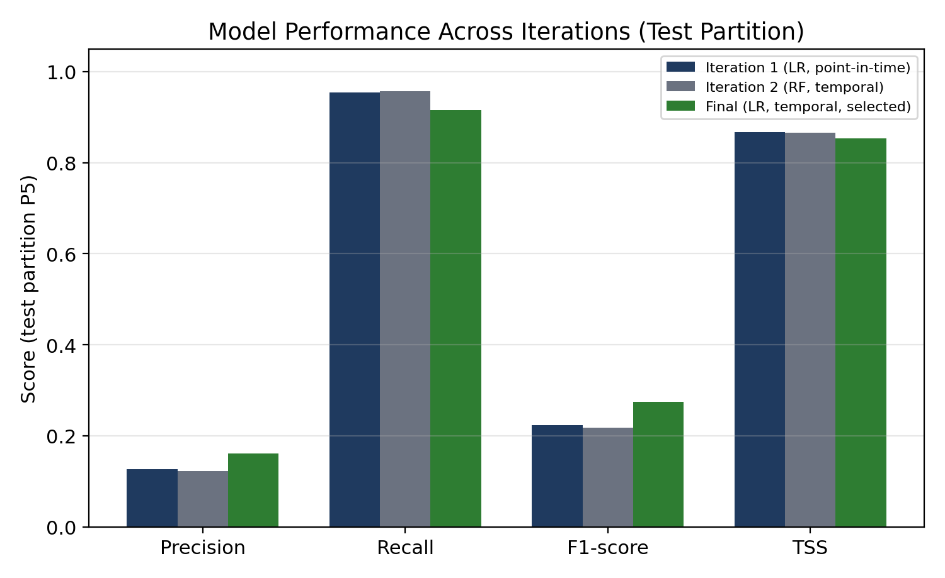
Input, Analysis & Insights
Input / Data Sources
• SWAN-SF v1.2 benchmark, Harvard Dataverse (DOI 10.7910/DVN/EBCFKM).
• 331,185 multivariate time-series windows spanning 2010-05-01 to 2018-08-17.
• Each window: 12 h of SDO/HMI SHARP magnetic parameters at 12-minute cadence — 60 readings × 24 parameters.
• Label y = 1 if a GOES M- or X-class flare begins within the next 24 h.
• Five chronological partitions: P1–P3 train (204,559), P4 validation (51,261), P5 test (75,365).
Analysis / Processing
• 24 parameters × 6 statistics = 144 features per window (mean, sd, min, max, slope, last value).
• Signed-log transform → median imputation → standardisation — all fitted on training data only.
• Partitions are region-disjoint and time-ordered: no window and no active region appears in two splits.
• Class imbalance (1.99 % positive in training) handled with class_weight="balanced" — a 49:1 weighting.
• Thresholds fixed on validation; the test partition was scored once.
Key Insights
• Trend beats snapshot. Adding slope and last-value features lifted validation TSS over point-in-time features alone.
• Accuracy is meaningless here. Only 1.31 % of test windows precede a major flare, so never alerting already scores 98.69 %.
• A constant-climatology baseline scores TSS 0.000 and detects nothing; this model scores TSS 0.853.
• Total unsigned current helicity and free magnetic energy dominate the fitted coefficients — consistent with the physics of flare onset.
Seven candidates were compared; the final model wins on F1 and PR-AUC while holding TSS.

Slide 4
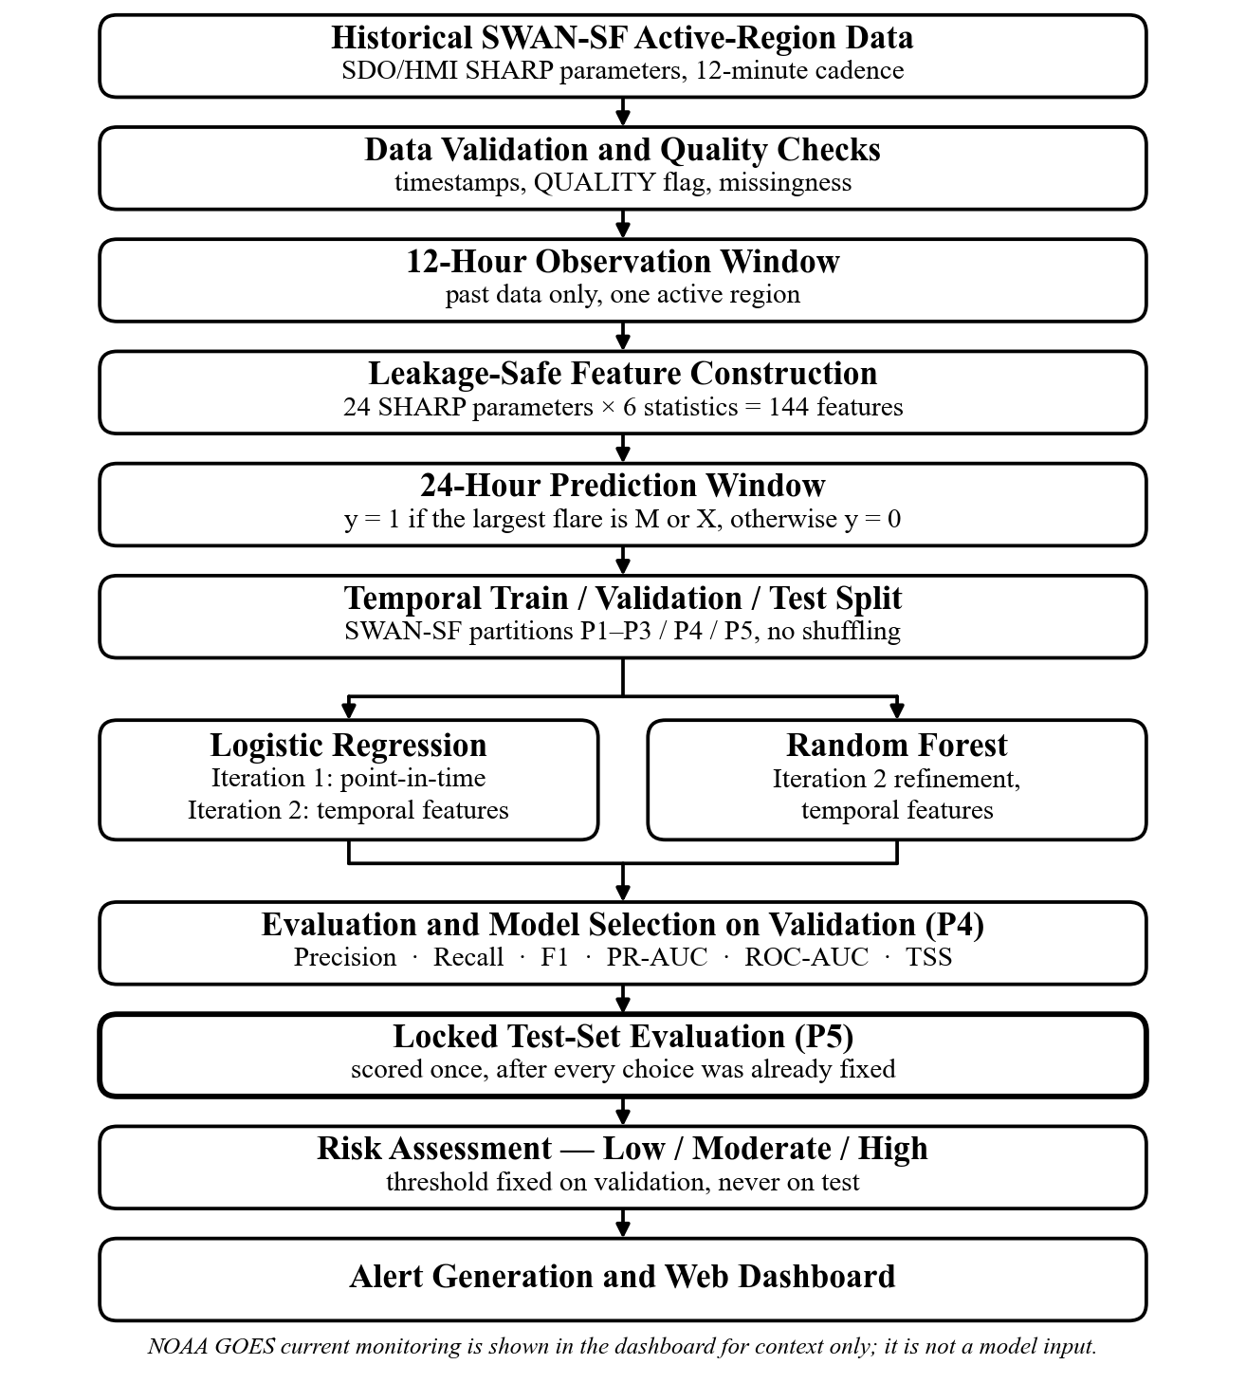
Technical Approach
Architecture
Five stages, end to end:
1. Ingest & validate — SWAN-SF archives, timestamp and QUALITY-flag checks.
2. Window & label — 12 h observation → 24 h prediction horizon, past data only.
3. Feature construction — 144 leakage-safe summary statistics.
4. Train & select — fit on P1–P3, choose on P4 by maximum TSS.
5. Serve — locked P5 evaluation → risk banding → web dashboard.
ML Methodology and Implementation Process
Technology Stack
• Python 3.12 · scikit-learn 1.8.0 · NumPy · pandas · SciPy · joblib · matplotlib
• Pipeline: signed-log → median imputer → StandardScaler → Logistic Regression (L2, class-balanced)
• Dashboard: HTML / CSS / vanilla JavaScript — the fitted model is re-run in the browser and agrees with scikit-learn to 1e-6
• Testing: pytest (202 tests), Playwright headless browser, Ruff + Black
• Reproducibility: one command — python -m solarflare all — running 375 metric checks and 397 consistency checks
Figure 4.1 — implemented end-to-end forecasting architecture.

Slide 5
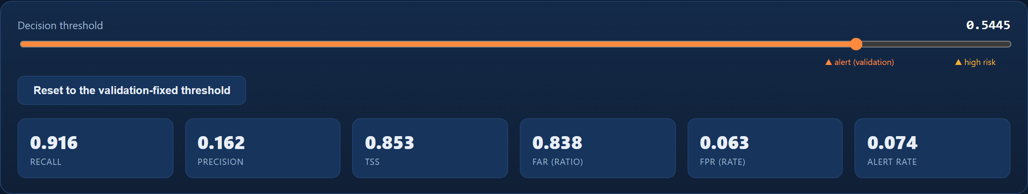
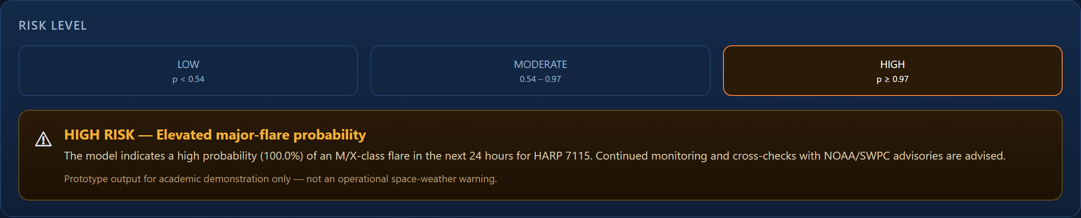
Feasibility, Risk and Challenges
Feasibility
• Data — a public, curated benchmark; no licence barrier and no collection cost.
• Compute — the full pipeline trains in about 15 minutes on a 4-core laptop. No GPU is required.
• Deployment — the model is 144 coefficients, so it runs inside a browser tab with the network switched off.
• Verification — every published number recomputes from the repository in about two minutes.
Risk and Challenges
• Severe class imbalance. Positives are 1.3–2.0 % of windows, so accuracy is misleading and naive training learns to answer “no flare” always.
• Data leakage is the dominant failure mode in flare forecasting: overlapping windows and shuffled splits inflate published results.
• Low precision. At the operating point, 84 % of alerts are not followed by a major flare.
• Outputs are not calibrated probabilities — they rank well but must not be read as literal chances.
• Two raw partition archives (P2, P5) are corrupt gzip streams that fail silently mid-stream rather than raising an error.
• Retraining is not bit-identical across platforms.
Mitigation
• Class weighting plus TSS / PR-AUC / HSS2 reporting, with a climatology baseline for context, instead of accuracy.
• Region-disjoint chronological splits, preprocessing fitted on train only, thresholds from validation only — enforced by 21 automated leakage tests.
• Precision is published rather than hidden, and an operating-point view exposes the trade-off. 78 % of the false alarms did precede a real B- or C-class flare.
• Archive integrity is verified before extraction; frozen artefacts are committed and write-protected in code.
Moving the threshold shows what each choice costs.
An uncalibrated probability is delivered as a three-level band.

Slide 6
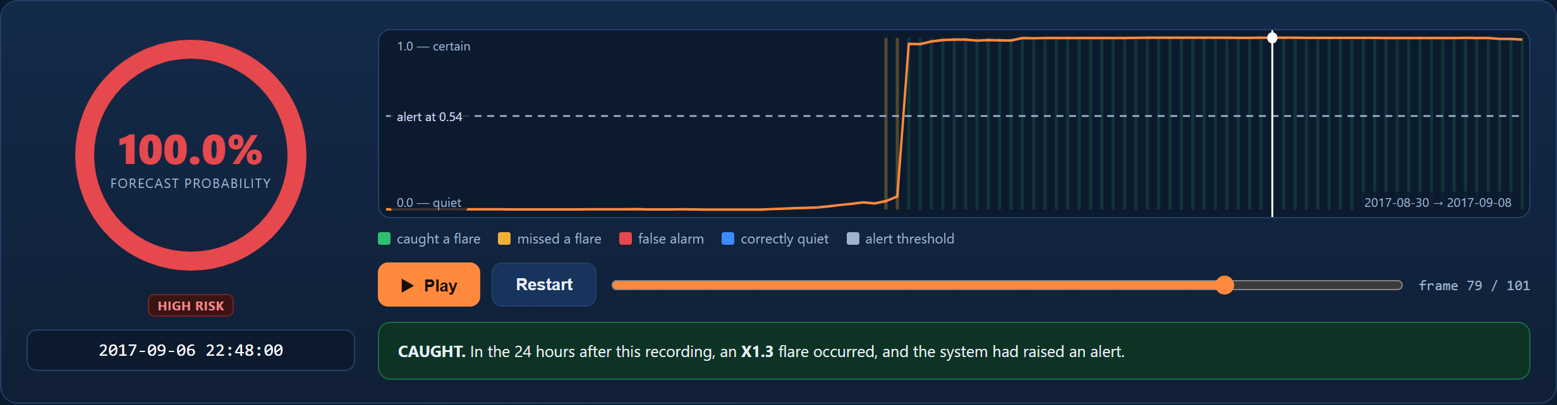
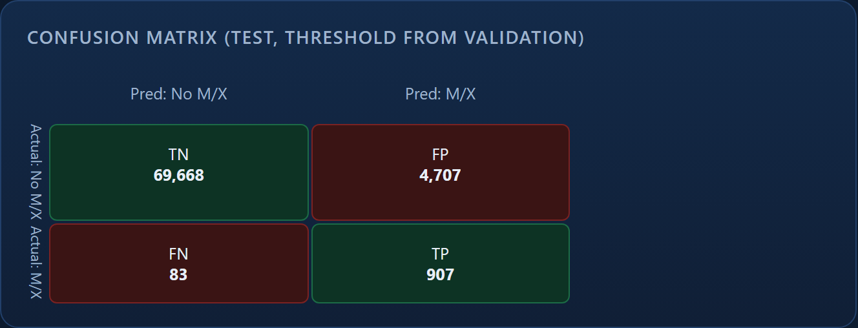
Result and Applications
Project Output — interactive dashboard, evaluated on 75,365 unseen windows
Replay of a real active region (HARP 7115, September 2017): the forecast crosses the alert threshold and stays high through the X1.3 flare.
Confusion matrix on the locked test partition.
907 of 990 flare-producing windows were caught (recall 0.916, 95 % CI 0.812–0.976), including 19 of 19 X-class windows, at a false-alarm rate of 0.063. Precision is 0.162 — shown, not hidden.
Applications
Satellite operations (safe-mode and manoeuvre scheduling) · Polar-route aviation (HF-radio and radiation planning) · Power-grid readiness against geomagnetically induced currents · Launch and spacewalk scheduling · Space-agency situational awareness · A teaching benchmark for severely imbalanced time-series forecasting.

Slide 7
Conclusion, Limitations & Future Scope
Conclusion
We developed a leakage-safe machine-learning pipeline using SWAN-SF SHARP magnetic-field parameters to forecast major (M/X-class) solar flares 24 hours in advance. Seven candidate models were trained on 204,559 windows and compared on a separate validation partition; the selected model — L2-regularised Logistic Regression on temporal features — was then scored once on 75,365 windows it had never seen.
It achieved a True Skill Statistic of 0.853 (95 % CI 0.751–0.915), detecting 907 of 990 flare-producing windows — 91.6 % recall, and all 19 X-class windows — at a false-alarm rate of 0.063 and ROC-AUC 0.979.
Every published number recomputes from the repository with a single command, and the project ships an interactive dashboard that runs the real trained model in the browser.
Limitations
• Precision is 0.162 — 84 % of alerts are not followed by an M/X flare (though 78 % do precede a smaller B/C flare).
• Outputs rank well but are not calibrated — they are not literal chances.
• One instrument, one span: SDO/HMI, 2010–2018. No validation beyond 2018 or on other instruments.
• Only 19 X-class windows in the test set, so that recall carries a wide interval.
• Two raw archives are corrupt; results rest on the previously extracted features.
• From-scratch retraining is not bit-reproducible across platforms.
Future Scope
• Probability calibration on a held-out year, so the output can be read as a genuine chance.
• Sequence models (LSTM / Transformer) on the raw 60-step series instead of summary statistics.
• Extend to solar cycle 25 (2019–present) and to other magnetograph instruments.
• Add magnetogram imagery alongside the scalar SHARP parameters.
• Cost-sensitive thresholds per user — a satellite operator and a power utility do not pay the same price for a miss.
• Ingest a live SHARP feed to move from prototype toward an operational service.

Slide 8




Project Video Link
<paste the drive / YouTube URL of the voice-over demo here>
GitHub Repository Link
https://github.com/Madhavan777/Solar-Flare-Prediction-System-Weather
Madhavan G · Sriram Sivakumar
B.E. Computer Science and Engineering
Scan for the repository
GitHub Repository

