Slide 1



SMART INDIA HACKATHON 2026
Eva
•Problem Statement ID – SIH26108
•Problem Statement Title - AI-Powered Recommendation Engine for Applicable Indian Standards.
•Theme - Smart Automation.
•Problem Statement Category – Software.
•Team ID -
•Team Name - Eva

Slide 2



IDEA TITLE
Eva
Proposed Solution :
AI-powered system that analyses a product description and recommends the most relevant Indian Standards automatically.
Addresses The Problem :
Reduces the time and effort required to manually search through thousands of Indian Standards and identify applicable ones.
Innovation :
Uses AI and semantic understanding to provide context-based recommendations, even when the user doesn't know the exact standard number.
SIH26108
SIH26108

Slide 3
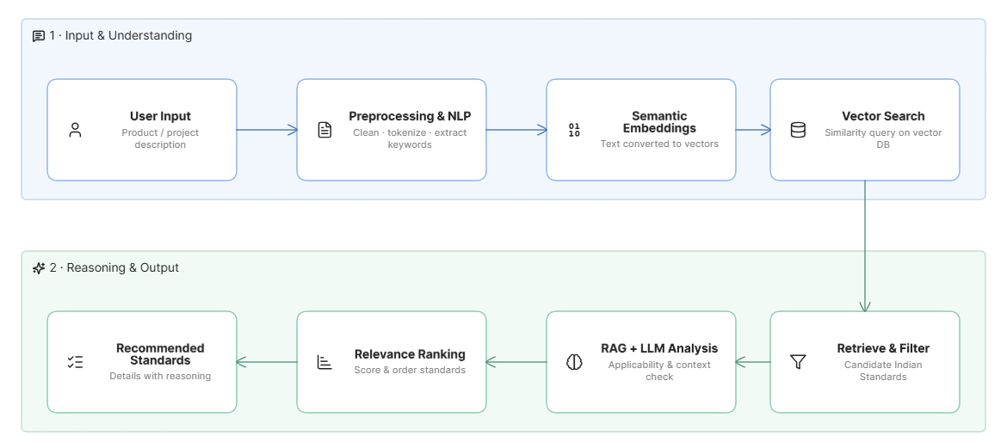
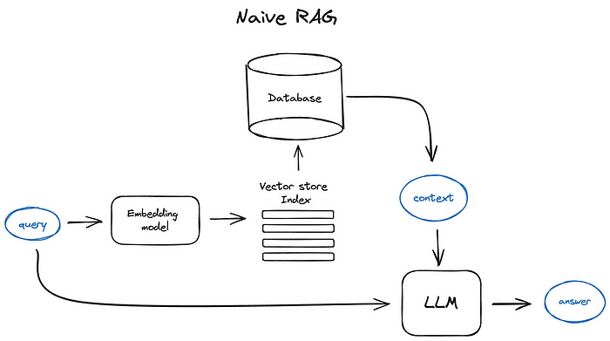
TECHNICAL APPROACH
Eva
Technologies :
Python
React.js
Fast-API
Olama 3.2 3B LLM
Local RAG Pipeline
Vector Database
Embeddings
Multi-Language NLP
Methodology

Slide 4


FEASIBILITY AND VIABILITY
Eva
Analysis Of The Feasibility Of The Idea :
Uses scalable AI and web technologies with readily available standards data, making the solution technically and economically feasible.
Potential Challenges And Risks :
Data quality, incomplete standards information, AI-generated inaccuracies, and keeping standards up to date.
Strategies For Overcoming These Challenges :
Use verified BIS sources, regular data updates, RAG-based validation, relevance scoring, and human verification for critical recommendations.

Slide 5



IMPACT AND BENEFITS
Eva
Potential impact on the target audience :
Enables industries, manufacturers, engineers and researchers to quickly identify applicable Indian Standards, reducing manual effort and search time.
Benefits of the solution :
Improves compliance, reduces costs and errors, supports faster product development, and promotes standardized and sustainable practices.

Slide 6
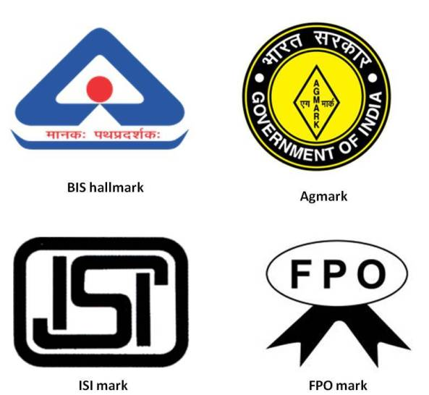
RESEARCH AND REFERENCES
Eva
Bureau of Indian Standards —
Official Standards Portal
BIS Standards Portal
Know Your Standard —
Search standards by IS number/keyword
BIS Know Your Standard
BIS –
Compendium of Indian Standards
BIS Compendium of Indian Standards
RAG for Large Language Models –
Research Survey
RAG Research Paper
Retrieval-Augmented Generation –
Research Survey
RAG Survey
Indian Standards –
Standardization Research Papers
Bureau of Indian Standards

