Slide 1

CAPSTONE PROJECT I
Mutual Fund Analytics
An End-to-End Data Analytics Platform for Fund Performance, Risk & Investor Behaviour Analysis
40
10
46,000+
32,778
Schemes
Fund Houses
NAV Records
Transactions

Slide 2




Problem Statement
Raw performance figures rarely tell the full story
Fragmented Data
No Risk-Adjusted View
Fund master, NAV, AUM, SIP inflows, transactions and holdings arrive as ten disconnected raw files with no common relational structure.
Raw returns alone don't reveal whether performance came with excessive volatility, concentration, or drawdown risk.
Investor Behaviour Blind Spot
No Consolidated Reporting
SIP discontinuation, irregular contribution gaps and cohort patterns are invisible from raw transaction logs.
There is no single dashboard for stakeholders to explore fund performance, investor analytics and market trends together.
Mutual Fund Analytics | Capstone Project I
2

Slide 3





Objectives
What this Capstone Project set out to deliver
01
02
03
Ingest & Validate
Clean & Standardize
Design a Star Schema
Ten raw mutual fund datasets — fund master, NAV, AUM, SIP inflows, transactions, holdings & benchmarks.
Handle missing values, duplicates, and inconsistent types; persist analysis-ready outputs.
A normalized SQLite database — one fund dimension plus four fact tables.
04
05
06
Explore the Data
Compute Performance Metrics
Advanced & Dashboard Layer
EDA across fund categories, risk bands, fund houses, NAV trends & transaction patterns.
CAGR, Sharpe, Sortino, Alpha, Beta, Max Drawdown and a composite Fund Scorecard.
VaR/CVaR, rolling Sharpe, HHI, cohorts, SIP risk-flagging, recommender & a Power BI dashboard.
Mutual Fund Analytics | Capstone Project I
3

Slide 4
Dataset Overview
The Bluestock Mutual Fund dataset — 10 CSV files simulating real-world industry data
40
46,000+
32,778
12
Schemes / 10 Fund Houses
NAV History Records
Investor Transactions
Sub-Categories Covered
Dataset File | Key Fields | Description
01_fund_master.csv | amfi_code, fund_house, category, risk_category | Master reference data for all 40 schemes across 10 fund houses
02_nav_history.csv | amfi_code, nav_date, nav | Historical daily NAV records used for return & risk computation
07_scheme_performance.csv | returns, alpha, beta, sharpe, sortino | Pre-computed performance & risk indicators per scheme
08_investor_transactions.csv | investor_id, type, amount, state, age_group | 32,778 SIP / Lumpsum / Redemption transactions with demographics
09_portfolio_holdings.csv | amfi_code, stock_name, sector, weight_pct | Underlying holdings per scheme, used for HHI concentration
10_benchmark_indices.csv | index_name, index_date, index_value | Daily NIFTY index values used for Alpha/Beta & tracking error
Mutual Fund Analytics | Capstone Project I
4

Slide 5

ETL Pipeline
Raw CSVs → cleaned data → SQLite star schema, orchestrated end-to-end by scripts/etl_pipeline.py
Extract
Transform
Load
Compute
Visualize
Raw CSVs +
live_nav API
Clean, type-cast,
de-duplicate
SQLite star
schema
Performance &
risk metrics
Power BI
dashboard
Post-Load Verification — Lossless ETL Run
40 rows
46,000 rows
32,778 rows
40 rows
90 rows
dim_fund
fact_nav
fact_transactions
fact_performance
fact_aum
Cleaning scripts: clean_nav_history.py → clean_transactions.py → clean_scheme_performance.py → load_to_sqlite.py → “ETL Pipeline Completed Successfully!”
Mutual Fund Analytics | Capstone Project I
5

Slide 6
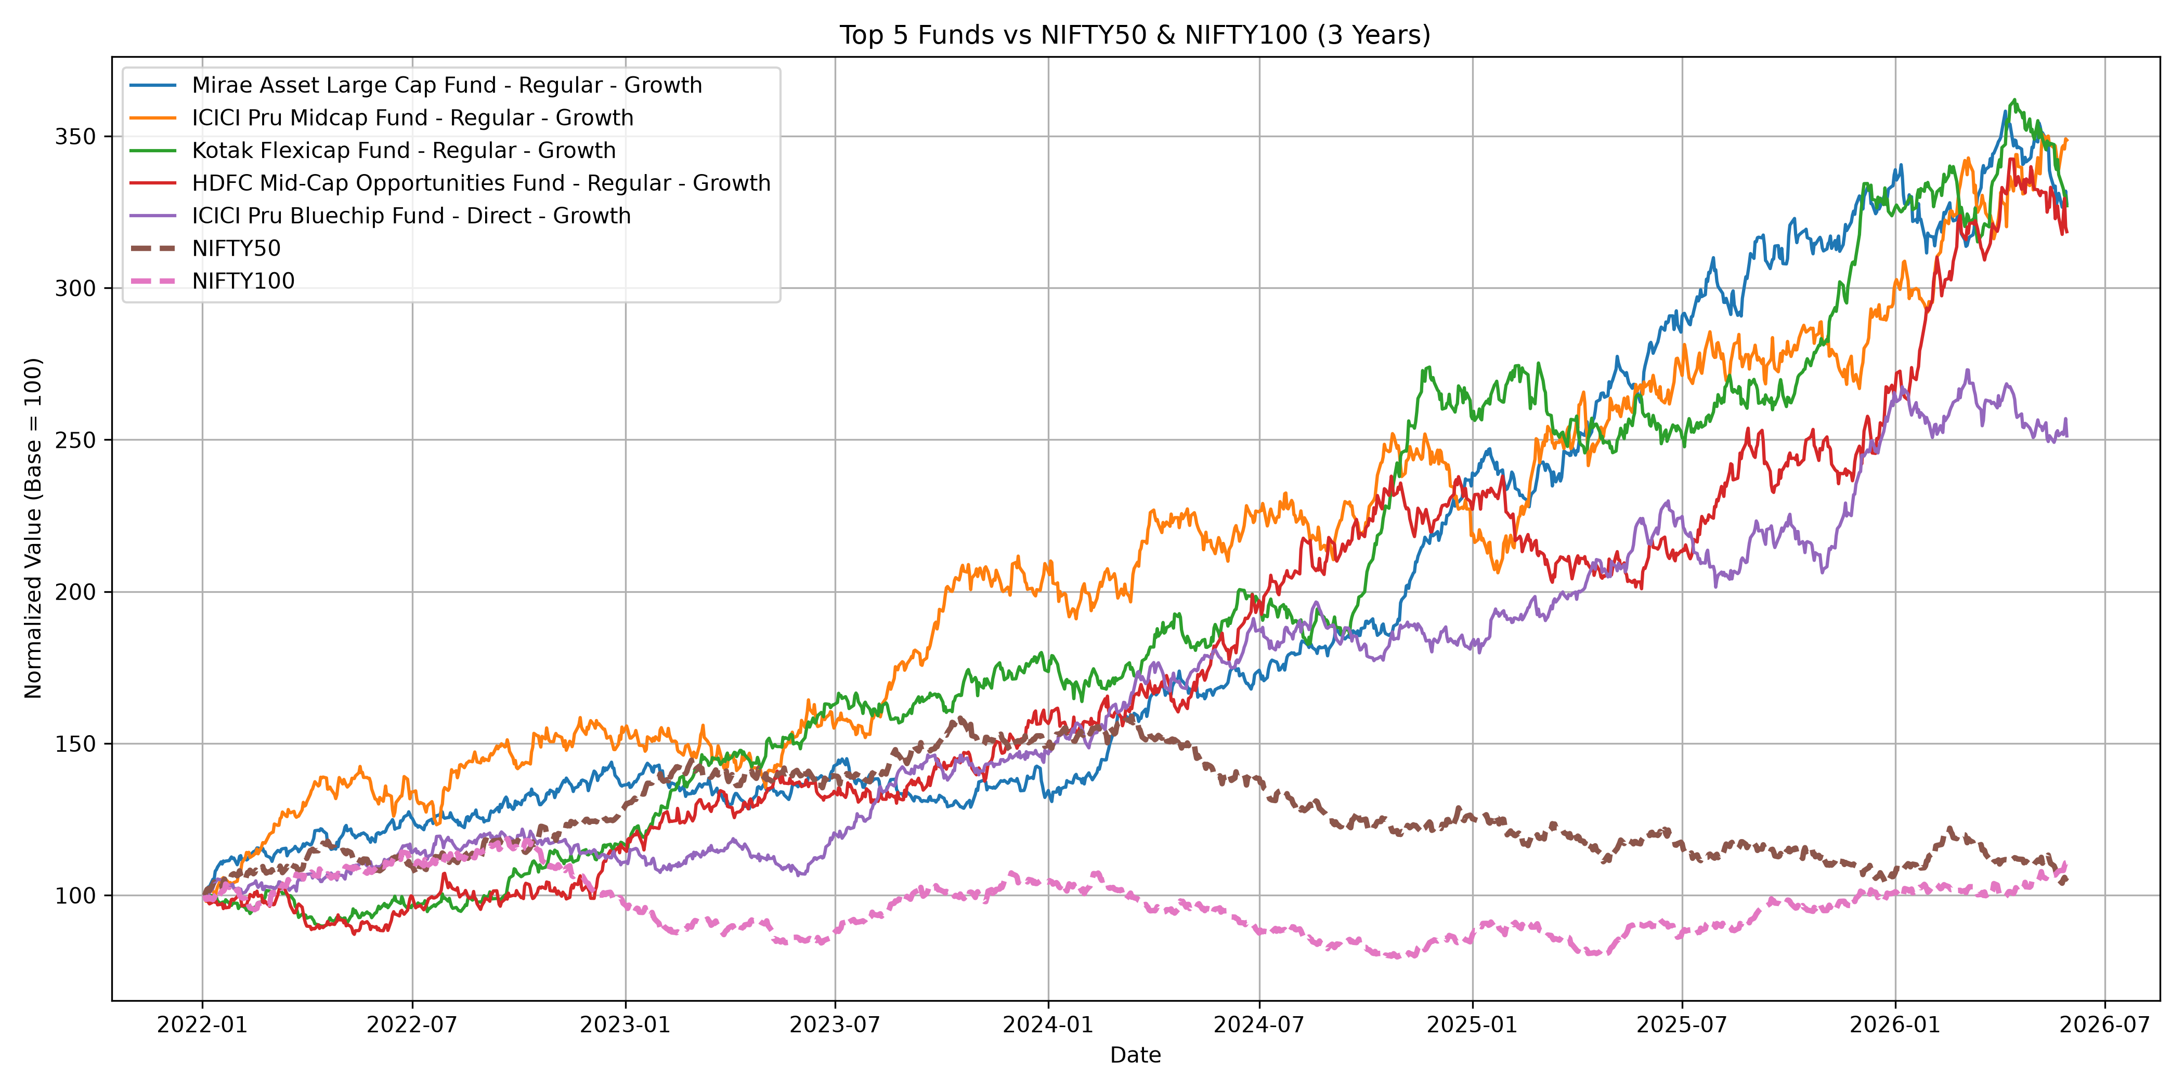
Performance Metrics
Standard return & risk-adjusted metrics computed for all 40 schemes
Metrics Computed
Daily Returns — base series for all risk metrics
CAGR — compound annual growth rate
Sharpe Ratio — return per unit of total volatility
Sortino Ratio — return per unit of downside risk
Alpha & Beta — vs. NIFTY benchmarks
Maximum Drawdown — worst peak-to-trough loss
Fund Scorecard — Top Ranked
Fig: Fund NAV growth vs. benchmark index (benchmark_comparison.py)
Fund | Score | CAGR | Sharpe
Mirae Asset Large Cap | 100.00 | 34.00% | 1.4483
ICICI Pru Midcap Fund | 94.44 | — | —
Kotak Flexicap Fund | 94.09 | — | —
Composite scoring — blending CAGR, Sharpe, Alpha, expense ratio & drawdown — reorders the leaderboard vs. raw returns alone.
Mutual Fund Analytics | Capstone Project I
6

Slide 7
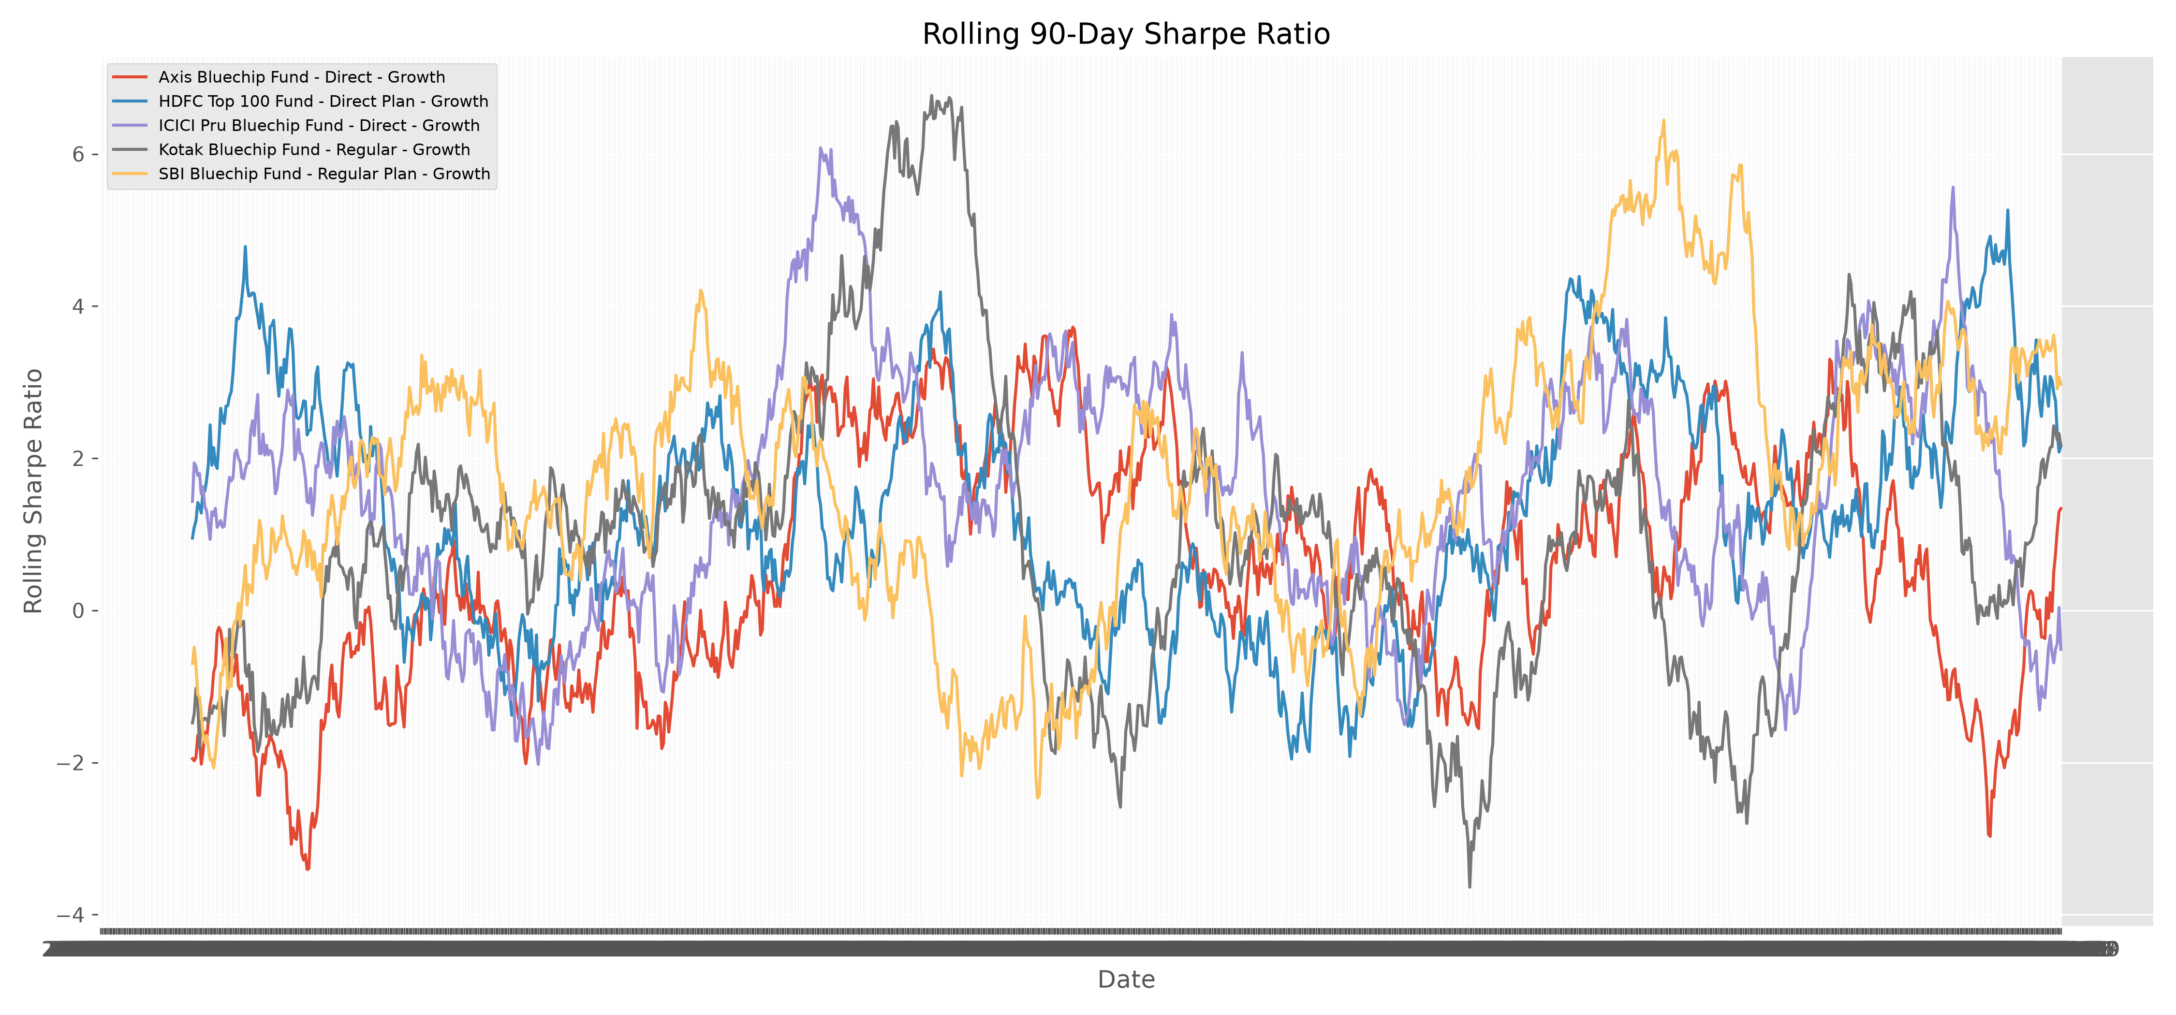
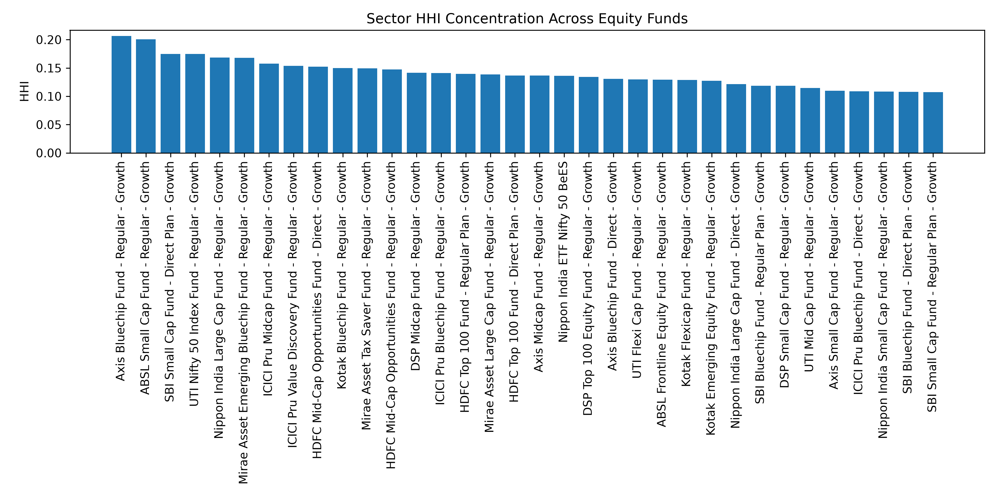
Advanced Analytics
Six deeper, risk- and behaviour-aware analyses beyond standard metrics
Historical VaR (95%) — Highest Risk
Scheme | VaR | CVaR
SBI Small Cap – Direct | -2.69% | -3.24%
Axis Small Cap – Regular | -2.62% | -3.17%
ABSL Small Cap – Regular | -2.60% | -3.25%
Nippon Small Cap – Reg. | -2.54% | -3.23%
Fig: Rolling 90-Day Sharpe Ratio — five key funds
98%
of frequent SIP investors (1,332 of 1,362) flagged
“At Risk” of discontinuation (avg. gap > 35 days)
Sector HHI: Axis Bluechip (0.206) & ABSL Small Cap (0.201) most concentrated
Recommender: filters by risk appetite, ranks by Sharpe Ratio, returns top 3 funds
Investor cohorts analyzed by first-transaction year for SIP amount & fund preference
Fig: Sector HHI concentration across equity schemes
Mutual Fund Analytics | Capstone Project I
7

Slide 8
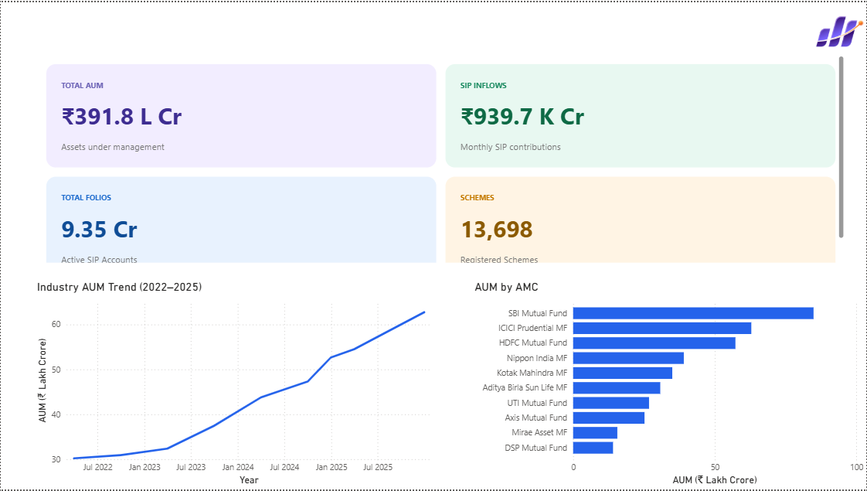
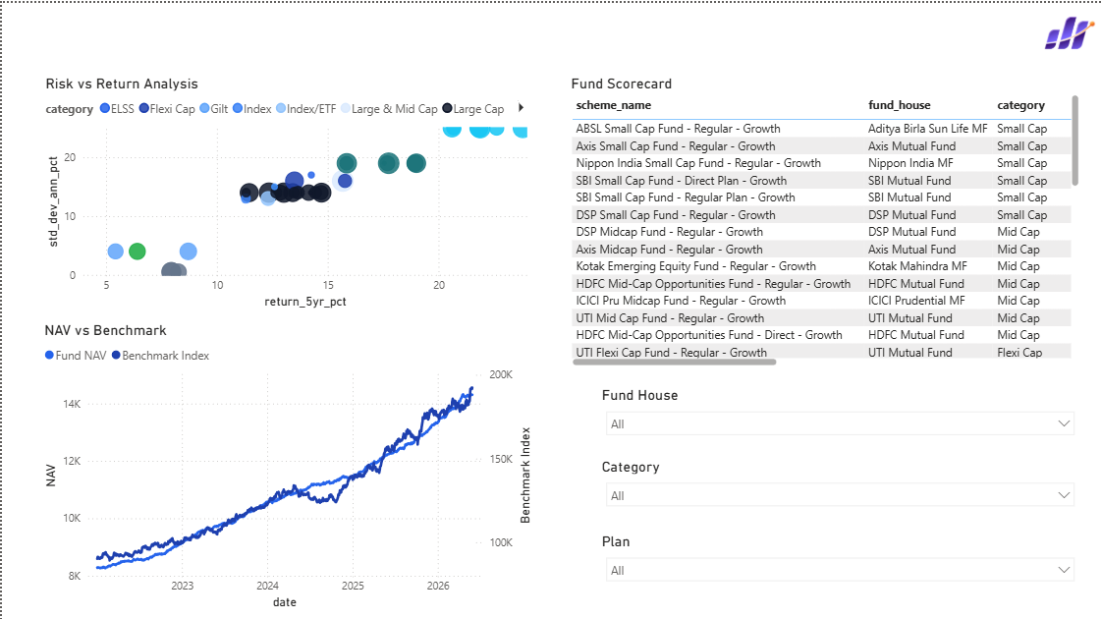
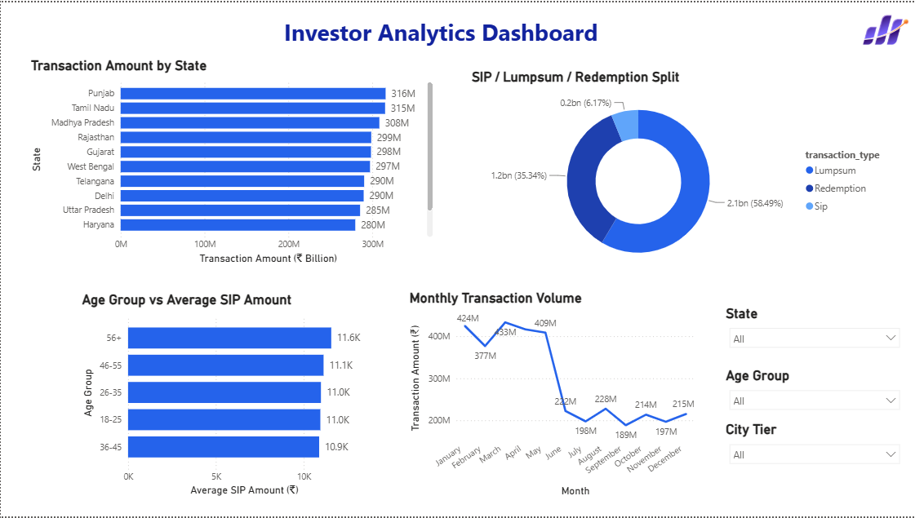
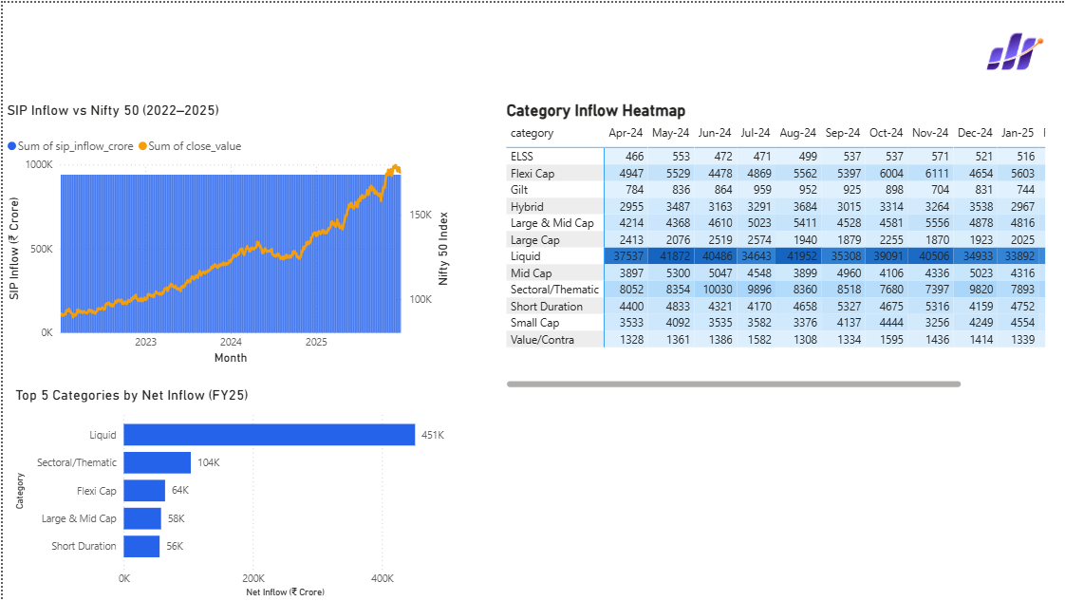
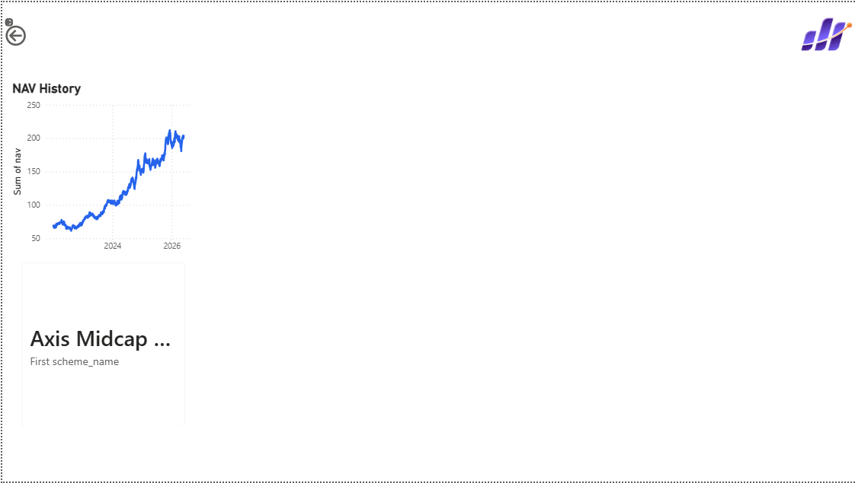
Power BI Dashboard
Five interactive report pages consolidating industry, performance, investor & NAV analytics
Industry Overview
Fund Performance
Investor Analytics
SIP & Market Trends
NAV Detail
Mutual Fund Analytics | Capstone Project I
8

Slide 9





Results & Insights
Key findings synthesized from EDA, performance and advanced analytics
AUM is concentrated among a few large houses — SBI, ICICI Prudential, HDFC & Nippon India dominate average AUM.
Scheme universe skews Equity-heavy (34/40) and Moderate-to-High risk (28/40).
Risk-adjusted ranking reorders the leaderboard — Mirae Asset Large Cap tops the Fund Scorecard (34% CAGR, Sharpe 1.4483).
Small Cap schemes carry the highest tail risk across VaR / CVaR.
SIP dominates by transaction count (~60%), but Lumpsum & Redemption tickets are ~23x larger on average.
98% of frequent SIP investors show irregular gaps — a strong signal for retention outreach.
Portfolio concentration (HHI) varies meaningfully even within similar equity categories.
Rolling 90-day Sharpe shows risk-adjusted performance shifts over time, not static.
Mutual Fund Analytics | Capstone Project I
9

Slide 10
Conclusion & Future Scope
Conclusion
Future Scope
A complete, validated end-to-end pipeline — raw CSVs through cleaning, star-schema database design, exploratory analysis, performance & advanced analytics, and an interactive Power BI dashboard.
Live data integration across all 40 schemes on a scheduled basis
ML-based recommendation using investor profile & fund similarity
Predictive SIP-discontinuation modeling
Migration to PostgreSQL / cloud data warehouse
Automated orchestration via Airflow or Prefect
Web-based self-service dashboard (Streamlit / Flask)
Lossless ETL: 46,000+ NAV rows & 32,778+ transactions loaded
Metrics cross-checked against domain expectations (e.g. small-cap tail risk)
Actionable insights on AUM concentration, fund ranking & SIP retention
Thank You
Mutual Fund Analytics | Capstone Project I
10

