Slide 1


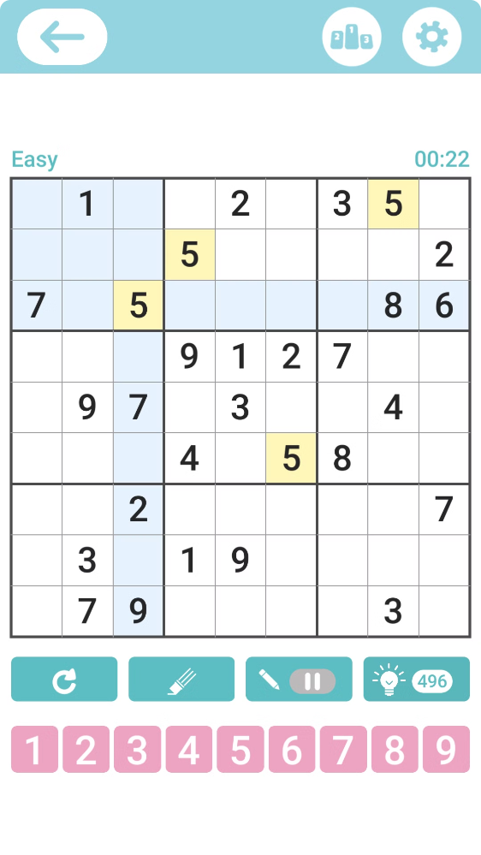
Sudoku Solver Visualization
Welcome to the fascinating world of Sudoku puzzles! This presentation will delve into the fundamentals of Sudoku, explore algorithms used to solve them, and showcase innovative visualization techniques.
Submitted by Madhav Arora
Reg No : 12217099
Section : 9SK02
Roll No : 28

Slide 2

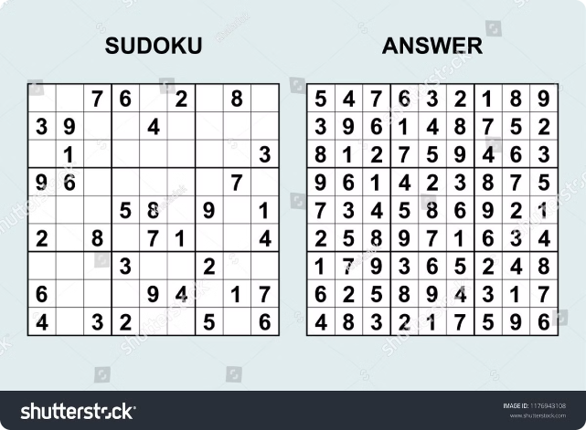
Introduction to Sudoku
Objective
Fill a 9x9 grid with digits from 1 to 9, ensuring each row, column, and 3x3 subgrid contains all the digits.
Rules
Each digit can appear only once in each row, column, and 3x3 subgrid.
Difficulty Levels
Sudoku puzzles come in various difficulty levels, ranging from easy to extremely challenging.

Slide 3
Sudoku Solving Techniques
Brute Force
Constraint Propagation
Backtracking
A simple method that systematically tries all possible combinations until a solution is found. It's effective for easy puzzles but becomes inefficient for more complex ones.
Utilizes logical reasoning to eliminate potential values in each cell, gradually narrowing down the possibilities.
This technique explores all possible solutions and backtracks when it reaches a dead end. It guarantees finding the solution if one exists.

Slide 4


Visualization Techniques
1
Grid Highlighting
Emphasize the current cell, row, column, or 3x3 subgrid being processed for clearer understanding.
2
Value Trails
Visualize the path of each value as the solver explores and eliminates possibilities.
3
Progress Indicators
Display the solver's progress, such as the number of filled cells or the time spent solving.
4
Algorithmic Animations
Dynamically demonstrate the step-by-step execution of the solving algorithm.

Slide 5

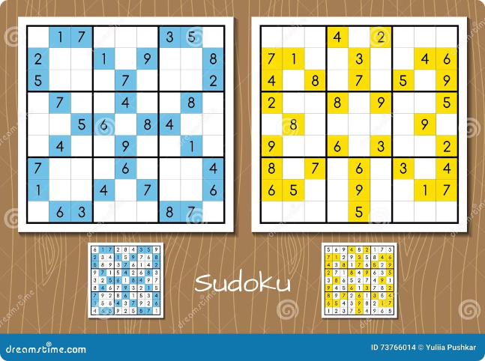
Step-by-Step Walkthrough
1
Initial State
The partially filled Sudoku grid is presented with the solver ready to start the solving process.
2
Logical Reasoning
The solver applies constraint propagation, eliminating potential values and filling in logical deductions based on the rules.
3
Backtracking
When a dead end is reached, the solver backtracks and explores alternative possibilities to find a valid solution.

Slide 6

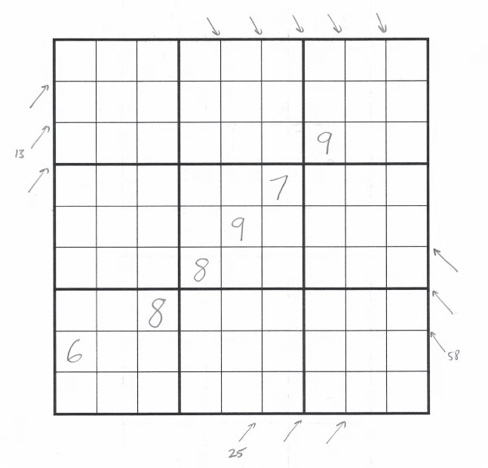



Backtracking Algorithm Demonstration
Explore
The solver tries a potential value in an empty cell.
Validate
The algorithm checks if the chosen value is valid based on the Sudoku rules.
Backtrack
If the value is not valid, the solver backtracks and tries a different value.

Slide 7


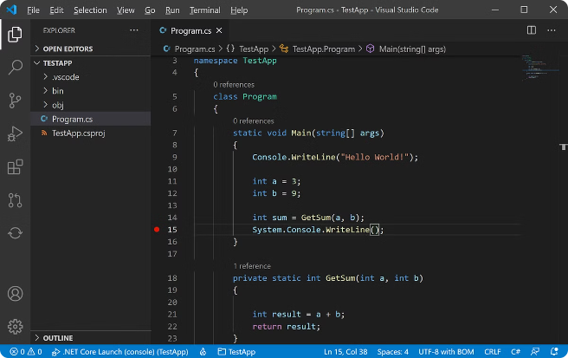


Optimization and Efficiency
Fast Execution
Optimized algorithms and data structures ensure rapid solving times, making the process efficient.
Memory Efficiency
Careful memory management minimizes resource consumption, ensuring optimal performance.
Scalability
Ability to handle puzzles of increasing complexity and size, demonstrating adaptability to various challenges.

Slide 8

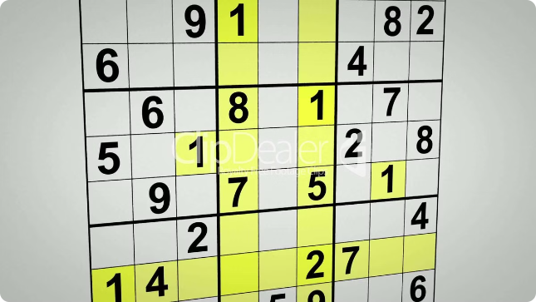
Conclusion and Future Directions
Recap
Fundamentals of Sudoku puzzles and various solving algorithms were explored.
Visualization Insights
Understanding the solving process was enhanced through effective visualization techniques.
Future Potential
Opportunities for further optimization, integration with AI, and broader applications of Sudoku solving techniques exist.

