Slide 1
Title: Diabetes Prediction Application
Objective: Introduce the project and its goals.
Content:
Overview of the project scope.
Importance of early diabetes detection and management.
Brief introduction to machine learning and its application in healthcare.

Slide 2
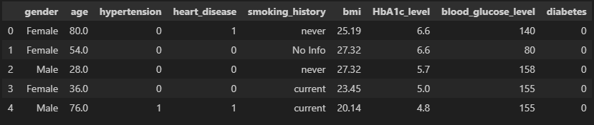
Data Collection I downloaded a dataset from Kaggle containing 100,000 rows and 9 columns. This dataset is used for predicting diabetes. It has the following structure:

Slide 3
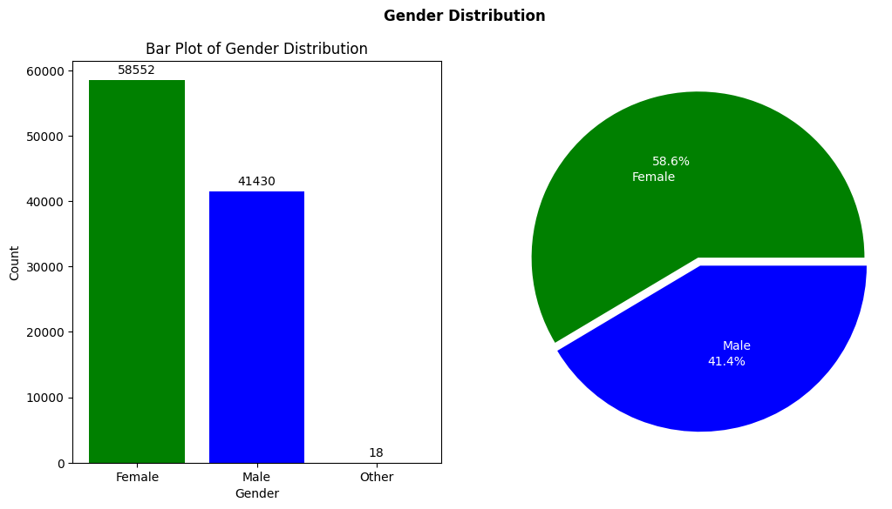
Data Pre-Processing Upon examining the data, I observed a significant gender imbalance, with a notably higher number of females compared to males. To address this and ensure an accurate analysis of the correlation between gender and diabetes, I balanced the dataset by randomly sampling an equal number of female and male participants.

Slide 4
Exploratory Data Analysis Data Transformation: -Converted gender to numeric values: 0 (male) and 1 (female) for correlation analysis. Correlation Heatmap Analysis: -Visualized relationships among features using a heatmap. -Identified significant positive correlations: -Diabetes with HbA1c levels. -Diabetes with Blood-Glucose levels. Key Insights: -Numeric transformation enhances accuracy in analyzing gender correlations. -Heatmap highlights critical factors influencing diabetes risk.

Slide 5
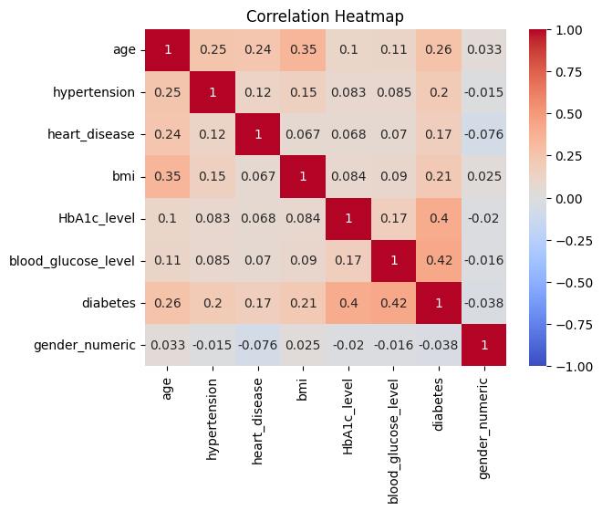

Slide 6
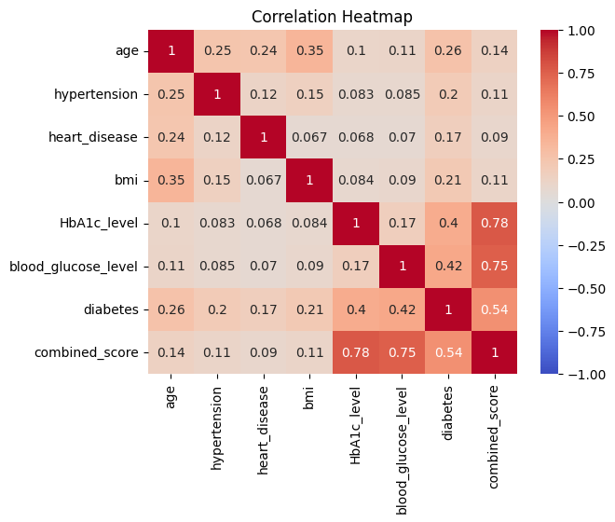
Feature Engineering After identifying the correlations, I combined the HbA1c and Blood-Glucose levels to create a new feature. This engineered feature demonstrated a stronger correlation with diabetes compared to the individual features alone, enhancing the predictive power of the model.

Slide 7
Model Development To develop a robust model, I utilized pipelines to test different algorithms using 20% of the data for training and 80% for testing. The models tested and their respective accuracies were as follows: Linear Regression: 95% Support Vector Machine (SVM): 96% Decision Tree: 97% The Decision Tree model proved to be the most accurate and efficient, achieving the highest accuracy of 97%.

Slide 8
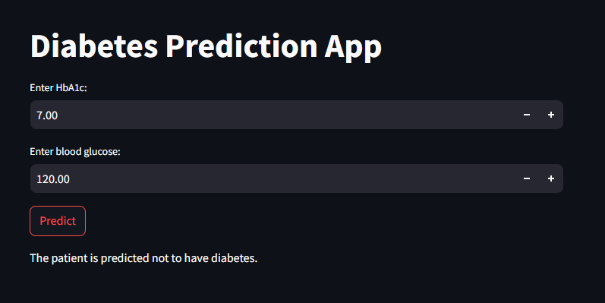
Model Deployment -To deploy the model, I exported it using joblib and then loaded it in a script named deployment.py. In this script, I take HbA1c and Blood Glucose levels as input to predict whether a patient is likely to have diabetes. -For the user interface, I utilized Streamlit, which allows for a simple and interactive web application to input the data and display the prediction results.

Slide 9
Libraries Used Pandas: 1.3.3 NumPy: 1.21.2 scikit-learn: 0.24.2 matplotlib: 3.4.3 seaborn: 0.11.2 Streamlit: 0.88.0 joblib: 1.1.0

Slide 10
Conclusion This project successfully developed a diabetes prediction application using machine learning techniques and data analysis. By carefully preprocessing the data, engineering relevant features, and selecting an optimal model, the application achieved high accuracy in predicting diabetes. The use of Streamlit for deployment ensures an easy-to-use interface for users to input their health data and receive a prediction. This tool can help in early detection and management of diabetes, potentially improving health outcomes through timely intervention.

