Slide 1


Team 5: Power Prediction and Energy Arbitrage Modeling for Wind Farms Using ML
Market Integration and Commercial Optimization, WiSe 2025/26
Presented by: Matriculation No.
Madhvesh Gorakhiya 730251
Soni Karan 760153
Guided by: Prof. Dr. Andreas Heinen
Date : 06.01.2026
Place: Flensburg
GitHub Link: https://github.com/MadhaveshG/wind-h2-arbitrage

Slide 2
Overview
1
2
3
4
5
Introduction
Problem Statement
Data & Preprocessing
Flowchart
ML Models
6
7
8
9
10
Hydrogen Storage Concept
Future Tasks
Economic Analysis
Results
Conclusion

Slide 3

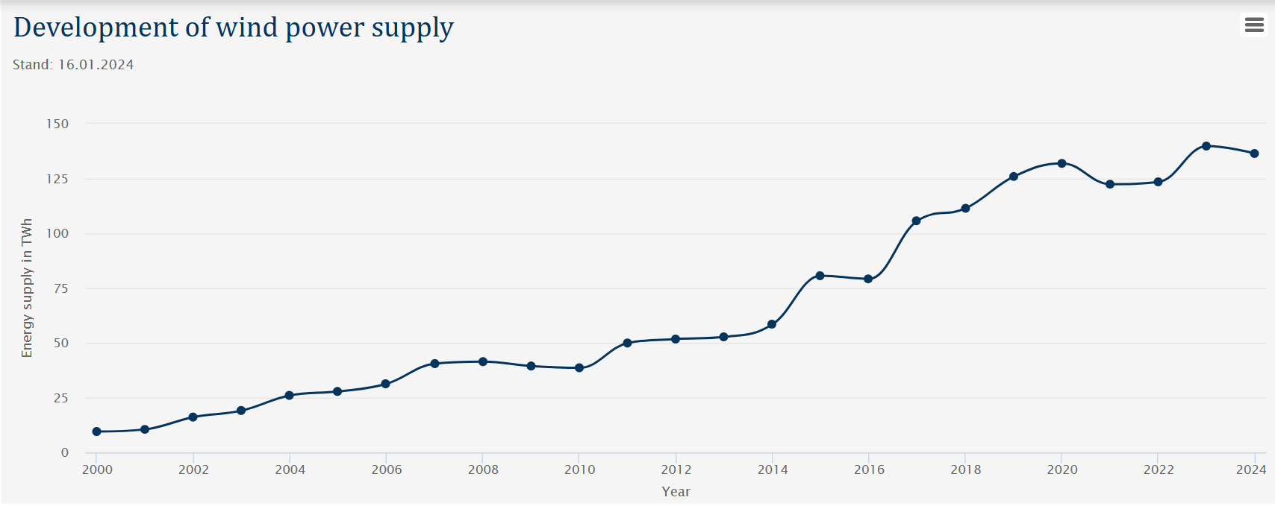
1. Introduction
Wind Energy: One of the fastest‑growing (Germany)
Wind power (variable) → wind speeds (change)
Electricity markets (fluctuate) → Wind production (high)
Modern energy systems increasingly use data and machine learning:
improve forecasting
operational decisions
Fig 2.1: Development of wind power supply (6)

Slide 4
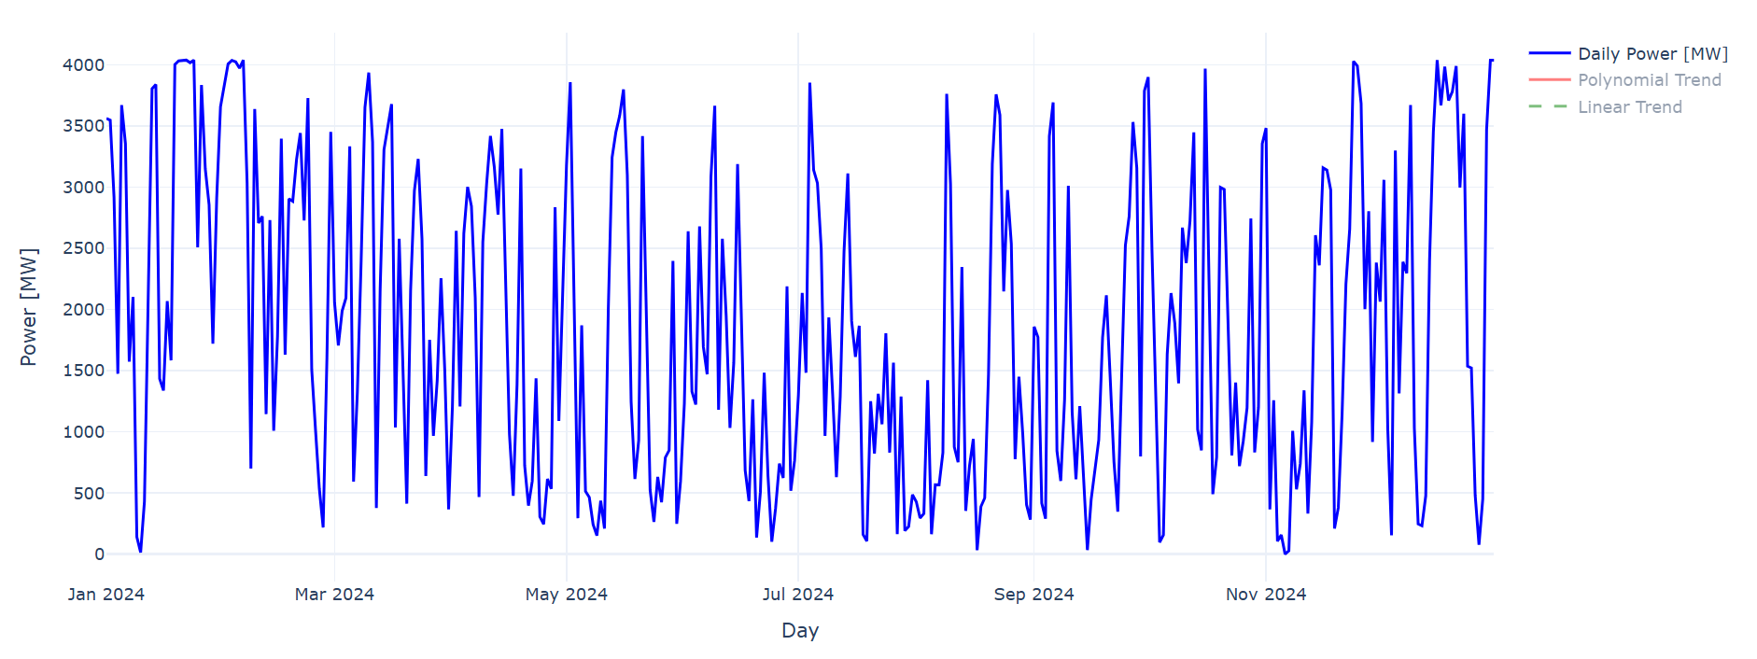
2. Problem Statements
Wind power output changes every hour → difficult to predict
Electricity prices fluctuate strongly → revenue is uncertain
Selling at the wrong time reduces profit for wind‑farm operators
Hard to know when storing energy will be more profitable than selling
A data‑driven ML model is needed to support STORE vs SELL decisions
Fig 2.1: Day Vs Power generation (MW) (Own).
1. Can machine‑learning models accurately predict wind‑farm power output and identify the optimal hours to STORE or SELL energy?
Research Question:
2. If low‑price energy is stored as hydrogen, can the hybrid system remain economically profitable without subsidies?

Slide 5
3. Data and Preprocessing
3. Power Curve Processing:
Location: Reusenkoog, Germany
Scaled for 51 turbines (total farm capacity) (1)
Used Vestas V112‑3.3 MW turbine power curve (2)
Converted wind speed → power output
Wind Data (ERA5):
Used ERA5 reanalysis dataset for wind components (u100, v100) (3)
Calculated wind speed at 100m
Converted to a clean CSV file (wind_speed.csv)
2. Electricity Price Data:
Imported sport market prices (EUR/MW) (5)
Cleaned timestamps and extracted hour and month
4. Electrolyze Data:
Model: 50 MW PEM System (4)
Efficiency: 52.2 kWh /kg H2 Nominal
Min Load: 10% (5MW)

Slide 6
4. Flowchart
Load wind data, Finding wind speed & Save CSV file
Load market prize data
Compute form power output based on power curve
Apply Polynomial & Linear regression ML models
Start
CSV File
Plot graphs
Verified model
Apply Logistic regression ML model
Evaluate or verification of models
GitHub Link: https://github.com/MadhaveshG/wind-h2-arbitrage
Compare economical model
Create plots
Stop

Slide 7

5. Machine Learning Models
Why ML?
1
Fast growing and widely used field
2
ML helps automate STORE vs SELL decisions
Gives a more mathematical and accurate solution
Reference: https://www.vecteezy.com/free-photos/machine-learning
3
4
Patterns are non‑linear and difficult to capture manually
5
ML learns from historical data and improves decision accuracy

Slide 8
5. Machine Learning Models
Block Diagram of Wind Farm Model:
Number of Wind Turbine
Polynomial and linear trend on hourly based
Polynomial & Regression Model
Wind speed
Input
Output
polynomial and linear trend on days based
Power curve
R2
Date & time
Evaluate Model
RMSE
No focusing yet
MAE

Slide 9
5. Machine Learning Models
Decision Arbitrage Model:
Power (Model 1)
Store if price < 25
Coefficient Interpretation
Price
Logistic Regression Model
Date & time
Input
Output
Decision Plot
(SELL (0) or STORE (1))
Seasonal Demand Index
Season | Months | Factor
Winter | 12, 1, 2 | 1.2
Spring | 3, 4, 5 | 0.9
Summer | 6, 7, 8 | 0.8
Autumn | 9, 10, 11 | 1
Gives Hours and Days for store energy
No focusing yet
Final CSV File
Date
Hour
Power, price
Store decision

Slide 10
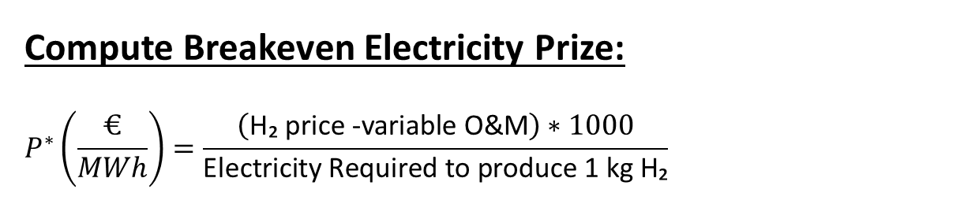
6. Hydrogen Storage Concept
Set Economical and Technical Parameters:
H₂ price = 5 (€/kg)
variable O&M = 20% (€/kg)
Electricity Required to produce 1 kg H₂= 52.2 (kWh/kg)
Maximum power capacity of the electrolyze = 50 (MW)
Min load fraction = 10%
For Each hour, decide and dispatch:
Store as H₂ :
Sell Electricity:
If store_decision = 1 and (optionally) price ≤ p*:
Run electrolyzer at min(wind, 50 MW) if ≥ 5 MW; else off
H₂ produced = (MW × 1000) / 52.2 kg/h
Electricity sold = wind − electrolyzer_MW
Hybrid net = elec revenue + H₂ revenue − var O&M
Compute Breakeven Electricity Prize:
$$P^{∗}\left(\frac{€}{MWh}\right)=\frac{\left(\text{H}\text{₂ }\text{price}\text{ −}\text{variable} \text{O}\text{\&}\text{M}\right)∗1000}{\text{Electricity} \text{Required} \text{to} \text{produce}\text{ 1 }\text{kg} \text{H}\text{₂}}$$

Slide 11
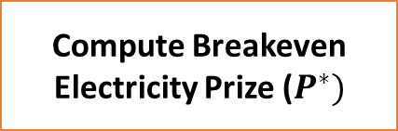
7. Economic Analysis Modelling
Load: Final_energy_arbitrage_csv
Input
Compute Breakeven Electricity Prize ($P^{∗})$
Set Economic Technical Parameters
Hybrid:
Electricity Revenue
H2 Revenue
OM Cost
Sell without Storage
Hybrid Model
Store Decision Map
Compare Strategies
Line Plot of Hourly Net
Output
Cumulative Net Over time

Slide 12
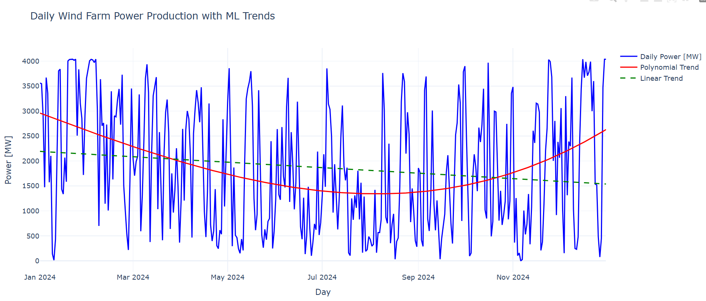
8. Results
Model 1: Polynomial and Regression Model
Polynomial Regression Model:
R2 : 0.14
RMSE : 1155
MAE : 993
Linear Regression Model:
R2 : 0.02
RMSE : 1230
Mae : 1079
Fig 8.1: Day Vs Power

Slide 13
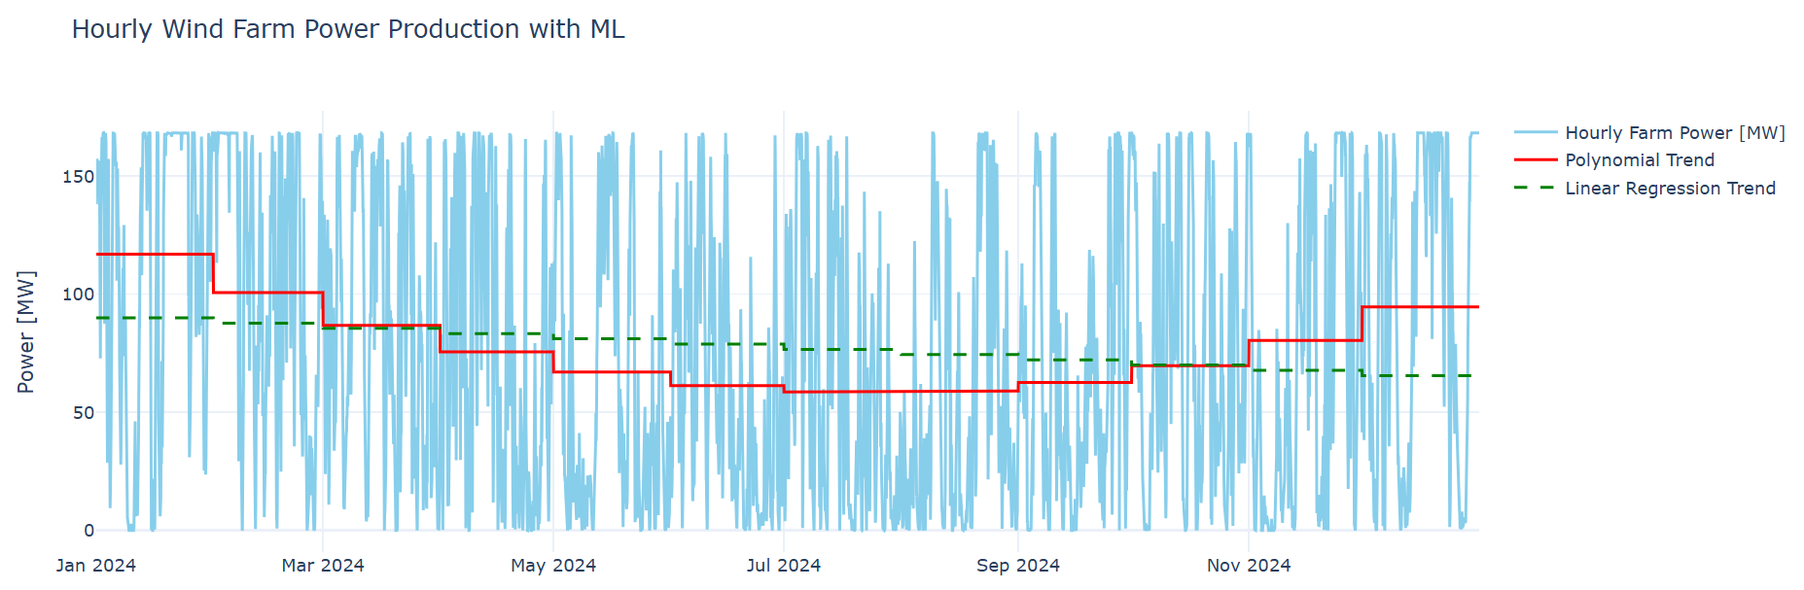
8. Results
Model 1: Polynomial and Regression Model
Polynomial Regression Model:
R2 : 0.94
RMSE : 3347
MAE : 2723
Linear Regression Model:
R2 : 0.16
RMSE : 12308
Mae : 10524
Fig 8.2: Hours Vs Power

Slide 14
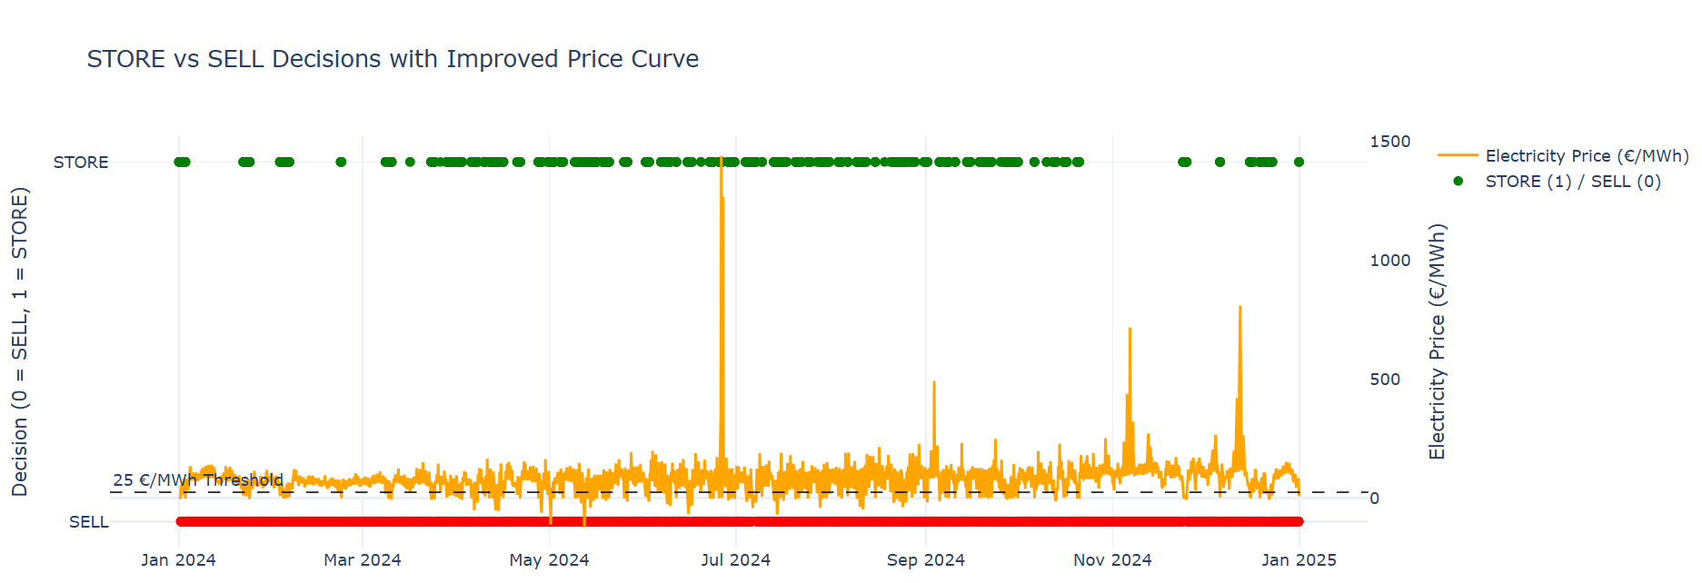
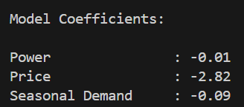
8. Results
Model 2: Logistic Regression Model
Fig 8.3: Hours Vs Store or Sell Vs Electricity Price

Slide 15
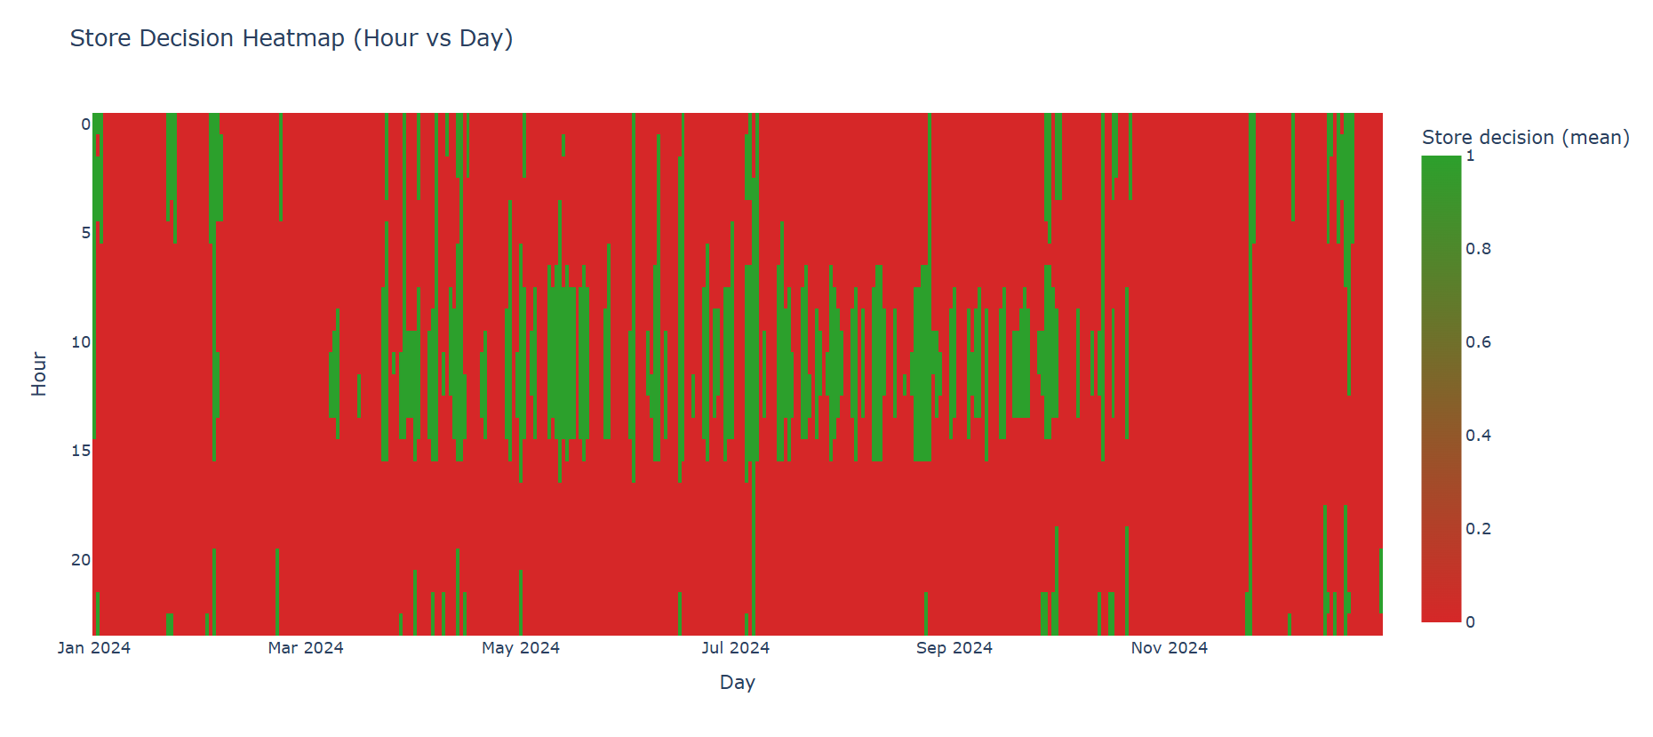
8. Results
Model 3: Hydrogen Storage Concepts
Fig 8.4: Store Decision Map

Slide 16
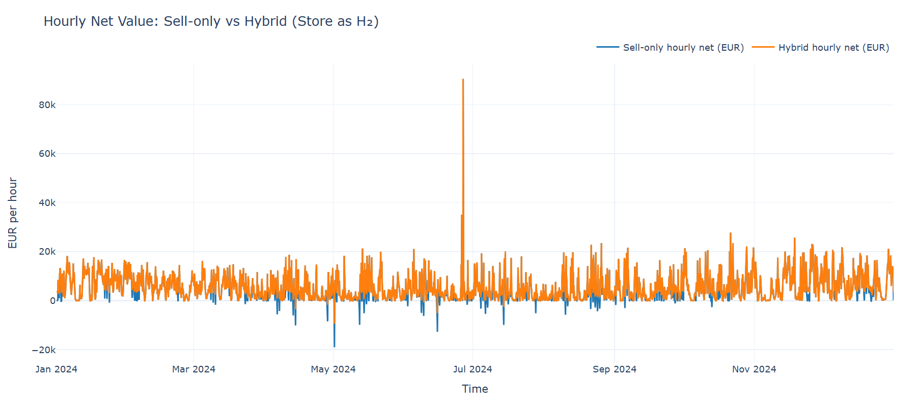
8. Results
Model 3: Hydrogen Storage Concepts
Fig 8.5: Hourly Net Value : Without Storage and With Storage

Slide 17
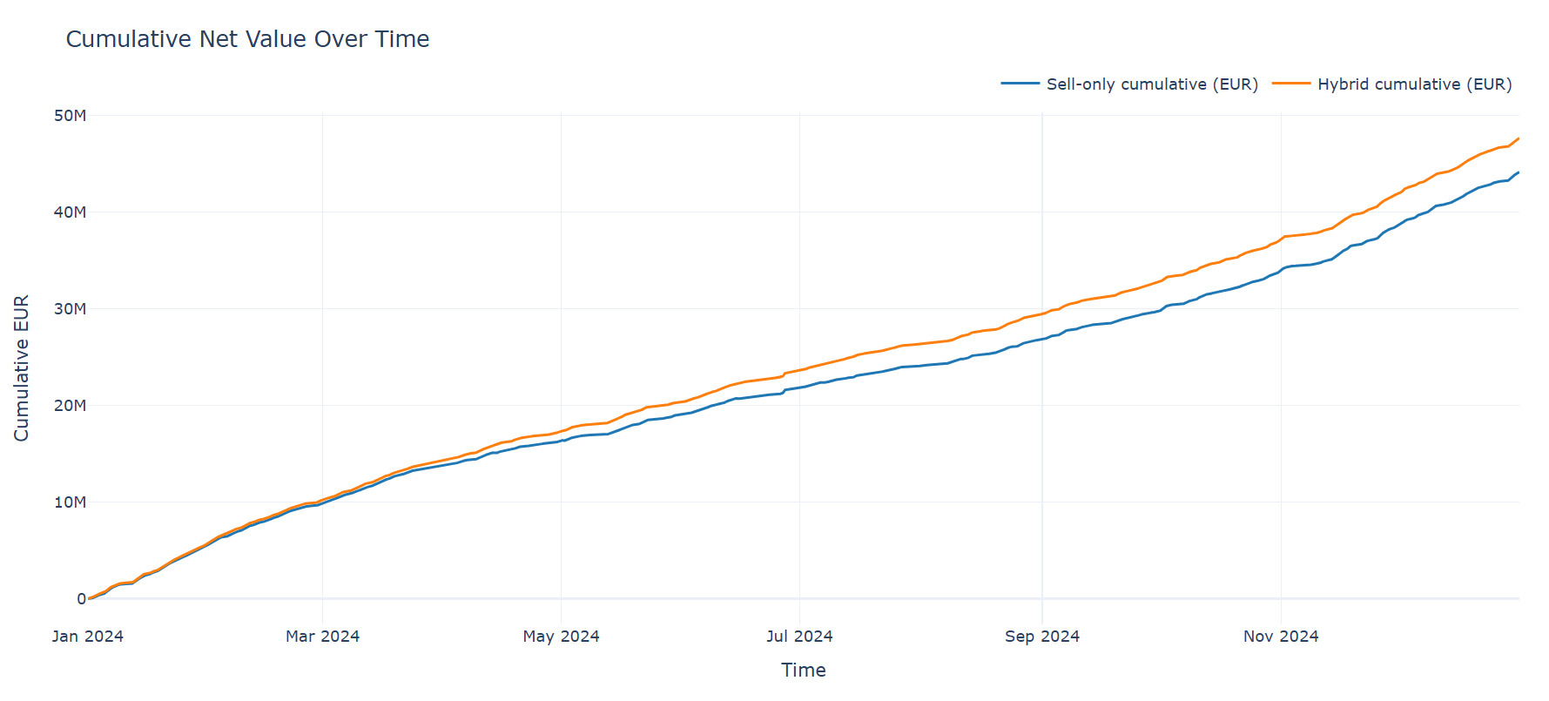
8. Results
Model 3: Hydrogen Storage Concepts
Fig 8.6: Cumulative Net Value Over Time

Slide 18
9. Conclusion
Improves predicting of wind power output
Optimizing when to sell electricity or store as hydrogen
the current ML model is not fully accurate:
It ignores some additional input variables
Uses only one year of data (2024)
Profitability depends on hydrogen price and system efficiency

Slide 19
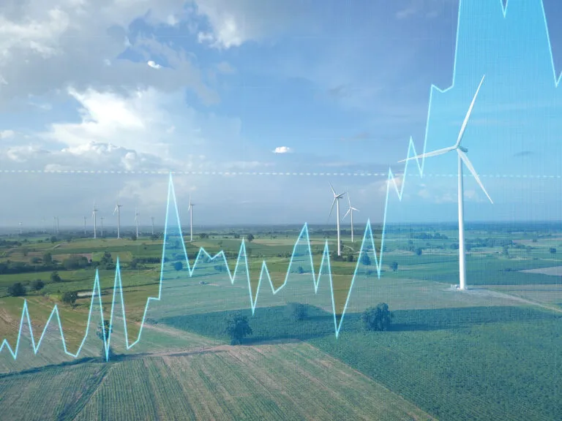
10. Future Tasks
Add more feature of wind (air density, wind direction, turbulence)
Improve power curve for better outputs
Try higher order polynomial regression
Use some other ML models
Improve data cleaning
Possible to use more years of data
Add more economic features (forecasted prices, market demand, so on)
Optimize the decision threshold
Use real seasonal power demands data
Reference: Wind Farm Layout Design at NAYXA || We´re Wind Energy Experts

Slide 20
References
https://www.nsenergybusiness.com/projects/reusenkoge-wind-farm-expansion/?cf-view
https://en.wind-turbine-models.com/turbines/693-vestas-v112-3.3
ECMWF. (2024). ERA5 Reanalysis Data. Copernicus Climate Change Service.
Siemens Energy. (2023). Silyzer 300 PEM Electrolyzer Datasheet.
Day-Ahead Auction prices (DE-LU Zone, 2024)
Statistics Germany | BWE e.V.
GitHub Link: https://github.com/MadhaveshG/wind-h2-arbitrage

