Slide 1
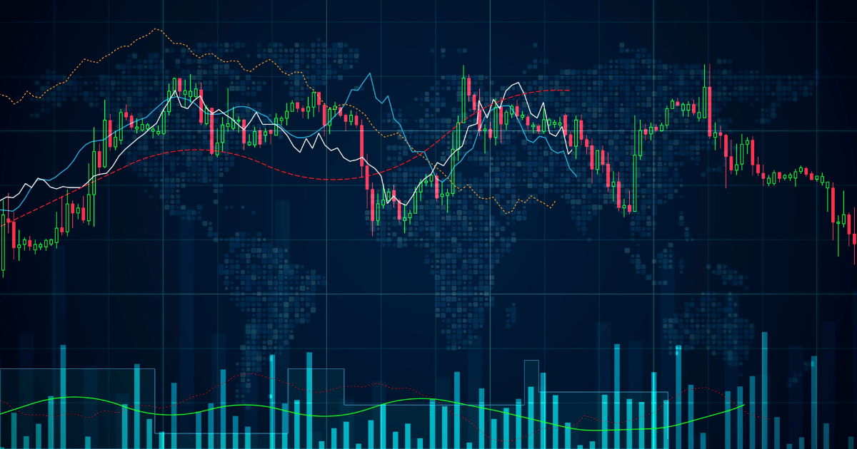
FORECASTING
Hindustan Petroleum Prices Dataset

Slide 2
Introduction
To develop a forecasting model for the given financial data, consisting of variables: Date, Open, High, Low, Close, Adjusted Close prices, and Volume.
Our approach involves implementing time-series forecasting models such as:
ARIMA, SARIMA, FbProphet and LSTM.

Slide 3





STEPS
Collection of data:
Hindustan Petroleum dataset
Source : Kaggle.com
Data set - 5478, csv
EDA:
Checking for duplication
Missing value detection
Data reduction
Data cleaning
Model Building:
ARIMA
SARIMA LSTM
FP prophet
Model Evaluation:
RMSE
MSE MAPE
Deployment:
Streamlit

Slide 4
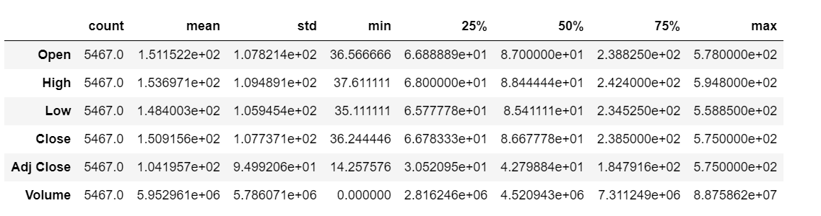
Exploratory Data Analysis (EDA)
No null values were detected.
No duplicates were found.
Outliers Detection is done.

Slide 5
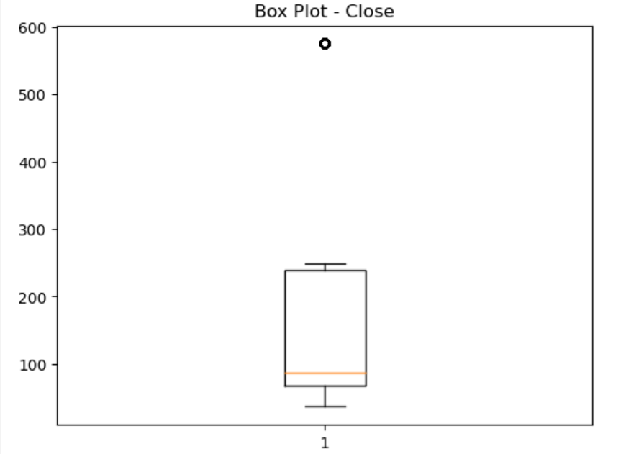
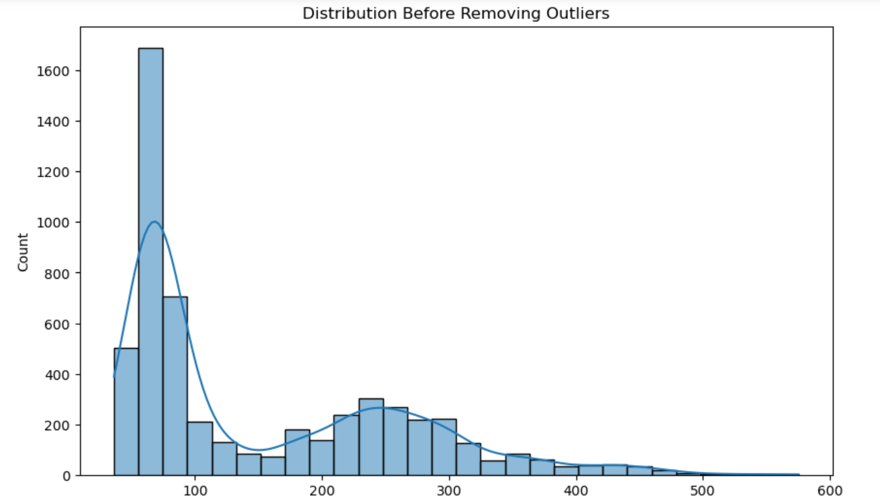
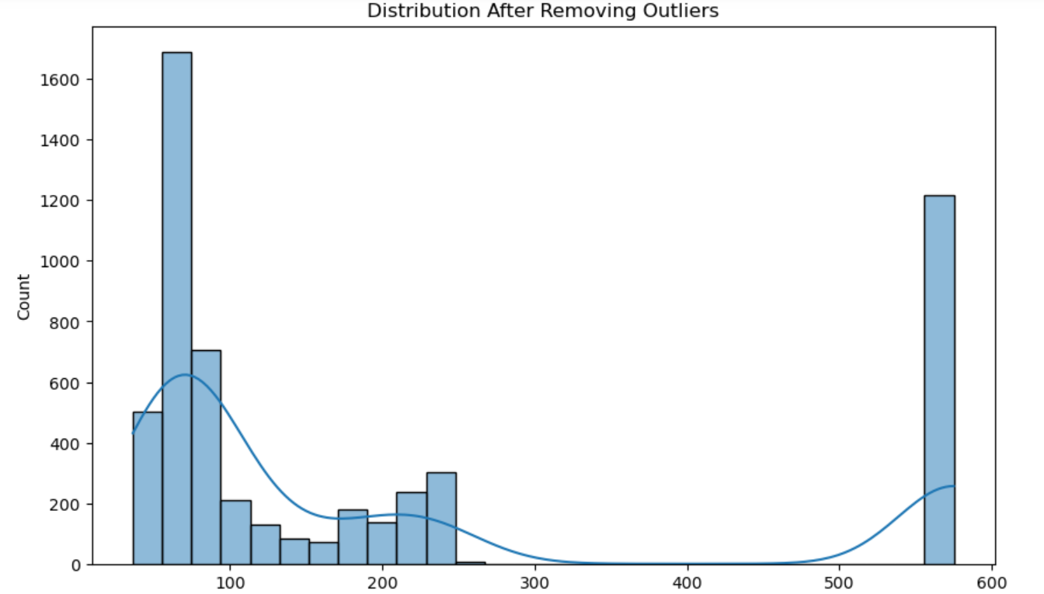
Dealing with outliers
Outliers were detected in all the variables.
The most relevant variable to build our forecasting model is the ‘ Close’ variable.
Hence we replace the outliers in the ‘Close’ column with the maximum value in the column.

Slide 6
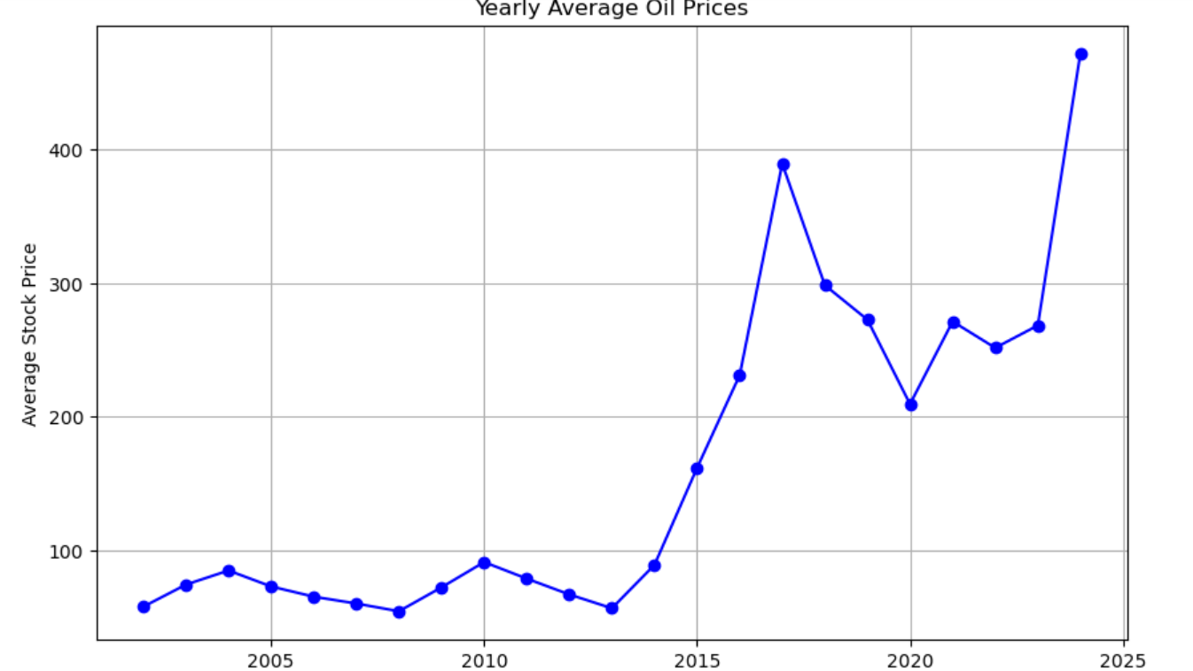
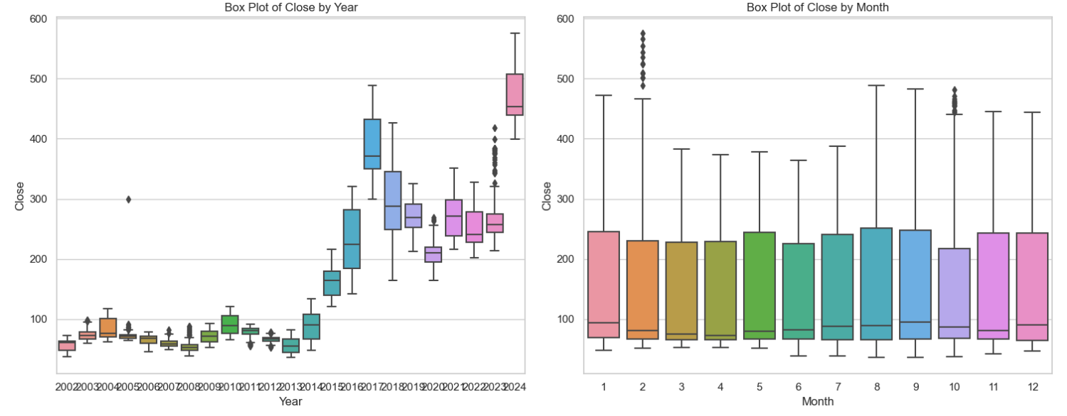
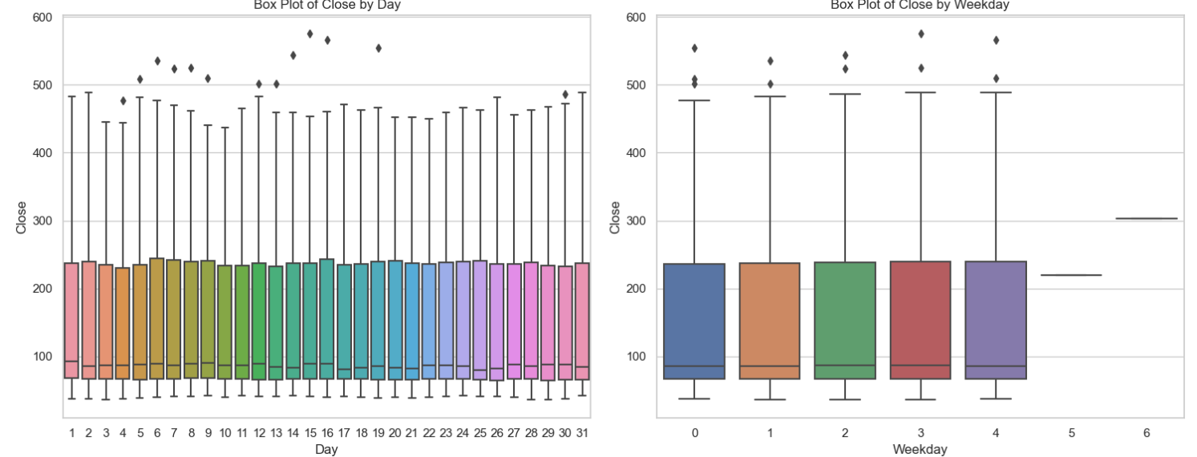
DATA VISUALISATIONS

Slide 7
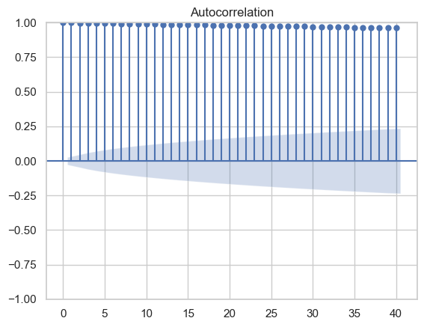
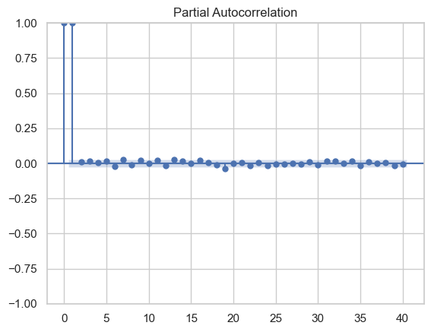
ACF and PACF plots

Slide 8
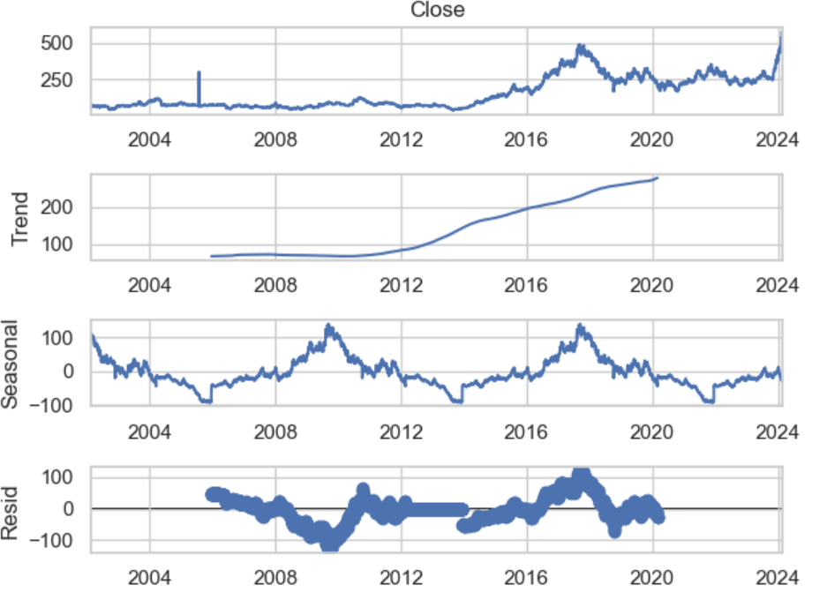
SEASONAL DECOMPOSITION
As we see , the time series has seasonality.

Slide 9
MODEL BUILDING
Autoregressive Integrated Moving Average ( ARIMA)
The time series dataset is non- stationary( Mean and Variance are a function of time hence not constant.).
By performing first Order Differentiation the dataset becomes Stationary ( having constant Mean and Variance).
Afterwards, the p,d,q values are found out using the module called “pdmarima” ,where ‘p’ represents “AutoRegression” of the dataset, ‘q’ represents the “Moving Average” and ‘d’ represent the “Degree of Ordering “ (or) “Lagged Values” .
Mean Absolute Percentage Error: 0.0061

Slide 10
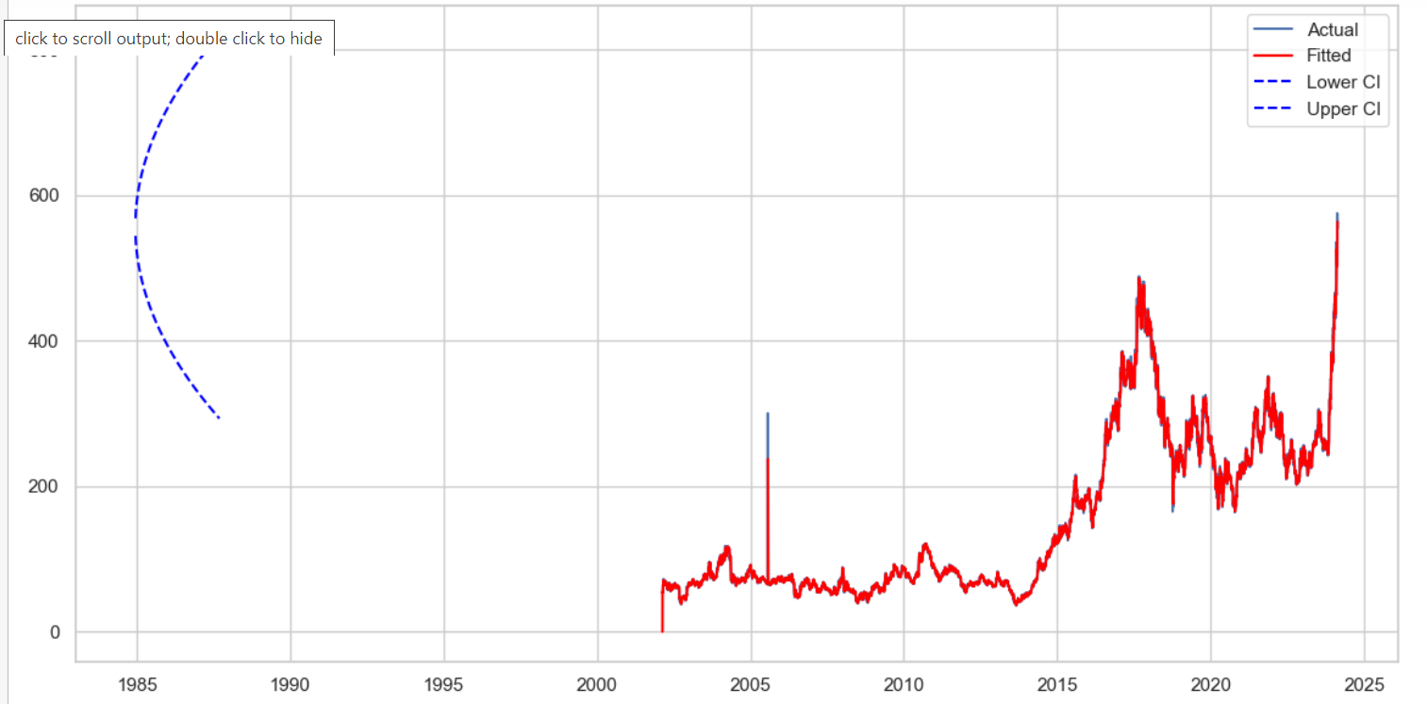
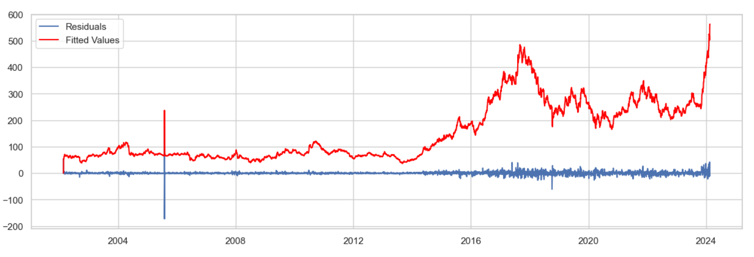
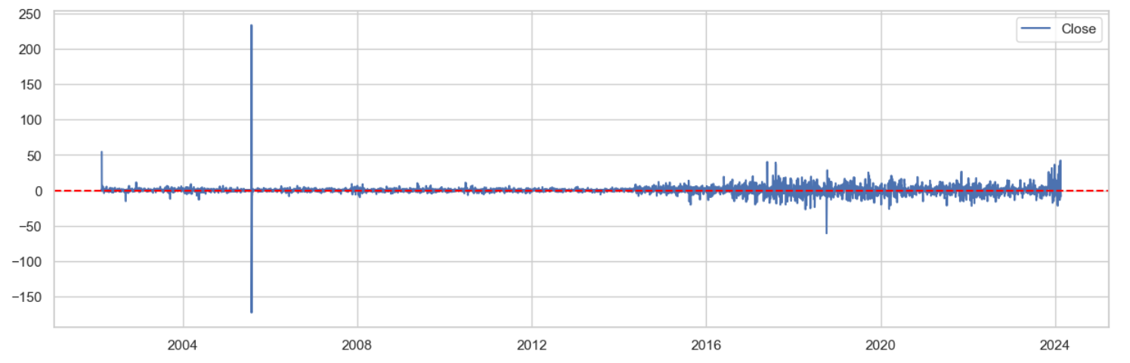
2057116
PLOTS
2057116
Metrics Evaluation for the Model
Root Mean Square Error: 6.2057116
Mean Absolute Percentage Error : 0.026832

Slide 11
Long Short Term Memory cell (LSTM)
The LSTM is a part of Deep Learning, which used for handling sequential data .
Belongs to the family of Recurrent Neural Network (RNN) that are capable of learning long-term dependencies, especially in problems involving sequence prediction.
LSTM has feedback connections, i.e., it is capable of processing entire sequences of data, making it suitable for tasks involving sequential data. However, LSTMs are also versatile and can handle individual data points, such as images.
Here, we use some activation rules like Sigmoid, Tanh etc

Slide 12
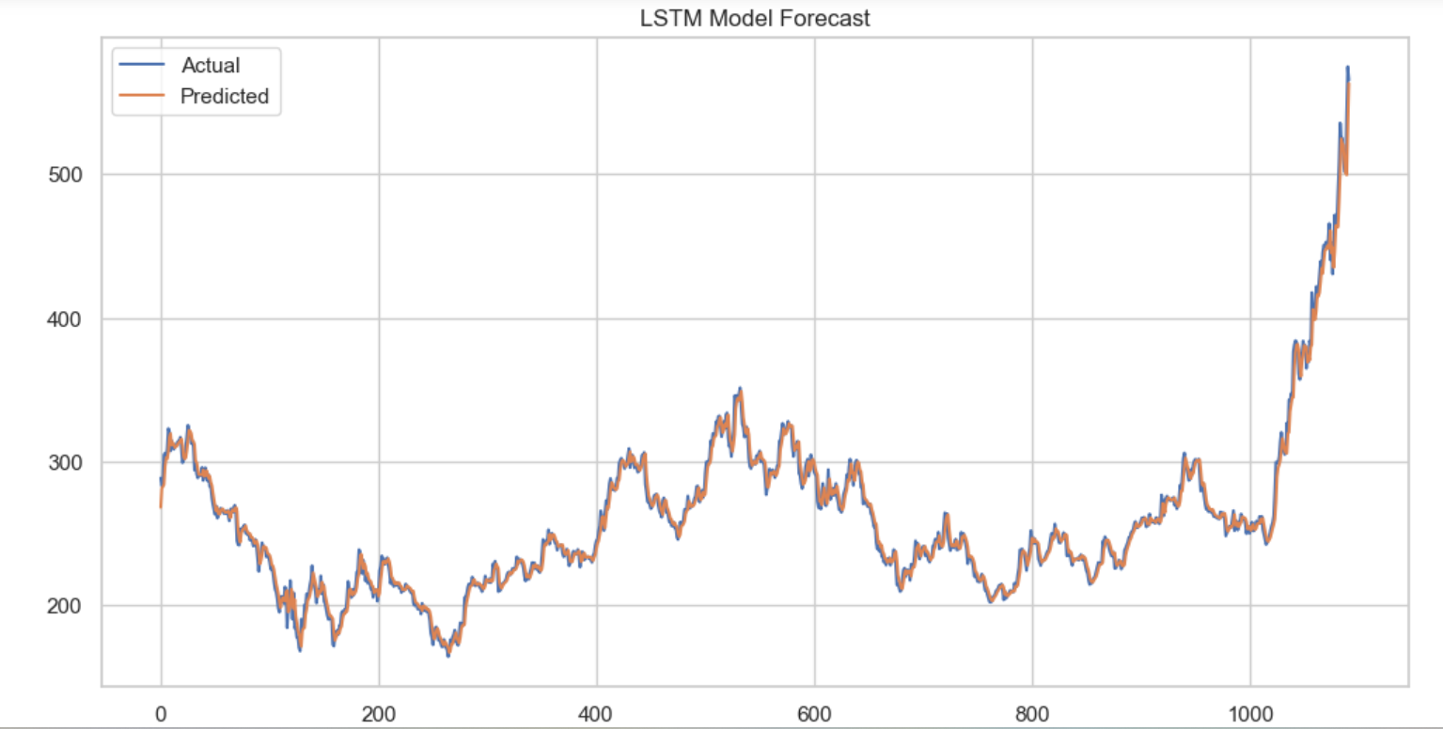
Metrics Evaluation for the Model
Root Mean Square Error: 7.025468
Mean Absolute Percentage Error : 1.894914

Slide 13
Linear Regression
Linear regression algorithm shows a linear relationship between a dependent (y) and one or more independent (x) variables.
Linear regression makes predictions for continuous/real or numeric variables such as sales, salary, age, product price, etc.
RMSE : 144.89329

Slide 14
SARIMA
Seasonal AutoRegressive Integrated Moving Average, is an extension of the ARIMA model that incorporates seasonality into time series forecasting.
The notation for SARIMA is SARIMA(p, d, q)(P, D, Q, s), where:
p, d, q are the non-seasonal AR order, differencing, and MA order.
P, D, Q are the seasonal AR order, seasonal differencing, and seasonal MA order.
s is the length of the seasonality.
SARIMA models are particularly useful when dealing with time series data that exhibit a repeating pattern or seasonality, such as sales data that shows regular peaks during certain months of the year.

Slide 15
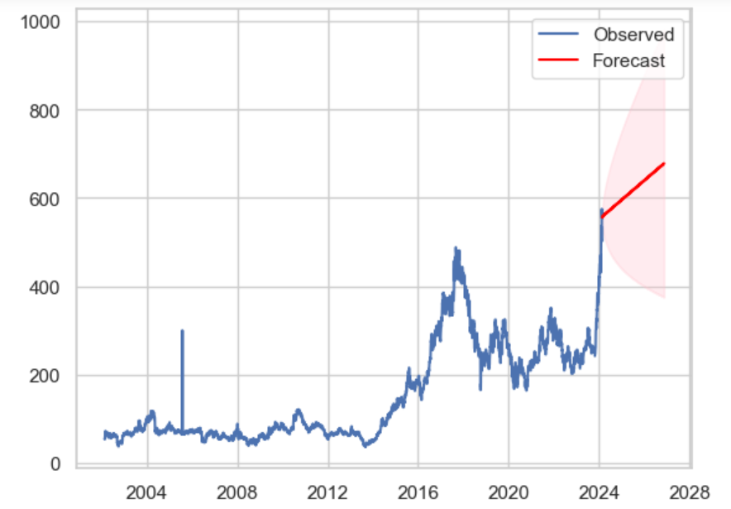
Visualization of the prediction.
Metrics Evaluation for the Model
Mean Absolute Error: 360.43571
Mean Squared Error : 132360.76740
Root Mean Square Error : 363.81419

Slide 16
FB Prophet
Prophet is a forecasting tool developed by Facebook for time series analysis and prediction. It is designed to handle daily observations that exhibit patterns on different time scales, including holidays and special events
Prophet is known for its simplicity, flexibility, and ability to generate accurate forecasts with minimal input from users.
Prophet decomposes time series data into three main components: trend, seasonality, and holidays. The model assumes that these components act in an additive manner.

Slide 17
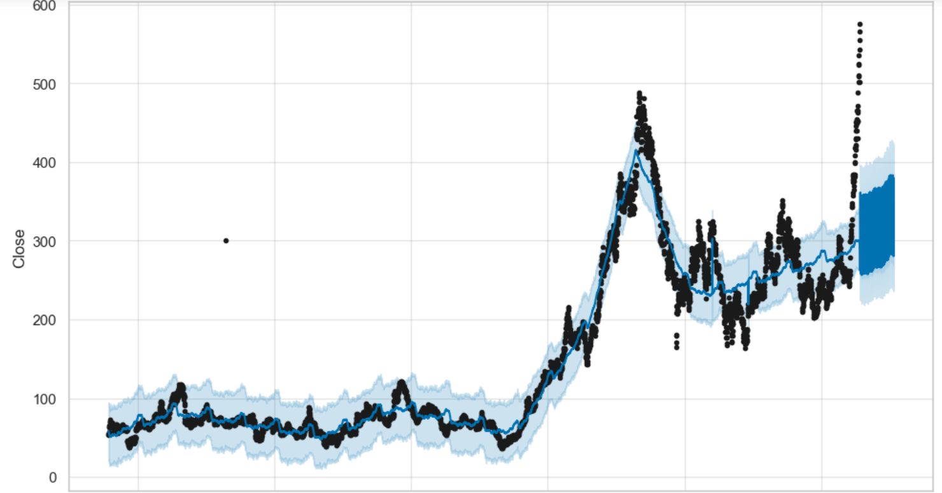
Visualization of the prediction.
Metrics Evaluation for the Model
Mean Absolute Error: 184.04794
Mean Squared Error : 47092.341347
Root Mean Square Error : 217.00769

Slide 18
Deployment
Here, we have used the Streamlit Application for Deployment purpose.
In, these we have Python Programming for deployment purpose.
The Streamlit Application have to run using Anaconda Prompt and we have to write as “Streamlit run Application.py” .
We have used the LSTM model in the deployment.
The Application will predict the all weekdays price of the Oil.

Slide 19
COMPARISON OF MODELS
 | ARIMA | LSTM | SARIMA | FbProphet | LINEAR REGRESSION
RMSE | 6.2057116 | 7.025468 | 360.43571 | 184.04794 | 144.89329
MAE | 0.026832 | 1.894914 | 363.81419 | 217.00769

Slide 20
THANK YOU

