Slide 1

BREAST CANCER SURVIVAL
By MADHAVI RAMAN
10-Mar-2019

Slide 2

Introduction
Breast Cancer is a condition where the cells in the breast grows out of control.
These cells usually form a tumor which can be benign or malignant. It is usually detected by mammogram.
The breast cancer begins in ducts or lobules.
If the cancer has spread to other parts of the body, it has said to have metastasized.
It is the second leading cause of mortality in women

Slide 3
Risk Profile
Age: Risk of the cancer is high among women above 55 years.
Family History: A woman is at high risk if the first-degree relative has a previous known history of cancer.
Radiation to chest before 30.
Race/Ethnicity: African-American women are at high risk than Asian, American and Hispanic women.
Being over-weight
Pregnancy: Women who hadn’t had full term babies before 30 are at high risk.

Slide 4
DataSource and DataSet
Name: Breast Cancer Survival Description: The data set contains attributes which describes the age of the patient at the time of the operation and number of positive axillary nodes detected and if the patient has survived more than 5 years or not. Is it a Sample data: Yes, it is a sample set of 306 rows.

Slide 5
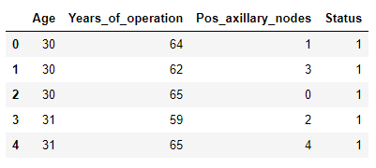
Data Set & Analysis Performed
Age: Numerical – Age of the patient at the time of operation.
Year_of_Operation: Numerical – Calendar year of when the patient was operated.
Pos_axillary_nodes: Numerical – Number of positive axillary node that was detected in the patient.
Survival_status: Numerical
If 1: patient has survived more than 5 years.
2: Patient ha not survived more than 5 years.

Slide 6
ATTRIBUTE INFORMATION
Age: Numerical – Age of the patient at the time of operation.
Year_of_Operation: Numerical – Calendar year of when the patient was operated.
Pos_axillary_nodes: Numerical – Number of positive axillary node that was detected in the patient.
Survival_status: Numerical
If 1: patient has survived more than 5 years.
2: Patient ha not survived more than 5 years.

Slide 7
DATA STATISTICS
sample set has 306 rows with no null values.
average age of patient who has undergone the operation is 52 years, with the youngest patient being 30 years and the oldest being 83 years.
The number of axillary nodes has a considerable deviation from the mean which means, there are patients who are having 0 positive axillary node to as much as 52 postive axillary nodes and 75% of people are having 4 axillary_nodes and 25% are having 0 nodes.
Status is either 1 or 2, with 75% people as 2

Slide 8
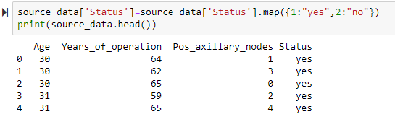
DATA NORMALISATION
Status column is boolean and has values either 1 or 2 and it is not meaningful. So, categorizing it as Yes or No
1- Yes(If the patient has survived more than 5 years)
2- No(If the patient has not survived more than 5 years)

Slide 9
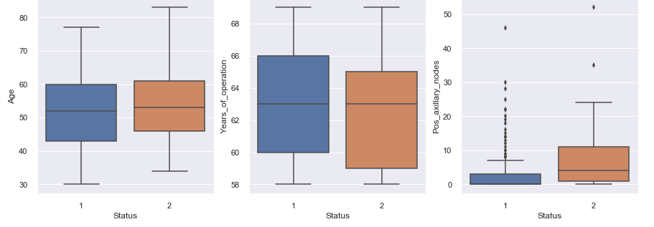
OUTLIERS TREATMENT
From the above box plot, status vs pos_axillary_nodes, it can be observed that patients who are operated after 1965, the survival rate is high.

Slide 10
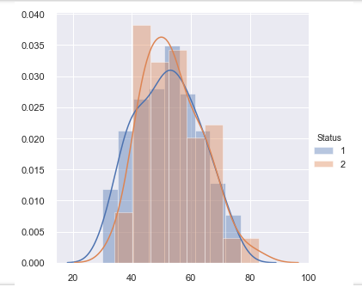
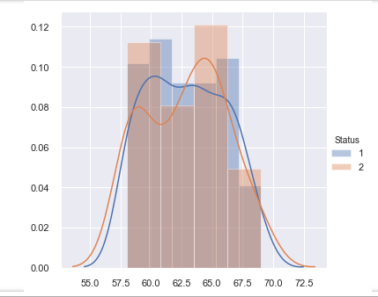
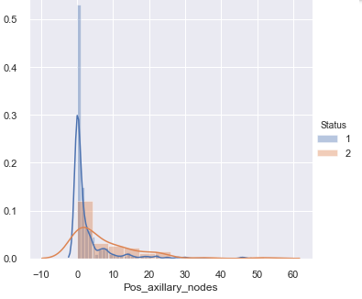
FACET GRID
It can be observed that number of positive axillary nodes are highly dense from 0 to 5.

Slide 11
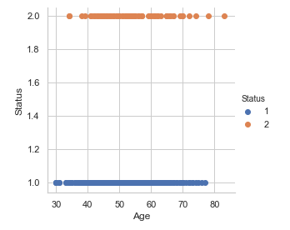
QUESTIONS
Has the age played any role in determining the survival status?
From the above plot, it is evident that if the breast cancer is detected at a young ag(i.e age<40), the survival rate is higher when somapred with age>70

Slide 12
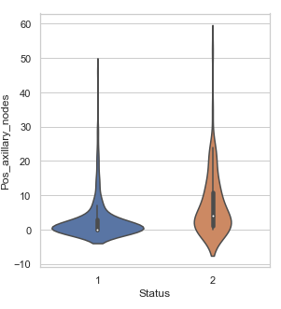
QUESTIONS
Based on the pos_Axillary_nodes how is the survival status?
Survival rate is high for the people with 0 pos_axillary_nodes

Slide 13
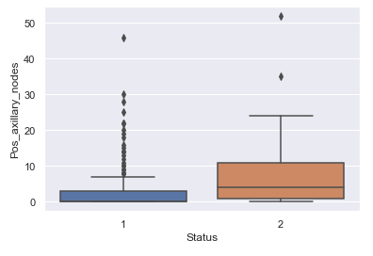
QUESTIONS
Based on the pos_Axillary_nodes how is the survival status?
Survival rate is high for the people with 0 pos_axillary_nodes

Slide 14
Conclusion
1. Pos_axillary_nodes is a useful feature that let us know the survival status.
2. From the above box plot and violin plot, it can be concluded that people who survived had 0 postive nodes.
3. Mean age who survived is 52 years and who did not is 54 years.

