Slide 1
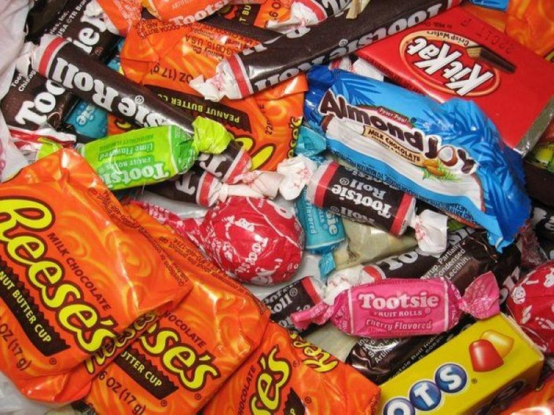

CANDY DATA
By MADHAVI RAMAN
10-Mar-2019

Slide 2
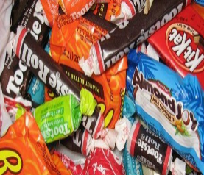
Introduction
The dataset contains study of candy data.
In this project,we will analyse as such
Which is the best popular and least popular candy.
What is the flavour of the least and best popular candy.
Predictive modeling

Slide 3
Data Profile
Competitor Name: Different Candy names that are under observation
Chocolate: Candy is chocolate flavored.
Fruity: Candy is fruity flavored.
Caramel: Candy is caramel flavored
Peanutyalmody: Candy is caramel flavored
Nougat: Candy is caramel flavored
Crispedricewafer: Candy is caramel flavored

Slide 4
Data Profile
Hard: Is the candy hard?
Bar: Is the candy a bar?
Pluribus: Will the candy come in pack or single?
Sugarpercent: The sugarpercent in the candy.
Pricepercent: The price of the candy.
Winpercent: How much is favoured?

Slide 5
Data Source and DataSet
-Name: Candy Data -Description: The data set contains attributes like the different candies,the flavour of the candy if it is chocolate or fruity or caramel or peanutmondy and so on and its corresponding sugar percentage, winpercentage and price percentage. -Is it a Sample data: Yes, it is a sample set of 87 rows

Slide 6
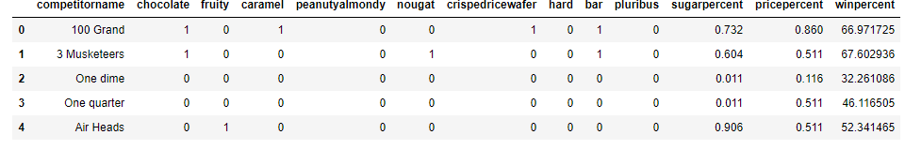
Data Set & Analysis Performed
1- Indicates the flavor present in the candy
0- indicates the flavor not present in the candy.

Slide 7
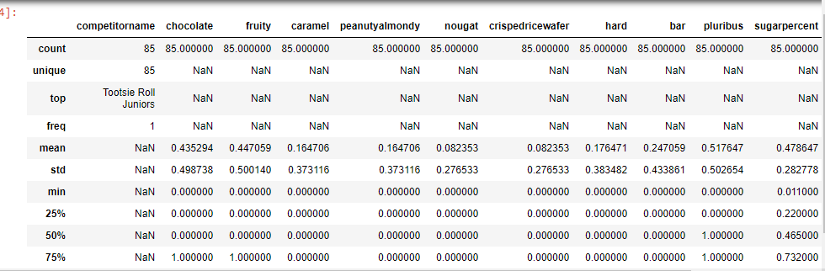
DATA STATISTICS
1.The sample set has 85 rows with no null values in it. 2.The flavor of each candy if it contains chocolate or fruity or caramel or peanut almonds or rice crisp wafers is indicated by 1 or 0. 3.If it is 1 then it indicates, that the candy has that particular flavor. If it is 0 then that ia absent. 4.pluribus indicates if it is many candies in a bag or box. 5.Sugarpercent indicates the the percentile of sugar it falls with in the data set.

Slide 8
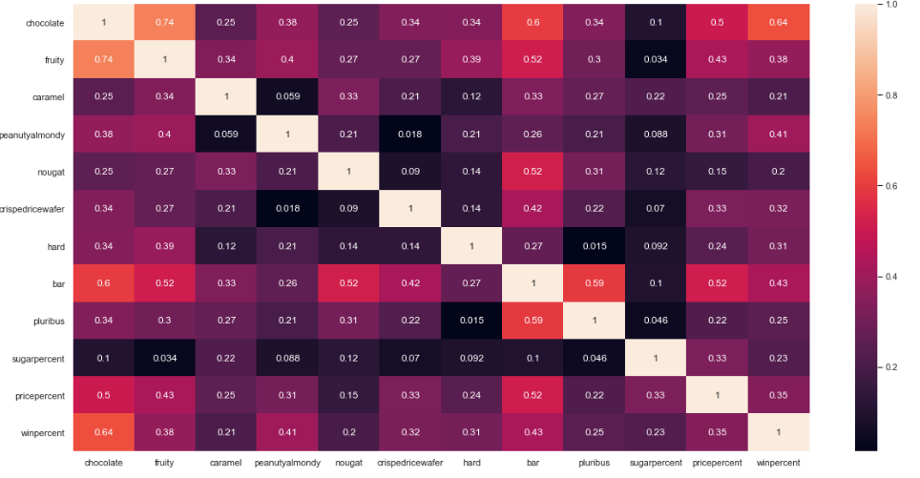
Heat Map

Slide 9
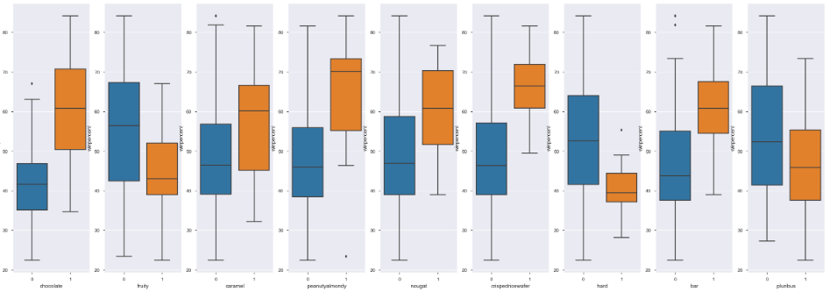
Box Plot
The winpercent for every candy.

Slide 10
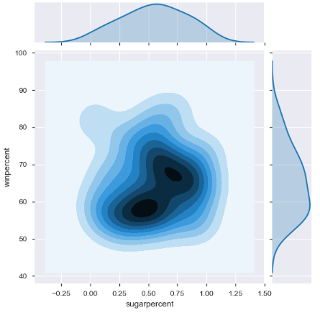
QUESTIONS
Is there a relationship between sugarpercent and winpercent?
?
From the above plot, it can be observed that the amount of sugar present in the candy does not favour the candy.

Slide 11
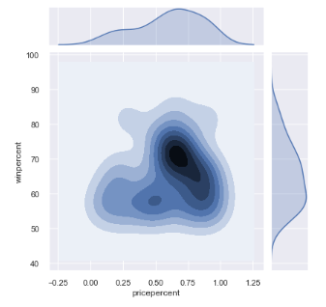
QUESTIONS
Is there a relationship between x`pricepercent and winpercent?
From the above plot, it can be observed that the cost of the candy does not contribute to best favoured candy.

Slide 12
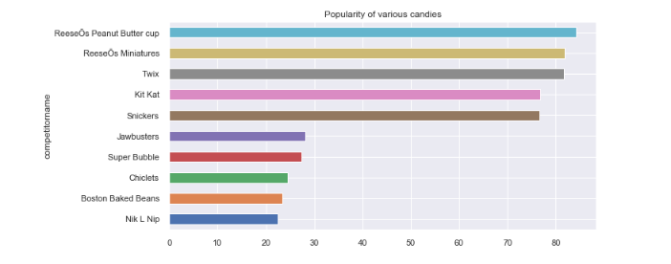
Most Popular and the least popular candy
From the above plot, it can be concluded that Reeses Peanut butter cup is the most popular candy and Nik L Nip is the least popular candy, This has concluded based on the winpercentage

Slide 13
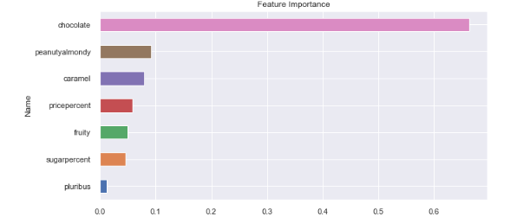
Identifying the components that make good candy
From the above plot, it can be concluded that,chocolate is the component that makes good candy. This has concluded based on the winpercentage

Slide 14
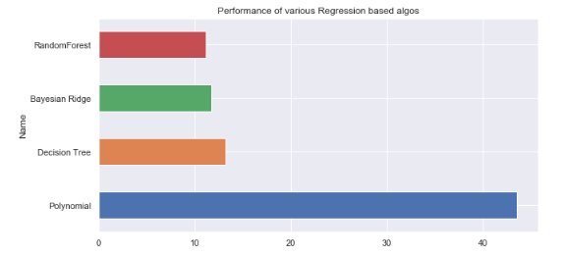
Models

Slide 15
Conclusion
1.Reeses Peanut butter cup is the most popular candy and Nik L Nip is the least popular candy, This has concluded based on the winpercentage.
2. From the above plot, it can be concluded that,chocolate is the component that makes good candy. This has concluded based on the winpercentage

