Slide 1


IT1010 – Introduction to Programming
Introduction to Programming
SLIIT - Faculty of Computing
Lecture 1 – Part 1 Algorithms and Flowcharts

Slide 2
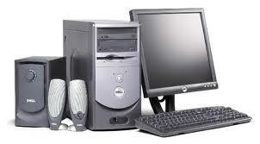
What is a computer ?
Introduction to Programming
A computer is a machine for processing data to produce information.

Slide 3
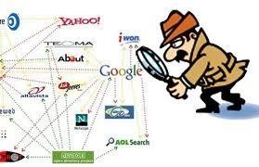
What can it do ?
Introduction to Programming
Store large amounts of data.
Process large amount of data quickly.
Fast access to information and records
Increase productivity

Slide 4

What can it do ?
Introduction to Programming
What else…………..
Calculate
Process ( word, numbers, pictures, sound )
Store and retrieve
Match / compare / sort
Merge
And some more…..

Slide 5
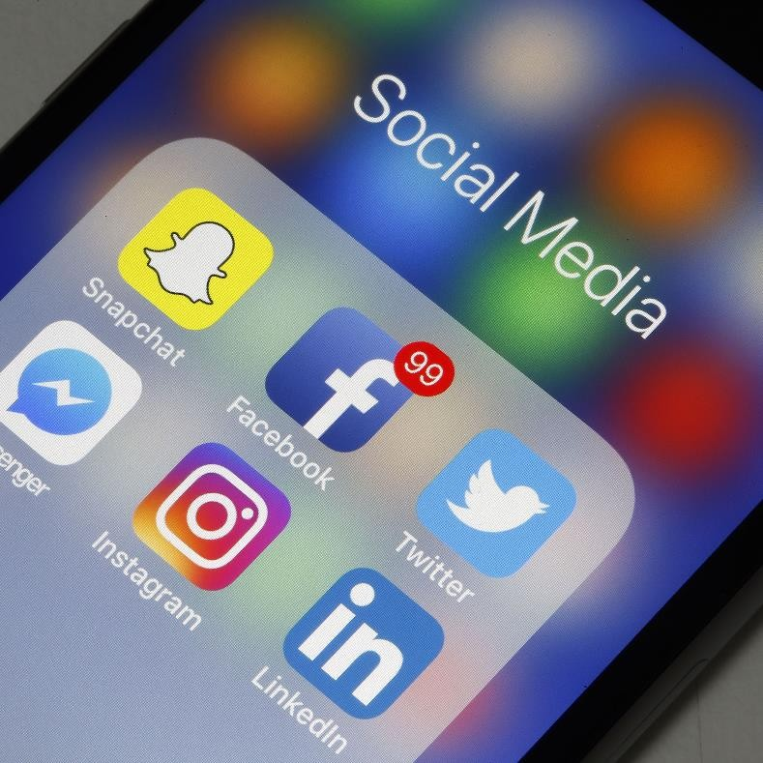

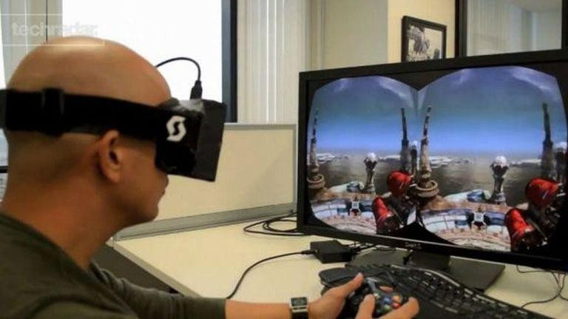
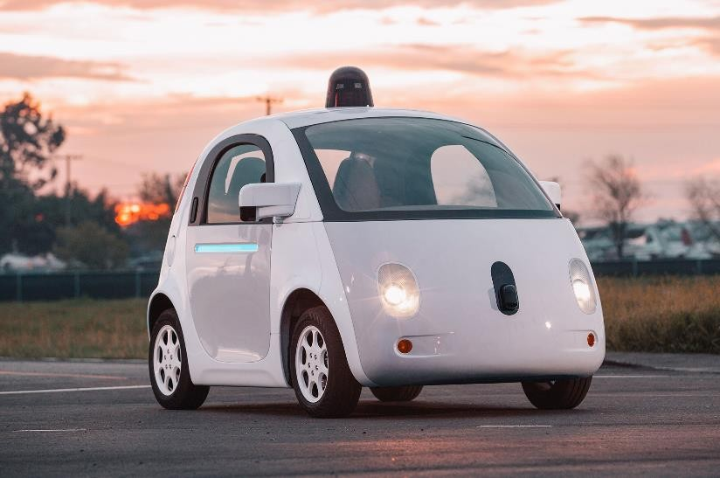
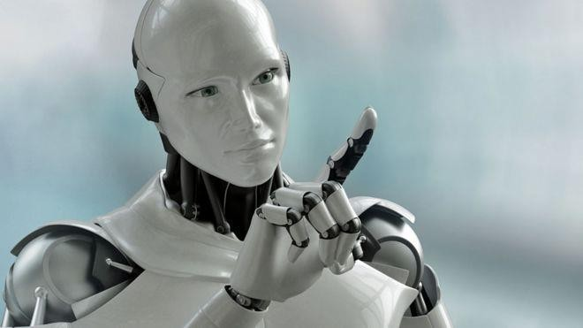

Introduction to Programming

Slide 6


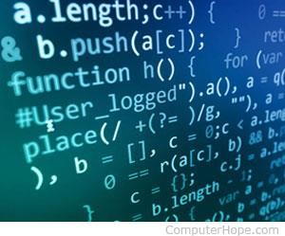
How do computers do all these
Introduction to Programming
How do you instruct a computer to do tasks?
Write a program???
Program
is a set of step-by-step instructions written to perform a specific task…
Program consist of a set of instructions that are executed by the computer
SLIIT - Facu
lty of Computing

Slide 7
How do computers do all these…?
Introduction to Programming
This process of writing programs is called programming
These programs are written by a programmer
A set of rules that tell a computer what operations to perform are called programming language
In other words, we can call this program Software

Slide 8
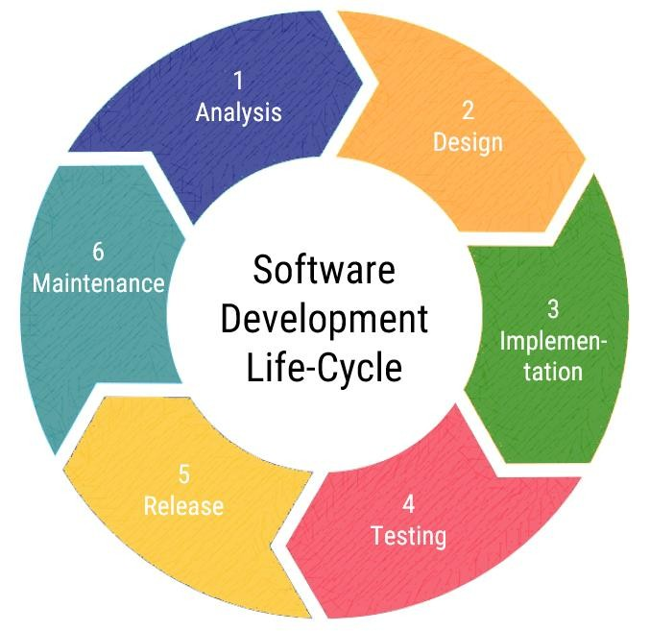
How do you write programs
Introduction to Programming
In developing a computer program the programmer must:
Analysis - Understand/Define the problem
Design – plan the solution
Implement - Write/Code the program
Test - Compile, Debug & Test
Release - Implement the program
Maintain - Document the program

Slide 9

What can the computer do ?
Introduction to Programming
Process
Input
Output
Screen Print File
Keyboard File
Calculate
Store
CPU

Slide 10
Analyze / Understand the problem
Introduction to Programming
Problem : Given 2 numbers (say a and b) where a < (is less than) b , I want to find the sum of numbers between a and b
Input
Task
Output
: Integers a & b (where a<b)
: Find the sum of numbers between a & b
: The sum

Slide 11

Planning the solution
Introduction to Programming
It is important to spend considerable time in planning your solution (program) in
order to ensure it is properly structured
If properly planned and presented, the time and effort in ‘coding’ the solution, will be minimal
Use algorithms to prepare a solution

Slide 12
Algorithms
Introduction to Programming
An algorithm is a complete step-by-step set of instruction of how to solve a
problem.
Consist of
The instructions
The order of the instructions

Slide 13
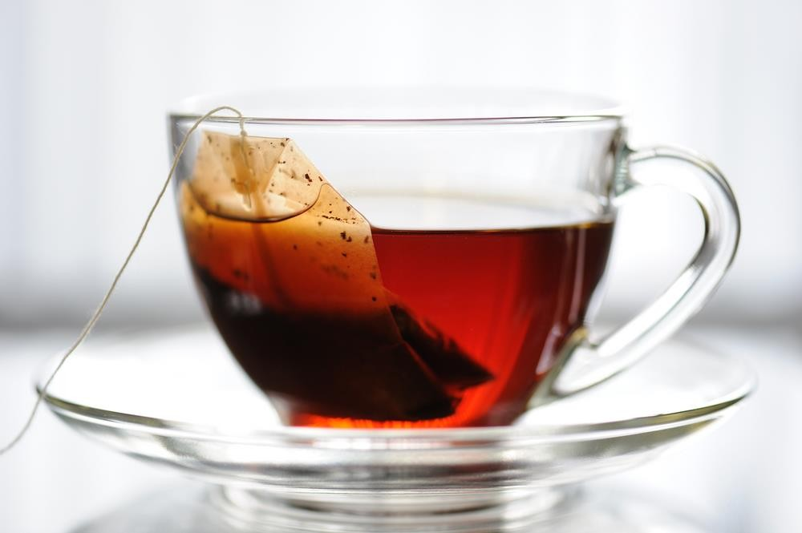
How to make a cup of Tea ?
Introduction to Programming
Fill electric tea kettle
Bring it to a boil
Pour hot water in cup
Put teabag in cup
Steep for 4 minutes
Remove teabag

Slide 14
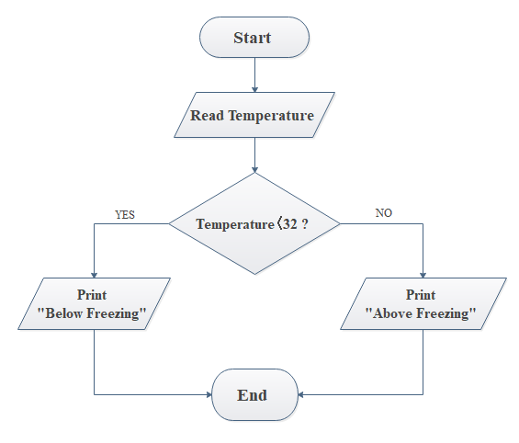

Algorithms
Introduction to Programming
Algorithms is Programming are represented by
Flowcharts
Pseudo codes
Start
Input Temperature If Temperature < 32
Then Print “Below freezing” Else
Print “ Above Freezing
End

Slide 15
Flow charts
Introduction to Programming
It is a step by step diagrammatic representation of the program
Each instruction is represented by a Symbol.
Arrow shows the order in which the instructions are executed.

Slide 16
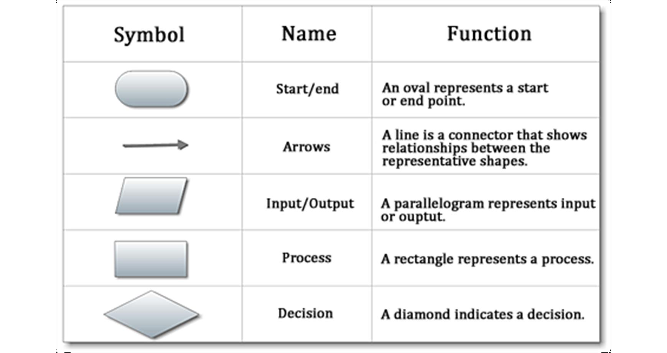
Flow chart symbols
Introduction to Programming

Slide 17
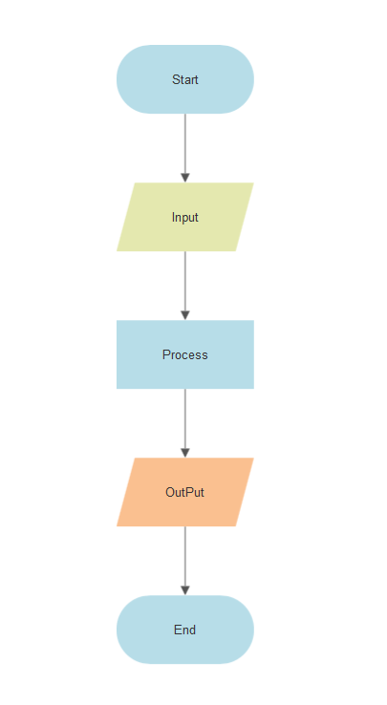
Flow charts
Introduction to Programming
Most simple algorithms that you will develop will involve inputting some data, performing some calculation and finally displaying the output.

Slide 18
The Logical Constructs / Control structures
Introduction to Programming
Three basic constructs that controls the flow of an algorithm;
Sequence
Selection
Iteration

Slide 19
Sequence
Introduction to Programming
SEQUENCE is a linear progression where one task is performed sequentially after
another…
solution steps must follow each other in a logical sequence
Statements are executed in the same order as they are written.

Slide 20
Example 01
Introduction to Programming
Put the following steps in correct order and draw a flowchart to show
“ How to arrange a flower vase”.
Cut the selected flower
Go to the garden
Arrange the flowers in the vase
Get the vase
Select some flowers
Pour some water into the vase

Slide 21





Introduction to Programming
Start
Example 01 - Solution
Go to the garden
Select some flowers
Cut the selected flowers
Get the vase
Pour some water into the vase
Arrange the flowers in the vase
Stop
21

Slide 22
Example 02
Introduction to Programming
Draw a flowchart to input two numbers and find the sum and average.

Slide 23





Start
Introduction to Programming
Example 02 - Solution
Sum = 0
Average = 0
Input Number1
Input
Number2
Sum = Numbe1 + Number2
Average = Sum / 2
Display
Sum, Average
Stop

Slide 24
Exercise
Introduction to Programming
Draw a flowchart to input the radius of a circle and calculate and display the area.
24

