Slide 1

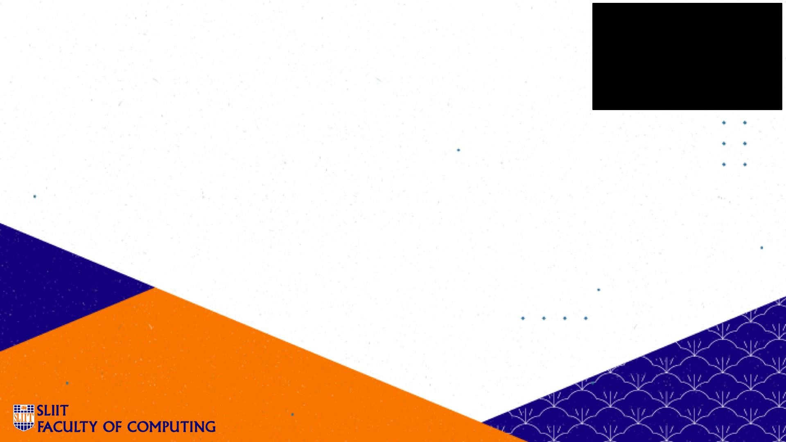


IT1010 – Introduction to Programming
Introduction to Programming
SLIIT - Faculty of Computing
Lecture 1 – Part 2
Introduction to C programming

Slide 2
Objectives
Introduction to Programming
At the end of the Lecture students should be able to
Describe the evolution of programming languages
Write a simple C program

Slide 3


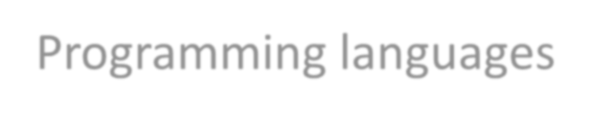
Computer Program
Introduction to Programming
Computer Program
Set of instructions given to the computer.
Programmers write programs in various programming languages.
Programming languages can be mainly divided into :
Low-level programming languages
Machine Language
Assembly Language
High-level programming languages

Slide 4

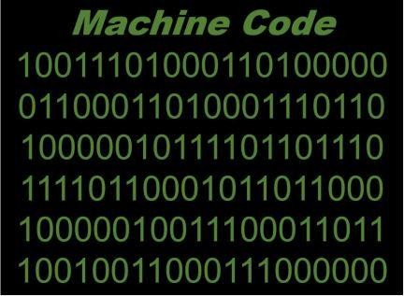
Programming Languages
Introduction to Programming
Low-level programming Languages
Machine Languages
Consist of 1 s and 0 s
Machine dependent
Computer can directly understand its own machine language
Tedious and error prone for programmers

Slide 5

Programming Languages
Introduction to Programming
Assembly Languages
English-like abbreviations called mnemonics formed the basis
Clearer to humans but incomprehensible to computers
Need to translate to machine language using translator programs
called assemblers
Example:
load salary add bonus store total

Slide 6
Programming Languages
Introduction to Programming
High Level Programming Languages
Instructions look almost like English and mathematical notations
Substantial tasks can be accomplished from a single statement
Easy for humans to understand
Translator programs convert high-level programming languages into machine language
Example:
total = salary + bonus;
C, C++, Python, Visual Basic and Java are some of the high level programming languages.

Slide 7


Program Code Translation
Introduction to Programming
Source Code
Object Code (machine language code)
Translator
Translator
Assemblers (convert assembly language programs to machine language)
Compilers (convert high-level language programs to machine language)
- Interpreters (execute high-level language programs line by line)

Slide 8
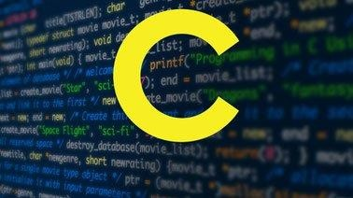
History of C
Introduction to Programming
C language was evolved from two previous languages, BCPL and B by Dennis Ritchie at Bell
Laboratories in 1972.
C initially became widely known as the developing language of the UNIX operating system.
C99 and C11 are revised standards for C programming language that refines and expands the
capabilities of C.

Slide 9



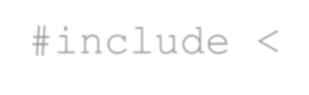




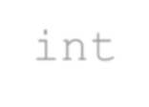
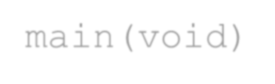


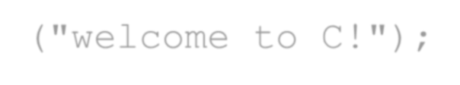


Simple C Program
Introduction to Programming
Source Code
Output
/* First program in C
This program displays a message */ #include <stdio.h>
welcome to C!
// function main begins program
execution
int main(void)
{
printf("welcome to C!");
return 0;
} // end of function main

Slide 10






Introduction to Programming
Simple C Program Description
/* First program in C
This program displays a message */
// function main begins program execution
These are comments. Comments are used to document programs and it improves the program readability. C compiler ignores comments.
Line comments begin with // and continue for the rest of the line. /* … */ multi-line comments can also be used. Everything from /* to */ is a comment.
#include <stdio.h>
This is a directive to C preprocessor. Lines begin with # are processed by the preprocessor before compiling the program. Here,
preprocessor includes the content of stdio.h in the program. stdio.h is a header file which contains information about standard input/output library function calls such as printf.

Slide 11




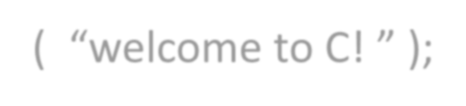
Simple C Program Description
Introduction to Programming
int main(void)
Every C program has this main function and it begins executing at main. “int” to left of main indicates that the
function returns an integer. “void” in parentheses indicates that main does not receive any information
{
Left brace , { , begins the body of every function. Functions ends with a corresponding right brace. The portion of the program between the braces is called a block.
printf( “welcome to C! ” );
Entire line is called a statement. It instructs the computer to perform an action. A statement must end with a semicolon. This statement prints a string of characters marked by the quotation marks on the screen.

Slide 12

Simple C Program Description
Introduction to Programming
Included at the end of every main function. It is used to exit the main function and the value 0 indicates a successful termination.
Blank Lines and White Space
Blank lines, space characters and tab characters are known as white space. White-space characters are normally ignored by the compiler.
return 0;

Slide 13







Introduction to Programming
C Program Development Environment
Creating the C program in the editor. C program file names end with the .c extension
Preprocessor executes automatically before the compiler’s translation phase begins. It obeys special commands called preprocessor directives.
Compiler translates the C program into object code.
Linker links the object code with the libraries and creates the executable file.
Loader puts the executable image in memory . Program is executed under the control of the CPU.
Editing
Preprocessing
Compiling
Linking
Loading
Execution

Slide 14


































More Examples
Introduction to Programming
// A text break into two printf statements #include <stdio.h>
/* function main begins program execution */ int main(void)
{
printf( "welcome "); printf( "to C!\n");
return 0;
} // end of main function
// A text printed in multiple lines using single printf
#include <stdio.h>
/* function main begins program execution */ int main(void)
{
printf("welcome \nto C! \n");
return 0;
} // end of main function
The backslash (\) is called escape character.
The escape sequence \n means newline.

Slide 15
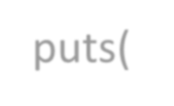

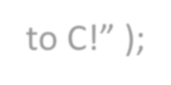

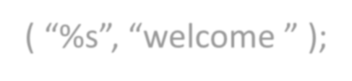
printf() function
Introduction to Programming
printf( “welcome to C!\n” ); can be written as,
puts( “welcome to C!” );
puts function adds newline automatically.
printf( “welcome “ ); can be written as,
printf ( “%s”, “welcome ” );

