Slide 1


IT1050- Object Oriented Concepts
IT1050| Object Oriented Concepts| Introduction|
1

Slide 2

Agenda
Introduction to Module
Recalling C
C to C++
2

Slide 3
OOC Lecture Panel
Ms Anjalie Gamage – (Lecturer in Charge) Metro Campus
Ms. Kushnara Suriywansa – Malabe Campus
Ms. Bhagyani Chathurika – Matara Centre
Ms. Chandula Rajapakse – Kandy Centre
Ms. Sachinthra Thilakarathne – Kurunagala Centre
Mr. Umaselvan Kanapathippillai – Jaffna Centre

Slide 4
Introduction to Module

Slide 5
Learning Outcomes
Understand and apply the basic concepts of Object Oriented Programming
Design solutions by identifying the classes and relationships (Object Oriented Analysis and Design)
Implement a solution to the given problem using the C++ Language

Slide 6
Delivery
Lectures - Recorded / Live
1 Hour per week
Tutorial
1 Hour per week
Labs
2 Hours per week

Slide 7
Assessment Criteria
Continuous Assessment
Assignment 1 - Practical/Submissions 10%
Assignment 2 - Group work ( case study ) 10%
Mid Term Examination 20%
Final Examination
60%

Slide 8
Content
Introduction to C++
Introduction to OOP Concepts
Abstraction
Encapsulation
Information Hiding
Identifying classes and objects
Object Oriented Design
Noun Verb Analysis
CRC Cards
Introduction to Object Oriented Programming
Advanced Object Oriented Concepts
Relationships
Polymorphism

Slide 9
Teaching Learning Activities
Case Study
Home work
Quizzes
Group work
Library System
Watching Videos
Based on Home work
Assignment 2

Slide 10
Academic Integrity Policy
Are you aware that following are not accepted in SLIIT???
Plagiarism - using work and ideas of other individuals intentionally or unintentionally
Collusion - preparing individual assignments together and submitting
similar work for assessment.
Cheating - obtaining or giving assistance during the course of an
examination or assessment without approval
Falsification – providing fabricated information or making use of such
materials
From year 2018 the committing above offenses come with
serious consequences !
See General support section of Courseweb for full information.

Slide 11

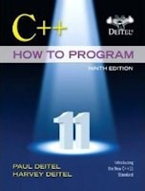
Reference
Deitel & Deitel’s (2016), C++ How to Program, 9th Edition
Grady Brooch (2008), Object- Oriented Analysis and Design with Application,
3rd Edition

Slide 12

Introduction to C++

Slide 13
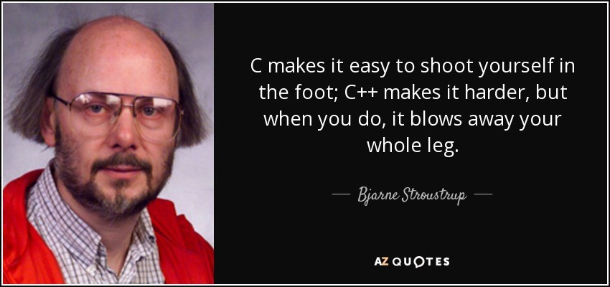
C++
One of the most powerful and popular programming languages
Evolved from C
Developed by Bjarne Stroustrup in 1979 at Bell Laboratories
Provide capabilities for Object Oriented Programming
Current Version – C++ 20

Slide 14
C vs C++
// C Program
// C++ Program
#include <iostream>
#include <stdio.h>
int main ( )
{
std::cout << "Hello World !" ;
std::cout << std::endl;
void main ( void)
{
printf ("Hello World ! \n ");
return 0;
}
}
Output :
Hello World !

Slide 15
First C++ Program
// C++ Program : prg_01.cpp
//Printing a String
#include <iostream> // allows program to output data to the screen
int main ( ) // Function main begins program execution
{
std::cout<< "Hello World ! "; // Display message
std::cout<< std::endl; // New line
return 0; // indicate that program ended successfully
} // End of main function

Slide 16
Comments
// C++ Program : prg_01.cpp
//Printing a String
Comments provide information to the people who read the
program
Comments are removed by the preprocessor, therefore the compiler ignores them
In C++, there are two types of comments
Single line comments |  | //
Delimited comments line. | /* | */ for comments with more than one

Slide 17
Preprocessing Directives
#include <iostream>
Lines begin with # are processed by the preprocessor before the
program is compiled.
Notifies the preprocessor to include in the program the content of the
input/output stream header <iostream>
“iostream” is a header file containing information used by the compiler when compiling a program with output data to screen or input data from the keyboard using C++ input/output stream

Slide 18
The main function
int main()
{
}
C++ programs begin executing at function main.
It is the main building block of a program.
int indicates that main returns an integer value.
{ ( left brace ) indicates the begin of the main body and } ( right brace )
indicates the end of the function’s body.

Slide 19
Output Statement
std:: cout<< "Hello World ! ";
cout |  | : to indicate the computer to output something on screen
<< |  | : is the stream insertion operator used to send information to cout
"Hello | World !" | :String / String Literal. What you need
 |  | to display on screen
; |  | : statement terminator

Slide 20
New Line
std:: cout<< std::endl ;
endl
: to go to a new line ( same as " \n ") eg : std::cout<< " \n ";
std:: cout<< "Hello World ! " << std::endl ;
Hello World !
_
Output :

Slide 21
Exercise
Write a C++ program to display your first name, your home town and school using three lines

Slide 22
Reference
Chapter 01 & 02
Deitel & Deitel’s (2016), C++ How to Program, 9th Edition

