Slide 1
Shipping Optimization Using Apache Spark

Slide 2

Proposed Problem Statement:
A truck is loaded with goods that need to be delivered to 19 cities across the United States.
The challenge is to find the most efficient route that minimizes total distance traveled.
The journey begins in Harrisburg, PA, and the goal is to reach each destination exactly once with the least mileage possible.
Real-world constraints such as weather and traffic conditions are also considered for realistic and adaptive planning.
Project Goals:
Build a distance matrix using Google Maps API
Optimize routes using algorithms
Visualize routes, distances, and weather effects
Handle large-scale data using Apache Spark

Slide 3
Project Implementation Highlights
Google Maps API used to build a real-world distance matrix between 20 major US cities.
WeatherAPI integrated to apply time penalties based on conditions:
+10% time for rain
+20% time for snow
Generated a ~20GB shipping dataset with features like:
Shipment type, driver ID, fuel cost, temperature, delivery status, traffic delay
Built and visualized:
Distance heatmaps
Shipment and weather impact charts
Applied two route optimization methods:
TSP (Greedy Heuristic) – baseline route
Genetic Algorithm – optimized for real-world delays
Displayed optimized delivery paths on an interactive map using Folium

Slide 4
Original Defense and Changes
Data Collection
• Use APIs (Google Distance Matrix, OpenRouteService) to retrieve distance data between cities.
• Store the data in a distributed format using Spark DataFrame for processing.
Route Optimization
• Use Dijkstra’s Algorithm to compute the shortest path between cities.
• Use Genetic Algorithm and Heuristic approach
Data Processing & Visualization
• Utilize Apache Spark for large scale data handling and processing.
• Generate interactive charts to display the analysis and results.
Changes : No major changes implemented. Switched fully to Google Distance Matrix API due to consistency and better documentation.

Slide 5
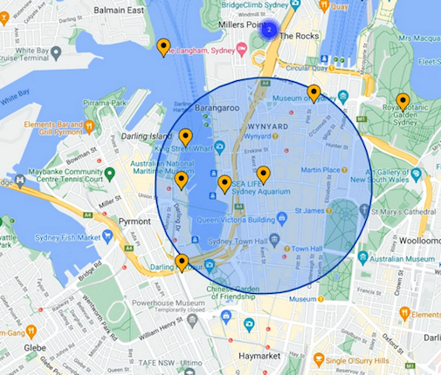
Input Data Sources and Types
Data Sources Used
Google Distance Matrix API
City-to-city driving distance and duration
WeatherAPI
Real-time weather conditions at destination cities
Data generation using Python
20GB shipping dataset with shipment type, vehicle, fuel cost, weather, etc.
Static City Coordinates
Latitude & longitude for map plotting (Folium)
Data Types Used
Structured CSV and Parquet files
JSON responses from APIs
Python dictionaries for coordinates
Spark DataFrames for big data processing

Slide 6
Tools and Technologies Used
Apache Spark – Big data processing and scalable analytics
Python – Primary programming language for scripting, APIs, and simulation
Google Distance Matrix API – Real-time distance and duration data
WeatherAPI – Added realistic delays due to weather conditions
Folium & Plotly – Interactive maps and visualizations
Jupyter Notebook – Code development, EDA, and experimentation
Hadoop HDFS – Storage and handling of 20GB dataset
Pandas & PySpark – Data manipulation and transformation
Genetic Algorithm & TSP – Route optimization logic

Slide 7
Data Pipeline and Flow
City Input & Coordinates
Start from Harrisburg, PA + 19 delivery cities
API Integration
Google Distance Matrix API → Real distances & durations
WeatherAPI → City-specific weather data
Data Generation (~20GB)
Created shipping records with vehicle, driver, weather, cost, etc.
Data Processing with Spark
Clean, join, transform, and store in CSV & Parquet formats
Route Optimization
TSP (greedy) for baseline
Genetic Algorithm with weather/traffic-aware scoring
Visualization
Folium for maps, Plotly for interactive charts, EDA summaries

Slide 8
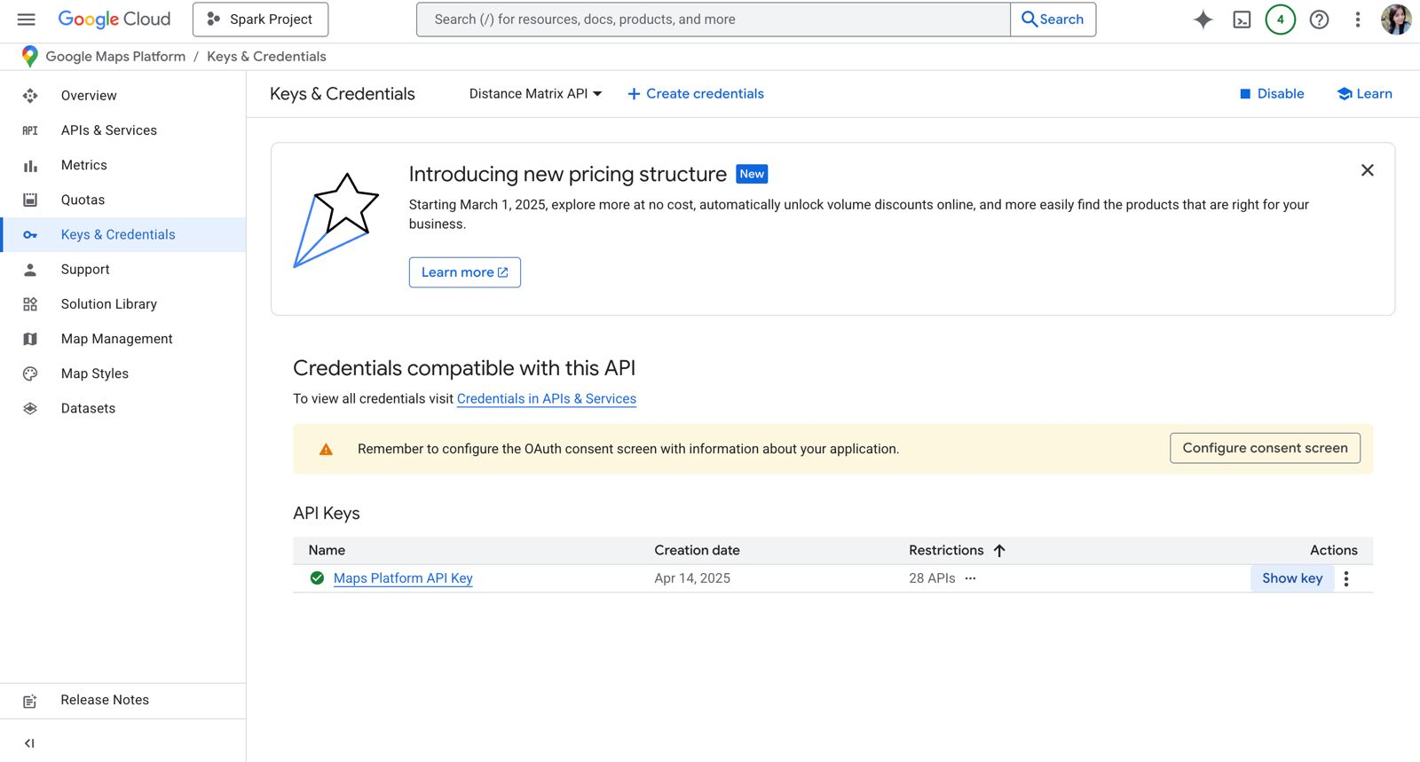
Google Maps API

Slide 9
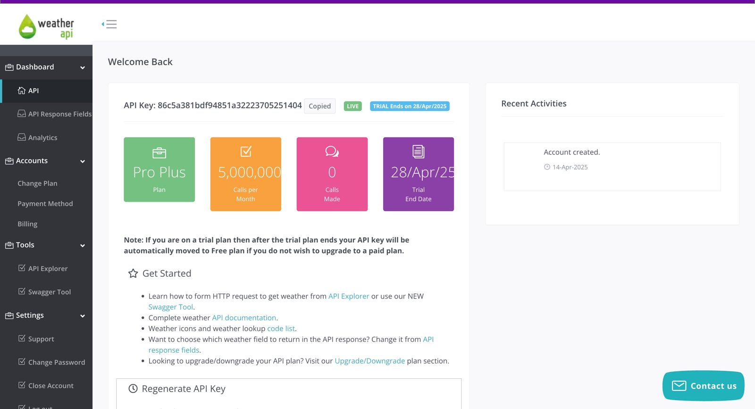
Weather API

Slide 10
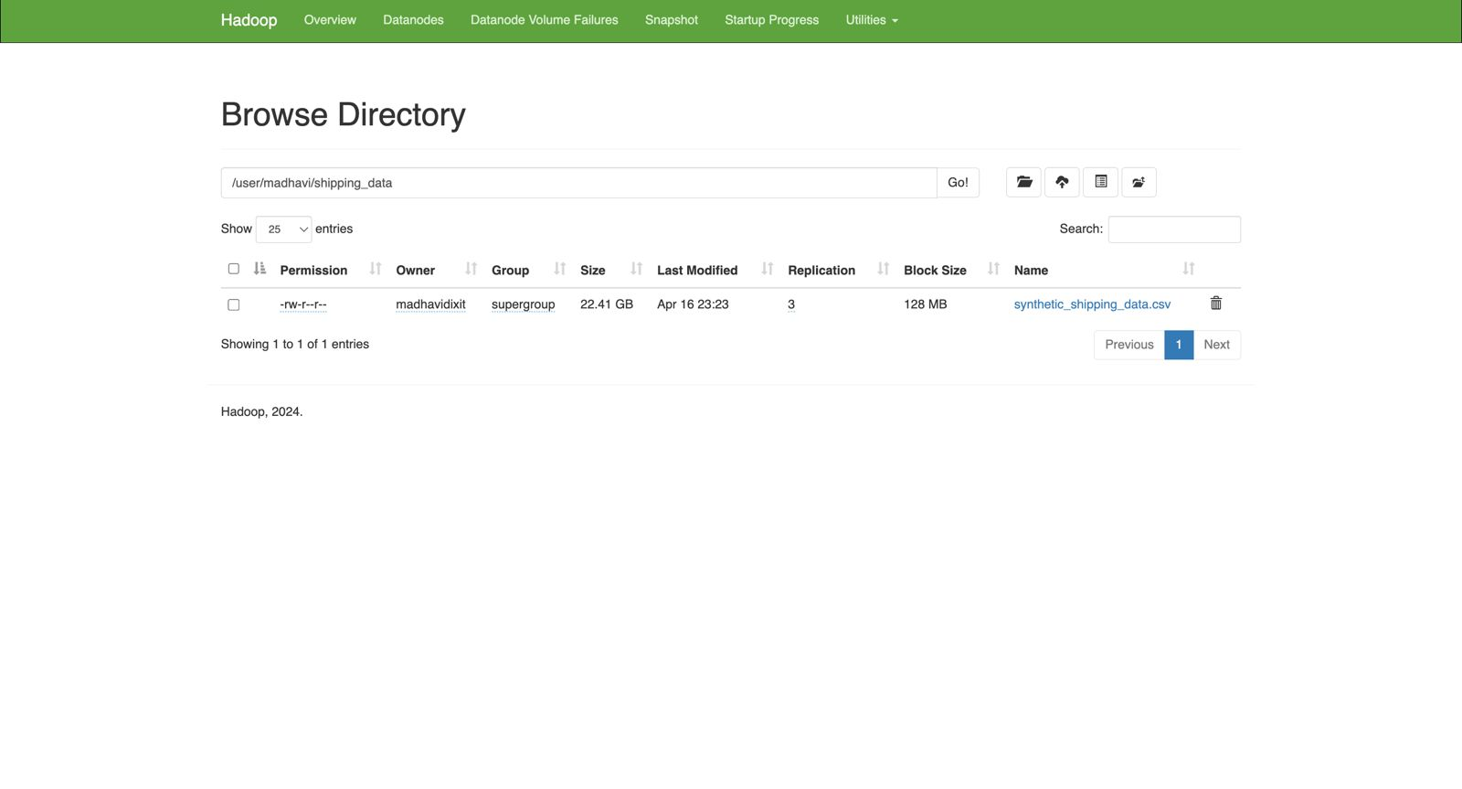
HDFS

Slide 11
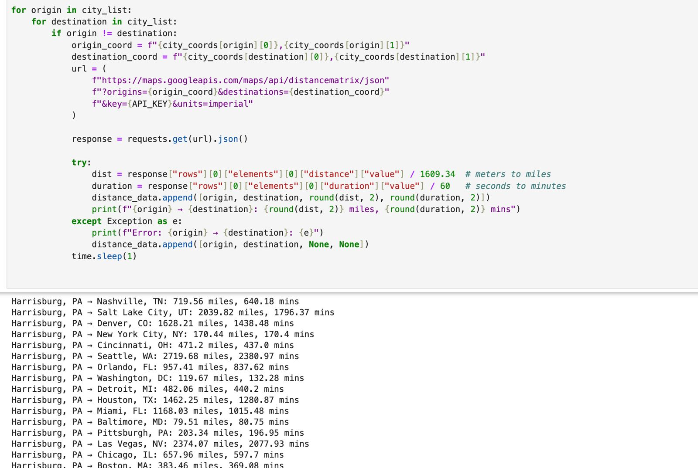
Fetching GoogleMaps API Data

Slide 12
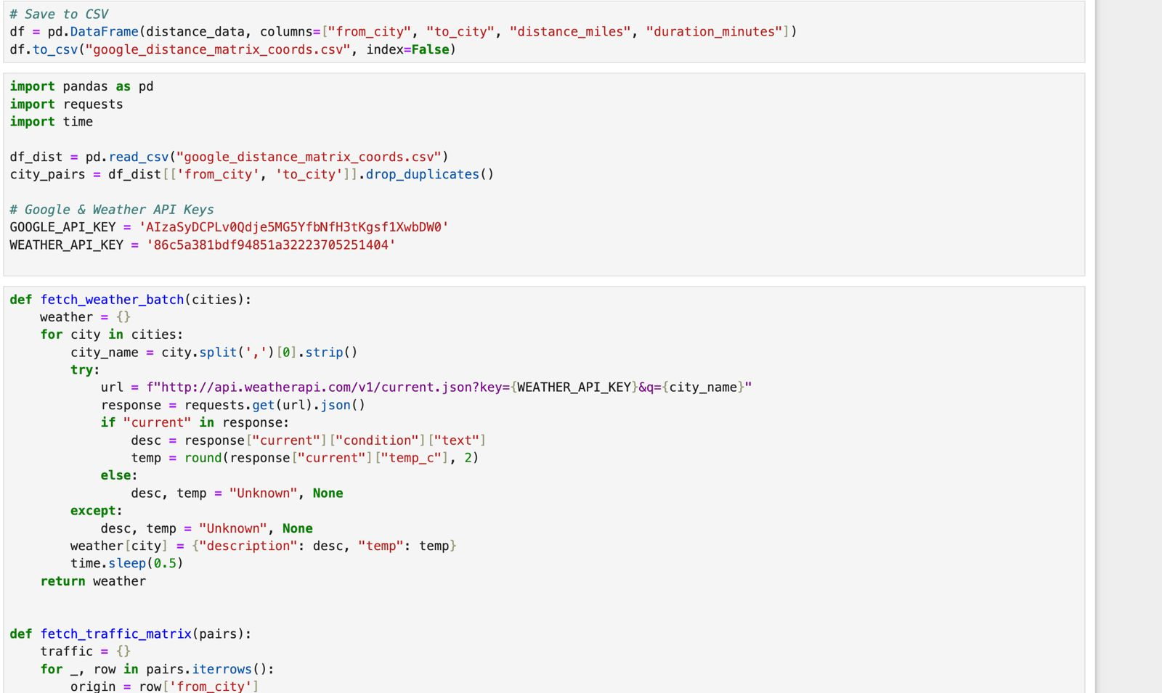
Fetching Weather and Traffic Data

Slide 13
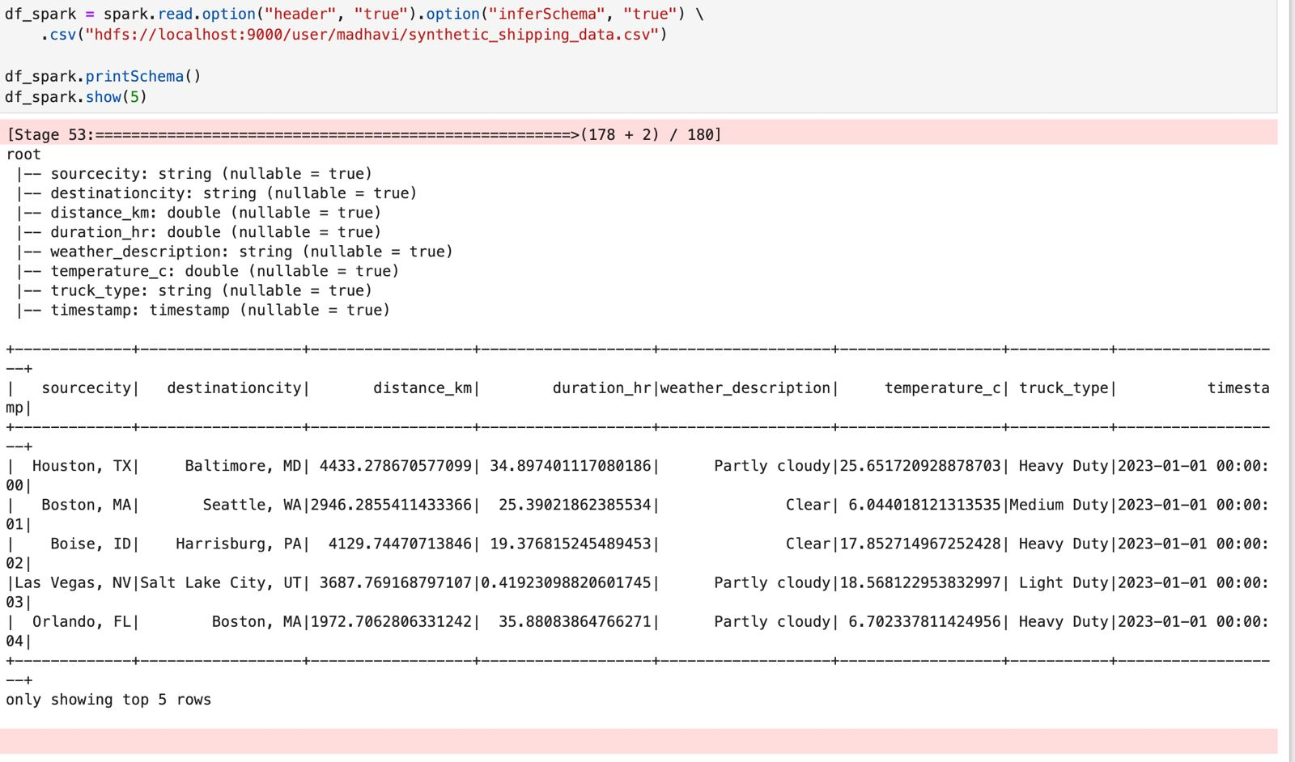
Sample of Data Generated

Slide 14
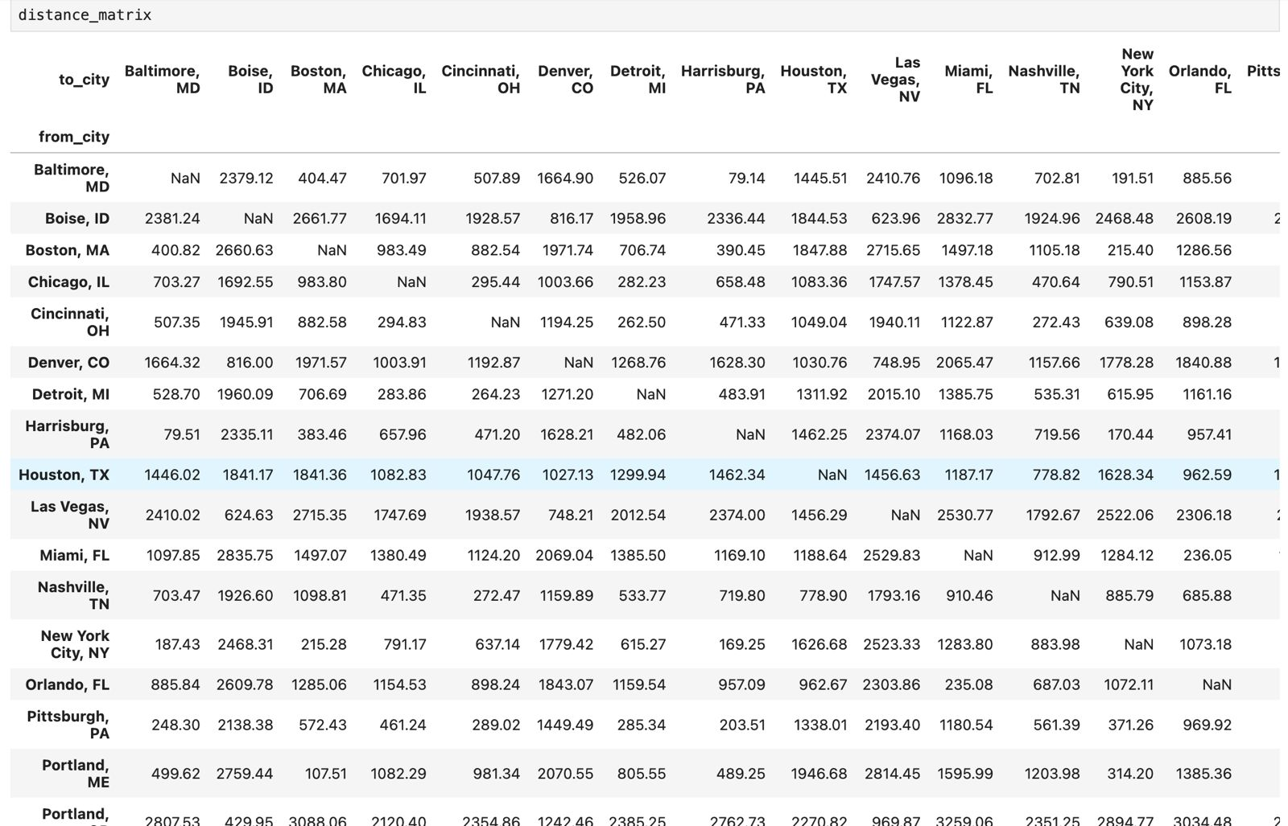
Distance Matrix

Slide 15
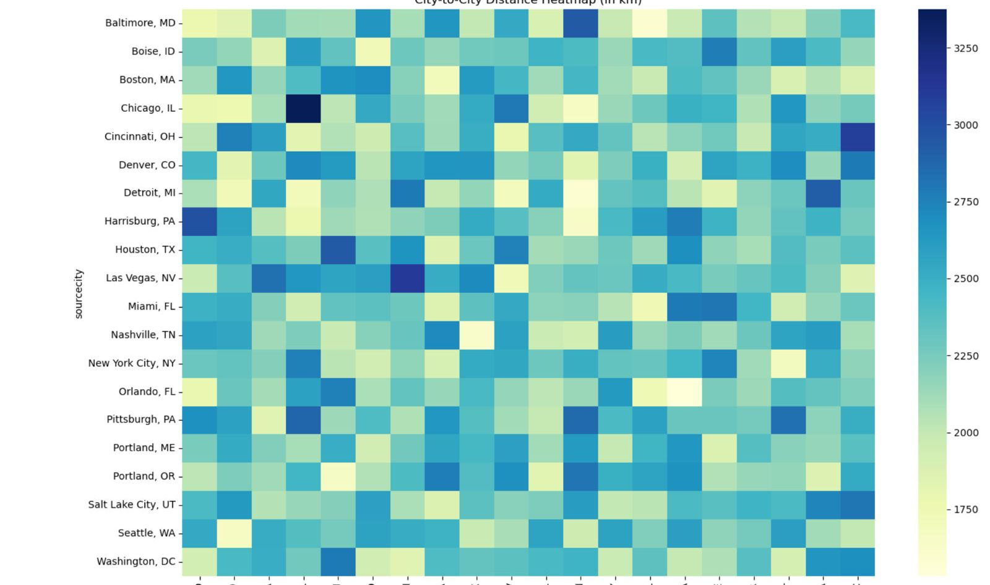
City-to-City Distance Heatmap

Slide 16
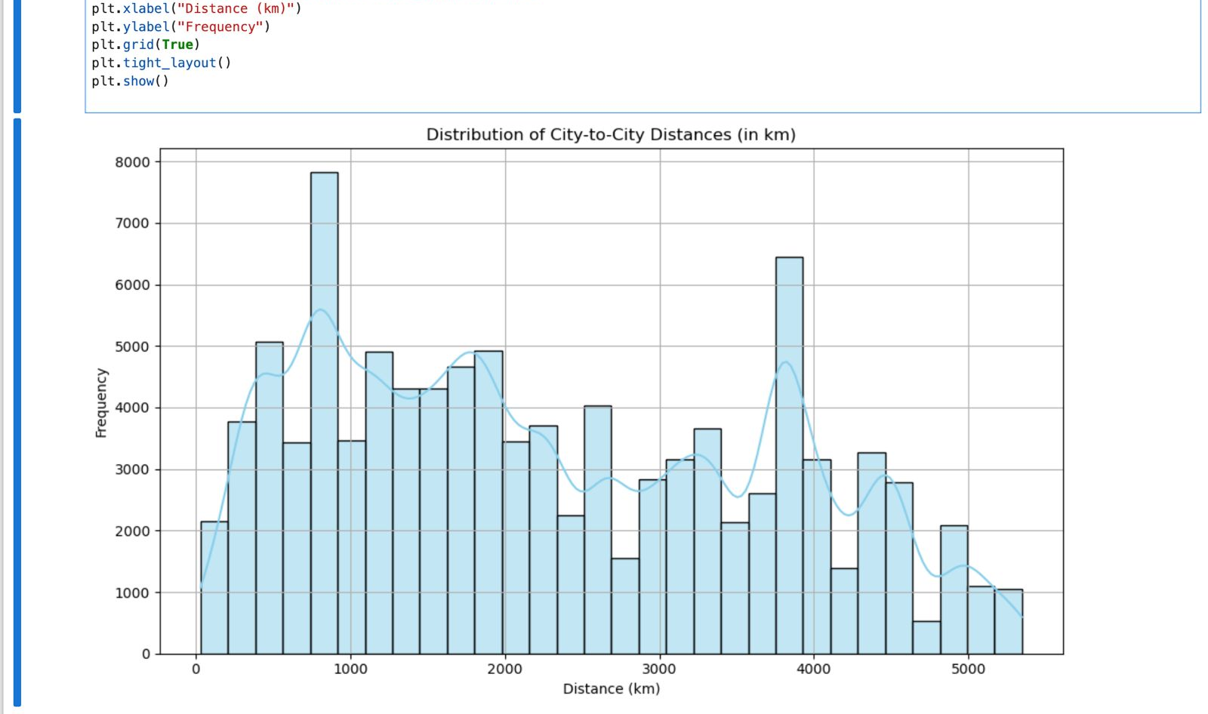
Distribution of City-to-City Distances

Slide 17
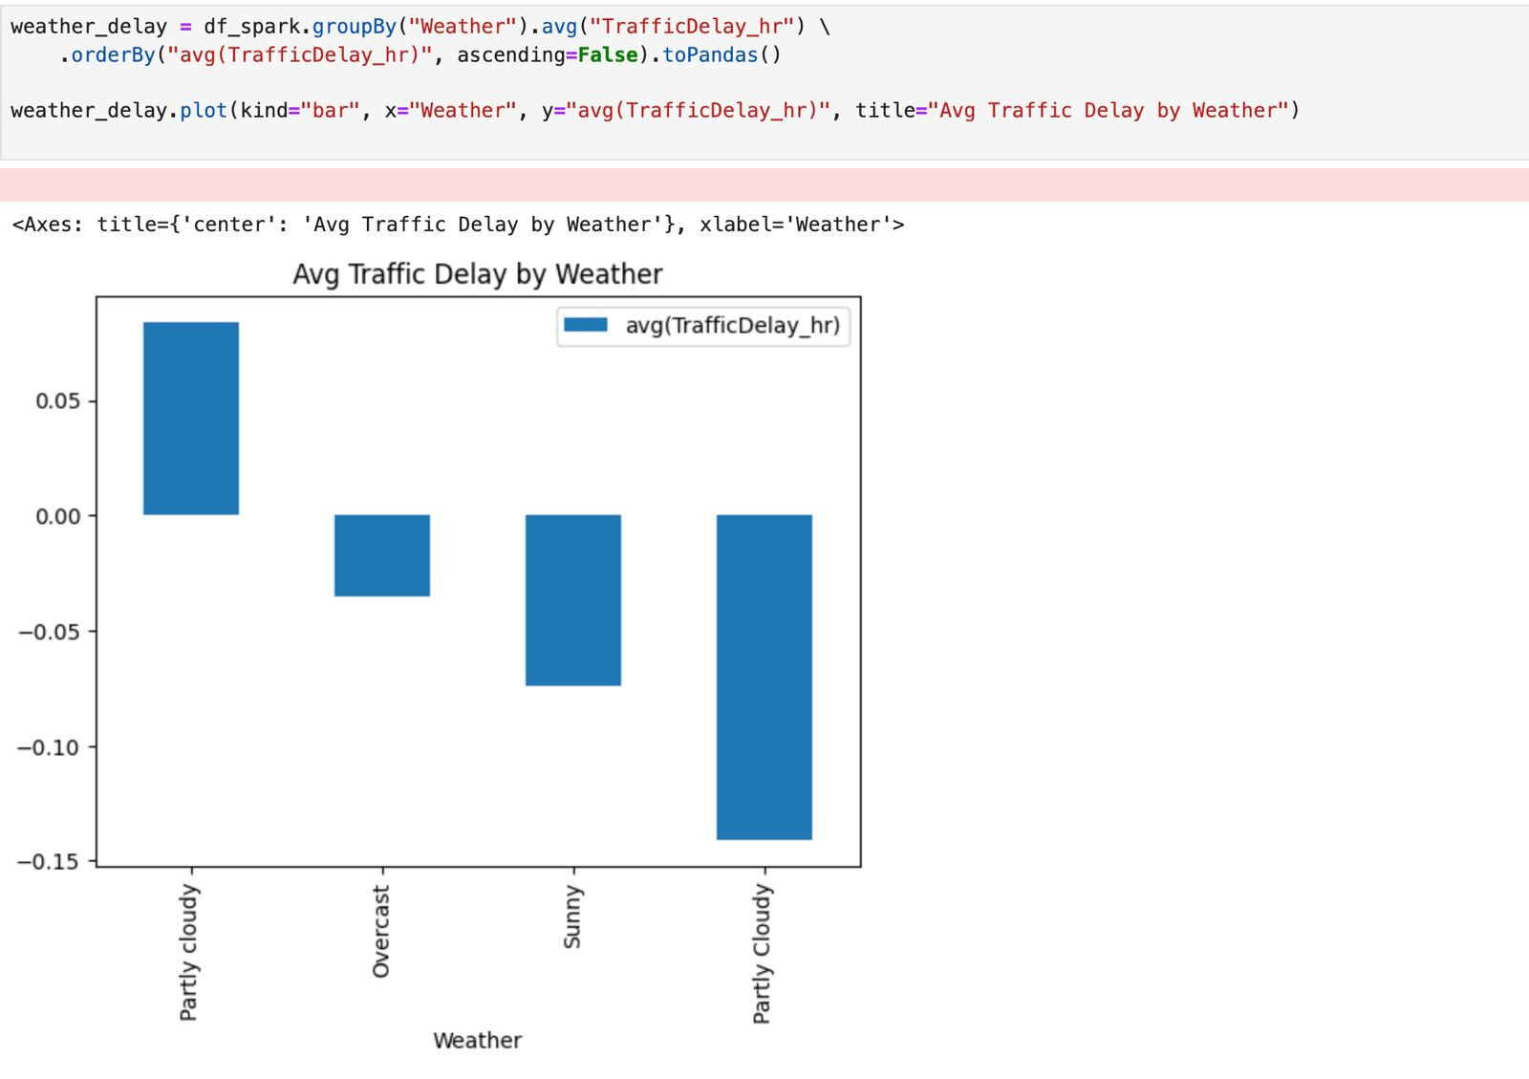
Avg Traffic Delay by Weather

Slide 18
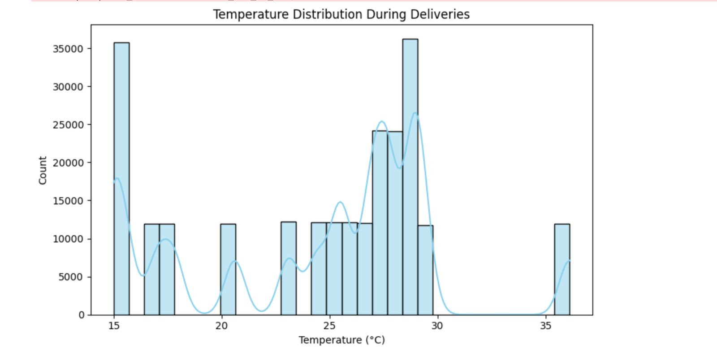
Temperature Distribution in Celcius

Slide 19
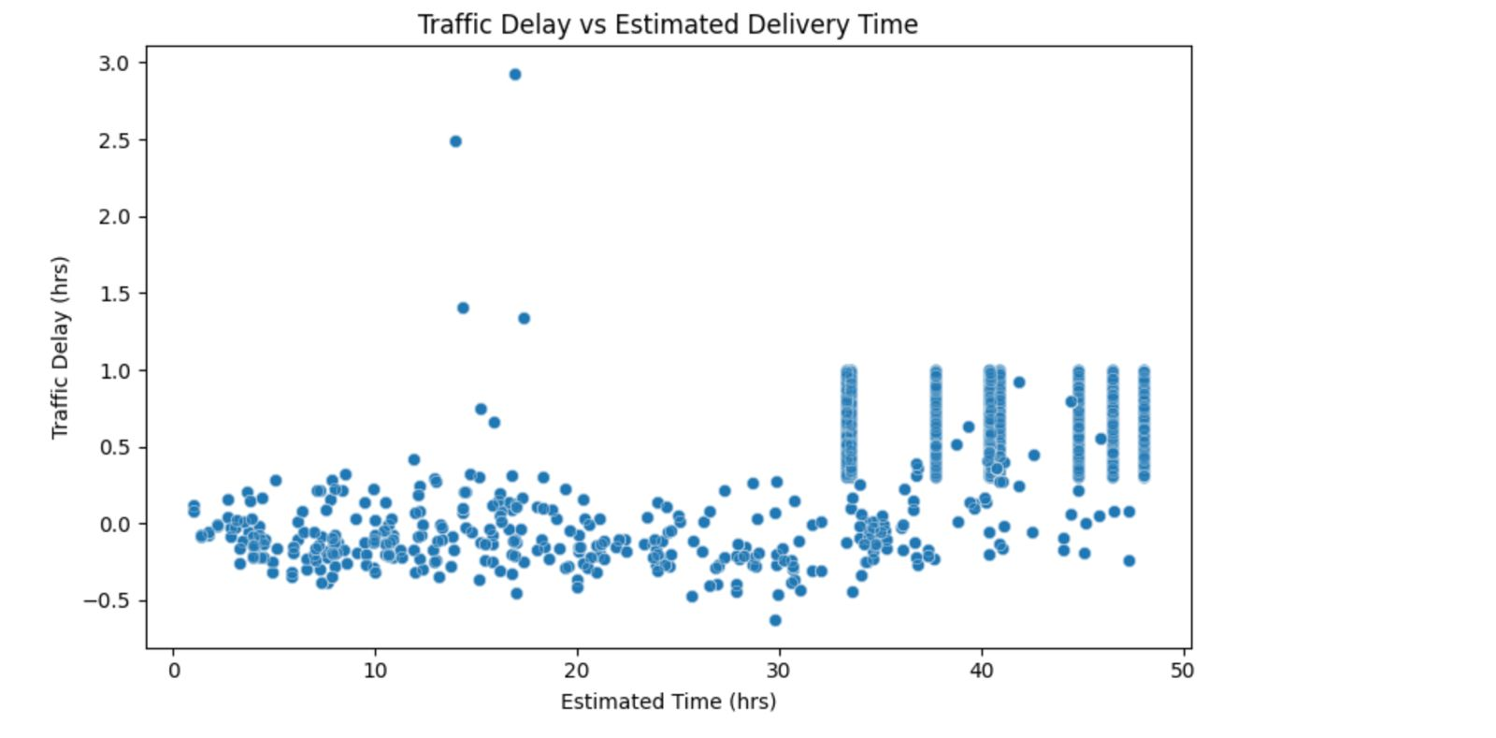
Traffic Delay vs Estimated Delivery Time

Slide 20
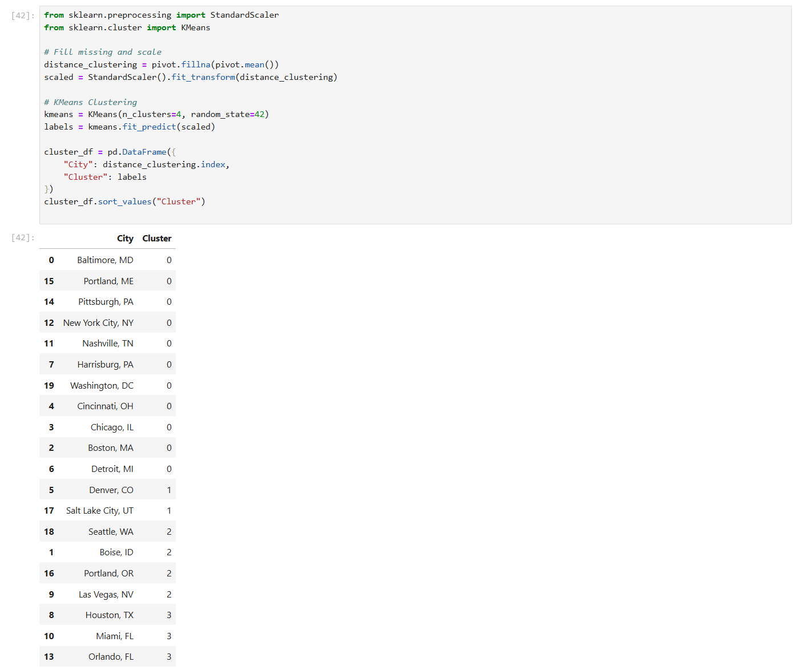
Clustered Data

Slide 21
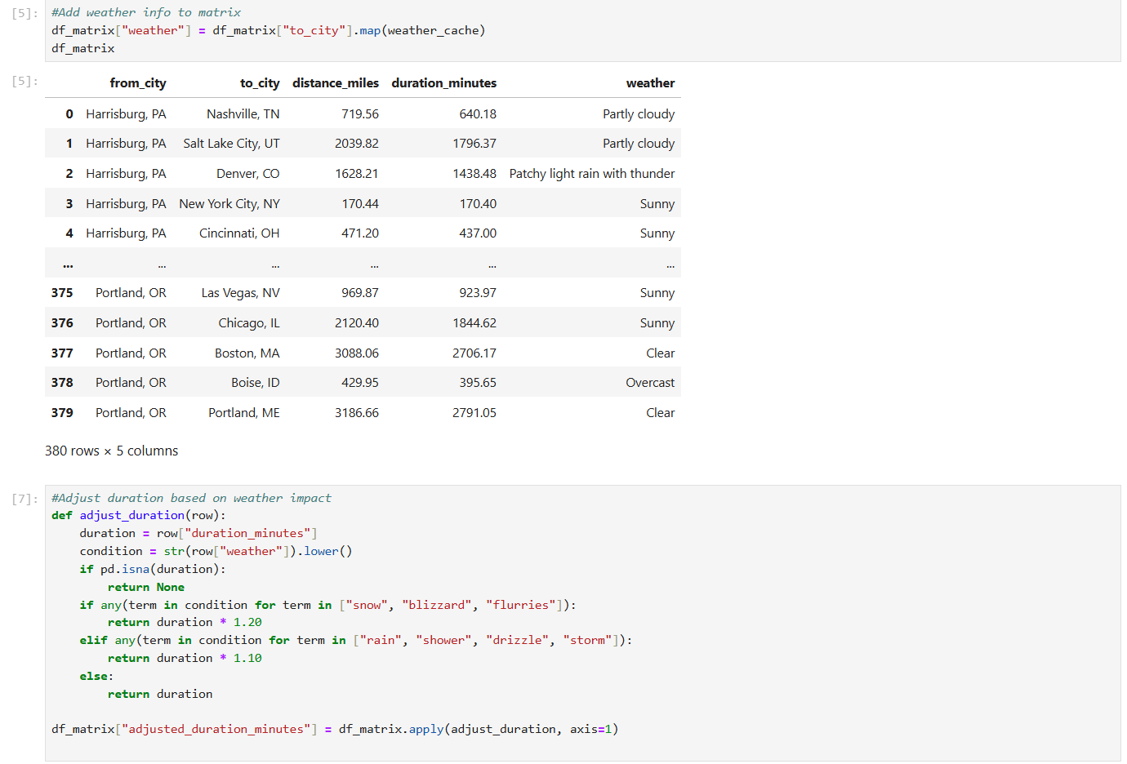
Making Weather Adjustments

Slide 22
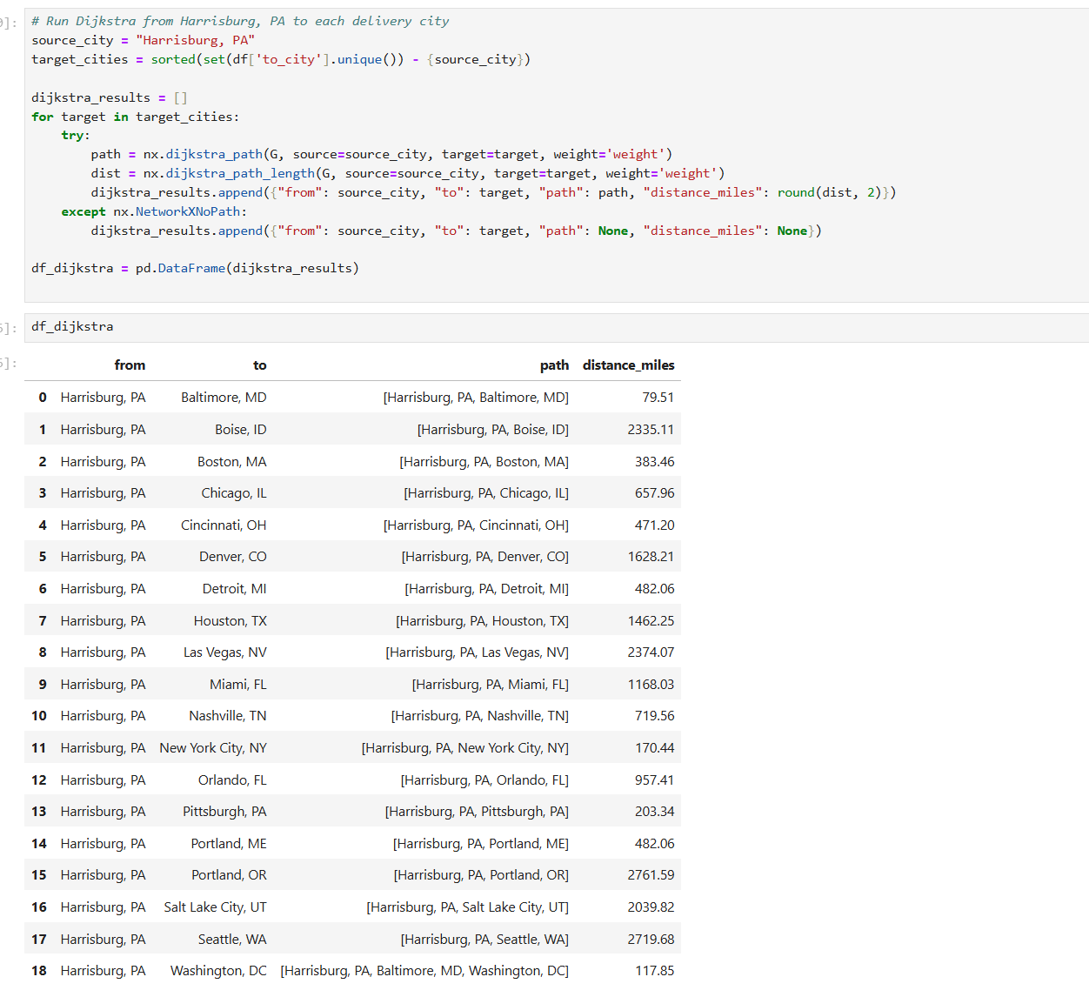
Testing Dijkstra’s Algorithm

Slide 23
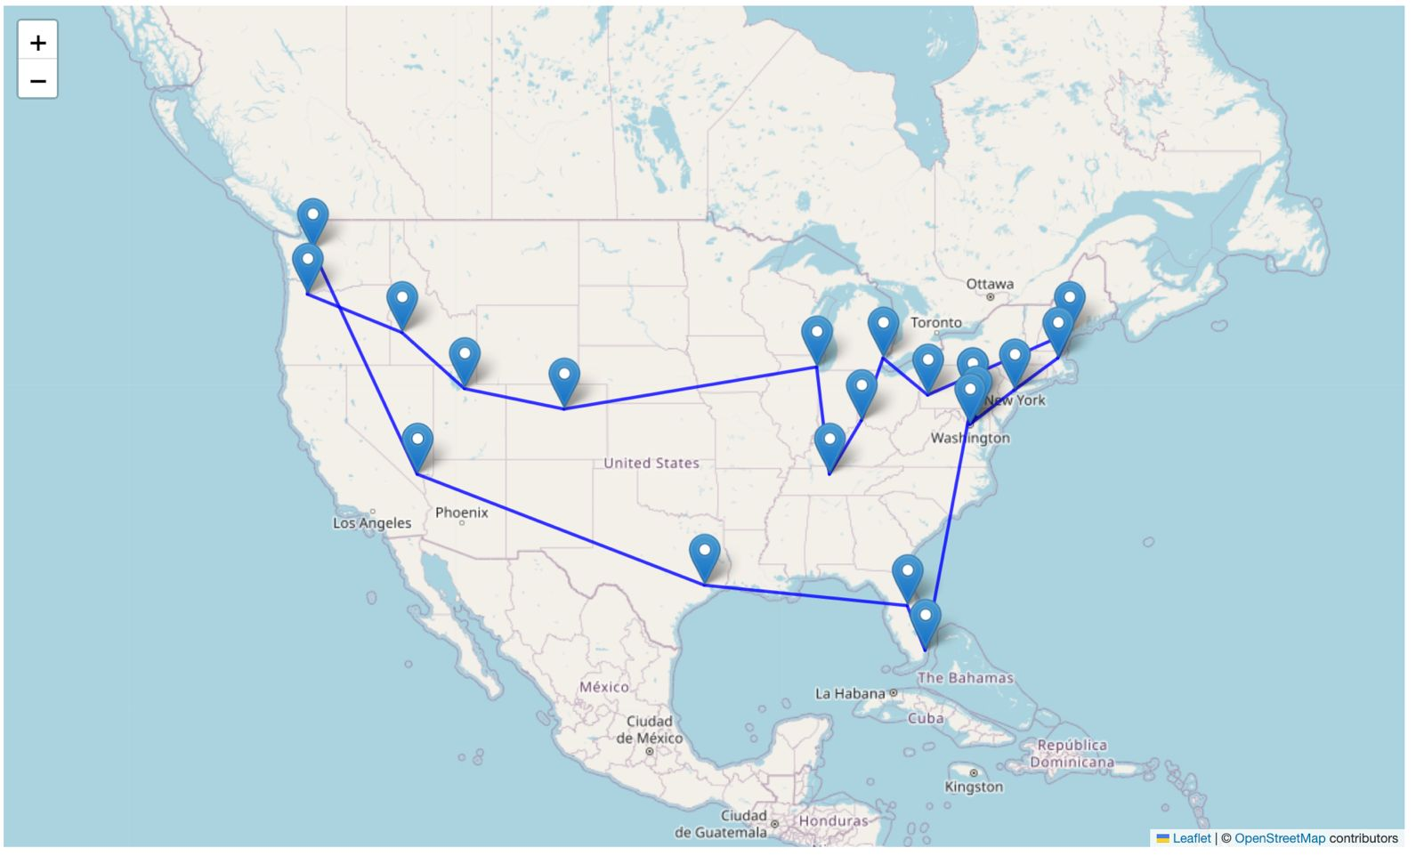
Results for TSP’s Optimization

Slide 24
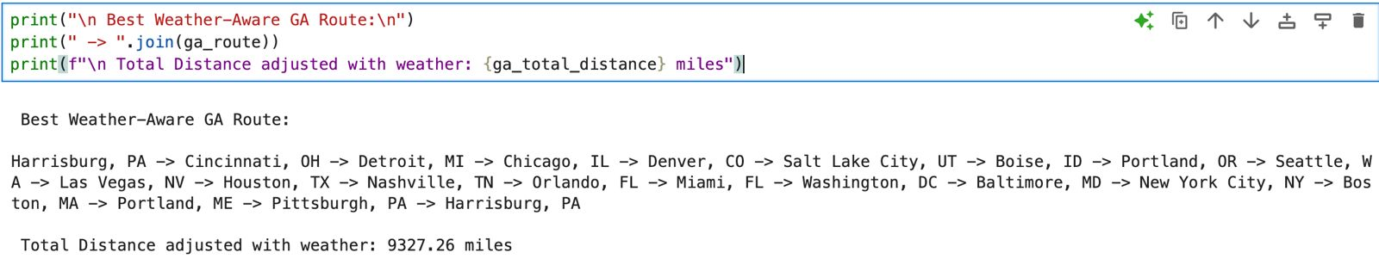
Best Optimized Distance using Genetic Algorithm

Slide 25
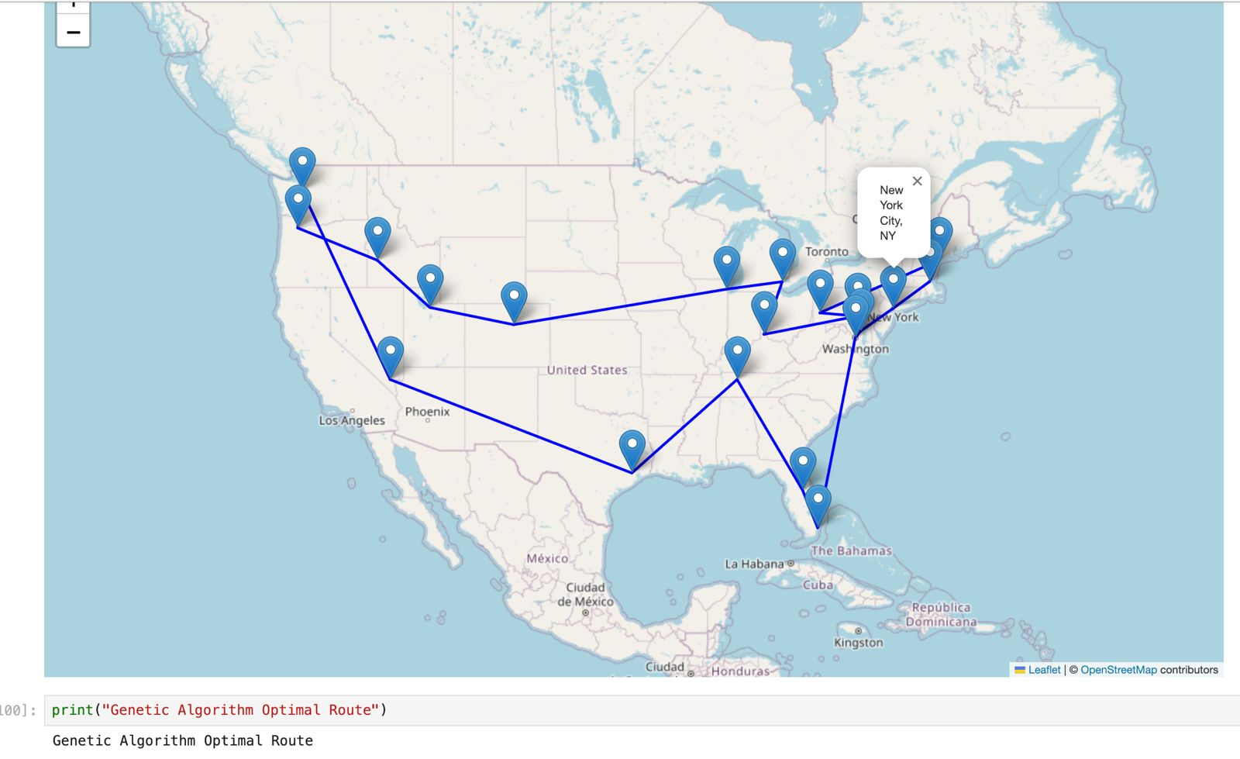
Best Optimized Route

Slide 26
Algorithms Used & Results
Traveling Salesman Problem (TSP) – Greedy Heuristic ▫️ Generated a baseline path by visiting the nearest unvisited city ▫️ Total Distance: 10,047.69 miles
Genetic Algorithm (GA) ▫️ Inspired by natural selection – evolves better paths over generations ▫️ Considers distance, weather delay, and traffic
▫️ Total Distance: 9,758.64 miles ▫️ Weather-adjusted GA path: 9,327.26 miles

Slide 27

Conclusion
The Genetic Algorithm provided a more efficient delivery route than the traditional TSP heuristic, saving nearly 289 miles in raw distance.
After accounting for weather delays, the Genetic Algorithm route was further optimized to 9327.26 miles — a 7.2% improvement over TSP.
This shows that real-world conditions like rain, snow, and traffic significantly impact logistics and should be considered in any practical shipping solution.
Genetic Algorithm is more flexible and scalable for large datasets and dynamic environments.

Slide 28

Big Data Concepts Learned:
Spark RDDs and DataFrames for distributed data processing
HDFS storage management for high-volume datasets
Performance tuning using Spark transformations and actions
GraphFrames for graph-based computation
Data enrichment and simulation at scale
Key Takeaways:
External factors like weather and traffic significantly impact routing decisions.
Genetic Algorithm provided the most optimized route under constraints.
Real-time data enriches route optimization and supports dynamic logistics planning

Slide 29

Thank You

