Slide 1
SECURE DATA HIDING IN IMAGE USING STENOGRAPHY
CAPSTONE PROJECT
Presented By:
Student Name :
College Name & Department :
NYATHARI MADHAV
MALLA REDDY COLLEGE OF ENGINEERING
& ARTIFICIAL INTELLIGENCE AND MACHINE LEARNING

Slide 2
OUTLINE
Problem Statement
Technology used
Wow factor
End users
Result
Conclusion
Git-hub Link
Future scope

Slide 3
Problem Statement
In the digital age, the need for secure communication has become paramount due to the increasing threats to data privacy and integrity. Steganography, the art of hiding information within other non-secret data, offers a potential solution for secure data transmission. This project aims to address the problem of securely embedding confidential data within digital images without arousing suspicion or compromising the quality of the host image.

Slide 4
Technology used
Platforms:
Operating System: Ubuntu 20.04
Compiler: GCC
File Format: BMP (Bitmap Image)
Additional Points:
Least Significant Bit (LSB) Technique:
Cryptographic Techniques
Mention libraries, platforms,

Slide 5
Wow factors
1 LSB-Based Steganography Hides data in the Least Signif cant Bit, ensuring security without visible image changes.
2 Lossless BMP Processing - Works with uncompressed BMP images to maintain data integrity.
3 Lightweight & Fast - Written in C for high ef tiency, outperforming Python/Java-based tools.
4 Simple CLI Interface - Easy command-line usage for embedding and extracting data, ideal for automation.

Slide 6
End users
1 Cybersecurity Professionals - Use steganography for secure data transmission and covert communication.
2 Forensic Experts - Extract hidden information from images for digital investigations.
3 Government & Defense Agencies - Securely embed sensitive data in images for intelligence and conf dential operations.
4 Researchers & Academics - Study and improve steganographic techniques for data security and cryptography.
5 Privacy-Conscious Users Individuals who want to protect personal or confidential information from unauthorized access.

Slide 7
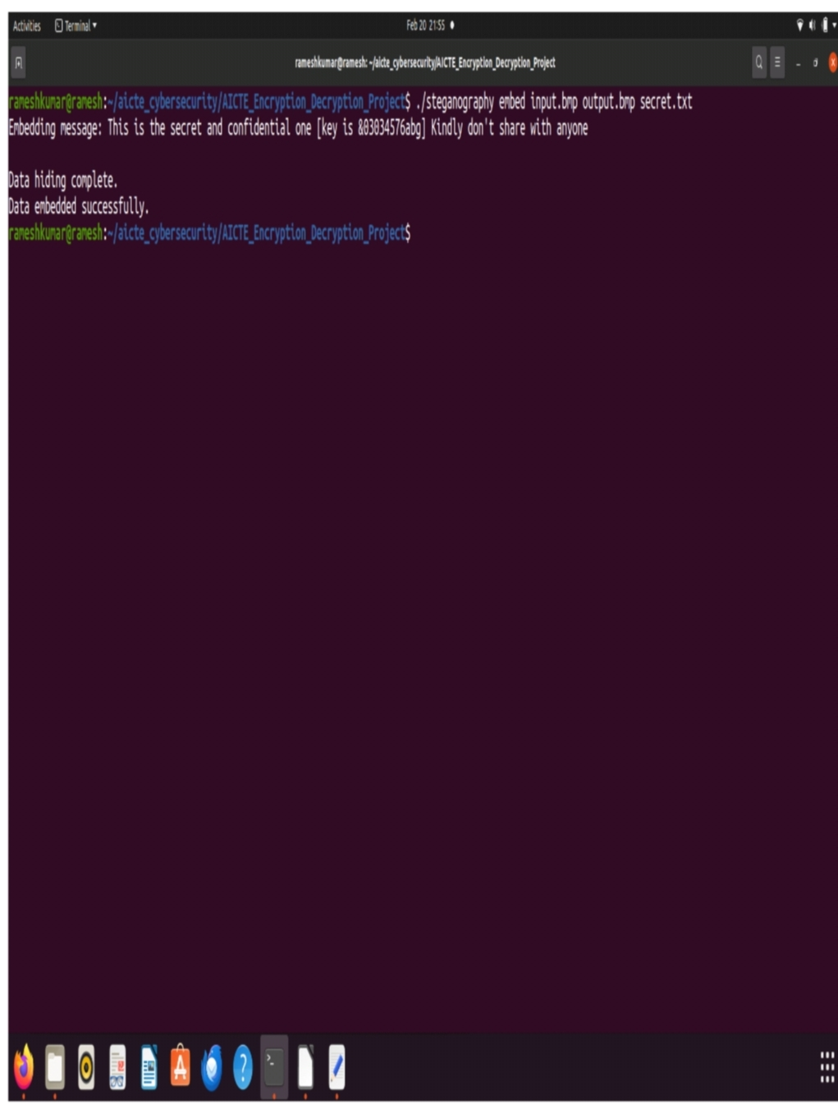
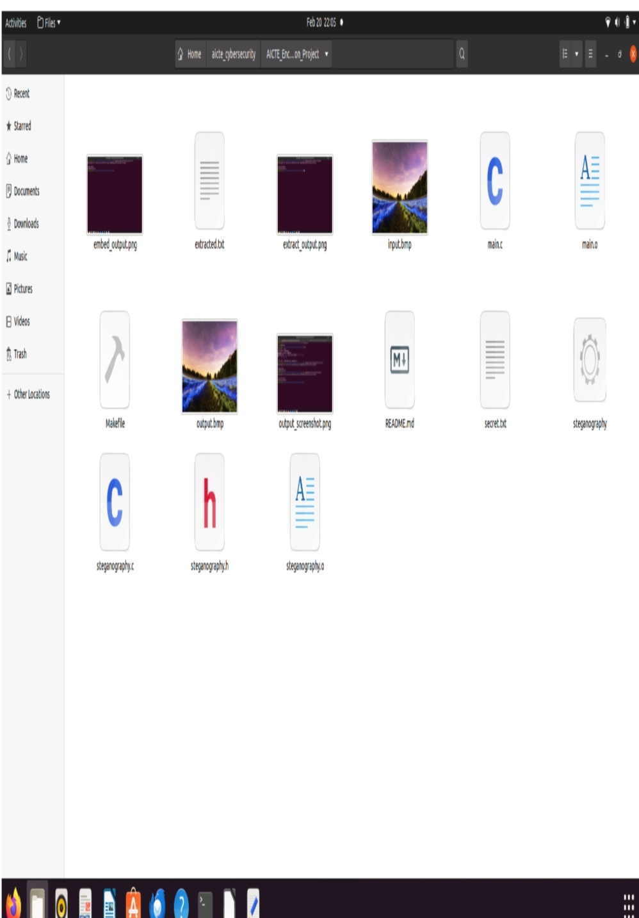
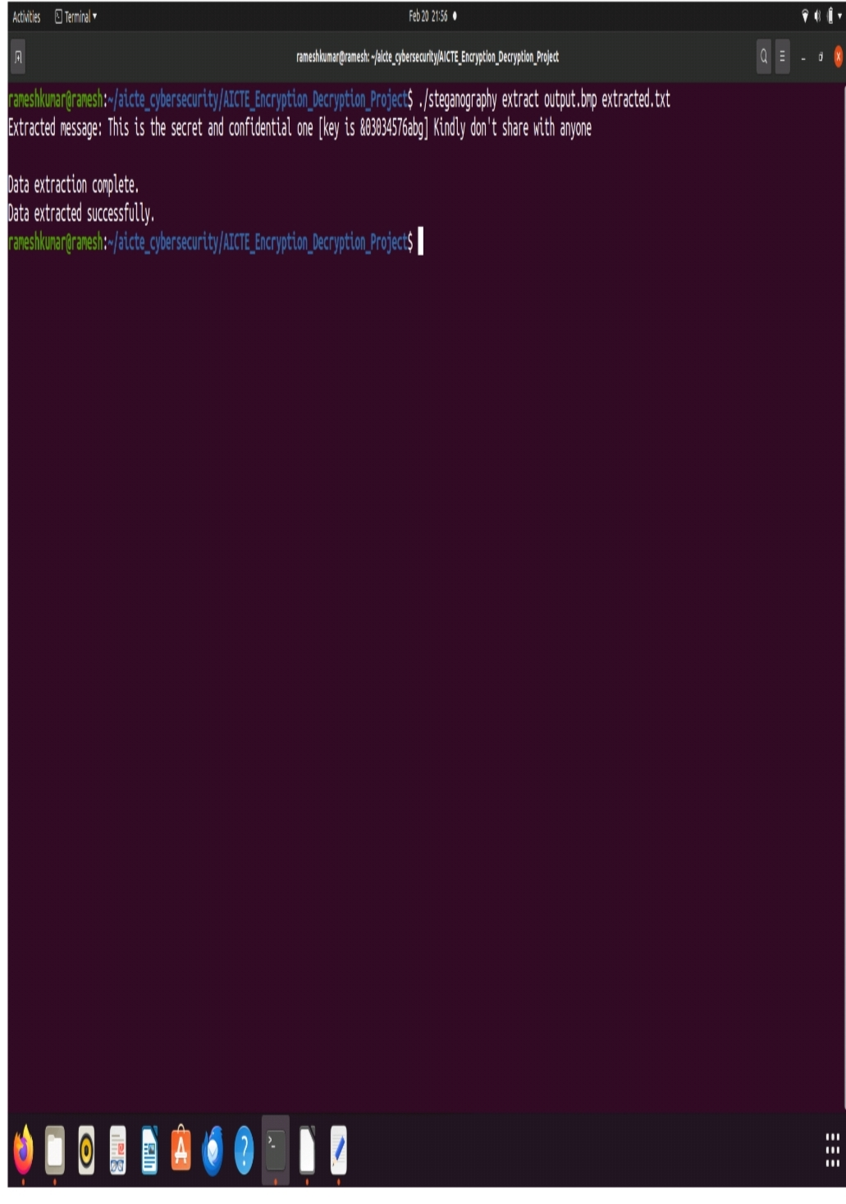
Results
Screenshots of the outcome (min 3)

Slide 8
Conclusion
In conclusion, secure data hiding in images using steganography presents a viable solution for protecting sensitive information in an increasingly digital and interconnected world. By leveraging various techniques such as Least Significant Bit (LSB) modification, transform domain methods, and cryptographic measures, steganography enables the discreet embedding of data within digital images while maintaining the visual integrity of the host medium.

Slide 9
GitHub Link
https://github.com/Madhavmax/Steganography-.git

Slide 10
Future scope(optional)
1. Advanced Encryption & Security
Combining steganography with cryptography to enhance security.
Quantum cryptography-based steganographic methods.
AI-driven adaptive steganography to counteract steganalysis.
2. AI & Machine Learning Integration
Deep learning models for more robust and undetectable data hiding.
AI-based steganalysis for detecting hidden threats in images.
Reinforcement learning to optimize hiding techniques.
3. Medical & Legal Applications
Secure transmission of confidential medical images and patient records.
Hidden watermarking for legal document verification.

Slide 11
THANK YOU

