Slide 1
Semantically Similar Question Detection
CPG No. 277

Slide 2
Problem Statement
To design and implement a Duplicate question detection system using deep-learning techniques that identifies semantically similar questions and provide the existing top rated questions for the asked questions.

Slide 3
Introduction
Our goal is to create a website that would help to detect semantically similar questions when a user type a question and give Top 5 questions as answer or if the question is not present it redirects it to Q/A sites.

Slide 4
Updates
Creating the UI of the website
Completed the report
Model applied in website(Tried)

Slide 5
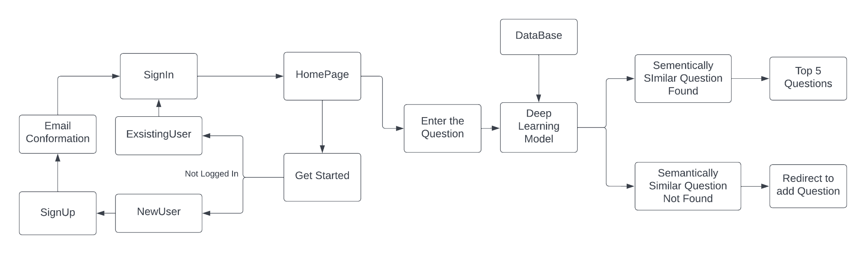
Block Diagram
A block diagram is a diagram of a system in which the principal parts or functions are represented by blocks connected by lines that show the relationships of the blocks.
Figure: Block Diagram

Slide 6
DataSet
Data set consist of 6 columns namely “id”, “quid1”, “quid2”, “question1”, “question2”, “is_duplicate” and contains 404290 rows. The id of the dataset show the no. of set which we are checking for duplicates and quid1 and quid2 are there respective id and “question1” and “question2” are questions pair for duplicate checking in “string” format. Is_duplicate columns tells us if these questions are duplicates or not.

Slide 7
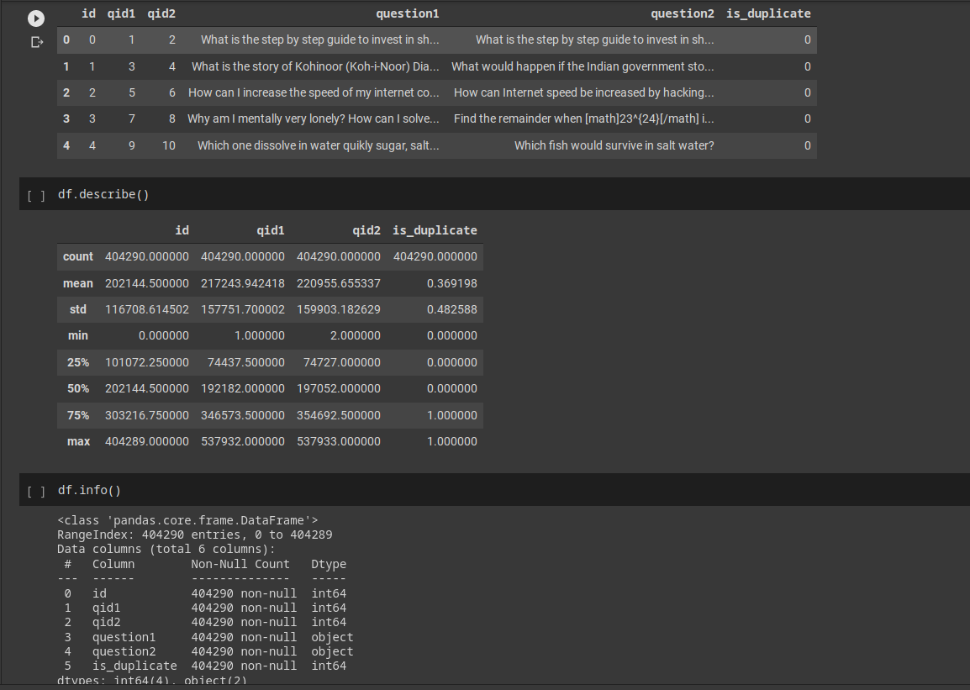

Slide 8
New Dataset
Data Set Contains 9 column
Id
Subject
Content
Document
Maincat
Cat
BestId
BestAnswer
NbestAnswers
Here “Subject” Contains the question “BestAnswer” the best answer for that question given by the person with id as “BestID” and “NbestAnswer” are the answers for the same question

Slide 9
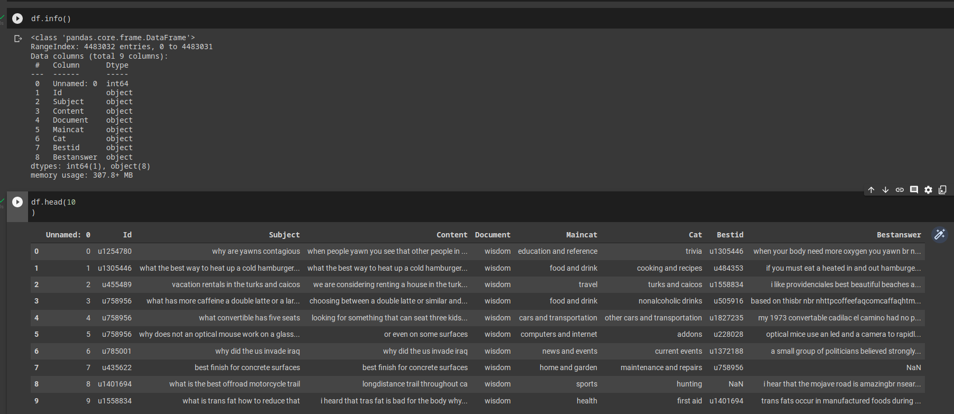

Slide 10
Methodology
Bag of words
TF-Idf
Word2Vec
Glove

Slide 11
Bag of Words
Bag of Words model is used to preprocess the text by converting it into a bag of words, which keeps a count of the total occurrences of most frequently used words.
In this approach, we use the tokenized words for each observation and find out the frequency of each token.

Slide 12
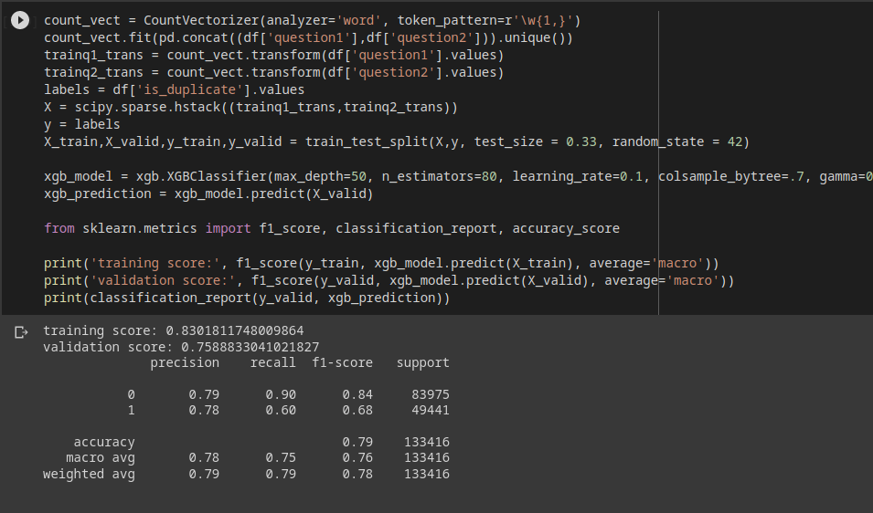

Slide 13
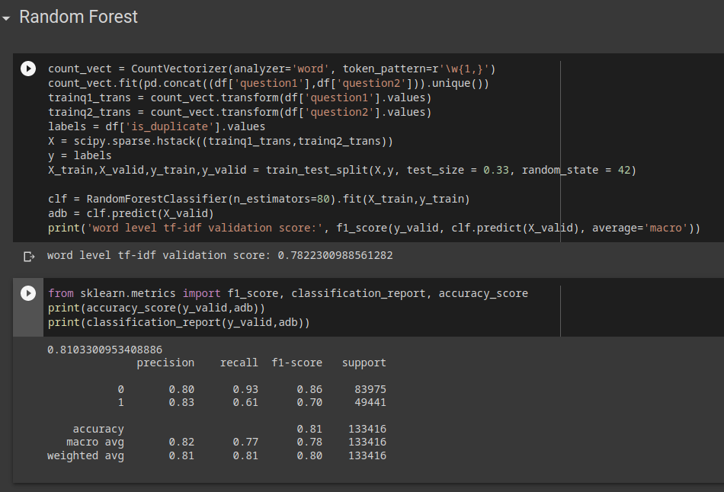

Slide 14
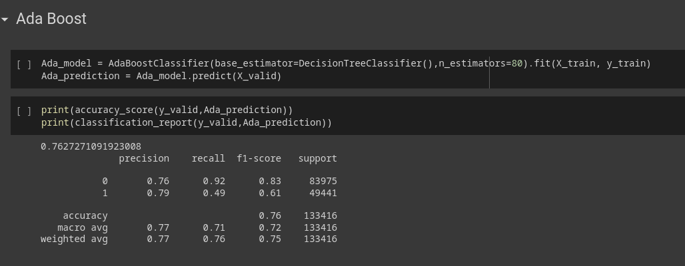

Slide 15
Advantages and drawbacks of BoW
Advantages:
It is particularly helpful when we are working on a few documents and they are very domain-specific.
Get an idea of the performance of their work before proceeding to better word embeddings.
Disadvantages:
It won’t provide any semantic information about the words.
It only gives how many times has word occurred in a sentence and not its location or correlation with other words in the sentence.

Slide 16
TF-IDF
TF: Term Frequency, which measures how frequently a term occurs in a document. Since every document is different in length, it is possible that a term would appear much more times in long documents than shorter ones.
TF(t) = (Number of times term t appears in a document) / (Total number of terms in the document)
IDF: Inverse Document Frequency, which measures how important a term is. While computing TF, all terms are considered equally important. However it is known that certain terms, such as “is”, “of”, and “that”, may appear a lot of times but have little importance.
IDF(t) = log_e(Total number of documents / Number of documents with term t in it)

Slide 17
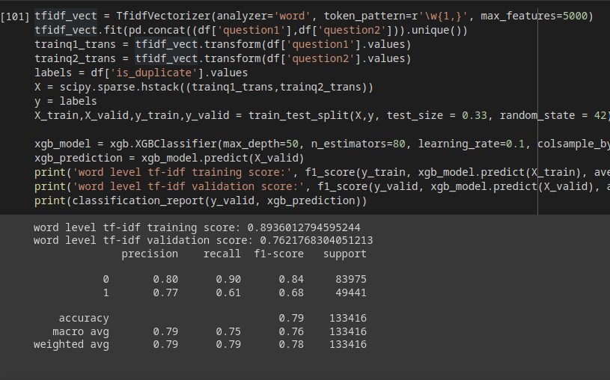

Slide 18
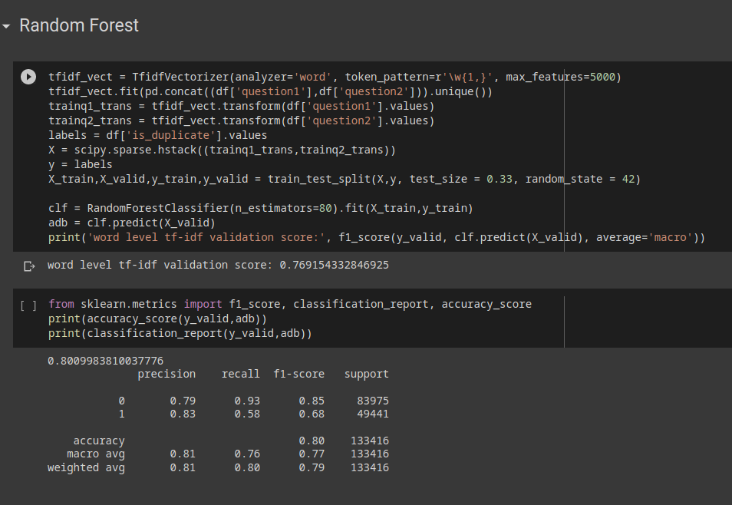

Slide 19
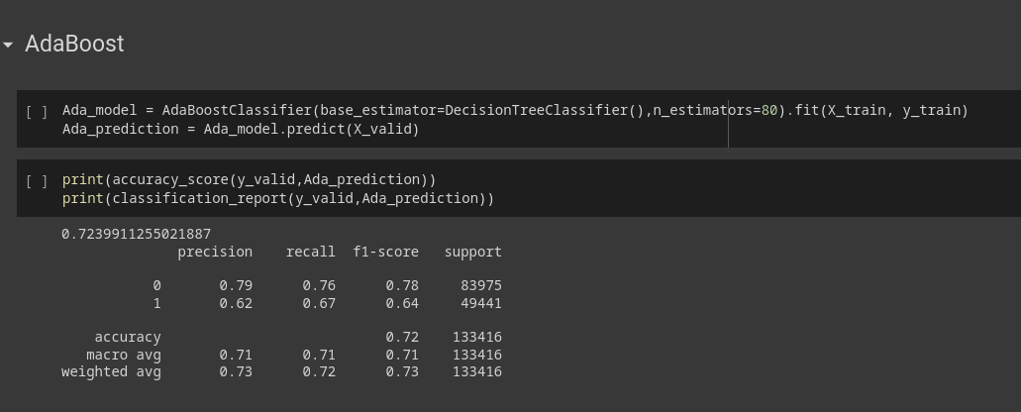

Slide 20
Advantages and disadvantages
Advantages:
Easy to compute
You have some basic metric to extract the most descriptive terms in a document
You can easily compute the similarity between 2 documents using it
Disadvantages:
TF-IDF is based on the bag-of-words (BoW) model, therefore it does not capture position in text, semantics, co-occurrences in different documents, etc.
For this reason, TF-IDF is only useful as a lexical level feature
Cannot capture semantics (e.g. as compared to topic models, word embeddings)

Slide 21
Word2vector
The word2vec algorithm extracts features from the text for particular words.
Using those features, word2vec creates vectors that represent a word in the vector space.
These vectors are chosen using the cosine similarity function, which indicates the semantic similarity between words.

Slide 22
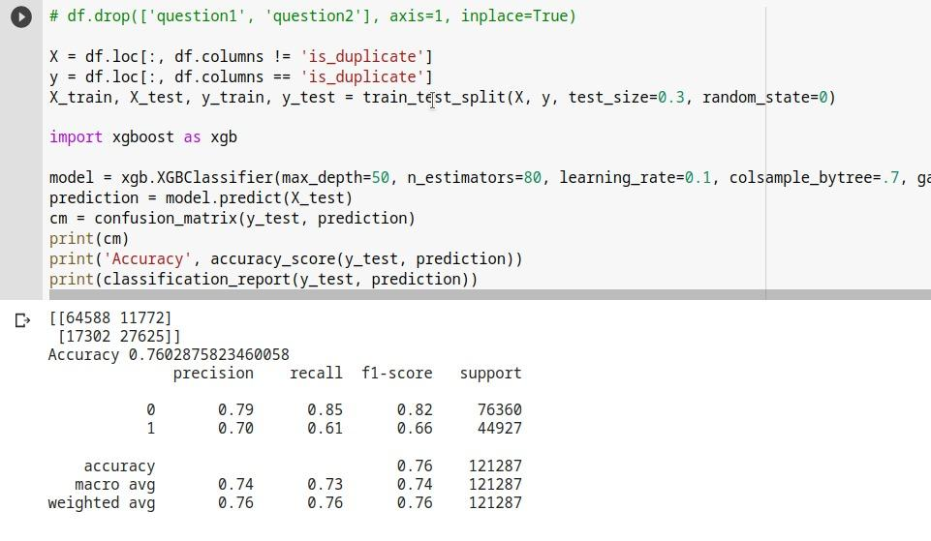

Slide 23
Glove
Glove is an unsupervised learning algorithm for obtaining vector representations for words
Training is performed on aggregated global word-word co-occurrence statistics from a corpus.

Slide 24
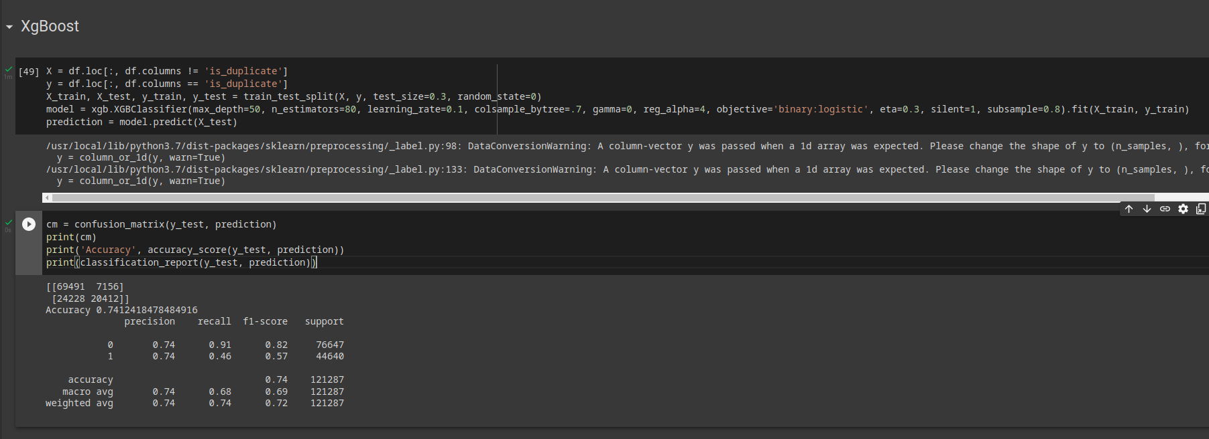

Slide 25
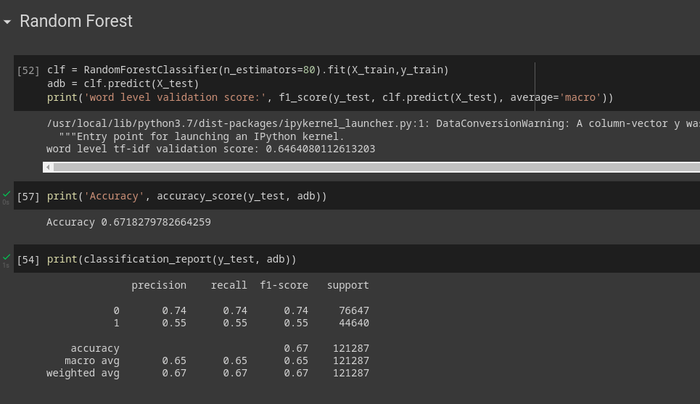

Slide 26
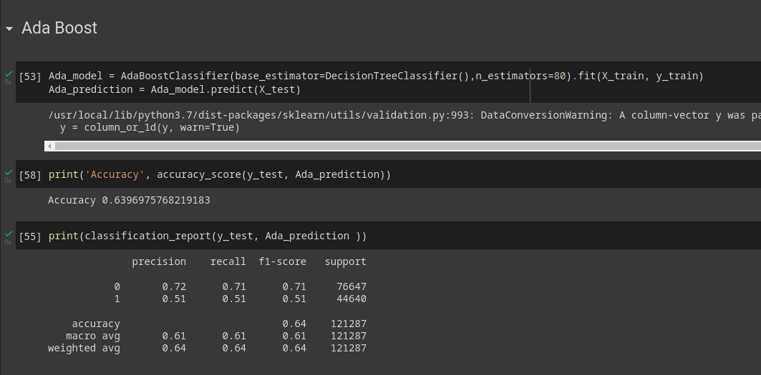

Slide 27
Advantages and disadvantages
Advantages:
CBOW is faster and represents frequent words more better.
When it comes to memory utilization, CBOW tends to consume Low memory.
Disadvantages:
Fails to Represent Infrequent words.

Slide 28
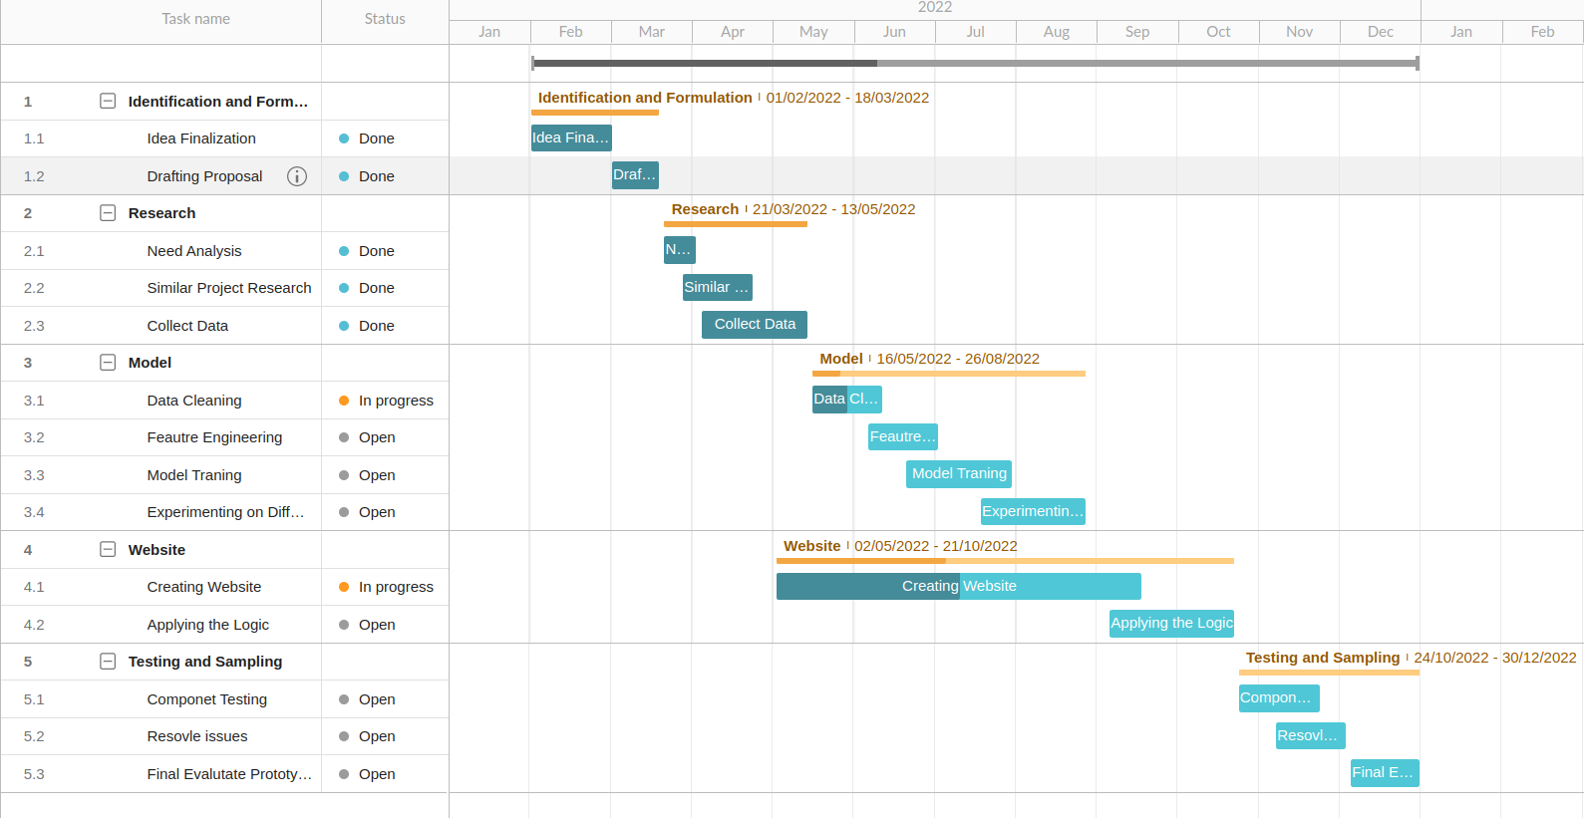
Gantt Chart
Gantt charts are a visual view of tasks displayed against time.
They represent critical information such as who is assigned to what, duration of tasks, and overlapping activities in a project
Figure: Gantt Diagram

Slide 29
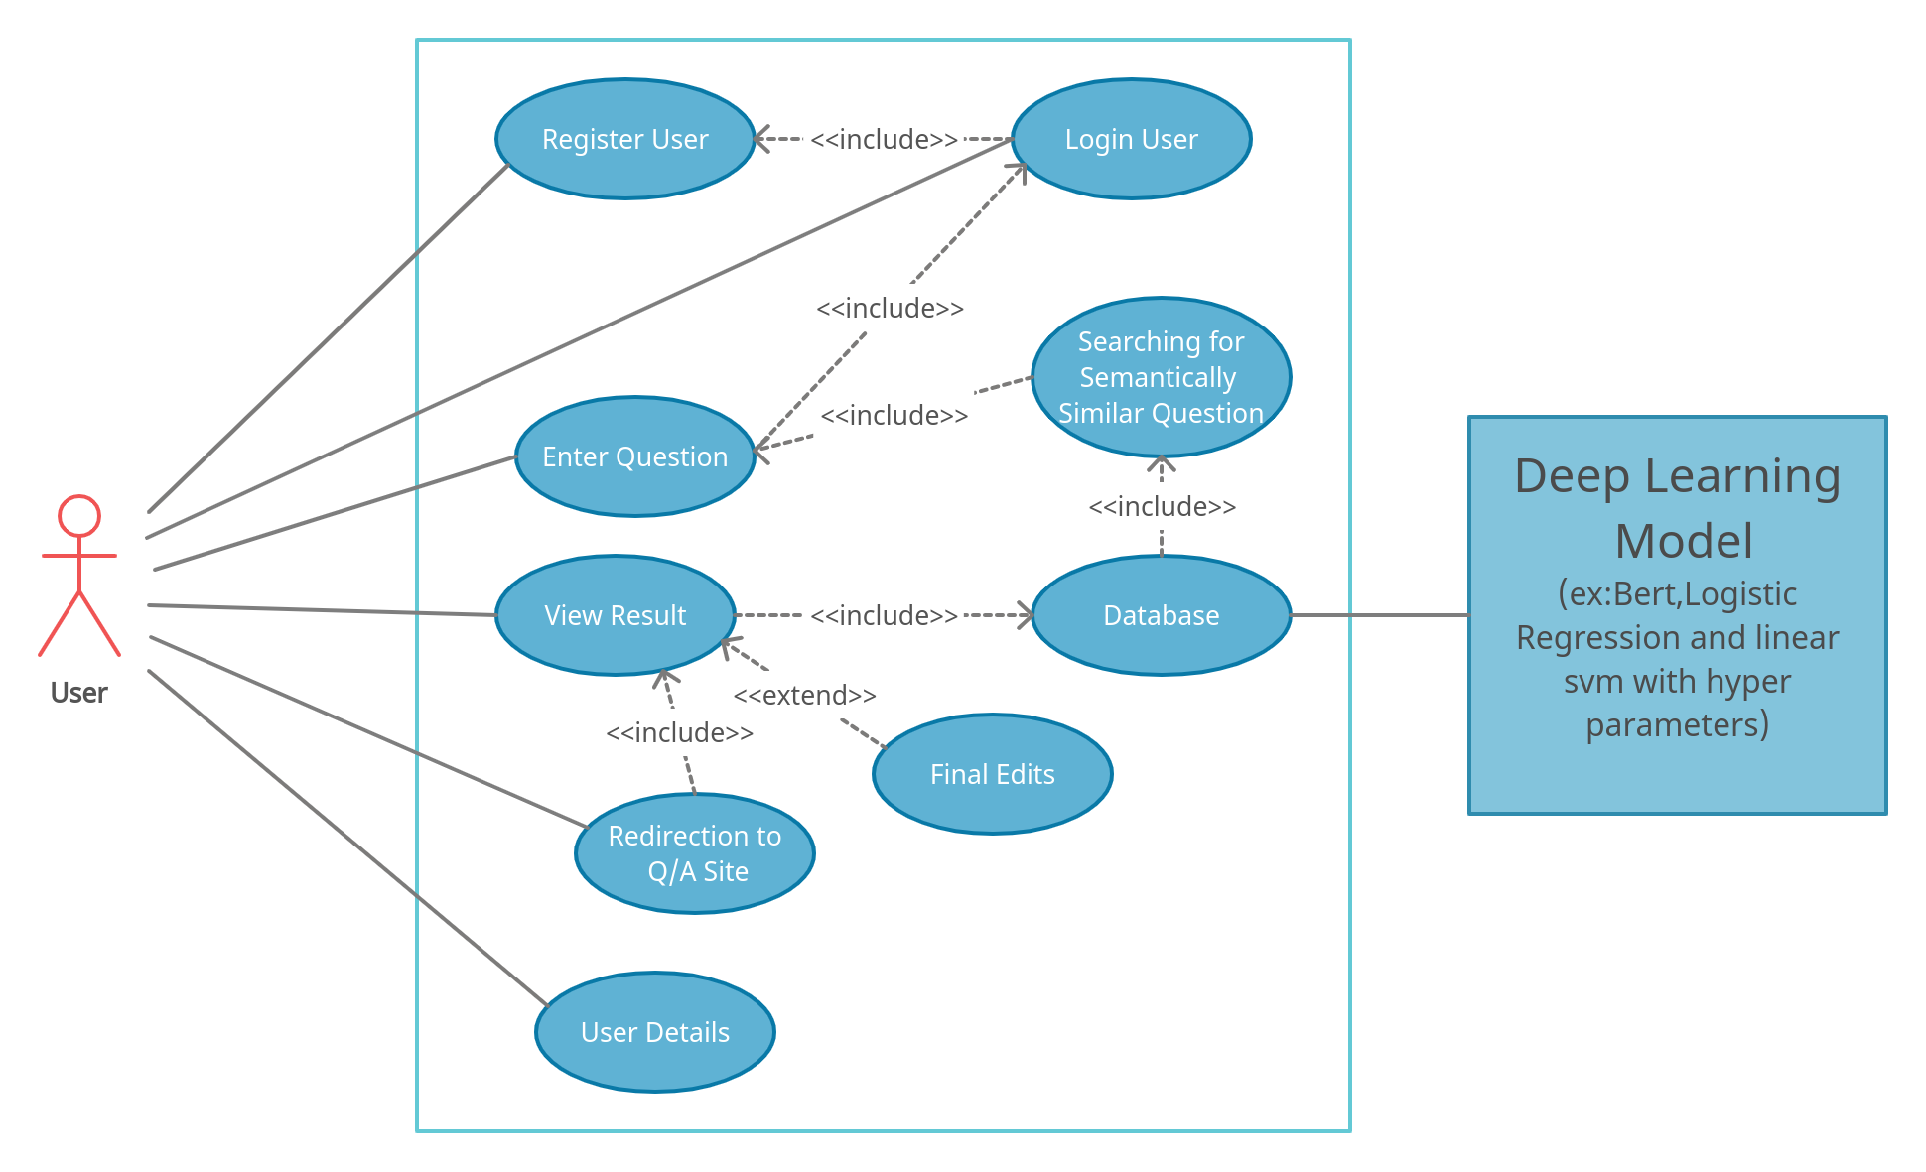
USE CASE DIAGRAM
Use-case diagrams describe the high-level functions and scope of a system.
These diagrams also identify the interactions between the system and its actors.
Figure: Use case Diagram

Slide 30
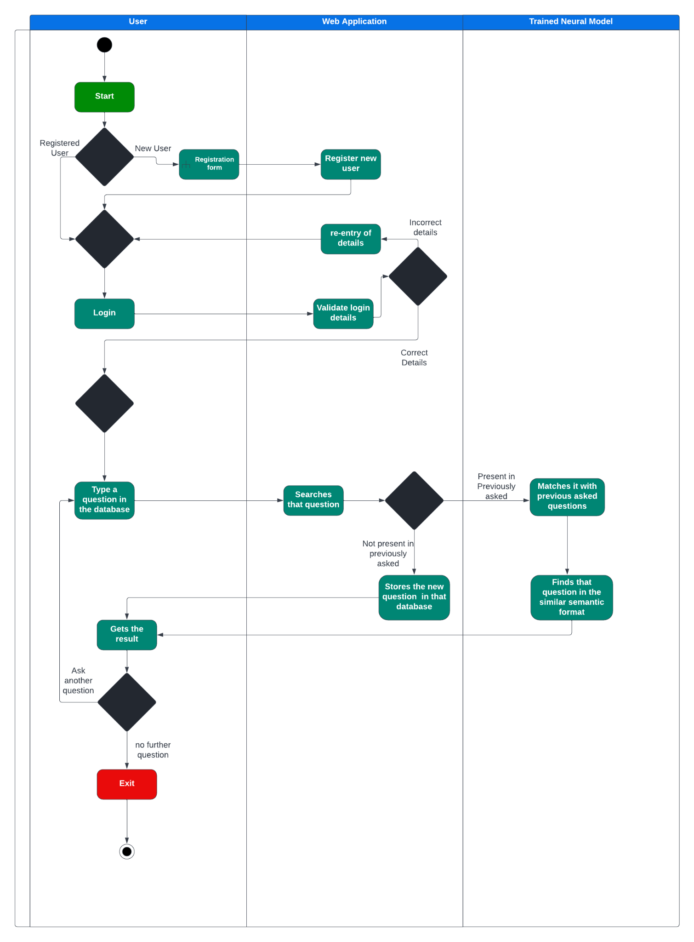
Swimlane Diagram
A swimlane is used in process flow diagrams, or flowcharts, that visually distinguishes job sharing and responsibilities for sub-processes of a business process.
Swimlanes may be arranged either horizontally or vertically.
Figure: Swimlane/ Activity Diagram

Slide 31
FUNCTIONAL AND NON FUNCTIONAL REQUIREMENTS
ID: FR1
TITLE: Access website
DESC: A user should be able to access the website. The website should be free to use.
ID: FR2
TITLE: User registration – Website
DESC: Given that the user has access to the website, the user should be able to register through. The user must provide user-name, password & email-id.
ID: FR3
TITLE: User log-in
DESC: Given that the user has registered, the user should be able to log-in on the website.

Slide 32
Continued..
ID: FR4
TITLE: Reset password
DESC: Given that the user has registered, the user should be able to retrieve their password by the e-mail.
ID: FR5
TITLE:Input question
DESC: After successful log-in, the user should be able to enter required question.
ID: FR6
TITLE: View question and answer pairs
DESC: Given that the user has entered text, they should be able to view questions.
ID: FR7
TITLE: Download question and answer pairs
DESC: Given that the user has uploaded the text/file and questions are generated, they should be able to download questions.

Slide 33
Continued..
ID: NFR1
TAG: ResponseTime
SCALE: The response time of the system.
ID: NFR2
TAG: SystemDependability
GIST: The fault tolerance of the system.
SCALE: If the system loses connection to the internet or the system receives some strange Input, the user should be informed.
ID: NFR3
TAG: SystemReliability
GIST: how reliable our system is
SCALE: The reliability that the system gives the right result on a search.

Slide 34
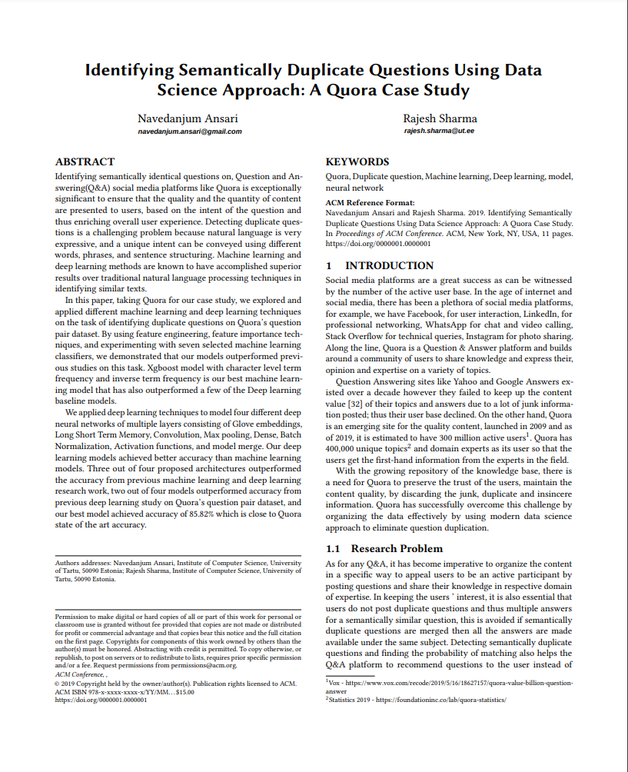
So Far….
Research Paper
Basic Website Deployment using Flask
Running previously built models
Used three Embedding(BOW, TF-IDF, Word2Vec)

