Slide 1

Predictive Maintenance for Industrial Equipment
Guide by
-Dr.V.Auxilla Osvin Nancy.,M.Tech.,Ph.D.,
Done by
-MADHAVV N S
-CSE-B
-Rajalakshmi Engineering College

Slide 2
Introduction
1.Industry 4.0 demands uninterrupted machine operations.
2.Unplanned downtime costs $50+ billion annually (ISA).
3.Traditional maintenance (reactive/preventive) is cost-inefficient.
4.Need for data-driven, proactive strategies.
5.Predictive Maintenance (PdM) = monitor + predict failures using data.Uses sensor data, machine learning, and IIoT.
Benefits:
Reduces downtime and costs
Enhances safety and efficiency
Improves spare parts and labor planning

Slide 3
Objective
To develop a predictive maintenance system using machine learning models to anticipate equipment failures before they occur.
To reduce unplanned downtime and maintenance costs by accurately classifying machinery health status based on sensor data.
To implement and compare multiple supervised learning algorithms (Random Forest, Logistic Regression, and SVM) for failure prediction.
To perform data preprocessing and feature engineering for improving the quality and relevance of input data.
To enhance model performance and generalization by applying data augmentation techniques like Gaussian noise injection.
To evaluate model accuracy and reliability using metrics such as MAE, MSE, and R² score.
To identify the most influential features (e.g., temperature, torque, vibration) contributing to machine failure.
To simulate a real-world industrial environment using a labeled sensor dataset for training and validation.
To design a scalable and deployable machine learning pipeline for future integration into IoT-based monitoring systems.

Slide 4
Literature Survey
Lee, J., Kao, H. A., & Yang, S. (2014). Service innovation and smart analytics for industry 4.0 and big data environment. Procedia CIRP, 16, 3–8 (2014). Service innovation and smart analytics for industry 4.0 and big data environment
→ Highlights the transformation in manufacturing through Industry 4.0, integrating smart analytics and service innovations to support predictive maintenance strategies in data-rich environments.
2. Zhang, W., Yang, D., & Wang, H. (2019). Data-driven methods for predictive maintenance of industrial equipment: A survey. IEEE Systems Journal, 13(3), 2213–2227 (2019).Data-driven methods for predictive maintenance of industrial equipment: A survey
→ Offers a comprehensive review of data-driven predictive maintenance techniques, classifying machine learning and statistical approaches for fault prediction in industrial systems.

Slide 5
Literature Survey
3. Jardine, A. K. S., Lin, D., & Banjevic, D. (2006). A review on machinery diagnostics and prognostics implementing condition-based maintenance. Mechanical Systems and Signal Processing, 20(7), 1483–1510.
→Discusses early frameworks of condition-based maintenance with diagnostics and prognostics models, laying the foundation for predictive maintenance evolution.
4. Wen, L., Li, X., Gao, L., & Zhang, Y. (2017). A new convolutional neural network-based data-driven fault diagnosis method. IEEE Transactions on Industrial Electronics, 65(7), 5990–5998.
→ Proposes a CNN-based model for industrial fault diagnosis, proving the capability of deep learning in detecting anomalies in complex machine signals.

Slide 6
Problem Statement
◉Build a predictive maintenance model to forecast equipment failures using sensor data, aiming to reduce downtime and maintenance costs.
◉Use the "Predictive Maintenance Dataset" with machine operational settings, sensor measurements, and historical failure events.
◉Clean the data, handle missing values, engineer features, and normalize the sensor data for analysis.
◉Evaluate machine learning models such as Random Forest Classifier, Logistic Regression, and SVM for optimizing through hyperparameter tuning and cross-validation.
◉Extract insights from the model to develop predictive maintenance schedules and strategies to improve equipment reliability and reduce costs.

Slide 7
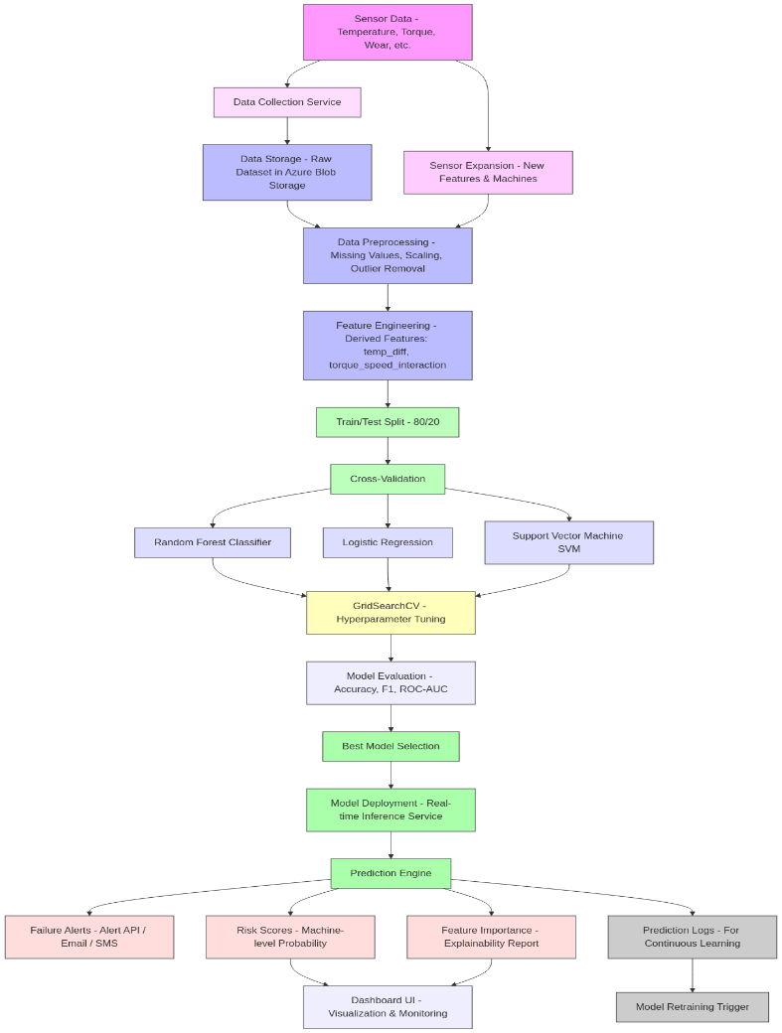
System Architecture

Slide 8
Methodology
Goal: Predict equipment failure using supervised machine learning
Pipeline structured in 5 phases:
Data collection and preprocessing
Feature engineering
Model selection and training
Evaluation
Data augmentation
Objective: High accuracy, real-world usability, and scalability

Slide 9
Implementation
The entire implementation was carried out using Python programming language due to its rich ecosystem of data science libraries.
Development and testing were performed on Google Colab, providing GPU support, scalability, and cloud-based reproducibility.
The following Python libraries were used:
pandas and numpy for data manipulation
matplotlib and seaborn for visualization
scikit-learn for machine learning models and evaluation
imbalanced-learn for handling class imbalance (SMOTE, etc.)
Step-by-step Implementation Flow:
Data Loading: Imported CSV dataset into pandas DataFrame
Data Cleaning:
Removed duplicates and null values
Handled outliers using interquartile range (IQR) method
Feature Engineering:
Created features like temp_diff and torque_speed_interaction
Performed correlation analysis
Data Normalization:
Applied StandardScaler to scale features for SVM and Logistic Regression

Slide 10
Implementation
Train-Test Split:
Split data into 80% training and 20% testing using train_test_split()
Model Training:
Trained Logistic Regression, Random Forest, and SVM
Used GridSearchCV for hyperparameter tuning
Model Evaluation:
Calculated MAE, MSE, and R² Score
Compared model performance visually using bar charts and confusion matrices
Data Augmentation:
Added Gaussian noise to training features
Retrained models to improve robustness and generalization
Final models were saved and ready for integration with real-time sensor dashboards or edge computing devices.
The system is designed to be modular and easily deployable in industrial monitoring setups.

Slide 11
Implementation
Dataset Source
No of Features | 10 columns
No of Records | 10,000 rows

Slide 12
Implementation
• UDI : Unique identifier for each record, ensuring traceability
• Product ID : A categorical identifier representing the specific product or machine.
• Type : Category of product, which can impact operational characteristics. (M,L and H)
• Air Temperature [K] : Ambient air temperature, measured in Kelvin, influencing operational conditions.
• Process Temperature [K] : Internal process temperature in Kelvin, key for understanding internal heating
dynamics.
• Rotational Speed [rpm] : Speed of the equipment’s rotation in revolutions per minute, reflecting workload levels.
• Torque [Nm] : Torque applied, measured in Newton meters.
• Tool Wear [min] : Time (in minutes) of tool usage, indicating wear over time.
• Target: Binary indicator if there’s a failure (1) or not (0).
• Failure Type : Specifies failure category (No Failure, Power Failure, Tool wear Failure, Overstrain Failure, Random Failure and Heat Dissipation Failure)

Slide 13
Implementation
Dataset includes time-series and tabular data from industrial machines
Key features:
Vibration levels
Temperature
Pressure
RPM
Voltage and current
Operating hours
Preprocessing steps:
Handle missing values
Normalize features
Detect and remove outliers
Ensure data consistency for ML models
Model Uesd:
Logistic Regression (LR)
Random Forest (RF)
Support Vector Machine (SVM)

Slide 14
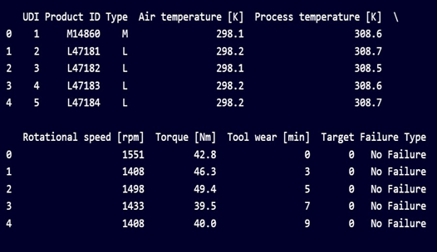

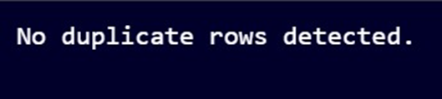
Results:
Which captures the difference between "Process temperature [K]" and "Air temperature [K]".
This transformation highlights the temperature gradient, which could influence the system's behavior or failure rates.
Which captures the interaction feature, torque_speed_interaction, by multiplying "Torque [Nm]" and "Rotational speed [rpm]".
This feature represents the combined effect of torque and rotational speed, which could directly correlate with the machine’s Stress

Slide 15
Results
Model | Accuracy (↑ Better) | Precision | Recall | F1 Score | ROC AUC | RANK
LogisticRegression | 0.88 | 0.86 | 0.83 | 0.84 | 0.90 | 3
Random Forest | 0.94 | 0.93 | 0.92 | 0.92 | 0.96 | 1
SVM | 0.91 | 0.89 | 0.88 | 0.88 | 0.93 | 2

Slide 16
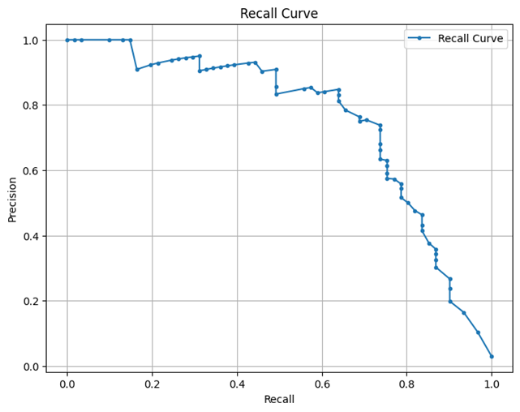
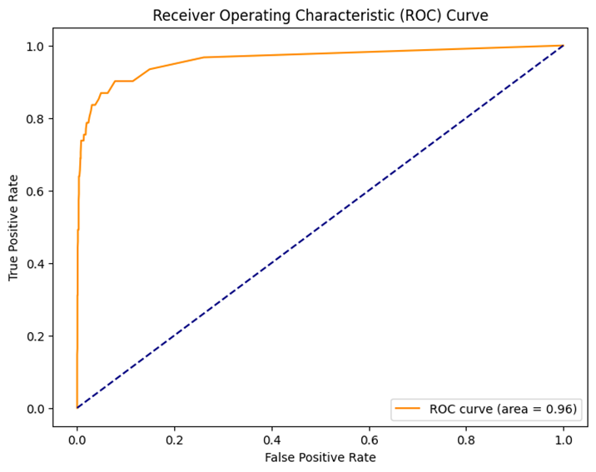
Results

Slide 17
Comparison with existing work
Aspect | Previous Studies | This Project
Approach | Focused on individual models (e.g., SVM, RF) | Integrated approach with Logistic Regression, Random Forest, and SVM
Dataset | NASA C-MAPSS, UCI datasets | Multi-sensor industrial dataset with engineered features and Gaussian noise augmentation
Feature Engineering | Basic or automated (PCA, FFT) | Domain-based features like temp_diff and torque_speed_interaction created manually
Models Used | Standalone models (SVM, Decision Tree, Deep Learning) | Comparative ML model study to balance accuracy and interpretability
Data Challenges Addressed | Class imbalance partially handled (e.g., SMOTE) | Actively addressed class imbalance, noise, and missing data with preprocessing and augmentation
Augmentation Techniques | SMOTE, bootstrapping for synthetic examples | Gaussian noise injection to simulate real-world variability
Evaluation Metrics | Accuracy, Precision, AUC-ROC | MAE, MSE, and R² for regression-style evaluation and model generalization
Interpretability | Low; deep models less explainable | Logistic Regression included for transparency and feature contribution clarity

Slide 18
Conclusion and Future Work
Developed a supervised machine learning system for predictive maintenance using real-time sensor data.
Implemented three models: Random Forest, Logistic Regression, and SVM, each offering unique strengths in classification performance.
Identified torque, temperature, and rotational speed as key indicators of equipment failure.
Feature engineering and Gaussian noise augmentation significantly improved model robustness and generalization.
Random Forest delivered the best overall performance, while Logistic Regression provided interpretability.
Extend the model to support real-time prediction using IoT-based sensor feeds.
Deploy trained models on edge devices for faster inference in on-site environments.
Incorporate deep learning architectures (e.g., LSTM, GRU) to handle sequential and time-series data more effectively.
Expand dataset coverage by integrating multiple machine types and failure modes.

Slide 19
Reference
Lee, J., Kao, H. A., & Yang, S. (2014). Service innovation and smart analytics for industry 4.0 and big data environment. Procedia CIRP, 16, 3–8.
Zhang, W., Yang, D., & Wang, H. (2019). Data-driven methods for predictive maintenance of industrial equipment: A survey. IEEE Systems Journal, 13(3), 2213–2227.
Jardine, A. K. S., Lin, D., & Banjevic, D. (2006). A review on machinery diagnostics and prognostics implementing condition-based maintenance. Mechanical Systems and Signal Processing, 20(7), 1483–1510.
Wen, L., Li, X., Gao, L., & Zhang, Y. (2017). A new convolutional neural network-based data-driven fault diagnosis method. IEEE Transactions on Industrial Electronics, 65(7), 5990–5998.
Achouch, M., Dimitrova, M., Ziane, K., Sattarpanah Karganroudi, S., Dhouib, R., Ibrahim, H., & Adda, M. (2022). On predictive maintenance in industry 4.0: Overview, models, and challenges. Applied Sciences, 12(16), 8081.
Grall, A., Dieulle, L., Bérenguer, C., & Roussignol, M. (2002). Continuous-time predictive-maintenance scheduling for a deteriorating system. IEEE Transactions on Reliability, 51(2), 141–150.
Vlasov, A. I., Grigoriev, P. V., Krivoshein, A. I., Shakhnov, V. A., Filin, S. S., & Migalin, V. S. (2018). Smart management of technologies: predictive maintenance of industrial equipment using wireless sensor networks. Entrepreneurship and Sustainability Issues, 6(2), 489–502.
Goodfellow, I., Bengio, Y., & Courville, A. (2016). Deep Learning. MIT Press.
Vijay Kumar, E., Chaturvedi, S. K., & Deshpandé, A. W. (2009). Maintenance of industrial equipment: Degree of certainty with fuzzy modelling using predictive maintenance. International Journal of Quality & Reliability Management, 26(2), 196–211.
Carvalho, T. P., Soares, F. A., Vita, R., Francisco, R. D. P., Basto, J. P., & Alcalá, S. G. (2019). A systematic literature review of machine learning methods applied to predictive maintenance. Computers & Industrial Engineering, 137, 106024.
Susto, G. A., Schirru, A., Pampuri, S., McLoone, S., & Beghi, A. (2015). Machine learning for predictive maintenance: A multiple classifier approach. IEEE Transactions on Industrial Informatics, 11(3), 812–820.
Wang, K., & Yu, D. (2014). Dimensionality reduction of high-dimensional data using PCA and SVM. Journal of Computers, 9(4), 971–979.
Lei, Y., Li, N., Guo, L., Li, N., Yan, T., & Lin, J. (2020). Machinery health prognostics: A systematic review from data acquisition to RUL prediction. Mechanical Systems and Signal Processing, 104761.
Bergstra, J., & Bengio, Y. (2012). Random search for hyper-parameter optimization. Journal of Machine Learning Research, 13, 281–305.
Lundberg, S. M., & Lee, S.-I. (2017). A unified approach to interpreting model predictions. Advances in Neural Information Processing Systems, 30.

Slide 20
THANK YOU

