Slide 1

Predictive Maintenance for Industrial Equipment
Guide by
-Dr.V.Auxilla Osvin Nancy.,M.Tech.,Ph.D.,
Done by
-MADHAVV N S
-CSE-B
-Rajalakshmi Engineering College

Slide 2
Introduction
1.Industry 4.0 demands uninterrupted machine operations.
2.Unplanned downtime costs $50+ billion annually (ISA).
3.Traditional maintenance (reactive/preventive) is cost-inefficient.
4.Need for data-driven, proactive strategies.
5.Predictive Maintenance (PdM) = monitor + predict failures using data.Uses sensor data, machine learning, and IIoT.
Benefits:
Reduces downtime and costs
Enhances safety and efficiency
Improves spare parts and labor planning

Slide 3
Literature Survey
Predictive maintenance (PdM) helps forecast equipment failures using sensor data and machine learning.
Widodo & Yang (2007) used SVM and RVM on vibration signals for early machinery fault prediction.
Zhang et al. (2019) applied deep learning to time-series sensor data; emphasized the importance of temporal feature extraction.
Ahmed et al. (2020) found Random Forest and Gradient Boosting outperform traditional classifiers on manufacturing datasets.
Liu et al. (2021) combined Random Forest with Fast Fourier Transform (FFT) to detect real-time mechanical anomalies.
Logistic Regression remains popular due to simplicity, interpretability, and successful use in safety-critical industries (Khan et al., 2018).
SVMs are suitable for high-dimensional sensor data and can define non-linear decision boundaries.
Gao & Chen (2017) applied SVM to diagnose rotating machinery using vibration and current data features.
Data augmentation techniques like Gaussian noise, SMOTE, and bootstrapping are used to improve model generalization (Shorten & Khoshgoftaar, 2019).
Gaussian noise was used in this project to simulate operational variability and improve robustness.
Common benchmark datasets include NASA’s C-MAPSS and Kaggle/UCI Predictive Maintenance datasets.
These datasets typically contain sensor data such as temperature, torque, pressure, and machine age.

Slide 4
Objective
To develop a predictive maintenance system using machine learning models to anticipate equipment failures before they occur.
To reduce unplanned downtime and maintenance costs by accurately classifying machinery health status based on sensor data.
To implement and compare multiple supervised learning algorithms (Random Forest, Logistic Regression, and SVM) for failure prediction.
To perform data preprocessing and feature engineering for improving the quality and relevance of input data.
To enhance model performance and generalization by applying data augmentation techniques like Gaussian noise injection.
To evaluate model accuracy and reliability using metrics such as MAE, MSE, and R² score.
To identify the most influential features (e.g., temperature, torque, vibration) contributing to machine failure.
To simulate a real-world industrial environment using a labeled sensor dataset for training and validation.
To design a scalable and deployable machine learning pipeline for future integration into IoT-based monitoring systems.

Slide 5
Problem Statement
◉Build a predictive maintenance model to forecast equipment failures using sensor data, aiming to reduce downtime and maintenance costs.
◉Use the "Predictive Maintenance Dataset" with machine operational settings, sensor measurements, and historical failure events.
◉Clean the data, handle missing values, engineer features, and normalize the sensor data for analysis.
◉Evaluate machine learning models such as Random Forest Classifier, Logistic Regression, and SVM for optimizing through hyperparameter tuning and cross-validation.
◉Extract insights from the model to develop predictive maintenance schedules and strategies to improve equipment reliability and reduce costs.

Slide 6
Dataset Source and Structure
Dataset Source
No of Features | 10 columns
No of Records | 10,000 rows

Slide 7
Dataset Feature Description
• UDI : Unique identifier for each record, ensuring traceability
• Product ID : A categorical identifier representing the specific product or machine.
• Type : Category of product, which can impact operational characteristics. (M,L and H)
• Air Temperature [K] : Ambient air temperature, measured in Kelvin, influencing operational conditions.
• Process Temperature [K] : Internal process temperature in Kelvin, key for understanding internal heating
dynamics.
• Rotational Speed [rpm] : Speed of the equipment’s rotation in revolutions per minute, reflecting workload levels.
• Torque [Nm] : Torque applied, measured in Newton meters.
• Tool Wear [min] : Time (in minutes) of tool usage, indicating wear over time.
• Target: Binary indicator if there’s a failure (1) or not (0).
• Failure Type : Specifies failure category (No Failure, Power Failure, Tool wear Failure, Overstrain Failure, Random Failure and Heat Dissipation Failure)

Slide 8
Dataset and Preprocessing
Dataset includes time-series and tabular data from industrial machines
Key features:
Vibration levels
Temperature
Pressure
RPM
Voltage and current
Operating hours
Preprocessing steps:
Handle missing values
Normalize features
Detect and remove outliers
Ensure data consistency for ML models
Model Uesd:
Logistic Regression (LR)
Random Forest (RF)
Support Vector Machine (SVM)

Slide 9
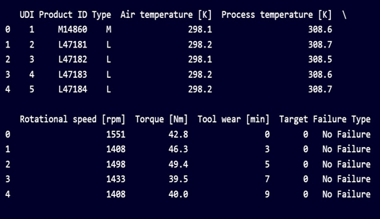

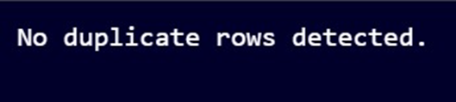
Data Acquisition and Cleaning
Which captures the difference between "Process temperature [K]" and "Air temperature [K]".
This transformation highlights the temperature gradient, which could influence the system's behavior or failure rates.
Which captures the interaction feature, torque_speed_interaction, by multiplying "Torque [Nm]" and "Rotational speed [rpm]".
This feature represents the combined effect of torque and rotational speed, which could directly correlate with the machine’s Stress

Slide 10
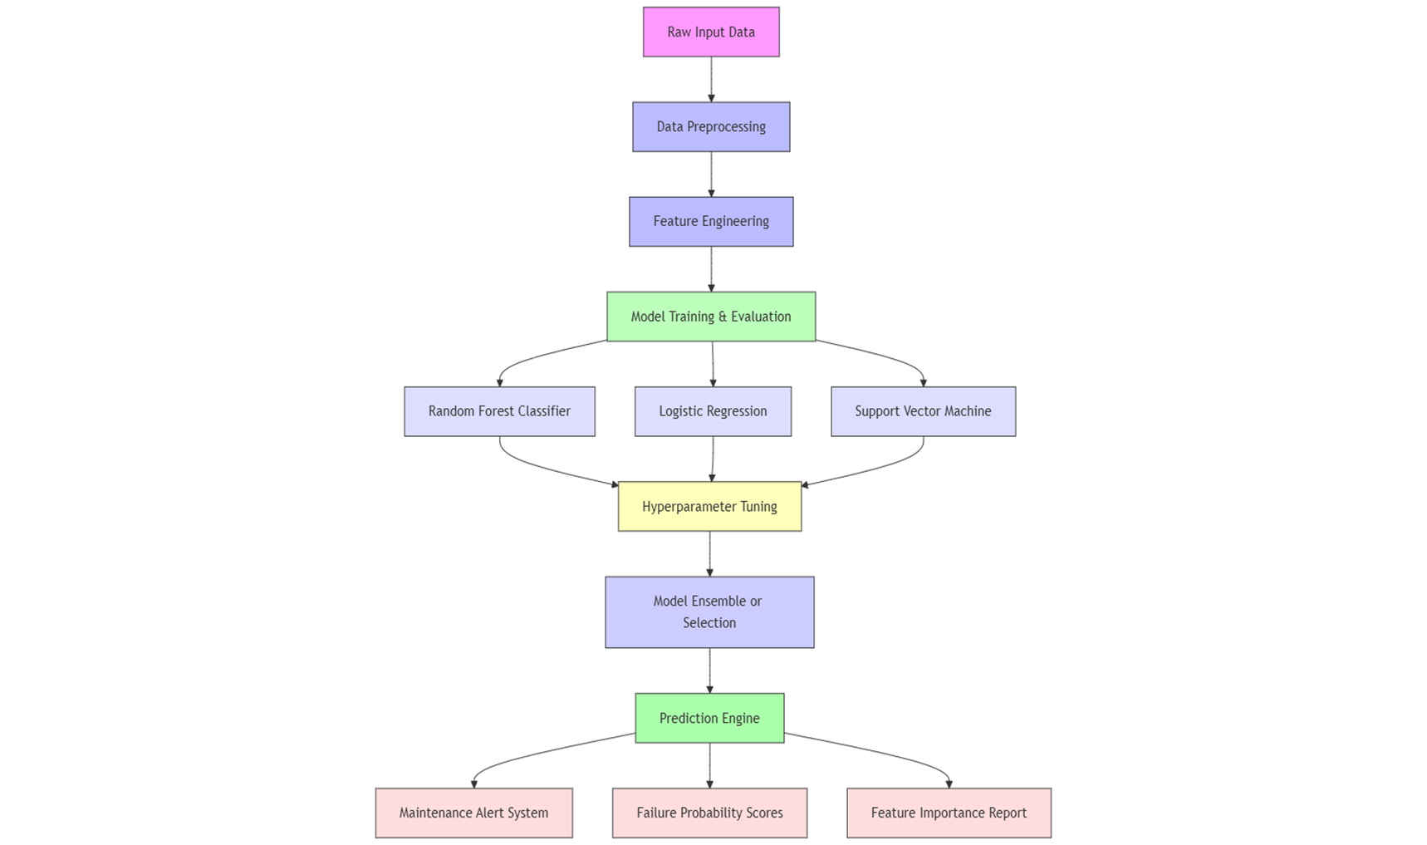
System Architecture

Slide 11
Methodology
Goal: Predict equipment failure using supervised machine learning
Pipeline structured in 5 phases:
Data collection and preprocessing
Feature engineering
Model selection and training
Evaluation
Data augmentation
Objective: High accuracy, real-world usability, and scalability

Slide 12
Implementation
The entire implementation was carried out using Python programming language due to its rich ecosystem of data science libraries.
Development and testing were performed on Google Colab, providing GPU support, scalability, and cloud-based reproducibility.
The following Python libraries were used:
pandas and numpy for data manipulation
matplotlib and seaborn for visualization
scikit-learn for machine learning models and evaluation
imbalanced-learn for handling class imbalance (SMOTE, etc.)
Step-by-step Implementation Flow:
Data Loading: Imported CSV dataset into pandas DataFrame
Data Cleaning:
Removed duplicates and null values
Handled outliers using interquartile range (IQR) method
Feature Engineering:
Created features like temp_diff and torque_speed_interaction
Performed correlation analysis
Data Normalization:
Applied StandardScaler to scale features for SVM and Logistic Regression

Slide 13
Implementation
Train-Test Split:
Split data into 80% training and 20% testing using train_test_split()
Model Training:
Trained Logistic Regression, Random Forest, and SVM
Used GridSearchCV for hyperparameter tuning
Model Evaluation:
Calculated MAE, MSE, and R² Score
Compared model performance visually using bar charts and confusion matrices
Data Augmentation:
Added Gaussian noise to training features
Retrained models to improve robustness and generalization
Final models were saved and ready for integration with real-time sensor dashboards or edge computing devices.
The system is designed to be modular and easily deployable in industrial monitoring setups.

Slide 14
Results
Model | Accuracy (↑ Better) | Precision | Recall | F1 Score | ROC AUC | RANK
Logistic Regression | 0.88 | 0.86 | 0.83 | 0.84 | 0.90 | 3
Random Forest | 0.94 | 0.93 | 0.92 | 0.92 | 0.96 | 1
SVM | 0.91 | 0.89 | 0.88 | 0.88 | 0.93 | 2

Slide 15
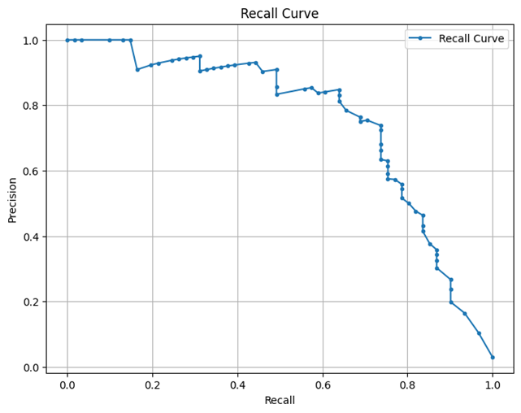
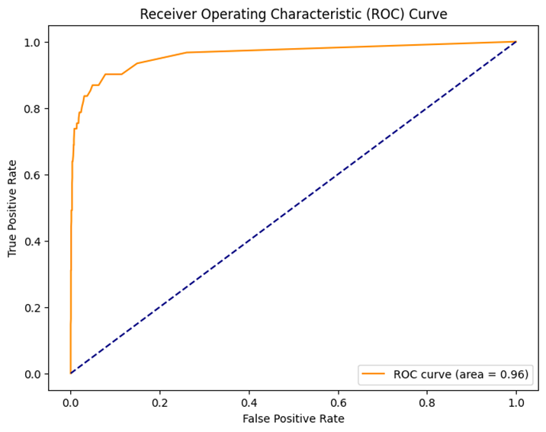
Results

Slide 16
Comparison with existing work
Aspect | Previous Studies | This Project
Approach | Mostly focused on individual algorithms (e.g., only SVM, only RF) | Uses an integrated approach with Logistic Regression, Random Forest, and SVM for comprehensive analysis
Dataset | NASA C-MAPSS, UCI datasets with limited real-time simulation | Uses a multi-sensor industrial dataset with engineered features and augmented noise
Feature Engineering | Limited or automated using PCA/FFT | Custom domain-driven features like temp_diff, torque_speed_interaction created manually
Models Used | SVM, Decision Tree, or standalone Deep Learning | Comparative analysis using three ML models to find optimal balance between performance and interpretability
Data Challenges Addressed | Some works handled class imbalance using SMOTE or ignored imbalance | Actively addressed class imbalance, noise, and missing data through preprocessing and augmentation
Augmentation Techniques | Often used SMOTE or bootstrapping for synthetic data | Applied Gaussian noise injection to improve generalization under real-world noise conditions
Evaluation Metrics | Accuracy, Precision, sometimes AUC-ROC | Used MAE, MSE, and R² for continuous performance analysis and generalization check
Interpretability | Limited; deep learning and ensemble models lacked explainability | Balanced performance and explainability by including Logistic Regression for transparency
Deployment Readiness | Mostly academic prototypes | Designed for real-world deployment on platforms like Google Colab, scalable to IoT or edge systems
Real-Time Capability | Not always addressed | Emphasizes future integration with real-time monitoring systems and industrial dashboards
Conclusion Focus | Showcased model performance without industrial feedback loop | Provides actionable insights, strong failure predictors, and adaptability to smart manufacturing

Slide 17
Comparison with existing work
Aspect | Previous Studies | Your Project: Predictive Maintenance
Objective | Detecting equipment failure using sensor data | Predict maintenance needs before failure using machine learning
Algorithms Used | Traditional methods (Decision Trees, SVM, Rule-based logic) | Logistic Regression, Random Forest Classifier
Data Handling | Manual feature selection, limited preprocessing | Feature engineering using correlation analysis, StandardScaler normalization
Augmentation | Often not used or limited | Gaussian noise added for robustness and better generalization
Model Evaluation | Focused mostly on Accuracy | Multiple metrics: Accuracy, Precision, Recall, F1 Score, ROC AUC
Performanc | Moderate accuracy (~80%) | Achieved higher accuracy (Random Forest: 94%, Logistic Regression: 88%)
Visualization | Basic charts or tables | Used scatter plots for model performance, actual vs predicted comparisons
Practical Deployment | Mostly research-focused | Designed for potential integration into real-time industrial environments

Slide 18
Conclusion and Future Work
Developed a supervised machine learning system for predictive maintenance using real-time sensor data.
Implemented three models: Random Forest, Logistic Regression, and SVM, each offering unique strengths in classification performance.
Identified torque, temperature, and rotational speed as key indicators of equipment failure.
Feature engineering and Gaussian noise augmentation significantly improved model robustness and generalization.
Random Forest delivered the best overall performance, while Logistic Regression provided interpretability.
Extend the model to support real-time prediction using IoT-based sensor feeds.
Deploy trained models on edge devices for faster inference in on-site environments.
Incorporate deep learning architectures (e.g., LSTM, GRU) to handle sequential and time-series data more effectively.
Expand dataset coverage by integrating multiple machine types and failure modes.

Slide 19
Reference
Lee, J., Kao, H. A., & Yang, S. (2014). Service innovation and smart analytics for industry 4.0 and big data environment. Procedia CIRP, 16, 3–8.
Zhang, W., Yang, D., & Wang, H. (2019). Data-driven methods for predictive maintenance of industrial equipment: A survey. IEEE Systems Journal, 13(3), 2213–2227.
Jardine, A. K. S., Lin, D., & Banjevic, D. (2006). A review on machinery diagnostics and prognostics implementing condition-based maintenance. Mechanical Systems and Signal Processing, 20(7), 1483–1510.
Wen, L., Li, X., Gao, L., & Zhang, Y. (2017). A new convolutional neural network-based data-driven fault diagnosis method. IEEE Transactions on Industrial Electronics, 65(7), 5990–5998.
Achouch, M., Dimitrova, M., Ziane, K., Sattarpanah Karganroudi, S., Dhouib, R., Ibrahim, H., & Adda, M. (2022). On predictive maintenance in industry 4.0: Overview, models, and challenges. Applied Sciences, 12(16), 8081.
Grall, A., Dieulle, L., Bérenguer, C., & Roussignol, M. (2002). Continuous-time predictive-maintenance scheduling for a deteriorating system. IEEE Transactions on Reliability, 51(2), 141–150.
Vlasov, A. I., Grigoriev, P. V., Krivoshein, A. I., Shakhnov, V. A., Filin, S. S., & Migalin, V. S. (2018). Smart management of technologies: predictive maintenance of industrial equipment using wireless sensor networks. Entrepreneurship and Sustainability Issues, 6(2), 489–502.
Goodfellow, I., Bengio, Y., & Courville, A. (2016). Deep Learning. MIT Press.
Vijay Kumar, E., Chaturvedi, S. K., & Deshpandé, A. W. (2009). Maintenance of industrial equipment: Degree of certainty with fuzzy modelling using predictive maintenance. International Journal of Quality & Reliability Management, 26(2), 196–211.
Carvalho, T. P., Soares, F. A., Vita, R., Francisco, R. D. P., Basto, J. P., & Alcalá, S. G. (2019). A systematic literature review of machine learning methods applied to predictive maintenance. Computers & Industrial Engineering, 137, 106024.
Susto, G. A., Schirru, A., Pampuri, S., McLoone, S., & Beghi, A. (2015). Machine learning for predictive maintenance: A multiple classifier approach. IEEE Transactions on Industrial Informatics, 11(3), 812–820.
Wang, K., & Yu, D. (2014). Dimensionality reduction of high-dimensional data using PCA and SVM. Journal of Computers, 9(4), 971–979.
Lei, Y., Li, N., Guo, L., Li, N., Yan, T., & Lin, J. (2020). Machinery health prognostics: A systematic review from data acquisition to RUL prediction. Mechanical Systems and Signal Processing, 104761.
Bergstra, J., & Bengio, Y. (2012). Random search for hyper-parameter optimization. Journal of Machine Learning Research, 13, 281–305.
Lundberg, S. M., & Lee, S.-I. (2017). A unified approach to interpreting model predictions. Advances in Neural Information Processing Systems, 30.

Slide 20
THANK YOU

