Slide 1
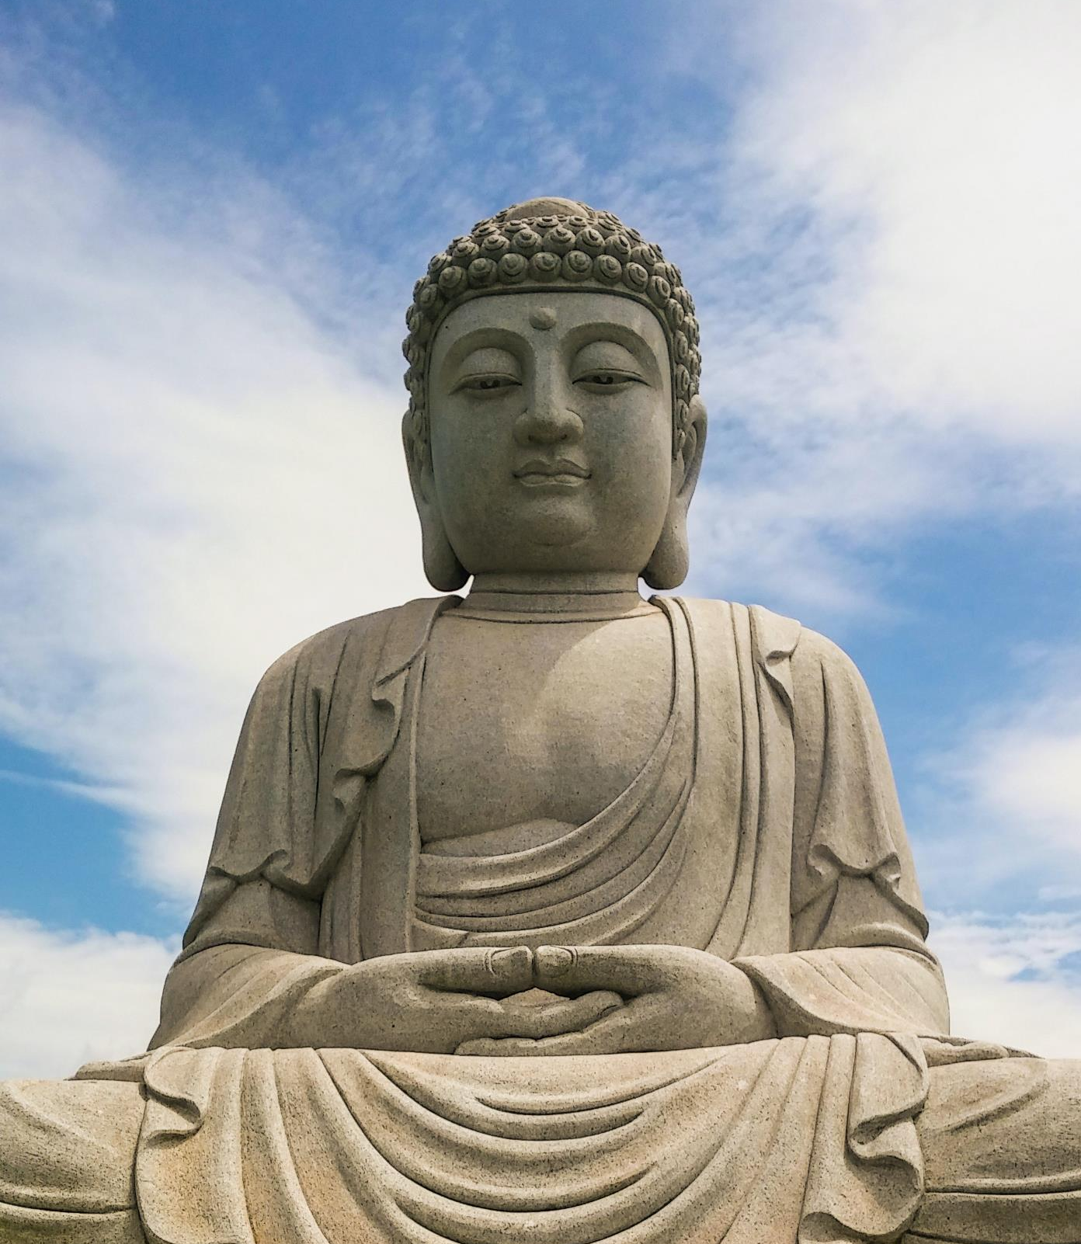
DESIGN GENERATOR

Slide 2
INTRODUCTION
The project focuses on automating the extraction of designs from sculpture images using Python.
Techniques like blurring, thresholding, edge detection, and contour detection will be used.
The project has potential applications in various fields related to art and cultural heritage.

Slide 3
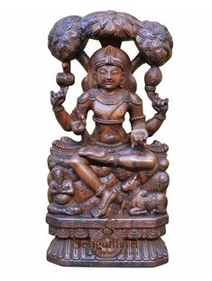
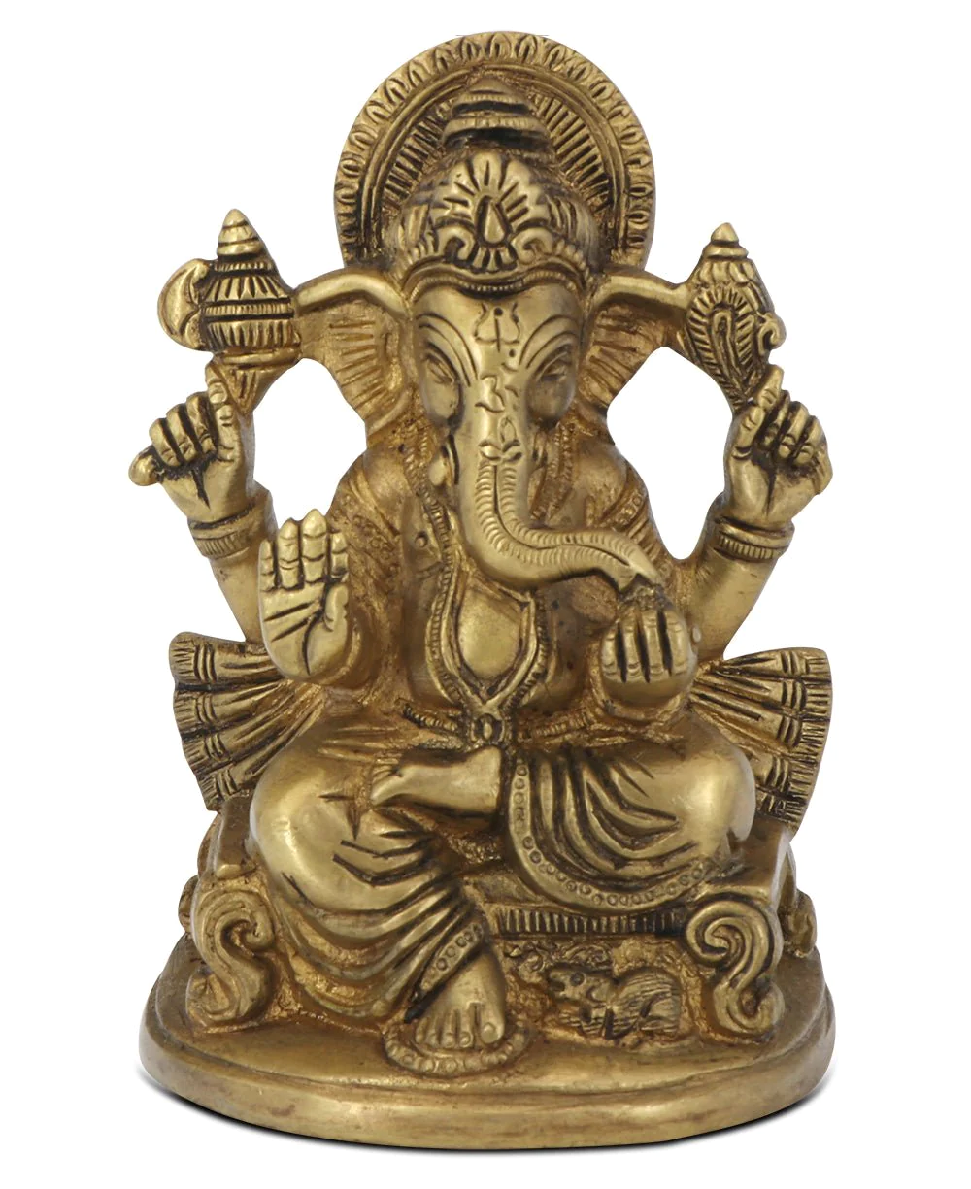
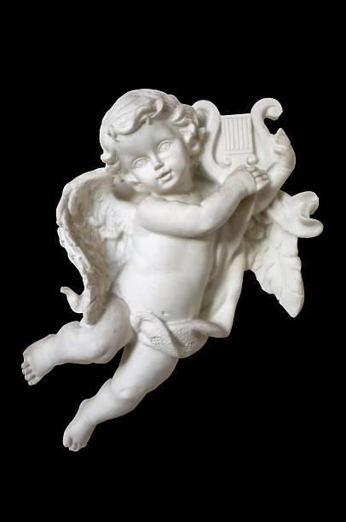
DATASET
Wood Brass Ceramic

Slide 4
PROBLEM STATEMENT
Manual extraction of designs from Sculpture/Satchu images is time-consuming and labor-intensive.
Project goal is to develop an automated solution that can accurately extract designs from various types of sculptures.

Slide 5
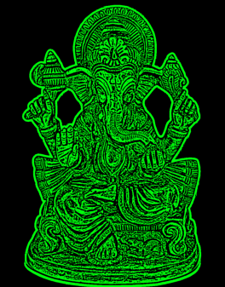
PROGRESS SO FAR….
Successfully obtained the design output for brass sculptures.
Able to reduce unnecessary details and noises.
Obtained the design mask for ceramic Satchu images

Slide 6
TO DO LIST
My focus now is to extend the automated design extraction to wooden and cement sculptures.
Improve coding to enhance the current output
currently working on coding and adapting the techniques for these specific sculpture types.

Slide 7
CHALLENGES
Varying lighting conditions and texture variations.
Finding better quality images
Extracting the design pattern without the material patterns.
To handle these challenges, blurring, adaptive thresholding and contour detection techniques are included.

Slide 8
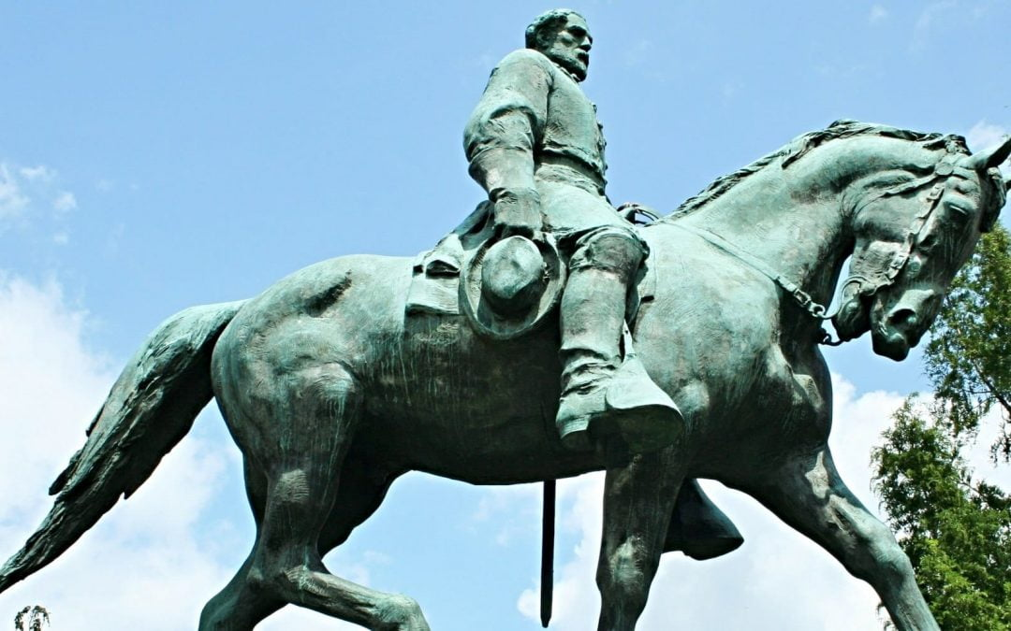
THANK YOU!

