Slide 1
CANOPY
Draw an organization. Run it.
The chart isn't a diagram of the system. The chart is the system.
Notes:
(0:00) COLD OPEN — before touching the slide: 'Every story about AI right now is the same story, and it's told in the passive voice.' The illustrator is being replaced. The copywriter is being made redundant. The developer's job is being automated. The strange thing about that story is who's telling it — it's not a law of physics, it's a description of who currently owns the machines. Then the flip: the same technology that can do an artist's job for a corporation can do a corporation's job for an artist. This is Canopy. One line: you draw an org chart, and it runs. Not a diagram of a plan — the chart IS the system. BEAT — let the one-liner land. This is the sentence people repeat. (Advance ~1:30)

Slide 2
The story you've been told
“The artist is being replaced.”
“The writer is being made redundant.”
“The developer is being automated.”
Notice the passive voice. That story is not a law of physics — it’s a description of who currently owns the machines.
The same technology that can do an artist’s job for a corporation
can do a corporation’s job for an artist.
Notes:
(1:30 → still §1/§2 bridge) Read the three quotes almost bored — they're wallpaper by now. Point at the passive voice: nobody says WHO is doing the replacing. Land the gold line slowly; it's the thesis of the whole talk. Then ask the room: so what does a corporation actually have that you don't? (Advance ~2:00)

Slide 3




The real moat was never talent
Coordination is expensive — so scale became a privilege.
Ideas — You have those.
Talent — One person can be world-class.
Money — Not the real gap, most days.
Organization
500 specialists, one goal, nothing collapses. That’s the moat — and it’s been the moat for 150 years.
The corporation got to be an organization.
The individual got to join one.
Notes:
(2:00 – 3:30) §2. Walk the left rows fast: not ideas, not talent, not even money. What they have is ORGANIZATION — 500 specialists pointed at one goal without collapse. Economists have a name for why firms exist: coordination is expensive. Hiring, managing, reviewing, budgeting, unblocking — so costly you must be big to afford it. Scale became a privilege. Artist example verbally: she doesn't lose on art — she loses on the release pipeline, the marketing cadence, the licensing review, the fan support. She has the one thing the corporation has to fake — a voice — and none of the machinery. Closing question: what happens when the machinery becomes something you can just… draw? (Advance ~3:30)

Slide 4



You draw it. It runs.
YOUR INTENT
Every box is an AI agent
A role from the catalog, an isolated workspace, durable memory, a salary.
CEO agent
Every line is real
Managers delegate only to their reports. Two teams can’t even talk unless the chart says so. No back-channels the chart didn’t create.
Eng lead
Mktg lead
Work flows back up
Pull requests, test reports, drafts — reviewed, accepted against a contract, rolled up to you.
Engineer
QA
Writer
Editor
delegation flows down • artifacts flow up
The org chart used to be the most fictional document in the building. Not anymore.
Notes:
(3:30 – 5:30) §3. Describe the editor like a whiteboard: pick an organization type — software company, creative agency, research lab, newsroom, franchise. That choice gives you a palette of roles. Drag them on, wire who reports to whom, give each a salary. Then hand the ROOT a goal — and it runs. Walk the three left rows. Emphasize: the org chart used to be the most fictional document in the building — the official flow everyone worked around. In Canopy there is no working around it. The structure you draw is the truth of the running system. (Advance ~5:30)

Slide 5
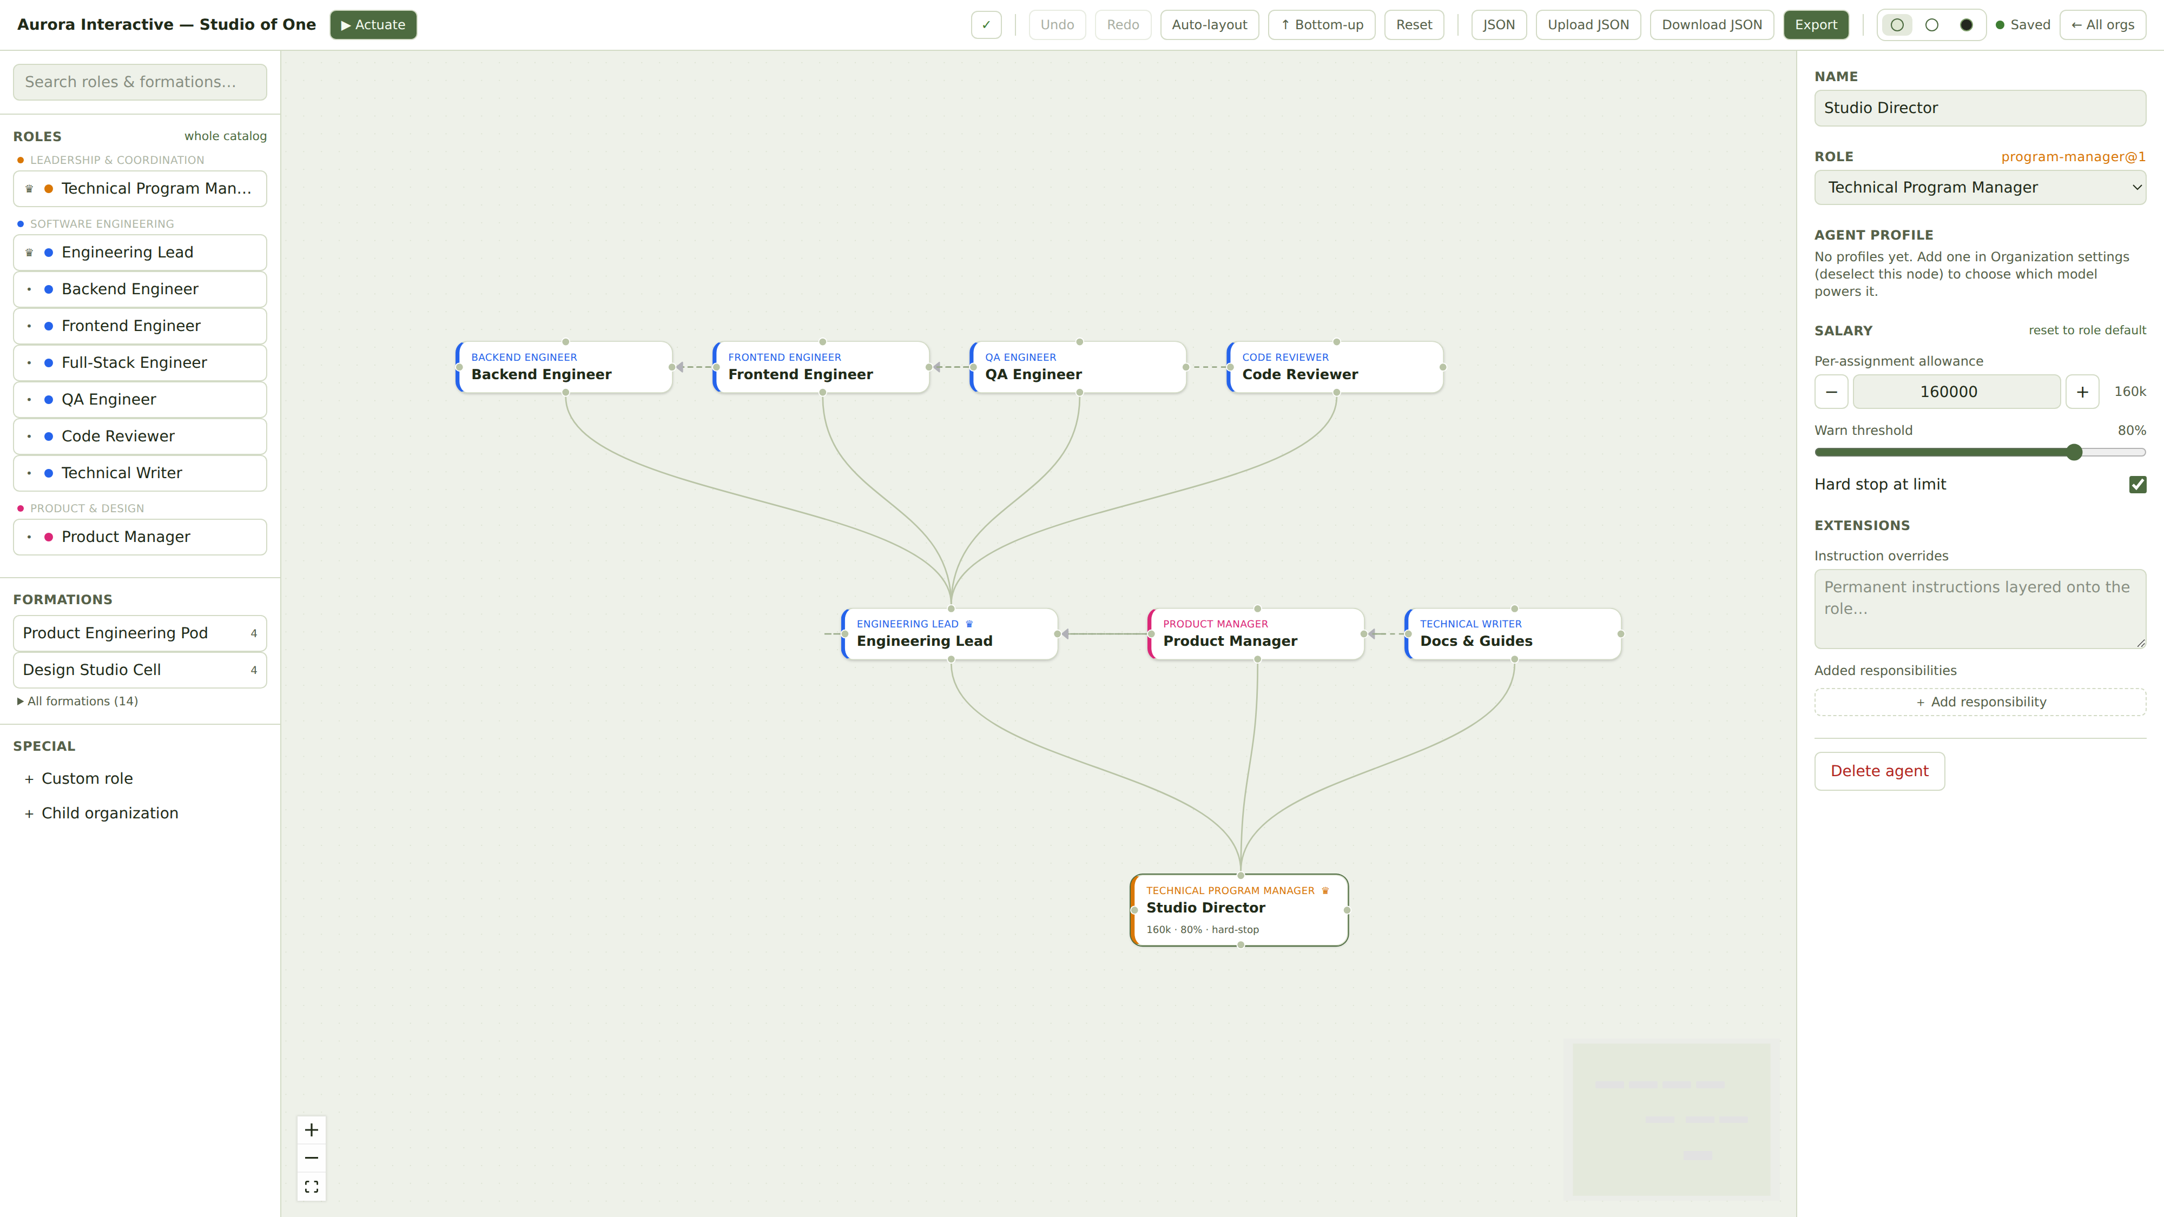
This part isn’t a mockup
The Phase-1 editor, running today: an eight-agent studio — salaries, reporting lines, dependency gates — drawn bottom-up, trunk to canopy.
Notes:
(≈5:20 — a 30-45 second proof beat; steal the time from §4's padding, don't tour the UI.) 'So we're clear this isn't a concept video: this is the phase-one editor, running today.' Point at exactly two things: 1) The trunk node — 160k token salary, warn at 80%, hard stop at the limit. Salary is a first-class field on the node, not a metaphor. 2) Which way the tree grows — the canvas draws organizations bottom-up by default: trunk at the bottom, canopy on top. The product agrees with the pitch. If someone wants to see it live, offer a demo after Q&A. Then advance into 'Why an org chart?'

Slide 6
Why an org chart, of all things?
Swarms sound more futuristic. They also fail in exactly the ways org charts were invented to prevent.
150 years of debugging
Zero learning curve
The most battle-tested coordination technology humans have ever built: clear ownership, one manager per node, escalation paths, review before acceptance.
Unsupervised agent swarms fail like unmanaged people: duplicated work, nobody accountable, spend nobody approved, sub-goals drifting off mission.
No workflow language. No graph theory. If you have ever worked a job, you already understand reporting lines, deliverables, and budgets.
The interface to this power is the one piece of corporate technology every worker on Earth was forced to learn.
We’re handing it back — pointed the other way.
Notes:
(5:30 – 7:30) §4. Acknowledge the objection head-on: isn't the org chart the most corporate artifact imaginable? Two answers. One: 150 years of management practice encoded in that shape — we know how it fails AND how it works. When agent swarms run wild, the failure modes are the exact ones org charts were invented to prevent. Two (more important): everyone in this room can already read one. Slow down for the last line — 'handed back, pointed the other way' is a applause-line beat. (Advance ~7:30)

Slide 7



Delegation without abdication
Hard rules the framework enforces — not suggestions politely made to an LLM.
Nothing is done by vibes
Every responsibility ends in something checkable: an artifact — a document, a patch, a dataset — or an attestation that a real-world action happened, with evidence. Accepted against a contract, or redone.
Every agent earns a salary
A token budget, metered by the platform between every step. The meter is checked before each call — the agent can’t opt out. Overruns, stalls, and drift glow on your chart in real time, not on next month’s bill.
Consequences require consent
Before an agent contacts a real customer, spends real money, or publishes to the world — it stops and waits for a human. Consent before the act, evidence after it.
Notes:
(7:30 – 9:30) §5. Frame: none of this matters if you can't trust it — so these are MECHANICAL rules, not prompts. Row 1: nothing is done by vibes — artifacts or attested actions, accepted against contracts. Row 2: salaries are real token budgets, metered between steps by the runtime itself; a runaway task cannot become a runaway bill. Row 3: approval gates — consequential actions wait for a human. You hold the pen on everything that touches reality. Close with the slide title as the sentence: that's the deal — delegation without abdication. (Advance ~9:30)

Slide 8
An economy’s worth of shapes
The runtime is still being built. The bar it must clear is already written, in public, as a catalog.
26
87
16
31
organization types
roles in the catalog
pre-wired formations
acceptance use cases
software pod
newsroom
research lab
creative agency
franchise shift
support desk
event crew
fundraising office
If a dream on this list can’t be expressed with the shipped catalog, the catalog is wrong — not the dreamer.
Different dreams, same machinery. The machinery was never the special part — it was just the expensive part.
Notes:
(9:30 – 11:30) §6, part 1 — HONESTY BEAT FIRST, it buys credibility for everything after: 'I want to be straight with you — nothing runs end-to-end today. The editor is shipped; the runtime is in progress; I'll show you exactly where it stands at the end.' What IS real today is the catalog: 26 archetypes, 87 roles, 16 formations — written, machine-readable, integrity-checked in CI. The 31 use cases are the ACCEPTANCE SUITE: the contract the runtime is being built to satisfy. House rule: if an ask can't be expressed with the shipped catalog, the catalog is wrong — not the user. Then paint the pictures, future tense: the solo game developer will run an engineering pod — PRs, QA gated behind them, a content machine drafting the launch — while she decides what the game should FEEL like. The researcher without a lab: manuscript drafter structurally blocked until BOTH the lit review and data model are accepted — rigor wired into the team's shape. The community organizer: permit waits for human approval because it spends real money. The newsroom whose fact-check cannot be silently skipped. Land the bottom line verbatim. (Advance ~10:45 — next slide is still §6)

Slide 9
The artist, versus the art business
THE CORPORATION, THEN
THE ARTIST, NOW
Two hundred people between the art and the world.
She keeps the voice. She gets the machinery.
Release pipeline. Marketing cadence. Licensing review. Fan support. Bookkeeping. The machinery money could buy — and the one thing it couldn’t: a voice. That, they had to hire.
An editor holding the quality bar
A social manager publishing on cadence
A support desk answering fans
A contracts analyst triaging every license request in 24 hours
The moat is shrinking.
Notes:
(≈10:45 – 11:30) §6, part 2 — the story this pitch was born from. Slow down. Keep the future tense honest: this is what the catalog is built to give her. The corporation had two hundred people between the art and the world; the artist will have none, and lose nothing. She was the one irreplaceable node in their chart all along. Say 'the moat is shrinking' plainly — no flourish. Pause. (Advance ~11:30)

Slide 10
So what, exactly, got automated?
Every responsibility a manager holds — across all 26 archetypes — consolidates into six families. All six now run through the platform.
Decompose & delegate
Control scope
Monitor progress
Enforce quality
Unblock work
Manage budgets
The role that dissolves is not the maker.
It’s the manager.
Notes:
(11:30 – 13:30) §7, part 1. This is the money slide — earn it with the setup: 'we went through every responsibility a manager holds, across every kind of org in the catalog — thirty duties, six families. That's the job.' Delegation follows the chart, scope drift trips an alarm, progress is observable to the step, acceptance is contract-based, gates route themselves, every token metered. Then the line. IMPORTANT: immediately soften — this is not contempt for managers. Management is real, definable work; that's exactly WHY it can be encoded and delegated. What can't be encoded is wanting something. That bridge takes you to the next slide.

Slide 11
What’s left is the part that matters
The chart
The pen
The intent
Only you change the structure. The system can surface evidence — queues, bottlenecks, repeat escalations — but the org never rewires itself.
Every action that touches reality — money, customers, publishing — waits for your consent. Always.
The one thing no agent can generate: wanting something. Which game gets made. Which story gets told. Which community gets stronger.
You’re not being automated out of the economy. You’re being promoted to founder.
Notes:
(≈12:45 – 13:30) §7, part 2 — the hopeful turn. Three things stay human by DESIGN, not by limitation: the chart, the pen, the intent. Then flip the decade-old narrative explicitly: automation anxiety said the worker is redundant and whoever owns the org keeps the value. This says: the org is now software — and YOU own one. Deliver the bottom line to the room, not the screen. (Advance ~13:30)

Slide 12
A million one-person organizations, each shaped exactly like its founder’s ambition.
For 150 years, the org chart was the map of who you answered to.
Now it’s the map of what answers to you.
Notes:
(13:30 – 14:30) §8. Paint it: some orgs a single agent, some a hundred-node tree with a nested support center. The moat that protected scale is draining — organization is no longer a privilege of the already-large. Ideas stop dying of logistics. The gap between having a vision and fielding an organization to pursue it collapses to an afternoon with a canvas. Then the closing couplet — slowly. This is the emotional peak; let the silence work. (Advance ~14:30)

Slide 13
Where it stands
Phase 1 — Build
Phase 2 — Actuate
Phase 3 — Execute
SHIPPED
IN PROGRESS
DESIGNED
The org-chart editor: draw, validate, serialize a runnable organization.
Spin the chart up into live, sandboxed agents — ready and waiting.
The work engine: assignments, gates, budgets, deliverables rolling up.
Core going open source — a tool for redistributing organizational power shouldn’t have a gatekeeper. Roles are data, not code: the catalogs of the future — for architects, filmmakers, farmers — get written by people like you.
Come dream with me. Bring the organization you always wished you had — and let’s draw it.
Notes:
(14:30 – 15:00) §9. Honest and quick: it's real and it's early. Domain model settled; the editor is built and working today; actuation is in progress; the execution engine is designed in detail. Open source, because a tool whose whole point is redistributing organizational power shouldn't have a gatekeeper. Extensibility beat: roles are data — future catalogs get written by this room. End on the invitation, then stop talking. (15:00)

