Slide 1



GHG EMISSION PREDICTION
NAME : MADHESH.S
AICTE Student ID : STU681304f87332f1746076920
AICTE Internship ID: INTERNSHIP_1746416864681834e0e35d8

Slide 2

Learning Objectives
Understand GHG Emission Data – Explore how greenhouse gases are measured and linked to U.S. industries and commodities.
Perform Data Preprocessing – Clean, encode, and scale real-world data to prepare it for machine learning.
Build ML Models – Train and evaluate Linear Regression and Random Forest Regressor models to predict
GHG emissions.
Learn Hyperparameter Tuning – Improve model performance using techniques like Grid Search for optimal parameters.
Visualize Insights Effectively – Use plots and heatmaps to interpret data and model predictions clearly.
Deploy ML Model with Streamlit – Create an interactive web app for real-time GHG emission prediction.
GOAL
Source :
www.freepik.com/

Slide 3
Tools and Technology used
Python – Used as the core programming language for data preprocessing, modeling, and deployment.
Pandas & NumPy – For data manipulation, cleaning, and handling large numerical datasets efficiently.
Matplotlib & Seaborn – Libraries used to create insightful visualizations such as bar charts, heatmaps, and trend lines.
Scikit-learn – Machine learning library used to build and evaluate models like Linear Regression and Random Forest Regressor.
Google Colab – Cloud-based Jupyter notebook environment used for coding, training models, and sharing notebooks.
Streamlit – Used to deploy the trained ML model into an interactive web application for real-time GHG predictions.

Slide 4
Methodology
Data Collection – Collected the Supply Chain Greenhouse Gas Emission Factors dataset from [Data.gov], which contains emissions data linked to U.S. industries and commodities.
Data Preprocessing – Cleaned the dataset by handling missing/null values. – Standardized units and encoded categorical variables (e.g., Industry, Commodity). – Scaled numerical data for better model performance.
Exploratory Data Analysis (EDA) – Explored data patterns, outliers, and correlations using visual tools. – Identified high-emission industries and trends.
Model Building – Trained Linear Regression and Random Forest Regressor to predict GHG emissions based on input features. – Split the dataset into training and testing sets.
Model Evaluation – Used evaluation metrics like RMSE, MAE, and R² Score to measure performance. – Compared models to select the most accurate one.
Hyperparameter Tuning – Optimized model parameters using techniques like Grid Search to improve prediction accuracy.
Model Deployment – Developed a Streamlit web application for user-friendly, real-time GHG

Slide 5
Problem Statement:
Climate change has become an urgent global issue, with greenhouse gas (GHG) emissions being one of its primary contributors. Across various industries and commodities, emissions vary significantly, making it difficult to identify the sectors that contribute the most to environmental degradation. The available emission data is often complex, unstructured, and not easily interpretable, limiting its practical use for decision-makers and stakeholders.
Moreover, there is a lack of intelligent systems that can predict emissions based on historical data, industry type, and commodity usage. Without predictive tools, businesses and policymakers struggle to make proactive, data-driven decisions to reduce their carbon footprint. Additionally, most existing tools are either too technical or lack real-time interactivity, creating a gap for accessible, user-friendly solutions. This project aims to address these challenges by using machine learning to build a model that predicts GHG emissions and deploys it through an interactive web app for broader usability.

Slide 6
Solution:
To address the challenges of understanding and managing greenhouse gas (GHG) emissions, this project proposes a machine learning–based solution that can predict emissions associated with various U.S. industries and commodities. By leveraging a public dataset from Data.gov, the system is designed to process, analyze, and model emission factors using supervised learning algorithms such as Linear Regression and Random Forest Regressor.
The solution follows a complete data science pipeline—from data cleaning and exploratory analysis to model training, evaluation, and deployment. Hyperparameter tuning is applied to improve the model’s accuracy and performance. Finally, the trained model is deployed using Streamlit, enabling users to interact through a simple web interface, where they can input industry or commodity details and receive real-time emission predictions.
This approach not only simplifies the interpretation of complex emission data but also empowers businesses, researchers, and policymakers with actionable insights for climate-conscious decision-making.

Slide 7
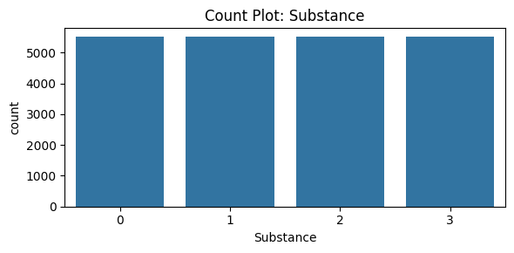
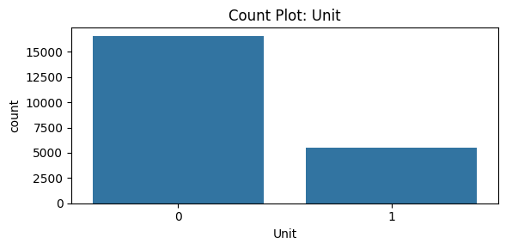
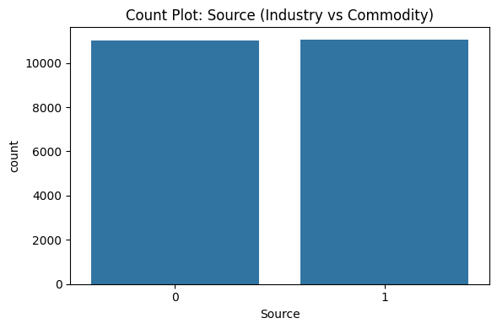
Screenshot of Output:
Dataset Analysis
Substance Count: Shows that all four substances in the dataset are evenly represented.
Unit Distribution: Highlights that the majority of emission data is measured in a specific unit (kg/2018 USD, purchaser price), which may influence modeling.
Source Distribution: Industry and commodity sources are almost equally represented, indicating a balanced dataset.

Slide 8
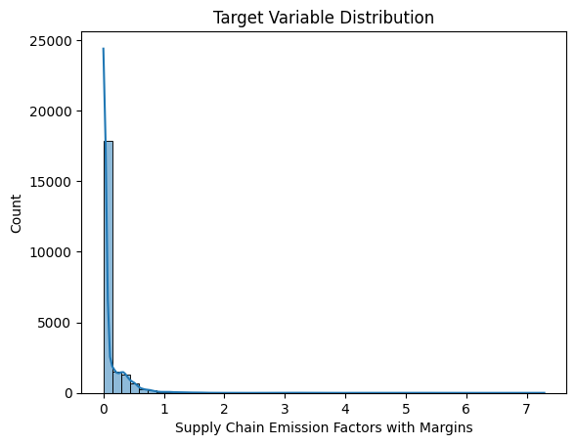
TARGET VARIABLE DISTRIBUTION
The target variable Supply Chain Emission Factors with Margins is highly skewed, with most values clustered between 0 and 1. This skewness is important when selecting models and preprocessing steps

Slide 9
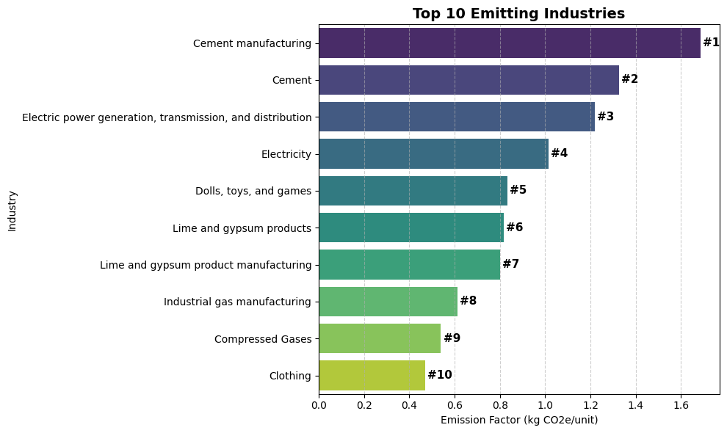
TOP 10 EMITTING INDUSTRIES
Cement and power generation industries are among the highest GHG emitters. Understanding which sectors contribute most helps prioritize sustainability efforts and justify predictive modeling.

Slide 10
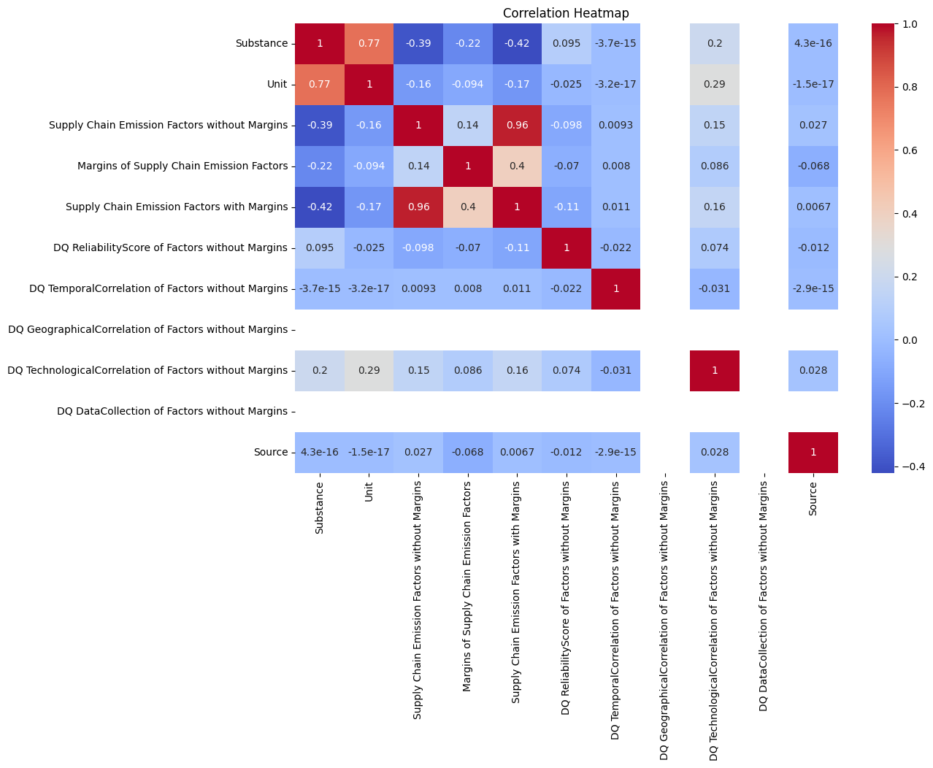
CORRELATION ANALYSIS
The correlation heatmap shows strong relationships between certain features, such as supply chain emission factors with and without margins. This helps in feature selection and identifying redundancy.

Slide 11
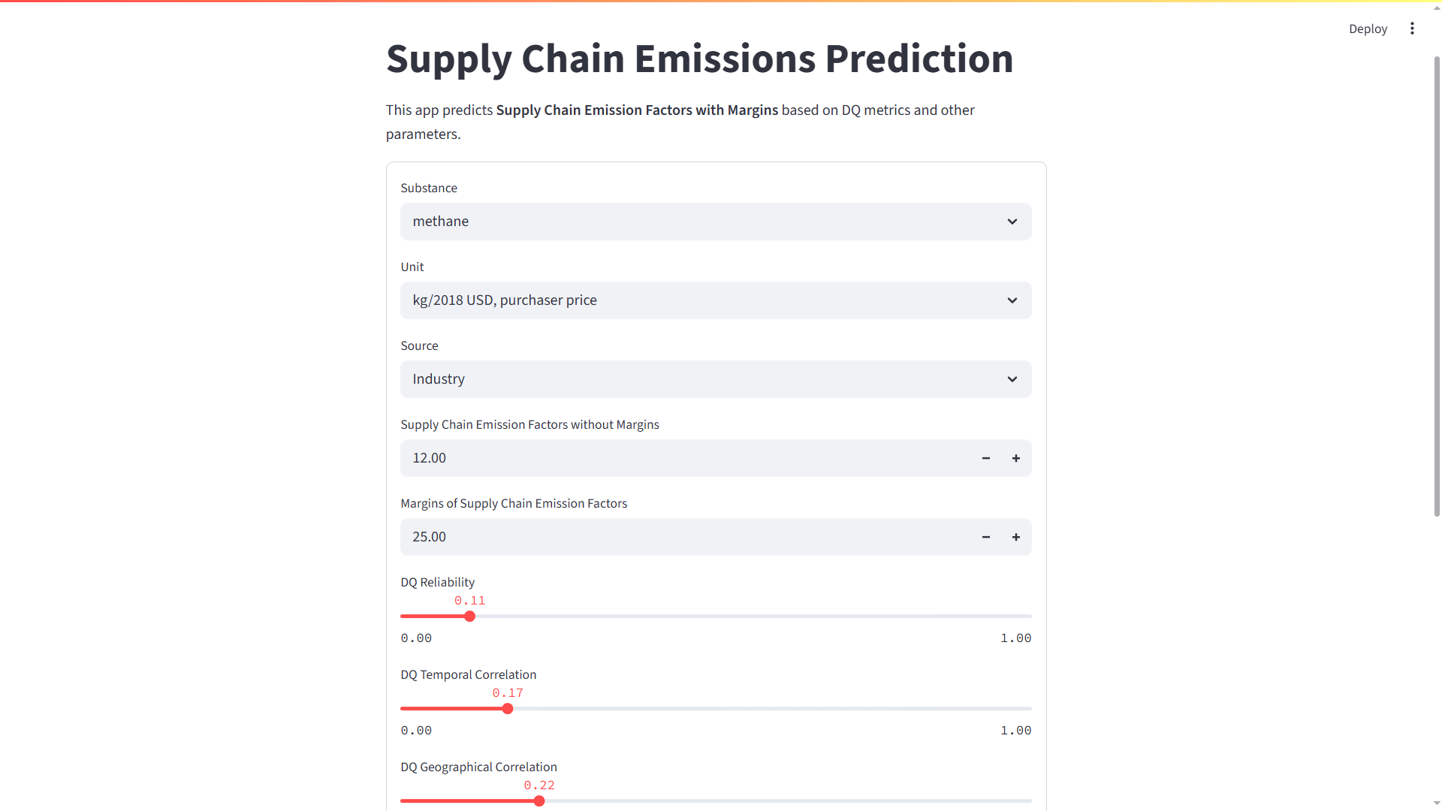
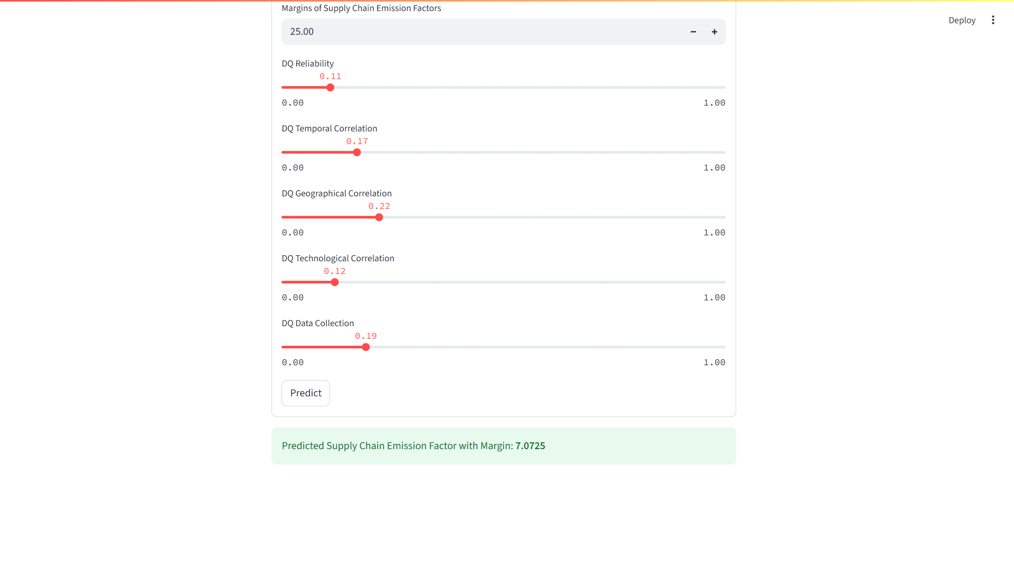
MODEL DEPLOYMENT – STREAMLIT INTERFACE

Slide 12
Conclusion:
This project successfully demonstrates the application of machine learning to address a critical environmental challenge—predicting greenhouse gas emissions across U.S. industries and commodities. Through careful data preprocessing, exploratory analysis, and model development using Linear Regression and Random Forest, we were able to estimate emission factors with measurable accuracy.
The final deployment using Streamlit provided an accessible and interactive interface, enabling users to make real-time predictions based on key input parameters. This makes the solution not just technically sound, but also practical for use by researchers, policymakers, and industry stakeholders.
By combining data-driven insights with modern ML techniques, this project contributes towards promoting sustainability and enabling informed decision-making for a greener future.

