Slide 1

EAST WEST INSTITUTE OF TECHNOLOGY
DEPARTMENT OF ARTIFICIAL INTELLIGENCE AND DATA SCIENCE
DATABASE MANAGEMENT SYSTEM
MINI-PROJECT
4th Semester 2025
PROJECT NAME: GAME COMPLEX MANAGEMENT SYSTEM
Guidance of : Prof. Vinayak S
Presented By:
MADHU.S (1EW23AD025)
MEGHRAJ.D L (IEW23ADO29)
JAGATHISH.M (1EW23AD018)

Slide 2


Slide 3

INTRODUCTION
This mini-project, a Game Complex Management System using MongoDB, streamlines game sales and customer data. It efficiently collects and stores detailed customer information, including purchase history, enabling easy access and flexible, scalable data storage with real-time updates. Key features include customer registration, purchase tracking, and an intuitive interface for monitoring trends. The system enhances operational efficiency and maintains data integrity.

Slide 4
TOOLS USED
FRONTEND TECHNOLOGIES:
HTML (Hypertext Markup Language)
CSS (Cascading Style Sheets
Tailwind CSS
Bootstrap
jQuery
Lucide Icons
BACKEND TECHNOLOGIES:
MySQL.
Django
python

Slide 5
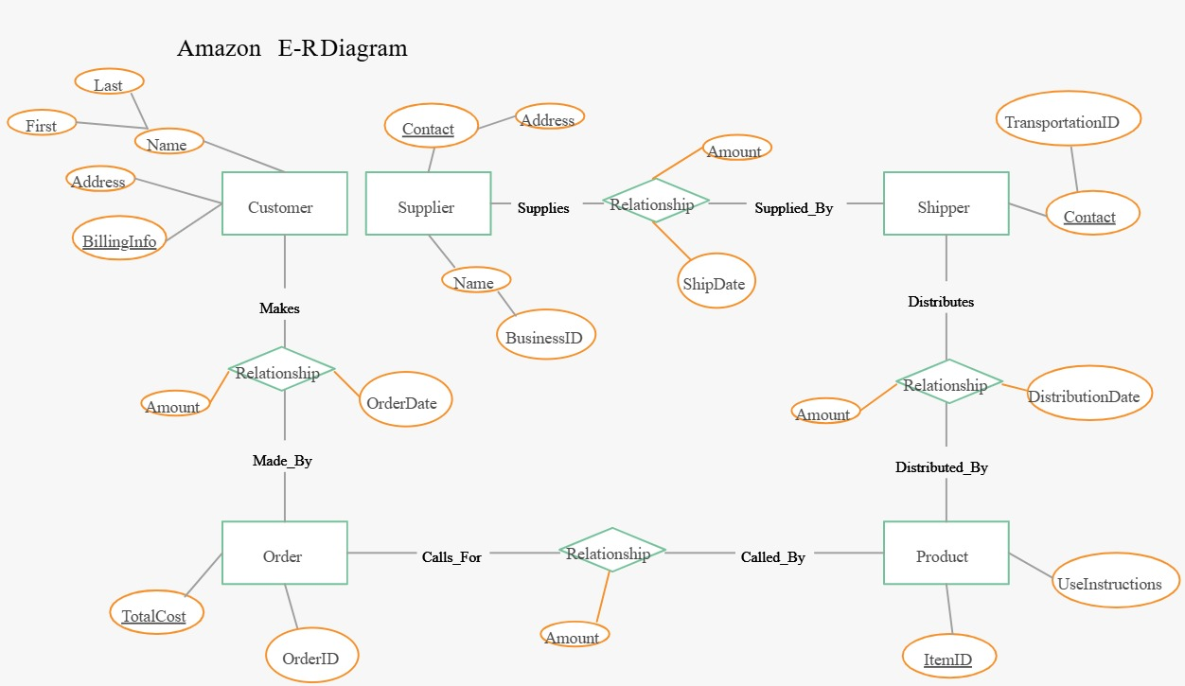

Slide 6
IMPLEMENTATION
User Management:
Store user data Authenticate users & authorize actions Allow users to view/update their profile.
Facility & Game Management:
Display available facilities & games Enable filtering/searching of facilities & games Retrieve pricing info for bookings.
Booking Management:
Create new bookings Check availability to prevent overlaps Retrieve user/staff bookings.
Store membership plan details Assign memberships to users Apply membership discounts during booking.
Inventory Management :
Track item availability Record rented items per booking Generate reports on booking trends, popular items, revenue, customer demographics.
Enable data analysis for business insights.

Slide 7
APPLICATIONS
Membership and Subscription Management
Membership Sales and Renewals
Member Benefits and Access Control
Loyalty Programs
Customer Relationship Management (CRM)
User Data Management
Communication and Notifications
Personalized Experiences
Point of Sale (POS) and Payment Processing
Handling Payments
Sales Tracking Integration with Payment Gateways
Reporting and Analytics
Business Intelligence
Performance Monitoring
Data-Driven Decision Making
Performance Tracking
Marketing and Promotion
Promotional Campaigns
Social Media Integration

Slide 8
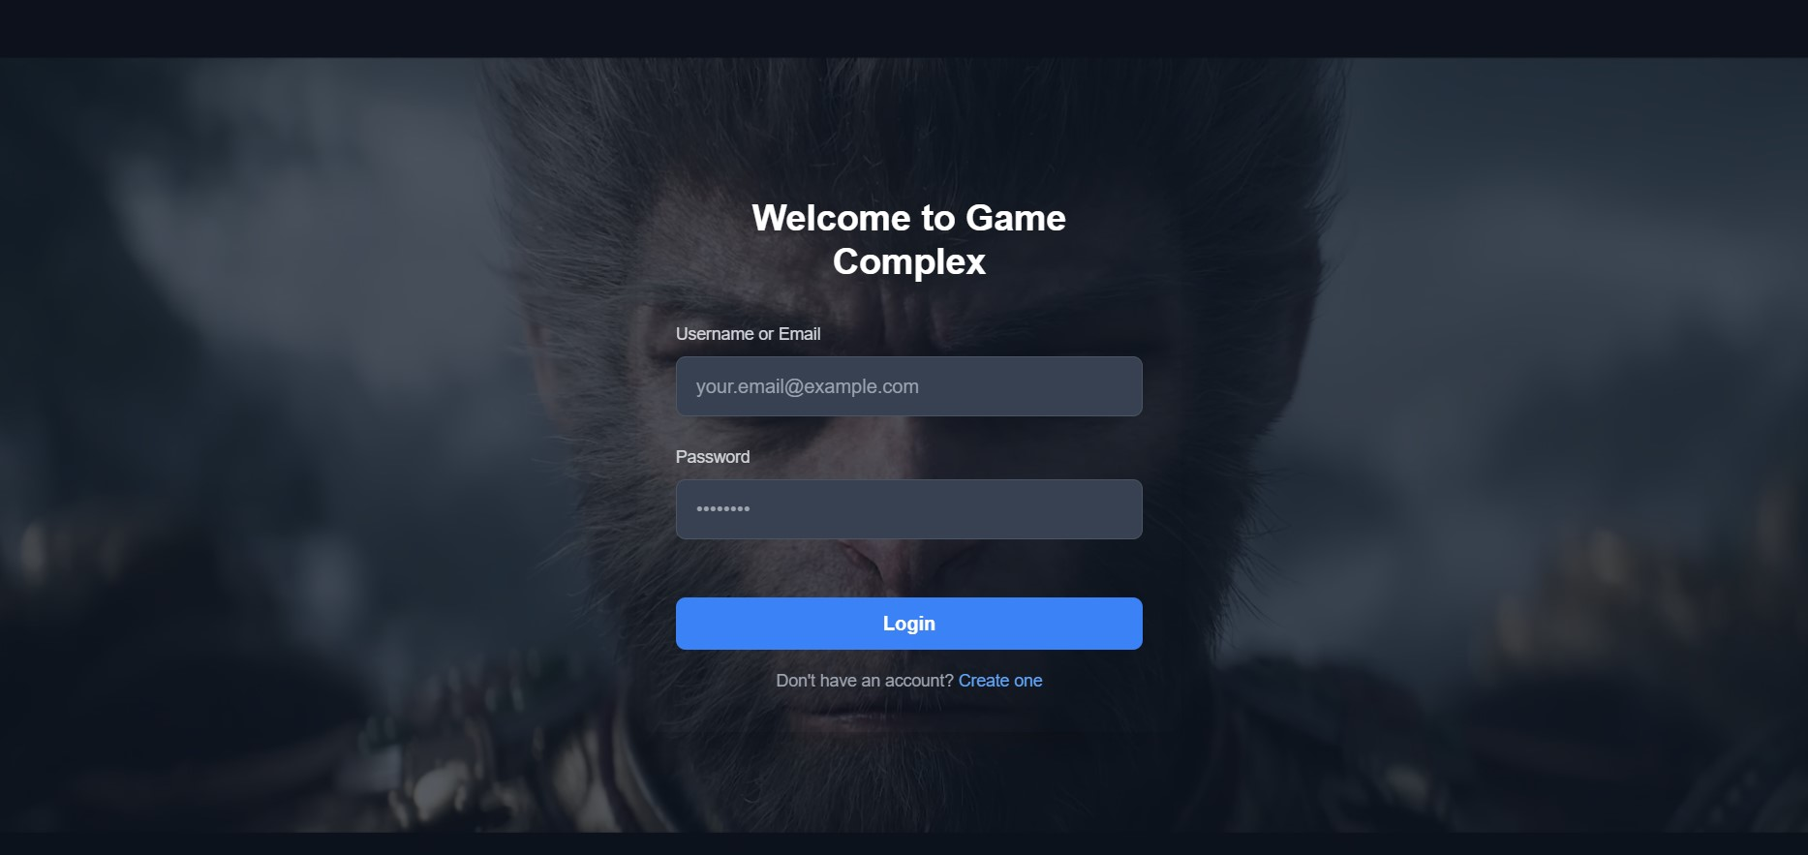
screenshots
Login page

Slide 9
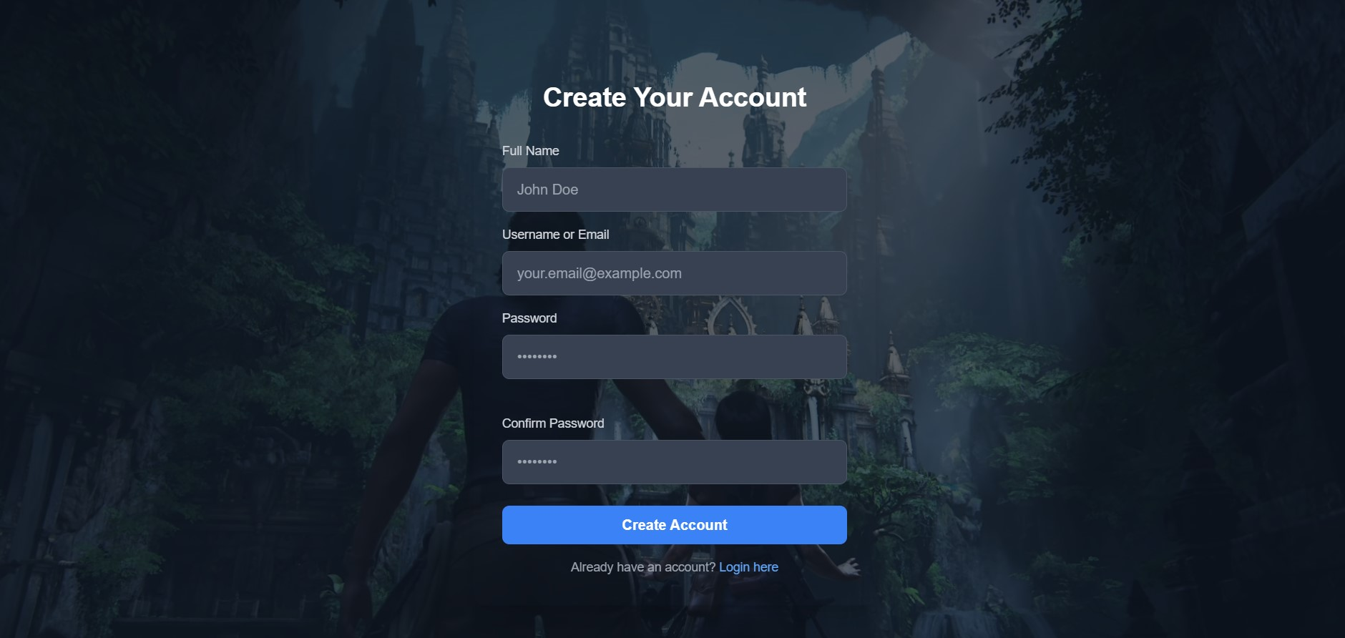
PASSWORD REQUIREMENTS

Slide 10
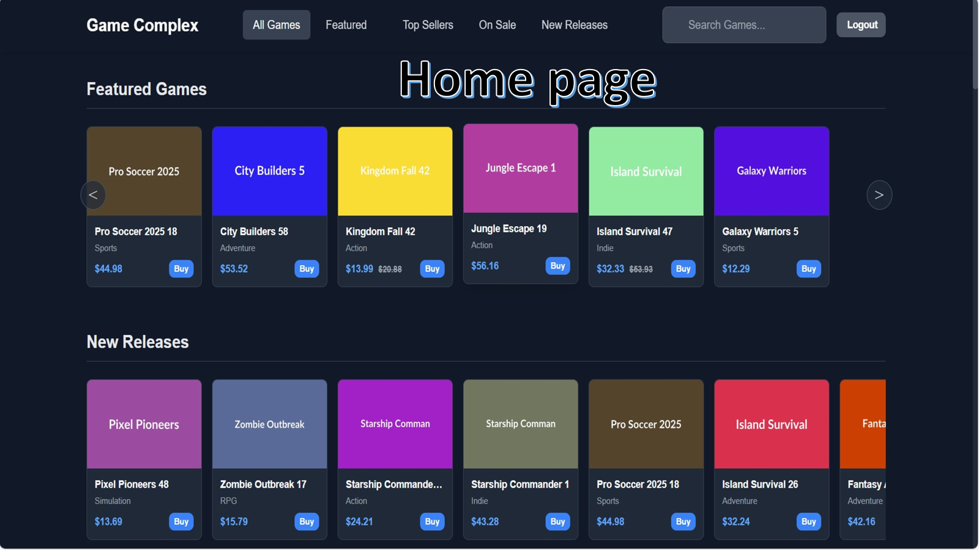

Slide 11
CONCLUSION
Make it easy for customers to book games online.
Like booking a movie ticket, but for your favorite sport or activity.
Keep track of which courts, fields, or games are free and when.
No more double bookings or guessing!
Help manage memberships and payments smoothly.
Less paperwork, faster transactions.
Collect information about what's popular and when.
This helps the owners make smart decisions about schedules and what to offer.

Slide 12
Future works
Enhanced Personalization & AI-Driven Recommendations
Immersive Experiences with AR/VR Integration
Internet of Things (IoT) Integration for Smart Facilities
Gamification and Loyalty Programs
Enhanced Communication and Community Building
Blockchain for Secure Transactions and Ownership
Cross-Platform Integration and Mobile-First Approach
Advanced Reporting and Predictive Analytics

Slide 13

Thank you

