Slide 1


NEXT GEN EMPLOYABILITY PROGRAM
CREATING A FUTURE-READY WORKFORCE
Student Name :
Pathlavath Madhu
Student ID :
College Name :
STU64c38fe7963391690537959
Hyderabad Institute of Technology and Management

Slide 2
CAPSTONE PROJECT SHOWCASE
Project Title
Customer Segmentation Models
Abstract | Problem Statement | Project Overview | Proposed Solution | Technology Used | Modelling & Results | Conclusion | Q&A

Slide 3
Abstract
1
Objective: Enhance marketing efficiency and increase sales in online retail through customer segmentation using transactional data from a UK-based retailer.
2
Methodology: Transform transactional data into a customer-centric dataset and segment customers into distinct groups using the K-means clustering algorithm.
3
Approach: Analyze transactional behavior to identify key features for segmentation. Apply K-means clustering to group customers based on purchasing similarities, revealing diverse preferences and characteristics.
4
Outcome: Refine understanding of customer segmentation, enabling tailored marketing strategies, improved targeting, and increased sales in the online retail sector.

Slide 4


Problem Statement
The project aims to improve marketing strategies and boost sales in the online retail sector. It utilizes transactional data from a UK-based retailer spanning 2010-2011. By transforming this data into a customer-centric dataset and employing the K-means clustering algorithm, the project seeks to segment customers effectively. The outcome will be enhanced marketing efficiency through tailored strategies based on customer segmentation, ultimately leading to increased sales in the online retail sector.

Slide 5

Project Overview
The project involves analyzing transactional data from a UK-based retailer (2010-2011) to enhance marketing strategies and increase sales in online retail.
Data Cleaning & Transformation: The dataset is cleaned and transformed to prepare it for effective clustering.
2.Feature Engineering: New features are created based on transactional data to build a customer-centric dataset.
3.Data Preprocessing: Feature scaling and dimensionality reduction techniques are applied to streamline the data.
4.Customer Segmentation: Using K-means clustering, customers are segmented into distinct groups to enable targeted marketing.

Slide 6
Cluster Analysis & Evaluation: Each cluster is analyzed to develop targeted marketing strategies and evaluate their quality.
6.Recommendation System: A system is implemented to recommend best-selling products to customers within each cluster, aiming to boost sales and marketing effectiveness.
Overall, the project aims to optimize marketing efforts and drive sales growth in the online retail sector through data-driven customer segmentation and personalized recommendations.

Slide 7
Proposed Solution
1. Data Cleaning & Transformation:
Handle missing values, duplicates, and outliers in the dataset.
Ensure data is prepared for effective clustering by addressing any data quality issues.
2. Feature Engineering:
Create new features based on transactional data to develop a customer-centric dataset.
Extract relevant information from transactional records to capture customer behavior and preferences.
3. Data Preprocessing:
Apply feature scaling and dimensionality reduction techniques to streamline the dataset.
Normalize numerical features and reduce the dimensionality of the dataset to enhance clustering performance.
4. Customer Segmentation using K-Means Clustering:
Utilize the K-means clustering algorithm to segment customers into distinct groups based on their transactional behavior.

Slide 8
Determine the optimal number of clusters using techniques such as the elbow method or silhouette score.
5. Cluster Analysis & Evaluation
Analyze each cluster to understand the unique characteristics and preferences of c customers within it.
Evaluate the quality of the clusters formed to ensure they are meaningful and actionable.
6. Recommendation System:
Develop a recommendation system to suggest top-selling products to customers within each cluster.
Personalize recommendations based on customer preferences and past purchasing behavior to increase the likelihood of purchase.
By implementing these solutions, the project aims to enhance marketing efficacy and foster increased sales in the online retail sector through targeted marketing strategies and personalized recommendations tailored to the preferences of different customer segments.

Slide 9
Technology used
Python Programming Language
Pandas
NumPy
Scikit-learn
Malplotlib and Seaborn
Jupyter Notebook
UCI Machine Learning Repository

Slide 10
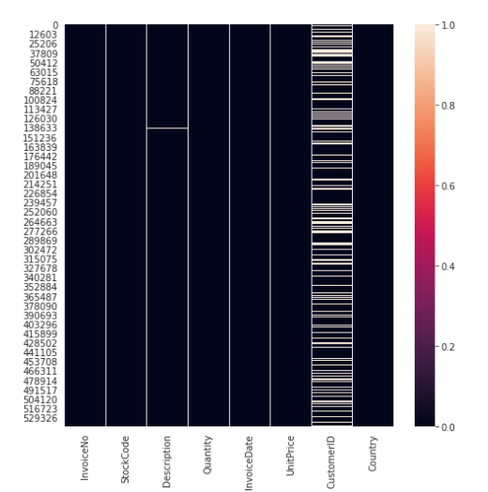
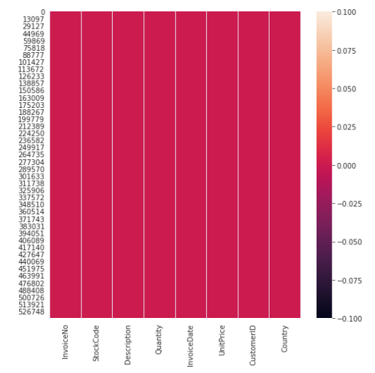
Modelling & Result
Data Exploration

Slide 11
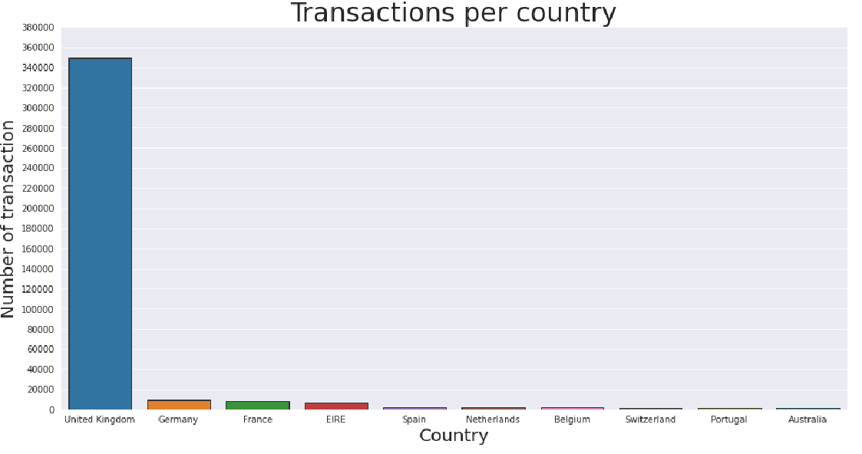
Modelling & Result

Slide 12
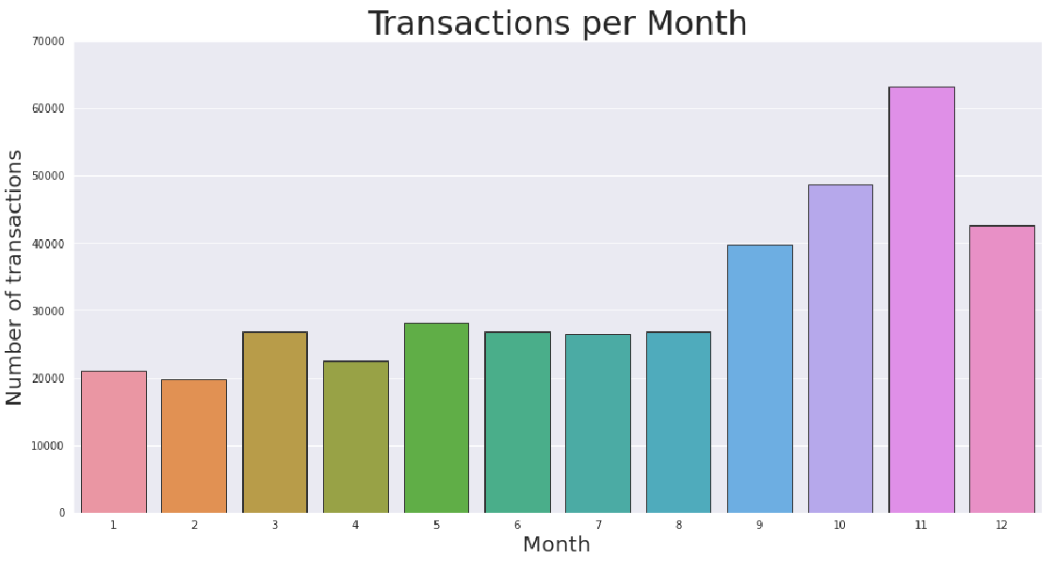
Modelling & Result

Slide 13
RFM Segmentation
RFM stands for Recency, Frequency and Monetary
RFM analysis is commonly used technique to generate and assign a score to
each customer based on:
How recent their last transaction was (Recency)
How many transactions they have made in the last year (Frequency)
What monetary value of their transaction was (Monetary)

Slide 14
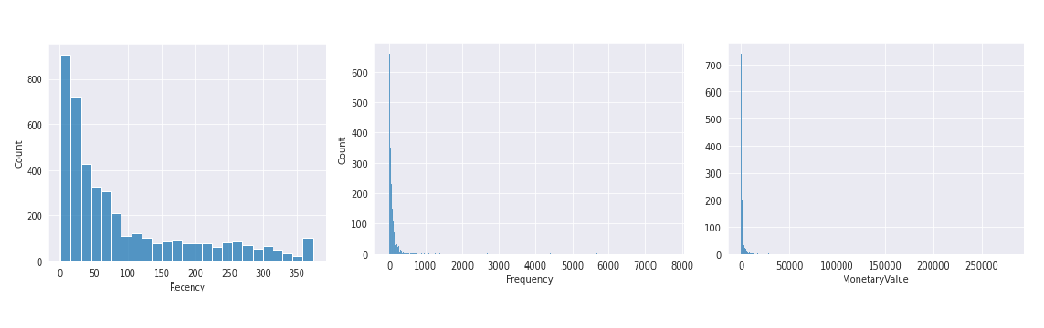
Feature Extraction

Slide 15
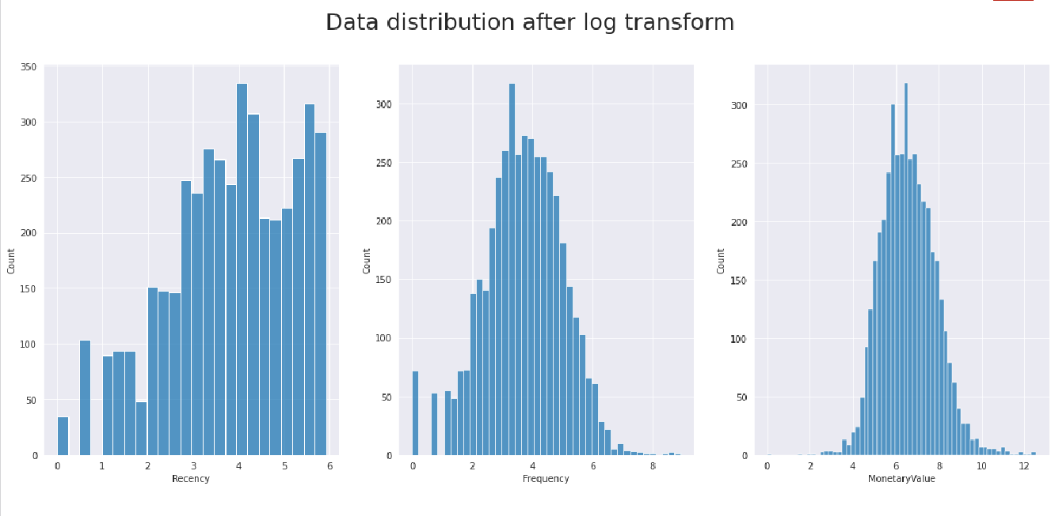

Slide 16
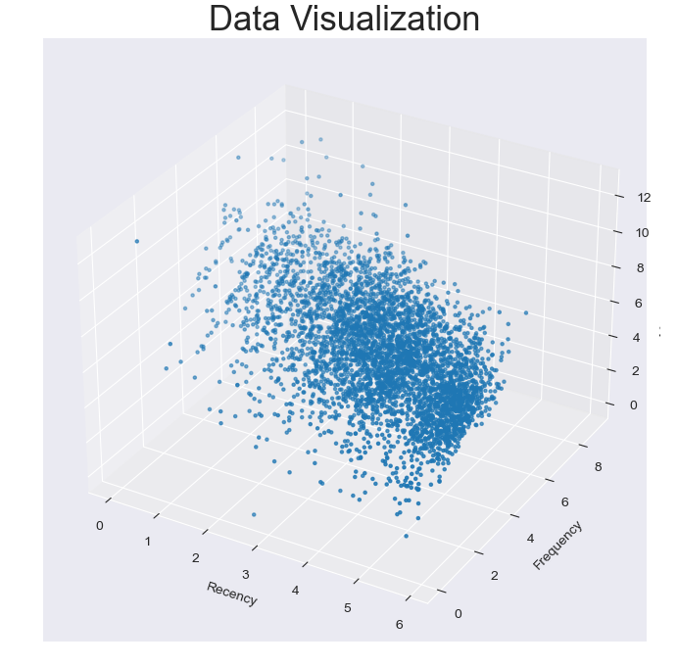
Each transaction is assigned
values based on Recency,
Frequency and Monetary
Each point in plot represent a
Transaction

Slide 17
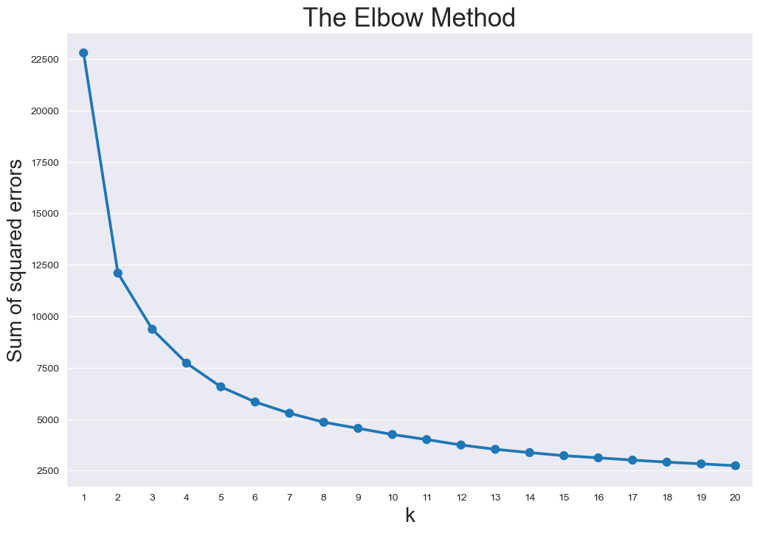
K-Means Clustering

Slide 18
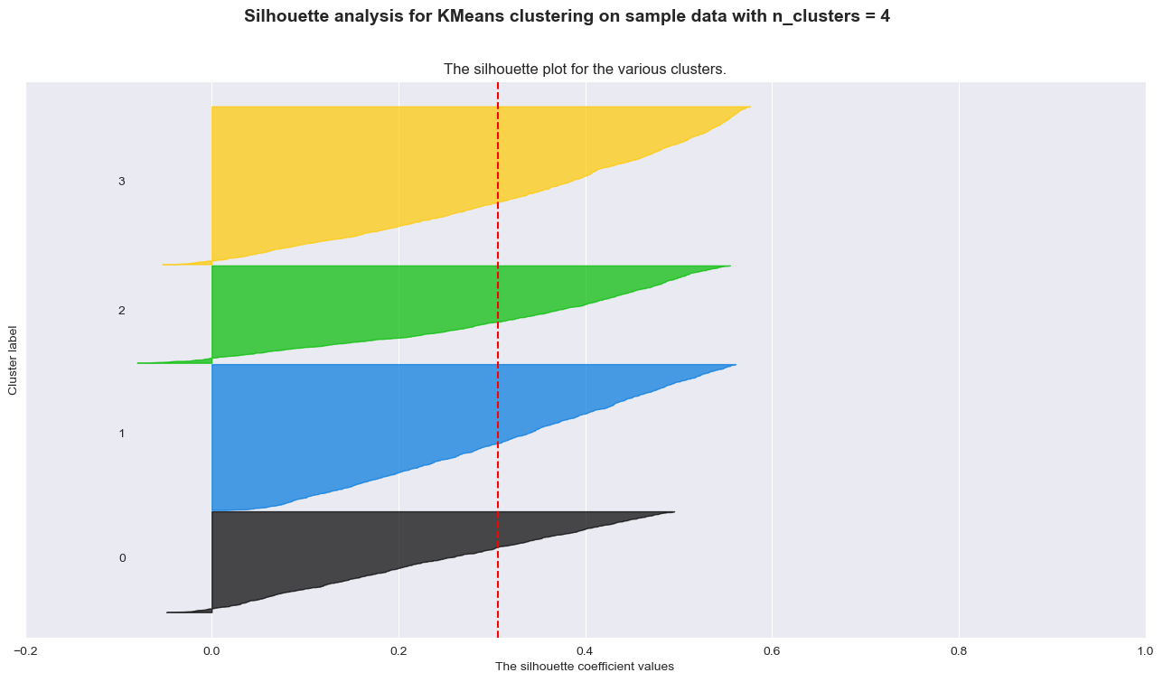

Slide 19
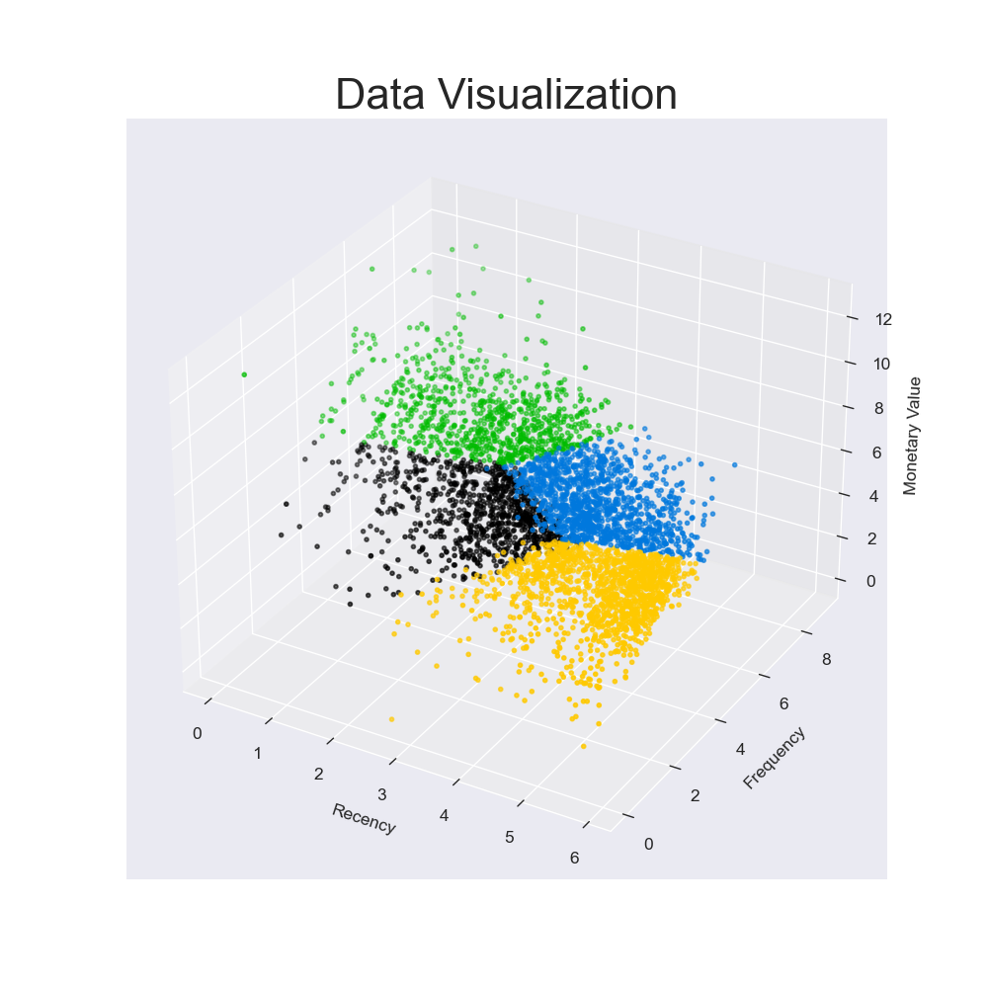
Each transaction is assigned a
cluster based on Recency,
Frequency and Monetary
Optimal number of cluster by
silhouette analysis is four
Each color in plot represent a
Cluster

Slide 20
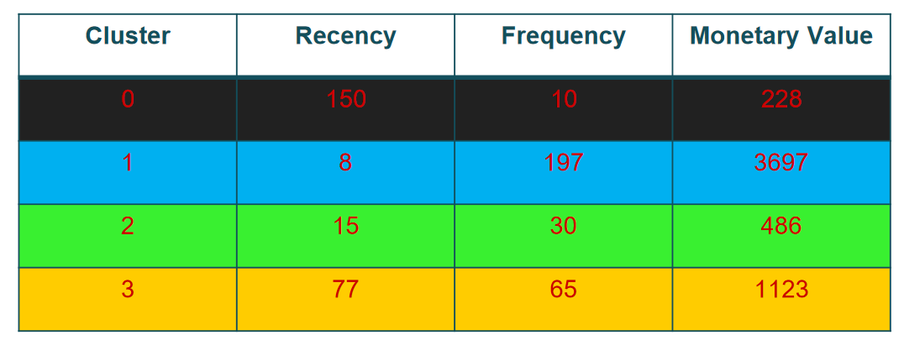
Mean value of each feature

Slide 21
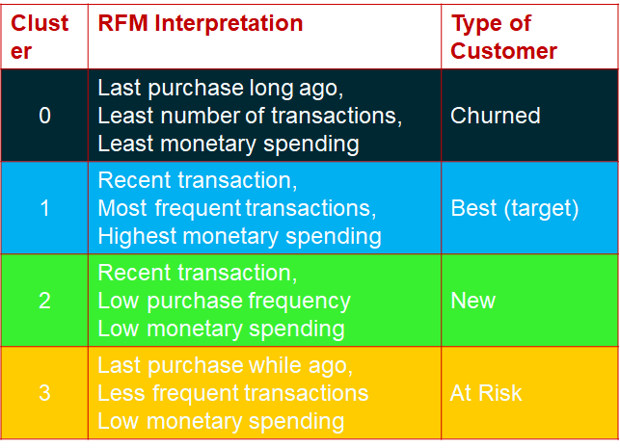

Conclusion

Slide 22


Notes:
Thank You !!

