Slide 1
Hyderabad Institute of Technology and Management
Multi - Disease Prediction System
Date:2211/2024
P. Madhu- 6737
P. Kundana-6738
V. Sowrya-6763
V. Eshwar- 6764
Mini Project Review-4

Slide 2
Abstract
Chronic health conditions like heart disease, Parkinson's, and diabetes are serious health risks. Early detection is key to effective treatment, but with a growing population and limited healthcare facilities, many people remain undiagnosed until their symptoms worsen. Traditional methods usually focus on detecting one disease at a time, which can be slow and less efficient.
The Multi-Disease Prediction System tackles this problem by evaluating multiple health conditions simultaneously. It uses advanced tools like Predictive Modeling, Deep Neural Networks, and Bio-Inspired Optimization Algorithms to provide fast and accurate health assessments. With an interactive interface built using Streamlit, users can easily check their health status and take action early. This system helps individuals manage their health better and get timely medical care.
Keywords: Random Forest, SVM, XGBoost, Predictive Analytics, Deep Learning, Chronic Disease Prediction, Early Diagnosis, Health Monitoring, Streamlit.

Slide 3
Introduction
In the digital world, data is an asset, and the healthcare industry generates large amounts of patient-related data.
Existing models focus on analyzing one disease at a time, like diabetes or cancer, with no common system for multiple diseases.
We propose a system that predicts multiple diseases at once based on the symptoms entered by the user.
The initial diseases included are diabetes, heart disease, and Parkinson’s, with the potential to add more in the future.
The system will use machine learning and Bio-Inspired Optimization algorithms and Streamlit for user interaction, with Python pickling to save model behavior.
By considering all the parameters causing the disease, this system aims to provide accurate and efficient predictions.

Slide 4
Literature Survey
Mallula et al. (2024) introduced a predictive framework for diagnosing multiple chronic conditions, including metabolic diseases (diabetes), cardiovascular disorders, renal dysfunctions, neurodegenerative conditions (Parkinson’s), and oncological risks (breast cancer). The platform utilizes machine learning models such as Support Vector Machine (SVM) and Logistic Regression, as well as deep learning frameworks like TensorFlow with Keras. These models are deployed via Streamlit Cloud, enabling user-friendly interaction and disease selection. The framework achieved impressive precision for individual conditions, such as 90% accuracy for renal disease prediction, demonstrating the potential of these algorithms in single-condition diagnostics.
Gaps:
Comorbidity Analysis: Lacks integrated multi-disease assessments to analyze comorbidities and interconnected risks.
Algorithm Adaptability: Focuses on established algorithms without adaptive techniques to handle imbalanced or diverse datasets.
Holistic Health Insights: Emphasizes single-disease prediction, missing a holistic approach to health analysis.

Slide 5
Literature Survey
Kallepalli et al. (2024) developed a Multi-Disease Prediction System (MDPS) that predicts conditions like diabetes, cardiovascular disorders, and Parkinson’s disease. The system employs Logistic Regression and Support Vector Machines (SVM) models, with data sourced and refined from Kaggle datasets. Deployed using a Streamlit interface, the system achieved accuracies of 78% for diabetes, 85% for cardiovascular risks, and 89% for Parkinson’s disease. These results highlight the effectiveness of machine learning in improving early disease detection, personalized care, and resource efficiency in healthcare.
Gaps:
Comorbid Conditions: Focuses on single-disease predictions, limiting the ability to understand complex comorbidities.
Scalability Challenges: Relies on traditional algorithms like Logistic Regression and SVM, which may struggle with multi-layered, non-linear data relationships.
Deep Learning Integration: Does not integrate advanced deep learning techniques for improved accuracy and adaptability.

Slide 6
Literature Survey
Kumar Bibhuti B. Singh et al. (2024) presented a Multiple Disease Prediction System (MDPS) using various machine learning models to forecast risks for diabetes, cancer, and cardiovascular health. Logistic Regression was applied for cardiovascular prediction, Convolutional Neural Networks (CNN) for cancer diagnosis, and Support Vector Machines (SVM) for diabetes prediction. The framework emphasizes early detection and personalization by analyzing symptoms and vital signs to identify risk patterns.
Gaps:
Disease Interactions: Focuses on individual disease predictions, lacking insights into interactions or combined effects of multiple diseases.
Limited Scalability: Heavy reliance on traditional ML models like Logistic Regression and SVM limits scalability and adaptability.
Insufficient Deep Learning Usage: Limited use of advanced deep learning methods beyond CNN for holistic disease analysis.

Slide 7
Literature Survey
Ramesh et al. (2023) proposed an Automated Multi-Disease Prediction System employing machine learning models such as decision trees, SVM, and random forests. The system predicts various diseases based on patient symptoms and medical histories, achieving accuracy rates exceeding 95%. It aims to enhance early detection, personalized treatment, and overall healthcare outcomes through data-driven predictions.
Gaps:
Comorbidities Neglected: Treats disease predictions independently, ignoring possible interactions or co-occurrences (comorbidities).
Complexity Handling: Traditional machine learning models struggle to capture intricate, non-linear relationships in complex datasets.
Real-Time Data Integration: Does not integrate real-time patient data or continuous monitoring for dynamic and timely predictions.

Slide 8
Literature Survey
Mathew et al. (2024) introduced a system for predicting multiple diseases using machine learning algorithms while focusing on data integration for improved healthcare outcomes. Their approach emphasizes the importance of feature selection, model evaluation, and multi-data fusion for enhancing the accuracy of disease predictions. Additionally, the system promotes remote consultations to make healthcare more accessible, efficient, and cost-effective.
Gaps:
Comorbidity Handling: Does not address handling interrelated comorbidities or shared risk factors among diseases.
Comprehensive Health Assessments: Focuses on isolated disease predictions, missing opportunities for holistic health analyses.
Real-Time Monitoring: Lacks real-time data integration and continuous monitoring to improve prediction timeliness and precision.

Slide 9
Proposed Solution
Heart Disease Prediction Using Ensemble Learning and Ant Colony Optimization
Cardiovascular diseases (CVDs), such as Coronary Artery Disease (CAD), Myocardial Infarction (MI), Hypertension, Arrhythmias, and Heart Failure, are leading causes of death worldwide. Early and accurate prediction of these conditions is essential to reduce their impact. This project uses Ensemble Learning methods combined with Ant Colony Optimization (ACO) to predict heart disease risk based on clinical and demographic data.
Ensemble learning combines multiple models to improve accuracy and make robust predictions. Five key ensemble techniques are applied:
Adaboost (Adaptive Boosting)
Combines weak models (e.g., simple decision trees) to form a stronger one.
Focuses on misclassified data in each iteration to improve performance.
Useful for identifying patterns like coronary blockages or plaque buildup.

Slide 10
Proposed Solution
2. Bagging (Bootstrap Aggregating)
1. Trains multiple models on random subsets of the data and averages their predictions.
2. Reduces overfitting, ensuring better performance on unseen data.
3. Ideal for conditions like hypertensive or valvular heart disease.
3. Random Forest
Builds multiple decision trees and combines their results for prediction.
Captures complex relationships between factors like age, cholesterol levels, and blood pressure.
Effective for predicting conditions like heart failure and ischemic heart disease.
4. Gradient Boosting
Adds new models to correct errors from previous ones, creating a stronger model over time.
Excels at identifying specific conditions like arrhythmias or myocardial infarctions.
Highlights key indicators such as ECG anomalies and heart rate variability.

Slide 11
Proposed Solution
5. Extra Trees (Extremely Randomized Trees)
Similar to Random Forest but introduces more randomness in tree construction.
Reduces overfitting and performs well with complex conditions like coronary artery disease.
Handles interactions between multiple clinical factors effectively.

Slide 12
Proposed Solution
Ant Colony Optimization (ACO) for Heart Disease Prediction
ACO is a bio-inspired optimization technique modeled after the foraging behavior of ants. It uses artificial "ants" to explore possible solutions by mimicking how real ants find the shortest path to food using pheromone trails. It is particularly effective for solving complex problems like feature selection and combinatorial optimization.
Role in Heart Disease Prediction
Feature Selection: ACO identifies the most relevant clinical and demographic features (e.g., cholesterol levels, age, blood pressure) for predicting heart disease.
Enhanced Ensemble Learning: By selecting optimal features, ACO boosts the accuracy and efficiency of ensemble models like Random Forest and Gradient Boosting.
Improved Predictions: ACO ensures that only the most important attributes contribute to the final prediction, reducing noise and enhancing model performance.

Slide 13
Proposed Solution
Diabetes Diagnosis via Supervised Learning Enhanced by Crow Search Optimization
Algorithms for Diabetes Prediction
1. K-Nearest Neighbors (KNN):
Classifies data points based on the majority class of their nearest neighbors.
Simple, and effective for classification tasks like pattern recognition and data mining.
2. Logistic Regression:
Predicts the probability of binary outcomes (e.g., diabetic or non-diabetic).
Establishes relationships between independent variables and outcomes.
3. Random Forest:
Combines multiple decision trees to improve prediction accuracy.
Handles complex data and prevents overfitting by aggregating tree outputs.

Slide 14
Proposed Solution
Crow Search Algorithm (CSA)
Crow Search Algorithm (CSA) is a metaheuristic optimization technique inspired by the intelligent foraging behavior of crows. It was developed to solve complex optimization problems by mimicking how crows efficiently locate and protect food resources.
Key principles of CSA include:
Initialization: Crows (solutions) are placed in a search space.
Exploration: Finds new solutions by exploring unknown areas.
Exploitation: Focuses on refining the best-found solutions.
Memorization: Crows remember and share the best solutions found.
Role in Diabetes Prediction:
Optimizes feature selection and model parameters to improve accuracy.
Ensures efficient search for the best-performing models among KNN, Logistic Regression, and Random Forest.

Slide 15
Proposed solution
Parkinson’s Disease Diagnosis Using Support Vector Machine (SVM)
Objective: Diagnose Parkinson's disease (PD) using machine learning, specifically through a Support Vector Machine (SVM) model, which classifies individuals as healthy or PD-affected based on selected features.
Process:
Feature Selection: Extract relevant features (e.g., motor skills, physical characteristics) from the patient data.
SVM Model: Train an SVM model to distinguish between healthy individuals and those with Parkinson’s disease.
How SVM Works:
Hyperplane: SVM finds a hyperplane that separates healthy individuals from those with PD.
Margin: The margin is the distance between the hyperplane and the nearest data points from each class.
Classification: New data points are classified based on which side of the hyperplane they fall on.

Slide 16
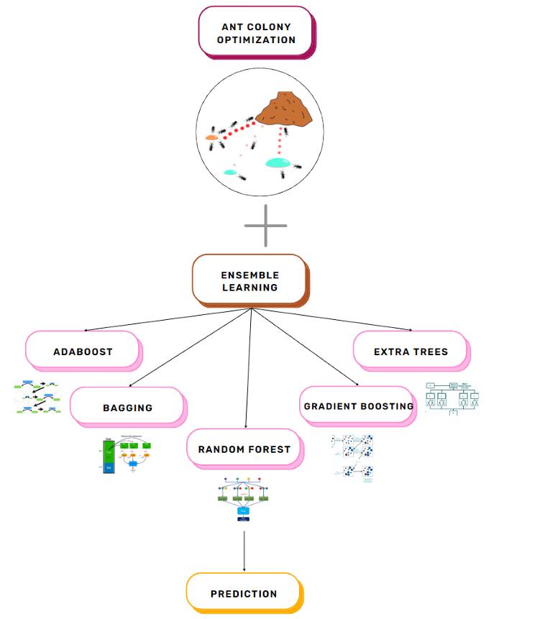
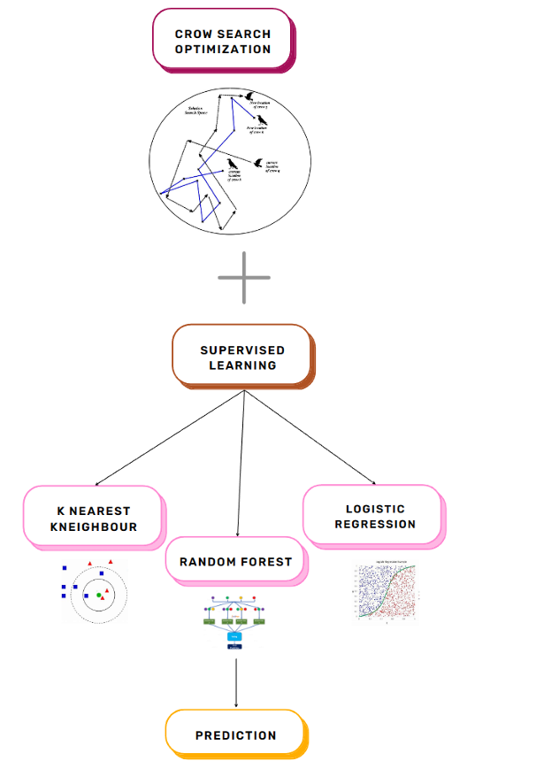
Architecture
Heart Disease Prediction using Ant Colony Optimization
Diabetes Prediction using Crow Search Optimization

Slide 17
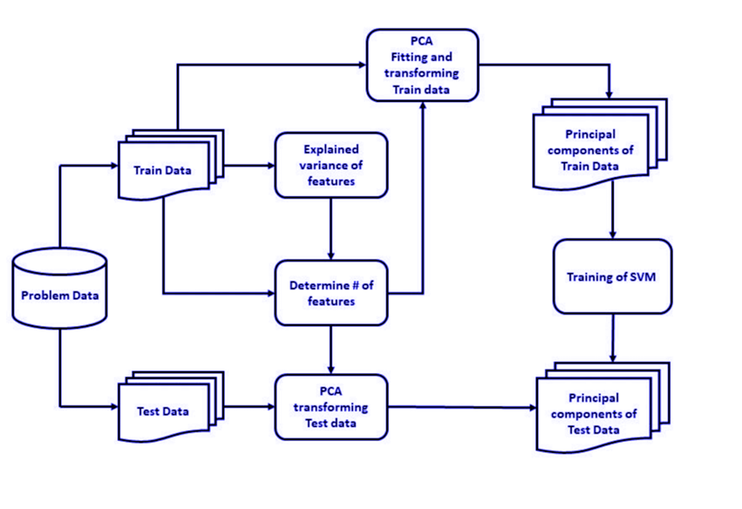
Parkison’s Disease Prediction using SVM

Slide 18
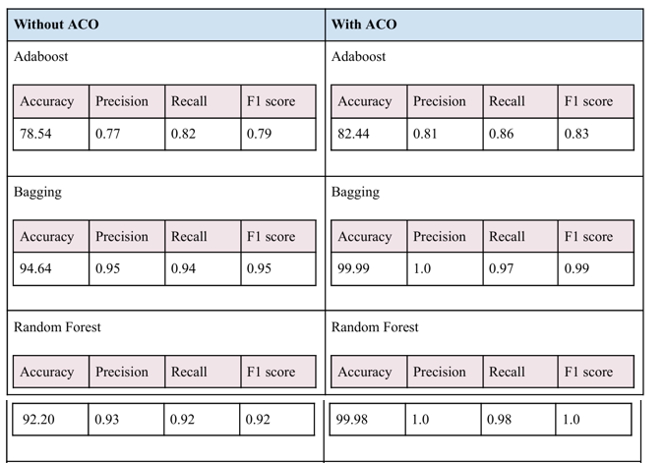
Comparison of Model Accuracy with and without ACO for Heart Disease Prediction

Slide 19
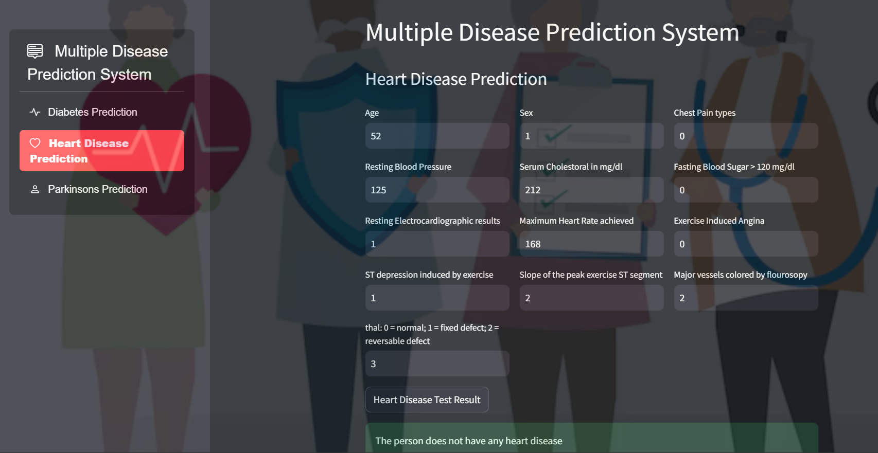
Heart Disease Prediction

Slide 20
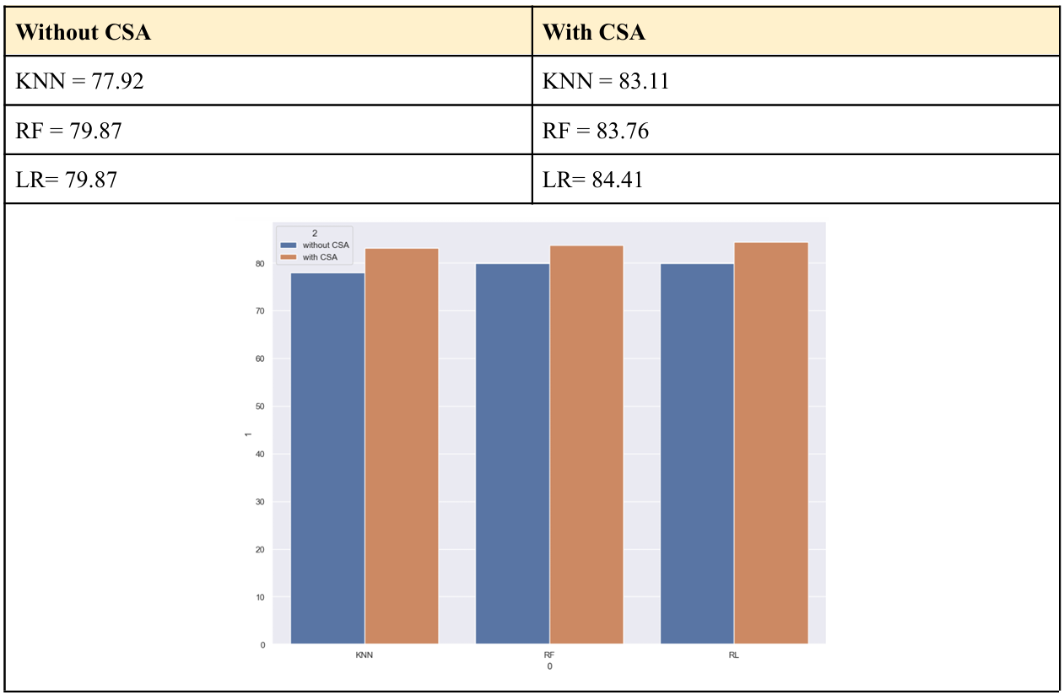
Comparison of Model Accuracy with and without CSA for Diabetes Prediction

Slide 21
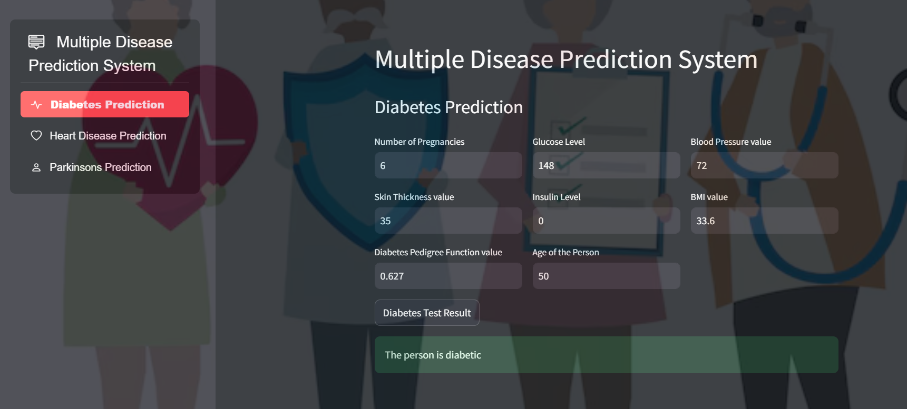
Diabetes Prediction

Slide 22
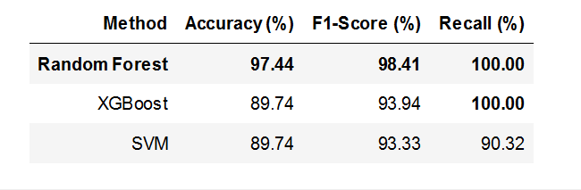
Comparison of Model Accuracy for Parkison’s Disease Prediction

Slide 23
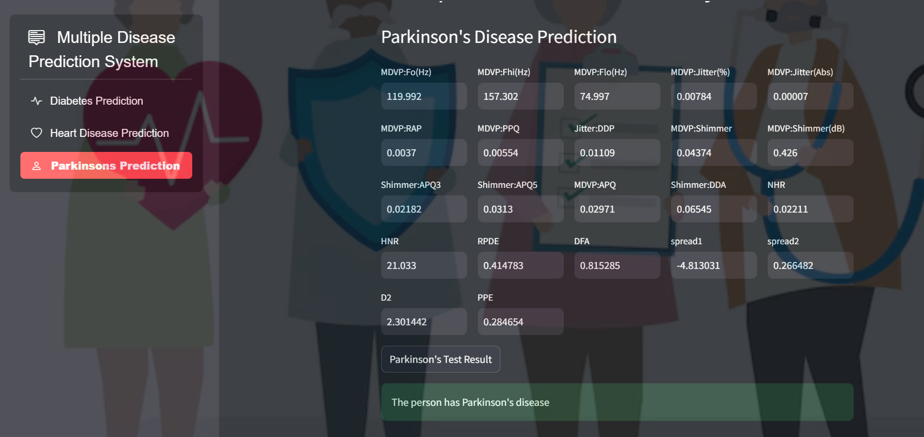
Parkinson’s Disease Prediction

Slide 24
Conclusion
The Multi-Disease Prediction System uses advanced machine learning and optimization algorithms to improve healthcare forecasting for heart disease, diabetes, and Parkinson's disease.
Heart Disease: Ensemble learning with Ant Colony Optimization (ACO) achieved 99% accuracy, highlighting the power of hybrid models in predicting cardiovascular risk.
Diabetes Prediction: Supervised learning (KNN, Random Forest, Logistic Regression) optimized by Crow Search Optimization (CSA) reached over 83% accuracy, enhancing feature selection and model reliability.
Parkinson’s Disease: Voice analysis using SVM and XGBoost, with Random Forest at 97% accuracy, demonstrates a non-invasive method for early disease detection.

