Slide 1
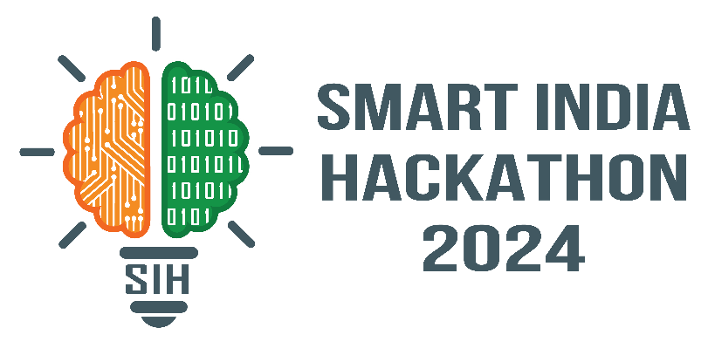
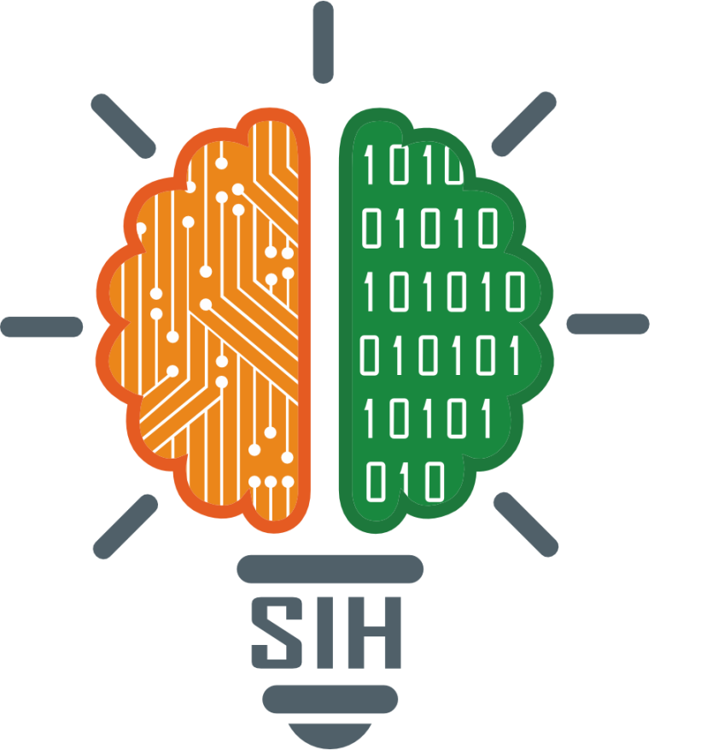
SMART INDIA HACKATHON 2024
TITLE PAGE
Problem Statement ID - 1605
Problem Statement Title - Women Safety Analytics – Protecting Women from safety threats
Theme - Miscellaneous
PS Category - Software
Team ID – T58
Team Name (Registered on portal) – The Bots

Slide 2
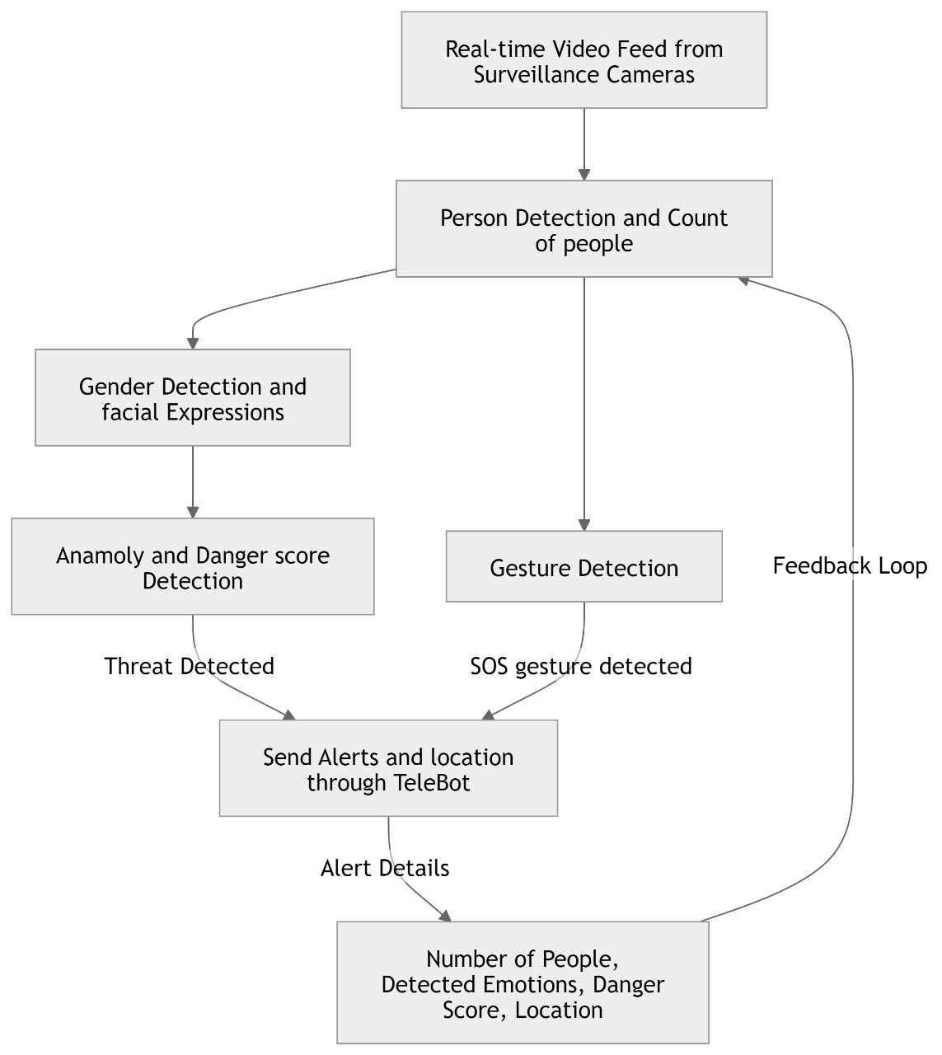
AI-Based Surveillance System for Enhancing Women's Safety in Public Spaces
The Bots
PROCESS FLOW ARCHITECTURE :
PROPOSED SOLUTION :
Person and Gender Detection helps identify individuals and analyze their gender in public spaces.
Emotion Detection and Facial Expression Analysis recognize distress and potential threats.
AI-driven monitoring system ensures proactive safety measures.
Detects lone women in distress or suspicious behavior, and assigns a Danger Score to assess the severity of the situation.
Reduces risks by identifying threats before incidents occur, creating safer environments.
UNIQUE VALUE PROPORTIONS (UVP) :
Danger Score(0-5) Analysis to quickly evaluate threat levels in real-time.
Tele-Bot for instant SOS alerts to law enforcement or emergency contacts.
Continuous Learning to improve accuracy over time by learning from new situations.
GPS Tracking to pinpoint the location of potential threats and send accurate alerts to Tele-Bot.
Weapon Detection to identify potential risks and raise alerts.

Slide 3
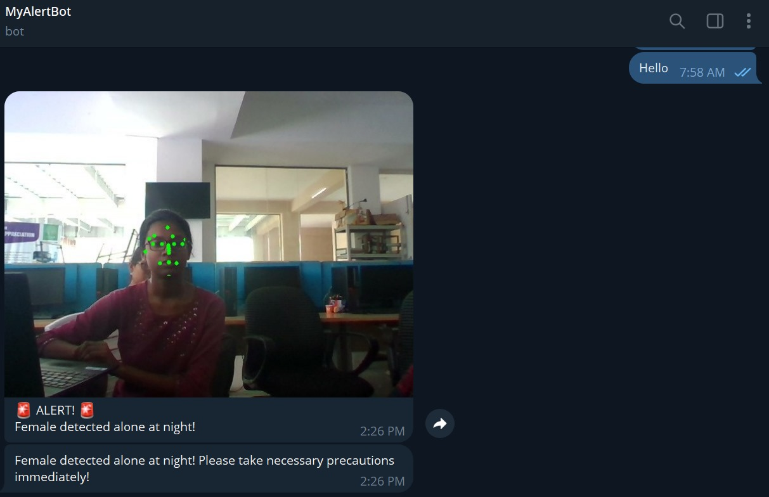
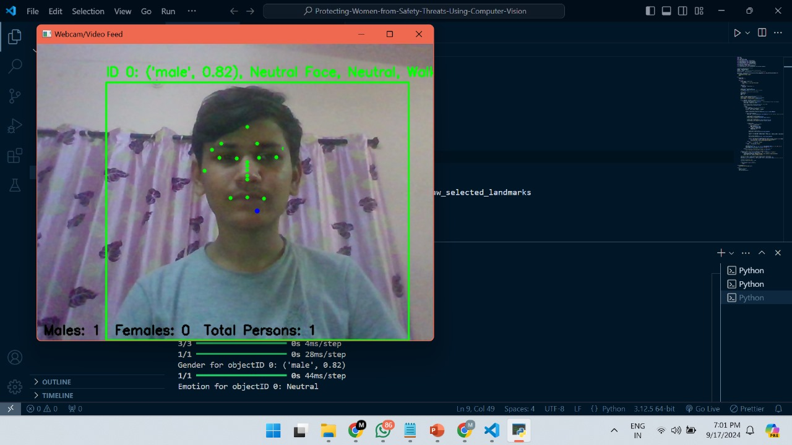
TECHNICAL APPROACH
The Bots
MODEL DEVELOPMENT:
YOLOv8(You Only Look Once) - Detect individuals in real-time to establish a baseline count for anomaly detection.
Pretrained models from Hugging Face - Classify detected individuals as male or female to monitor gender distribution.
Face Net - Analyze facial emotions (e.g., fear, anxiety)
Integration of YOLO and gender classification data for identifying crowd behavior patterns.
Tele-Bot (Telegram Bot API) - To Send real-time alerts to authorities when a potential SOS situation is detected.
OUTPUT/RESULT:
PRODUCT STATUS:
60% of the product has been completed, with further development in progress. An additional 3 features remain to be added.

Slide 4
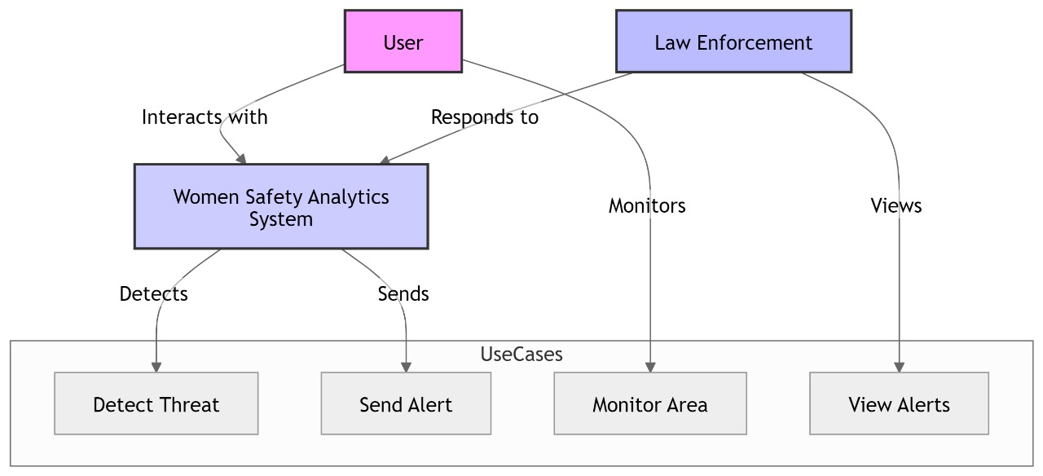
FEASIBILITY AND VIABILITY
The Bots
Technical Feasibility: Leverage cutting-edge AI (YOLO, Hugging Face, FaceNet, MediaPipe) for real-time detection and gender classification while ensuring data privacy.
Market Opportunity: Target city governments and security firms amidst rising safety concerns, with unique features to stand out in the smart city space.
Challenges: Key challenges include privacy concerns, AI model accuracy (avoiding bias), and integration with existing systems like law enforcement.
Strategies: To address privacy concerns, robust data protection measures must be implemented, such as secure communication channels for alert notifications and compliance with privacy laws. To enhance AI model accuracy and reduce bias, strategies like diverse data collection, bias testing, human oversight, algorithmic fairness techniques, and transparency should be employed.

Slide 5
IMPACT AND BENEFITS
The Bots
Enhanced Public Safety: Real-time monitoring and threat detection will significantly improve safety for women in public spaces, reducing incidents of harassment or violence.
Proactive Crime Prevention: Early detection of potentially dangerous situations (such as a lone woman at night or suspicious gestures) allows law enforcement to intervene before incidents occur, shifting from reactive to proactive crime prevention.
Data-Driven Insights: Continuous analysis of gender distribution and incident patterns can help identify high-risk areas (hotspots), enabling more effective deployment of resources and improving urban safety planning.
Empowerment and Confidence: Women will feel more secure in public spaces, knowing that a system is in place to detect and respond to threats, fostering a sense of empowerment and trust in public safety measures.
Support for Law Enforcement: Automated alerts and data analytics will assist law enforcement agencies by providing actionable insights and reducing their response times, ultimately enhancing their efficiency and effectiveness.

Slide 6
RESEARCH AND REFERENCES
The Bots
Madhubala, D., M. Rajendiran, and D. Elangovan. 2020. “A Study on Effective Analysis of Machine Learning Algorithm towards the Women’s Safety in Social Media.” Pp. 1151–56 in 2020 4th International Conference on Electronics, Communication and Aerospace Technology (ICECA). Vol. 7. Coimbatore, India: IEEE.
Navaneethakrishnan, M., R. Kalaiyarasi, T. A. Mohanaprakash, B. Bala Abirami, A. S. Prakaash, and V. Malathi. 2023. “(WoExP)Women Express-Artificial Intelligence Based Women Security and Safety System.” Pp. 416–21 in 2023 International Conference on Inventive Computation Technologies (ICICT). Vol. 4. Lalitpur, Nepal: IEEE.
Premi, P., K. S. Savita, and N. Millatina. 2022. “FRNDY: A Women’s Safety App.” Pp. 1–5 in 2022 6th International Conference On Computing, Communication, Control And Automation (ICCUBEA. Vol. 5. Pune, India: IEEE.

