Slide 1
Hyderabad Institute of Technology and Management
WOMEN SAFETY ANALYTICS- PROTECTING WOMEN FROM THREATS
Date:14/11/2024
Project Stage-1 review-3
P. Madhu- 6737
P. Kundana-6738
V. Sowrya-6763
V. Eshwar- 6764

Slide 2
Abstract
The proposed AI-driven safety monitoring system enhances public safety, focusing on women in public spaces. Utilizing advanced technologies such as YOLOv8 for real-time detection, Hugging Face pretrained models for gender classification, and FaceNet for emotion analysis, the system identifies individuals, monitors gender distribution, and detects distress or suspicious behavior. It assigns a unique Danger Score (0-5) to assess threat severity and enables proactive safety measures.
Key features include GPS tracking for precise location identification, weapon detection for risk alerts, and Tele-Bot integration for instant SOS notifications to authorities or emergency contacts. The system continuously learns and adapts, improving accuracy and effectiveness over time. By combining data on crowd behavior patterns and high-risk areas, it provides actionable insights for urban safety planning and resource allocation.
This solution empowers women by fostering confidence in public spaces and supports law enforcement with real-time alerts and data-driven insights, reducing response times and enhancing efficiency. With strong privacy protections and bias mitigation strategies, it addresses key challenges while offering a scalable, innovative approach to public safety. By shifting from reactive to proactive crime prevention, this system creates safer environments and contributes to the vision of smarter, more secure cities.

Slide 3
Introduction
Public safety in urban environments is a growing concern, particularly for women who often face risks such as harassment, violence, and distressing situations in public spaces. Traditional safety measures, including CCTV surveillance and manual monitoring, have inherent limitations, such as dependence on human oversight, delayed responses, and the inability to detect or prevent threats proactively. These challenges emphasize the need for a smarter, technology-driven solution to enhance safety and provide timely intervention.
The proposed AI-driven safety monitoring system addresses these issues by leveraging cutting-edge artificial intelligence and machine learning technologies. The system combines real-time person and gender detection, facial emotion analysis, and behavioral monitoring to identify potential threats. It assigns a Danger Score to assess threat levels, tracks locations via GPS, and integrates with a Tele-Bot API for instant SOS alerts to law enforcement or emergency contacts. Additionally, features like weapon detection further enhance its ability to mitigate risks proactively.
This innovative system aims to create safer public spaces and empowers individuals by fostering a sense of security. By enabling data-driven insights for law enforcement and urban planners, it represents a significant step forward in proactive crime prevention and smarter city safety initiatives.

Slide 4
Women's Security System
Akuskar, Jadhav, and Kabade (2024) propose a Women's Security System aimed at providing a safe environment for women, featuring an SOS switch that activates loud alarms, an electric shock device for self-defense, and shares the user's location and emergency message with designated contacts.
Identified Gaps:
Manual Activation Dependency: The system relies on the user manually pressing the SOS button, which may not be feasible if the individual is unable to reach the device or is restricted in movement.
Lack of Automated Threat Detection: The system does not have automated features to detect potential threats or suspicious behaviors in real time.
Absence of Advanced AI Integration: The system lacks the use of AI techniques such as machine learning or emotion detection, which could enhance the ability to assess risks and improve response times.
Limited Data Collection and Predictive Analytics: The system does not incorporate continuous data collection or predictive analytics, hindering its capacity to recognize patterns and provide proactive interventions.

Slide 5
Identifying Women’s Harassment in Public CCTV Cameras Using AI Techniques
B. Sankara Babu’s (2024) system uses AI to detect harassment through public CCTV, focusing on gender prediction and suspicious behavior detection. Alerts are sent to nearby police, reducing the need for personal safety devices. However, the system has several limitations compared to Women Safety Analytics:
Identified Gaps:
No Emotion Analysis: Lacks real-time distress/emotion detection, reducing accuracy.
Lack of Threat Scoring: No multi-dimensional "Danger Score" to prioritize threat levels.
Static Learning: No continuous learning to improve with new data, limiting adaptability.

Slide 6
Analysis of Women Safety in Indian Cities Using Machine Learning on Tweet Data
Syeda Surrayya Jabeen et al. (2024) utilize machine learning to analyze social media data, especially tweets, to assess women’s safety in Indian cities. The study leverages sentiment analysis, SVM, and categorization models to gauge public sentiment on women’s safety and highlight high-risk areas based on social media content. While insightful, this approach has limitations compared to Women Safety Analytics.
Identified Gaps:
Reactive Insights: Focuses on public sentiment and post-event reactions rather than real-time threat detection or prevention.
Limited to Social Media: Relies on social media data, missing real-time monitoring capabilities in physical spaces.
No Immediate Response: Lacks mechanisms for instant alerts or direct law enforcement integration during distress situations.
Absence of Emotion and Danger Scoring: This does not provide real-time distress analysis or a danger scoring metric to assess and prioritize threats.

Slide 7
Women Safety - Safest Route Using Machine Learning
Prof. Malan Sale et al. (2024) propose a system to ensure women’s safety, particularly when traveling in public places like buses, railways, and roads, using machine learning models, specifically Support Vector Machines (SVM). The focus of the system is to identify and suggest the safest routes for women, incorporating machine learning techniques for classification and regression.
Identified Gaps:
Route Safety Focus: The system is primarily focused on route safety, but lacks a broader, real-time safety monitoring approach during travel, such as identifying immediate threats.
Limited Data Integration: The model does not mention integration with other safety technologies, such as real-time video surveillance or emergency alerts.
Absence of Proactive Safety Mechanisms: The system suggests safe routes but does not actively prevent or respond to on-the-ground incidents (e.g., harassment or assault).
Dependency on Smartphones: The solution relies on smartphone apps, which may not be feasible for all women, especially those in rural or economically disadvantaged areas without access to smartphones or the internet.

Slide 8
Raksha – The Women’s Safety Application
The "Raksha" app is a women’s safety platform that integrates emergency alerts, location tracking, and community support to empower women. It aims to create a safer and more inclusive world by connecting users with resources and fostering a supportive community. The platform goes beyond technology, emphasizing the importance of inclusivity and advocacy, offering workshops, educational initiatives, and a global network of users for solidarity and empowerment.
Identified Gaps :
Lack of Predictive Analytics: No use of machine learning to anticipate safety threats before they occur.
Limited Real-Time Threat Detection: No proactive monitoring or real-time analysis for identifying threats.
Absence of Wearable Integration: No detailed framework for integrating wearables for continuous safety monitoring.
Urban-Centric Focus: Limited effectiveness in rural areas with low connectivity and smartphone access.

Slide 9
Women Safety Analytics
This paper introduces a comprehensive AI-driven safety system that enhances women’s security in public spaces. The system integrates several key features, including real-time detection of potential threats, gender classification, identification through citizen databases, proactive intervention, gesture recognition for distress signals, and crime hotspot mapping integrated with Google Maps for safer route recommendations. The AI system demonstrated high accuracy rates in detecting individuals, lone women, group behavior, and distress signals, ultimately reduceng the risk of crime in urban environments.
Identified Gaps:
Privacy Concerns: Use of citizen databases raises privacy issues.
Rural Area Support: Limited focus on rural environments.
Predictive Analytics: Lacks proactive crime prediction.
False Positives: No handling of false alarm scenarios.
User Interaction: Limited user engagement features.

Slide 10
Empirical Study on Women Safety Concerns at Public Places: Case Study of Lahore City
Bajwa, Khan, and Nadeem (2024) present an empirical study on women's safety concerns in public places, focusing on Lahore city. The study highlights the challenges women face in urban spaces, such as harassment at bus terminals and public areas, and the efforts of various authorities to improve safety through policies, helplines, and complaint centers.
Identified Gaps:
Lack of Technological Integration: The study emphasizes physical interventions and policies but does not incorporate real-time technological solutions, such as AI-based surveillance or mobile applications, to enhance safety monitoring.
Limited Awareness of Safety Features: While government initiatives exist, many women are unaware of these services. The study does not explore how technology could increase awareness and accessibility of safety features.
Absence of Predictive and Proactive Solutions: The study identifies safety issues but lacks the application of predictive technologies or real-time detection systems that could help identify potential threats before they escalate.
Urban-Centric Focus: The study primarily addresses safety concerns in urban areas, with little focus on rural or less urbanized regions, where similar safety challenges may exist.
No Integration with Existing Infrastructure: While government measures are mentioned, there is no discussion on integrating them with existing technologies, such as mobile apps or AI, for immediate response and proactive safety alerts.

Slide 11
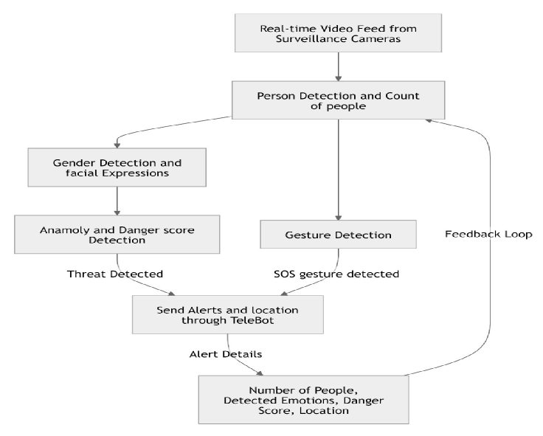
Methodology

Slide 12
Methodology
MODEL DEVELOPMENT:
YOLOv8(You Only Look Once) -Detect individuals in real-time to establish a baseline count for anomaly detection.
Pretrained models from Hugging Face -Classify detected individuals as male or female to monitor gender distribution.
Face Net -Analyze facial emotions (e.g., fear, anxiety)
Integration of YOLO and gender classification data for identifying crowd behavior patterns.
Tele-Bot (Telegram Bot API) -To Send real-time alerts to authorities when a potential SOS situation is detected.

