Slide 1
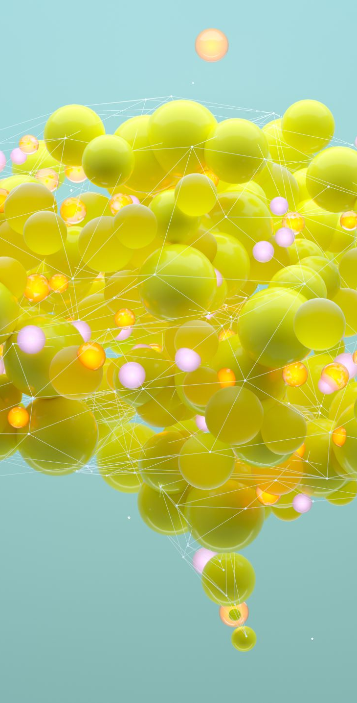
Mental Health Analysis and Prediction Using Social Media
By
Kondappa
Sujith
Adithya

Slide 2

Introduction
Mental health concerns are growing due to social media usage.
Aim:
To create a system that analyzes social media text to predict mental health conditions.
Target Conditions:
Stress
Depression
Bipolar Disorder
Personality Disorder
Anxiety

Slide 3
Project Overview
Objective:
Collect social media data.
Preprocess text for sentiment analysis.
Build and train machine learning models.
Create a web interface for real-time predictions.
Goal:
Predict mental health conditions based on user input.

Slide 4
Technologies and Tools Used
Python:
For backend and machine learning.
Flask:
Web interface development.
Scikit-learn & NLTK:
For machine learning and text preprocessing.
TF-IDF:
Feature extraction.
Seaborn & Matplotlib:
For visualizations.
GitHub & VSCode: For collaboration and development.

Slide 5
System Architecture
Data Preprocessing Layer: Cleans and preprocesses text.
Model Training Layer: Trains a Logistic Regression model with 80% data.
Web Interface Layer: Flask interface for real-time input and predictions.
Prediction & Output Layer: Displays prediction with confidence scores.

Slide 6
Key Features
Real-time mental health prediction.
Flask-based user interface.
Confusion matrix visualization for model evaluation.
High accuracy with balanced precision and recall.
Easy setup for local installation.

Slide 7
Challenges and Solutions
Noisy Text Data:
Extensive preprocessing of text.
Initial Model Performance: Improved feature extraction and tuning.
Deployment Compatibility: Provided detailed setup guide.

Slide 8
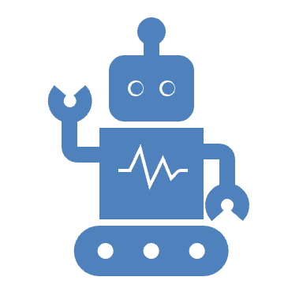
Future Improvements
Integrating advanced NLP models like BERT.
Real-time data collection using APIs (Tweepy, PRAW).
User feedback mechanism for model accuracy.
Ethical considerations for privacy and bias mitigation.

Slide 9
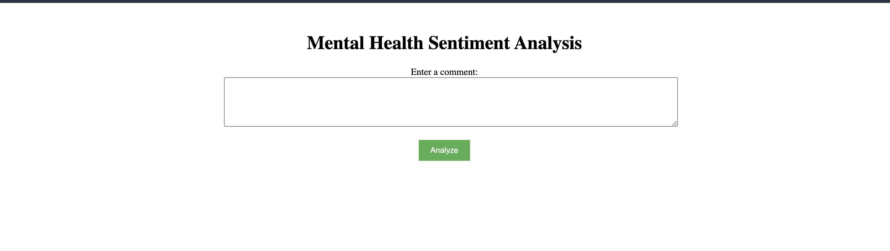
Web Interface

Slide 10
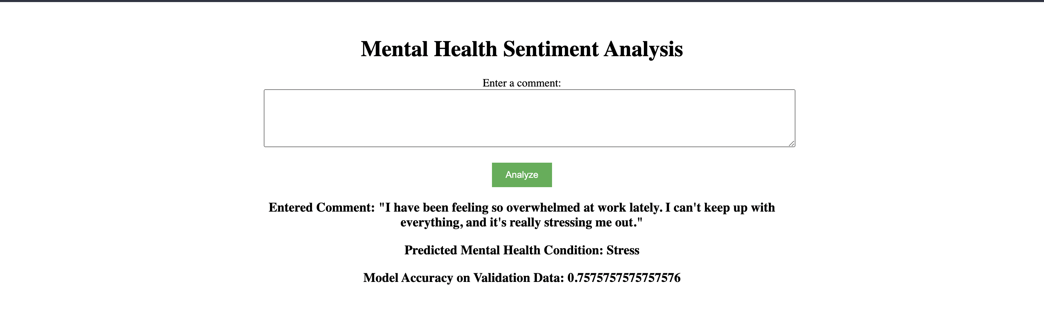
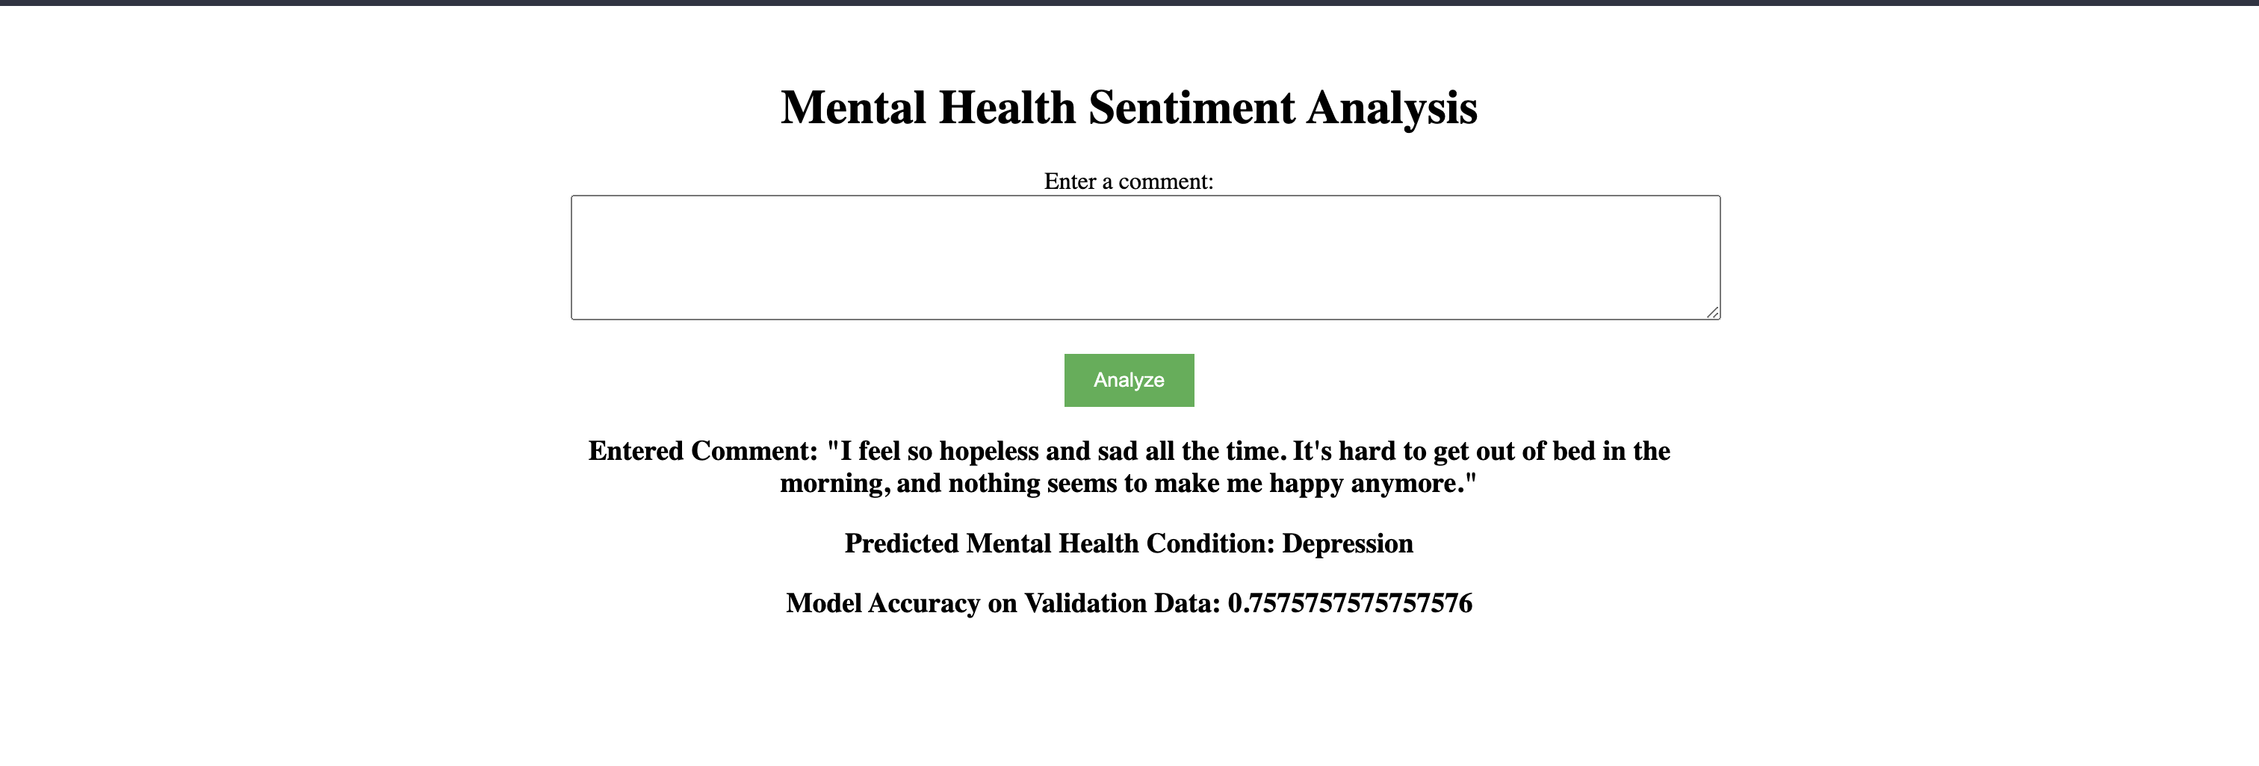
Prediction Results

Slide 11
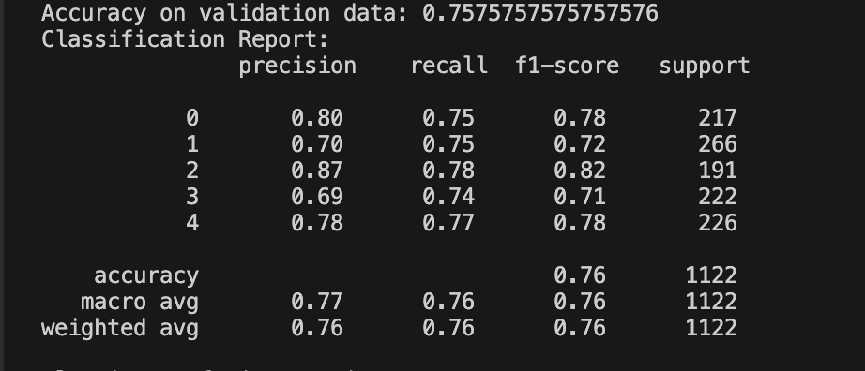
Confusion Matrix

Slide 12
Conclusion
AI and ML can predict mental health conditions via social media analysis.
Combines NLP, machine learning, and a user-friendly web interface.
Future scope: Advanced models and real-time data integration.

Slide 13


