Slide 1
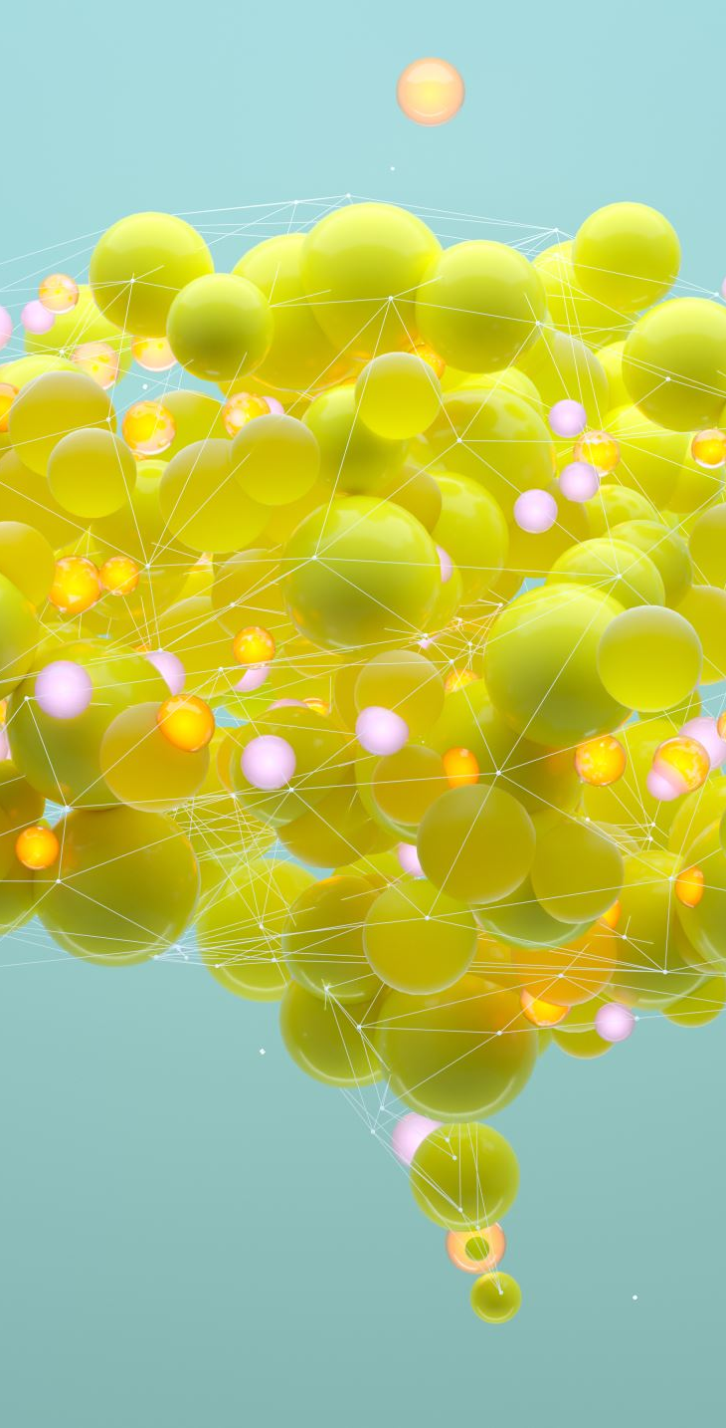
Mental Health Analysis and Prediction Using Social Media
By
Kondappa
Sujith
Adithya

Slide 2

Introduction
Mental health concerns are growing due to social media usage.
Aim:
To create a system that analyzes social media text to predict mental health conditions.
Target Conditions:
Stress
Depression
Bipolar Disorder
Personality Disorder
Anxiety

Slide 3
Project Overview
Objective:
Collect social media data.
Preprocess text for sentiment analysis.
Build and train machine learning models.
Create a web interface for real-time predictions.
Goal:
Predict mental health conditions based on user input.

Slide 4
Technologies and Tools Used
Python:
For backend and machine learning.
Flask:
Web interface development.
Scikit-learn & NLTK:
For machine learning and text preprocessing.
TF-IDF:
Feature extraction.
Seaborn & Matplotlib:
For visualizations.
GitHub & VSCode: For collaboration and development.

Slide 5
System Architecture
Data Preprocessing Layer: Cleans and preprocesses text.
Model Training Layer: Trains a Logistic Regression model with 80% data.
Web Interface Layer: Flask interface for real-time input and predictions.
Prediction & Output Layer: Displays prediction with confidence scores.

Slide 6
Key Features
Real-time mental health prediction.
Flask-based user interface.
Confusion matrix visualization for model evaluation.
High accuracy with balanced precision and recall.
Easy setup for local installation.

Slide 7
Challenges and Solutions
Noisy Text Data:
Extensive preprocessing of text.
Initial Model Performance: Improved feature extraction and tuning.
Deployment Compatibility: Provided detailed setup guide.

Slide 8

Future Improvements
Integrating advanced NLP models like BERT.
Real-time data collection using APIs (Tweepy, PRAW).
User feedback mechanism for model accuracy.
Ethical considerations for privacy and bias mitigation.

Slide 9
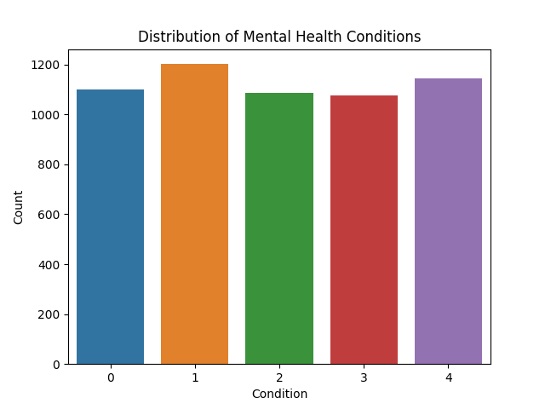
Distribution of Classes

Slide 10
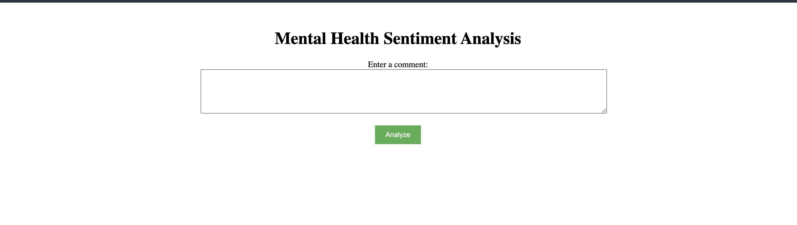
Web Interface

Slide 11
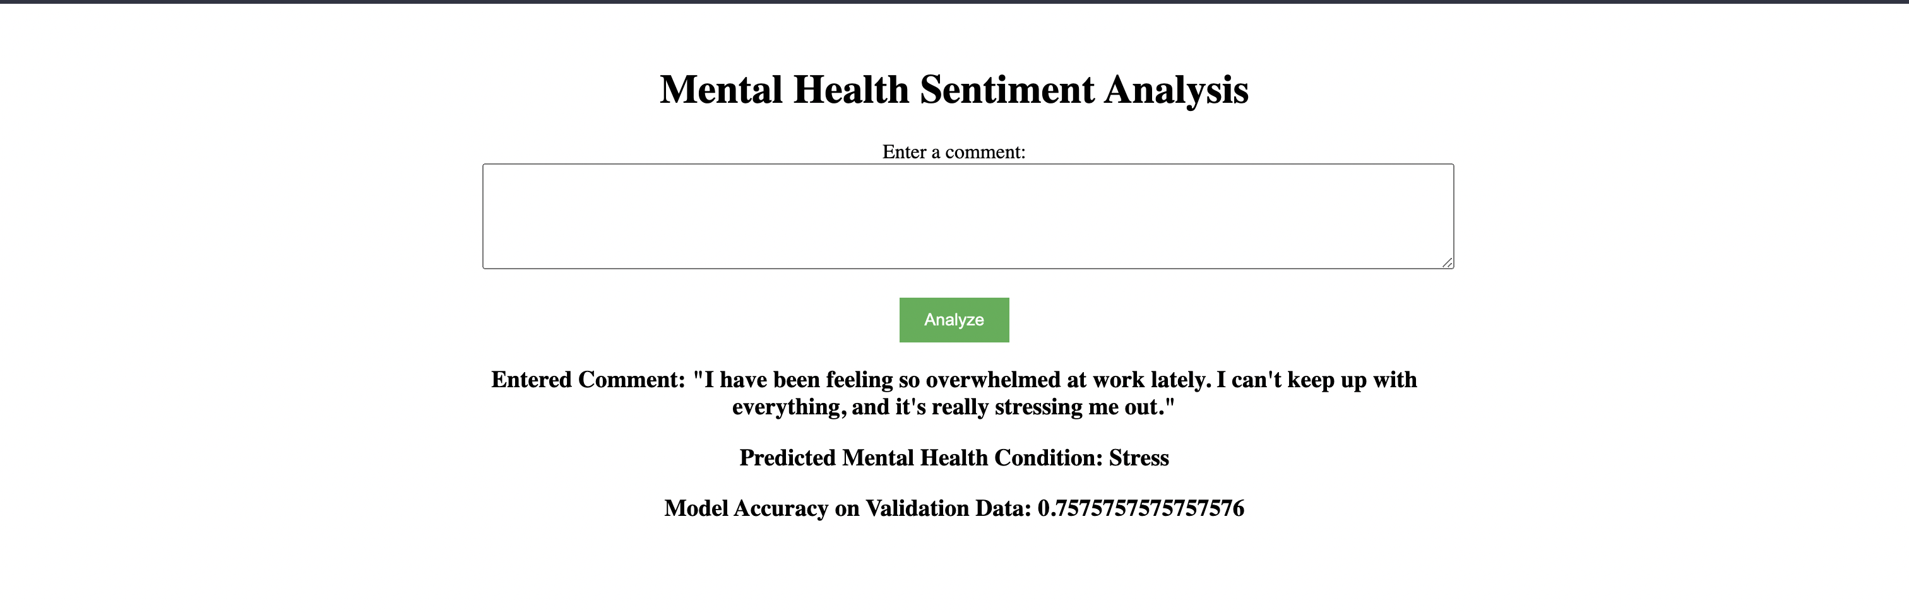
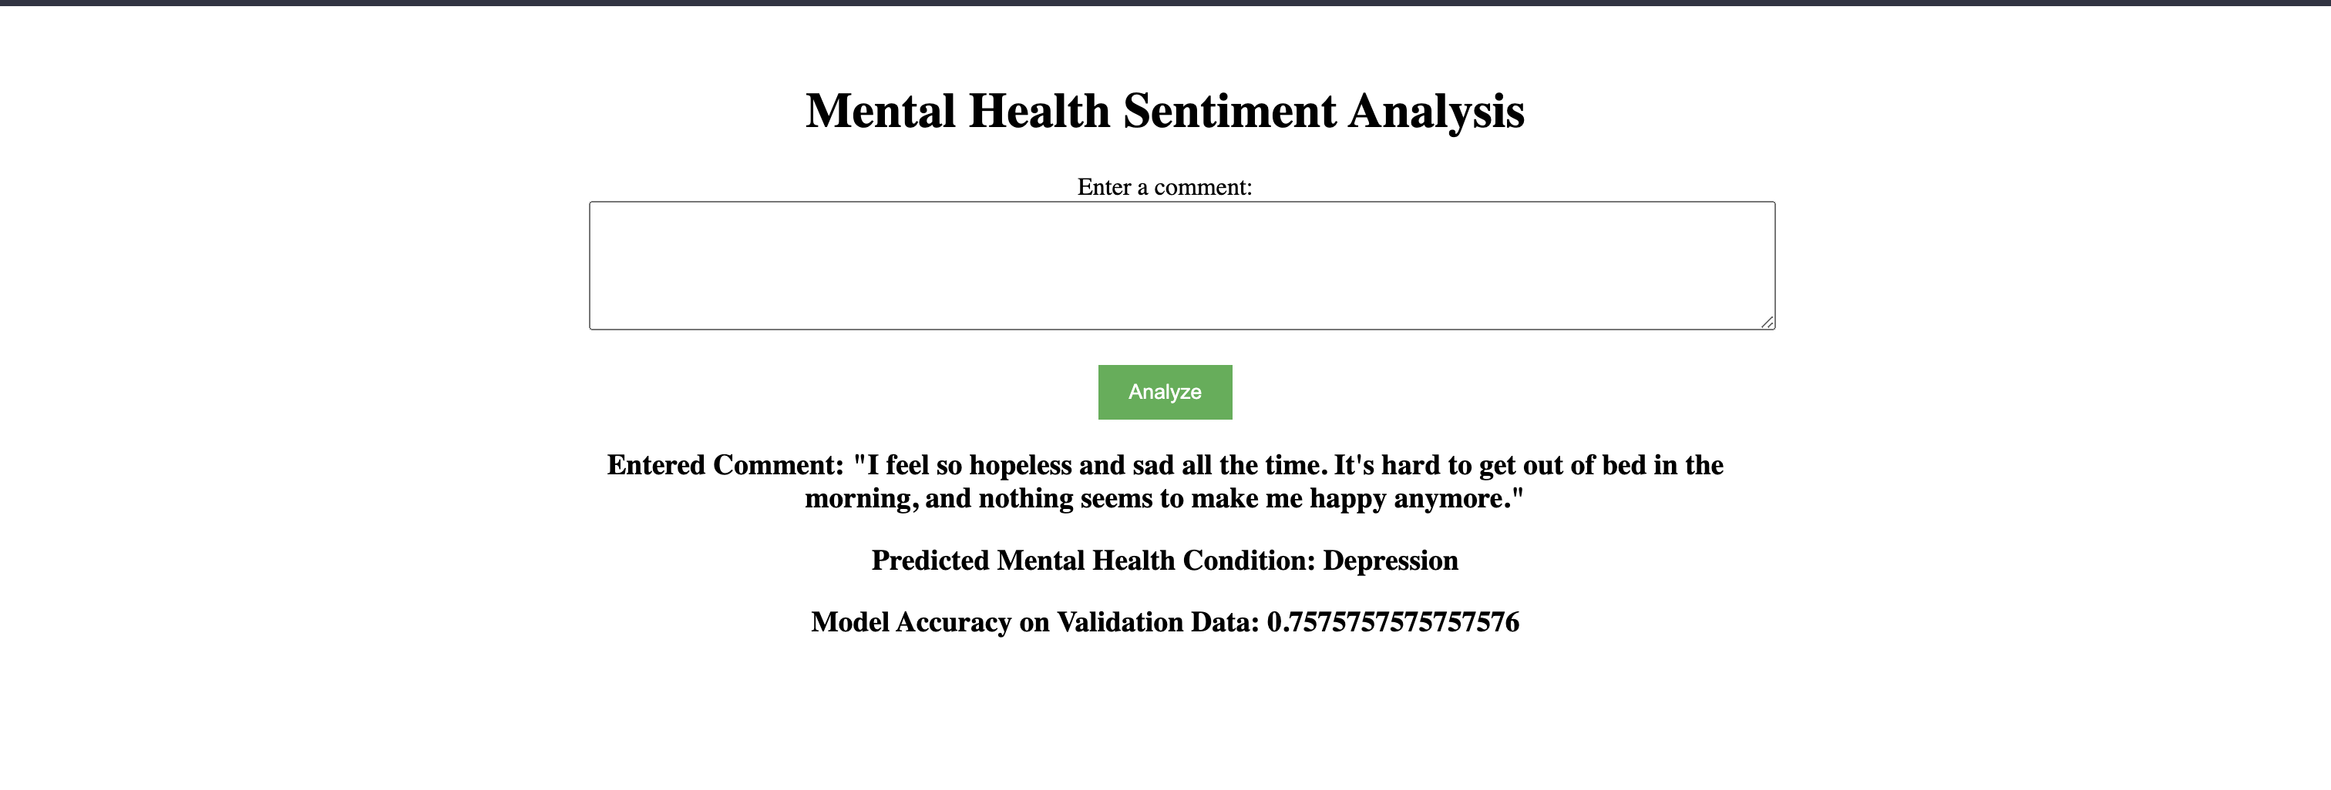
Prediction Results

Slide 12
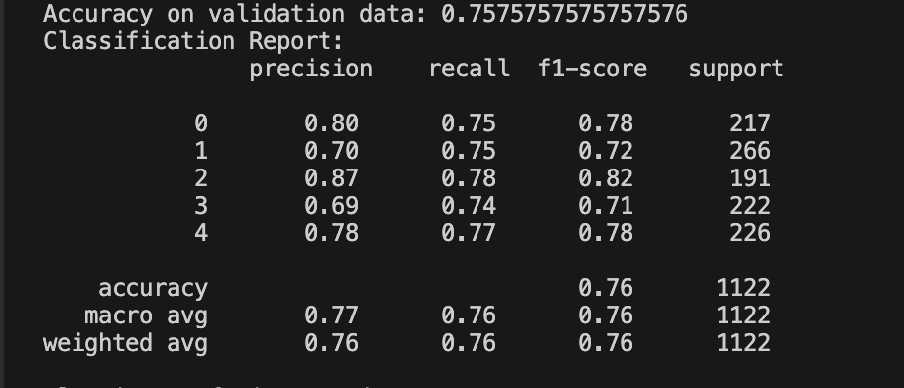
Confusion Matrix

Slide 13
Conclusion
AI and ML can predict mental health conditions via social media analysis.
Combines NLP, machine learning, and a user-friendly web interface.
Future scope: Advanced models and real-time data integration.

Slide 14


