Slide 1
MEASURING SUCCESS IN TALENT MANAGEMENT
Introduction:
This Measuring success is comprehensive collection of information on HR data. It contain information such as Employee count, Age, Attrition cate, Job role, Satisfaction , etc,.
Uses:
1. This Helps to provide insights to management and support decision making.
2. Helps to gain insight into to work force such as turnover rates, productivity.

Slide 2
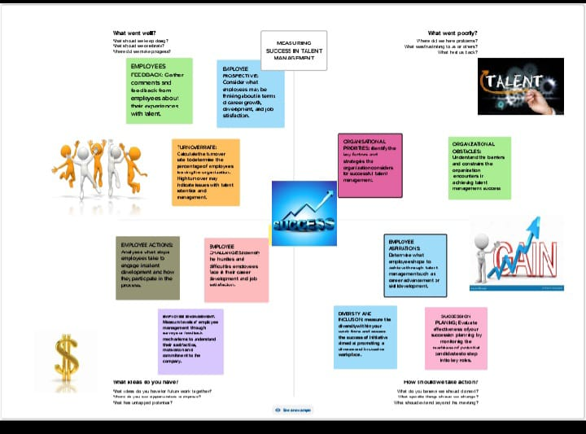
3. Analysing HR data can help control costs related to staffing, benefits and other HR expenses.
4. HR data can help organization understand. Their current workforce ,anticipated future needs.
EMPATHY MAP:

Slide 3
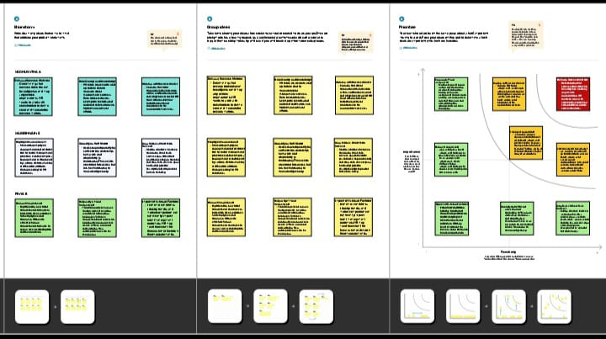
BRAINSTORM:
RESULT:
It gives path to improved workforce productivity, enhanced requirement and selection, better employee retention increased employee engagement, success planning etc.

Slide 4
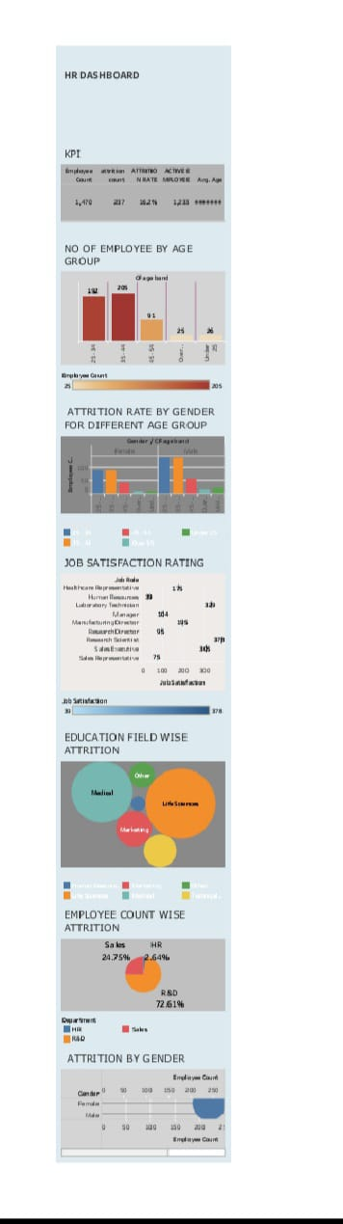

Slide 5
ADVANTAGE:
1. Talent management metrics provide objective, data based insights into the effectiveness of HR and talent strategies.
2. Efficient TM can lead to cost savings by identifying high performing employees.
3. TM metrics can pinpoint skill gaps within the workforce.
DISADVANTAGE:
1. Some talent management metrics may be subjective, relying on manager assessments or self-evaluations, which can introduce bias and inaccuracies.
2. Employees may be apprehensive about being continuously monitored and evaluated, potentially leading to decreased morale and engagement.

Slide 6
3. Managing and analysing a vast amount of talent management data can be complex and resource-intensive, requiring advanced systems and expertise.
APPLICATION:
1. Identifying the most effective recruitment channels and sources. Evaluating the quality and fit of candidates during the selection process.
2. Assessing the effectiveness of onboarding programs in terms of employee integration and productivity.
FUTURE SCOPE:
1. Envisioning the possibilities of space exploration, including missions to Mars and lunar colonization.
2. Examining how the digitalization of processes and services will continue to reshape various industries. Predicting future cybersecurity challenges and measures to protect digital assets.

