Slide 1

PhishShield ML
Machine Learning-Powered Phishing Defense
Capstone Project Phase-1
Presented By:
Madhura Naik
PES1PG24CA260
Section D
Under the Guidance of:
Prof. Archana A

Slide 2
Abstract
Phishing is a social engineering attack that deceives users by mimicking trusted URLs to steal confidential data. This project develops an adaptive, ML-based phishing detection system that: Classifies URLs in real-time as phishing or legitimate using supervised machine learning. Identifies attack types (10 distinct phishing attack patterns). Provides educational content to enhance user cybersecurity awareness. Implements dual deployment: Web-based GUI + Browser Extension. Extracts 16 URL features from lexical, host-based, and content-based characteristics Achieves high accuracy with ensemble learning methods (LightGBM, Random Forest, XGBoost).

Slide 3
Introduction
Problem Scenario:
Phishing attacks increased day by day, posing a significant risk to personal credentials, financial data, and corporate systems.
Traditional blacklist-based solutions are reactive and ineffective against zero-day attacks.
Users lack awareness of attack types and safe practices
Proposed Solution:
ML Detection Engine: Trained models for binary classification with confidence scoring.
Attack Classification System: Identifies 10 phishing attack types with risk scoring (0-100 scale) and severity classification (Low to Critical).
Dual Deployment & Education: REST API, web GUI, browser extension, and educational platform with threat info and response guides

Slide 4
Purpose:
Protect users from phishing attacks through early detection.
Educate users about cybersecurity threats and prevention.
Provide real-time protection via browser integration.
Enable security auditing through bulk URL analysis and reporting.
Scope:
ML model training, feature extraction, attack classification, REST API, web GUI, educational content, and risk scoring.
Development is moving forward on a browser extension, persistent logging and report export, and a user feedback mechanism.
The platform's core components are in place, with additional features and enhancements planned.

Slide 5
Motivation to Select This Project
Increasing phishing attacks demand effective and early detection mechanisms.
Static blacklists cannot keep up with sophisticated, emerging phishing campaigns.
Real-time browser-integrated protection reduces user exposure.
Combination of real-time extension and manual GUI tool empowers users.
Classification of phishing URLs by attack type enables tailored prevention.

Slide 6
Functionalities
1. Dataset Acquisition – Collects and cleans phishing and legitimate URLs.
2. Feature Extraction – Generates 16 key URL features for ML analysis.
3. Phishing Detection – Classifies URLs as phishing or legitimate.
4. Attack Type Classification – Identifies the specific phishing attack category.
5. Risk Scoring – Assigns a 0–100 risk score with severity level.
6. Prevention and Educational Content – Provides warnings and prevention tips for users.
7. Batch URL Analysis – Scans multiple URLs at once for audits.
8. Web GUI – User-friendly dashboard for URL scanning and results.
8. REST API – Backend endpoints for URL scanning and system info.
9. Browser Extension – Real-time phishing detection inside the browser.
10. Logging & Reporting – Saves scan results for tracking and analysis.

Slide 7
Tools & Technologies
Backend & ML:
Python 3.13 - Core programming language
Pandas 2.2.3 & NumPy 2.2.3 - Data processing,
Scikit-learn 1.6.1 - ML model training
Models : XGBoost, Random Forest, Decision Tree, Multilayer Perceptron, SVM, LightGBM 4.6.0(Best Model), KNN, Gradient Boosting
Flask 3.1.0 + Flask-CORS 6.0.1 - REST API framework, Joblib 1.4.2 - Model serialization
urllib.parse 2.4.0 - URL parsing and analysis
python-whois 0.9.6 - Domain age/expiration lookup, dnspython 2.8.0 - DNS record validation
requests 2.32.5 - HTTP requests for content analysis, BeautifulSoup4 4.14.2 - HTML/JavaScript parsing
Frontend:
React 18 - Web UI framework
Browser Extension and Database
Browser Extension: JavaScript, Chrome/Firefox APIs
Enhanced Logging: MongoDB for persistent storage

Slide 8
Real-World Applications
Personal Security: Browser extension provides on-the-fly phishing alerts and blocking, safeguarding credentials and personal data.
Email Security: Integration to filter malicious links from emails automatically.
Enterprise Security: Bulk URL analysis and reporting to enhance organizational cybersecurity.
Mobile Security: Phishing URL warnings embedded in SMS and app messaging.
Security Auditing: Analysts use standalone GUI for fast, offline phishing investigations.

Slide 9
Literature Survey On
PhishShield ML
Capstone Project Phase - 2
Presented By:
Madhura Naik
PES1PG24CA260
Section D
Under the Guidance of:
Prof. Archana A

Slide 10
Detailed Literature Survey
Paper - 1
Title : Phishing Website Detection Using Deep Learning Models
Authors : Ume Zara, Kashif Ayyub, Hikmat Ullah Khan, Ali Daud, Tariq Alsahfi, Saima Gulzar Ahmad
Publication with Year : IEEE Access, Volume 12, Published October-November 2024
Summary :The paper presents a comprehensive evaluation of machine learning, deep learning, and ensemble methods for phishing website detection. Using a well-annotated Kaggle dataset and rigorous feature selection, it compares SVM, Decision Tree, KNN, LSTM, RNN, GRU, AdaBoost, XGBoost, and Random Forest. Random Forest yields the best performance (99% accuracy), demonstrating its superiority for this task. The study concludes ensemble learning approaches, especially Random Forest, achieve the highest accuracy among evaluated models. It also shares insights on top feature selection strategies and suggests future work integrating visual and behavioral website analysis.
Relevance:
Confirms that ensemble models like Random Forest/XGBoost give top accuracy, validating your choice of LightGBM/XGBoost.
Shows the importance of feature engineering, which your 16-feature pipeline uses.

Slide 11
Paper - 2
Title: URL-based Phishing Websites Detection via Machine Learning
Authors : Qasem Abu Al-Haija, Ahmad Al Badawi
Publication with Year : 2021 International Conference on Data Analytics for Business and Industry (ICDABI), IEEE
Summary :This paper introduces an ML-based phishing website detection system relying on URL features. It evaluates shallow and wide neural network models alongside an optimizable decision tree ensemble. Using a comprehensive phishing URL dataset, they report excellent accuracy around 97% for decision trees. The study emphasizes efficient feature selection and the importance of balancing dataset classes. The system provides a practical approach with scope for extension into more complex detection using enhanced models or additional features.
Relevance:
Uses pure URL-based features, the same approach as your system.
Demonstrates strong performance using neural networks + decision trees, similar to my model selection workflow.
Highlights data balancing, which also apply during preprocessing.

Slide 12
Paper - 3
Title : Phishing URL Detection Using Machine Learning and Deep Learning
Authors : Rawshon Ferdaws, Nahid Ebrahimi Majd
Publication with Year : Proceedings of the 2024 IEEE World AI & IoT Congress (AIIoT), 2024
Summary :This paper proposes a combined machine learning and deep learning framework for phishing URL detection using a large Kaggle dataset. Extensive feature engineering supports ML models, while DL models learn representations directly from character sequences. LSTM-based models outperform others, achieving near 99% F1-score. The study balances accuracy with computational considerations and addresses dataset imbalance issues. These findings and methods provide a strong foundation and practical guidance for designing robust URL phishing detection in real-world applications.
Relevance :
Provides a comparison of ML vs DL models, helping justify model selection in proposed project.
Emphasizes F1-score for imbalanced datasets, which you also use.

Slide 13
Paper - 4
Title : Phishing Detection System Through Hybrid Machine Learning Based on URL
Authors : Abdul Karim, Mobeen Shahroz, Khabib Mustofa, Samir Brahim Belhaouari, S. Ramana Kumar Joga
Publication with Year : IEEE Access, Volume 11, 2023
Summary :This paper presents a hybrid phishing URL detection system using ensemble machine learning classifiers operating on 33 features extracted from 11,000 URLs. It applies rigorous preprocessing, canopy-based feature selection, and tuning to improve model accuracy. The hybrid model combining Logistic Regression, SVM, and Decision Tree outperforms individual classifiers, achieving an accuracy of 98.12%. The results support the use of ensemble methods and comprehensive feature engineering in phishing detection, guiding your project’s design and evaluation pipeline.
Relevance :
Shows that hybrid ensemble models outperform single models, supporting multi-model training strategy.
Reinforces importance of feature selection and tuning, which current project pipeline includes.

Slide 14
Paper - 5
Title : A Hybrid Machine Learning based Phishing Website Detection Technique through Dimensionality Reduction
Authors : Nusrath Tabassum, Farhin Faiza Neha, Md. Shohrab Hossain, Husnu S. Narman
Publication with Year : 2021 IEEE International Black Sea Conference on Communications and Networking (BlackSeaCom)
Summary : This paper presents a hybrid machine learning-based phishing website detection method using URL and hyperlink features. By combining multiple classifiers and applying dimensionality reduction, the system achieves high detection accuracy and low false positives. The methodology emphasizes the integration of diverse feature sets and ensemble learning to address phishing threats effectively. It proposes future directions for improving detection on non-standard and mobile phishing websites, aligning closely with your project's goals for real-time and accurate phishing protection.
Relevance :
Demonstrates benefits of dimensionality reduction, useful for optimizing model.
Highlights bagging + boosting, matching your XGBoost and LightGBM models.

Slide 15
Paper - 6
Title : Phishing URL Detection: A Real-Case Scenario Through Login URLs
Authors : Manuel Sánchez-Paniagua, Eduardo Fidalgo Fernández, Enrique Alegre, Wesam Al-Nabki, Víctor González-Castro
Publication with Year : IEEE Access, Volume 10, 2022
Summary :This paper introduces PILU-90K, a novel dataset emphasizing phishing URL detection against legitimate login pages, which are often overlooked. Through extensive ML and deep learning evaluations, it shows models trained on standard datasets may not accurately detect phishing when legitimate login URLs are used as controls. The best results were obtained with TF-IDF and logistic regression on character-level n-gram features, achieving around 96.5% accuracy. The work advocates for updated datasets and realistic scenario modeling, addressing practical limitations in phishing detection. This study is highly relevant for developing robust, user-centric phishing detection and prevention systems.
Relevance :
Introduces real-world dataset challenges, especially login-page phishing, relevant for risk scoring.
Highlights false positives in login URLs, guiding your UI warnings and advice section.

Slide 16
Paper - 7
Title : Machine Learning Techniques for Detection of Website Phishing: A Review for Promises and Challenges
Authors : Ammar Jamil Odeh, Ismail Mohamed Keshta, Eman Abdelfattah
Publication with Year : 2021 IEEE 11th Annual Computing and Communication Workshop and Conference (CCWC)
Summary : This review surveys the field of phishing website detection using ML and DL, comparing traditional and advanced approaches. It concludes that while deep learning solutions (CNN, RNN) show better accuracy, traditional models like Random Forest and SVM remain strong contenders with good feature engineering. It recommends continued exploration of hybrid ensemble models and emphasizes the need to reduce false positives/negatives and select optimal features. The paper is a comprehensive resource for understanding past, present, and future advances in phishing detection using machine learning.
Relevance :
Provides a broad comparison of traditional ML vs DL, helping justify model architecture.
Validates the use of Random Forest, SVM, CNN, aligning with model evaluation list.

Slide 17
Paper - 8
Title : Enhancing Online Safety Phishing URL Detection Using Machine Learning and Explainable AI
Authors : Bhupathi Vishva Pavani, Desham Mahitha, B. Uma Maheswari
Publication with Year : 2024 15th International Conference on Computing Communication and Networking Technologies (ICCCNT), IEEE
Summary :This study presents a highly accurate machine learning framework for phishing URL detection paired with Explainable AI techniques (SHAP and LIME) to provide transparency into model decisions. Random Forest emerged as the top performing model, and XAI methods elucidated contributions of features like external hyperlink percentages and domain mismatches to predictions. This enhances user and cybersecurity professional understanding, in addition to detection accuracy. The approach’s integration of explainability is crucial for real-world adoption and trust, guiding cybersecurity solutions like your project.
Relevance :
Introduces XAI (SHAP/LIME) techniques, supporting educational content + explainability features.
Shows how feature importance can enhance user trust.
Reinforces approach of making results interpretable (attack type + risk score).

Slide 18
Paper - 9
Title : Phishing URL Detection Using Machine Learning: A Comparative Study
Authors : Dr. Sahana Lokesh R
Publication with Year : Proceedings of the 6th International Conference on Mobile Computing and Sustainable Informatics (ICMCSI), 2025, IEEE
Summary :This paper systematically compares six popular machine learning algorithms for phishing URL detection using a Kaggle dataset. Random Forest achieves the highest accuracy (94.5%) and best balance of precision and recall. SVC is a strong alternative, while Naive Bayes performs weaker due to feature independence assumptions. The study underscores the importance of feature selection and presents a confusion matrix analysis for model interpretability. It suggests future work on integrating deep learning and multi-data sources to further improve phishing detection accuracy and robustness.
Relevance :
Offers a benchmark comparing six ML models, similar to proposed multi-model comparison table.
Supports selection of Random Forest and SVC as strong candidates.

Slide 19
Paper - 10
Title : Advanced Learning for Phishing URLs Detection to Secure Consumer-Centric Applications
Authors : Pradeep Kumar Roy, Abhinav Kumar, Ashish Singh
Publication : IEEE Transactions on Consumer Electronics, Volume 70, No. 3, August 2024
Summary :This paper proposes an advanced phishing URL detection system combining multiple feature types with machine learning and deep learning models. Random Forest classifier delivered high accuracy (96% F1-score) with manually extracted features. CNN models with different depths improved recall for phishing detection. The study underscores the value of diverse feature engineering and layered model architectures for robust phishing threat mitigation. The dataset size and methodology offer a strong foundation for practical consumer-centric application deployments.
Relevance :
Provides DL benchmark via CNN models, useful for future extension.
Reinforces hybrid ML + DL approach, aligning with proposed Hybrid Autoencoder-XGBoost model.

Slide 20
Comparative Study of Existing Applications
No. | System / Approach | Key Features | Strengths | Weaknesses | Relevance to Your Project
1 | Google Safe Browsing | Blacklist + heuristic | Wide deployment, browser integrated | Relies on known threats; limited zero-day detection | Base comparison point for effectiveness
2 | Netcraft Anti-Phishing Extension | ML + crowdsourced URL reputation, alerts in browser | Combines ML with user reports, frequent updates | Some false positives, intrusion in user experience | ML integration, real-time alerts
3 | PhishTank Community Database | Public phishing URL repository with reporting and API access | Open, community-driven, useful dataset source | Not proactive, reactive detection only | Dataset for training and testing
4 | Microsoft Defender SmartScreen | Browser and OS integrated, blacklist + heuristic scanning | OS integrated, real-time | Limited explainability, slow to detect zero-day | Target platform relevance, heuristic supplement
5 | Proposed ML Browser Extension With GUI (Our System) | ML/DL models with attack type classification and explainability | Proactive, explainable, educational, attack classification, user feedback | Needs regular updates and user action | Directly builds on existing methods; explains result

Slide 21
Functional Requirements - Users
1. End Users (Individual)
Goal: Protect personal data from phishing attacks, Access: Web GUI + Browser Extension
Actions: Scan URLs, view threat analysis, learn security best practices
2. Cybersecurity Analysts
Goal: Investigate suspicious URLs, generate reports, Access: Web GUI + API
Actions: Bulk URL analysis, export reports, track attack trends
4. Developers/Integrators
Goal: Integrate phishing detection into applications, Access: REST API
Actions: API calls, custom implementations, security automation
5. Educators/Researchers
Goal: Study phishing patterns, teach cybersecurity, Access: Web GUI + Educational content
Actions: Access attack type data, use for training purposes

Slide 22
Functional Requirements - Functionalities
1. Dataset Acquisition and Data Preprocessing
Description: Collect diverse URL datasets from trusted sources (PhishTank, Tranco site etc.), Clean and structures collected URLs.
2. URL Feature Extraction
Description: Automatically extracts 16 features from input URL
Features:
  Address Bar (8): IP presence, @ symbol, length, depth, redirects, HTTPS in domain, URL shorteners, prefix/suffix
  Domain-based (4): DNS records, web traffic rank, domain age, domain expiration
  Content-based (4): iFrames, mouse-over manipulation, right-click disable, redirects
Output: Feature vector for ML model

Slide 23
3. Phishing Detection
Description: Binary classification using trained ML model
Algorithm: XGB (ensemble)
Output:
  Prediction: Phishing (1) or Legitimate (0)
  Confidence Score: 0-100%
4. Attack Type Classification
Description: Identifies specific phishing attack pattern
Attack Types (10): IP-Based Phishing, URL Shortener Phishing, Typosquatting/Homograph Attack, Domain Spoofing, Open Redirect Phishing, New Domain Phishing, DNS Anomaly Phishing, iFrame Overlay Phishing, Social Engineering Phishing, Sophisticated Multi-Vector Attack
Output: Primary attack type with severity level

Slide 24
5. Risk Scoring System
Description: Calculates numerical risk score (0-100)
Factors: Attack type severity, feature count, confidence level
Risk Levels:
  0-25: LOW (Green)
  26-50: MEDIUM (Yellow)
  51-75: HIGH (Orange)
  76-100: CRITICAL (Red)
6. Prevention & Educational Content
Description: Provides actionable security advice
Components: Security warnings specific to attack type, Prevention recommendations, Technical explanation of how attack works, Real-world examples, Identification tips, Incident response guidelines

Slide 25
7. Batch URL Analysis - Analyzes multiple URLs simultaneously
Input: List of up to 50 URLs
Output: Summary statistics, per-URL results, high-risk count
Use Case: Enterprise security auditing
8. Web-Based GUI - Interactive dashboard for manual URL analysis
Features: Real-time URL scanning, Session statistics tracking, Scan history (last 10 scans), Tabbed interface(Overview: Attack type, risk score, Security Advice: Warnings, recommendations, Learn More: Educational content, Technical Details: Feature breakdown)
9. REST API - Backend API for integration
Description: Endpoints:
  POST /api/scan - Single URL analysis
  POST /api/batch - Bulk URL analysis
  GET /api/health - System status check
  GET /api/stats - Feature information
Response Format: JSON with full analysis

Slide 26
10. Browser Extension - Chrome/Firefox extension for real-time URL monitoring
Features: Enable/disable toggle for user control, Automatic URL scanning when enabled, Warning banner display (non-blocking approach), User choice: Block page or proceed with caution, Risk score and attack type display, Notification system for threats, Scan history in popup
Key Design: User always has final control, not forced blocking
11. Logging and Reporting
Tracks all scan results with timestamps and attack metadata, supports report export for security auditing and monitoring.

Slide 27
Non-Functional Requirements
1. Performance Requirements
Response Time: < 5 second for single URL scan
Model Load Time: < 3 seconds on startup
Batch Processing: 50 URLs in < 2 minutes
2. Reliability & Availability
System Uptime: 99% availability target
Error Handling: Graceful degradation on feature extraction failures
Model Fallback: Rule-based detection if ML model unavailable
3. Scalability
Horizontal Scaling: API can run on multiple instances
Database: NoSQL support for large-scale logging (planned)
Load Balancing: Support for distributed deployment

Slide 28
4. Security Requirements
Data Privacy: No URL logging without user consent
Model Integrity: Signed model files, version control
Input Validation: Sanitization of user-provided URLs
5. Usability
User Interface: Intuitive, < 3 clicks to scan URL
Response Clarity: Clear threat explanations, no jargon
Cross-Platform: Works on Windows, macOS, Linux
Browser Support: Chrome, Firefox, Edge
6. Maintainability
Code Quality: Modular design, documented functions
Model Updates: Easy retraining pipeline
Version Control: Git-based, semantic versioning

Slide 29
Architecture Diagram
.
Presentation Layer
Business Logic (Flask REST API)
Service Layer
(Core Processing Engine)
Data Layer
/api/health
URL Validation Engine Feature Extraction Engine
ML Prediction Engine Attack Classification Module
Risk Scoring Engine
Educational Content Generator
MongoDB Database Scan Logs Prevention
Attack Knowledge Base
ML Model (.pkl file)
Web Browser
/api/validate-url
/api/scan
/api/batch
Browser Extension
/api/logs
/api/stats

Slide 30
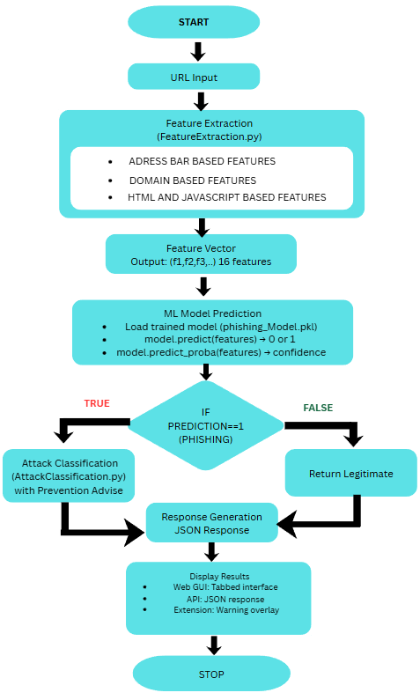
Process Flow Diagram
.

Slide 31
Design Methodology - ML Training Pipeline
.
PHASE 1: DATA PREPARATION
Dataset Collection
Data Cleaning
Feature Extraction
PHASE 2: MODEL TRAINING
Data Split (80/20)
Model Selection & Training
Model Evaluation
PHASE 3: MODEL DEPLOYMENT
Model Serialization(.pkl)
Integration with Flask API
Performance Monitoring
PHASE 4: SYSTEM OPTIMIZATION
Log Monitoring
Threat Analysis
Performance Review

Slide 32
Implementation and Model Testing
PhishShield ML
Capstone Project Phase - 3
Presented By:
Madhura Naik
PES1PG24CA260
Section D
Under the Guidance of:
Prof. Archana A

Slide 33
Implementation Status
Completed (80% )
1. Feature Extraction
FUNCTION featureExtraction(url): Initialize feature_list = [] // Address Bar Features Check if URL contains IP address → add 0/1 Check for '@' symbol → add 0/1 Compute URL length → add 0/1 Extract URL depth → add 0/1 Detect multiple redirects → add 0/1 Detect "https" inside domain → add 0/1 Check if URL is shortened → add 0/1 Check for prefix/suffix '-' in domain → add 0/1 | // Domain-based Features Resolve DNS records → add 0/1 Estimate web traffic using Tranco ranking → add 0/1 Calculate domain age from WHOIS → add 0/1 Check domain expiration date → add 0/1 // HTML / JavaScript Features request webpage Detect hidden iframe(s) → add 0/1 Detect mouse-over manipulation → add 0/1 Detect right-click disable → add 0/1 Count redirections → add 0/1 RETURN feature_list (16 features)

Slide 34
2. EDA and Preprocessing
Loading the final dataset(Finaldataset.csv) and performing data inspection.
Data Visualization:
Shuffling the data -> data = df.sample().reset_index(drop=True)
Separate target and feature columns, split the dataset into train and test dataset.
1. Class Distribution Analysis(pie chart)
label_counts = df['label'].value_counts()
2. Feature-Wise Distribution Analysis
df.hist(figsize=(18, 14))
3. Correlation Analysis
corr = df.corr()
4. Outlier Detection(boxplot)
df[numeric_cols].boxplot(grid=False)
5. Statistical Fetaure Importance
Chi-Squared (χ²)

Slide 35
3. Model Evaluation Workflow
FUNCTION evaluate_model(model, X_train, X_test, y_train, y_test):
TRAIN model on (X_train, y_train)
PREDICT y_train_pred = model.predict(X_train)
PREDICT y_test_pred = model.predict(X_test)
IF model has predict_proba:
y_prob = model.predict_proba(X_test)[1]
roc = ROC_AUC(y_test, y_prob)
ELSE:
roc = None
CALCULATE train_accuracy, test_accuracy
DISPLAY classification_report, confusion_matrix, roc (if available)
IF model has feature_importances:
PLOT bar chart of importances
END FUNCTION

Slide 36
4. Multi-Model Training & Metrics Comparison
INITIALIZE results_table
FOR each (name, model, use_scaled) in model_list:
SELECT X_train_set, X_test_set based on scaling flag
TRAIN model on training data
PREDICT y_pred on test data
IF model has predict_proba:
y_prob = model.predict_proba()[1]
roc_auc = ROC_AUC(y_test, y_prob)
ELSE:
roc_auc = None
COMPUTE accuracy, f1, precision, recall
ADD [name, accuracy, f1, precision, recall, roc_auc] to results_table
DISPLAY results_table as dataframe (rounded)
models = [
("XGBoost", xgb, False),
("Random Forest", forest, False),
("Decision Tree", tree, False),
("MLP Neural Network", mlp, True),
("LightGBM", lgbm, False),
("K-Nearest Neighbors", knn_model, True),
("Gradient Boosting", gbc, False),
("Hybrid Autoencoder-XGBoost", hybrid_xgb, False)
]

Slide 37
5. Enhanced Attack Classification
classify_attack_type(features):
if suspicious_count >= 5: return ['SOPHISTICATED_MULTI_VECTOR_ATTACK’]
if feature_dict['Have_IP’]: return ['IP_BASED_PHISHING’]
if feature_dict['Prefix/Suffix’]: return ['TYPOSQUATTING_HOMOGRAPH’]
if feature_dict['https_Domain’]: return ['DOMAIN_SPOOFING’]
if feature_dict['iFrame’]: return ['IFRAME_OVERLAY_PHISHING’]
if feature_dict['DNS_Record’]: return ['DNS_ANOMALY_PHISHING’]
if feature_dict['Redirection’]: return ['OPEN_REDIRECT_PHISHING’]
if feature_dict['TinyURL’]: return ['URL_SHORTENER_PHISHING’]
if feature_dict['Domain_Age’]: return ['NEW_DOMAIN_PHISHING’]
if feature_dict['Mouse_Over'] or feature_dict['Right_Click’]: return ['SOCIAL_ENGINEERING_PHISHING’]
return ['GENERAL_PHISHING’]

Slide 38
6. Risk Score Calculation
Formula:
risk_score = max_risk_score_from_attack_type + 5 * max(0, suspicious_features - 2)
Final_risk_score = min(100, calculated_score)
calculate_risk_score(features, attack_types)
Set base_score = highest risk_score among attack_types
Count suspicious features
IF suspicious_features ≥ 3:
Add 5 points for each feature above 2
RETURN final risk_score

Slide 39
7. Prevention + Educational Content
ENHANCED_PREVENTION Database
Dictionary mapping each attack type → {
severity,
risk_score,
warning,
technical_details,
advice,
how_to_identify,
real_examples,
prevention_techniques,
if_clicked
}
FOR each attack:
load info from prevention database
fill prevention fields (severity, advice, warnings, etc.)
build education fields:
- overview
- how it works
- why dangerous
- identification tips
- examples
- prevention steps
- incident response
APPEND general reading resources
RETURN prevention + educational content

Slide 40
8. Phishing Detection Backend – Core Logic (app.py)
LOAD model(phishing_model.pkl)
START Flask app
validate_url(url):
check format → return valid/invalid
/api/health:
return status + model_loaded + validation status
/api/validate-url:
validate url → return formatted or error
/api/scan:
validate url
extract features
predict (label + confidence)
classify attack + risk score
generate prevention + educational content
log and return result
/api/batch:
for each url:
validate, extract, predict, classify, score
build summary
log and return batch results
/api/logs:
return saved scan logs
/api/stats:
return model + feature + attack info
RUN server

Slide 41
9. Database Configuration and Logging Engine
Config.py
System Configuration Module (MongoDB conn & Log Retention Settings)
define MongoDB URI, database name(PhishingDB), collection name(scan_logs)
define log retention period (auto-deletion rules for old logs)
Logger.py
Scan Logging Engine (Store & Retrieve Analysis Logs)
IMPORT config file settings
CONNECT to MongoDB
access scan_logs collection
apply TTL index for automatic log expiry
FUNCTION log_scan_result(data, is_batch):
add timestamp
mark entry as batch or single
insert record into MongoDB
return inserted log_id
FUNCTION get_scan_reports(limit, start_date):
build query with optional date filter
fetch logs sorted by newest
convert timestamps to readable format
ensure confidence exists for single scans
return list of formatted logs

Slide 42
10. Web Based GUI – Frontend (React.js)
App.js – Main Controller
(Navigation + API health check)
START app
CHECK /api/health → update status indicator
WHEN user selects a tab:
SHOW Single Scan OR Batch Analyzer OR Reports Logger
PASS backend URL to child components
SingleScanComponent.js – Single URL Scanner
USER enters URL
SEND POST /api/scan
IF validation error:
show URL format guidance
ELSE:
DISPLAY:
prediction (phishing / legitimate)
confidence %
risk score
attack types
prevention advice
educational content
SAVE scan to recent history

Slide 43
10. Web Based GUI – Frontend (React.js)
BatchAnalyzer.js – Bulk URL Processing
USER enters multiple URLs
SEND POST /api/batch
BACKEND returns:
per-URL results
phishing count, errors, invalid URLs
DISPLAY:
summary table
individual results table
risk color indicators
ReportsLogger.js – Audit Log Viewer + Feedback
System
FETCH /api/logs with filters (limit, date)
DISPLAY logs:
timestamp (IST format)
scan type (single / batch)
URL or batch size
prediction + confidence
risk score + risk label
attack types
IF batch scan:
ALLOW expand → show individual URL results

Slide 44
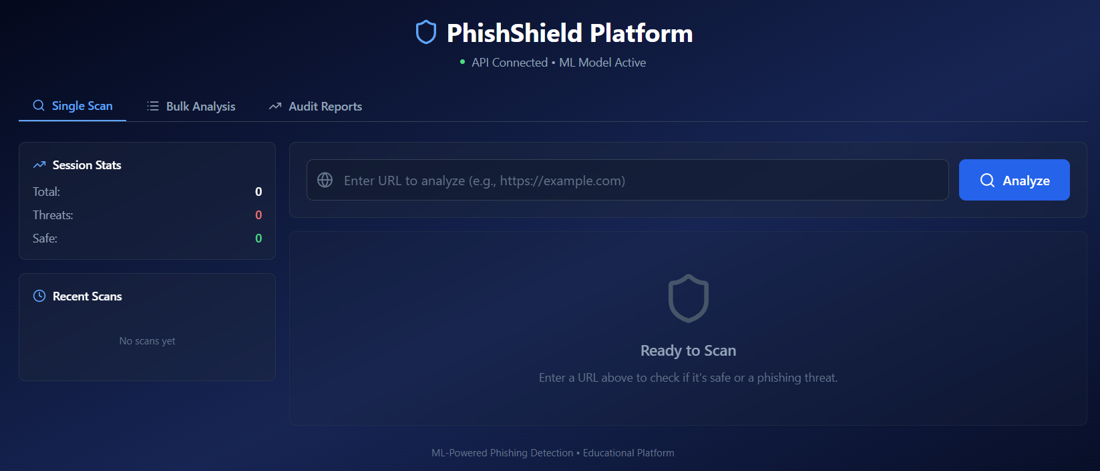
Implementation Screenshots
1. User Interface

Slide 45
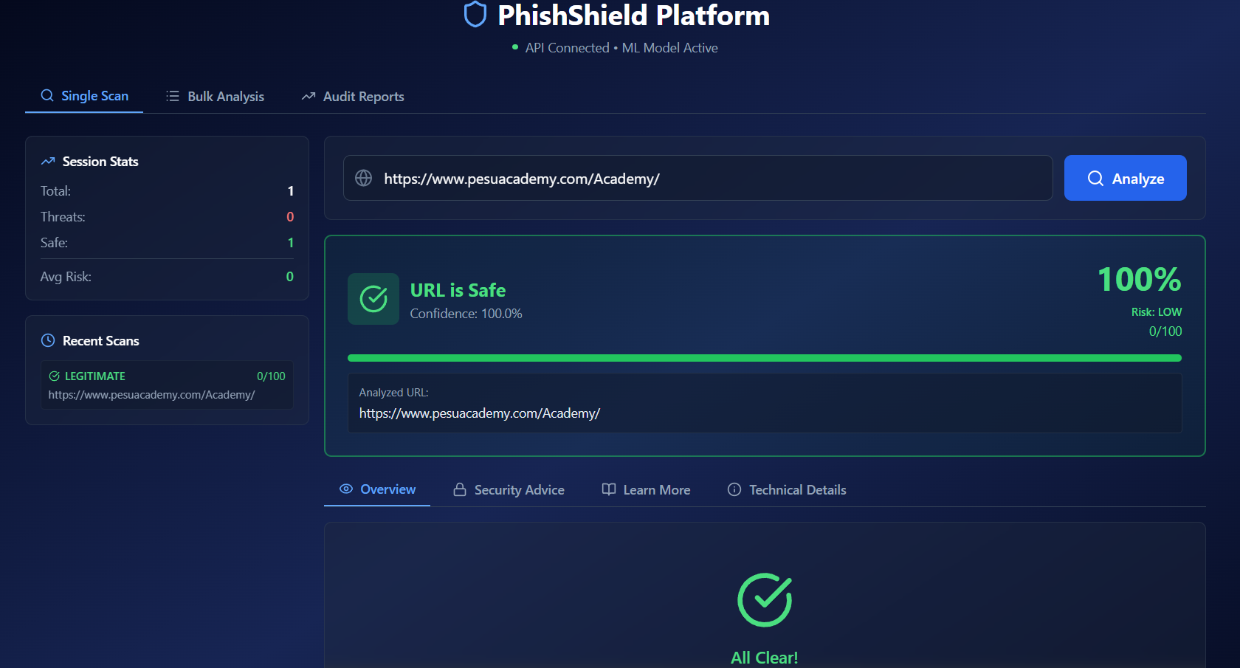
Implementation Screenshots
2. Single URL Phishing Detection Interface

Slide 46
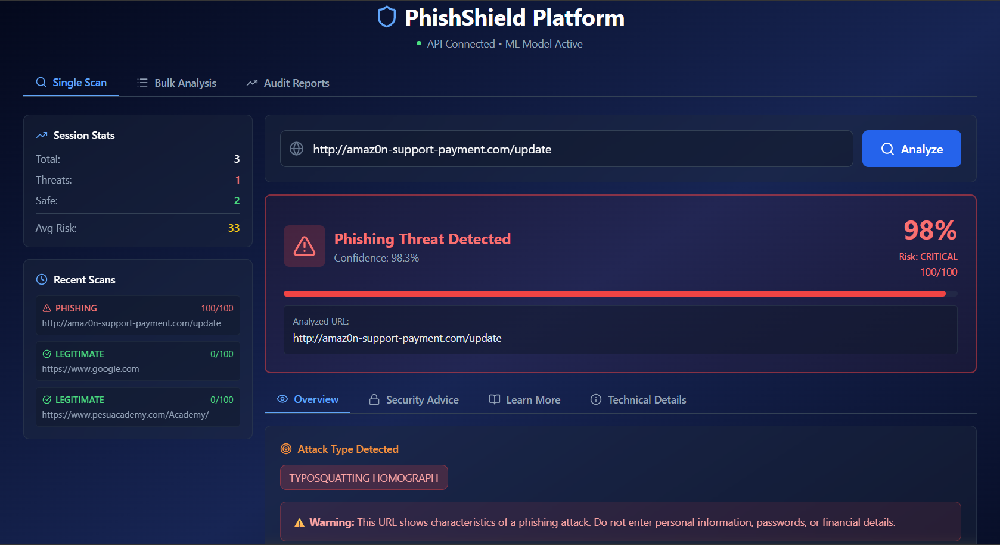
Implementation Screenshots
3. Single Phishing URL detection

Slide 47
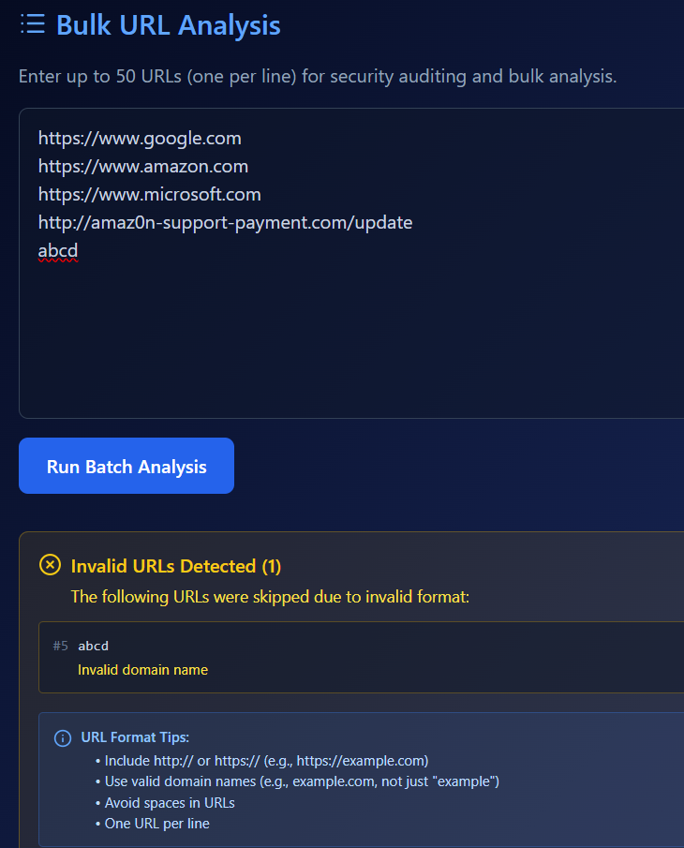
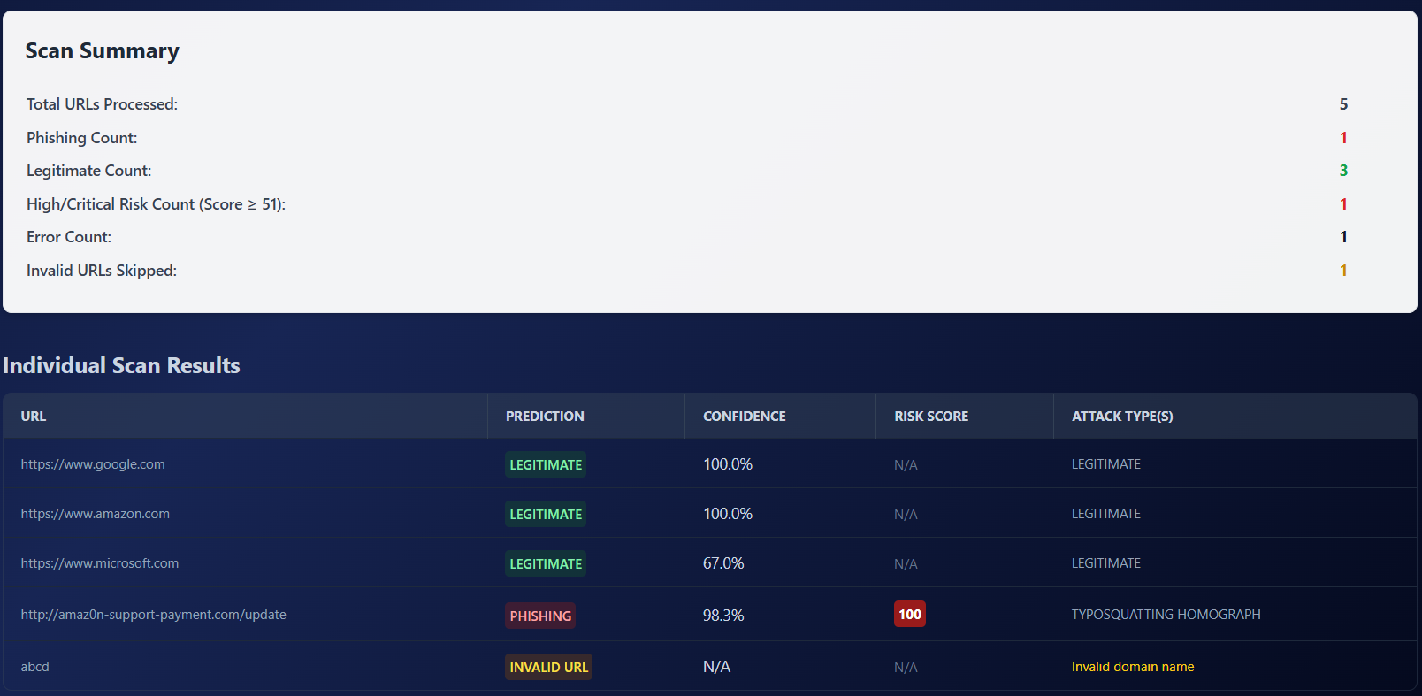
4. Bulk URL Analysis Interface

Slide 48
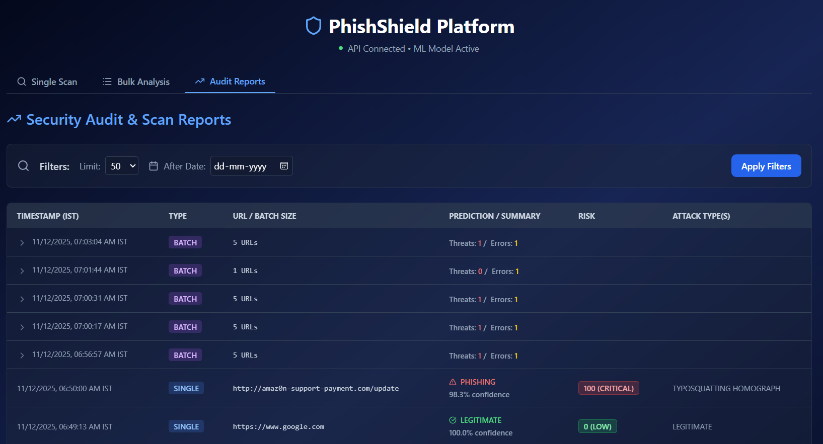
5. Audit Reports Page

Slide 49
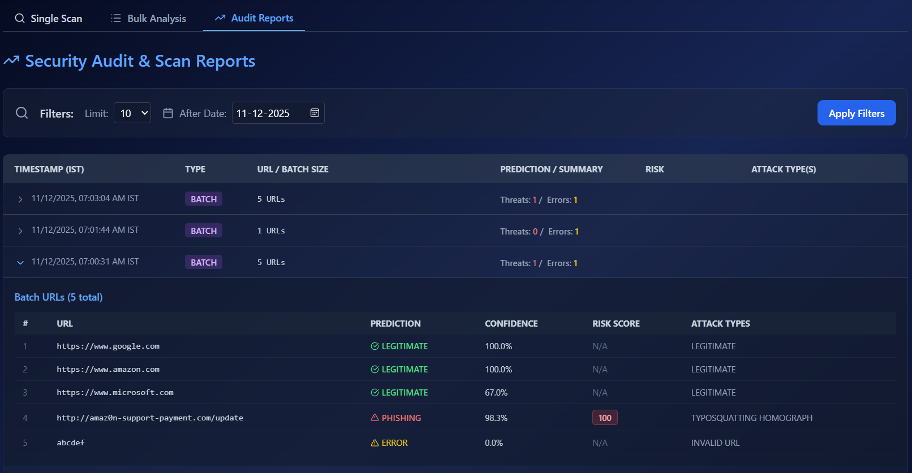
6. Applying Filter and Expanding Batch URLs

Slide 50
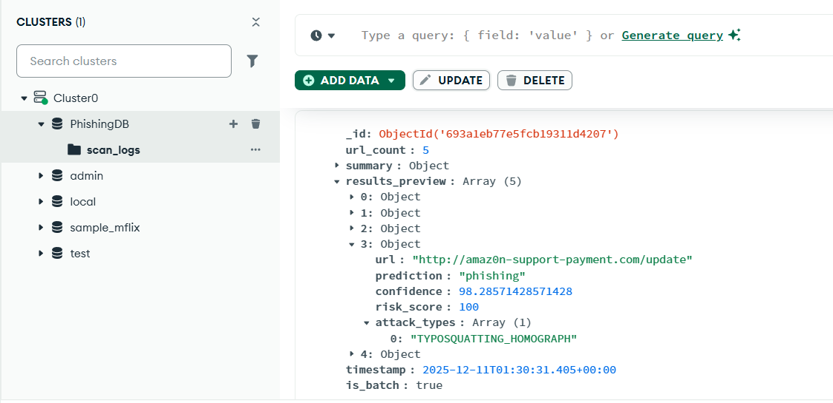
6. Database (MongoDB Atlas)

Slide 51
Part A: Model Testing
To ensure accuracy and robustness, multiple machine learning models were evaluated using all essential performance metrics.
Evaluation Metrics Used:
Metric | Should Be High or Low? | Why?
Accuracy | HIGH | Indicates overall correctness of predictions.
F1-Score | HIGH | Balances precision and recall; best when both are strong.
Precision | HIGH | High precision = fewer false alarms (less mislabeling legitimate URLs as phishing).
Recall | HIGH (Most Important) | High recall = detects majority of phishing URLs → avoids false negatives.
ROC-AUC | HIGH | Measures probability-based discrimination; higher = better model separation.

Slide 52
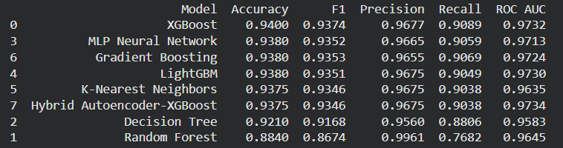
Model Testing Results Summary
Each model was assessed based on accuracy, precision, recall, F1-score, and ROC–AUC.
Models Evaluated :

Slide 53
Comparative Performance Overview
Model | Accuracy | F1-Score | Precision | Recall | ROC-AUC | Performance Summary
XGBoost | 0.9400 | 0.9374 | 0.9677 | 0.9089 | 0.9732 | Best balanced performance across all metrics; high precision & recall.
MLP Neural Network | 0.9380 | 0.9352 | 0.9665 | 0.9059 | 0.9713 | Very competitive with XGBoost; stable deep-learning model.
Gradient Boosting | 0.9380 | 0.9353 | 0.9655 | 0.9069 | 0.9724 | High recall; excellent consistency across metrics.
LightGBM | 0.9380 | 0.9351 | 0.9675 | 0.9049 | 0.9730 | High precision and strong AUC; efficient and robust.
K-Nearest Neighbors | 0.9375 | 0.9346 | 0.9675 | 0.9038 | 0.9635 | Performs well; high precision but slightly lower recall.
Hybrid Autoencoder–XGBoost | 0.9375 | 0.9346 | 0.9675 | 0.9038 | 0.9734 | Best ROC–AUC among all; hybrid features improved probability separation.
Decision Tree | 0.9210 | 0.9168 | 0.9560 | 0.8806 | 0.9583 | Moderate performance; simple model with limited generalization.
Random Forest | 0.8840 | 0.8674 | 0.9961 | 0.7682 | 0.9645 | Extremely high precision but weak recall; many phishing URLs missed.

Slide 54
Part B: User Interface Testing
Single URL Scan UI
1.1 URL Input Validation Tests
Test Case ID | Test Scenario | Input | Expected Result | Actual Result | Status
UI-01 | Click Analyze button with empty input | Leave input blank → Click Analyze | Error message: "Please enter a URL" | As observed | Pass
UI-02 | Valid URL scan | Enter a valid URL (e.g., https://www.google.com) | API call to /api/scan → Should return: prediction, confidence %, risk score, attack types, features | As observed | Pass
UI-03 | URL Input Error Handling | Invalid Text Input (e.g., https://google) | Yellow validation error box Message: "Invalid domain name. Please enter a valid URL..." Blue guidance box with examples and tips | As observed | Pass

Slide 55
1.2 Scanning Process Tests
Test Case ID | Test Scenario | Input | Expected Result | Actual Result | Status
UI-04 | Successful Phishing Detection | Use a known phishing test URL(e.g., http://paypa1-services-login.com/session) | Red-themed result card, "Phishing Threat Detected" title, Confidence percentage displayed, Risk score shown (HIGH/CRITICAL), Attack types listed, Progress bar in red | As observed | Pass
UI-05 | Successful Legitimate Detection | Enter a valid legitimate URL (e.g., https://www.google.com) | Green-themed result card, "URL is Safe" title, Confidence percentage displayed, Risk score shown (LOW), Progress bar in green | As observed | Pass
UI-06 | API Connection Error | Stop Flask server, then scan URL | Error message: "Error: ... Make sure Flask API is running" . Red error box with AlertCircle icon | As observed | Pass

Slide 56
1.3 Results Display Tests
Test Case ID | Test Scenario | Input / Steps | Expected Result | Actual Result | Status
UI-07 | Overview Tab Content | View results with Overview tab active | Attack types displayed (if phishing), Feature detection summary (3 cards: Address Bar, Domain, HTML/JS), Warning message (if phishing), Success message (if legitimate) | As Observed | Pass
UI-08 | Security Advice Tab | Click "Security Advice" tab | Threat level badge displayed Security, warnings listed (if applicable), Recommendations listed with arrow icons | As Observed | Pass
UI-09 | Learn More Tab | Click "Learn More" tab | Threat overview with description, Identification tips list, Real-world examples, Prevention steps | As Observed | Pass
UI-10 | Technical Details Tab | Click "Technical Details" tab | All 16 features listed Feature names and values displayed Color coding (red for 1, green for 0) Scrollable list if more than screen height | As Observed | Pass
UI-11 | Tab Navigation | Click between all 4 tabs multiple times | Active tab highlighted in blue with underline Content switches correctly No console errors | As Observed | Pass

Slide 57
1.4 History & Stats Tests
Test Case ID | Test Scenario | Input / Steps | Expected Result | Actual Result | Status
UI-12 | History Updates | Scan 3 different URLs | Each scan added to Recent Scans sidebar Maximum 10 scans shown Most recent at top | As Observed | Pass
UI-13 | Stats Calculation | Scan 2 phishing URLs and 3 legitimate URLs | Total: 5 Threats: 2 Safe: 3 Avg Risk: Calculated correctly | As Observed | Pass
UI-14 | History Hover Effect | Hover over history items | Border color changes on hover | As Observed | Pass

Slide 58
2. Batch Analyzer Tests
2.1 URL Input Tests
Test Case ID | Test Scenario | Input | Expected Result | Actual Result | Status
UI-15 | Scanning URLs with empty input | Leave input blank → Click Run Batch Analysis | Error Message: "Please enter at least one URL to scan." | As observed | Pass
UI-16 | Single URL or Multiple URL | Enter single or Multiple URLs | Single: Batch processes successfully with 1 result Multiple: All 3 URLs processed, results shown | As observed | Pass
UI-17 | Mixed Valid and Invalid URLs | https://www.google.com just text example https://www.github.com | 2 valid URLs processed 2 invalid URLs shown in yellow warning box Each invalid URL shows specific error message URL Format Tips displayed | As observed | Pass
UI-18 | 50 URLs (Maximum) | 50 valid URLs | All 50 processed successfully | As observed | Pass
UI-19 | More than 50 URLs | 60 URLs | Only first 50 processed (silently truncated) | As Observed | Pass

Slide 59
2.2 Result Display Tests
Test Case ID | Test Scenario | Input / steps | Expected Result | Actual Result | Status
UI-20 | Summary Table Display | Enter URLs and click to scan | Total URLs Processed, Phishing Count (red), Legitimate Count (green), High/Critical Risk Count (red), Error Count, Invalid URLs Skipped (if any, yellow) | As observed | Pass
UI-21 | Valid URL Results Display | Enter valid URLs and click to scan | Truncated URL Colored prediction badge Confidence percentage Risk score with color-coded badge Attack types list | As observed | Pass
UI-22 | Invalid URL Results Display | Enter invalid URLs and click to scan | Yellow "INVALID URL" badge Confidence: N/A Risk Score: N/A Attack Type shows error message | As observed | Pass
UI-23 | Risk Score Color Coding | 50 valid URLs | 76-100: Red background 51-75: Orange background 26-50: Yellow background (black text) 0-25: Green background | As observed | Pass

Slide 60
3. Reports Logger Tests
3.1 Filter Tests
Test Case ID | Test Scenario | Input / steps | Expected Result | Actual Result | Status
UI-24 | Default Load | Navigate to Audit Reports | Loads 50 most recent logs by default, Filters section visible, Limit set to 50 | As observed | Pass
UI-25 | Limit Filter | Change limit dropdown (10, 50, 100, 500) | Each selection updates correctly | As observed | Pass
UI-26 | Date Filter | Select a start date and click "Apply Filters" | Only logs after that date appear | As observed | Pass
UI-27 | Loading State | Click "Apply Filters" | Button disabled, Spinning loader icon, "Fetching logs from MongoDB..." message | As observed | Pass
UI-28 | Single Scan Log Display | Scan a single URL and check the Audit Reports page | IST timestamp, "SINGLE" badge (blue), Full URL (truncated if long), Prediction with icon and confidence Risk score badge, Attack types, Feedback button or "Reviewed" status | As observed | Pass
UI-29 | Batch Scan Log Display | Enter valid URLs and click to scan | IST timestamp with expand icon "BATCH" badge (purple), URL count Summary (Threats/Errors) No risk score or attack types, No feedback column | As observed | Pass

Slide 61
4. Navigation & Global Tests
4.1 Tab Navigation
Test Case ID | Test Scenario | Input / steps | Expected Result | Actual Result | Status
UI-30 | Single Scan Tab | Click "Single Scan" tab | Tab highlighted in blue with underline, SingleScanComponent displays, URL bar shows Search icon | As observed | Pass
UI-31 | Bulk Analysis Tab | Click "Bulk Analysis" tab | Tab highlighted, BatchAnalyzer displays, Tab shows List icon | As observed | Pass
UI-32 | Audit Reports Tab | Click "Audit Reports" tab | Tab highlighted, ReportsLogger displays, Tab shows TrendingUp icon | As observed | Pass
4.2 API Health Check
Test Case ID | Test Scenario | Input / steps | Expected Result | Actual Result | Status
UI-33 | API Connected | Start Flask server | Green dot indicator "API Connected" text "ML Model Active" text (if model loaded) | As observed | Pass
UI-34 | API Disconnected | Stop Flask server | Red dot indicator "API Disconnected" text | As observed | Pass
UI-35 | Loading Health Check | Reload page | Spinning loader shows briefly Then updates to connected/disconnected | As observed | Pass

Slide 62
Performance & Load Tests
5.1 Response Time Tests
Test Case ID | Test Scenario | Input / steps | Expected Result | Actual Result | Status
UI-36 | Single Scan Response Time | Scan a URL | Results displayed within 1 - 3 seconds | As observed | Pass
UI-37 | Batch Scan 50 URLs | Submit 50 URLs | Complete within 2 - 3 minutes | As observed | Pass
UI-38 | Large History List | Perform 100+ scans | UI remains responsive, Sidebar scrolls smoothly | As observed | Pass

Slide 63
References
[1] U. Zara, K. Ayyub, H. U. Khan, A. Daud, T. Alsahfi, and S. G. Ahmad, “Phishing Website Detection using Deep Learning Models,” IEEE Access, vol. 12, pp. 1–15, 2024,DOI: 10.1109/ACCESS.2024.3486462
[2] Q. Abu Al-Haija and A. Al Badawi, “URL-based Phishing Websites Detection via Machine Learning,” in 2021 International Conference on Data Analytics for Business and Industry (ICDABI), 2021,
DOI:10.1109/ICDABI53623.2021.9655851
[3] R. Ferdaws and N. E. Majd, “Phishing URL Detection Using Machine Learning and Deep Learning,” in IEEE World AI & IoT Congress (AIIoT), 2024, DOI: 10.1109/AIIoT61789.2024.10579005.
[4] A. Karim, M. Shahroz, K. Mustofa, S. B. Belhaouari, and S. R. K. Joga, “Phishing Detection System Through Hybrid Machine Learning Based on URL,” IEEE Access, vol. 11, 2023, DOI:10.1109/ACCESS.2023.3252366

Slide 64
[5] M. Sánchez-Paniagua, E. Fidalgo Fernández, E. Alegre, W. Al-Nabki, and V. González-Castro, “Phishing URL Detection: A Real-Case Scenario Through Login URLs,” IEEE Access, vol. 10, pp. 48746–48761, 2022, DOI:10.1109/ACCESS.2022.3168681.
[6] A. J. Odeh, I. M. Keshta, and E. Abdelfattah, “Machine Learning Techniques for Detection of Website Phishing: A Review for Promises and Challenges,” in 2021 IEEE 11th Annual Computing and Communication Workshop and Conference (CCWC), 2021, DOI:10.1109/CCWC51732.2021.9375997
[7] B. V. Pavani, D. Mahitha, and B. U. Maheswari, “Enhancing Online Safety Phishing URL Detection Using Machine Learning and Explainable AI,” in 2024 15th International Conference on Computing Communication and Networking Technologies (ICCCNT), 2024, 10.1109/ICCCNT61001.2024.10723976
[8] S. Lokesh, “Phishing URL Detection Using Machine Learning: A Comparative Study,” in Proc. 6th Int. Conf. Mobile Computing and Sustainable Informatics (ICMCSI), 2025, DOI: 10.1109/ICMCSI64620.2025.10883082
[9] P. K. Roy, A. Kumar, and A. Singh, “Advanced Learning for Phishing URLs Detection to Secure Consumer-Centric Applications,” IEEE Transactions on Consumer Electronics, vol. 70, no. 3, pp. 1–15, 2024, DOI: 10.1109/TCE.2024.3404459

Slide 65
Thank You

