Slide 1

DIGITAL SIGNAL PROCESSING
BUTTERWORTH IIR LOW PASS FILTER
Prepared By – Jit Kumar Ghosh (11500318079)
Itesh Maji (11500318080)
Hritwika Jana(11500318081)
Kaushal Kishore(11500318078)

Slide 2
INTRODUCTION
What is Butterworth Filter ?
A Butterworth filter is a type of signal processing filter designed to have a frequency response as flat as possible in the passband. Hence the Butterworth filter is also known as “maximally flat magnitude filter
The frequency response of the Butterworth filter is flat in the passband and roll-offs towards zero in the stopband. The rate of roll-off response depends on the order of the filter. The number of reactive elements used in the filter circuit will decide the order of the filter.
The inductor and capacitor are reactive elements used in filters. But in the case of Butterworth filter only capacitors are used. So, the number of capacitors will decide the order of the filter.

Slide 3

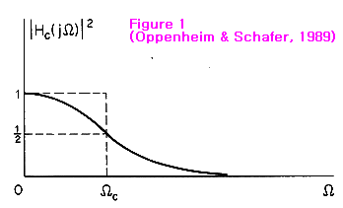
THEORY
The behavior of a filter can be summarized by the so-called frequency response function, Hc. The frequency response function of the Butterworth low-pass filter has the following form:
order of the filter. When = 0, = 0, the magnitude-squared function (Hc2) has shown and Figure 1 becomes 1 and the frequency component will be completely passed. When = , Hc2 becomes 0 and the frequency component will be completely stopped. Between the pass band and the stop band, there is the transition band (1 > Hc2 > 0) in which the frequency component will be completely stopped. Between the pass band and the stop band, there is the transition band (1 > Hc2 > 0) in which the frequency component will be partially passed but partially stopped at the same time.

Slide 4
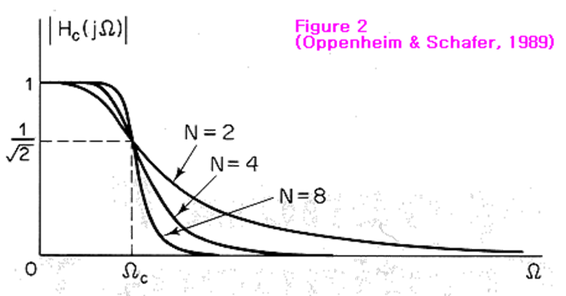
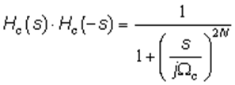
When = , Hc2 always becomes 0.5 (half-power) regardless of the order of the filter. As shown in Figure 1, a Butterworth low-pass filter does not completely pass the frequency components lower than the cutoff frequency, nor completely stops those higher than the cutoff frequency. Figure 2 shows the effects of the filter order on the frequency response. As the filter order increases, the transition from the pass band to the stop band gets steeper. At, H = 0.707, regardless of the order of the filter
The frequency response function of the Butterworth filter involves complex numbers since it is a function of j . Thus, the magnitude-squared function is the product of the response function pairs Hc(s) and Hc(-s) :

Slide 5
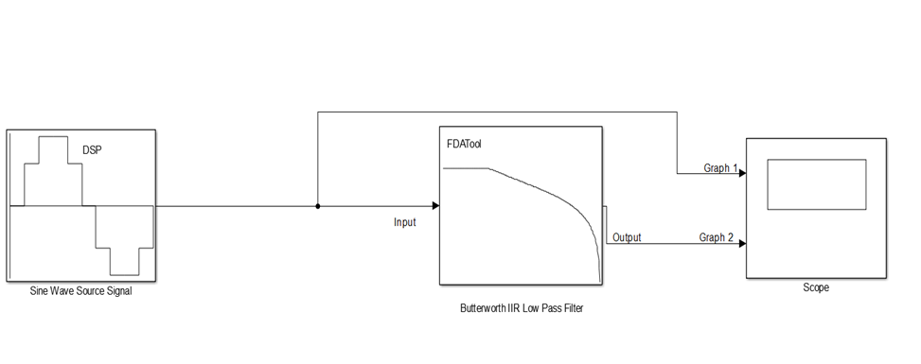
CIRCUIT DIAGRAM

Slide 6
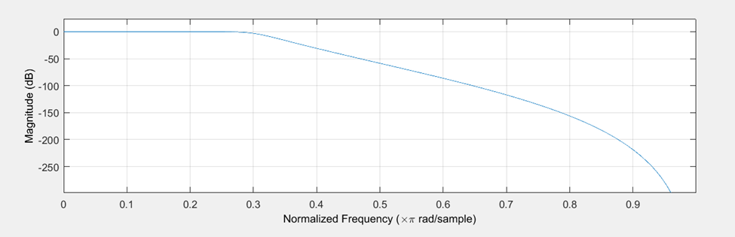
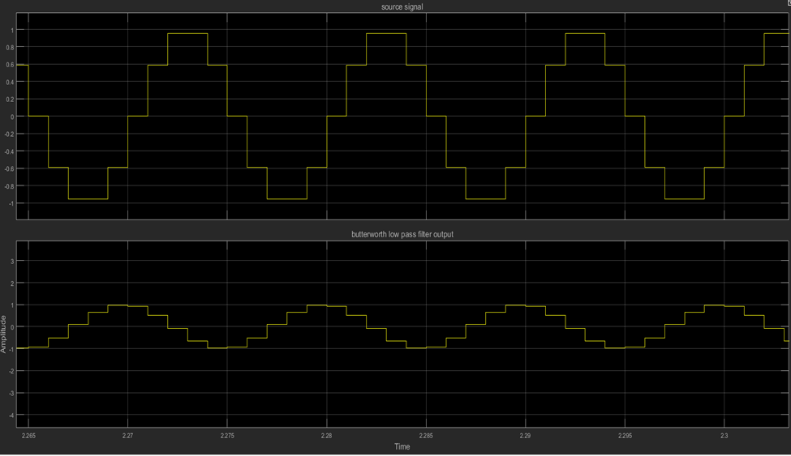
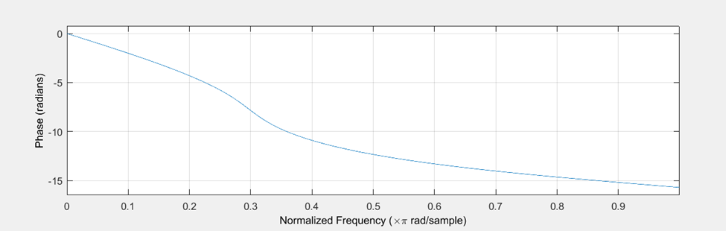
RESULTS
MAGNITUDE RESPONSE
PHASE RESPONSE
SPECTRUM ANALYSIS

Slide 7
APPLICATION
• Due to its maximum flat pass band nature it is used as anti-aliasing filter in data converter applications.
• It has applications in radars such as in designing the display of radar target track.
• In high quality audio applications these are used.
• These are used in digital filters for motion analysis.
• They are used in various applications such as broadcast receivers to select desired channel frequency.
• It is used in image processing for sharpening the images.
• Used in speakers for amplification.

Slide 8
CONCLUSION
So far we have looked at a low pass filter circuits, their resultant frequency and phase responses. An ideal filter would give us specifications of maximum pass band gain and flatness, minimum stop band attenuation and also a very steep pass band to stop band roll-off (the transition band) and it is therefore apparent that a large number of network responses would satisfy these requirements just like the Butterworth low pass filter. However, one main disadvantage of the Butterworth filter is that it achieves this pass band flatness at the expense of a wide transition band as the filter changes from the pass band to the stop band. It also has poor phase characteristics as well. The higher the Butterworth filter order, the higher the number of cascaded stages there are within the filter design, and the closer the filter becomes to the ideal “brick wall” response.In practice however, Butterworth’s ideal frequency response is unattainable as it produces excessive passband ripple.

Slide 9
REFERENCES
https://electricalfundablog.com/low-pass-filter/
https://www.electronics-tutorials.ws/filter/filter_8.html
https://www.electroschematics.com/first-order-butterworth-active-low-pass-filter-circuit/
https://www.dsprelated.com/freebooks/filters/Butterworth_Lowpass_Design.html

Slide 10
THANK YOU

