Slide 1
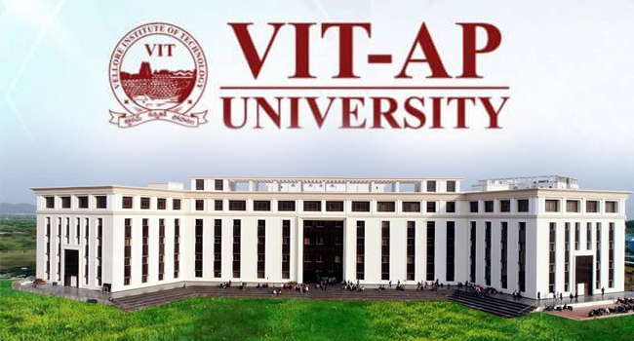
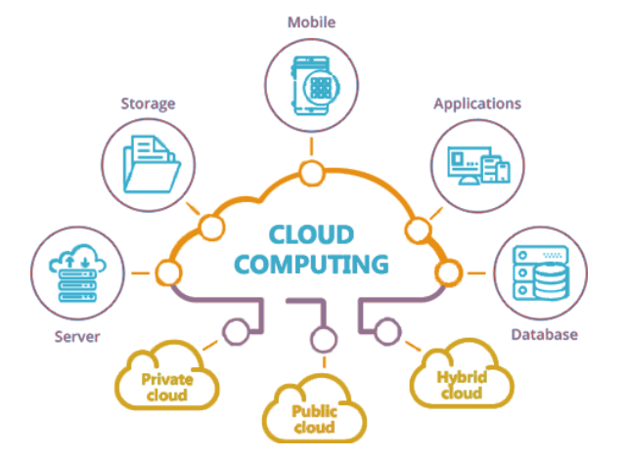
"drive smart bob: a Traffic Regulatory guide"
MADHU ALPAKA

Slide 2

1. Introduction​: I. Content coverage. 2. Primary goals i. individual contributions. ​3. Areas of growth i. problem-solving and innovation. 4. development 5. deployment ​6. Summary​

Slide 3

introduction
"Welcome to our Voice-Based Chatbot Project! We're excited to introduce a revolutionary way of interaction. This project focuses on creating a virtual assistant that you can talk to, making information and assistance just a voice command away. The bot helps us to understand more about traffic rules and regulations “
“THE MOST RELEVANT ASPECTS OF THE PROJECT

Slide 4
Content Coverage:
Provide Comprehensive Objectives, Methodology, And Outcomes Also Highlight Key Features, Functionalities, And Innovations Including an overview Of The Project

Slide 5
OBJECTIVES:
The primary objective of this project is to develop and implement a chatbot system that enables natural voice-based communication between a user and a conversational AI. The project aims to create a user-friendly and efficient system that leverages voice input and output for interactive conversations.
The key objectives include:
VOICE-ACTIVATED CHATBOT: Develop a chatbot that can understand and respond to spoken language, allowing users to interact with it through a microphone.
USER-FRIENDLY INTERACTION: Create a seamless and user-friendly experience for voice interaction, making it as intuitive as possible for users to engage in conversation with the chatbot.
INTEGRATION: Enable integration with different platforms and services, making it accessible through various devices and communication channels.

Slide 6
Methodology:
The project will involve several key phases to achieve its objectives:
1. Research and Requirements Gathering: Begin by conducting thorough research on existing voice-based chatbot systems and gathering requirements from potential users to identify their needs and expectations.
2. Development of Speech Recognition: Build a robust speech recognition component that can accurately transcribe user speech into text, ensuring the system can understand spoken input.
3. User Interface Design: Create an intuitive and user-friendly interface for the chatbot, ensuring that users can easily interact via voice commands.
4. Testing and Feedback: Conduct extensive testing to identify and rectify issues related to speech recognition accuracy, understanding user intents, and providing relevant responses. Collect user feedback to improve the system.
5. Integration and Deployment: Ensure that the chatbot system can be integrated with various platforms, devices, or services. Deploy the chatbot on chosen platforms and ensure its accessibility.
6. Continuous Improvement: Continuously monitor and enhance the system by implementing machine learning techniques to improve its understanding and responsiveness.

Slide 7
Outcomes:
The project's outcomes will include:
1. A Voice-Activated Chatbot:
A functional chatbot that can engage in voice-based conversations with users, making it easier and more convenient for them to interact with the AI.
2. Enhanced User Experience:
Users will benefit from a more natural and intuitive interaction with the chatbot, leading to increased user satisfaction.
3. Integration Options:
The chatbot can be integrated with different platforms and services, making it accessible on various devices and communication channels.
4. Ongoing Development:
The project will establish a foundation for continued improvement, ensuring that the chatbot remains up-to-date and aligned with user needs.

Slide 8
Key Features:
The project’s Main key phases Features:
Voice Interaction:
The system allows users to engage in natural, voice-based conversations with the chatbot, providing a more intuitive and convenient way to interact.
Multi-Platform Compatibility:
The chatbot can be seamlessly integrated into various platforms and services, such as websites, mobile apps, smart speakers, and more.
User-Friendly Interface:
The user interface is designed for ease of use, with a focus on simplicity and intuitiveness in voice commands and responses.

Slide 9
Key Functionalities:
The project’s Main key Functionalities:
Speech Recognition: Accurate speech recognition technology converts user voice input into text for analysis.
Intent Recognition: The system identifies the user's intent and purpose behind the conversation, allowing for tailored responses.
Context Management: The chatbot maintains context throughout the conversation, understanding references and maintaining coherence in the discussion.
Dynamic Responses: The system can provide dynamic responses based on real-time data, ensuring up-to-date information.

Slide 10

PRIMARY aspects
I. CONTRIBUTIONS:

Slide 11
my contribution of the project is I have done the *Software developing MANTANECS - developing the chatbot's backend system and infrastructure. - Integrating voice recognition and processing system technologies. - Creating and maintaining the database or knowledge base for the chatbot. - Implementing apis and third-party services for enhanced functionality. - Ensuring the chatbot’s data and reliability. - Handling user authentication and security aspects of the system. - Optimizing the chatbot for performance and responsiveness. - Collaborating with the designer to implement the conversational flow and user interactions.
Madhu

Slide 12
MY CONTRIBUTION IS Interaction Designer MANTANIES - Designing the conversational flow and user interactions for the chatbot. - Creating dialog scripts and defining the chatbot's personality and tone. - Specifying user prompts and responses to guide conversations. - Designing and structuring the chatbot's knowledge base or content repository. - Conducting user testing and feedback sessions to refine the conversational design. - Collaborating with the development team to implement and integrate the voice interface. - Ensuring the chatbot's responses are natural and contextually relevant. - Continuously improving the chatbot's conversational abilities based on user feedback.

Slide 13
We both deployed the chatbot: “drive smart: traffic regulation bot “using Amazon web services {“aws”} – learn the cloud serves utilizing analyzed the problem statements from the project to solve using by programming and developed the key functionalities ,features for more utilizing also we develop easy to use and user friendly chatbot
COLLABORATIVELY DONE

Slide 14

Areas of growth
“
”
i. problem-solving and innovation.

Slide 15
Problems and Solving
As the population is increasing day by day the use of vehicles are more and the traffic is increased so the more accidents prone to occur so there should be a guide for the young kids to have a grasp on the traffic rules to avoid getting into accidents So we came with an solution to solve this problem by providing a chatbot that can answer your queries about traffic rules this bot is only restricted to traffic rules and other questions cannot be answered as our goal is to bring traffic awareness to children from a young age we have imbedded a voice recognition operator into the bot

Slide 16
Innovations:
The project’s Main key phases Features:
Voice-First Interaction:
The innovation lies in the emphasis on voice-first interaction, making the chatbot more accessible and user-friendly, especially for users who prefer spoken language over typing.
Multi-Platform Integration:
The system's flexibility in integrating with various platforms and services is an innovation that ensures widespread accessibility.
Real-Time Data Integration:
The chatbot's capability to provide dynamic responses based on real-time data added an innovative dimension, ensuring that users receive the most current information.

Slide 17
Plan for SERVER launch
Deploy strategic networks with compelling needs information
Requirements
Information gathering and analysis
Plan of execution
Disseminate standardized step-by-step metrics
Design
Implements the process methodologies of various performances
Deployment
TESTING
Coordinate chatbot front-end applications

Slide 18

development
FILES DEVELOPMENT

Slide 19
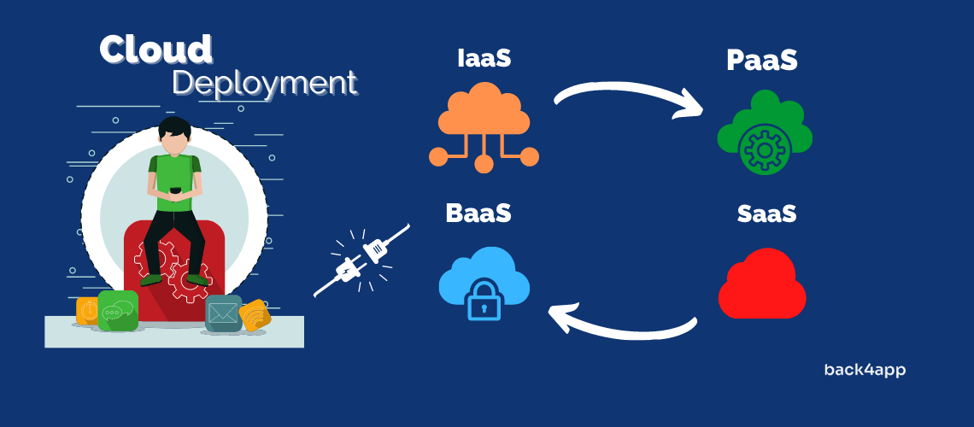
deployment
https://main.d2qz7p5bg0i5eo.amplifyapp.com/

Slide 20
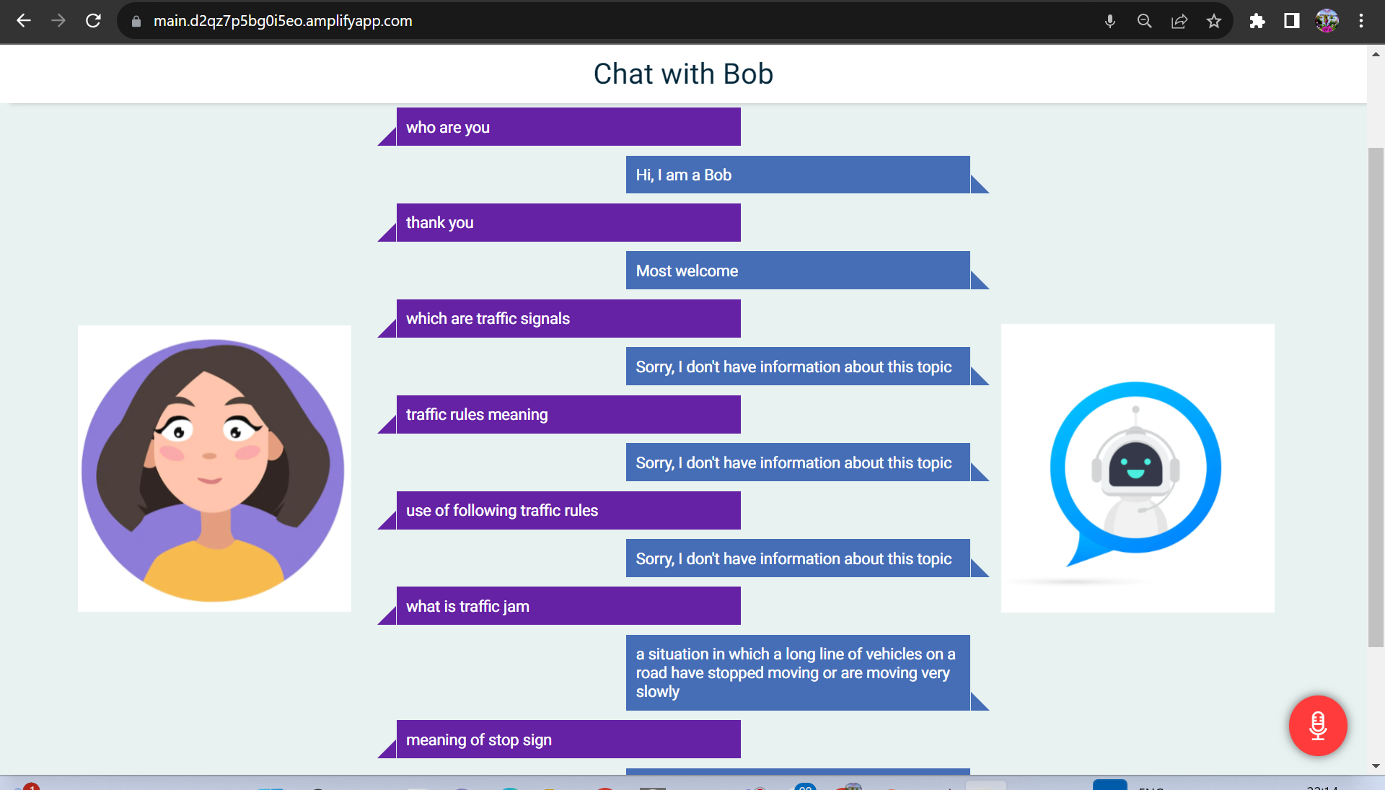
deployment
https://main.d2qz7p5bg0i5eo.amplifyapp.com/

Slide 21
Areas of main using
Interaction of the 3 - phases
CLOUD-BASED OPPORTUNITIES
Develop winning strategies to keep ahead of the competition
Capitalize on low-hanging to identify a main performance interaction
Visualize customer-directed convergence
User friendly interaction of bot and user
Iterative approaches to corporate strategy
Establish a management framework from the inside

Slide 22



Summary: performances of the three MAIN COMPONENTS
user
microphone
chatbot
The user asks his query about the traffic rules and regulations and solves his query by receiving the answer from chatbot The user is instructed to ask the questions based on the traffic rules and not any other topics
The microphone captures the voice of the user and then the is processed through speech recognition technology the the words are converted into text to make the system understand the query and provide a suitable answer for the given query
The bot responds to the query and provides a suitable answer for the query to get a better understanding on the query the user has asked

Slide 23
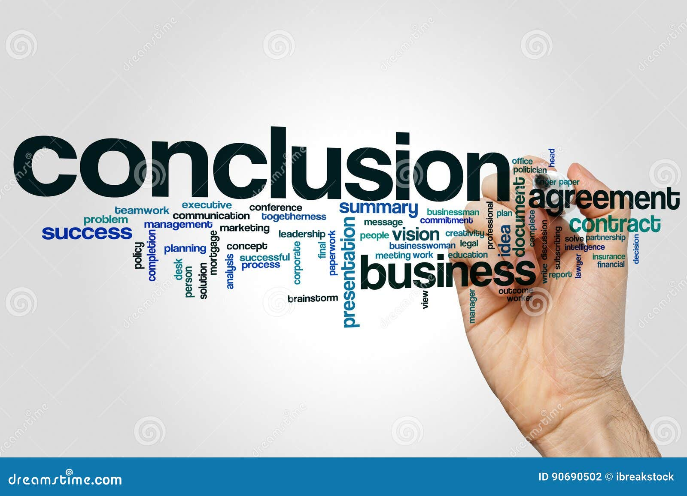
conclusion:
Finally conclusion of this project is to give the necessary things of traffic rules and regulations to children at the primary level of child to decrease the so many accidents and in regular driving e.c.t cases of traffic final aim of the service is to provide easy to use and the user-friendly access any where any time any places any software website it’s will be providing traffic awareness to young age to change the society to clear
Also we have increased this Application service to so many key functionalities and features e.c.t for that this software can easily be used also it helps easy-to-understand voice recognition it will be used to provider friendly interaction.

Slide 24
Thank you
MADHU-21MIS7022

