Slide 1

medicine expiry date detection
-------------------------------- !!!!------------------------------

Slide 2
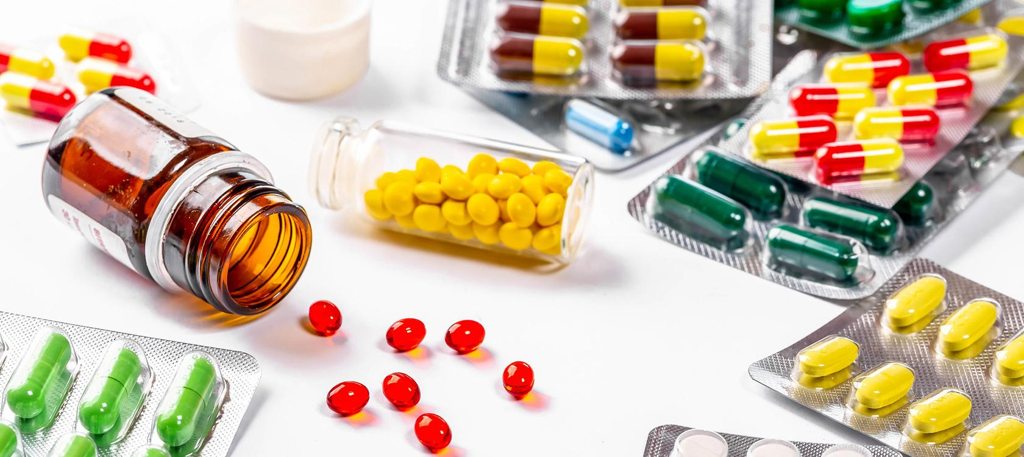
Abstract
>To avoid the usage of expired medicines
>Ensuring safe usage of medicines without being toxic to the users
>By getting the details expiry date and consequences

Slide 3

Introduction
>Many people unknowingly consume the expired medicines which leads to the many consequences causing illness and sometimes severe effects causing deaths.
>Detecting the expiry date
>QR code to fetch the details
>Getting notifications

Slide 4
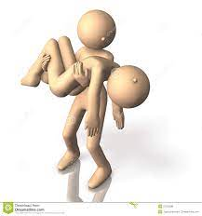
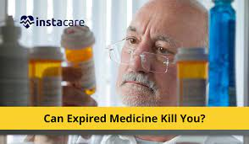
Purpose
Avoiding the innocent’s deaths due to the expiry date of medicines which they intake

Slide 5

Survey/Research
>How rarely you buy medicines in the medical store?
>Do you often check the manufacturing and expiring details of those medicines which are prescribed
> Do you think are there any consequences caused by intake of expired medicines?
>What are the effects of consuming expired medicines?

Slide 6
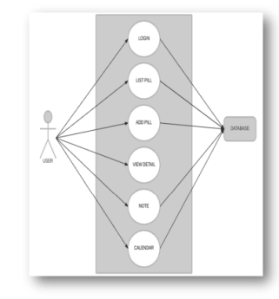
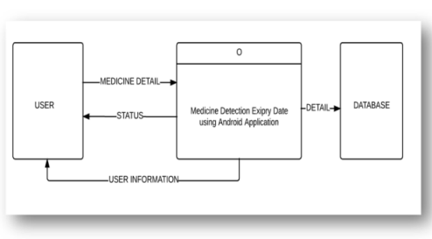
Methodology
Medicine expiry date detection that help users to facilitate the users to know the details of the medicine by using QR-code reader. With this application, users can know the details about medicine if they scan the QR-code which is available on medicine. It also keeps all the information about the details on the users to login this application on the database. The details of medicine such as name of medicine, function of medicine, expiry date of medicine, drug company that produces the medicine and pricing will be created using QR-code from hospital medical department or pharmacy.

Slide 7
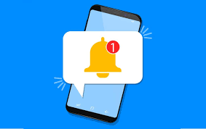
Conclusion
This application is used as an alerting system for the patients about the medicine expiry
QR code to be used on the medicines to ease the activity of fetching the details of medicines
Many lives will be saved by avoiding the usage of expired medicines

Slide 8

-D.Madhu (CSE-IoT/II year)
-K.Rajkumar (AIML-A/II year)

